Slide 1
TSVV3 – Regular advancement meeting
16/10/2024 – Stellarator modelling, TCV-X23
Project news
P. Tamain

Slide 2
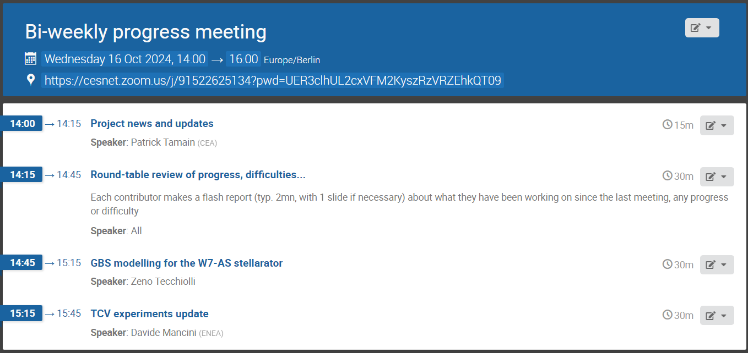
Today’s meeting agenda

Slide 3
Follow up from previous tasks
  ACH support requests:
    submitted for all codes
    next steps:
      ACHs analyze the bids, might contact you – on-going
      ACH propose support level to SB and code coordinators – no date given
  EUROfusion standard software survey:
    submitted last Monday

Slide 4
Review of code modelling capabilities
  Send to all code ROs Excel file to be filled on codes status and capabilities
    Will be used to try and match supply and demand in support to WPs
    Eventually, training sessions might be requested for codes for which a strong interest of WPs has been expressed
    Guide lines to fill the form not clear, fill to the best of your understanding

Slide 5
Call for HPC resources cycle 9
  Call open for next cycle, based on Pitagora a priori
  Official deadline = November 18th
    But ETASC General meeting the week before so internal deadline 8th
    Feedback requested for Friday October 25th

Slide 6
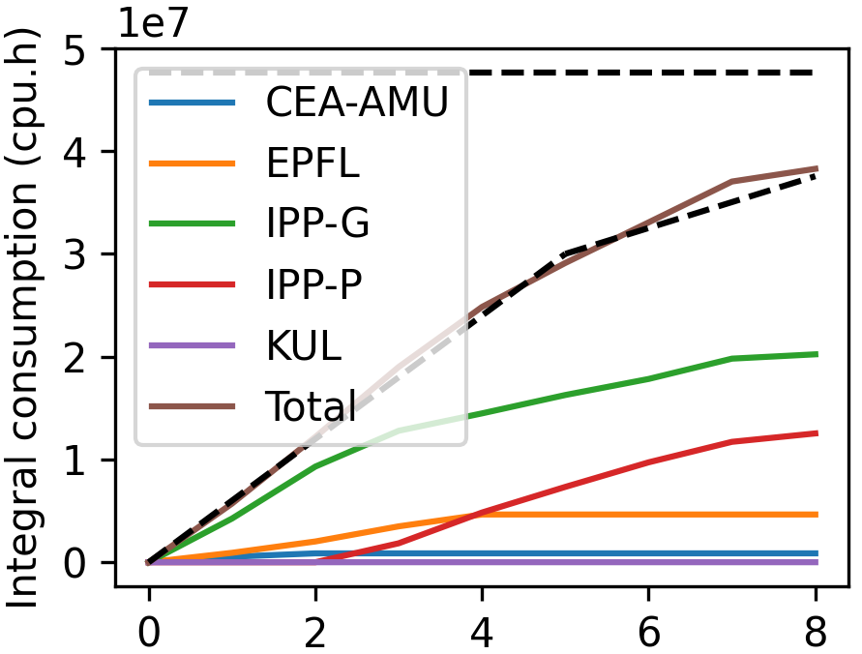
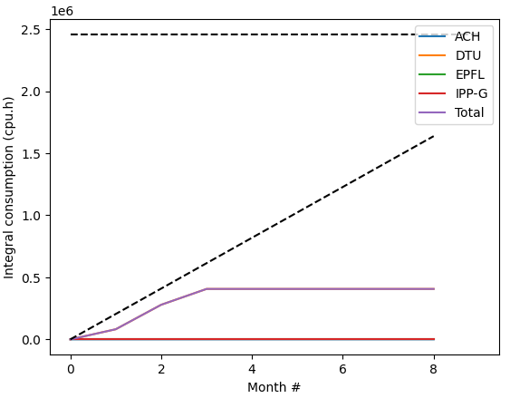
Marconi usage update
CPU
GPU

Slide 7
E-TASC General meeting
  “E-TASC General Meeting” organized in Garching November 11-15
  Travel money available for PI + (1-2) other contributors
    Registration requested
  In preparation of poster session, please send me back contributions illustrating latest results (e.g., 1 or 2 slides) before October 25th
    I might contact some of you for specific requests if I identify specific “holes”

Slide 8
Today’s meeting agenda
Upload presentations on https://indico.euro-fusion.org/event/2954/ or send to me please.

