Slide 1
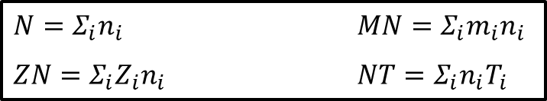


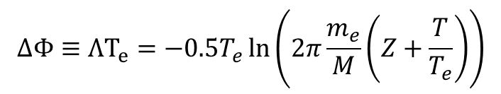
Status: partially achieved (50% of SOLEDGE3X part)
  Equations derived: common velocity assumption (strong coupling) => Single-ion-species plasma equivalent to arbitrary ion mix:
    Then apply standard Bohm / Bohm-Chodurah / Tskhakaya:
Evidence: internal report, can be made available on Wiki
Perspectives: Implementation in SOLEDGE3X on-going (will likely be finished in January)
$$u_{∥}≥\sqrt{\frac{ZT_{e}+T}{M}}$$
$$γ_{i}=2.5$$
$$γ_{e}=2+\frac{eΦ}{T_{e}}$$
$N=Σ_{i}n_{i}$ $MN=Σ_{i}m_{i}n_{i}$
$ZN=Σ_{i}Z_{i}n_{i}$ $NT=Σ_{i}n_{i}T_{i}$
$$ΔΦ≡ΛT_{e}=−0.5T_{e}\ln\left(2π\frac{m_{e}}{M}\left(Z+\frac{T}{T_{e}}\right)\right)$$

Slide 2
Status: not started
  Waiting for implementation in SOLEDGE3X
  Will be performed next year on ITER multi-species 2D mean-field cases

Slide 3
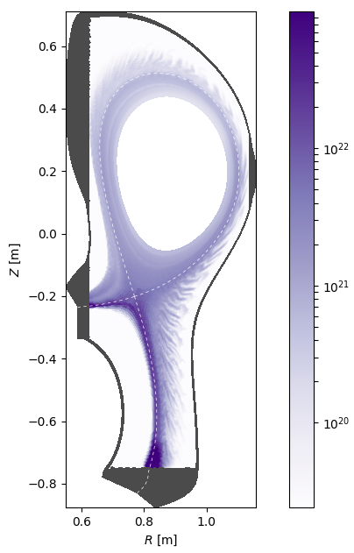
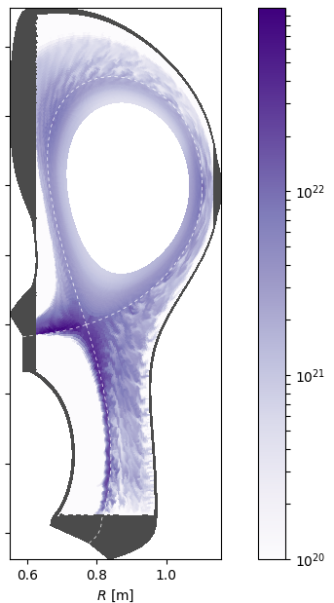

$$S_{n} (m^{−3}.s^{−1})$$
Status: achieved (100% of SOLEDGE3X part)
  SOLEDGE3X TCVX23 simulations completed in forward field for attached and detached conditions
Evidence:
    Paper: V. Quadri et al, Nuclear Materials and Energy 41, 101756 (2024)
    PhD: V. Quadri et al, Impact of neutrals and density regimes on turbulence in the edge plasma of tokamaks, PhD thesis, Aix-Marseille University (2024)

Slide 4
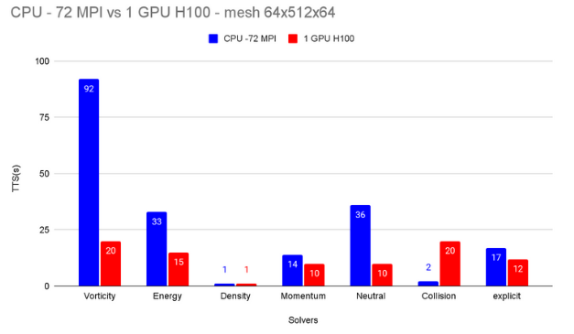
Status: achieved (100% of SOLEDGE3X part)
  SOLEDGE3X ported on GPU (except communications) and tested on H100 architecture (=Pitagora)
Evidence: ACH report
Perspectives: will be pursued in 2025 with ACH for optimization (communications, specific parts…)

Slide 5
Status: not started
  Not done yet, but can attempt this year again
  Likely to give the same result as last year (not enough nodes to run test without running into memory issues)

Slide 6
Status: achieved (~100% of SOLEDGE3X part)
  SOLEDGE3X currently still with only 1-moment model, but including convective term compared with CPP 2023 paper
Evidence: Paper: V. Quadri et al, Nuclear Materials and Energy 41, 101756 (2024)
Perspectives: implementation of 3-moment model scheduled to start with B. McGibbon PhD in 01/2025

Slide 7
Status: in progress
  Beta version of STYX2.0 library ready for integration in SOLEDGE3X
  Implementation in SOLEDGE3X as first test on-going
  On track for release to other codes by the middle of 2025

Slide 8
Status: achieved
  Start from converged 2D mean-field simulation allows improvement by factor of 2 of convergence ratio in TCVX23, but still 30% off
Evidence: PhD: V. Quadri et al, Impact of neutrals and density regimes on turbulence in the edge plasma of tokamaks, PhD thesis, Aix-Marseille University (2024)
Perspectives: still a major issue for converged simulations, other acceleration schemes wil be tested in 2025

Slide 9
Status: partially achieved for SOLEDGE3X part
  SOLEDGE3X TCVX23 simulations completed in forward field for attached and detached conditions
Evidence:
    Paper: V. Quadri et al, Nuclear Materials and Energy 41, 101756 (2024)
    PhD: V. Quadri et al, Impact of neutrals and density regimes on turbulence in the edge plasma of tokamaks, PhD thesis, Aix-Marseille University (2024)
Perspectives:
  Reversed field simulations started (pending on Marconi issue)
  Comparison to experimental data when available

Slide 10
Detached
Status: largely achieved for SOLEDGE3X part
  Analysis of first TCVX23 simulations up to detachment in terms of transport coefficients completed
  Standard mean-field transprot description problematic
Evidence: PhD: V. Quadri et al, Impact of neutrals and density regimes on turbulence in the edge plasma of tokamaks, PhD thesis, Aix-Marseille University (2024)
Perspectives:
  Extend analysis to other cases (intermediate density points, other neutrals models, reversed field)
  Investigate better mean-field description

Slide 11
Status: work in progress
  Currently focusing on improvement of cross-ionized-species collisions module in SOLEDGE3X

Slide 12
Status: not started
  Priority given to reversed field simulations and to improvement of neutrals model
  Simulations with baffle will come after

Slide 13
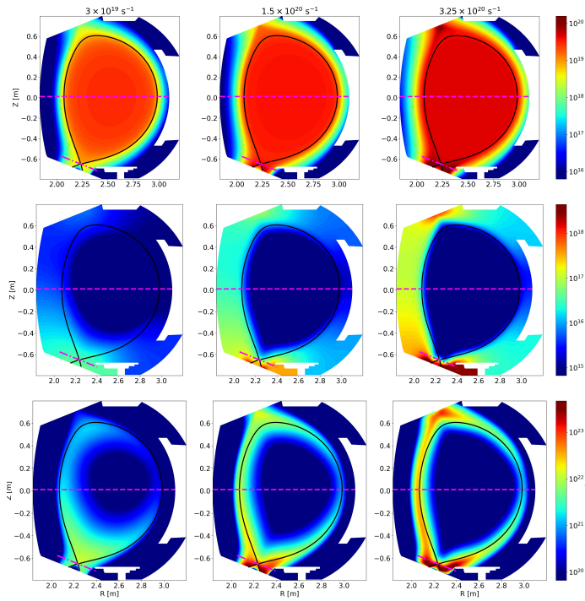




Status: achieved
  Done in SOLEDGE HDG with applications to WEST and ITER
Evidence:
  Paper: I. Kudasev et al, Frontiers in Physics 12 (2024)
  Paper: M. Scotto et al, Nuclear Materials and Energy 41, 101750 (2024)
Perspectives: integration in EBC (out of tasks)
$$n_{e}$$
$$n_{e}$$
$$n_{n}$$
$$n_{n}$$

Slide 14
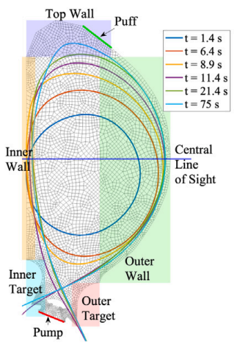
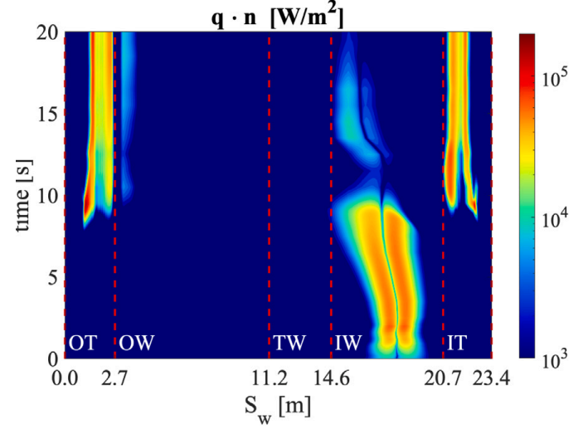
Status: achieved
Evidence:
  Paper: M. Scotto et al, Nuclear Materials and Energy 41, 101750 (2024)

Slide 15
Status: partially achieved for SOLEDGE3X part (~80%)
  Equilibrium and 3 fluid moments IMAS export tool exist
  Probably some fields missing for synthetic diagnostics
Evidence:
  EUROfusion Gitlab: https://gitlab.eufus.psnc.pl/ach/imas-interfaces/tsvv3codes
Perspectives:
  Possibly need to add additional fields for synthetic diagnostics

Slide 16
Status: started (~25%)
  Necessary information from TCV diagnostics gathered
Evidence:
  N/A
Perspectives:
  Building list of fields that need to be filled in IMAS
  Waiting for implementation in Python IMAS converter

Slide 17
Status: achieved
  All codes deploying quality policy
Evidence:
  EUROfusion standard software survey
Perspectives:
  Further progress still needed in some areas
  Continuous work for others (optimization, validation…)

Slide 18
Status: started
  Code features and capabilities gathered by WPs
  Waiting for feedback from WPs concerning training needs

Slide 19
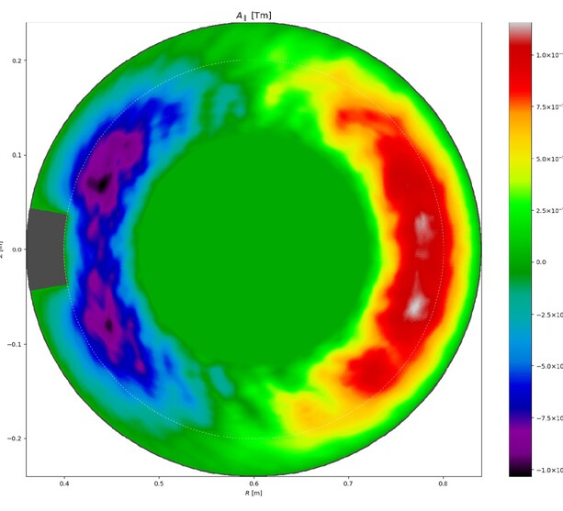
Status: achieved
  Electromagnetic model + flutter implemented in SOLEDGE3X and tested on limited and TCV cases
Evidence:
  Code: https://gitlab.eufus.psnc.pl/tsvv3/soledge3x
  Paper: R. Dull et al, Contrib. Plasma Phys. 64 (2024)
  Paper: R. Dull et al, submited to JCP
  PhD thesis: R. Dull, PhD thesis, Aix-Marseille University (2024)
Perspectives:
  Improve robustness of simulations in X-point configuration and when wall close to separatrix

Slide 20
Status: on-going (50% achieved)
  Proof-of-principle cases run
  need more systematic analysis and probably extension of simulations to steay-state

