Slide 1
TSVV3 – Regular advancement meeting 22/01/2025 – Task 1: gyrofluid modelling Project news
P. Tamain

Slide 2
Today’s meeting agenda

Slide 3
News
Report 2024 submitted successfully, thank you for your contributions
submitted version available on the Wiki: https://wiki.euro-fusion.org/wiki/TSVV-03#2024
Quite a significant number of tasks not fully completed or post-poned => should be high priority for 2025
MARCONI status
Growing complaints of PIs for absence of communication
No news available even at the top of EUROfusion…
Is the Wednesday time slot the best for all?
Poll to find a more suitable one?

Slide 4
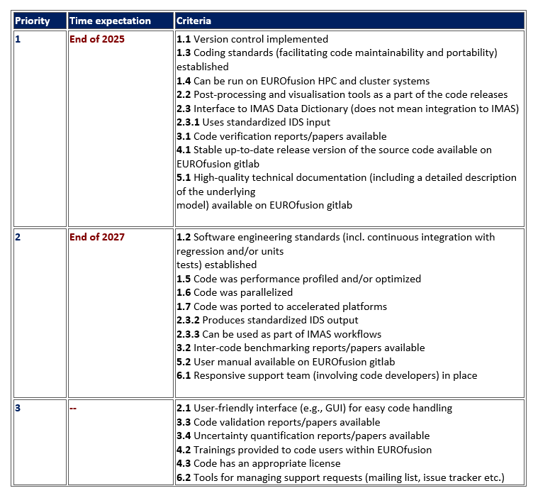
EUROfusion standard software
PMU currently revising the reference document defining the criteria for the EUROfusion standard software
Tries to give better definition of criteria
No traffic light but % of completion requested (0, 25, 50, 75, 100)
Defines “priorities” (1, 2, 3) between criteria with target completion dates
Does not solve all issues of clarity
I will send the document around for your info and feedback

Slide 5
Work-plan 2026 - 2027
Extension of EUROfusion grant for 2026 – 2027 under discussion
ETASC / TSVV likely to remain
Some projects will be merged, some new projects will be created
new project plans needed, might influence the decisions
PMU to organize general meeting at beginning of spring to get from each project proposal for new targets / plan
To prepare for this:
Each team: prepare short written document with proposals of objectives and deliverables => to be discussed in dedicated meeting
meeting with Nicola Vianello to get input from WPTE and present a synthesis of our own ideas => proposed date March 5th
Finalize document in the same form as we did for 2024-2025 workplan

Slide 6
Latest publications
Overview of GRILLIX results
W Zholobenko et al : 12th December 2024 | DocumentID : 39225
: Simulating boundary turbulence in fusion reactors in different confinement, ELM and detachment regimes
Conference : DPG Spring Meeting 2025, GÃ¶ttingen, Germany, 31st March 2025.
Turbulence in detached conditions
P Tamain et al : 22nd January 2025 | DocumentID : 39541
: 3D turbulence simulations in detached conditions and their implications for the mean-field modelling of divertor dissipative regimes
Conference : 51st EPS Conference on Plasma Physics (EPS 2025), Vilnius, Lithuania, 7th July 2025.
Plans for papers for IAEA conference?
H. Bufferand preparing review of TCVX21 results with SOLEDGE3X

Slide 7
Today’s meeting agenda
Upload presentations on https://indico.euro-fusion.org/event/2960/ or send to me please.

