Slide 2
The Varenna-model v0.2: from 4 to 6 moments
TSVV3 status meeting, M. Wiesenberger, 22.1.25

Slide 3
Outlook
Problems with the 4-moment gyro-fluid model
Going from a 4-moment to a 6-moment model
General moment expansion
The density – velocity moment symmetry
Going to an implementable form
Lorentz collision operator and Landau damping
Linear wave dynamics – how everything is explicit
Conclusion

Slide 4
What’s wrong with 4-moment model?
Module | Status
Magnetic field geometry | ✓
Parallelization MPI+X | ✓
Python interface | ✓
Timestepper | ✓
Multispecies | ✓
Elliptic solvers | ✓
Unit tests for 2nd gyroaverages | ✗
Perpendicular advection-diffusion | ✓
Parallel advection-diffusion | ✓
MMS | ✗
Boundary conditions | ✓
Collisional closure | ✓
Neutrals | ✗
“Density, perpendicular pressure, parallel pressure, parallel canonical velocity”
Disadvantages
Artificial heat flux closure, i.e. heat flux limiter or similar
Artificial parallel viscosity and heat conduction
Need to invert parallel heat Eq. in the context of implicit timesteppers
No Landau damping
Discussion TSVV3 workshop May 2024

Slide 5
Hypothesis: Everything easier with 6 moments?
Module | Status
Magnetic field geometry | ✓
Parallelization MPI+X | ✓
Python interface | ✓
Timestepper | ✓
Multispecies | ✓
Elliptic solvers | ✓
Unit tests for 2nd gyroaverages | ✗
Perpendicular advection-diffusion | ✓
Parallel advection-diffusion | ✓
MMS | ✗
Boundary conditions | ✓
Collisional closure | ✓
Neutrals | ✗
OLD Density, perpendicular pressure, parallel pressure, parallel velocity,
NEW parallel flux of perpendicular heat, parallel flux of parallel heat
Advantages
No need for heat flux closure, i.e. no heat flux limiter or similar
Parallel viscosity and heat conduction emerge for high collisionality from Lorentz collision operator
Everything explicit: No need for implicit timesteppers nor to invert parallel heat Eq.
Enable Landau damping
Easier parallel boundary conditions (no need to fix temperature gradient to heat flux)

Slide 6
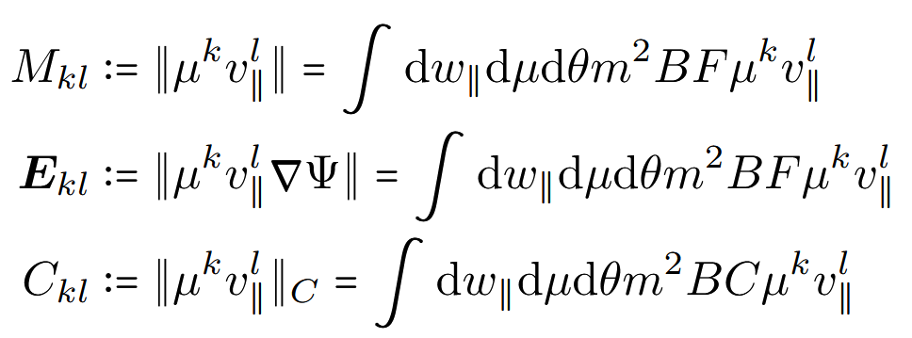
How to derive any moment equation:
“Gyro-kinetic Vlasov Equation”

Slide 7
6 moment equations: … Any Insights?

Slide 8
Moment equations come in pairs
“Magnetic moment is positive”
For l even and arbitrary k
Density-like “even” moment
Flux-like “uneven” moment
It seems “natural” to include heat flux equations

Slide 9
Can’t we just implement this?
Closure still needed (without closure gyro-kinetic “Galerkin type” code … )
We need advection velocities in order to implement upwind scheme
There is a time derivative on A_parallel !! Need to decouple. Cannot be reasonably implemented
does not directly correspond to physical quantities.
For example k = 0, l = 3
✗
✗
✗
✗

Slide 10
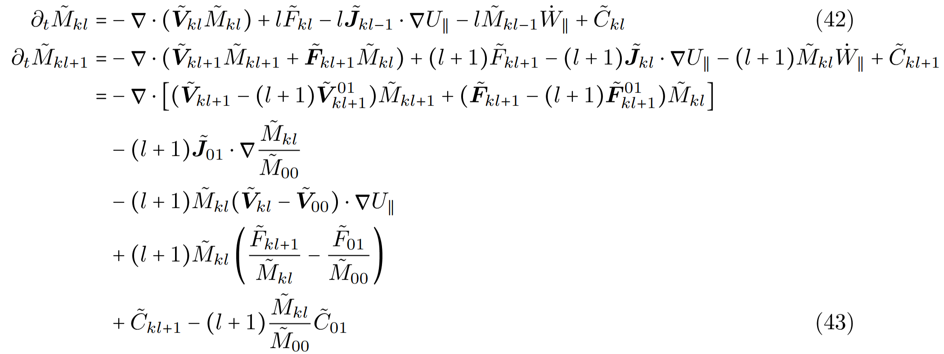
Everything better with fluctuating moments
“subtract average velocity from parallel velocity”
…
index battle
….

Slide 11
6 – moments model:
Closure by truncation of Hermite-Laguerre expansion of F [Held2020]
Clear Advection velocities in order to implement upwind scheme
A_parallel decoupled in canonical velocity W_parallel Can be easily implemented
does correspond to physical quantities.
For example k = 0, l = 3
✓
✓
✓
✓
[Held2020] M. Held, M. Wiesenberger, A. Kendl, Nuclear Fusion 60, 066014 (2020)

Slide 12
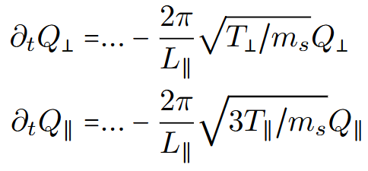
Add Lorentz collisions and Landau damping
Follow [Scott2021]:
“Lorentz collisions” = inter species collisions
Drive system towards isotropy
Recover Braginskii heat flux for high collisionality
“Landau damping”
[Scott2021] B. Scott Turbulence and Instabilities in Magnetised Plasmas, Volume 2, IOP Publishing, (2021)

Slide 13
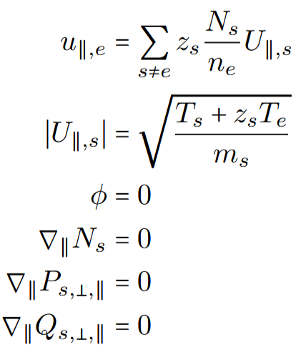
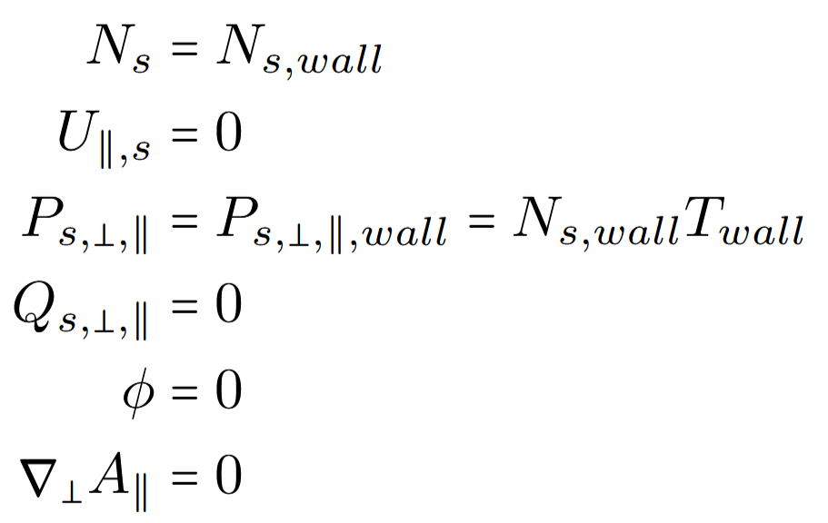
Boundary conditions
“Sheath”
“Wall”
No need to fix temperature gradient to match heat flux

Slide 14
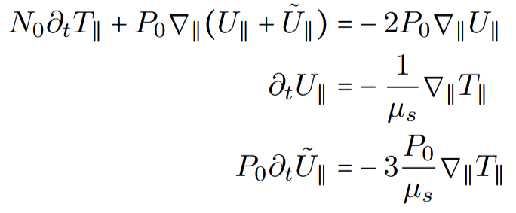
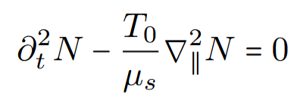
Linear wave dynamics along field-line
“Density + Parallel Velocity”
“Temperature + Parallel heat velocity”
Are these observed somewhere?
“Sound”
“Temperature wave: 2nd Sound” !?
In fact every pair of density-flux pair makes a wave
Heat travels as a wave similar to sound wave: Everything can be explicit
[Scott2021] B. Scott Turbulence and Instabilities in Magnetised Plasmas, Volume 2, IOP Publishing, (2021)

Slide 15
Conclusion: 6-moment gyro-fluid model derived
Advantages
No need for heat flux closure, i.e. no heat flux limiter or similar
Parallel viscosity and heat conduction emerge for high collisionality from Lorentz collision operator
Everything explicit: No need for implicit timesteppers nor to invert parallel heat Eq.
Enable Landau damping
Easier parallel boundary conditions (no need to fix temperature gradient to heat flux)
Implementation ongoing …
Module | Status
Magnetic field geometry | ✓
Parallelization MPI+X | ✓
Python interface | ✓
Timestepper | ✓
Multispecies | ✓
Elliptic solvers | ✓
Unit tests for 2nd gyroaverages | ✗
Perpendicular advection-diffusion | ✓
Parallel advection-diffusion | ✓
MMS | ✗
Boundary conditions | ✓
Collisional closure | ✓
Neutrals | ✗

Slide 16
Appendix: Density-like equations; i={0,1,2}

Slide 17
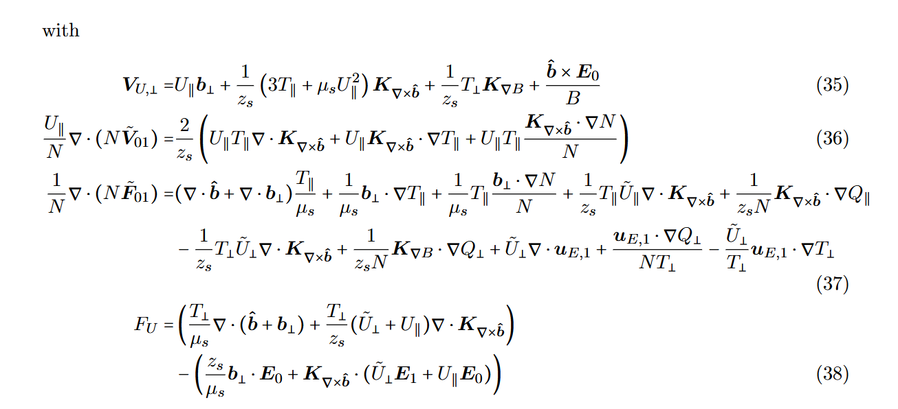
Appendix: Velocity equation

Slide 18
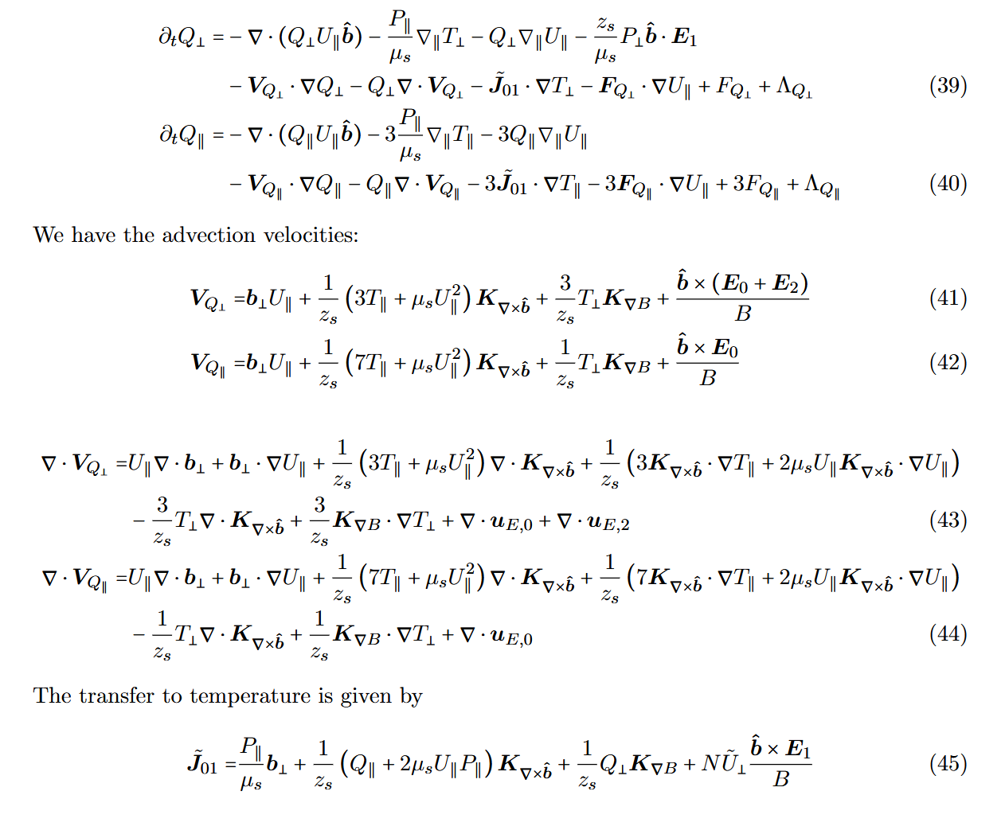
Appendix: Heat flux equations

