Slide 1
2D turbulence simulations involving the new parallel model
First investigation of the turbulence balances, transport behavior, and updates for use in a recycling setting
Notes:
²

Slide 2
Content
Reminder: goal of task 3
2D turbulence simulations without recycling
2D turbulence simulations with recycling
Look ahead

Slide 3
Reminder: goal of task 3
(Further) Development of consistent, reduced turbulence transport models
How:
Studying the anomalous transport via turbulence simulations ...
2D
TOKAM2D
3D
SOLEDGE3X / GRILLIX
... proposing closure relations and inferring free coefficients
Benchmark against 3D-codes & validate against experiments
$←$ proposed new model (density regimes)
Notes:
Consistent, reduced with aim to not need to manually tune the coefficients anymore (hence fixed values for the closure coefficients required)

Slide 4
2D turbulence simulations without recycling

Slide 5
2D turbulence simulations without recycling
Comparing mean-field balances between Arakawa and WENO simulations

Slide 6
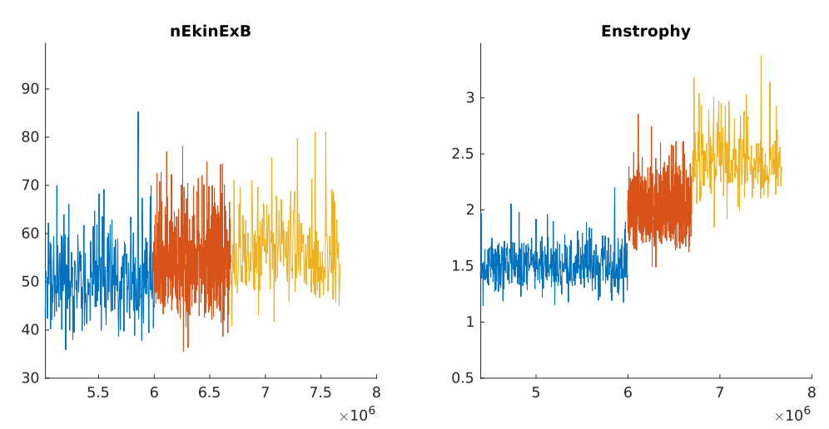
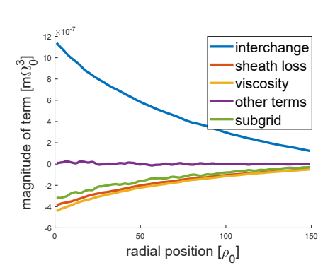
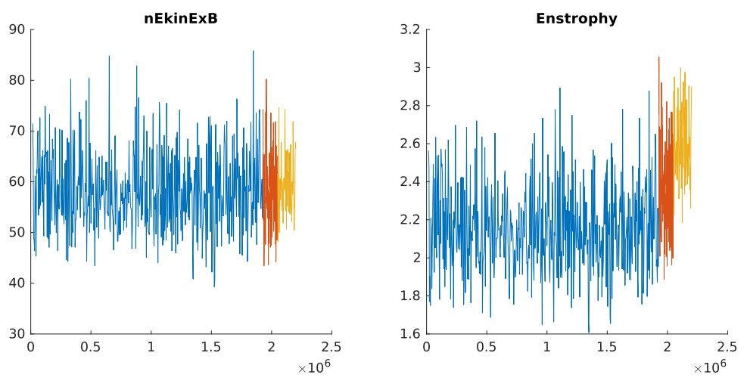
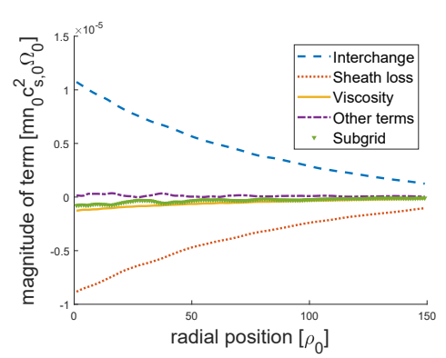
Comparing mean-field balances between Arakawa and WENO simulations
Arakawa scheme was implemented in TOKAM2D
Premise: reduce effect of implicit dissipation in advection term
WENO
$$k≜\frac{\overline{nV_{E}^{"2}}}{2\overline{n}}$$
$ξ$ $≜\frac{\overline{nW^{"2}}}{2\overline{n}}$
Arakawa (W-only)

Slide 7
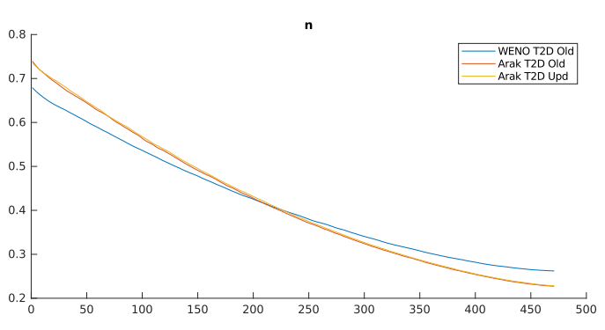
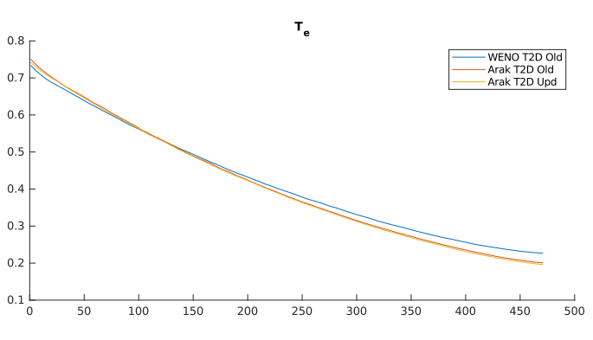
Comparing mean-field balances between Arakawa and WENO simulations
Steeper profiles in Arakawa simulations
Balances of state variables ($n,p_{e},p_{i}$)
Very similar
More pronounced noise level
with Arakawa (likely large dt)
(Note: D = 0 for more fair comparison?)
Notes:
NB simulation

Slide 8
Comparing mean-field balances between Arakawa and WENO simulations
Most prominent difference: reduced imbalance in balances of turbulent characteristics (& much larger $ξ$[x2,4], while $k$[x1,3])
$k$-balance
$ξ$-balance
“Imbalance”
(in original form.
next slide)
“Imbalance”

Slide 9
Comparing mean-field balances between Arakawa and WENO simulations
Interestingly, difference in ($k,ξ$-)error behavior between Arakawa and WENO?
Arakawa: centered around zero / WENO: similar to dissipation by diffusion
Given the implicit diffusion present in WENO-ExB advection term, one may re-interprete the equation solved by TOKAM2D as
Such that the governing eq for the k-balance becomes:
Notes:
As a ‘true divergence’ of the polarization drift, plus an ‘non-ideal term’

Slide 10
Comparing mean-field balances between Arakawa and WENO simulations
Similarly:
Noting:
Provides just an estimate of an ‘hidden dissipation’ term:
Arakawa does not have to be used for the reference
Also effect of choices for discretization may be qualitatively be assessed:
‘Implicit diffusion’-profile for Arakawa-simulations uses $Δ_{A−T2D}^{[φ,W]}=\left[φ,W_{CD}\right]−[φ,W_{Angus}]$
[2] Angus discretization: https://doi.org/10.1063/1.4863503

Slide 11
Comparing mean-field balances between Arakawa and WENO simulations
Picture of $k$ remains: interchange production compensated by sheath loss
Picture of $ξ$ confirmed: local balance between interchange production & viscous dissipation
Indication with
Grid analysis
$\left(D_{h}∝h^{\frac{1}{16}}\right)$
$k$-balance
$ξ$-balance
Interchange
$$⇒$$
$$⇒$$
Dissipation
Sheath loss

Slide 12
2D turbulence simulations without recycling
Preliminary look at transport character:
correlation based diffusion

Slide 13
Correlation based diffusion
Inspired by Manz. Et. Al. [3], the anomalous particle flux was decomposed as follows:
Starting from continuity equation:
Evolution of ensemble(*)-average:
Evolution of fluctuation:
Unclear terminology by Manz?
Background vs profile
(Not present in eq. By Manz,)
[3] https://doi.org/10.1063/1.5133839

Slide 14
Correlation based diffusion
By time-integration of the latter, the anomalous particle flux is expressed as:
(For a statistical steady state, for large times and FOR TOKAM2D)
(Note: $\overline{n^{′}\left(t\right)v_{E}^{′}\left(t\right)} →\overline{v_{E}^{′}\left(t\right){∂_{y}n}^{′}\left(t−T\right)}$ ...)
Aim of endeavor:
Exploring size of ‘diffusive’ contribution
(not per se trying to close all of them
from first principles ...)

Slide 15
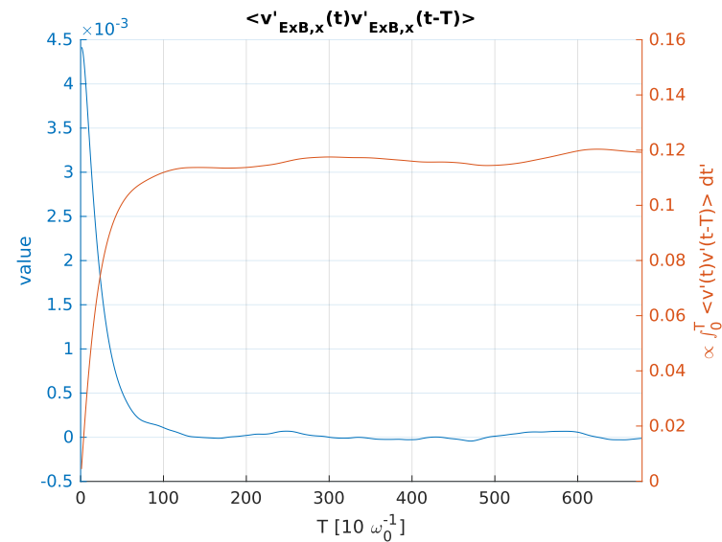
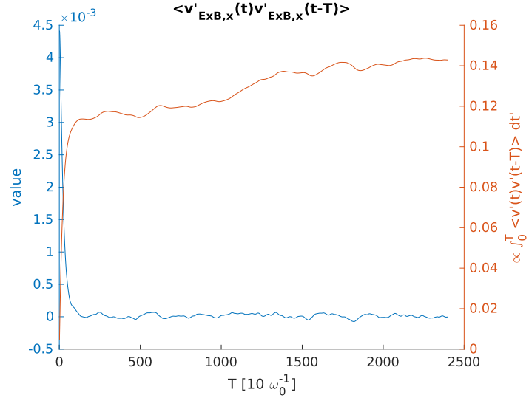
Correlation based diffusion in a R=0-simulation
Difficulty in the integration of the correlation functions for long time lag:
For this first analysis: scanning of max timelag ...
WIP
Notes:
(between brackets is this a more easy term as it is composed of quantities of which the mean should be zero for a T2D simulation)

Slide 16
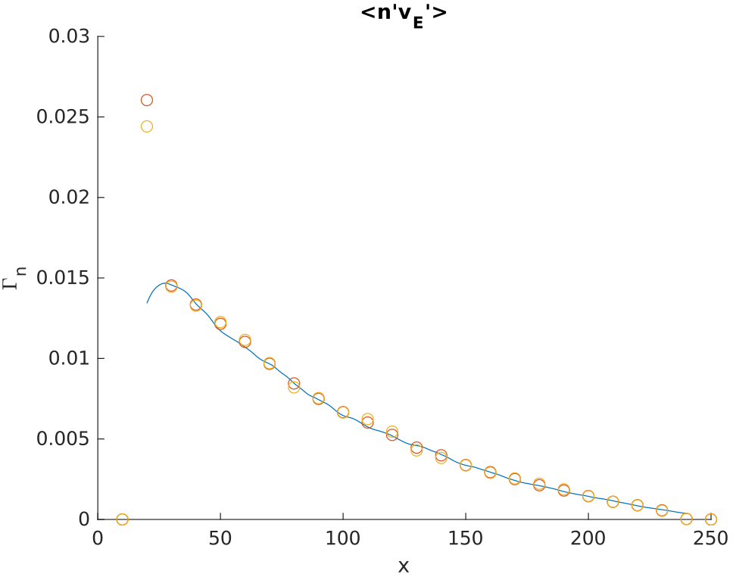
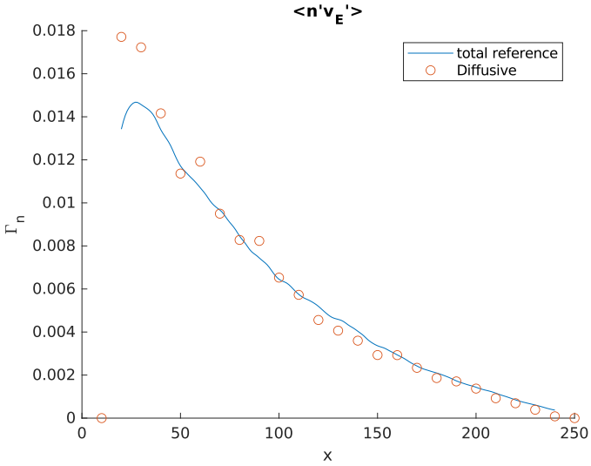
Correlation based diffusion in a R=0-simulation
Flux ‘well’ reproduced, and explicit diffusive contribution seems ‘centered’ around profile almost everywhere (except near-inner SOL)
(not all contributions
evaluated)
Total flux well reproduced
(for $T^{MAX}=300/600$)
WIP

Slide 17
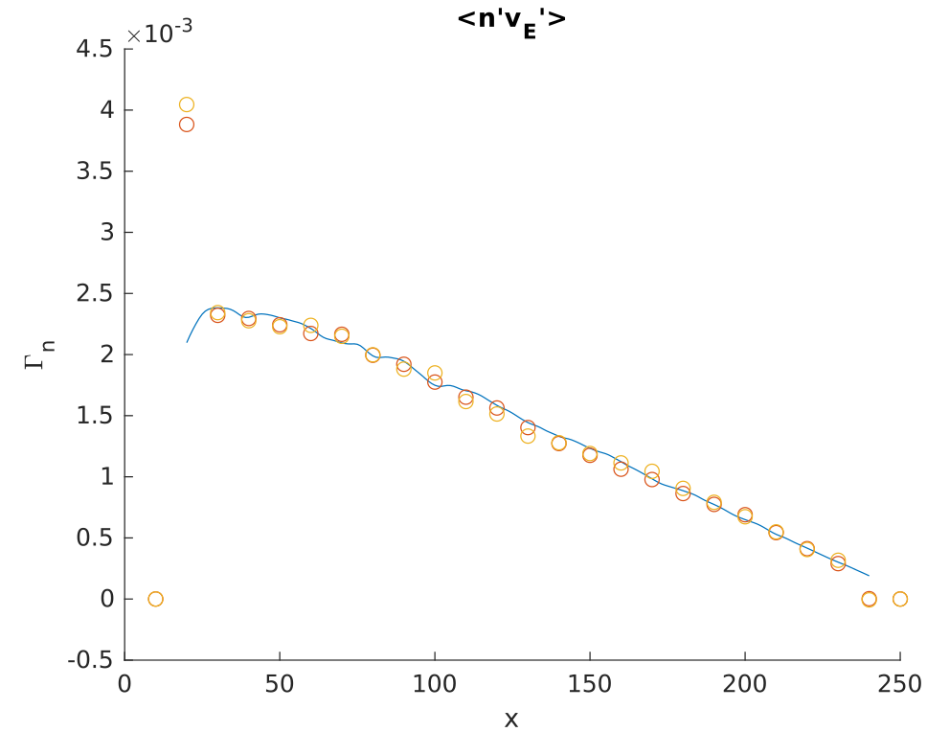
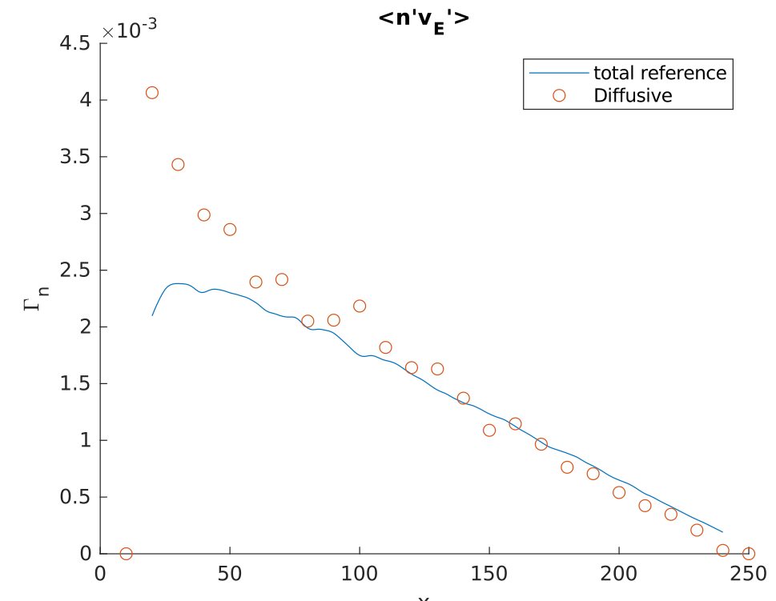
Correlation based diffusion in a R!=0-simulation
(not all contributions
evaluated)
Need for inward flux?
Indicate inward pinch? (speculative!)
May be interesting to evaluate in 3D-code?
WIP

Slide 18
2D turbulence simulations with recycling ?

Slide 19
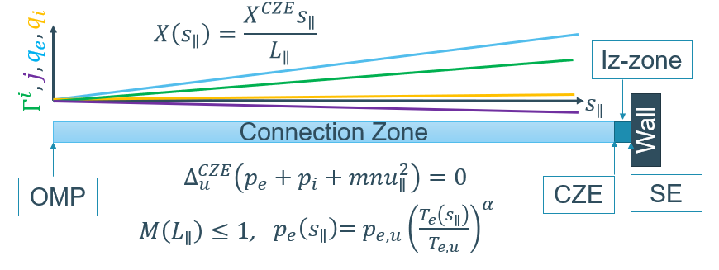
High level picture of the parallel model
Partly inspired by model used in (n)SOLT
$${⇒\left[\begin{matrix}n \\ T_{e} \\ \begin{matrix}T_{i} \\ φ\end{matrix}\end{matrix}\right]}^{CZE}=f\left({\left[\begin{matrix}n \\ T_{e} \\ \begin{matrix}T_{i} \\ φ\end{matrix}\end{matrix}\right]}^{OMP},{\left[\begin{matrix}Γ^{i} \\ j \\ \begin{matrix}q_{e} \\ q_{i}\end{matrix}\end{matrix}\right]}^{CZE}\right)$$
Temperature gradients
Conduction-limited
Evaluation of integral balances over ionization zone:
Local divertor recycling
$${\left[\begin{matrix}0 \\ 0 \\ \begin{matrix}0 \\ 0\end{matrix}\end{matrix}\right]}^{}=f\left({\left[\begin{matrix}n \\ T_{e} \\ \begin{matrix}T_{i} \\ φ\end{matrix}\end{matrix}\right]}^{CZE},{\left[\begin{matrix}Γ^{i} \\ j \\ \begin{matrix}q_{e} \\ q_{i}\end{matrix}\end{matrix}\right]}^{CZE}\right)$$
Fluxes consistent w.r.t. each other
Divertor-recycling
Foregoing presumed $L_{iz}$ was known ...
Notes:
Added extra effects w.r.t. PET, but basic idea remains. (Added effects: model for CX-neutrals, without momentum transfer, based on Hayashi: DOI:10.1016/S0022-3115(02)01534-9 and on Harisson (to which they refer)) / Current under limit to ‘cut of’ ion repelling sheath conditions / plasma quantities evaluated based on upstream conditions iso using fixed ones / ...)

Slide 20
Determining $L_{iz}$
Most obvious specifications had their own problems:
$L_{iz}=C^{te}$
$R=C^{te}$
Note: ‘detachment’ referred to:
$⇒$ Possibility of having only solutions with supersonic conditions at target
$⇒$ Possibility of having no solutions ( / require the need for a ‘detachment’ extension)
Model has a maximal realizable R for given upstream conditions
Observed that $T_{e}^{SE}→\sim 1 eV$ and $S_{ion}^{SE}≪S_{ion}^{CZE} or S_{⊥}$
when $R→R^{MAX}$
$⇒$ “Modeled ionization zone starts to detach”
$$R$$

Slide 21
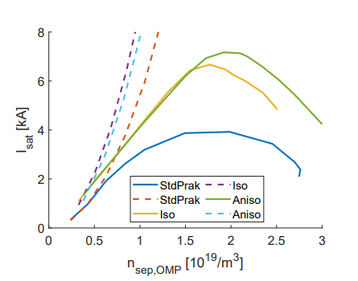
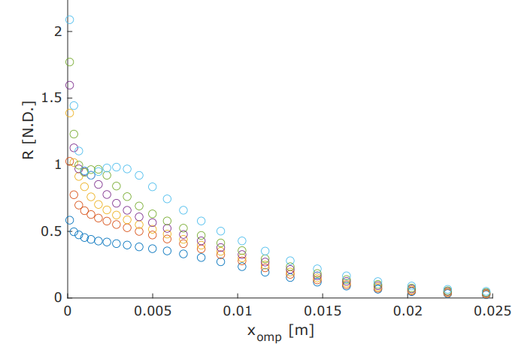
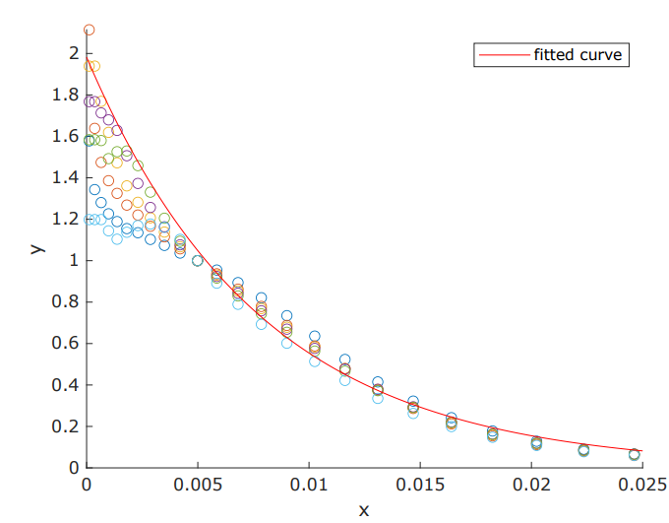
Determining $L_{iz}$
Looking at earlier performed n-scan in SOLPS-ITER of AUG (‘nondetached cases’)
Determination of attached simulations via roll-over curve(s)
Evaluation of $R^{FS}(ρ)=\int_{SE}^{OMP}{S_{ion}\left(s_{∥},ρ\right)ds_{∥}}/Γ_{i}^{SE}$
Normalization of ‘outer-SOL’
[4] Example of roll-over curve
(not the one actually used)
21
Faculteit, departement, dienst …
[4] O. Renders, master thesis

Slide 22
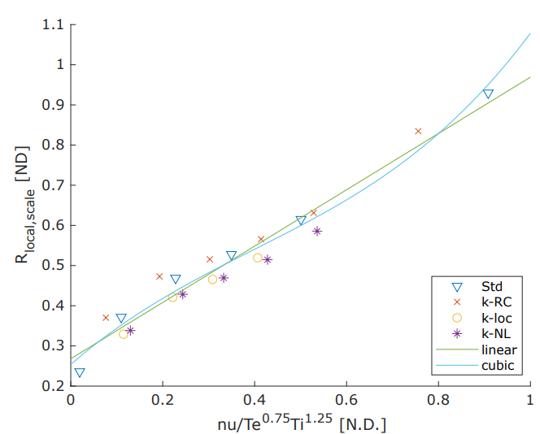
Determining $L_{iz}$
Looking at earlier performed n-scan in SOLPS-ITER of AUG (‘nondetached cases’)
Issue of scaling factor for profiles?
Test of correlation with a (generalized) collisionality:
$⇒$ rough guidance for set-up was inferred:
Perform flux-driven simulation with $R^{FS}(t)$ as $Λ(t)$
(Requires specifying model parameters as $λ_{R},…$)
When profiles saturate, determine $R^{FS}$ and fixate it in new simulation
(To not let profile variability influence simulation [‘non-local’])
Scaling factor
22
Faculteit, departement, dienst …
Notes:
Non-local refers to that the scaling factor is determined based on conditions at a certain FS

Slide 23
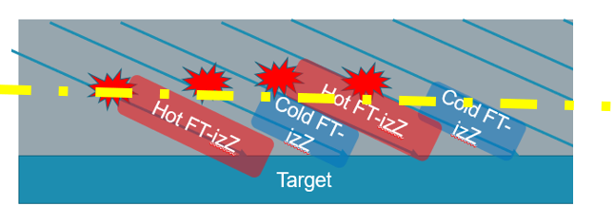
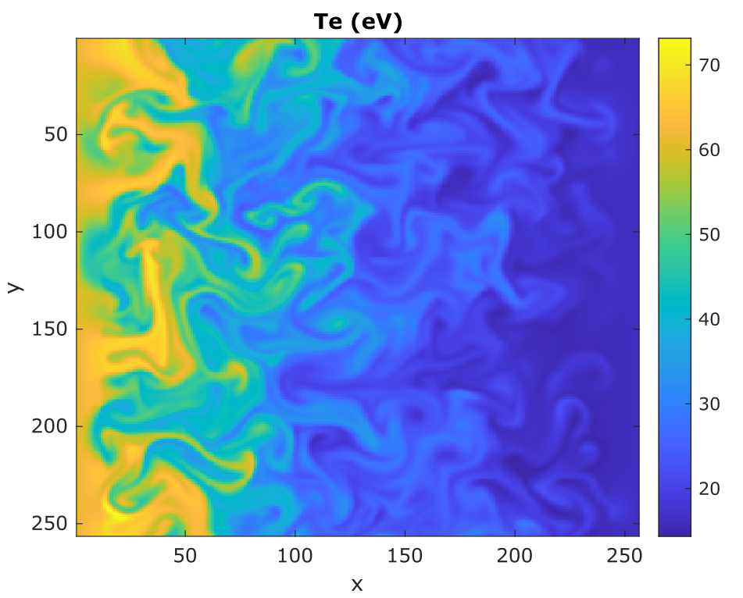
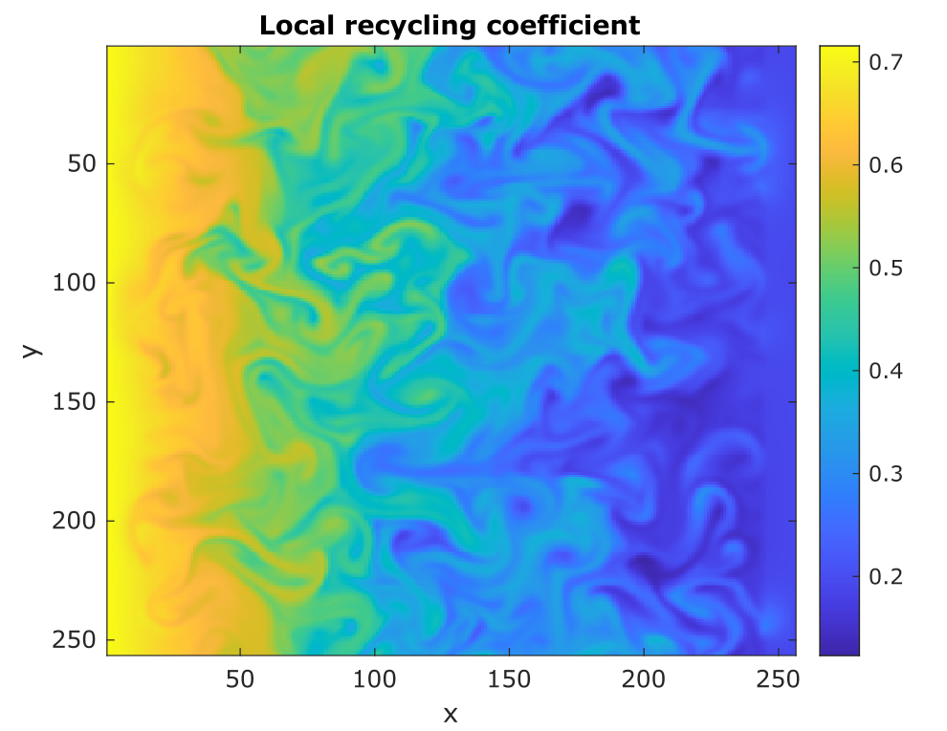
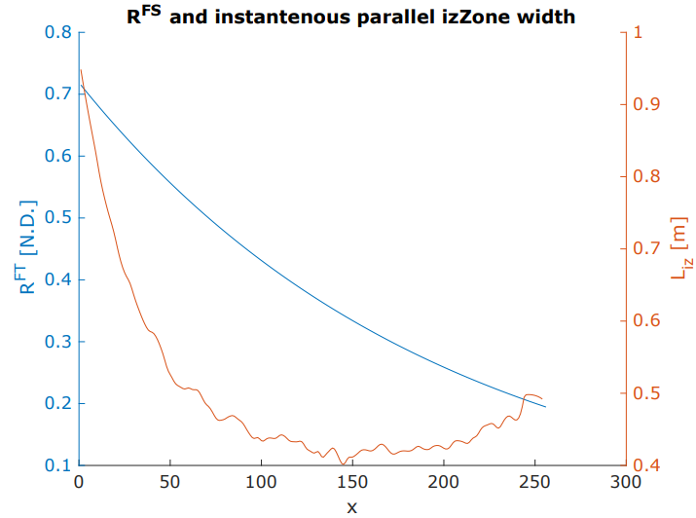
Example of snapshots
With $R^{FS}$-formulation: “holes”/”blobs” realize smaller/larger R
Prescribed $R^{FS}$-profile can require increase in $L_{iz}$ for ‘far’-SOL ($⇒$ Alternative: fixed $L_{iz}$-profile)
Note: $R^{FS}$ i.s.o. R determines $L_{iz}$
R from SOLPS reflects a “mean R” for the FS
Notes:
Holes in red, to iterate on them causing nonconvergence issues when running with fixed R

Slide 24
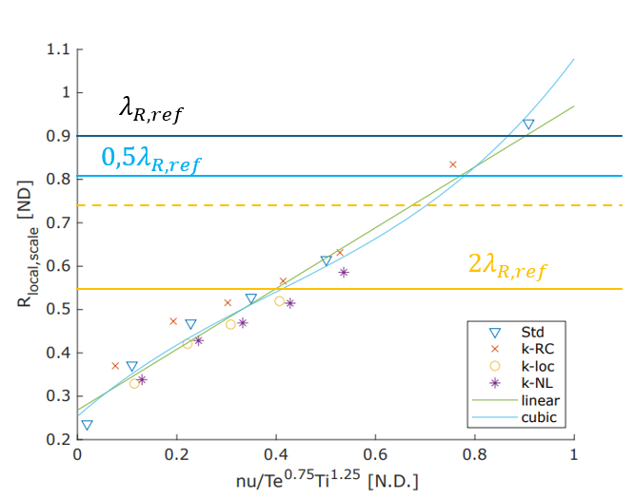
Example of snapshots
With $R^{FS}$-formulation: “holes”/”blobs” realize smaller/larger R
Prescribed $R^{FS}$-profile can require increase in $L_{iz}$ for ‘far’-SOL ($⇒$ Alternative: fixed $L_{iz}$-profile)
Schematic of obtained scaling R
$L_{iz}$-fixation

Slide 25
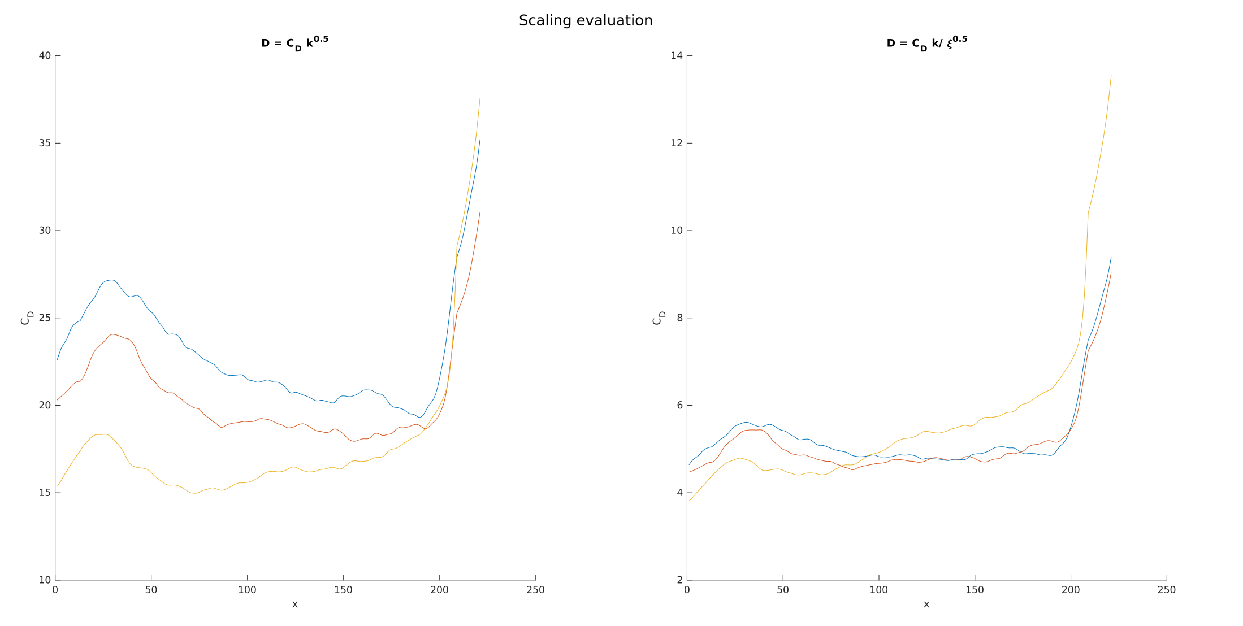
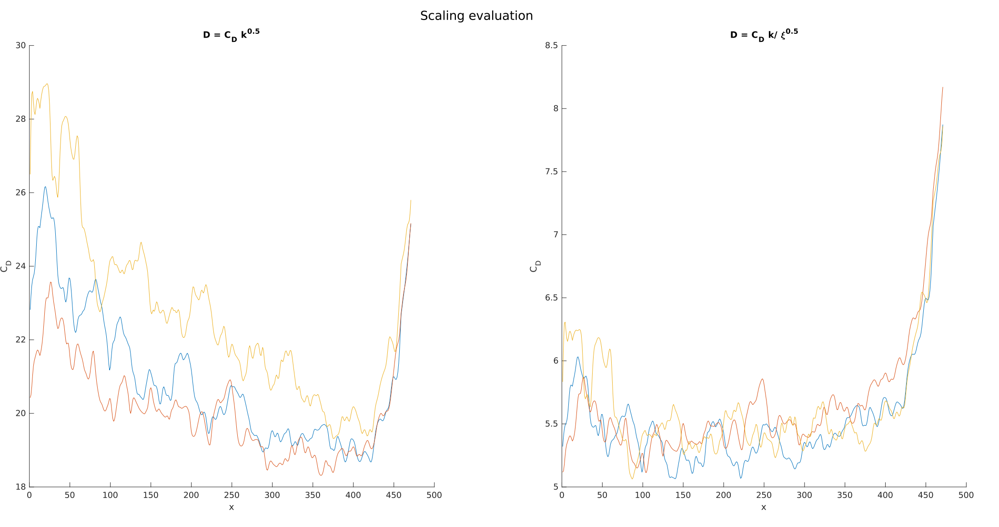
Turbulence scaling (prelim)
RC found 20,8$\sqrt{k}$-scaling and 6,5$k/\sqrt{ξ}$-scaling for aniso SCW1
Without R
With R
More flat
R increasing
[0,38-0,56->0,9]
$R↑:$Profile becomes inclined
Notes:
Global recycling coefficient varied between 22,7% for run 6 -> 35 % for reference -> 60 % for run0

Slide 26
Future work

Slide 27
Future work
2D simulations
Finalize ‘correlation based diffusion’ analysis
Start modeling the turbulent transport and the required turb. quantities
Both for R = 0 and R !=0 simulations
Goal: test them in TCV-X21/23 validation exercise
3D simulations
SOLEDGE3X: start analysis of balances (+UQ?)
GRILLIX: construct basic evaluation of anomalous fluxes

Slide 28
2D turbulence simulations with recycling ?

Slide 29
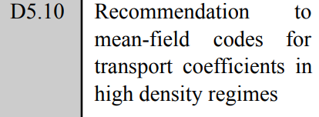
Comment about earlier ‘discussion’
During ‘status workplan’-meeting of 27/11/24: Input to MF-code?
Diffusion coefficients [a] or rather total-fluxes [b]?
Should MF-model options influence our output [c]? (i.e. inclusion of drifts)
From my POV it depends on purpose / ansatz:
Diffusion coefficients based on anomalous transport [a]:
Ansatz: “MF code wants description of anomalous transport, taking peace with ignorance about the magnitude of all other non-linearities”
Provision of ‘fundamanetal/first-principal’ relationship between $\overline{n^{′}v_{E}^{′}}$ ($Γ_{turb}$) and $∇\overline{n}$
Only influenced by assumptions/models used in turbulence code
If MF code does not include drifts, than bad-luck as they can get access to it ... [c]
(I.e. that drift transport is ‘per definition’ convective $→$ D should not account for it)

Slide 30
Comment about earlier ‘discussion’
During ‘status workplan’-meeting 27/11/24: Input to MF-code?
Diffusion coefficients [a] or rather total-fluxes [b]?
Should MF-model options influence our output [c]? (i.e. inclusion of drifts)
From my POV it depends on purpose / ansatz:
Infer mean-field D by providing total-fluxes [b]:
Ansatz: “The mean-field code wants to model the perpendicular transport as accurately as possible (???)”
Hence, D becomes not only a function of the assumptions in the turbulence model, but also of the one in the MF one. (drifts / fluids vs kinetic $n^{0}$ / fluxlimiters / [discretization error ...] / ignorance of all other non-linearities / ... )
... Note obtaining same perpendicular transport does not mean same loading of the divertor target (which is more of interest?)...
System which one then solves may be interpreted as:
Solving system of fluxtubes (radial fluxes are known, except J),
Coupled due to neutral sources and the potential equation
This then gives the plasma quantities, and in post-processing of them the required D would be obtained ...

