Slide 1
TSVV3 – Regular advancement meeting
30/04/2025 – TCV experiments modelling
Project news
P. Tamain

Slide 2
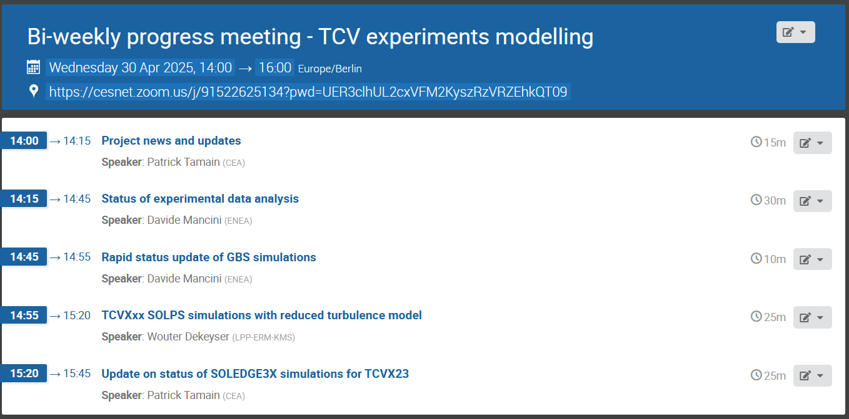
Today’s meeting agenda

Slide 3
Computing time update
  Still very small consumption… please let me know in case of problems
  Significant budget remaining on GPU partition

Slide 4
Latest publications

Slide 5
Today’s meeting agenda
Upload presentations on https://indico.euro-fusion.org/event/2968/ or send to me please.

