Slide 1




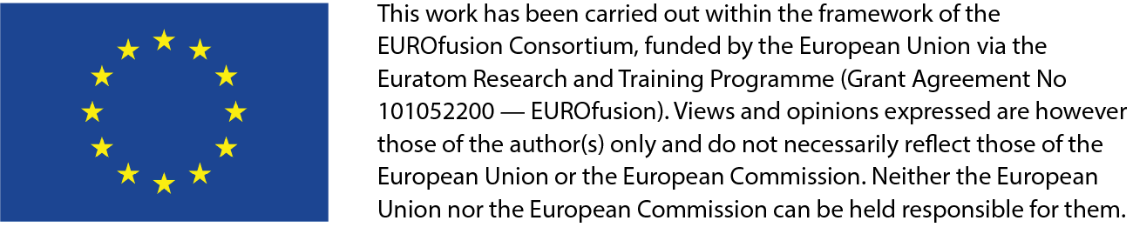
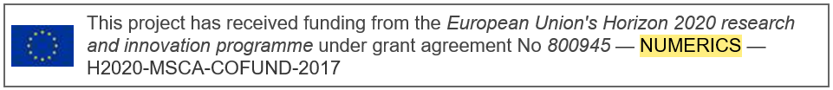
Update on status of SOLEDGE3X simulations for TCVX23
V. Quadri, B. McGibbon, D. S. Oliveira, P. Tamain, H. Bufferand, N. Rivals, R. Düll, G. Ciraolo, S. Sureshkumar, N. Varadarajan and the SOLEDGE3X team.

Slide 2
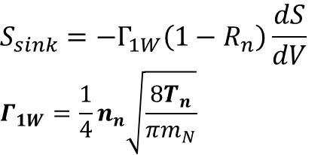
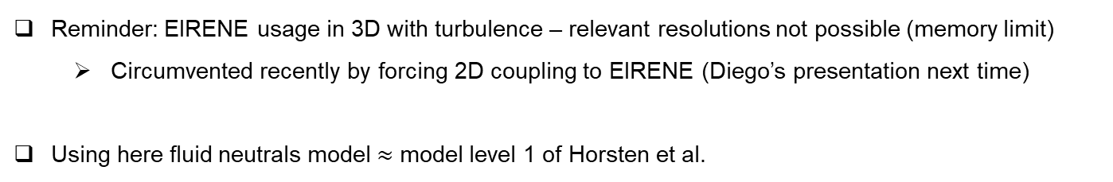
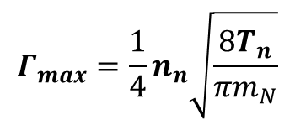
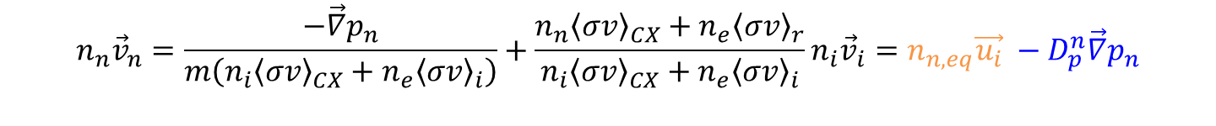
Fluid neutrals in SOLEDGE3X
Reminder: EIRENE usage in 3D with turbulence – relevant resolutions not possible (memory limit)
  Circumvented recently by forcing 2D coupling to EIRENE (Diego’s presentation next time)
Using here fluid neutrals model $≈$ model level 1 of Horsten et al.
$$∂_{t}n_{n}+\vec{∇} ⋅n_{n}{\vec{v}}_{n}=−n_{n}n_{e}{〈σv〉}_{i}+n_{i}n_{e}{〈σv〉}_{r}+S_{puff}+S_{sink}$$
$${n_{n}\vec{v}}_{n}=\frac{−\vec{∇}p_{n}}{m\left(n_{i}{〈σv〉}_{CX}+n_{e}{〈σv〉}_{i}\right)}+\frac{n_{n}{〈σv〉}_{CX}+n_{e}{〈σv〉}_{r}}{n_{i}{〈σv〉}_{CX}+n_{e}{〈σv〉}_{i}}n_{i}{\vec{v}}_{i}=n_{n,eq}\vec{u_{i}} −D_{p}^{n}\vec{∇}p_{n}$$
Wall pumping:
$$S_{sink}=−Γ_{1W}\left(1−R_{n}\right)\frac{dS}{dV}$$
$$Γ_{1W}=\frac{1}{4}n_{n}\sqrt{\frac{8T_{n}}{πm_{N}}}$$
neutrals flux limiter
$$Γ_{max}=\frac{1}{4}n_{n}\sqrt{\frac{8T_{n}}{πm_{N}}}$$

Slide 3


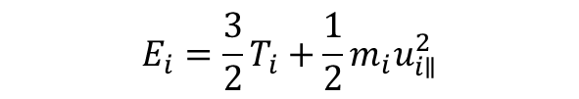
Some caveats with the fluid neutrals model as implemented
Boundary conditions: no effort to make fluid neutrals consistent with sheath and wall recycling models used in kinetic models
Some inconsistencies in source terms applied to the plasma:
$$S_{n}=n_{n}n_{e}{〈σv〉}_{i}−n_{i}n_{e}{〈σv〉}_{r}$$
Assumes $u_{n}=u_{i∥}$
Assumes $u_{n}=0$
$S_{G}={m_{i}n}_{n}n_{e}{〈σv〉}_{i}u_{i∥}−m_{i}n_{i}n_{e}{〈σv〉}_{r}$ $u_{i∥}$-${m_{i}n}_{n}n_{e}{〈σv〉}_{CX}u_{i∥}$
$S_{E_{i}}=n_{n}n_{e}{〈σv〉}_{i}R_{E}E_{i}−n_{i}n_{e}{〈σv〉}_{r}$ $E_{i}−m_{i}n_{n}n_{e}{〈σv〉}_{CX}u_{i∥}^{2}$
$$E_{i}=\frac{3}{2}T_{i}+\frac{1}{2}m_{i}u_{i∥}^{2}$$
$S_{E_{e}}=−n_{n}n_{e}{〈σv〉}_{i}E_{loss,i}$ $−n_{i}n_{e}{〈σv〉}_{r}E_{loss,r}$
“energy recycling coefficient”

Slide 4
Status of TCVX23 simulations
2D / 3D | Neutrals model | B direction | Status
2D | Fluid and kinetic | forward | Density scan run by Virginia, published in NME, analysed in PhD thesis, data lost, currently being re-run by Bridget
3D | Fluid | forward | One attached case, one detached case, partially published in NME, analysed in PhD thesis, data lost, currently being re-run by Bridget
2D | Fluid and kinetic | reversed | Density scan run by Bridget, partially analysed in Master thesis, data lost
3D | Fluid | reversed | Initial runs performed by Bridget for 2 densities, not analysed as not converged, data lost, to be re-run (Diego)
3D | Kinetic 2D | reversed | Simulations for 2 densities on-going (Diego)

Slide 5
TCVX23 cases: partially converged attached and detached cases (1)
Low n_{e}, 30%
Attached
Detached
High n_{e}, 30%

Slide 6
TCVX23 cases: partially converged attached and detached cases (2)

Slide 7


Reminder: change in profiles and turbulence properties
Mid-plane
Divertor
Mid-plane
Divertor
n_{e} (m⁻³)
$$σ_{n_{e}}/n_{e}$$
$$σ_{T_{e}}/T_{e}$$
T_{e} (eV)

Slide 8
Detachment leads to an increase of the SOL width
Both attached and detached case show inflexion point => double exponential fit
SOL width increases both in near SOL (x1,7) and in the far SOL (x2,7) in detached case
  Due to flattening of both n (mainly in near SOL) and T profiles (mainly in far SOL)
Position of inflexion point similar for both cases

Slide 9
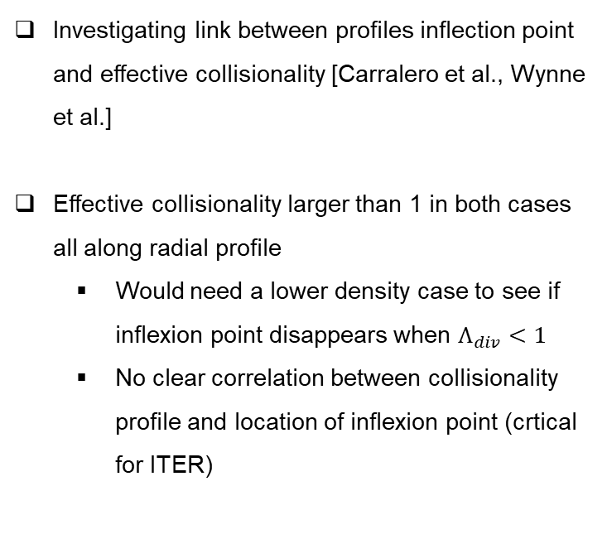
A link with density shoulders?
Investigating link between profiles inflection point and effective collisionality [Carralero et al., Wynne et al.]
Effective collisionality larger than 1 in both cases all along radial profile
  Would need a lower density case to see if inflexion point disappears when $Λ_{div}<1$
  No clear correlation between collisionality profile and location of inflexion point (crtical for ITER)

Slide 10
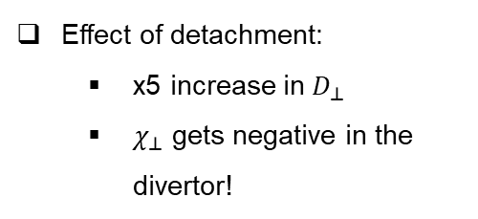
Impact on classic mean-field transport coefficients
Transport coefficients reconstructed from ExB fluctuations:
Attached
Effect of detachment:
  x5 increase in $D_{⊥}$
  $χ_{⊥}$ gets negative in the divertor!
Detached

Slide 11
Alternate mean-field transport models: heuristic $∇p$
Heuristic model driven by $∇p$:
Attached
Effect of detachment:
  No significant area with negative values
  ~x10 on all transport coefficients
Detached

Slide 12
Alternate mean-field transport models: from quasi-linear theory
Model inspired from quasi-linear theory:
Attached
Effect of detachment:
  No significant area with negative values
  Diffusion x2 away from divertor, but drops to zero in divertor
  Thermodiffusion / heat pinch x2 away from divertor, x5 in divertor
Detached

Slide 13


Reversed field: strong impact on mean-field simulations (1)
$$n_{sep}=0.5×{10}^{19} m^{−3}$$
$$n_{sep}=1.2×{10}^{19} m^{−3}$$

Slide 14
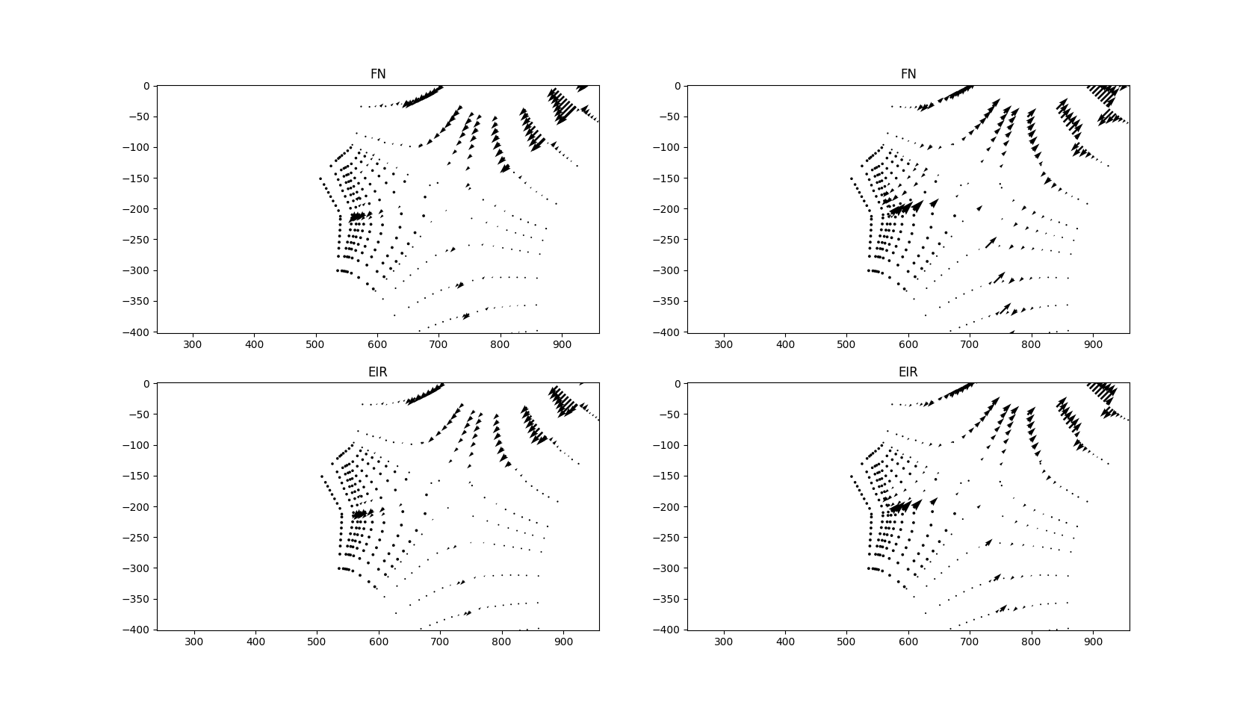
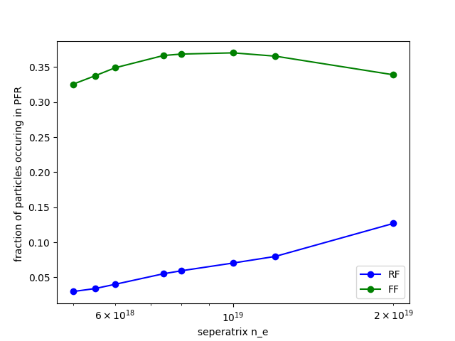
Reversed field: strong impact on mean-field simulations (2)
Forward field
Reversed field

Slide 15
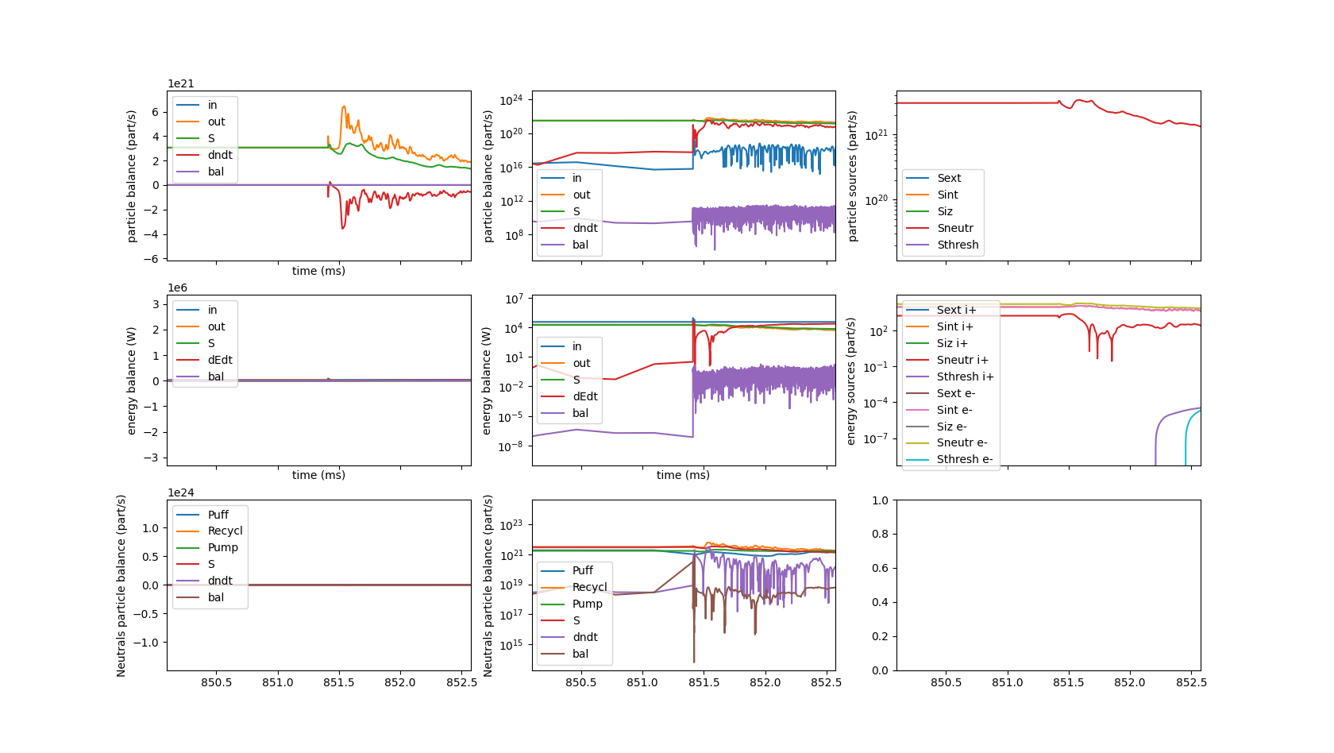
Reversed field: status of turbulence cases
3D simulations restarted from 2D steady-state solutions:
  High density simulation running smoothly: ~1ms since transition => pseudo-steady-state
  Low density one difficult: crashing due to divergence of potential profile in the center (issue with matrix conditioning?) => restarted at artificially increased resistivity (factor of 4) and seems to work
Time (ms)

Slide 16
Outlook
Virginia’s work to be presented at EPS, based on what could be scavenged from the Marconi crash (ie, not much, only figures)
  Simulations being re-run in parallel to serve at least as references for future cases
Near term priorities:
  Run 3D turbulence simulations with 2D axisymmetric kinetic neutrals (Diego)
    Compare with fluid neutrals
    Compare 3D fluid neutrals with 2D axisymmetric fluid neutrals
  Improve fluid neutrals model with by decreasing priority:
    Solve consistency issues in sources
    Move to 3-moment model
    Improve boundary conditions to mimic kinetic ones (following Horsten et al)
  Investigate impact of detachment on turbulence with improved fluid neutrals model

Slide 17
Backup Slides

Slide 18
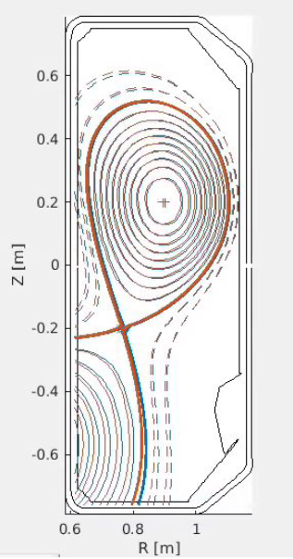
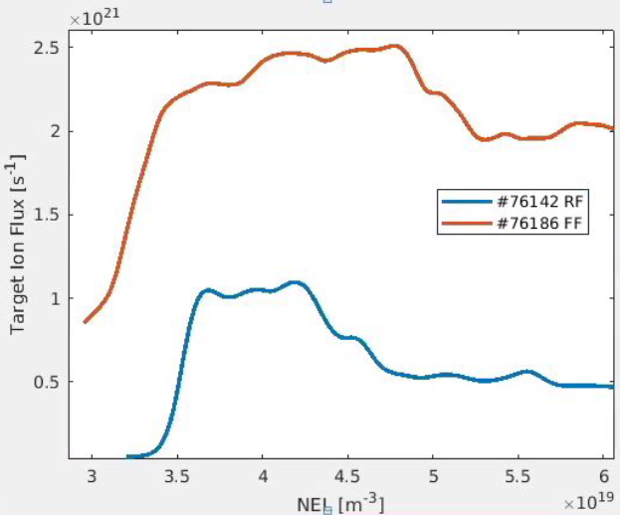
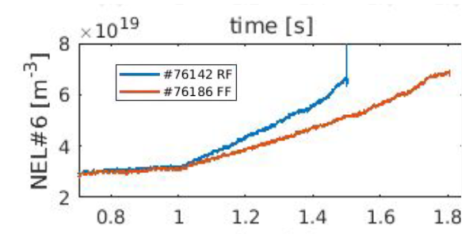
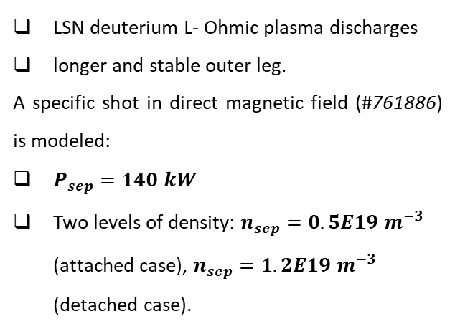
Modeling TCV-X23 experiments with Soledge3x
Why TCV-X23? Configuration which extends the scenario for turbulent codes validation up to detachment.
LSN deuterium L- Ohmic plasma discharges
longer and stable outer leg.
A specific shot in direct magnetic field (#761886) is modeled:
$P_{sep}=140 kW$
Two levels of density: $n_{sep}=0.5E19 m^{−3}$ (attached case), $n_{sep}=1.2E19 m^{−3}$ (detached case).
Fig. 1 Measurements for line integrated average density passing through the magnetic axis (NEL #6) in time, target ion flux w/r NEL #6 and TCV-X23 magnetic equilibrium [courtesy of D. Sales de Oliveira et SPC team].

Slide 19
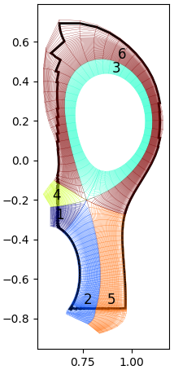
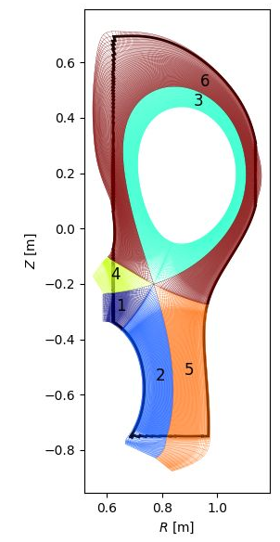


Modeling TCV-X23 experiments with Soledge3x
2D
3D
Strategy: 2D simulations served as a starter for 3D.
2D mean field simulations used to obtain the two density plasma backgrounds.
From 2D convergence, restart in 3D at higher resolution w/ turbulence.
Z$[m]$
Fig. 2 The SOLEDGE3X meshes used for 2D mean field transport (left) and 3D turbulent transport (right) [P. Tamain].
R$[m]$
Outlook: closer to a proper plasma background for particle balance, w/r to evolve it from scratch [V. Quadri et al, https://doi.org/10.1002/ctpp.202300146].
Convergence (~75%) still challenging, due to
  Increased resolution in 3D
  Neutrals recycling
Very slow transient phase for both plasma backgrounds, where turbulence properties are not going to evolve.

Slide 20
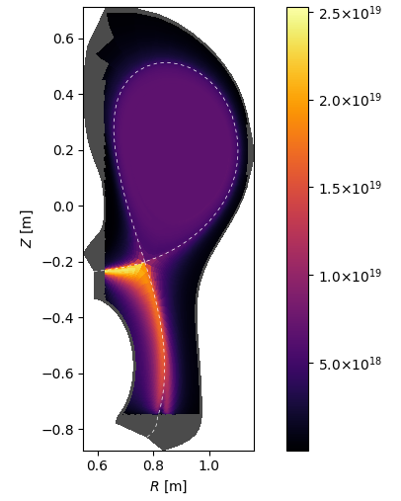
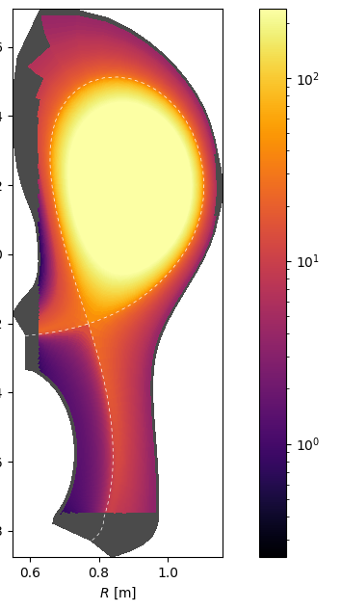
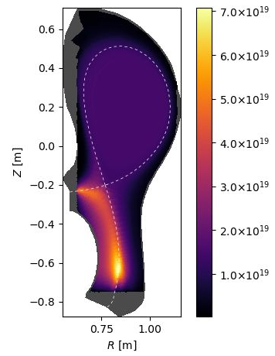
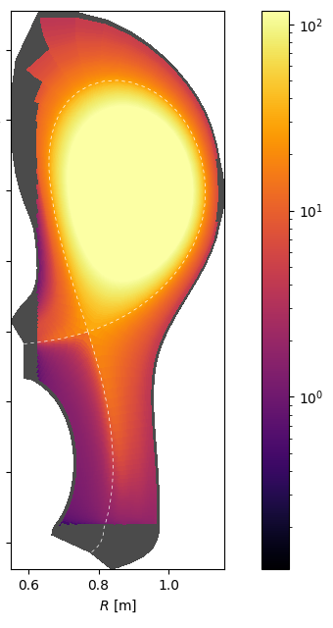

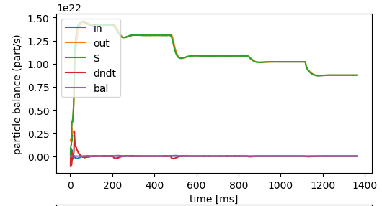
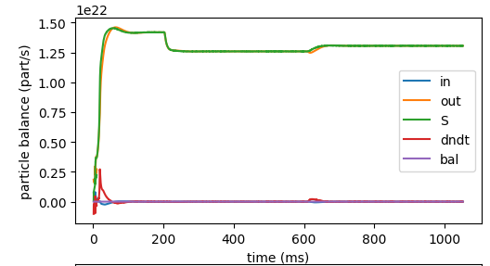








Plasma conditions provided by 2D mean field cases
$$n_{e−} [m^{−3}]$$
$$T_{e−} [eV]$$
$$n_{e−} [m^{−3}]$$
$$T_{e−} [eV]$$
$$n_{sep}=$$
$$0.5E19$$
$$m^{−3}$$
$$n_{sep}=$$
$$0.5E19$$
$$m^{−3}$$
$$n_{sep}=$$
$$1.2E19$$
$$m^{−3}$$
$$n_{sep}=$$
$$1.2E19$$
$$m^{−3}$$
Attached
Converged
Detached
Converged

Slide 21
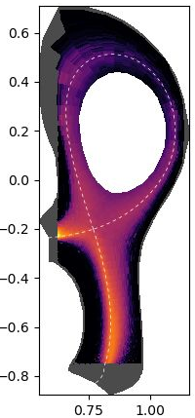
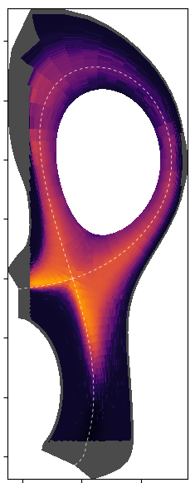
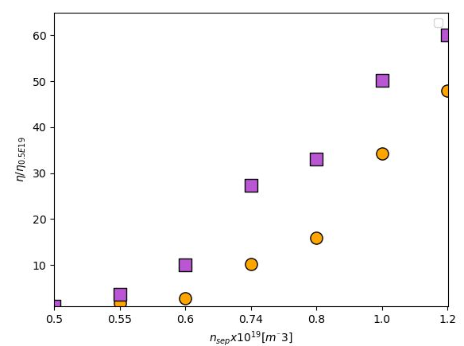
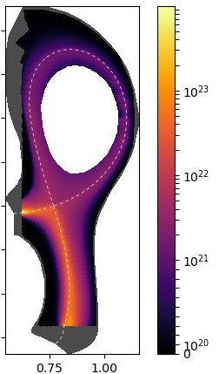
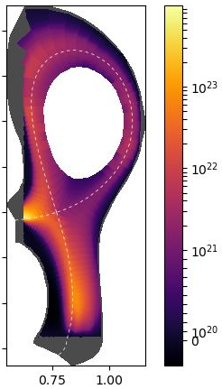
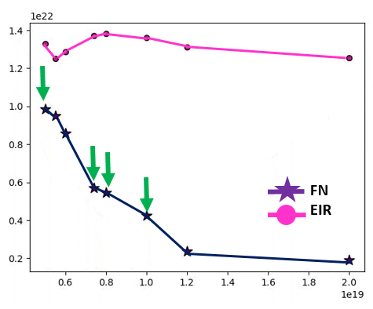








FN vs EIRENE: testing FN assumptions
1. Estimation of collisionality via $η\sim {\left(\frac{T_{e}}{n_{e}}\right)}^{−\frac{3}{2}}scan$
2. Realistic localization of the ionization source $S_{n}$
$Δη$same range w/ and w/out EIRENE
FN
EIR
$$\frac{η}{η_{0.5E18}}$$
EIRENE
FN
EIRENE
FN
$$n_{sep}=$$
$$0.5E19$$
$$n_{sep}=$$
$$0.5E19$$
$$n_{sep}=$$
$$1.2E19$$
$$n_{sep}=$$
$$1.2E19$$
However, still far from being perfect
Qualitative OK, quantitative NOK
$$n_{sep} [×19 m^{−3}]$$
$$max\left(Γ_{e^{+}, ψ}\right) [m^{−2}s^{−1}]$$
FN seems to rollover before EIRENE
FN fluxes amplitude much lower
fluid neutrals model in Soledge3X will need refinements
$$n_{sep} [×19 m^{−3}]$$

Slide 22
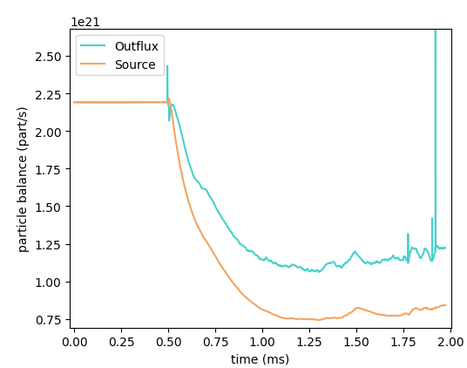
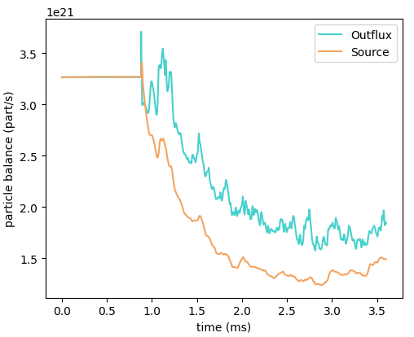
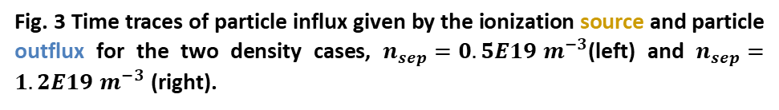
From 2D convergence, restart in 3D at higher resolution w/ turbulence.
Transit to 3D turbulence
2D
mean field
Statistical analysis on turbulence
Outlook: closer to a proper plasma background for particle balance, w/r to evolve it from scratch [V. Quadri et al, https://doi.org/10.1002/ctpp.202300146].
Convergence (~75%) still challenging, due to
  Increased resolution in 3D
  Neutrals recycling
Very slow transient phase for both plasma backgrounds, where turbulence properties are not going to evolve.
Transit to 3D turbulence
2D
mean field
Statistical analysis on turbulence
Fig. 3 Time traces of particle influx given by the ionization source and particle outflux for the two density cases, $n_{sep}=0.5E19 m^{−3}$(left) and $n_{sep}=1.2E19 m^{−3}$ (right).

Slide 23
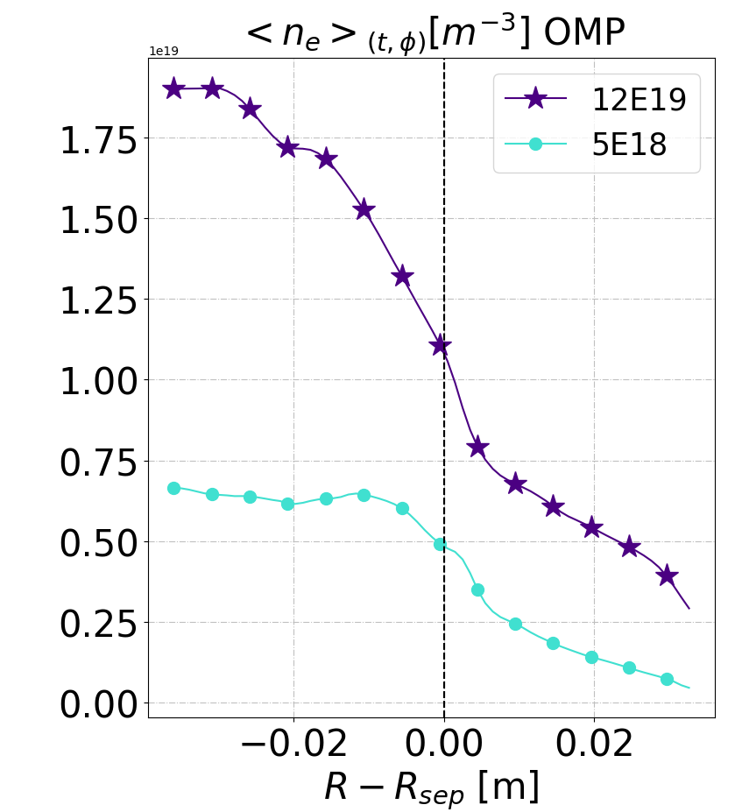


From 2D → 3D: two different densities at the sep with turbulence
Puff: $2.7E+21 [\frac{part}{s}]$
Puff: $1.3E+21 [\frac{part}{s}]$

Slide 24
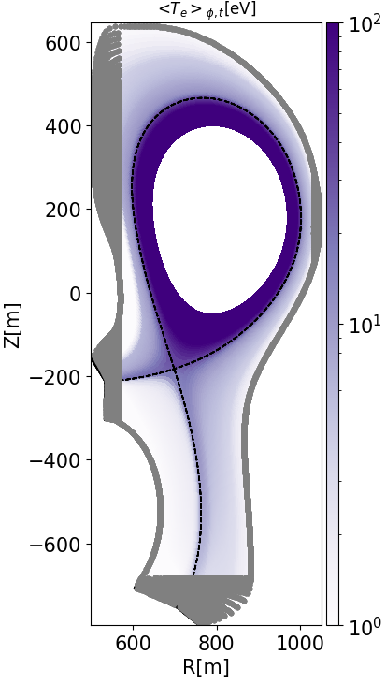
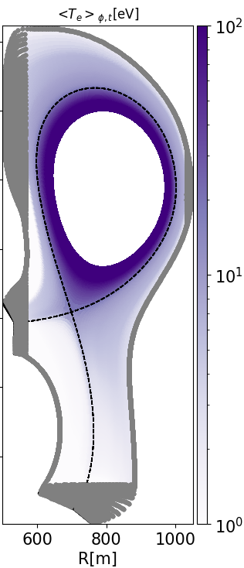
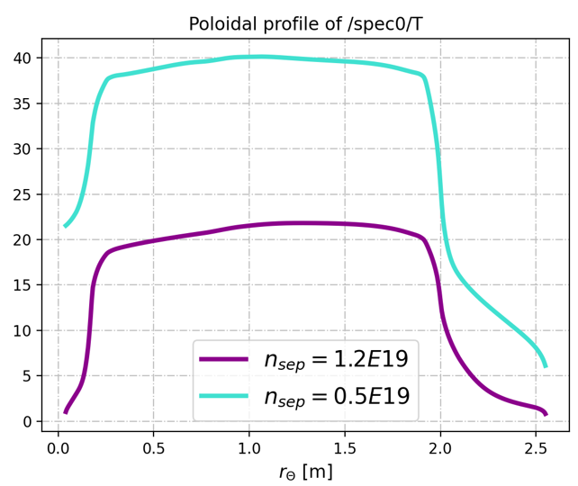



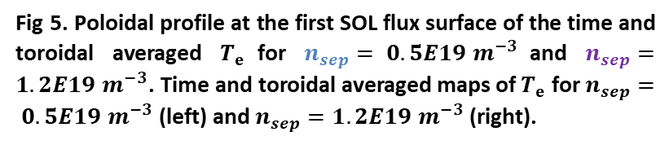

Different plasma conditions for the two density cases
$$T_{e}[eV]$$
$$T_{e}[eV]$$
$$n_{sep}=$$
$$0.5E19$$
$$m^{−3}$$
$$n_{sep}=$$
$$1.2E19$$
$$m^{−3}$$
$$T_{e}[eV]$$
Inner target
Outer mid-plane
Outer target
Fig 5. Poloidal profile at the first SOL flux surface of the time and toroidal averaged $T_{e}$for $n_{sep}= 0.5E19 m^{−3}$and $n_{sep}=1.2E19 m^{−3}$. Time and toroidal averaged maps of $T_{e}$for $n_{sep}= 0.5E19 m^{−3}$(left) and $n_{sep}=1.2E19 m^{−3}$ (right).
~ 1eV!

Slide 25
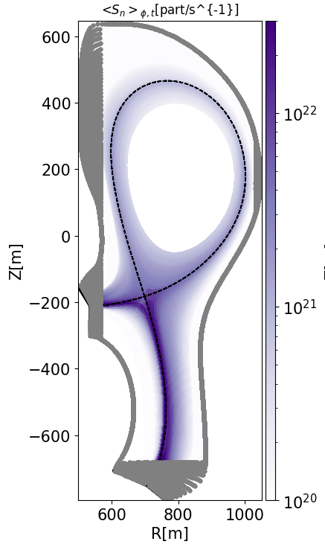
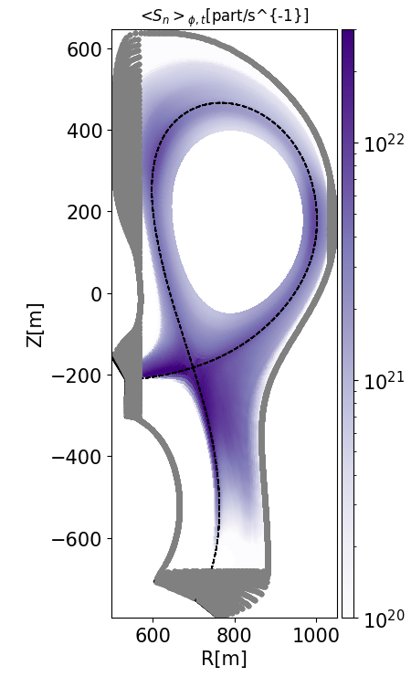
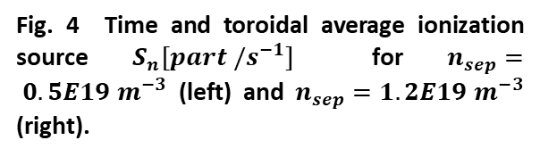

Different plasma conditions for the two density cases
$$S_{n}[part /s^{−1}]$$
High density case is detached!
$$n_{sep}=$$
$$0.5E19$$
$$m^{−3}$$
$$n_{sep}=$$
$$1.2E19$$
$$m^{−3}$$
Fig. 4 Time and toroidal average ionization source $S_{n}[part /s^{−1}]$ for $n_{sep}= 0.5E19 m^{−3}$ (left) and $n_{sep}=1.2E19 m^{−3}$ (right).

Slide 26
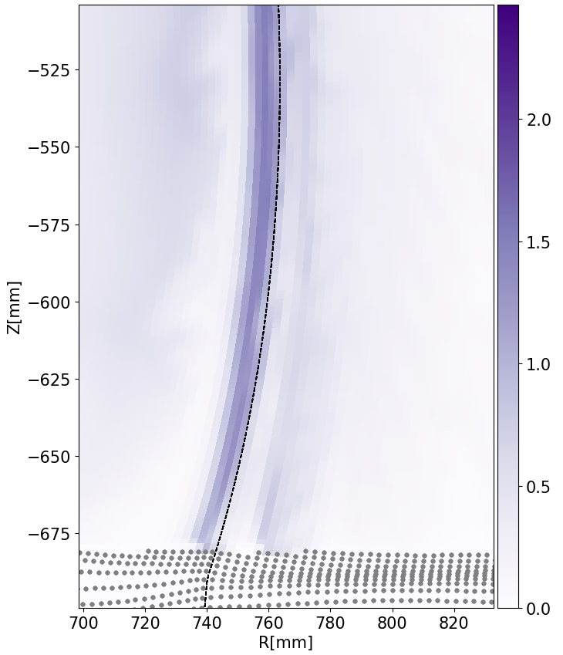
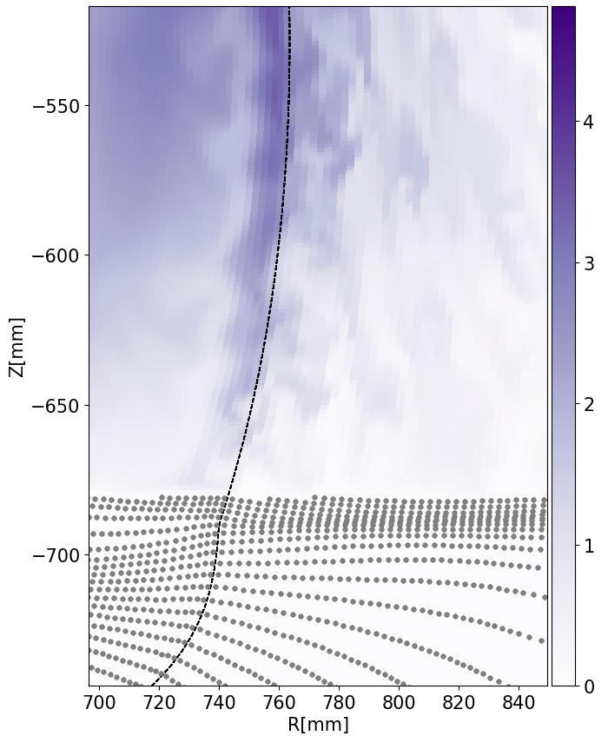
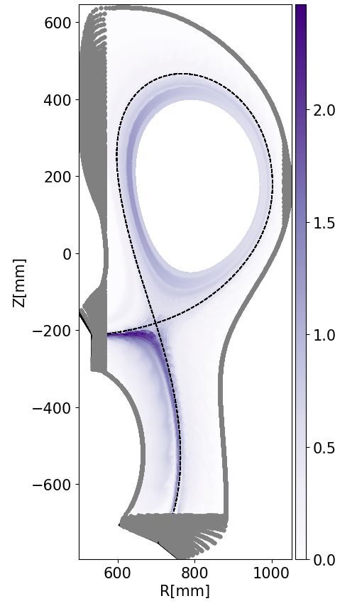



Different plasma conditions for the two density cases
Turbulence structures immediately exhibit qualitatively differences depending on the density level.
$n_{e} −{\overline{n}}_{e}$ ${[m}^{−3}]$
$$n_{sep}=$$
$$0.5E19$$
$$m^{−3}$$
$$n_{sep}=$$
$$1.2E19$$
$$m^{−3}$$
Commonly, turbulent transport dominates transverse fluxes both in the main SOL and in the divertor.
Specific turbulent activity all along the outer divertor leg up to the target.

Slide 27









Time-averaged radial profiles
OMP
Outer target
Mid-divertor
1. Plasma properties
The density is globally higher where we aimed for the simulation to have higher values.
At the midplane, the profiles match the values imposed by the experiments but are still evolving.
The temperature is higher for the low-density case in the edge, and slightly higher in the near SOL.
Temperature profiles flatten in the far SOL around 10 eV.
$$<n_{e}>_{\left\{t, φ\right\}} \left[m^{−3}\right]$$
PFR
SOL
PFR
SOL
PFR
SOL
PFR
$$<T_{e}>_{\left\{t, φ\right\}} \left[eV\right]$$
SOL
Fig 6. Radial profiles of the time and toroidal averaged electron density $n_{e} [m^{−3}]$ (upper) and temperature $T_{e} [eV]$ (bottom) for the two density cases, $n_{sep}= 0.5E19 m^{−3}$and $n_{sep}=1.2E19 m^{−3}$ at the outer midplane (left), outer target (cent) and mid divertor (right).

Slide 28





Impact on turbulence properties
$$Δ\left[{\left(\frac{σ_{n_{e}}}{<n_{e}> }\right)}_{high}−{\left(\frac{σ_{n_{e}}}{<n_{e}> }\right)}_{low}\right]$$
2. Turbulence properties
Relative fluctuations level of $n_{e}$ ($\frac{σ_{n_{e}}}{<n_{e}> }$)
Density fluctuations appear to increase with density itself.
However, fluctuations rate is globally larger for the low density case in the whole SOL (except some specific locations)
$$n_{sep}=$$
$$0.5E19$$
$$m^{−3}$$
$$n_{sep}=$$
$$1.2E19$$
$$m^{−3}$$

Slide 29






Impact on turbulence properties
The relative fluctuations are higher in the SOL, while they decrease at the separatrix where the increase in density is faster than the increase in absolute fluctuation level.
Globally, density fluctuations rate seems not so impacted: the amplitude of the fluctuations is not varying so much.
Skewness is strongly poloidal asymmetric.
Negative inside the separatrix; increasing positively for the ttached case [consistent w/ Zweben, MAST experimental dataset]
Flat and not skewed for the high density case at the MP

Slide 30



Impact on turbulence properties
Near SOL
Far SOL

Slide 31













Heat flux channel width
$q_{∥}[\frac{W}{m^{2}}]$ 2D mean-field
$q_{∥}[\frac{W}{m^{2}}]$ 3D turbulence
$$1e7$$
$$1e7$$
3. Transport properties
$$q_{peak}≈n \left(γ_{e}T_{e}+γ_{i}T_{i}\right)\sqrt{(T_{e}+T_{i}) }$$
Single exponential fit
Single exponential fit
Clear change in the profiles for MF vs turbulence.
Fig. 8 MF & turbulence comparison of parallel heat fluxes peaks at the mid-plane for $n_{sep}=0.5E19 m^{−3}$ and $n_{sep}=1.2E19 m^{−3}$ via single exponential fit.
$$\sim ×1.3$$
$$\sim ×2.5$$
$$n_{sep}[m^{−3}]$$ | $$λ_{q}\text{[}\text{mm}\text{]}$$ | $q_{peak}[\frac{W}{m^{2}}]$
$$0.5E19$$ | $$7.87$$ | $$2.0E7$$
$$1.2E19$$ | $$10.24$$ | $$2.7E7$$
$$n_{sep}[m^{−3}]$$ | $$λ_{q}\text{[}\text{mm}\text{]}$$ | $q_{peak}[\frac{W}{m^{2}}]$
$$0.5E19$$ | $$3.35$$ | $$1.75E7$$
$$1.2E19$$ | $$8.71$$ | $$1.4E7$$
In turbulence simulations, the “average” $λ_{q}$ in detachment has increased by a factor of 2.5.

Slide 32






Heat flux shoulder appearance in high density case
$q_{∥}[\frac{W}{m^{2}}]$ 3D turbulence
$$1e7$$
linear fit 5E18
Double exponential fit
Appearance of a far SOL shoulder in the heat flux decay
log
$$n_{sep}[m^{−3}]$$ | $λ_{q, NEAR}$ [mm] | $q_{peak, NEAR}[\frac{W}{m^{2}}]$ | $λ_{q, FAR}$ [mm] | $q_{peak, FAR}[\frac{W}{m^{2}}]$
$$0.5E19$$ | $$\sim 1$$ | $$1,6E7$$ | $$\sim 10$$ | $$2.1E5$$
$$1.2E19$$ | $$2.35$$ | $$1.24E7$$ | $$20.3$$ | $$4.4E6$$
$$\sim ×21‼‼$$

Slide 33





Exctrating the diffusion maps for 2D mean field
$$D_{⊥}\left[\frac{m^{2}}{s}\right]$$
Clear change in transport due to density regimes, with very different amplitudes.
Larger transport coefficients in the high density cases with respect to the low density case.
Particle transport is indeed strongly enhanced.
$$n_{sep}=$$
$$0.5E19$$
$$m^{−3}$$
$$n_{sep}=$$
$$1.2E19$$
$$m^{−3}$$

Slide 34
Summary
Restarting from mean field simulations helps to establish turbulence on the desired plasma background.
Turbulence simulations can adequately access high-density regimes; even if not fully converged, the turbulence properties will not change significantly during a very long transient period.
Significant changes in global and local properties of both plasma and turbulence are observed transiting from low to high density regimes.
By increasing the density, a significant volume of plasma is migrating along the divertor region leading to a broadening of the SOL.
The appearance of a far SOL shoulder is observed in the detached case.
Outlook: All the data for comparison with experiments are available. What is next?

Slide 35



${n_{e}, T}_{e}$ mid divertor

Slide 36









${n_{e}, T}_{e}$ inner target

Slide 37


$n_{e}$ absolute vs relative fluctuations 3 poloidal positions

Slide 38





$n_{e}$ absolute + relative fluctuations 3 poloidal positions

Slide 39



$T_{e}$ turbulence properties different poloidal locations

Slide 40



$n_{n}$ OMP and mid divertor

Slide 41







$n_{n}$ turb properties OMP and mid divertor

Slide 42



$T_{i}$ OMP and mid diverto

Slide 43






Ti turb properties

Slide 44



Density fluc time evolution
OMP
Outer strike point
Mid divertor

Slide 45





Different plasma conditions for the two density cases
$S_{n}[part /s^{−1}]$
Turbulence structures exhibit already qualitatively differences depending on the density level.
$$n_{sep}=$$
$$0.5E19$$
$$m^{−3}$$
$$n_{sep}=$$
$$1.2E19$$
$$m^{−3}$$
Z$[m]$
Commonly, turbulent transport dominates transverse fluxes both in the main SOL and in the divertor.
Specific turbulent activity all along the outer divertor leg up to the target.

Slide 46

Diffusion map $n_{sep}= 0.5E19$

Slide 47

Diffusion map $n_{sep}=1.2E19$

Slide 48




$$1.2E19$$
$$0.5E19$$

Slide 49






Strong drop of the heat fluxes at the targets
Not possible to perform an Eich fit there
$q_{∥}[\frac{W}{m^{2}}]$ outer target
$q_{∥}[\frac{W}{m^{2}}]$ inner target
$$1e6$$
$$1e7$$

