Slide 1
TSVV3 – Regular advancement meeting 11/06/2025 – Sheath boundary conditions Project news
P. Tamain

Slide 2
Today’s meeting agenda

Slide 3
Follow-up from previous discussions
Start of Pitagora: any feedback?
Call 2026-2027: any news?

Slide 4
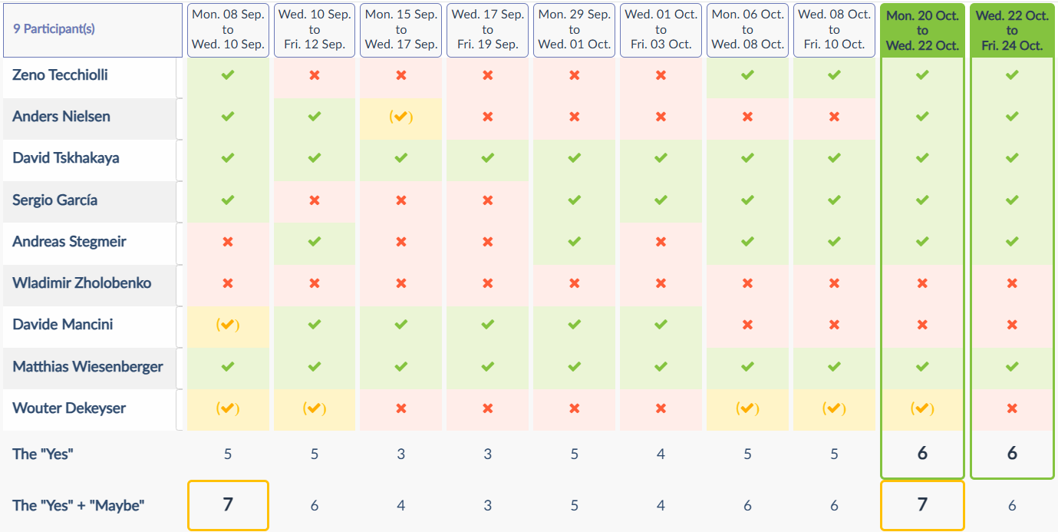
Annual workshop
Hard to find a satisfying time: would it change anything if organized somewhere else than DTU? E.g. Garching…

Slide 5
Latest publications
Numerical methods, solvers
M. Guido et al : 30th May 2025 | DocumentID : 40583
: Accelerated Neutral Solvers for Plasma Simulation
Journal : Journal of Computational Physics, .
MAST-U simulations
AH Nielsen et al : 4th June 2025 | DocumentID : 40611
: Simulating Edge Transport in MAST-U Using the FELTOR Code
Conference : 9th Asia-Pacific Conference on Plasma Physics (AAPPS-DPP2025), Fukuoka International Congress Center, Japan, 21st September 2025.

Slide 6
Today’s meeting agenda
Upload presentations on https://indico.euro-fusion.org/event/2971/ or send to me please.

