Slide 1
Simulating Edge Transport in MAST-U Using the FELTOR Code
Anders Henry Nielsen
Dept of Physics, Technical University of Denmark
ahnie@fysik.dtu.dk
M. Wiesenberger, A. Thrysøe, Y. Andrew, O. Myatra, D. Ryan, E. Kim, C. Jones, V. Hall-Chen, T. Aungcharoen, S. Brynjulfsen, O.E. Garcia, TSVV3 contributor and MAST-U contributors

Slide 2
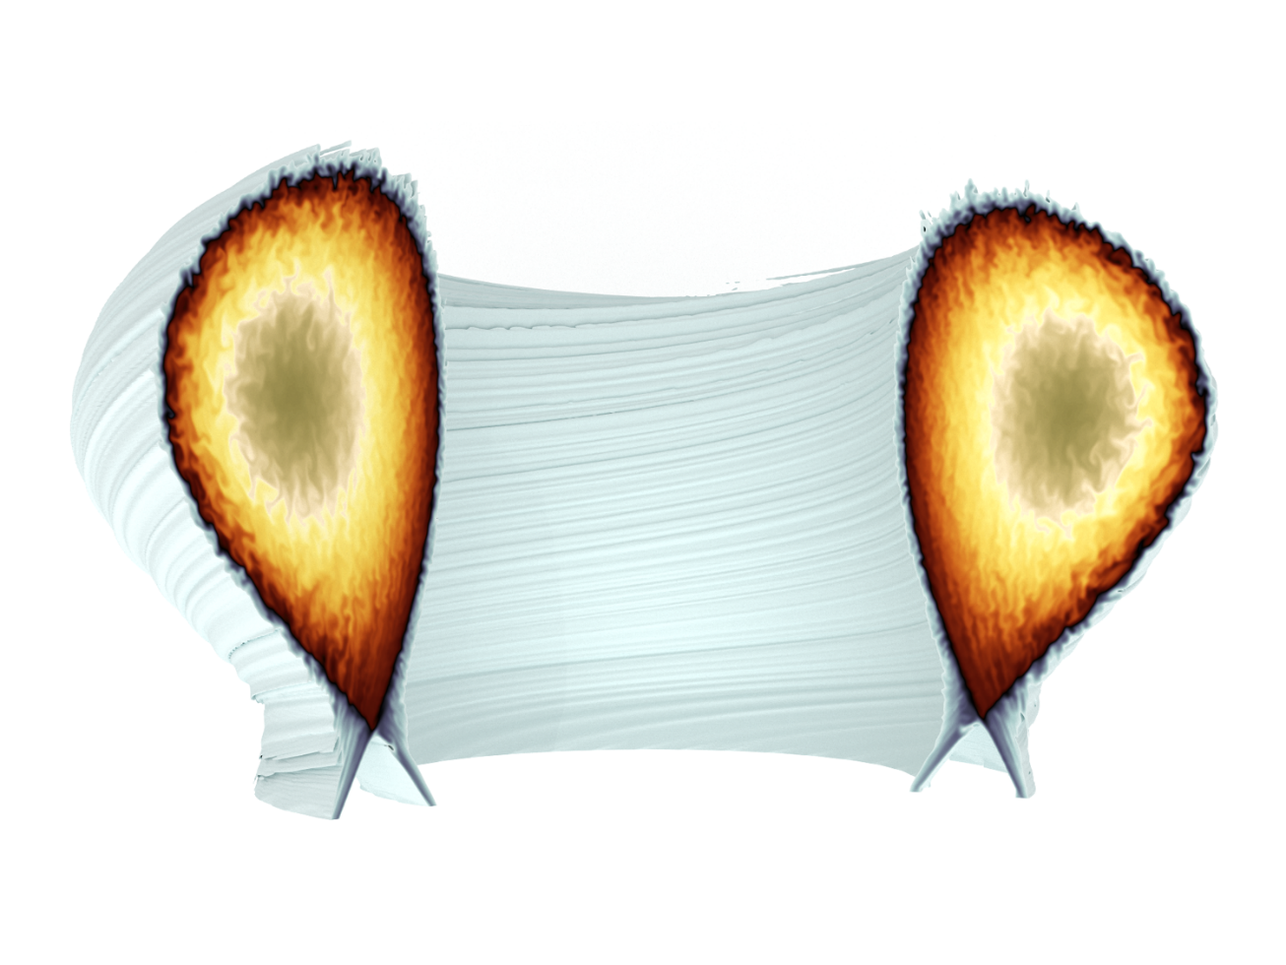
Agenda
TSVV-3 Goals and motivation
Feltor
Experimental input - MAST-U shot #48004
Simulation Feltor@MAST-U#48004 Analysis ongoing
Synthetic diagnostic - Probes - Doppler Backscattering (DBS)
Conclusions

Slide 3

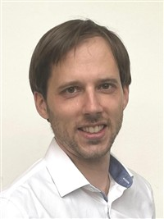
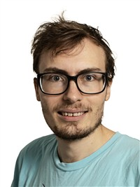

TSVV-3 Goals and motivation
TSVV = Theory, Simulation, Validation and Verification Eurofusion’s software development work packages
TSVV-3: “model the boundary plasma [edge/SOL] of magnetic fusion devices, ultimately allowing applications to reactor relevant devices such as ITER and DEMO with improved predictive capabilities and/or improved numerical cost”
CEA (France), DTU (Denmark), EPFL (Switzerland), MPG (Germany), KU Leuven (Belgium), IPP CR (Czech Republic)
4 edge turbulence codes involved: FELTOR, GBS, GRILLIX, SOLEDGE3X
Theory development “of gyro-fluid models for reactor-relevant conditions”
Boundary physics: heat loads on divertor targets
Code performance
Electromagnetic effects
Multispecies and neutral physics
Synthetic diagnostics
A.H. Nielsen
M. Wiesenberger
A. Thrysøe

Slide 4
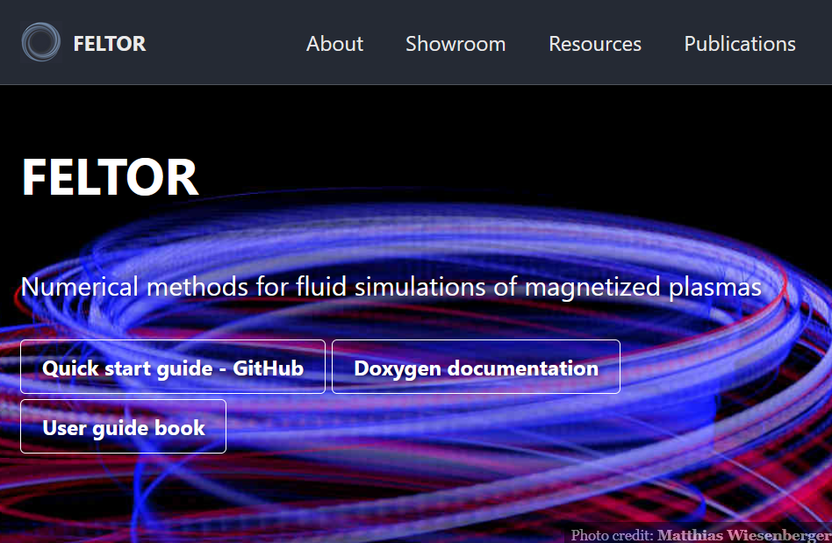
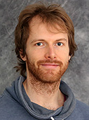
FELTOR
Code base for all 3d gyro-fluid simulations
Modular design: Can be used as a standalone library for HPC applications
Numerical methods fully parallelized and optimized (including GPUs)
Modern C++ software design, CI/CD, cmake integration, documentation, etc.
Open source
Get involved on the homepage https://feltor-dev.github.io
M. Wiesenberger
M. Held

Slide 5
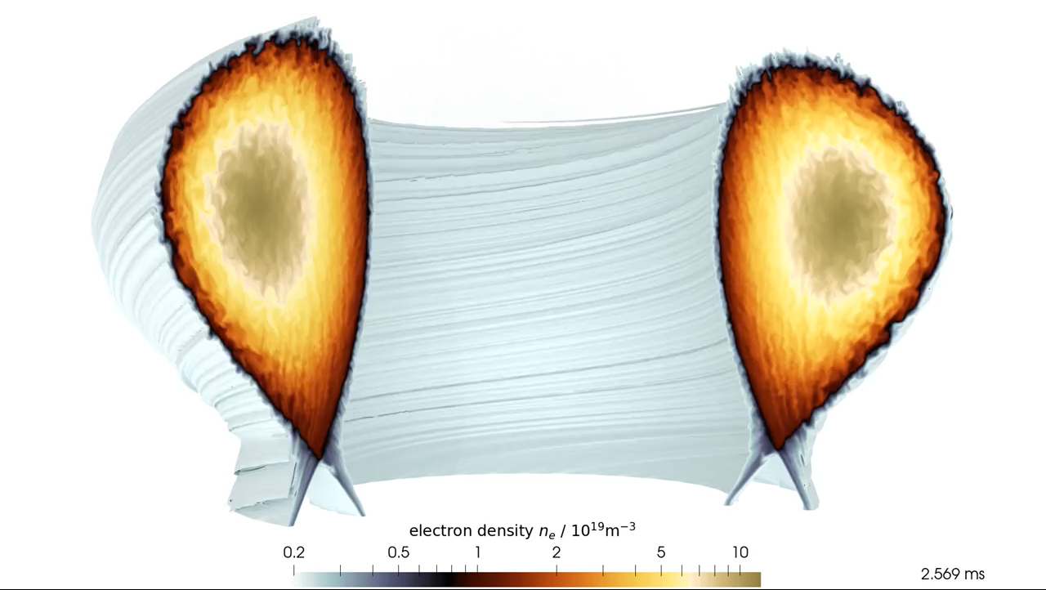
2024: A milestone: 5 ms of turbulence in COMPASS
20 Mio points on 16 GPUs for 10 days (Marconi-Leonardo cluster)
First stable three-dimensional turbulence simulations of several milliseconds
Enables physical studies:
Parameter scans
Synthetic diagnostics → probes
Radial electric field studies
Rotation and angular momentum
Magnetic islands
…
R = 0.56 m ,a = 0.23m Volume = 0.5 m³ B = 0.90 T
M. Wiesenberger and M. Held, Plasma Phys. Control. Fusion 66, 065003 (2024)
Notes:
VIDEO: The electron density $n_e$ for $\eta=10^{-4}$, $T_i = T_e = 7.8$eV and $B_0 = 0.4$T. We show an iso-volume of $n_e/n_0 \geq 0.22$ and choose a wave colormap constructed with the ColorMoves tool from \cite{sciviscolor} mapped to logarithmic density values. The three color regions (blue-grey, red-yellow and brown-grey) roughly coincide with the three regions scrape-off layer, edge and core/source region
Field alignment is visible and poloidal rotation in the edge

Slide 6
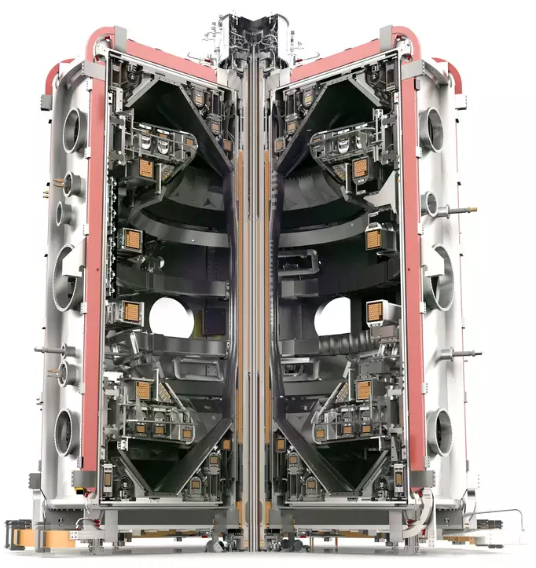
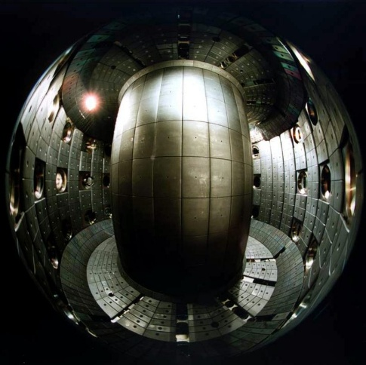
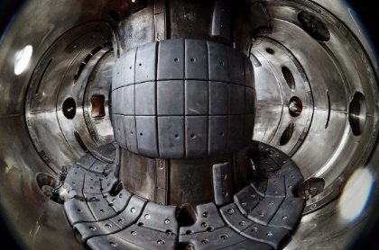
Machines simulated by Feltor
MAST-U !
COMPASS ✓
TCV ✓
R = 0.56 m ,a = 0.23m α = R/a = 2.4 Volume = 0.5 m³ B = 0.90 T
R = 0.88 m , a = 0.25 m α = R/a = 3.5 Volume = 1.0 m³ B = 1.40 T
R = 0.85 m , a = 0.65 m α = R/a = 1.3 Volume = 6.5 m³ B = 0.75 T
Wiesenberger & Held 2024 PPCF 66
S. Brynjulfsen et al 2025, in preparation
This presentation
✗ The present model is isothermal (N, U) gyro-fluid; temperature effects are certainly relevant
Notes:
Sizewise, MAST-U should be doable, especially because the magnetic field is small
Why are we in this meeting?

Slide 7
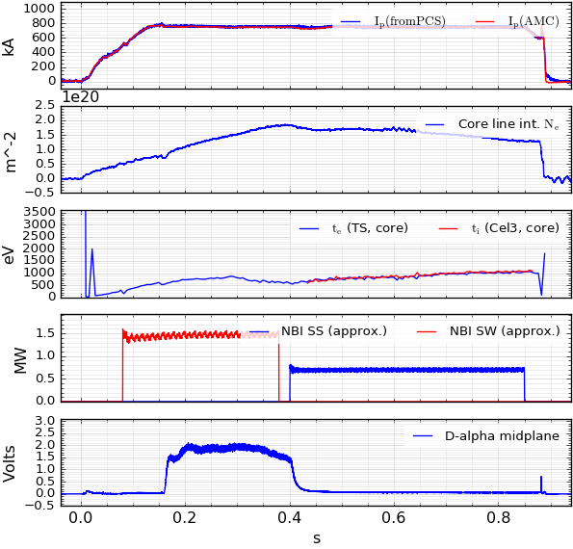
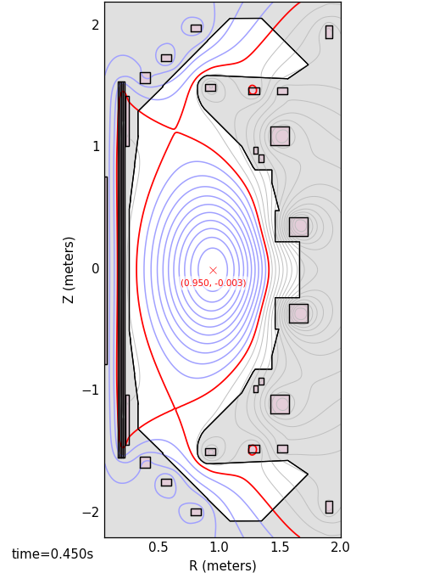
Experimental input
MAST-U#48004
Jones PPCF 67 (2025) 082501
L-mode
B₀ = 0.6 T
Time 0.45 s
NBI-heated MAST-U plasma with a Super-X double null divertor configuration

Slide 8
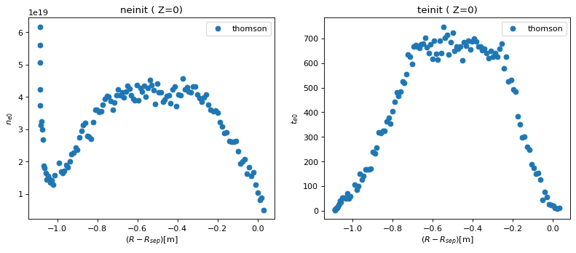
Experimental input
MAST-U#48004@time=0.45 sec
Force region
Feltor domain
T_{e,0}= 76 eV
Thomson diagnostic gives the electron density, maintained in the core region during simulation
The electron temperature, we use a typical edge value of 76 eV to obtain plasma parameters
Domain only up to divertor entries as Feltor is not capable of resolving the divertor geometry

Slide 9
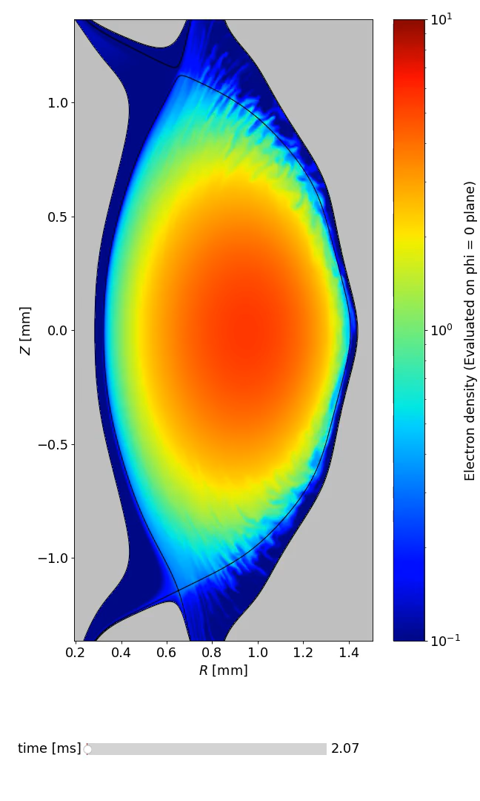
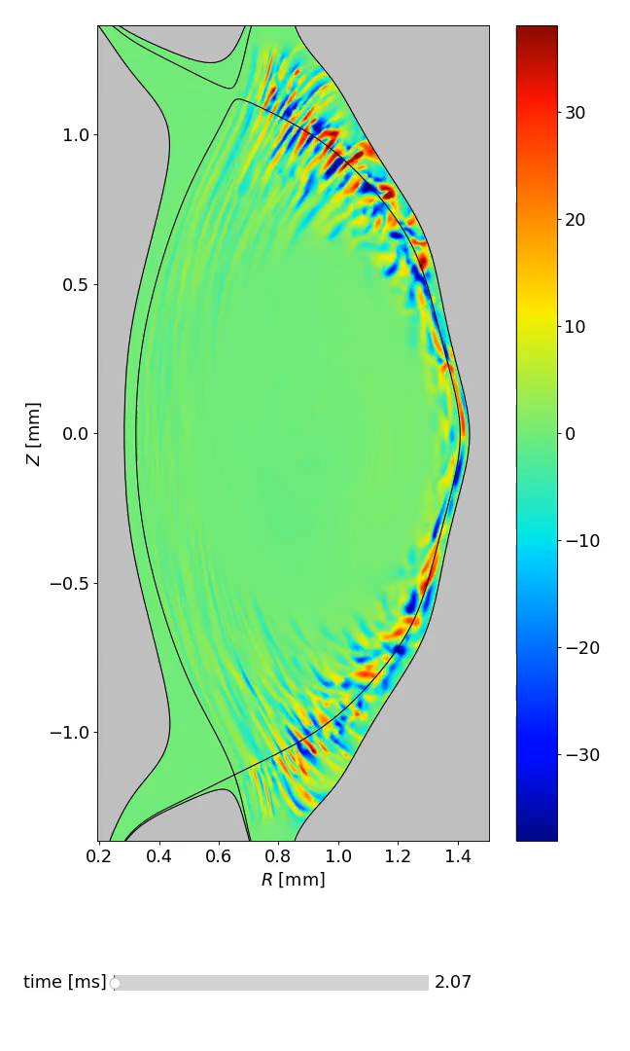
Simulation
Feltor@MAST-U#48004
Electron density
Potential fluctuations
5 ms of L-mode MAST-U has been simulated
Wall clock time was 25 days on Pitagora, CINECA, Italy using 16 GPU’s (NVIDIA H100 accelerators)
More than 1 TB of data
Fluctuations observed over most of the outboard side with associated transport across LCFS
No significant fluctuations observed on the inboard side
Plasma rotation anticlockwise inside the LCFS, in the electron diamagnetic direction

Slide 10
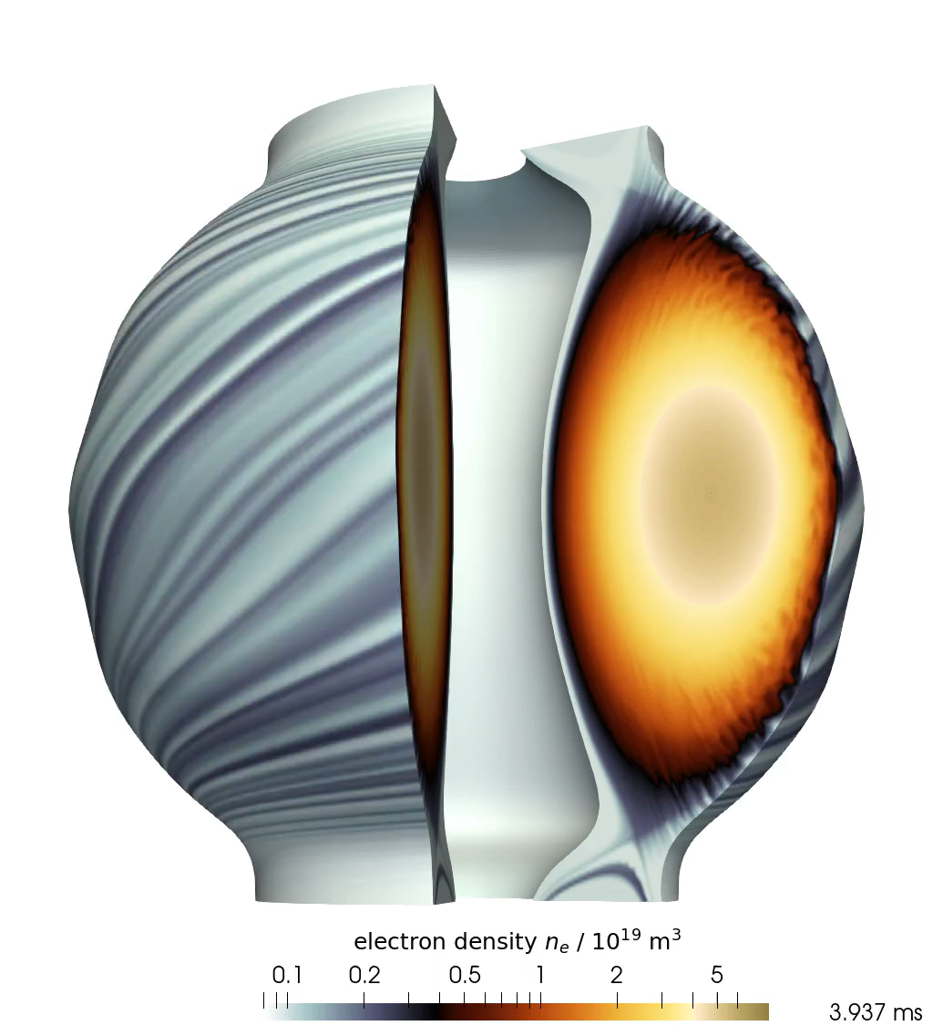
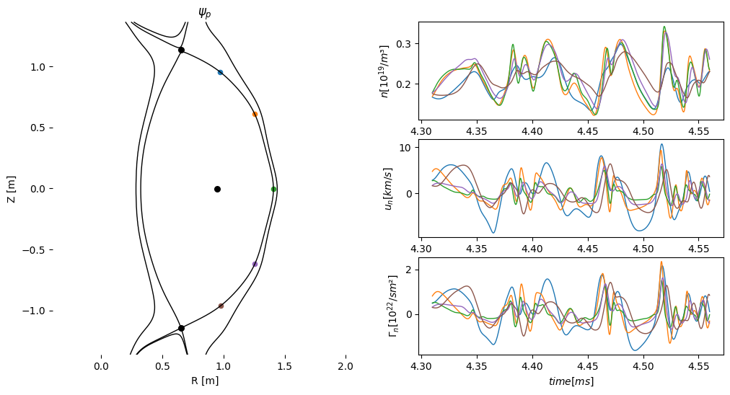
Synthetic diagnostics: Probes

Slide 11
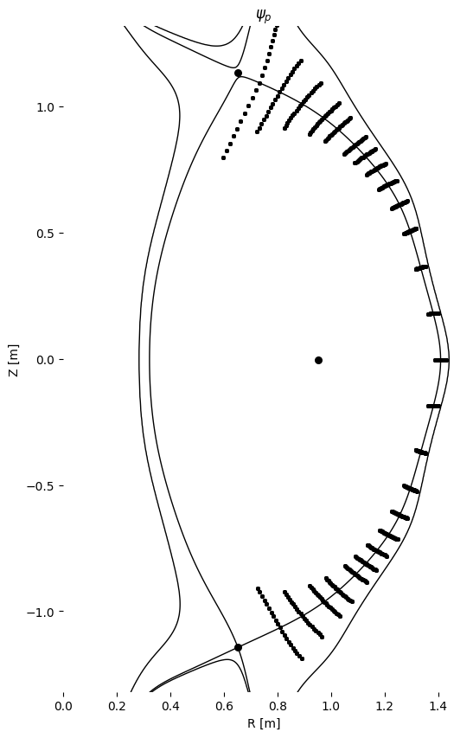
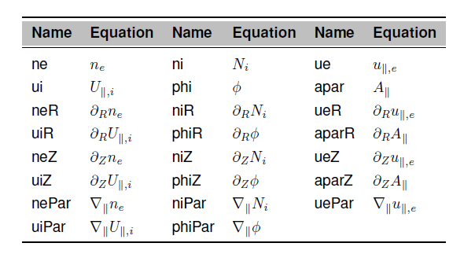
Synthetic diagnostics: probes
Initial Probe on LCFS (Outboard Midplane):
One probe is placed on the Last Closed Flux Surface (LCFS).
Probes Along Magnetic Field Toward X-Points:
28 additional probes are placed such that their poloidal projections are equidistant between the two X-points.
Radial Repetition of First Probe:
The radial position of the first probe is repeated with:
10 probes inside the LCFS
10 probes outside the LCFS
Drift Planes:
This setup is repeated for 32 drift planes.
Inboard Side Repetition:
The entire procedure is repeated for the inboard side.
Total Probe Count Calculation
29 (poloidal positions)×21 (radial positions)×32 (drift planes)×2 (sides)=38,976
All probes are collecting all relevant fields with 1 MHz sampling rate
250 Gb of probe data pr. simulation

Slide 12

Synthetic diagnostics: probes
Field-aligned probes at LCFS, outboard midplane
$${\vec{u}}_{n}$$

Slide 13
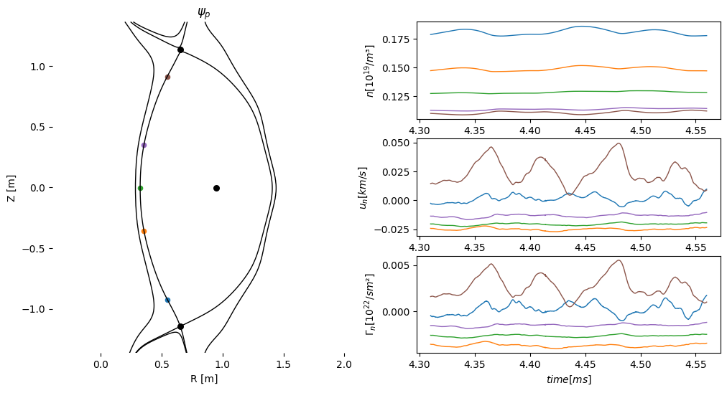

Synthetic diagnostics: probes
Field-aligned probes LCFS, inboard midplane
$Γ_{n,inb}≪$ $Γ_{n,outb}$

Slide 14
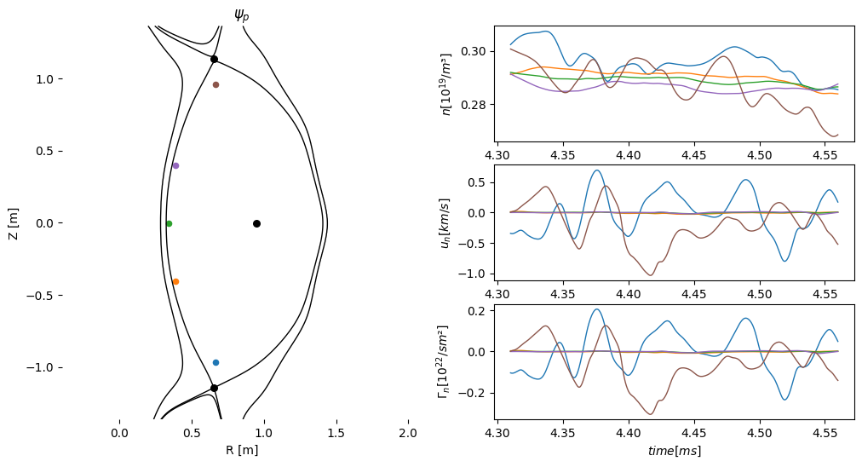
Synthetic diagnostics: probes
Field-aligned probes inside, inboard midplane

Slide 15



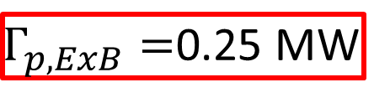

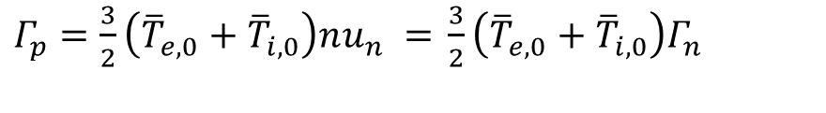
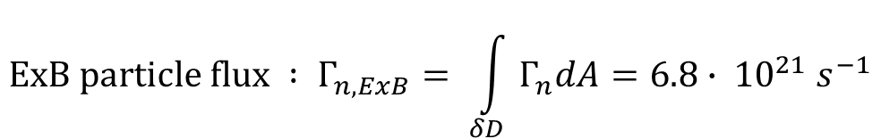

Synthetic diagnostics: probes
$$f=\overline{f}+\tilde{f} \text{where} \left\langle \tilde{f}\right\rangle =0$$
Field-aligned probes at LCFS, outboard midplane
$$\text{ExB} \text{particle} \text{flux} : Γ_{n,ExB}= \int_{δD}{Γ_{n}dA}=6.8∙ {10}^{21} s^{−1}$$
$$\text{Energy} \text{flux} \text{due} \text{to} \text{ExB} \text{drift} :$$
$$Γ_{p}=\frac{3}{2}\left(T_{e}+T_{i}\right)nu_{n}$$
Isothermal model
$${\vec{u}}_{n} , Γ_{n}$$
$$Γ_{p}=\frac{3}{2}\left({\overline{T}}_{e,0}+{\overline{T}}_{i,0}\right)nu_{n}+\frac{3}{2}\left({\tilde{T}}_{e}+{\tilde{T}}_{i}\right)nu_{n}$$
$Γ_{p}=\frac{3}{2}\left({\overline{T}}_{e,0}+{\overline{T}}_{i,0}\right)nu_{n} =$ $\frac{3}{2}\left({\overline{T}}_{e,0}+{\overline{T}}_{i,0}\right)Γ_{n}$
$Γ_{p,ExB}=$0.25 MW
MAST-U#48004 : 0.7 MW (NBI) + 0.1 MW Ohmic

Slide 16
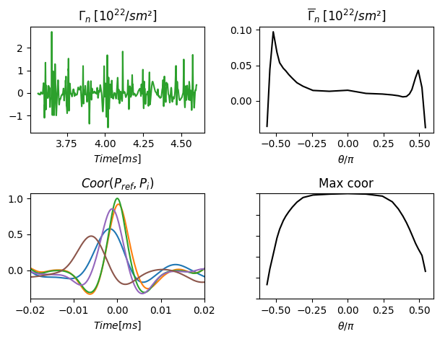

Synthetic diagnostics: probes
Notes:
Particle flux is very intermittent

Slide 17
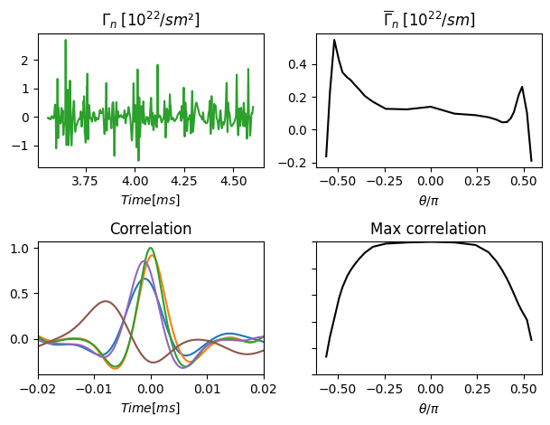
Synthetic diagnostics: probes
1.0
0.0
Notes:
Particle flux is very intermittent

Slide 18
Synthetic DBS diagnostic
Data hopefully coming before the conference☺
Jones PPCF 67 (2025) 082501

Slide 19
Conclusions
3D MAST-U simulation of shot 48004 has been successfully performed using the Feltor code
Transport out of the confined region is restricted to the outboard plane
Inboard plane is stable and carries no significant transport out of the confined region
Transport observed for a poloidal angle of π
Filamentary transport observed for a poloidal angle of ~π/2
Thank you for your attention

Slide 20
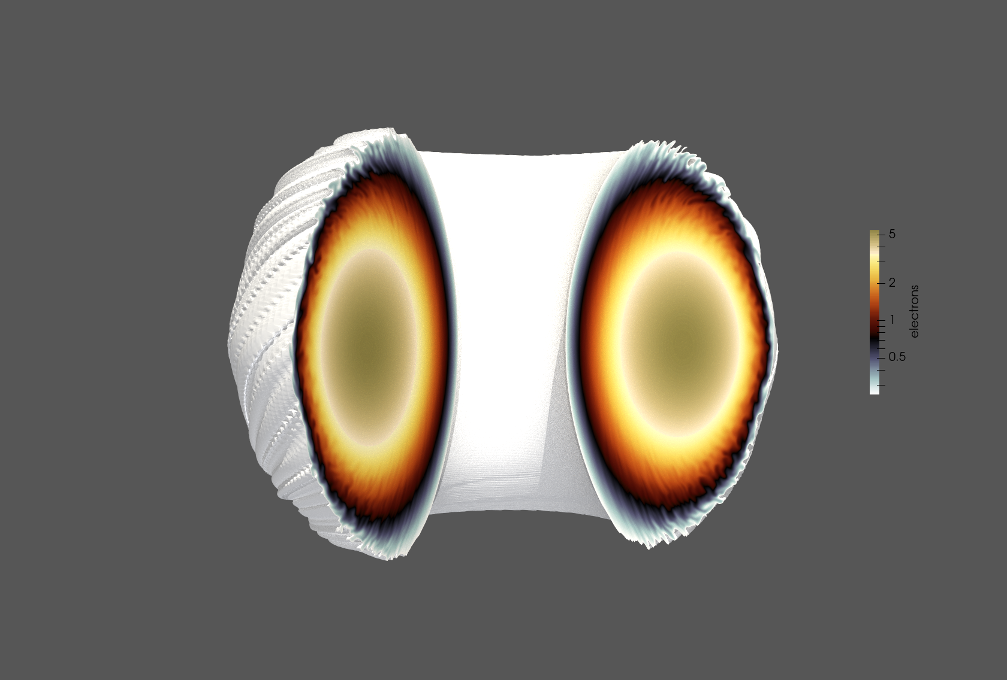
Backup

