Slide 1
TSVV3 – Regular advancement meeting 12/10/2025 – Turbulence-neutrals interaction Project news
P. Tamain

Slide 2
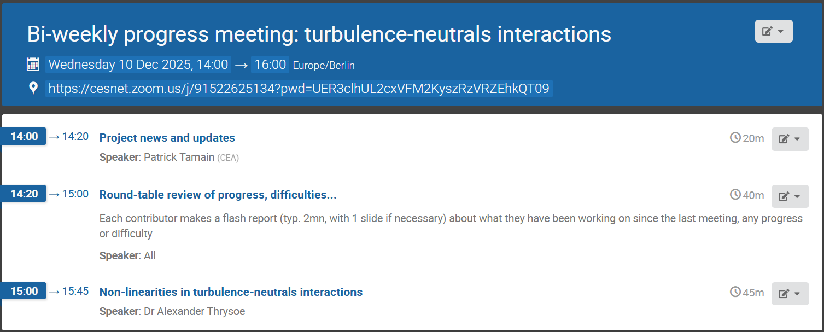
Today’s meeting agenda

Slide 3
Heads up on outcome of General Assembly
WPAC current budget request above the initial ceiling (in spite of successive compressions)
WPAC leadership could not secure additional funding for the moment
Decision made not to compress anymore for 2026
But facing risk of 30% reduction (!) in 2027 if no solution is found
To be updated as discussions unfold…

Slide 4
Pitagora computing time request
Computing hours request for cycle 10 submitted
Available on project wiki: https://wiki.euro-fusion.org/images/e/e8/Application_EUROfusion_HPC_resources_cycle10_TSVVB.pdf
No news concerning report from last year (cycle 8)
 | BIT1 | FELTOR | GBS | GRILLIX | SOLEDGE3X | ACH (cross-code) | TOTAL
CPU (Pitagora) | 115 000 |  | 235 000 | 399 000 | 248 000 | 5 000 | 1 002 000
GPU (Pitagora) |  | 40 000 |  |  | 29 000 | 1 000 | 70 000
Cycle 10 request
 | BIT1 | FELTOR | GBS | GRILLIX | SOLEDGE3X | ACH (cross-code) | TOTAL
CPU (Pitagora) | 80 000 |  | 390 000 | 400 000 | 220 000 | 5 000 | 1 095 000
GPU (Pitagora) |  | 40 000 |  |  |  | 50 000 | 90 000
Cycle 9 request (for comparison)

Slide 5
Pitagora update
Multiplying news that many code face issues with Pitagora, likely due to MPI communications behavior:
GENE-X: fluctuating and bad performances
SOLEDGE3X: average performances,random crashes, wrong solution behavior in some cases
SOLEDGE-HDG: random crashes (“mpi client disconnected”)
JOREK: simulations not giving same result as on other machines
EIRENE: getting stuck randomly when using more than 1 node
A collective action will be launched at high level with EUROfusion
Still no issue with other TSVV-3 codes?
No news concerning report from last year (cycle 8)

Slide 6
Project final report
TSVV-3 final project report due December 31st
Instructions sent by e-mail to contribute to the report
Please provide me your feedback before next Wednesday
Important to make sure all mentioned contributions are on the pinboard so that they can be referred to with a pinboard Id

Slide 7
PSI conference
Please upload your PSI contributions proposals on the pinboard asap (EUROfusion deadline + useful for the final report)
Reminder: PSI final deadline is December 15th
Contributions I am aware of:
invited talk (accepted) by Wladimir (not on pinboard)
GBS modelling of ADCs by Sergio
4 SOLEDGE3X contributions (none on pinboard yet…)
Turbulence in detached plasma with kinetic neutrals (Diego)
Turbulence in detached plasma with fluid neutrals (Diego)
Turbulent transport of impurities (Patrick)
Eich’s scaling law vs SOLEDGE3X (Hugo C.)

Slide 8
TSVV-3 final report at EUROfusion science meeting
Final reporting at EUROfusion science meeting finally postponed to Wednesday January 28th
30’ + 10’ presentation => ~20 – 25 slides
Requesting slides with key outcome of project over the last 5 years => up to 6 slides per team as I will likely merge some for common topics
Input slides needed for January 9th latest targeting dry-run in TSVV-B meeting on January 21st
NB: also asked to present the week after at EFPW on “Main outcomes of TSVV-3 (Plasma Particle & Heat Exhaust: Fluid/Gyrofluid Edge Codes) + current gaps & limitations”
20’ + 15’ presentation, will be a shorter version of the above

Slide 9
Second ETASC general meeting
WPAC planning a 2nd ETASC general meeting
Garching, February 9th – 13th
Only info concerning agenda: ½-day poster session on Tuesday 10th
I will not be able to attend the meeting
I will prepare a poster (based on the final report presentation) and connect as much as I can in VC
However I would need some TSVV-B representant on site, at the very least for the poster session
Voluntaries?

Slide 10
Latest publications (1)
Models and numerical implementation
B. De Lucca et al : 17th September 2025 | DocumentID : 41042
: Conservative formulation of the drift-reduced fluid plasma model
Journal : Journal of Plasma Physics, .
TCV-X21 and hierarchy of models
H Bufferand et al : 24th September 2025 | DocumentID : 41075
: Hierarchy of turbulent transport models with the SOLEDGE3X code
Conference : 30th IAEA Fusion Energy Conference (FEC), Vienna, Austria, 13th October 2025.
Turbulence and neutrals
K. Eder et al : 29th September 2025 | DocumentID : 41088
: The impact of plasma turbulence on atomic reaction rates in detached divertors
Journal : Nuclear Fusion, .

Slide 11
Latest publications (2)
Complex geometries
L. N. Stenger et al : 15th October 2025 | DocumentID : 41142
: Simulation of boundary plasma turbulence with realistic wall geometry
Journal : Plasma Physics and Controlled Fusion, .
S Garcia Herreros et al : 27th November 2025 | DocumentID : 41426
: Study of alternative divertor configurations with first-principles, self-consistent, global turbulence simulations
Conference : 27th International Conference on Plasma-Surface Interactions in Controlled Fusion Devices (PSI), Regensburg, Germany, 17th May 2026.

Slide 12
Today’s meeting agenda
Upload presentations on https://indico.euro-fusion.org/event/2984/ or send to me please.

