Slide 2
Nonlinearities in plasma-neutrals interactions
Alexander S. Thrysøe, Anders H. Nielsen

Slide 3

Nonlinearities in plasma-neutrals interactions

Slide 4
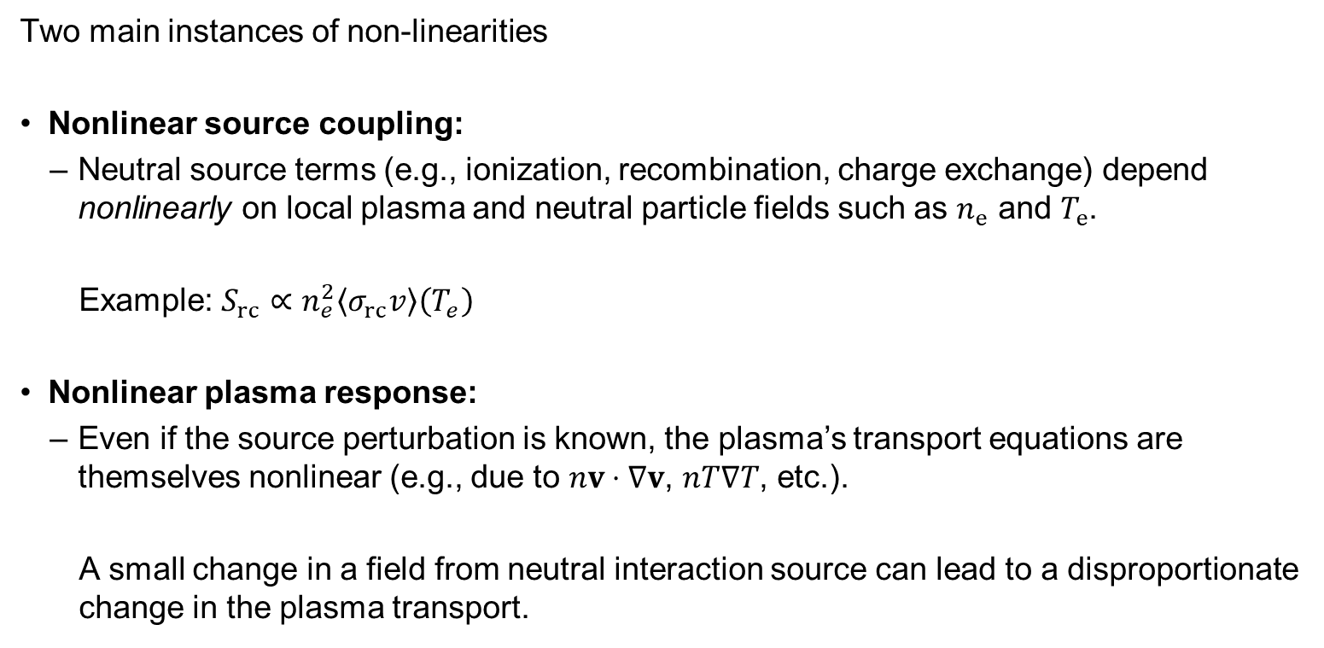
Input vs. System Nonlinearity
Two main instances of non-linearities
Nonlinear source coupling:
Neutral source terms (e.g., ionization, recombination, charge exchange) depend nonlinearly on local plasma and neutral particle fields such as $n_{e}$ and $T_{e}$.
Example: $S_{rc}∝n_{e}^{2}\left\langle σ_{rc}v\right\rangle \left(T_{e}\right)$
Nonlinear plasma response:
Even if the source perturbation is known, the plasma’s transport equations are themselves nonlinear (e.g., due to $nv⋅∇v$, $nT∇T$, etc.).
A small change in a field from neutral interaction source can lead to a disproportionate change in the plasma transport.

Slide 5
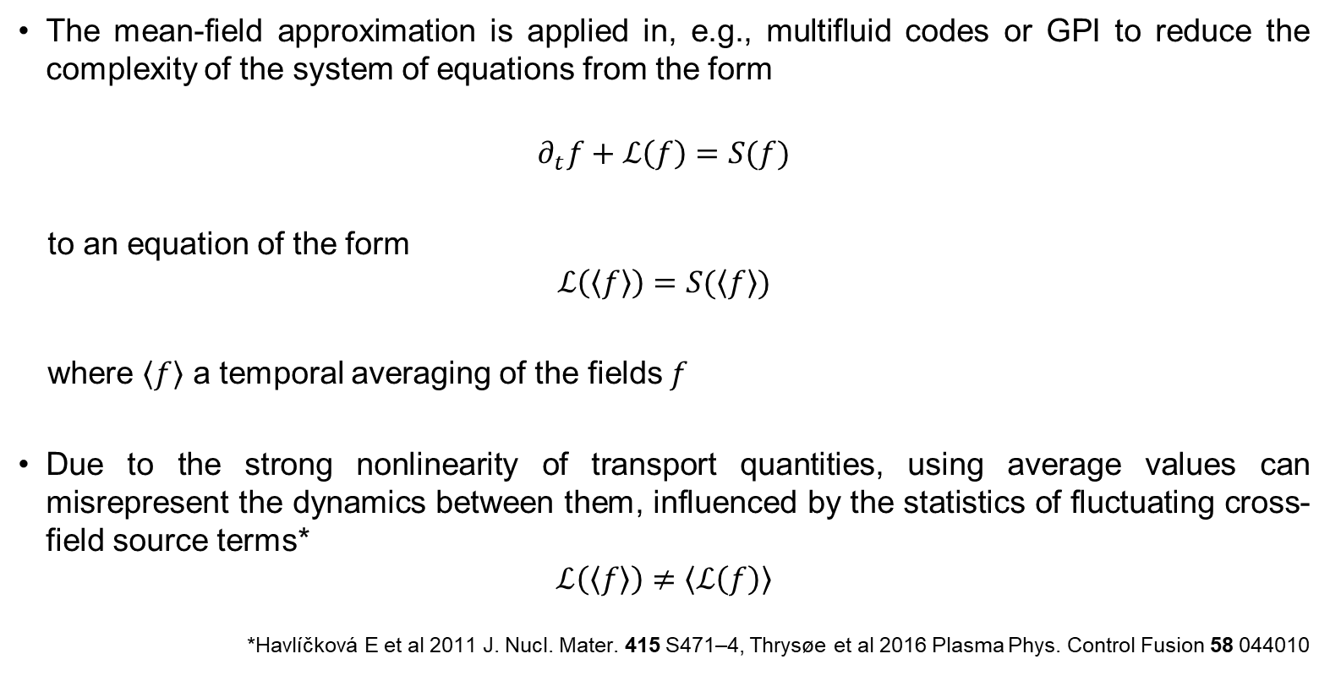
The mean-field approximation
The mean-field approximation is applied in, e.g., multifluid codes or GPI to reduce the complexity of the system of equations from the form
$$∂_{t}f+ℒ\left(f\right)=S(f)$$
to an equation of the form
$$ℒ\left(\left\langle f\right\rangle \right)=S(\left\langle f\right\rangle )$$
where $\left\langle f\right\rangle$ a temporal averaging of the fields $f$
Due to the strong nonlinearity of transport quantities, using average values can misrepresent the dynamics between them, influenced by the statistics of fluctuating cross-field source terms*
$$ℒ\left(\left\langle f\right\rangle \right)≠\left\langle ℒ\left(f\right)\right\rangle$$
*Havlíčková E et al 2011 J. Nucl. Mater. 415 S471–4, Thrysøe et al 2016 Plasma Phys. Control Fusion 58 044010

Slide 6

The mean-field approximation for the source term
For the neutral interaction source term the form is typically
$$S≈n_{e}n_{n}k$$
where $k=\left\langle σv\right\rangle$ is mostly a function of $T$
Writing $f=n_{e},n_{n},k$ as $f=\left\langle f\right\rangle +\tilde{f}$ we have
$$\left\langle S\right\rangle =\left\langle n_{e}n_{ n}k\right\rangle$$
$$=\left\langle n_{e}\right\rangle \left\langle n_{n}\right\rangle \left\langle k\right\rangle$$
$$+\left\langle n_{e}\right\rangle \left\langle {\tilde{n}}_{n}\tilde{k}\right\rangle$$
$$+⟨n_{n}⟩\left\langle {\tilde{n}}_{e}\tilde{k}\right\rangle$$
$$+⟨k⟩\left\langle {\tilde{n}}_{e}{\tilde{n}}_{n}\right\rangle$$
$$+\left\langle {\tilde{n}}_{e}{\tilde{n}}_{n}\tilde{k}\right\rangle$$

Slide 7
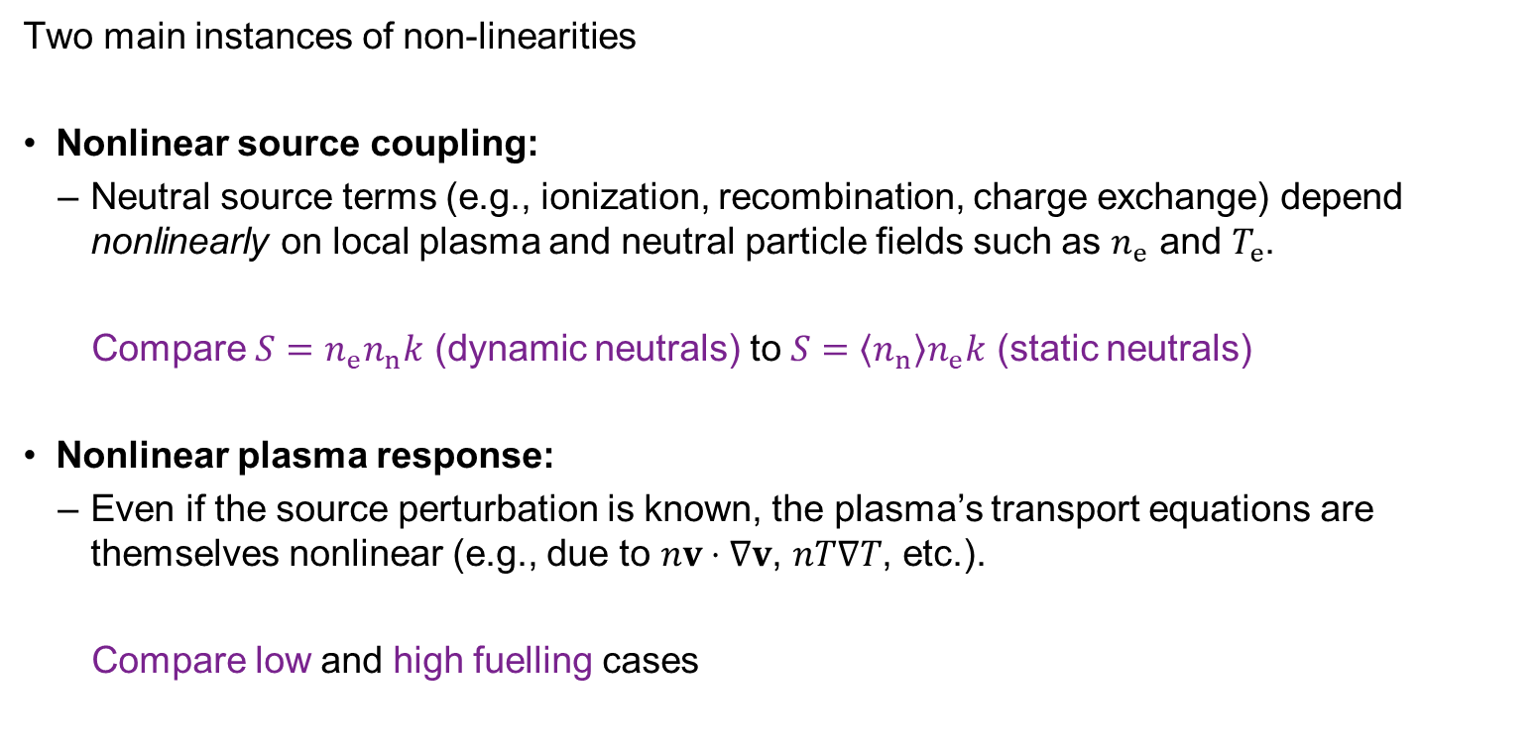
Input vs. System Nonlinearity
Two main instances of non-linearities
Nonlinear source coupling:
Neutral source terms (e.g., ionization, recombination, charge exchange) depend nonlinearly on local plasma and neutral particle fields such as $n_{e}$ and $T_{e}$.
Compare $S=n_{e}n_{n}k$ (dynamic neutrals) to $S=\left\langle n_{n}\right\rangle n_{e}k$ (static neutrals)
Nonlinear plasma response:
Even if the source perturbation is known, the plasma’s transport equations are themselves nonlinear (e.g., due to $nv⋅∇v$, $nT∇T$, etc.).
Compare low and high fuelling cases

Slide 8
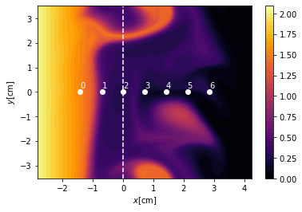
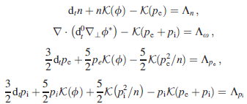
nHESEL equations
nHESEL equations
Drift-reduced Braginskii equations in 2D outer midplane domain
Use TCVX23 profiles for plasma forcing profiles
Synthetic high-resolution probe signals
normalized electron density

Slide 9
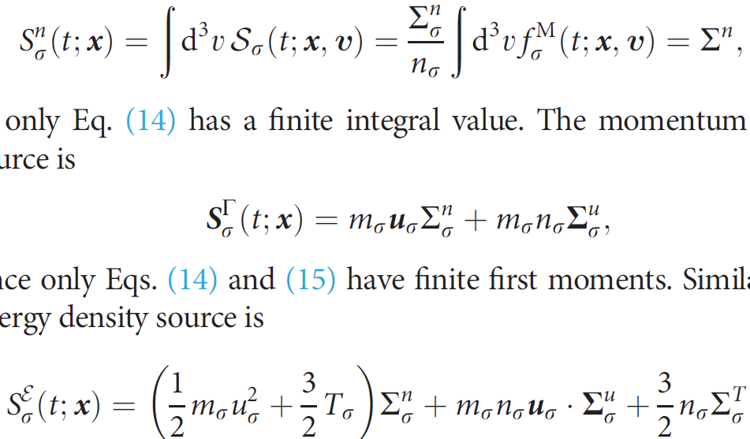
nHESEL equations
nHESEL neutral equations
Convective distinct interacting isothermal neutral molecule and atom species
normalized electron density

Slide 10
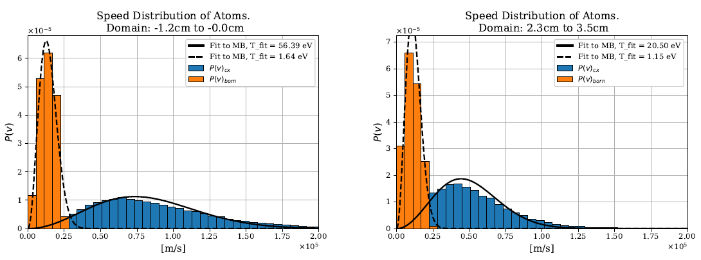





Sources from neutral interactions
Assume two-fluid neutral atoms model (reaction rate >> thermalization rate) and fluid molecules
Assumption supported by MC neutral simulations*
charge exchange
molecular ionization
$$H_{2}^{+}+e^{−}$$
$$H+H^{+}+e^{−}$$
$$H_{2}$$
charge exchange
atomic ionization
$$2H$$
$$H^{+}+e^{−}$$
molecular dissociation
atomic ionization
*K. Kvist, A.S. Thrysøe, T. Haugbølle, A.H. Nielsen, Phys. Plasmas 31, 032302 (2024)

Slide 11
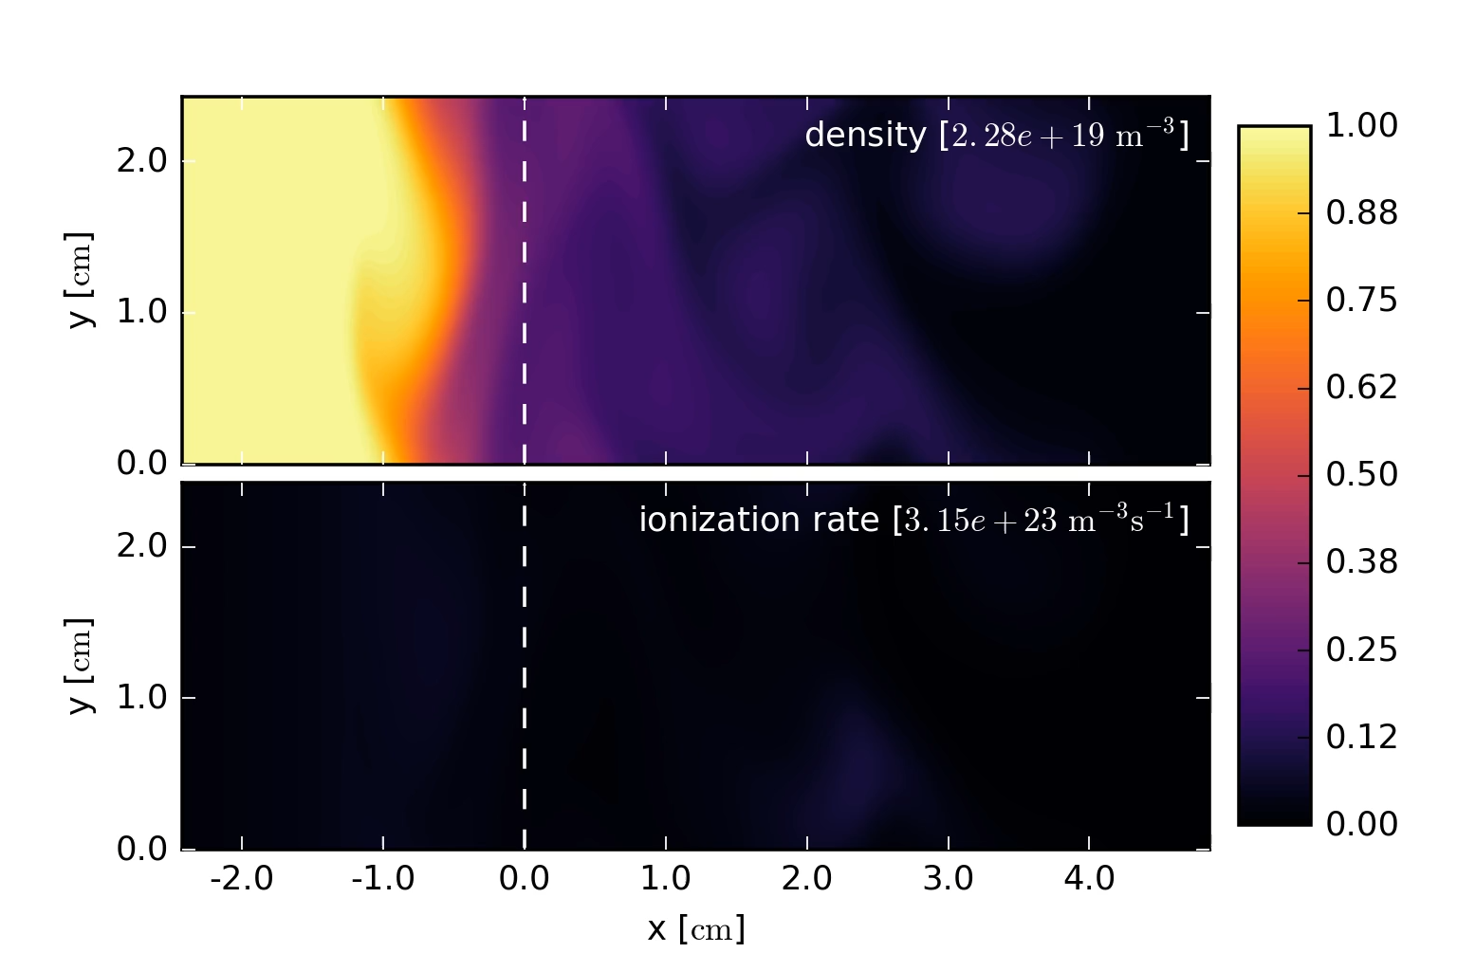
nHESEL simulation

Slide 12
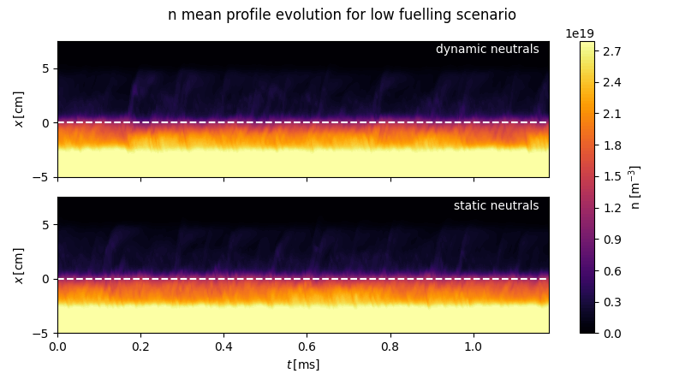
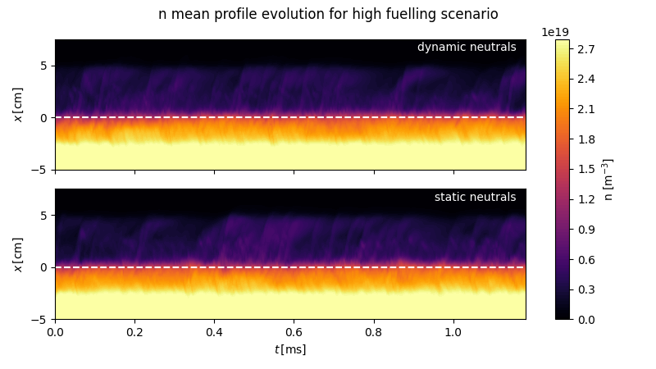
Electron density profile
Increasing fuelling rate from low to high leads to slightly elevated SOL electron density
No significant impact to density from dynamic vs. static neutrals

Slide 13
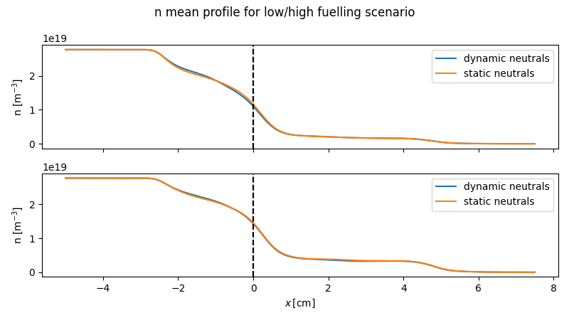
Electron density profile
Increasing fuelling rate from low to high leads to elevated SOL electron density
No significant impact to density from dynamic vs. static neutrals

Slide 14
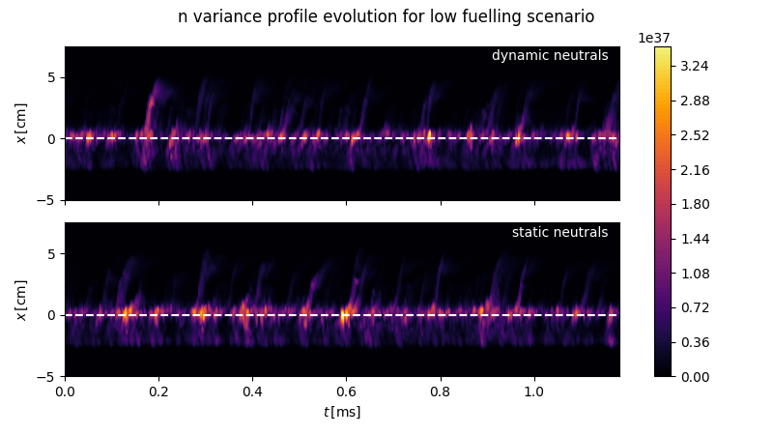
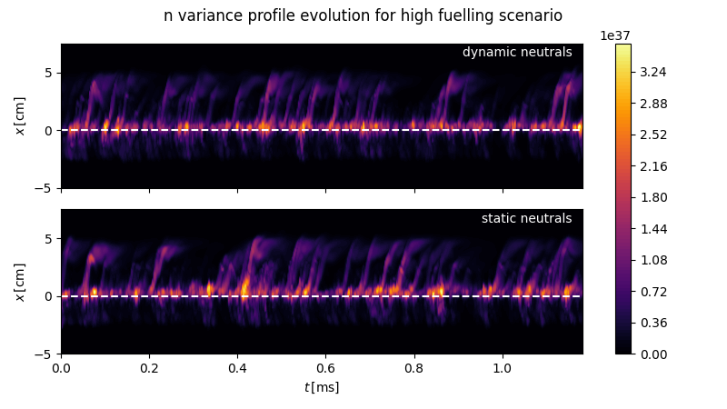
Electron density variance
Larger variance in density signal further out in SOL for higher fuelling

Slide 15
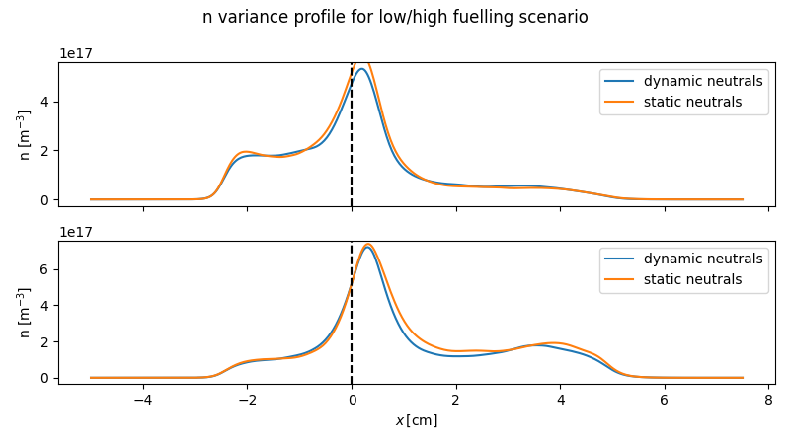
Electron density variance profile
Larger variance in density signal further out in SOL for higher fuelling
Mainly caused by local ionization, i.e., no reason to point to nonlinear transport effects observed

Slide 16
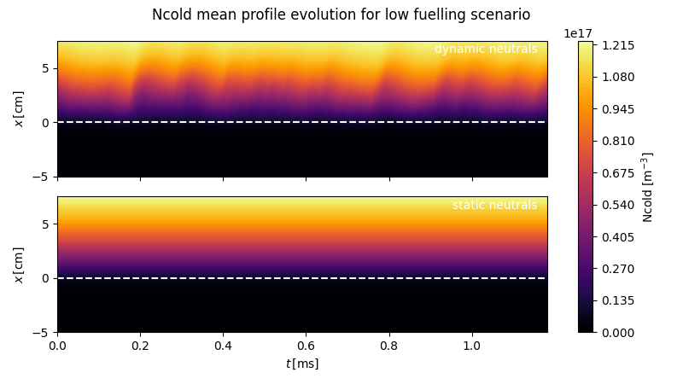
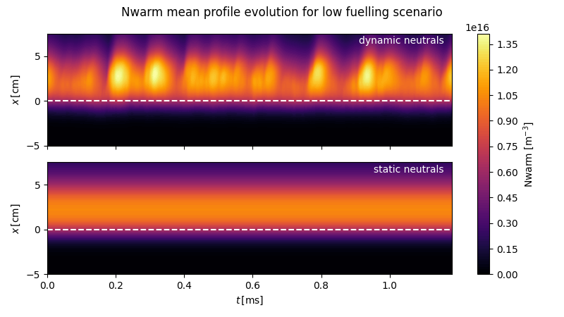
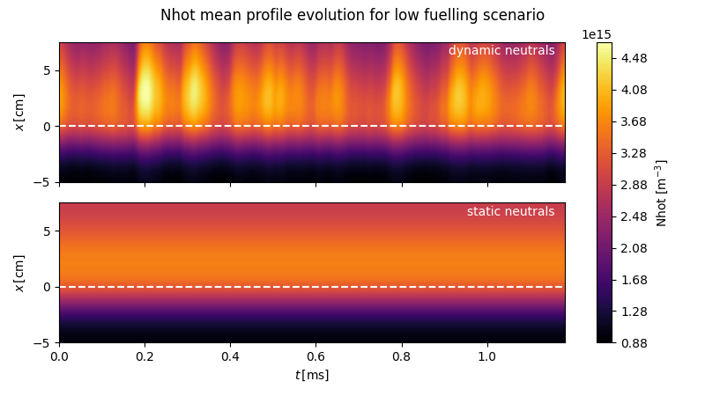
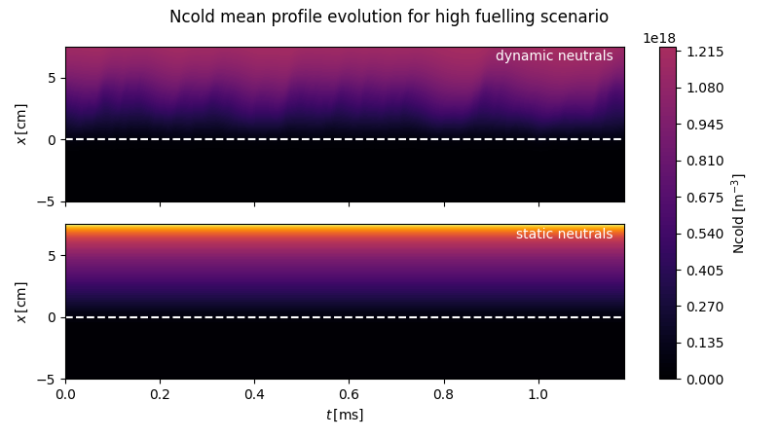
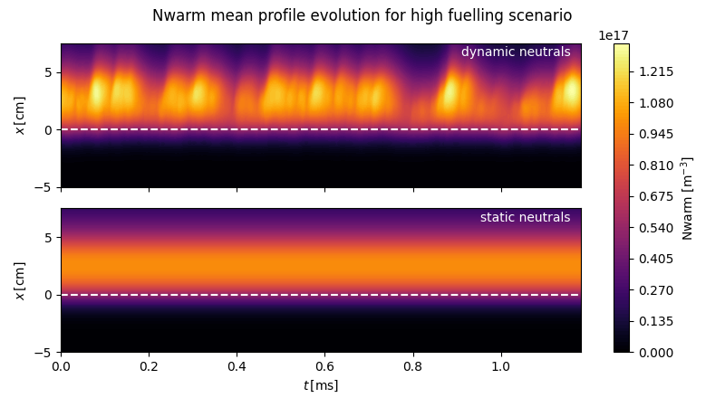
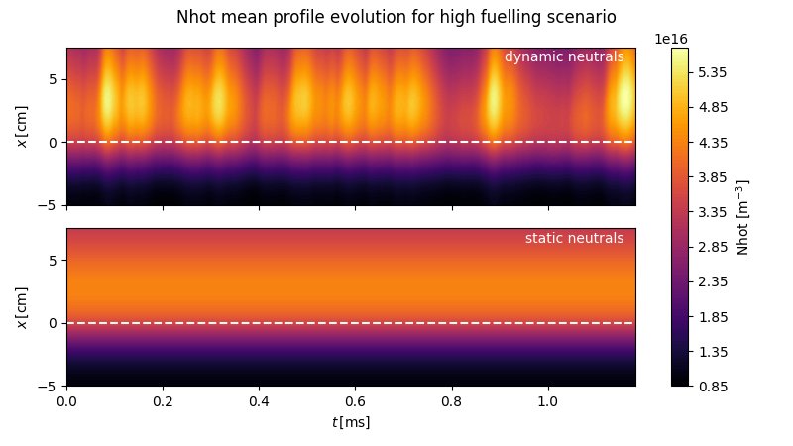
Neutral density profiles
Only small increase in SOL electron density despite order of magnitude increase in neutral density

Slide 17
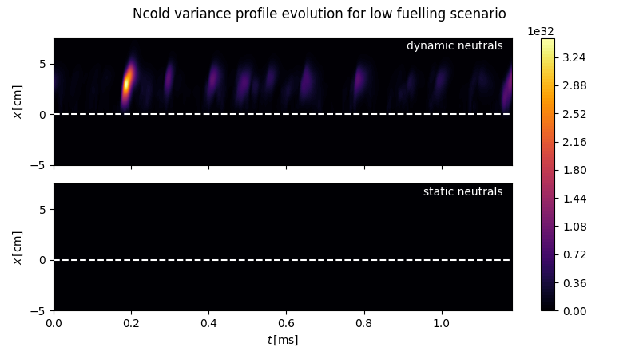
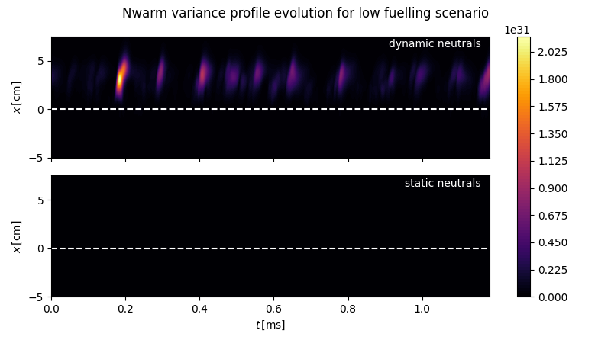

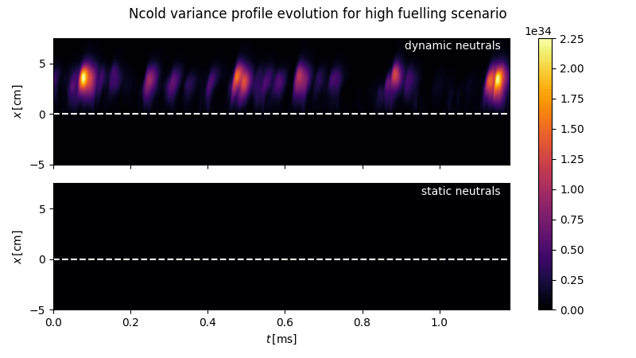
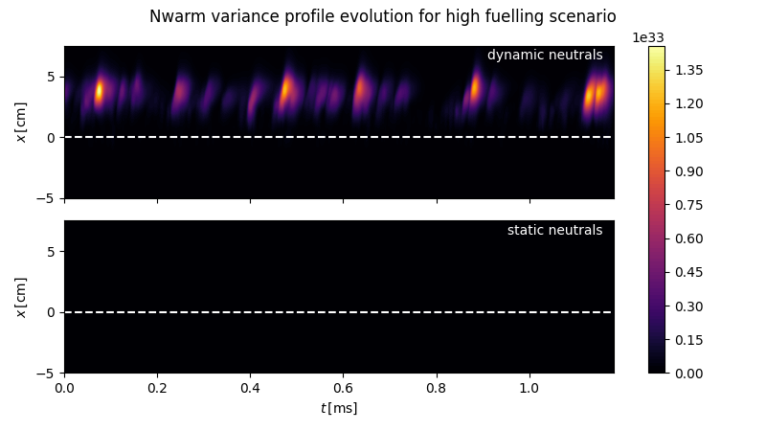
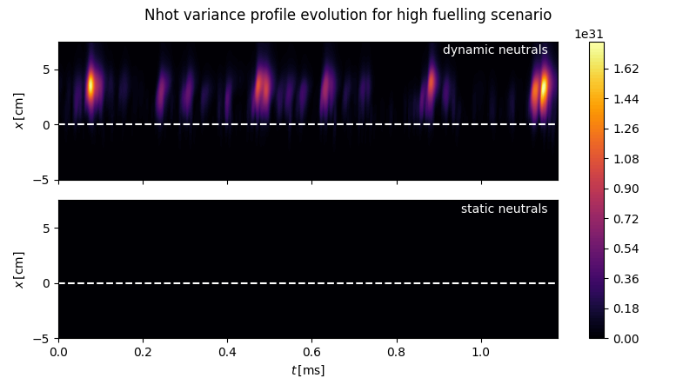
Neutral density variance
Significant variance in neutral densities in response to SOL filaments

Slide 18
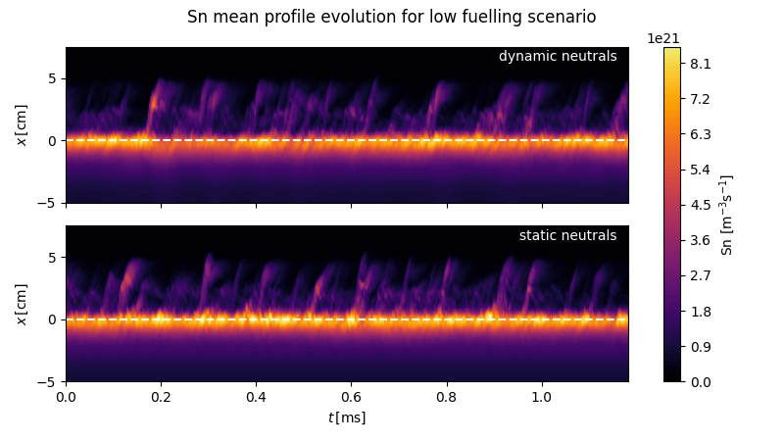
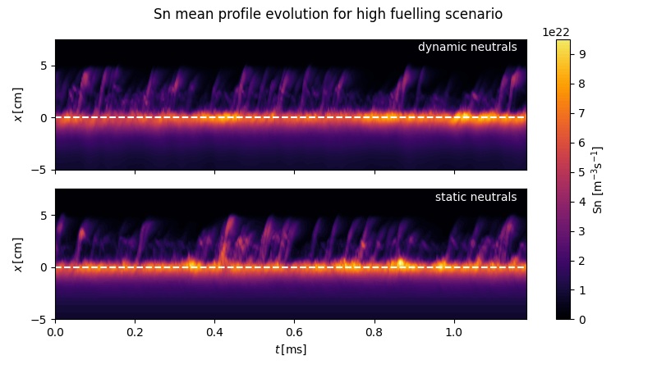
Electron density source
Similar response to electron density source from increased neutral fuelling rate
No distinct difference between dynamic and static neutrals, despite large variance in neutral density
related to anti-correlation between molecular and atomic fields in the SOL region

Slide 19


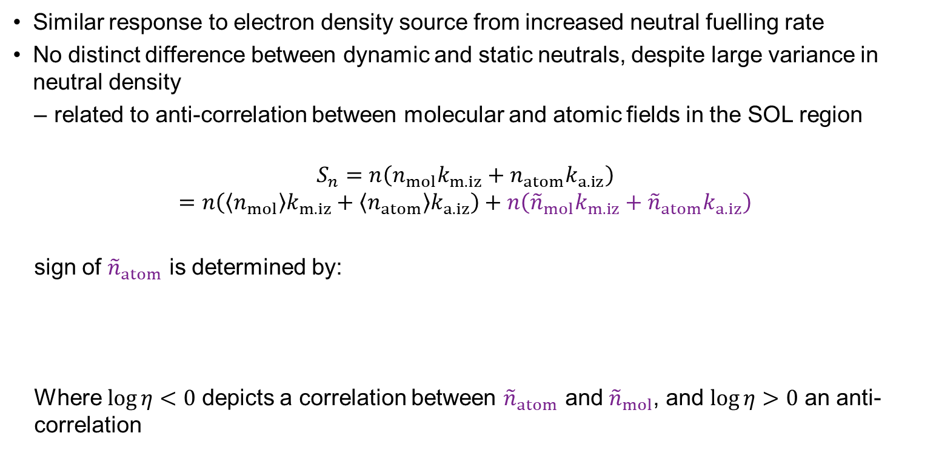
Electron density source
Similar response to electron density source from increased neutral fuelling rate
No distinct difference between dynamic and static neutrals, despite large variance in neutral density
related to anti-correlation between molecular and atomic fields in the SOL region
$$S_{n}=n\left({n_{mol}k}_{m.iz}+{n_{atom}k}_{a.iz}\right)$$
$$=n\left(\left\langle n_{mol}\right\rangle k_{m.iz}+{\left\langle n_{atom}\right\rangle k}_{a.iz}\right)+n\left({{\tilde{n}}_{mol}k}_{m.iz}+{{\tilde{n}}_{atom}k}_{a.iz}\right)$$
sign of ${\tilde{n}}_{atom}$ is determined by:
Where $\log{η}<0$ depicts a correlation between ${\tilde{n}}_{atom}$ and ${\tilde{n}}_{mol}$, and $\log{η}>0$ an anti-correlation

Slide 20
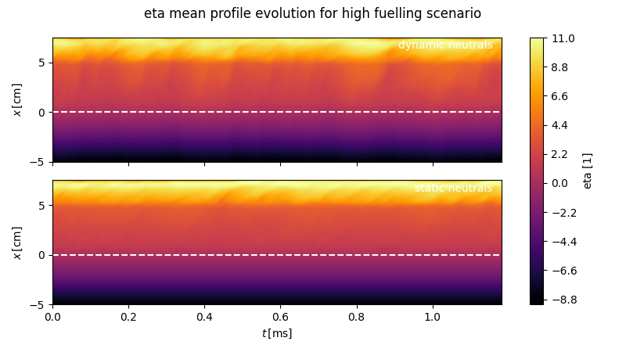


Electron density source
$$\log{η}$$
$$\log{η}$$

Slide 21
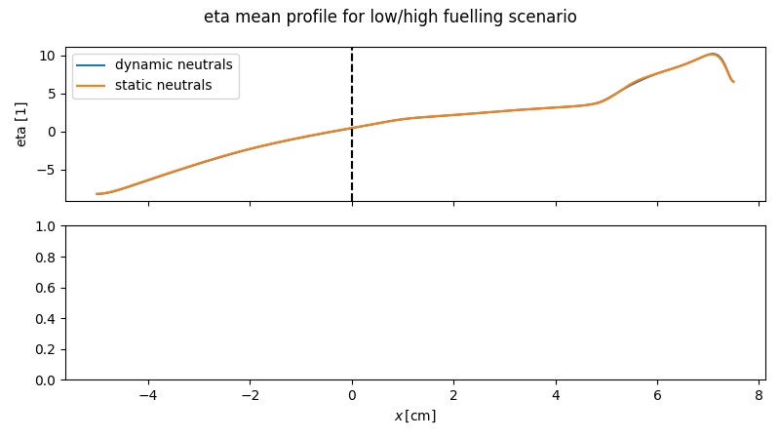



Input vs. System Nonlinearity
Nonlinear source coupling:
Compare $S_{n}=n_{e}n_{n}k$ (dynamic neutrals) to $S_{n}=\left\langle n_{n}\right\rangle n_{e}k$ (static neutrals) for TCVX23
Despite fluctuations in the neutral density fields from neutral-blob interactions, the impact on electron density source is relatively small and $S_{n}=\left\langle n_{n}\right\rangle n_{e}k$ is in this case a good approximation
Not the case for mono-atomic neutrals or different temperature regimes
$$\log{η}$$
$$\log{η}$$

Slide 22
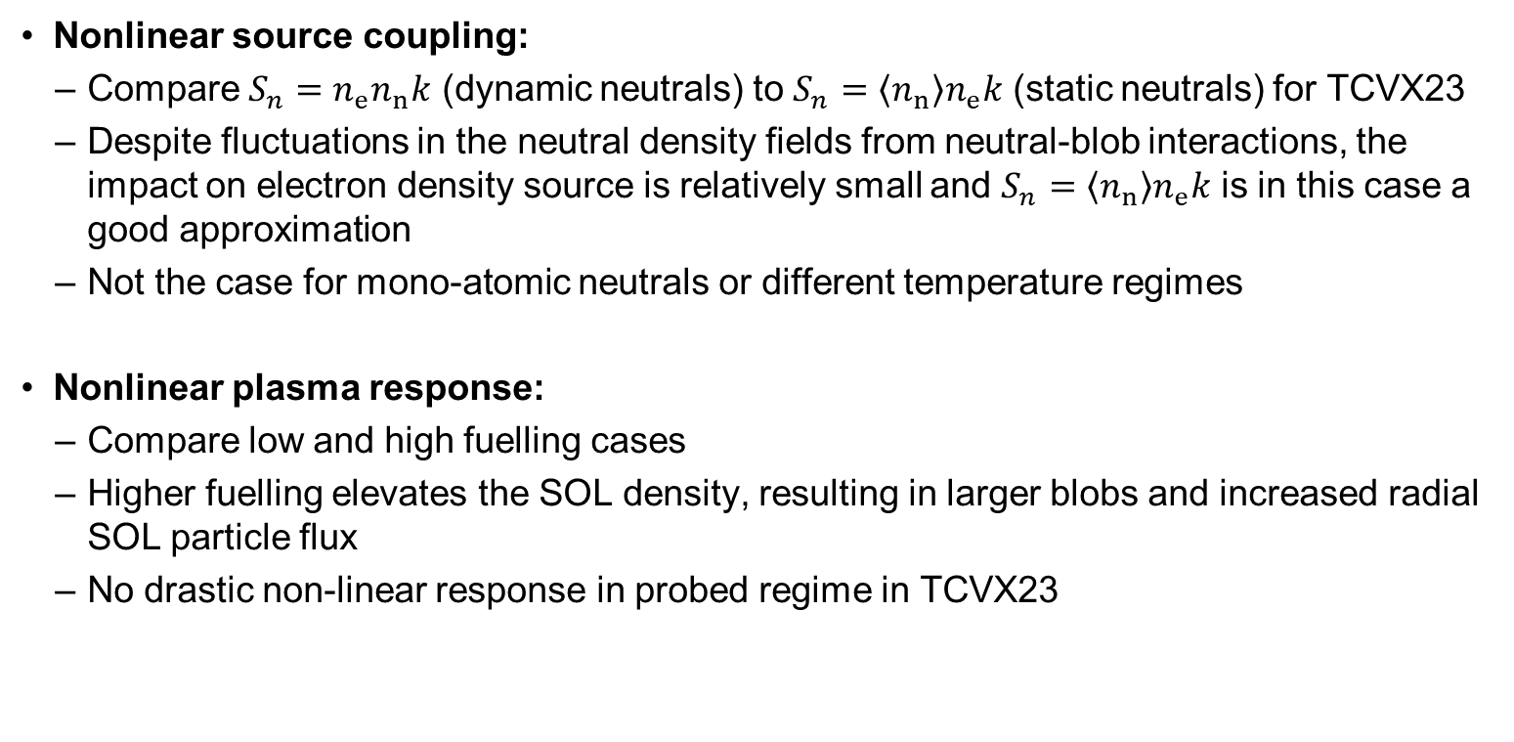
Input vs. System Nonlinearity
Nonlinear source coupling:
Compare $S_{n}=n_{e}n_{n}k$ (dynamic neutrals) to $S_{n}=\left\langle n_{n}\right\rangle n_{e}k$ (static neutrals) for TCVX23
Despite fluctuations in the neutral density fields from neutral-blob interactions, the impact on electron density source is relatively small and $S_{n}=\left\langle n_{n}\right\rangle n_{e}k$ is in this case a good approximation
Not the case for mono-atomic neutrals or different temperature regimes
Nonlinear plasma response:
Compare low and high fuelling cases
Higher fuelling elevates the SOL density, resulting in larger blobs and increased radial SOL particle flux
No drastic non-linear response in probed regime in TCVX23

