Slide 1
EUROfusion TSVV-5 Annual Report 2023,
Contributions Aalto University, Espoo, Finland
Ray Chandra, Mathias Groth
Notes:
1

Slide 2
Plans for 2023
Assessment of suitability of H_COLRAD (He_COLRAD, H2_COLRAD) Fortran routines in EIRENE
Re-implementation of EIRENE photon tracing and opacity model
Identify root cause of isotope effect on detachment in JET-ILW EIRENE benchmark case

Slide 3
Plans for 2023 - achievements
Assessment of H_COLRAD (He_COLRAD, H2_COLRAD) in EIRENE (Ray Chandra)
  Reimplementation of H_COLRAD for Ly-alpha opacity calculation
Re-implementation of EIRENE photon tracing and opacity model (Ray Chandra)
  Self-consistent photon-gas coupling implemented in EIRENE version coupled to EDGE2D
  Impact of photon opacity tested using existing EDGE2D-EIRENE JET81472 D+Be plasma solutions in varying midplane separatrix density,
  20% higher D ionization contribution from Ly-a and Ly-b re-absorption, results presented at EPS 2023
Physics of isotope effect in JET-ILW EIRENE benchmark case (Mathias Groth)
  EDGE2D-EIRENE does reproduce the non-linear dependence of T_{e} at/across the LFS divertor with upstream/core plasma density, but the not characteristic ion saturation and electron density at the detachment onset
  Standalone EIRENE runs to elucidate pure isotope effect on divertor densities for JET-ILW H, D and T L-mode plasmas, presented at IAEA-FEC 2023 and IAEA Technical Meeting on H2 and W 2023

Slide 4
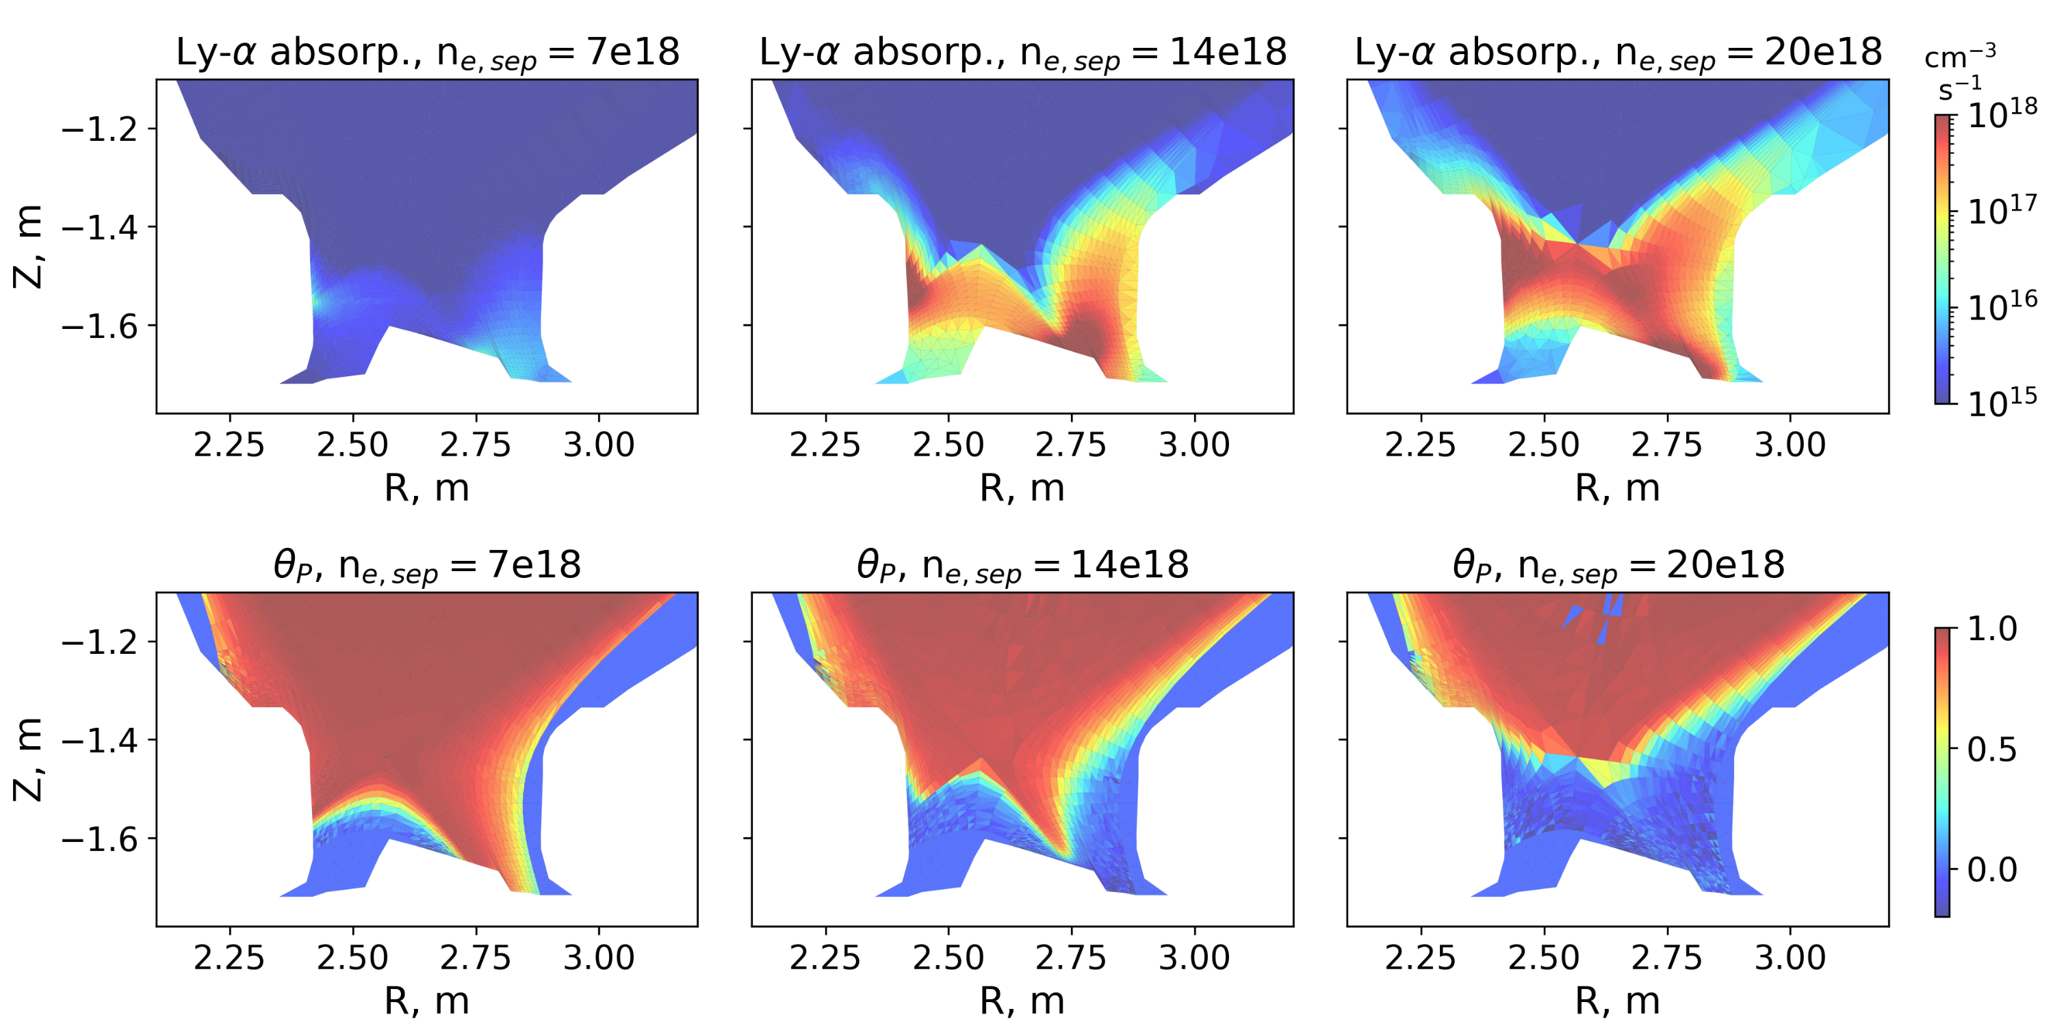
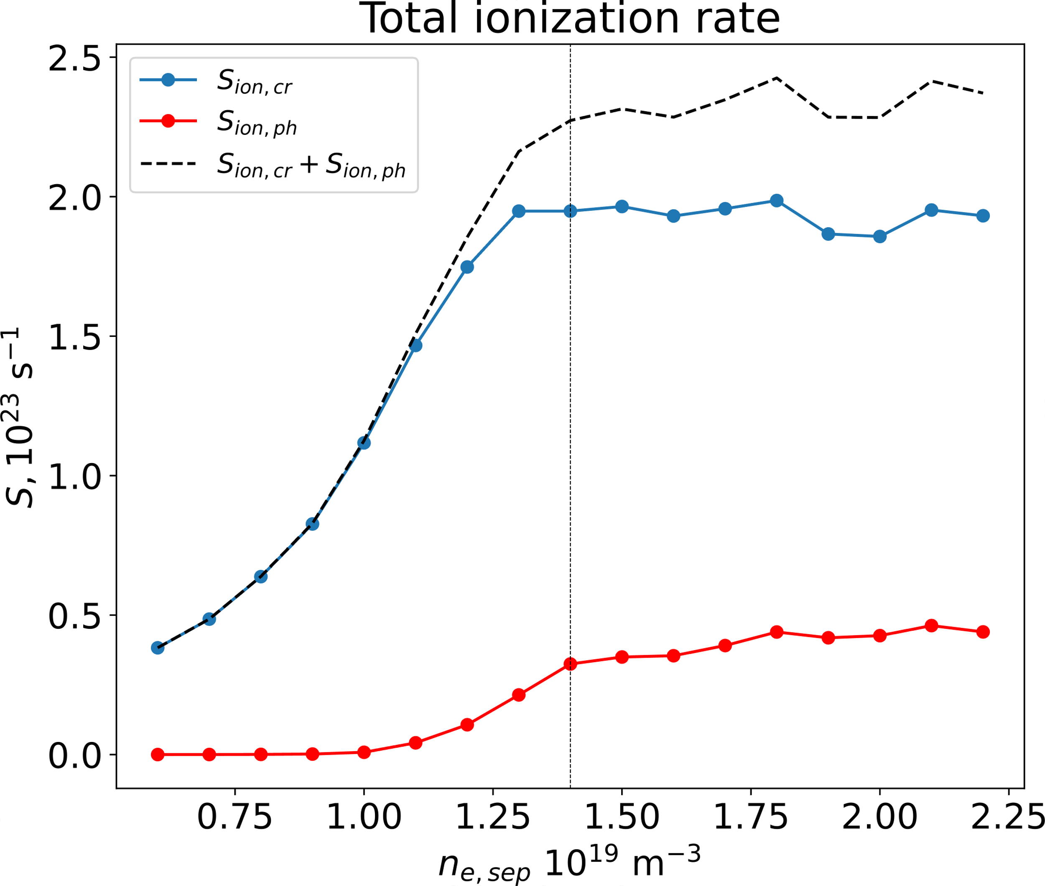
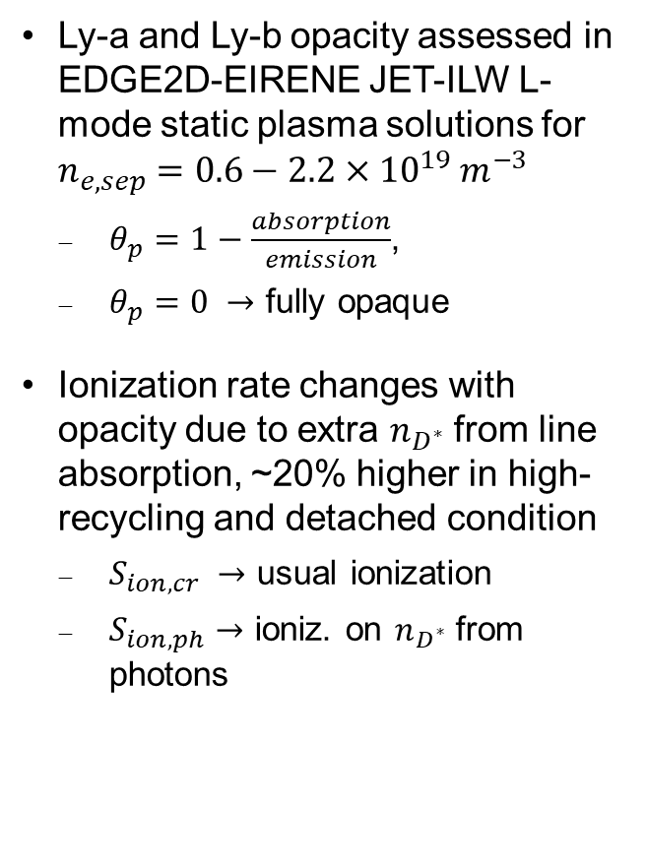
The JET-ILW L-mode plasma divertor is Ly-a and Ly-b opaque in high-recycling and detached conditions
R. Chandra et al., EPS 2023
Ly-a and Ly-b opacity assessed in EDGE2D-EIRENE JET-ILW L-mode static plasma solutions for $n_{e,sep}=0.6−2.2×{10}^{19} m^{−3}$
  $θ_{p}=1−\frac{absorption}{emission}$,
  $θ_{p}=0 →$ fully opaque
Ionization rate changes with opacity due to extra $n_{D^{∗}}$ from line absorption, ~20% higher in high-recycling and detached condition
  $S_{ion,cr} →$ usual ionization
  $S_{ion,ph}→$ ioniz. on $n_{D^{∗}}$ from photons

Slide 5
Status of discussion on EIRENE-internal CRM and Photon Transport Module (TSVV-5 code camp, Nov 2023)
w/AMU, Yannick: grid parallelization for input preparation and CRM calculation in EIRENE relevant when coupling to plasma, large grid sizes, or large CRM matrices (many species/excited levels) ⇒ initial implementation currently being tested
Current hard-coded implementation of the CRM based on the Sawada model to be improved as flexible allowing control from the EIRENE input file
⇒ w/FZJ, Dmitriy: ModCR
Suggested improvement on the reflection model from specular only to specular-diffusive mix, relevant for synthetic diagnostic generation ⇒ potentially use TRIM-like data for photons
Explore the implementation of exportable CRM results from EIRENE to be used in post-processing diagnostic tools, in the form of plasma-dependent emissivities containing opacity effects, population escape factor profiles, etc.

Slide 6
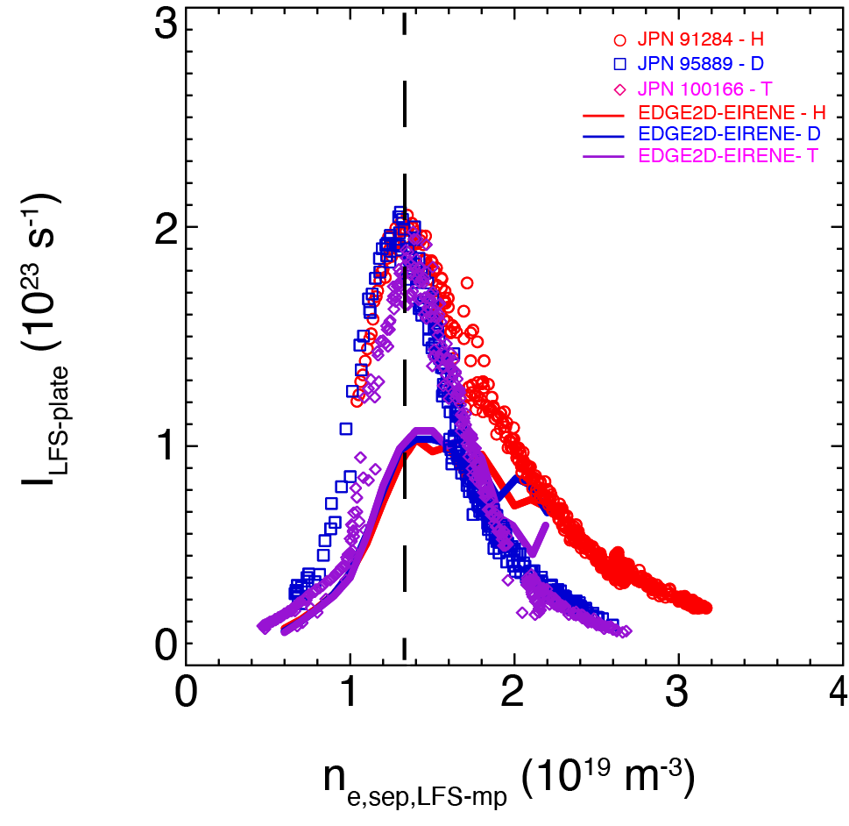
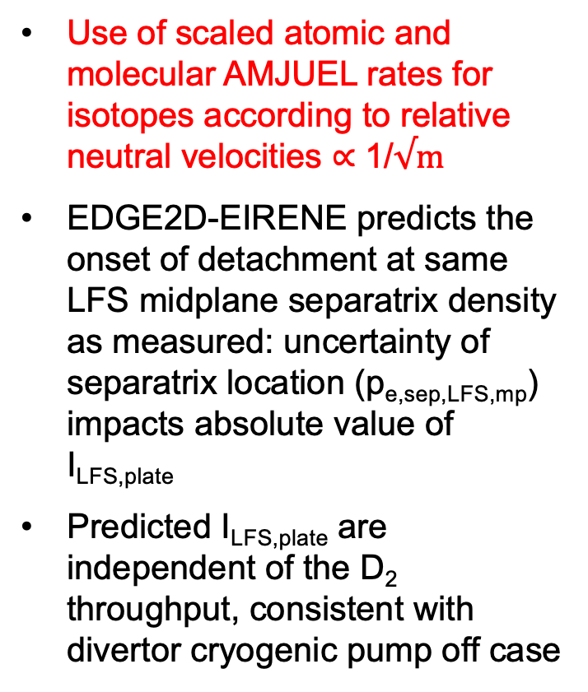
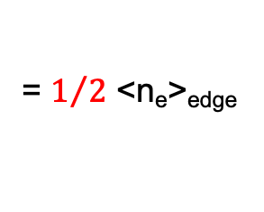
The EDGE2D-EIRENE predicted onset of detachment is independent of the isotope species, as measured
Use of scaled atomic and molecular AMJUEL rates for isotopes according to relative neutral velocities ∝ 1/√$m$
EDGE2D-EIRENE predicts the onset of detachment at same LFS midplane separatrix density as measured: uncertainty of separatrix location (p_{e,sep,LFS,mp}) impacts absolute value of I_{LFS,plate}
Predicted I_{LFS,plate} are independent of the D₂ throughput, consistent with divertor cryogenic pump off case
= $1/2$ <n_{e}>_{edge}

Slide 7
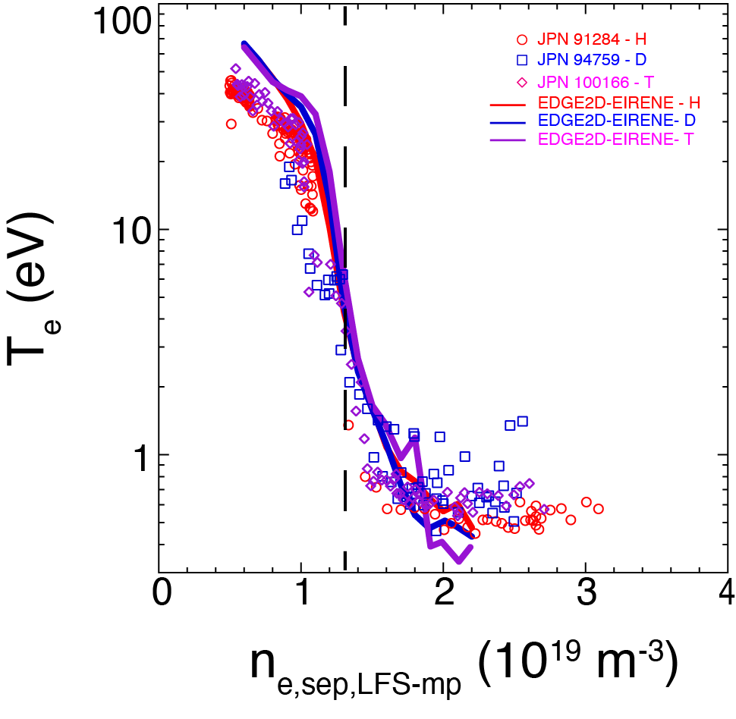
EDGE2D-EIRENE predicts non-linear reduction of T_{e,div} due to plasma radiation, ionisation and dissociation
Isotope effect negligible through transition down to T_{e,div} of 1 eV
Below 1 eV, predicted T_{e,div} lower for T than for H and D, unresolved experimentally
30 eV
Pred. T_{e,LFS-plate}
Meas. <T_{e}>_{LFS-div}
0.7 eV
= $1/2$ <n_{e}>_{edge}

Slide 8
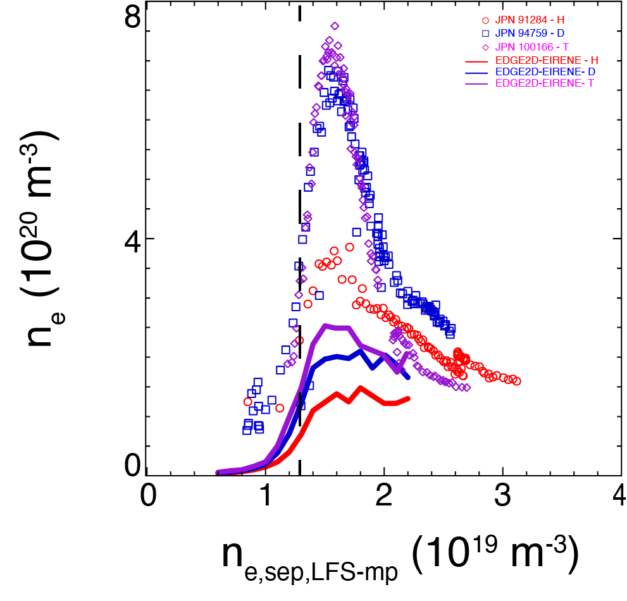
Predicted divertor density is approx. 50% higher in tritium than in hydrogen plasmas
Conceptually, for similar recycling flux (I_{div}) and M_{target} ≈ unity ⇒ n_{e} ∝ √m_{ion}/T_{e}
Predicted n_{e} at the plate reaches maximum when T_{e,div} ≈ 1 eV
n_{e} predicted to “build up” at plate, but not to decrease toward density limit
High-density (high-pressure) region does not move poloidally toward LFS X-point region as measured
1.0 eV
<n_{e}>_{LFS-div}
50%
n_{e,LFS-plate}
= $1/2$ <n_{e}>_{edge}

Slide 9
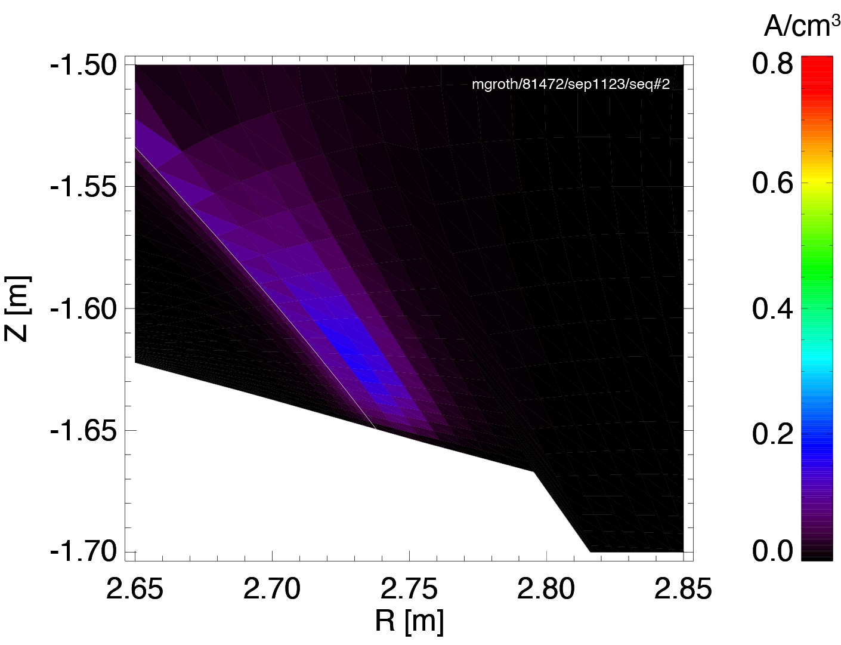
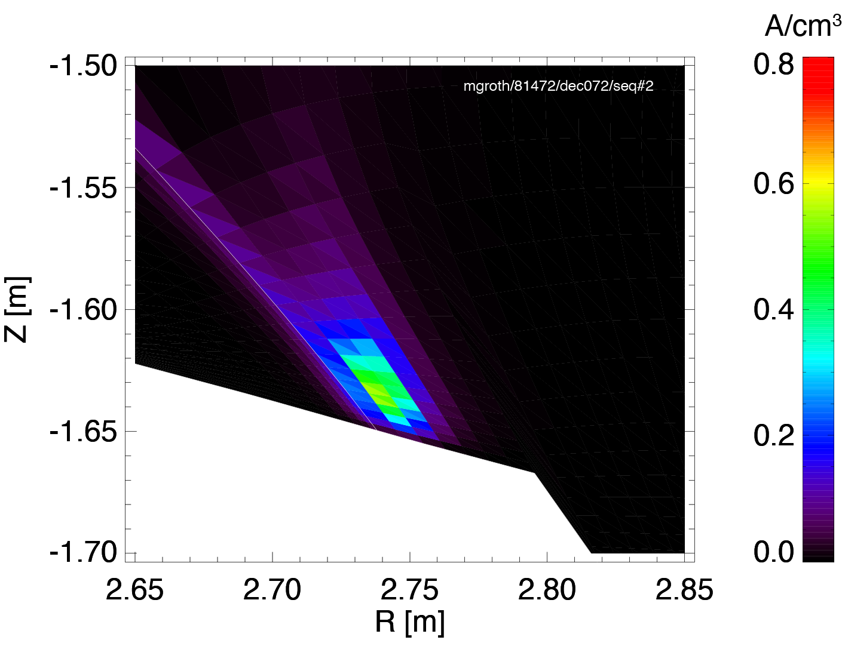

For T_{e,div} ≈ 1 eV, EIRENE predicts the peak ionisation source to be higher for T than for D and H
0.8 /cm⁻³
0.8 A/cm³
0.8 A/cm³
H
D
T
S_{ion}

Slide 10
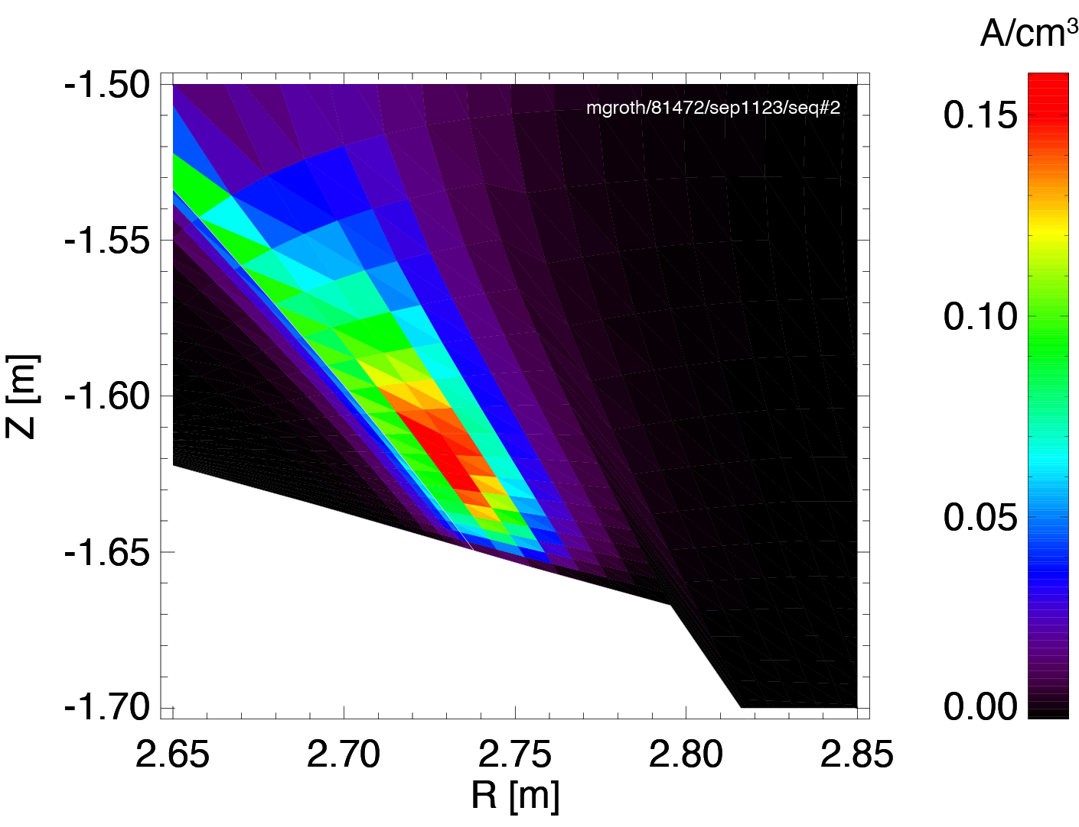
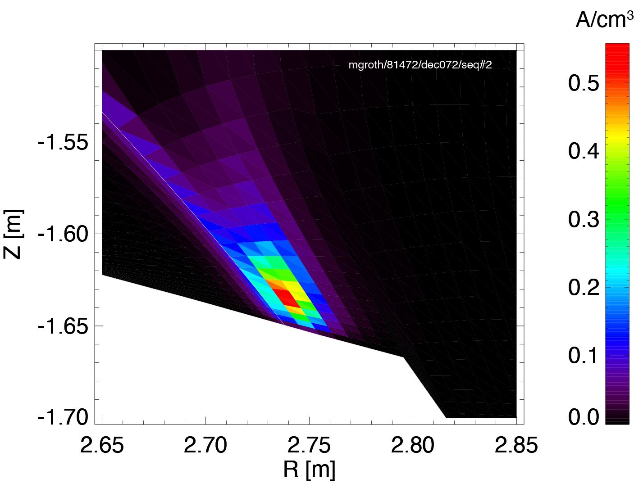

Predicted ionisation source more spread out poloidally due to approx. 3x longer ion. mfp of H than T atoms
λ_{ion}: 3.2 cm
max
1.2 cm
max
0.8 cm
max
H
D
T
S_{ion}
Velocity of Franck-Condon and charge-exchange atoms ∝ 1/√m_{atom}
Velocity of (fast) reflected ions off the target is 40% higher for H than for T (25% for D), due to the Mach number at sheath entrance ≈ unity

Slide 11
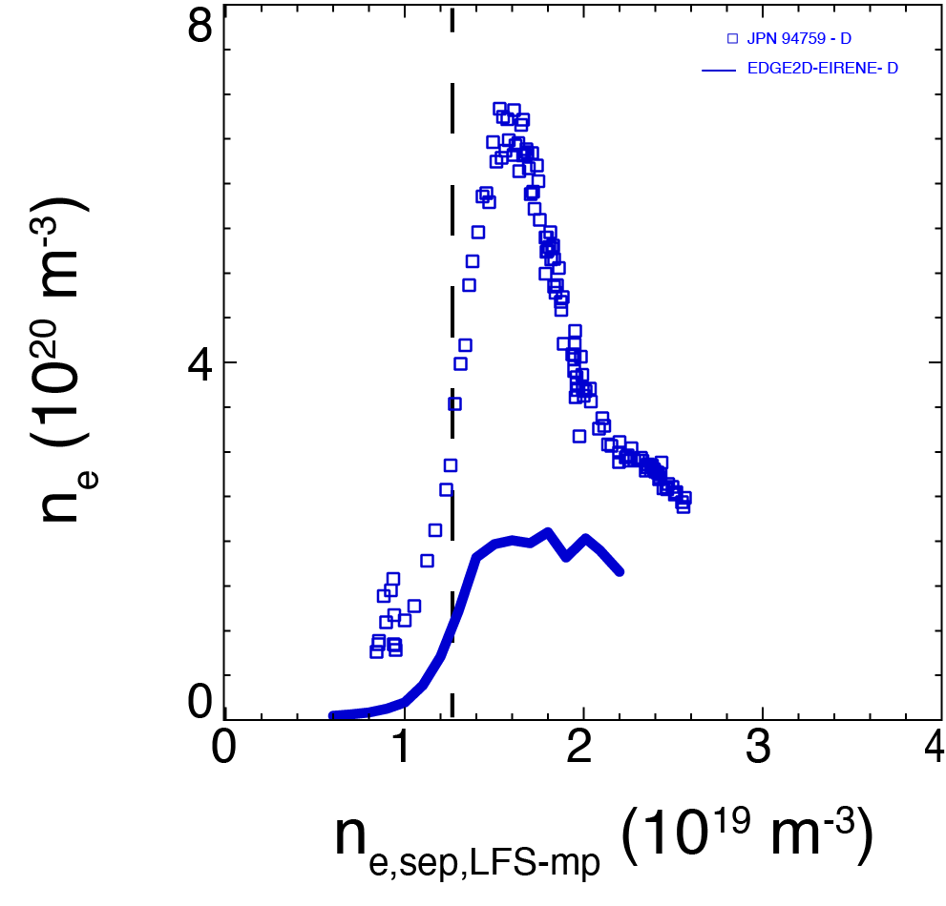
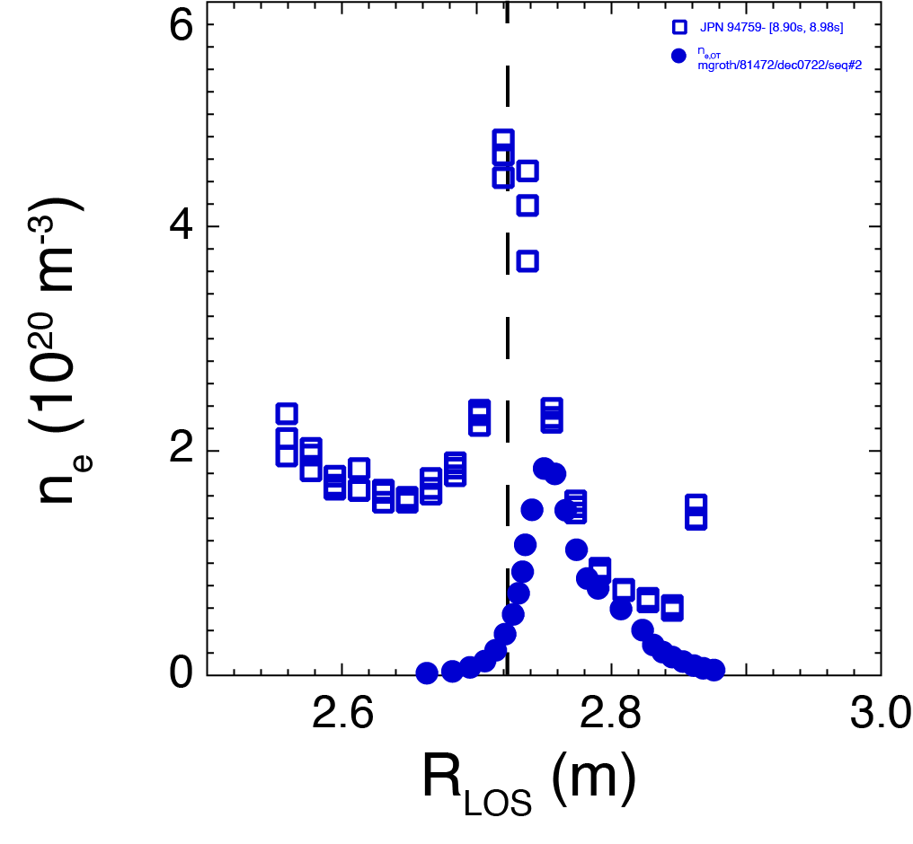
Discrepancy between predictions and experiments is exacerbated when considering line-integration as in actual measurements*
<n_{e}>_{LFS-div}
<n_{e}>_{LFS-div}
2.5x
n_{e,LFS-plate}
n_{e,LFS-plate}
*B. Lomanowski et al., NME 2019, PPCF 2020

Slide 12
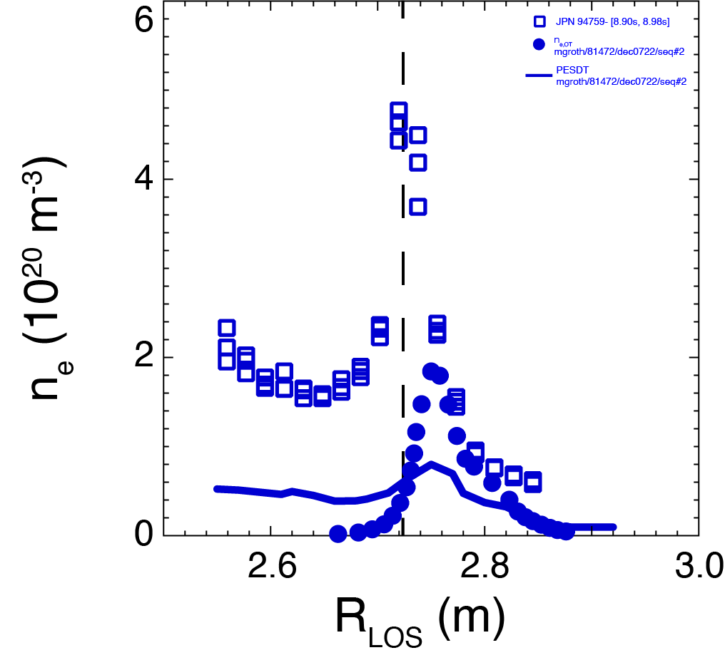
Discrepancy between predictions and experiments is exacerbated when considering line-integration as in actual measurements*
<n_{e}>_{LFS-div}
6x
n_{e,LFS-plate}
PESDT
*B. Lomanowski et al., NME 2019, PPCF 2020

Slide 13
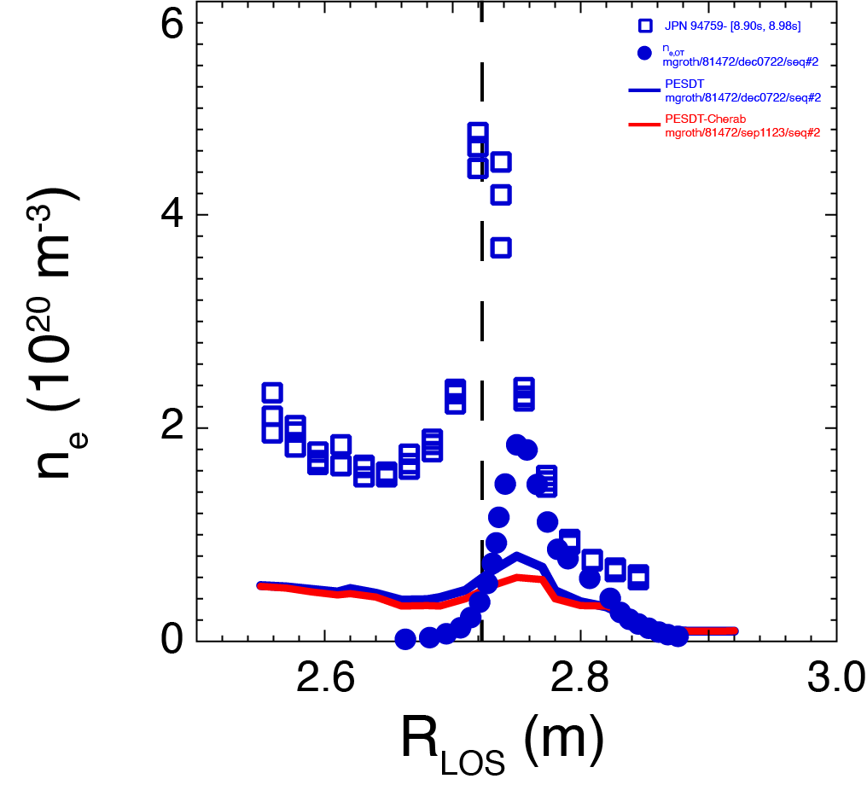
Discrepancy between predictions and experiments is exacerbated when considering line-integration as in actual measurements*
<n_{e}>_{LFS-div}
8x
n_{e,LFS-plate}
PESDT + Cherab reflections
*B. Lomanowski et al., NME 2019, PPCF 2020

Slide 14
Plans for 2024
Development and validation of self-consistent plasma-gas-photon coupled model in SOLPS-ITER ⇒ PSI 2024 (Ray Chandra)
  Technical implementation of EIRENE self-iteration scheme in B2.5-EIRENE coupling (required for photon-gas coupling) and the parallelization of grid for fast CRM calculation
  Re-evaluation of SOLPS-ITER JET81472 D plasma solutions in varying midplane separatrix density with the plasma-gas-photon coupled model ⇒ SOLPS-ITER cases for H and T, upon availability, w/ isotopologue-dep. rates
  Extension of atomic H collisional-radiative model to include molecular H₂ contributions to H* populations
Continue data analyses of JET-ILW H, D, T and DT L-mode plasmas for PSI 2024, using SOLPS-ITER to include changes to EIRENE ⇒ Aalto U / KU Leuven (PSI 2024 invited talk by Niels Horsten)
  Assessment of degree of recombination using additional KT3 D_{α} and D_{γ} measurements: Andy Meigs (UKAEA) and Vesa-Pekka Rikala (Aalto U)
  Comparison of hydrogenic to helium plasmas: David Rees (Aalto U)

Slide 15
Plans for 2024
PESDT post-processing routines for EIRENE, including CHERAB reflections (PSI 2024 Vesa-Pekka Rikala, Aalto U)
Validation of atomic and molecular fluxes versus atomic and molecular emission ⇒ S/XB (Lyman and Balmer series) and D/XB (Fulcher band emission) (Mathias)
Simulations of sub-divertor gas dynamics for H, D and T to assess potential fuel segregation (new collaborator, EIRENE trainee: Timo Kiviniemi, Aalto U)
  Heteronuclear molecules (e.g., D-T)?
He plasmas, AM rates, meta-stable transport (Mathias, David Rees)
Investigate impact of Yacora (ADAS format) versus AMJUEL (versus ADAS) rates on n_D2, n_D0 and S_ion in standalone EIRENE runs
Merge EIRENE w/photon module into Jugit and/or version at ITER (Ray)
Outside TSVV-5: re-investigate assumed boundary conditions at sheath (M≈1), for light versus heavy impurity species

