Slide 1
Boronisation ITER Overview
L. Moser
The views and opinions expressed herein do not necessarily reflect those of the ITER Organization

Slide 2
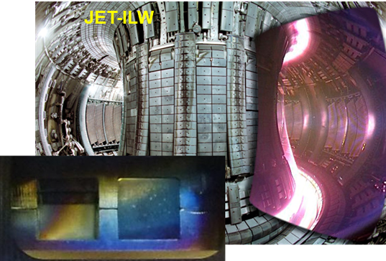
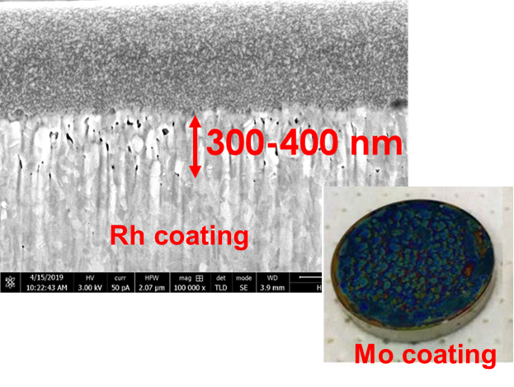
Introduction
In ITER, many risks exist for First Mirrors and their optical properties during operation:
Deposition of FW eroded material (Be, W, SS, O, D)
Thickness ~ λ/20.
Erosion from CXN with high energies (> 200 eV)
Removal of material, Pc mirrors & coatings.
Exposure to air or steam ingress during operation
Oxides;
Voids
Dust
Deposited or encrusted.
K. Soni et al., NME 2019, “Plasma cleaning of steam ingressed ITER first mirrors”, 21 100702

Slide 3
Introduction
And now…
Boronisation !
Shutters are required to protect First Mirrors while Mirror Cleaning is mandatory to re-condition them following an exposure to particles, steam, …

Slide 4
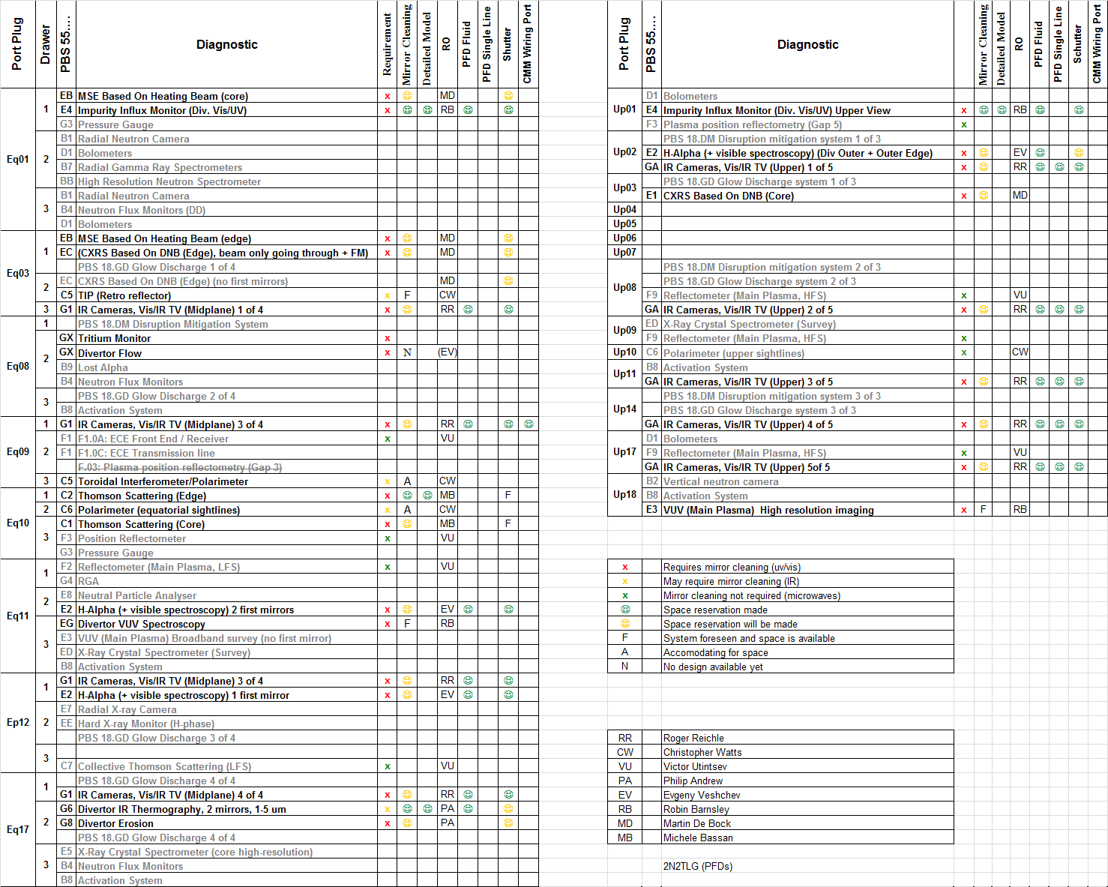
Optical Diagnostics with endangered mirrors (in 2014)
In 2014, 30 optical diagnostics listed as potential candidates for Mirror Cleaning.
Several systems are no longer planning to use Mirror Cleaning:
55.C5/C6 (and 55.FA) → Long Wavelength
55.G8/GC → Inter-pulses.
55.E3/EG/EH → Shutter + work at grazing angle.
https://user.iter.org/?uid=KRVAB9

Slide 5
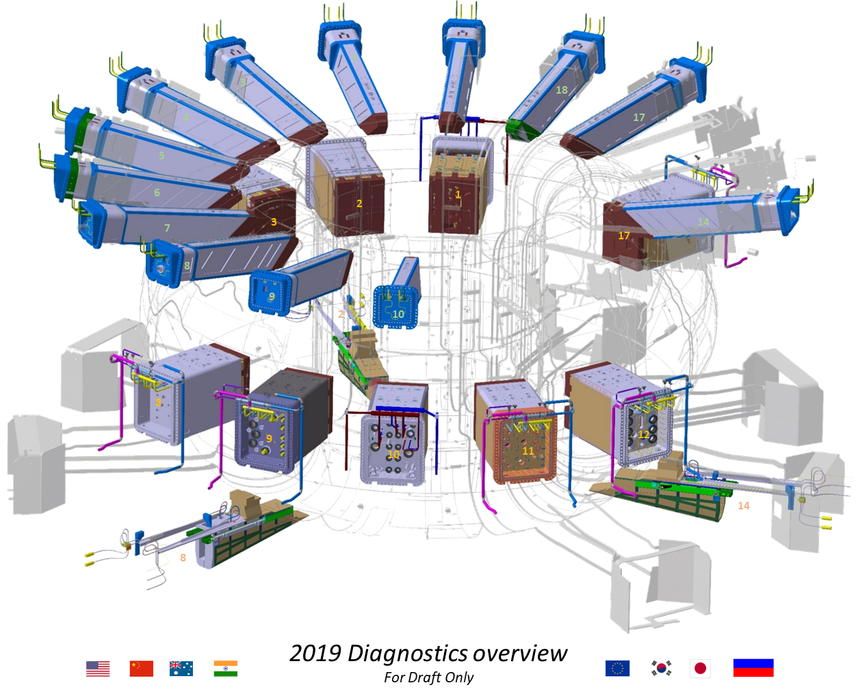
Mirror Cleaning impacted systems: 2024
14 Diagnostics need Mirror Cleaning System;
Impacts 7 Upper Ports, 8 Equatorial Ports and 2 Lower Ports;
Approx. 40 individual line of sights (usually impacting M1 and M2 mirrors).

Slide 6
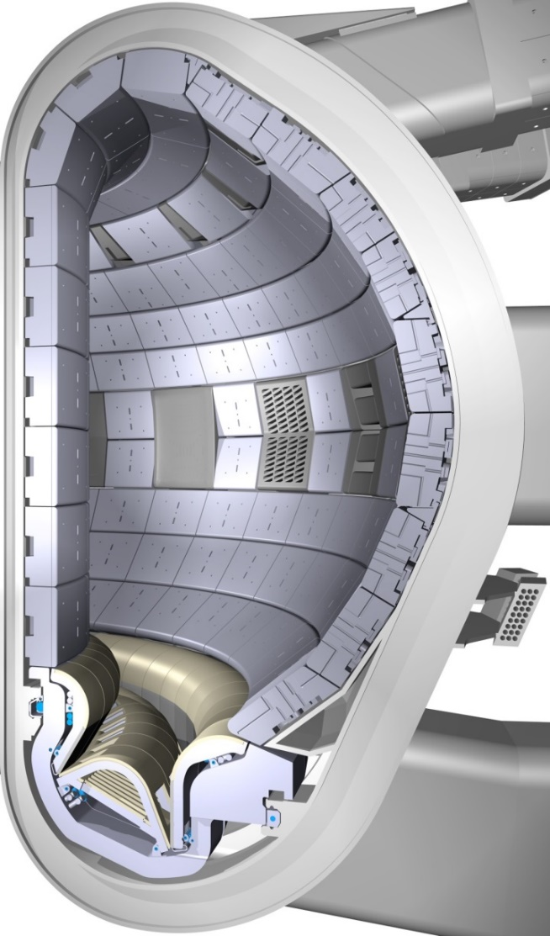
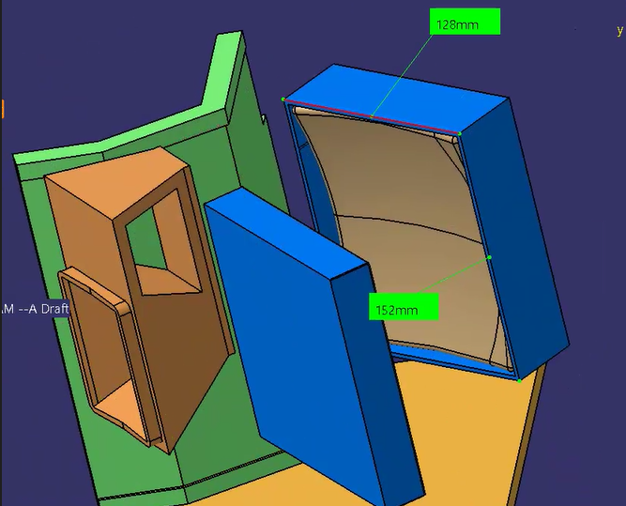
Boronisation impact
All first mirrors from the 14 mentioned diagnostic systems are located in Port Plugs, either Upper, Equatorial or Lower.
All diagnostics have a shutter that can be closed during the boronisation.
Boronisation as such is not a concern.
→ However the deposits on mirrors during Operations as the FW (W coated with B) gets eroded is a concern.
We need samples exposed to eroded boron for Mirror Cleaning recipes trials.
(Mirror station with shutter during boronisation)

Slide 7
Boronisation impact
Several diagnostic system were expected to be risk-free prior re-baselining as working at high wavelength:
55.FA DIP
55.C5 TIP
Both systems operate at wavelength 5-10 microns
Deposits of few hundreds of nms (Be, W) over lifetime were not considered an issue.
Diagnostics were designed (i) without shutter and (ii) without mirror cleaning.
Regular boronisation (every 2nd week with 200 nm deposits each time) now becomes challenging over lifetime.

Slide 8
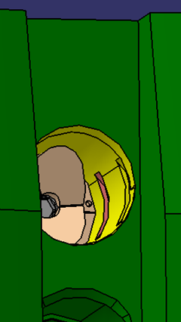
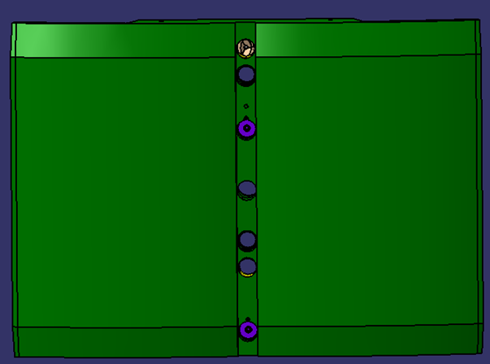
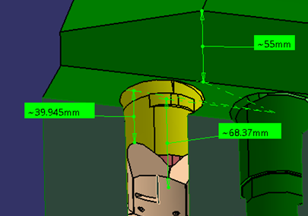
Boronisation impact
FA and C5 have mirrors in Port Plugs, but also retro-reflectors located in other Ports but also in the central column.
No shutter to protect them during boronisation.
Not clear how much boron they would get during a boronisation (impact of being recessed).

Slide 9
Boronisation impact
For new diagnostic systems without shutter…
We need samples exposed to *deposited* boron to assess if the optical properties heavily degrade. .
(Mirror station without shutter during boronisation)

