Slide 1

ITPA
Boronization in ITER: impact on mirrors
Review of existing studies in tokamaks
12.01.2024| A. Litnovsky

Slide 2









Content
Mirror stations
Mirror campaign in ASDEX Uprade
Boronization in ITER: impact on mirror R&D
Summary

Slide 3
Mirror Stations
Mirror stations
Mirror campaign in ASDEX Upgrade
Boronization in ITER: impact on mirror R&D
Summary

Slide 4
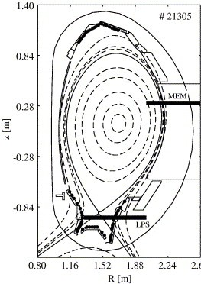
  Mirror Station: a concept
Ducts with fins to mitigate deposition
L: length of duct
D
0.6D
D: diameter of a mirror (20 mm )
Mirrors
Ducts
Fins
Front end: all ducts start at the same distance from plasma
D/2
L/D
Mirrors in the ducts with fins
Mirrors in the ducts without fins
L/D=6
I
III
L/D=13
L/D=13
II
IV
All ducts have same apertures

Slide 5
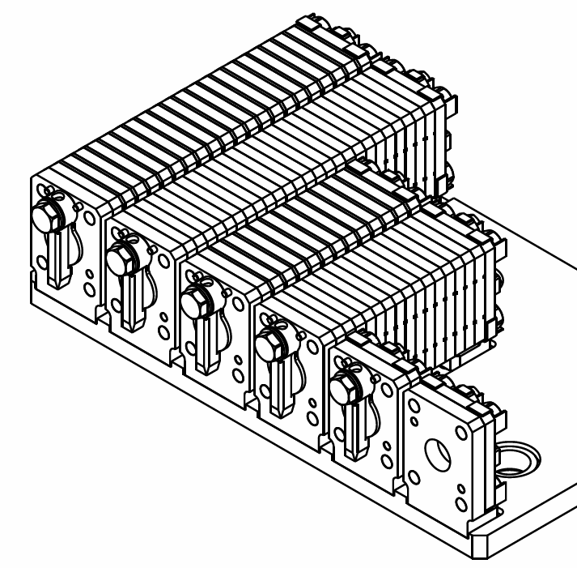
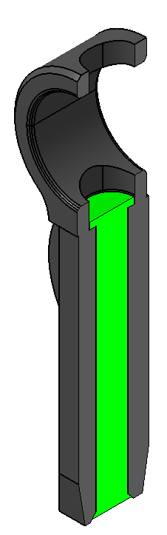
Mirror station: realization
Ducts without fins
Ducts with
fins
6 identical single – crystal Mo mirrors exposed
Mirrors pre-assembled with ducts of varying length with and without fins on a SS plate
5 mirrors have shutters activated by the B-field to prevent the effect from wall conditioning
One mirror without a shutter for comparison
SS shutter
Iron core

Slide 6
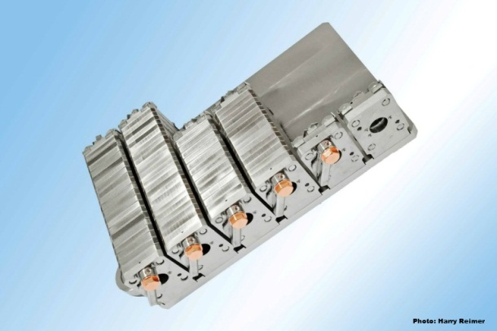
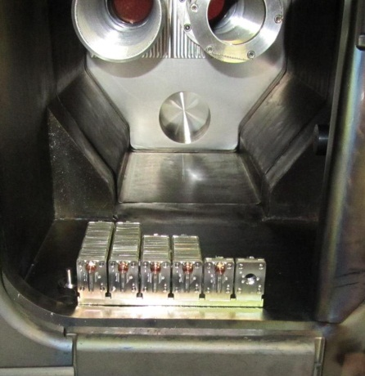
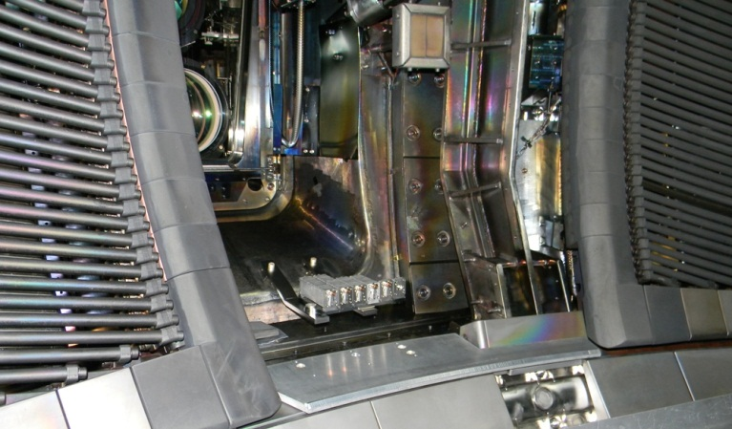
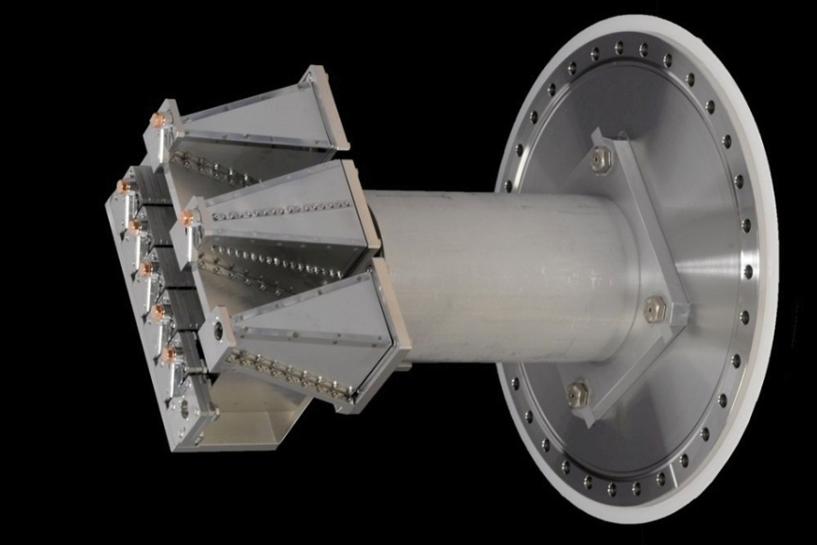
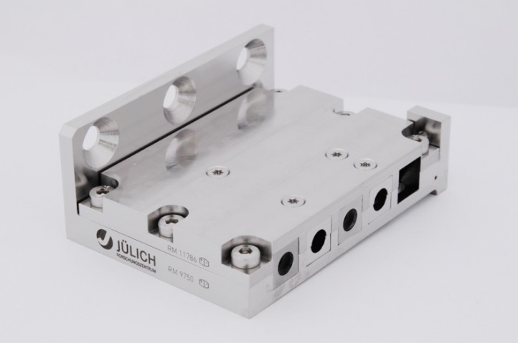
  Mirror Stations in tokamaks
DIII-D and ASDEX Upgrade version
JET mirror cassette
TEXTOR version

Slide 7
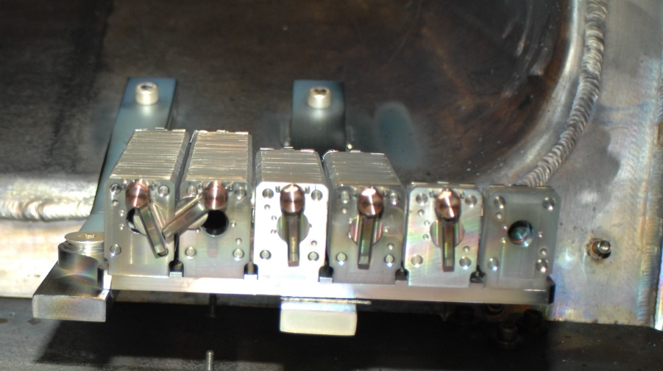
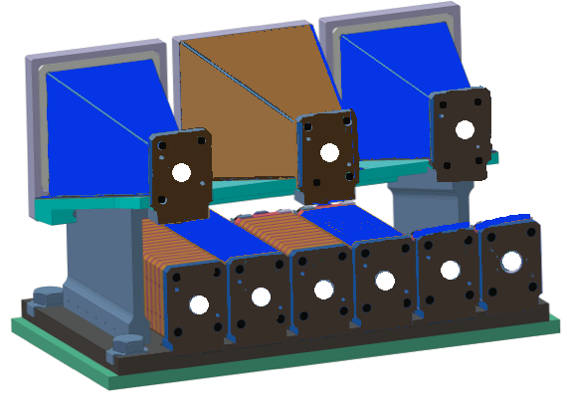
  Main results I: shutters did not work at 100% and cone-shaped ducts beneficial
AUG and DIII-D: some of shutters got stuck half-opened
Wall conditioning? Boronization?
Evaluation is very challenging
Reflectivity for the three mirrors: 7, 8-f, 9 in cone-shaped ducts preserved during exposure.
No difference for cone-shaped ducts: with or without fins
All other mirrors (1-6) demonstrate reflectivity drop
9 8-f 7
6-f 5 4-f 3 2 1

Slide 8
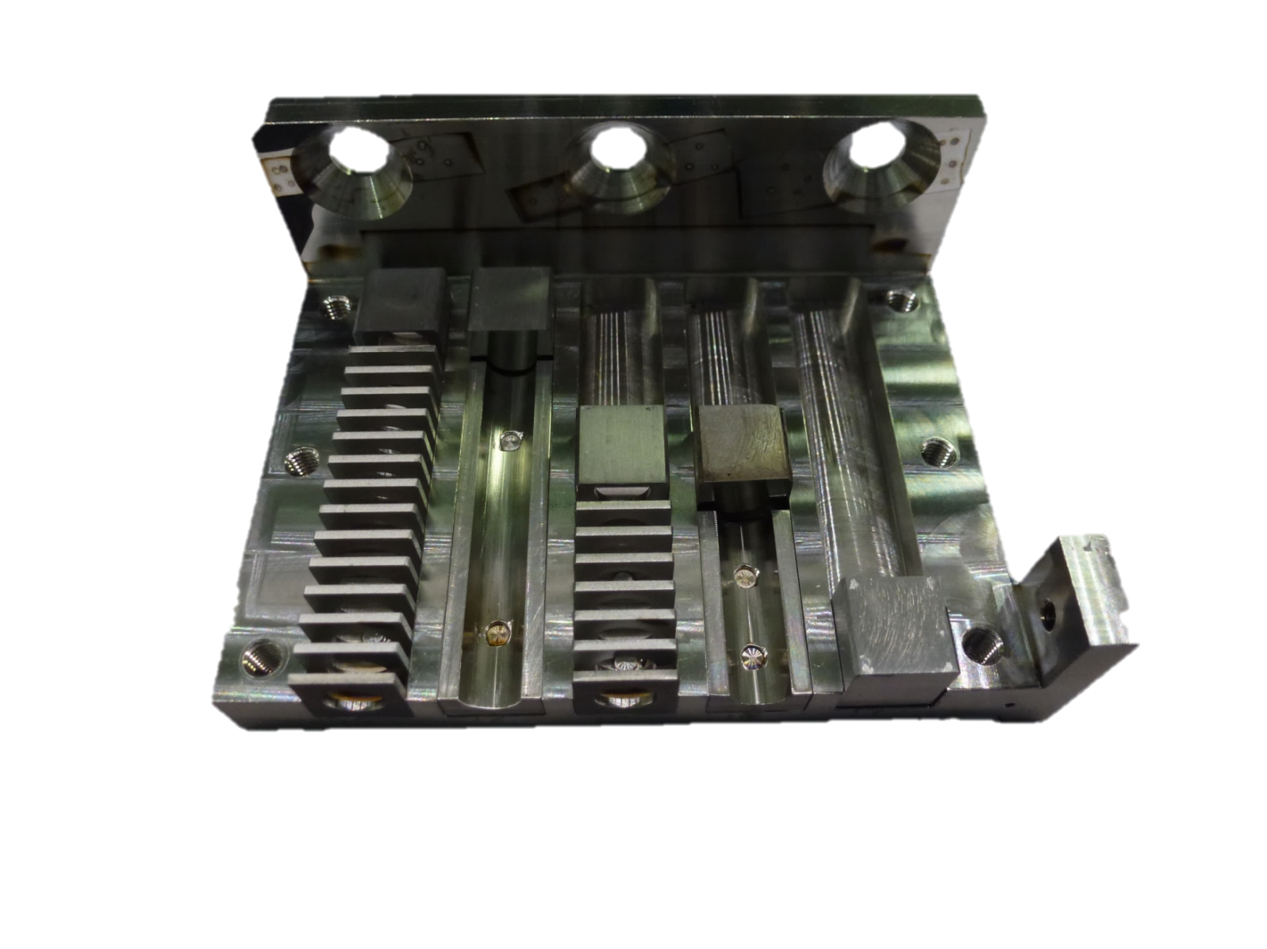
  Main results II: Beryllium does not travel long distance in ducts
C(Be) deposition, 10¹⁵ at/cm²
16
(6)
16
(0)
37
(0)
25
(0)
JET Campaign 2013-2014
MS at outer wall
18 (0)
14
(0)
15 (0)
22
(0)
1700
(9300)

Slide 9
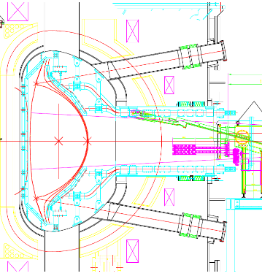
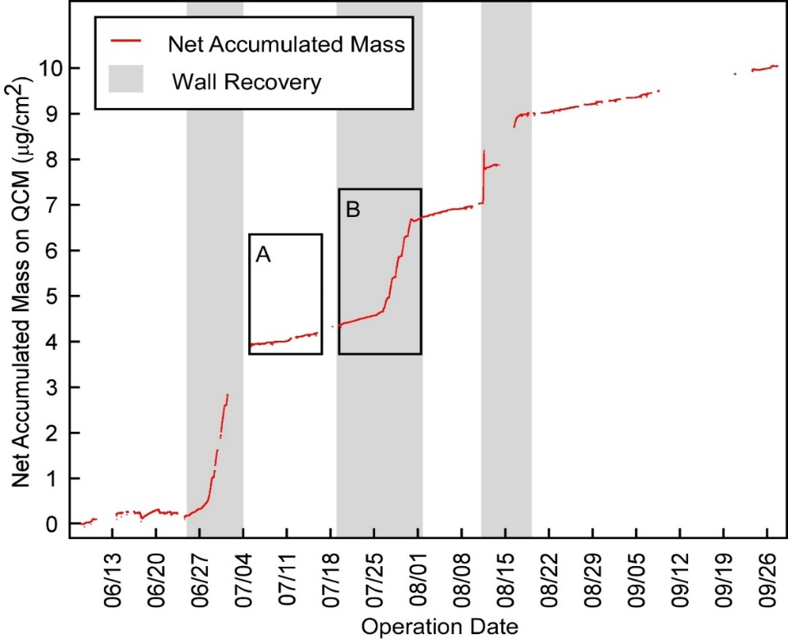
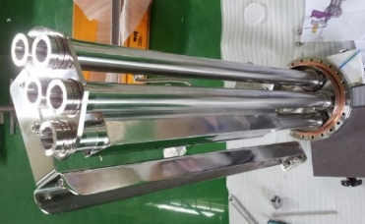
  Main results III: wall conditioning dominates mirror contamination
TEXTOR Mirror Station, campaign II w/o shutters
Modeling and parameter evaluation
1 hour
1.3x10¹⁵ CXA/cm²
125 conditioning sessions
127 hours
6.3x10¹⁸ ion/cm²
1
:
4800
KSTAR Deposition Mitigation (DeMi) system
Quartz crystal microbalances as mirrors
Installed in diagnostic ducts
Real-time monitoring of contamination
Deposition dominated by wall conditioning
DeMi
system
Operation time

Slide 10


  Mirror Stations: references
LHD:
  T. Akiyama et al., Nucl. Fusion, 52 (2012) 063014
TEXTOR (DIII-D and AUG)
  A. Litnovsky et al., Nucl. Fusion, 55 (2015) 093015
KSTAR
  B. Kim et al., Fus. Eng. and Design 129 (2018) 269
JET:
  S. Moon et al., Nucl. Mater. and Energy 19 (2019) 259
or
ask AL for these and other interesting reading ☺
You can download all these papers at: https://fz-juelich.sciebo.de/s/IhD1klWd6TMX260

Slide 11
Mirror campaign in ASDEX Upgrade
Mirror stations
Mirror campaign in ASDEX Upgrade
Boronization in ITER: impact on mirror R&D
Summary

Slide 12
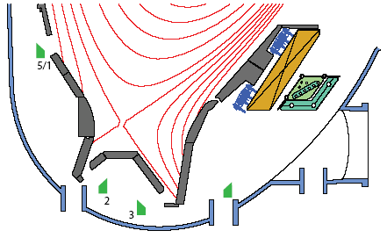
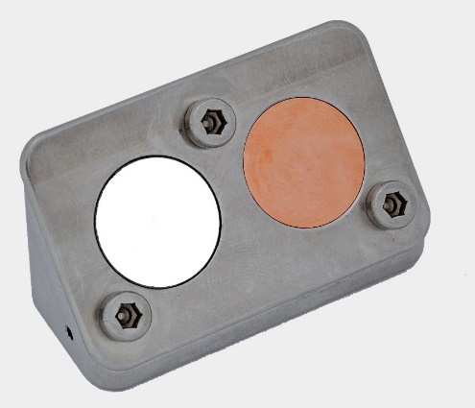
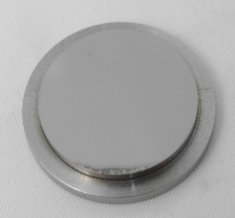
  Mirror campaign in full-W AUG: aims and overview
Studies of ITER candidate mirrors in a tokamak with all-metal interior
Aims
Means
Evaluate performance of mirrors in a tokamak
with all-metal PFCs
Assess an impact of deposits on reflectivity
Investigate elemental composition of deposits
Mo and Cu mirrors
In heated holders
Heated at 150ºC to study the effect of deposition on neutron- and gamma- heated mirrors in ITER divertor
Installation
Locations
Mirror holder
#5/1: Inner wall in between upper
baffle and centerpost;
#2: under dome facing inner divertor
#3: under dome facing outer divertor
#4: at the pump duct
Mirror
18 mm
4

Slide 13
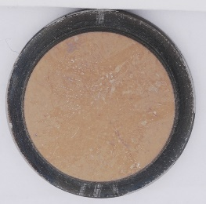
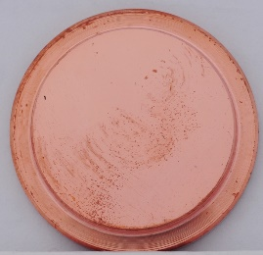
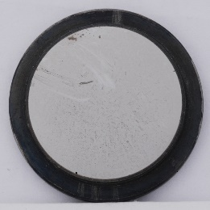
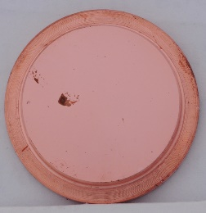
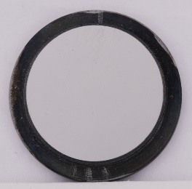
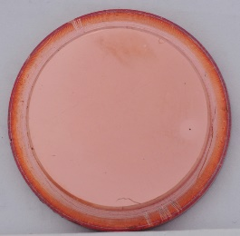
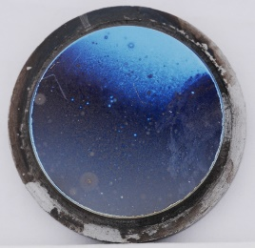
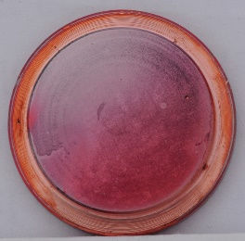
  Mirror campaign in AUG: exposure details and visual observations
Exposure: February – August 2011
945 plasma discharges,
~3500 sec divertor configuration
## 5/1, 2 and 4:
uniform deposited layers – deposition via neutrals
# 3 : Highly non-uniform: local impurity source at the strike point
4
4

Slide 14
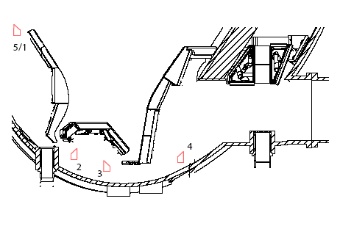
  Mirror campaign in AUG: boron deposition
Boron content, ×10¹⁶ at/cm²
0.1
0.2
0.3
6.8 (92%)
Boron deposited primarily on the mirror facing the outer divertor

Slide 15
  Mirror campaign in AUG: tungsten deposition
Tungsten content, ×10¹⁶ at/cm²
0.5
0.3
0.4
4.7 (80%)
Apart from the mirror facing outer divertor, W deposition is almost uniform on all locations

Slide 16
  Mirror campaign in AUG: carbon deposition
Carbon content, ×10¹⁶ at/cm²
0
0.2
0.7
1.9 (74%)
Carbon on the mirror facing outer divertor

Slide 17
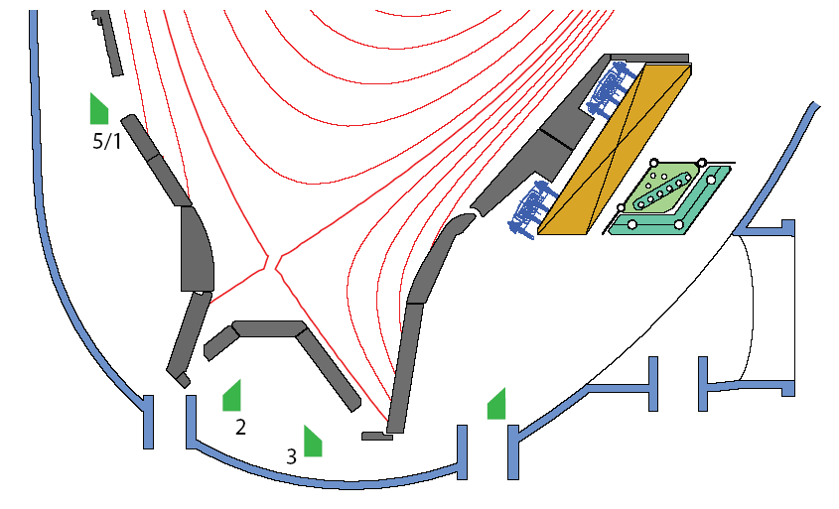
  Mirror campaign in AUG: deposition summary
Boron and tungsten (oxide) found on all mirrors
Amounts of B and W are comparable
Carbon found only on mirrors exposed under the dome
Strong intermixing of B/W/(C)
80% of entire deposition on the mirror facing outer strike point – local source [1]
Overall deposition ~ 10 lower than with carbon PFC [1]
0.1
0.5
0
4
0.2
0.3
0.2
0.3
0.4
0.7
6.8
4.7
1.9
B
W
C
×10¹⁶ at / cm²
Data from Electron Probe MicroAnalysis (EPMA)
[1] M. Mayer et al. Nuclear Fusion, 46 (2006) 914

Slide 18
  Mirror campaign in AUG: takeaways
Boron and tungsten (oxide) found on all mirrors at comparable amounts
Strong intermixing
Most deposition – under the dome facing the outer strike point
Least degradation in the pump duct
Reflectivity of all mirrors degraded, least degradation in the pump duct
The total exposure corresponds to apr. 22 ITER discharges: flux evaluation and comparison with modeling
None of mirrors would survive without cleaning in ITER

Slide 19


  Mirror campaign in AUG: references
  A. Litnovsky et al., Nucl. Fusion, 53 (2013) 073033
and
ask AL for an additional interesting reading ☺
You can download the paper at:
https://fz-juelich.sciebo.de/s/6Ky42E2ti107Hiz

Slide 20
Boronization in ITER:
impact on mirror R&D
Mirror stations
Mirror campaign in ASDEX Upgrade
Boronization in ITER: impact on mirror R&D
Summary

Slide 21
  Boronization in ITER: impact on mirror and mirror infrastructure
1. Mirror cleaning system:
  to be qualified to remove boron, likely intermixed with W
2. Shutters:
  have to work reliably with boronization

Slide 22
  What R&D would we need ?
A. Mirror samples from AUG and WEST:
    With B and B/W deposits
    Possibly with identical deposits (locations?)
    Dedicated (simple) mirror assemblies carrying several mirrors at once
    Mirrors exposed in ducts / ports
    Supporting studies on lab samples with B and B/W deposition
    Used to benchmark and qualify mirror cleaning systems
B. Modeling estimates of B contamination caused by boronization:
    Maximum B deposition rates
    Also, as a function of the duct depth
    Desirable, including glow discharge plasmas, not operational plasma only
C. Shutters:
    Data mining on existing shutter systems in AUG and WEST
    Review of ITER shutter design?

Slide 23
Summary
Mirror stations
Mirror campaign in ASDEX Upgrade
Boronization in ITER: impact on mirror R&D
Summary

Slide 24
  Summary
Mirror Stations at outer wall:
    Most deposition on distant mirrors happened during wall conditioning
    Seems like beryllium does not travel long distances along ducts
    Small tolerances during manufacturing caused shutters to stuck
    No or moderate advantageous effects of fins (baffles)
    Definite advantages of cone-shaped ducts
Mirror test in ASDEX Upgrade in divertor, inner baffle and pump duct:
    Most deposition on mirror facing outer divertor, the least – in the pump duct
    Deposits consist of boron mixed with tungsten oxide, minor fraction of C
    Reflectivity of all mirrors degraded
Boronization in ITER
    Will likely have an effect on mirror cleaning systems and shutters

Slide 25
  Thank you

