Slide 1
WP PWIE SPE kick-off meeting 23.1.2024
Jari Likonen

Slide 2
Goals and agenda of the meeting
The goals of the meeting are to
Introduce and discuss the tasks attached to each Research Unit under SPE
Identify possible gaps and opportunities for collaboration, and
Decide on concrete next steps, to be reviewed in the summer
9:30
9:50
Introduction to PWIE and SP E
Presentations of SP E task holders – please focus on the question ”What will be done in 2024 and what is needed from others/EUROfusion”
Please be brief: each presentation is 10 min + 5 min for quick feedback Discussion
End of the meeting
12:05
12:30
Everybody is invited to contribute to the discussions, also those who are not task holders of any of the SP E activities!

Slide 3
SP E focus points in 2024
I: LIBS on a Remote-Handling arm in JET→ SP E.1
II: Comparison of hydrogenic retention quantification by different techniques and fuel removal assessment (ITER housekeeping approach) → SP E.2
III: Post-mortem analysis of PFC and other objects in JET→ SP E.3

Slide 4
SP E resources 2024
Deliverable Owner | Beneficiary | PM
P. Veis | CU | 4
S. Almaviva | ENEA | 9
T. Dittmar | FZJ | 13
E. Grigore/C. Porosnicu | IAP | 8
P. Gasior | IPPLM | 4
E. Fortuna-Zaleśna | IPPLM | 2
J. Butikova | ISSP-UL | 4
E. Pajuste | ISSP-UL | 12
N. Catarino | IST | 7
P. Paris | UT | 6
D. Primetzhofer | VR | 6
J. Likonen | VTT | 12
Total |  | 87
Device | Beneficiary | Days
Accelerator | IST | 7
Accelerator | VR | 3
Accelerator | VTT | 2

Slide 5
Contact info and next steps
Your SP E contact
Jari Likonen (jari.likonen@vtt.fi)
Project leader
Sebastijan Brezinsek (s.brezinsek@fz-juelich.de)
Project Support Officer
Michael Reinhart (m.reinhart@fz-juelich.de)
PMU Coordination Officer
David Douai (david.douai@cea.fr)
Review meeting of WPPWIE– April 2024
Thematic meetings on more detailed planning of tasks March-May 2024
Midterm meeting of SP E activity areas – latter half of 2024
Minutes and slides of the meeting at https://indico.euro-fusion.org/event/2998/

Slide 6
SPE program 2024
LIBS experiment at VTT using the JET LIBS setup
Data analysis of VTT LIBS experiment
LIBS experiment at JET
Data analysis of JET LIBS experiment
Completion of tile analysis (C39 baking studies, LID-QMS)
Analysis of limiter tiles from top and bottom of IWGL and WPL limiters
Completion of metallography and microstructural studies of Langmuir probes and W lamellae
Analysis of louvre clip and mirror cassettes
Analysis of W lamellae and W sticky monitors
Planning of removal of in-vessel components

Slide 7
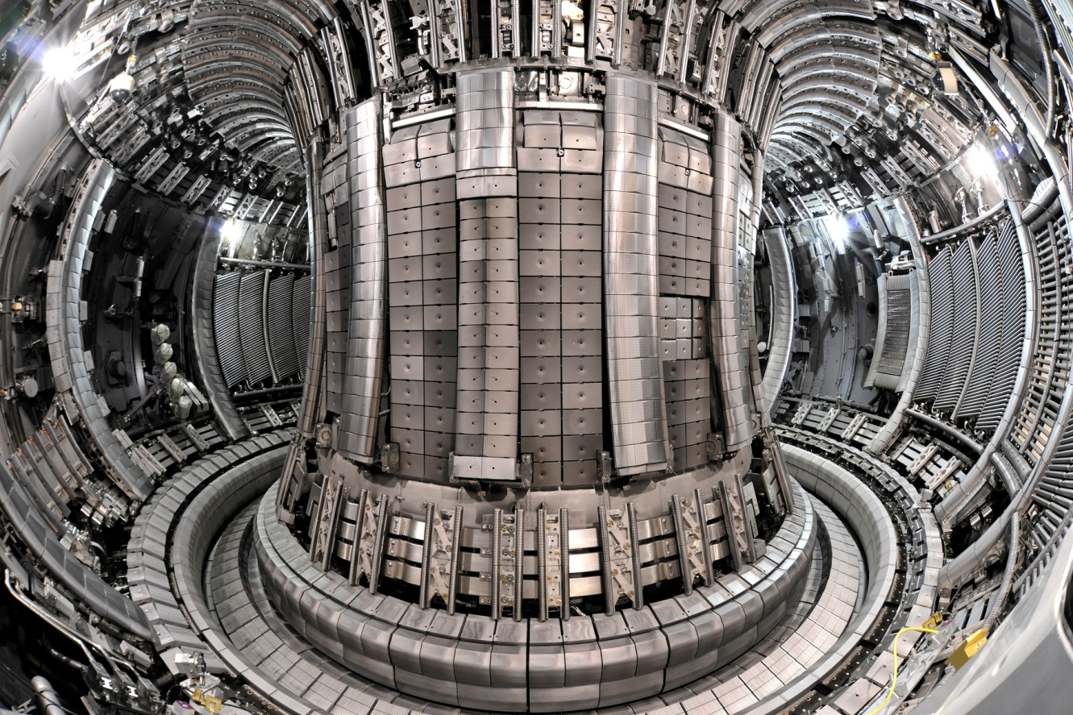
Typical PWIE materials for post-mortem analysis
MAIN CHAMBER
Upper Dump Plates (UDP)
Inner Wall Guard Limiters (IWGL)
Outer Poloidal Limiters (OPL)
Inner Wall Cladding (IWC)
Bulk Be
Be coated inconel
W – coated CFC
DIVERTOR
Inner & outer divertor
W-wedge, tile 5
W – coated CFC
Bulk W
PROBES
Rotating collectors
W sticking monitors
Mirrors, cassettes

Slide 8
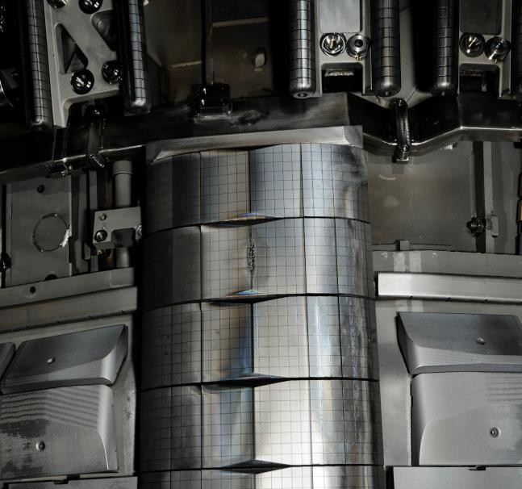
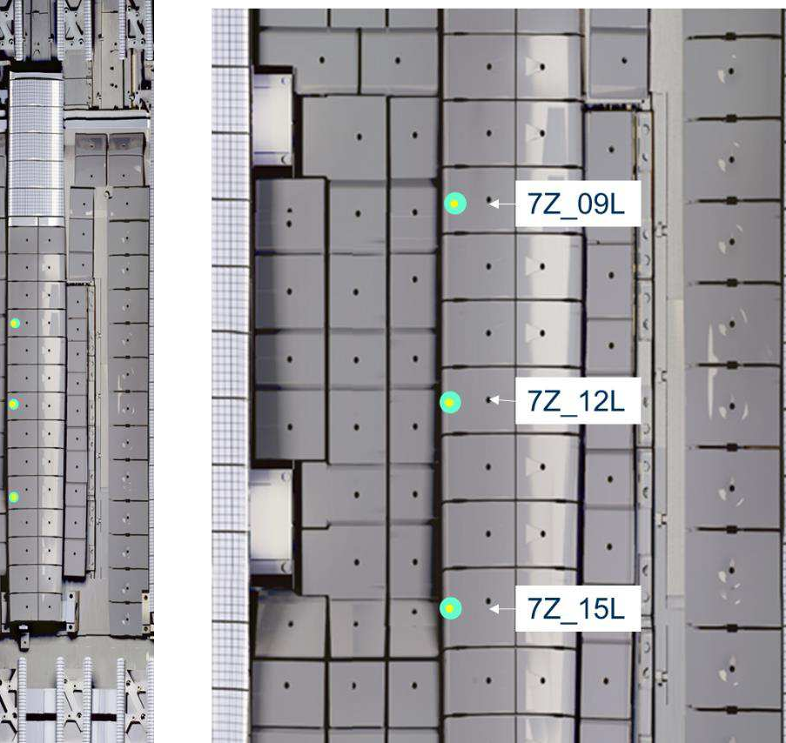
LIBS programme at JET, IWGL tiles
Tile ID | LIBS Detail | Number of Spots
2XR19 W Top Tile | R1 (All columns) | 25
2XR19 | R2 (All columns) | 25
2XR17 | R7 (All columns) | 25
2XR9 | High resolution | 200
2XR8 | R7 (All columns) | 25
2XR4 | R2 (All columns) | 25
2XR3 | R7 (All columns) | 25
8Z10 | R5 LM2-C3; R5 LW1-C2 | 2
7X7 | R5 LW1-C3 | 1
TOTAL |  | 353
2XR19
2019-2023
2XR18
2019-2023
not taken out
2XR17
2011-2023
Tile ID | LIBS Detail | Number of Spots
7Z_9L | Single Spot in KS8 shine through | 1
7Z_12L | Single Spot in KS8 shine through | 1
7Z_15L | Single Spot in KS8 shine through | 1
TOTAL |  | 3
Notes:
PD: Plasma Devices as in PEP listed
HHF: High Heat flux as in PEP listed
IBF: Ion beam Facility as in PEP listed
Other facilties as in PEP listed

Slide 9
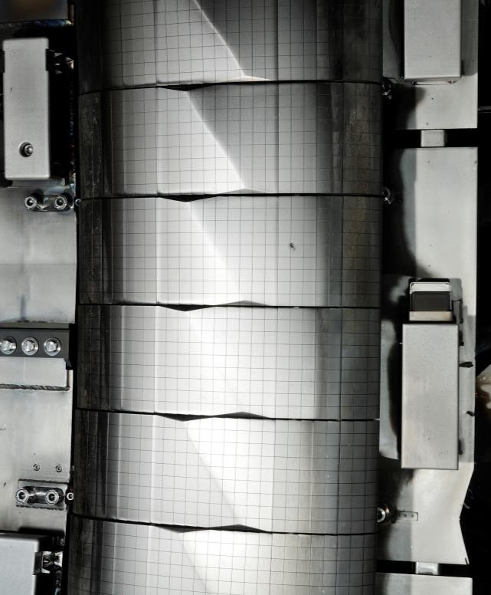
LIBS programme at JET, WPL tiles
Tile ID | LIBS Detail | Number of Spots
4D23 | R2 (All columns) | 26
4D22 | R8 (All columns) | 26
4D14 | R2 (All columns) | 26
4D13 | High Resolution | 234
4D4 | R2 (All columns) | 26
4D3 | R8 (All columns) | 26
TOTAL |  | 364
4D14
4D13
4D09
Notes:
PD: Plasma Devices as in PEP listed
HHF: High Heat flux as in PEP listed
IBF: Ion beam Facility as in PEP listed
Other facilties as in PEP listed

Slide 10
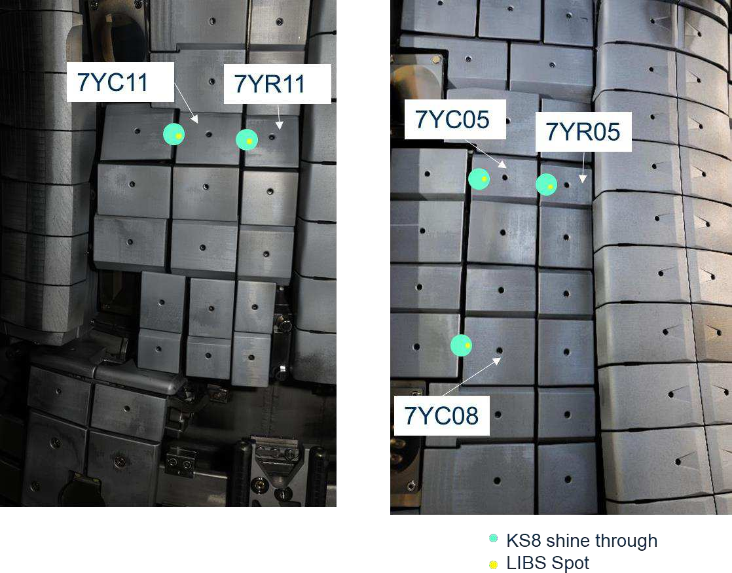
LIBS programme at JET, Inner Wall Protection (IWP) tiles
Tile ID | LIBS Detail | Number of Spots
IWP_428 | 20nm W calibration 2 micron Be calibration 8 micron Be calibration | 3
IWP_408 | Single Spot | 1
IWP_402 | Single Spot | 1
IWP_411 | Single Spot | 1
IWP_805 | Single Spot | 1
IWP_808 | Single Spot | 1
7YC05/705C | Single Spot in KS8 shine through | 1
7YR05/705R | Single Spot in KS8 shine through | 1
7YC08/708C | Single Spot in KS8 shine through | 1
7YC11/711C | Single Spot in KS8 shine through | 1
7YR11/711R | Single Spot in KS8 shine through | 1
TOTAL |  | 13
Notes:
PD: Plasma Devices as in PEP listed
HHF: High Heat flux as in PEP listed
IBF: Ion beam Facility as in PEP listed
Other facilties as in PEP listed

Slide 11
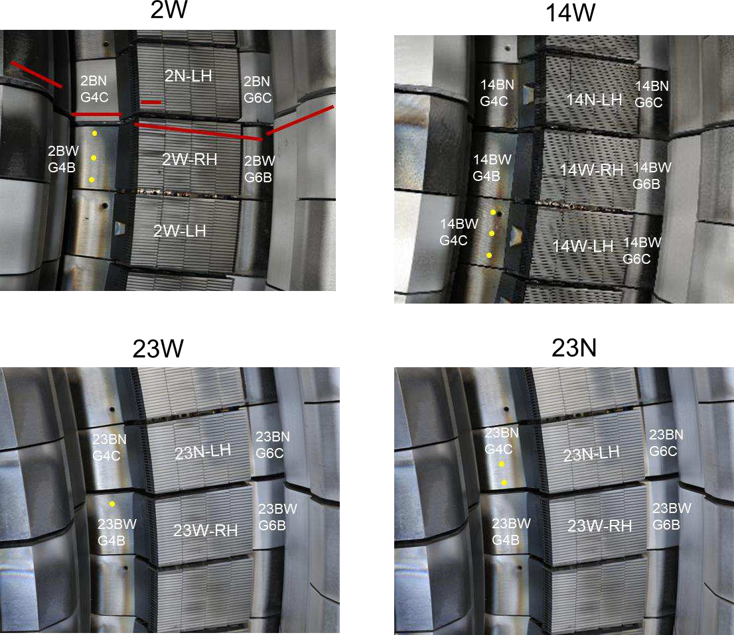
LIBS programme at JET, Base Divertor Carriers
Tile ID | LIBS Detail | Number of Spots
14BW | 1 row, 3 columns | 3
02BW | 1 row, 3 columns | 3
23BW | Single Spot | 1
23BN | 1 row, 2 columns | 2
TOTAL |  | 9
Notes:
PD: Plasma Devices as in PEP listed
HHF: High Heat flux as in PEP listed
IBF: Ion beam Facility as in PEP listed
Other facilties as in PEP listed

Slide 12
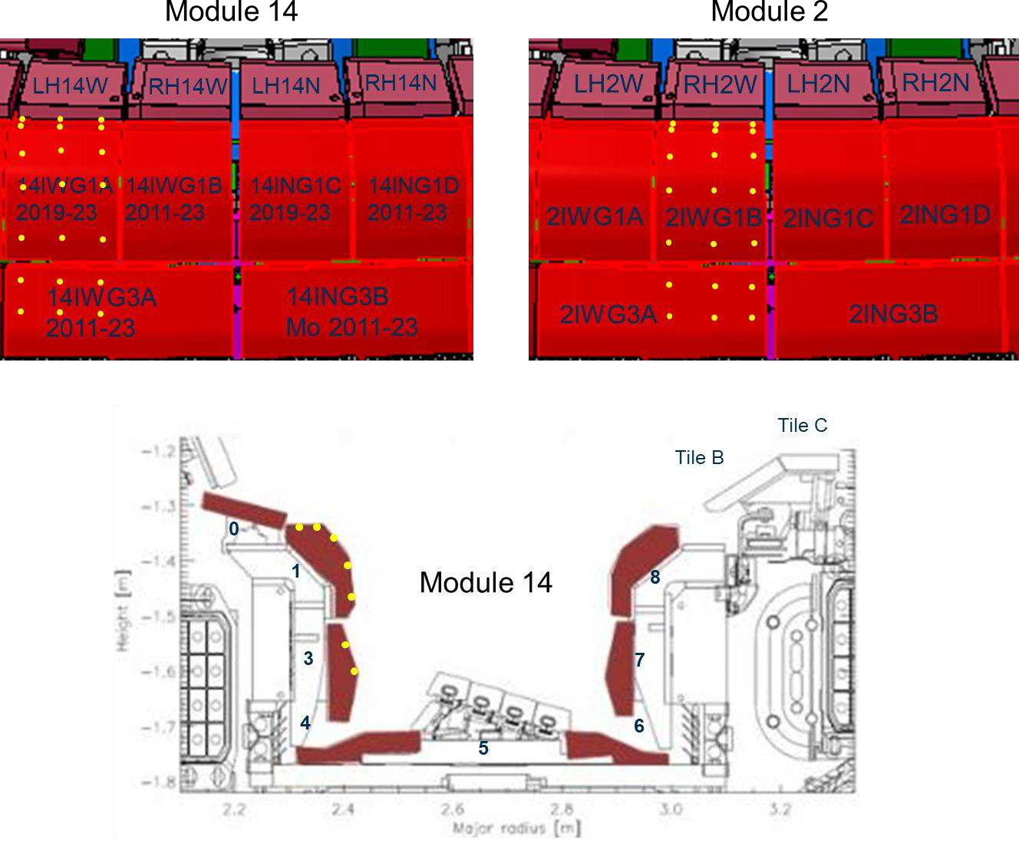
LIBS programme at JET, Inner Divertor Carriers
Tile ID | LIBS Detail | Number of Spots
14IW | 7 rows, 3 columns | 21
02IW | 7 rows, 3 columns | 21
TOTAL |  | 42
Notes:
PD: Plasma Devices as in PEP listed
HHF: High Heat flux as in PEP listed
IBF: Ion beam Facility as in PEP listed
Other facilties as in PEP listed

Slide 13
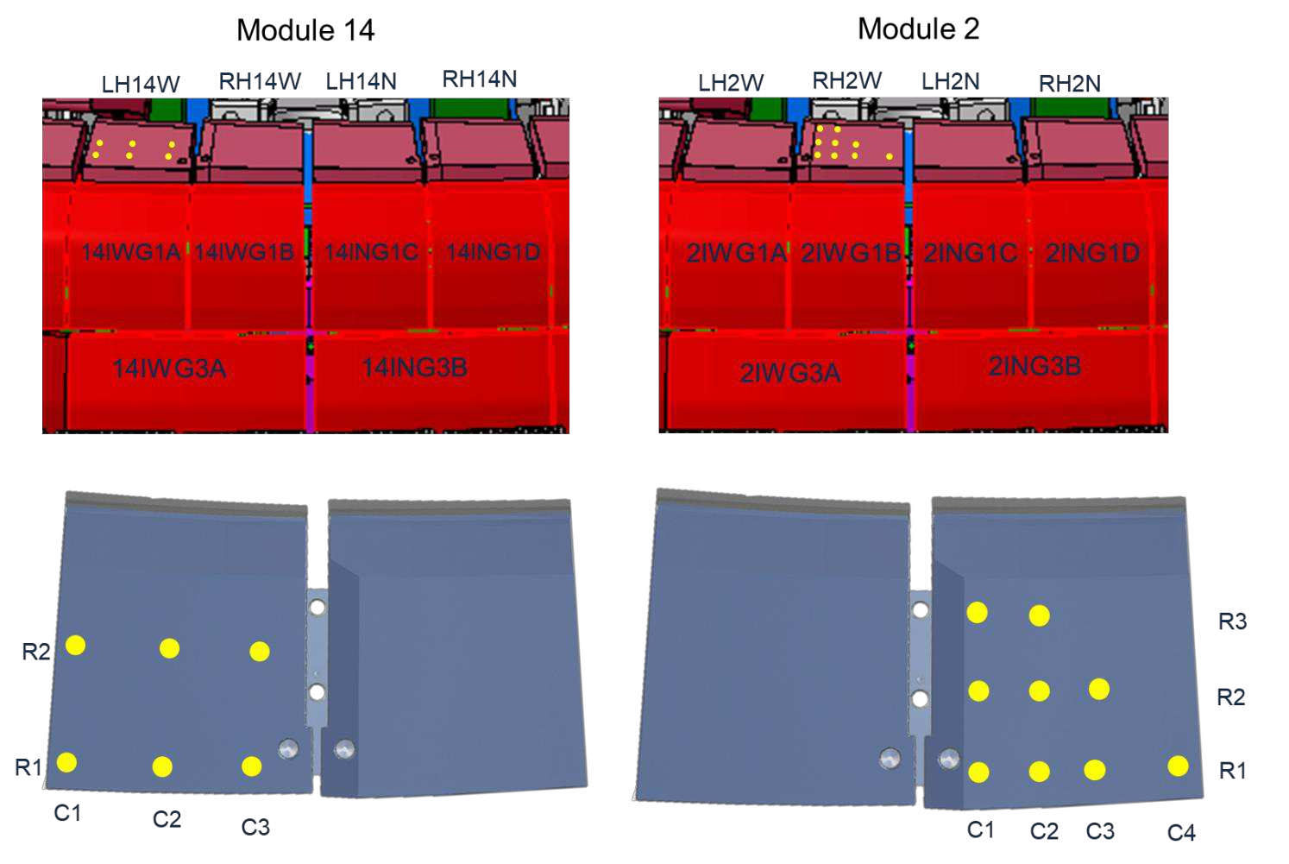
LIBS programme at JET, High Field Gap Closure (HFGC) Tiles
Tile ID | LIBS Detail | Number of Spots
HFGC_14W_Left | 2 rows, 3 columns | 6
HFGC_02W_Right | 3 rows of: 2, 3, and 4 columns | 9
TOTAL |  | 15
Notes:
PD: Plasma Devices as in PEP listed
HHF: High Heat flux as in PEP listed
IBF: Ion beam Facility as in PEP listed
Other facilties as in PEP listed

Slide 14
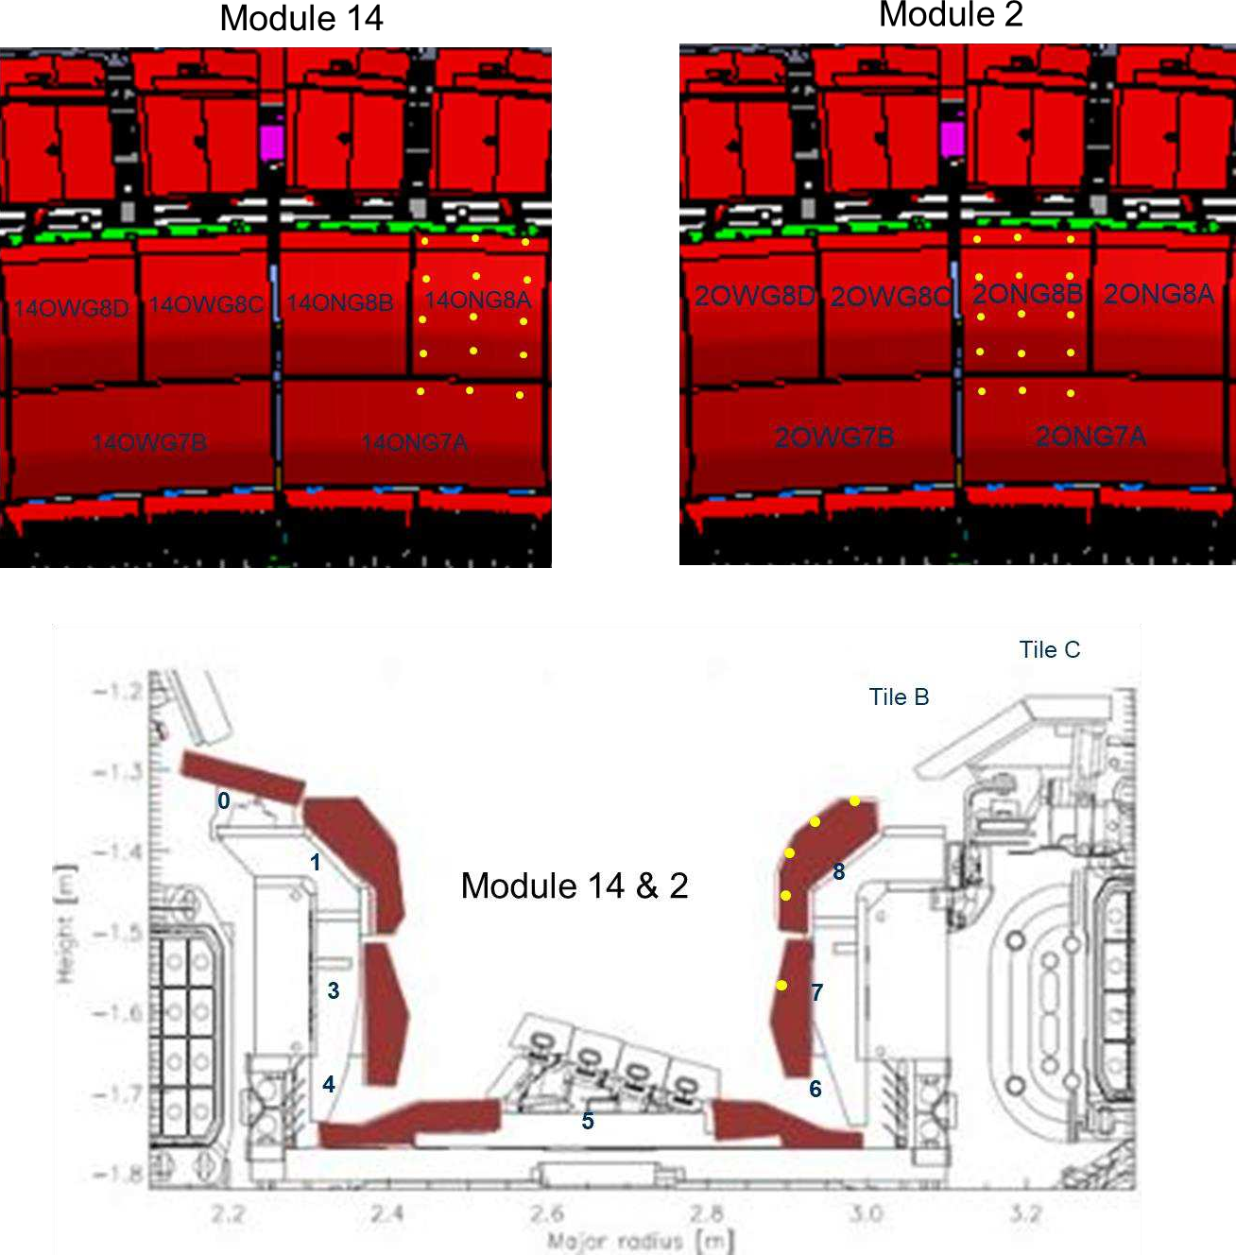
LIBS programme at JET, Outer Divertor Carriers
Tile ID | LIBS Detail | Number of Spots
14ON | 5 rows, 3 columns | 15
02ON | 5 rows, 3 columns | 15
TOTAL |  | 30
Notes:
PD: Plasma Devices as in PEP listed
HHF: High Heat flux as in PEP listed
IBF: Ion beam Facility as in PEP listed
Other facilties as in PEP listed

Slide 15

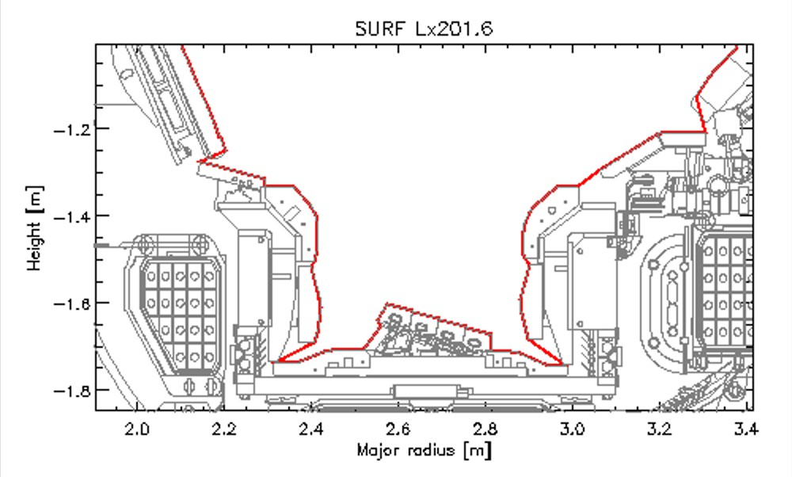




RH Operations
Operational Factors influencing LIBS design
Drives maximum tool height dimension
Access impossible due to optic layout
Minimum Tool Dimensions
JET Vessel Dimensions
Spot Locations
Example Spots
Access impossible due to min tool height dimension
Drives maximum tool length dimension
Official - Sensitive - Commercial

Slide 16
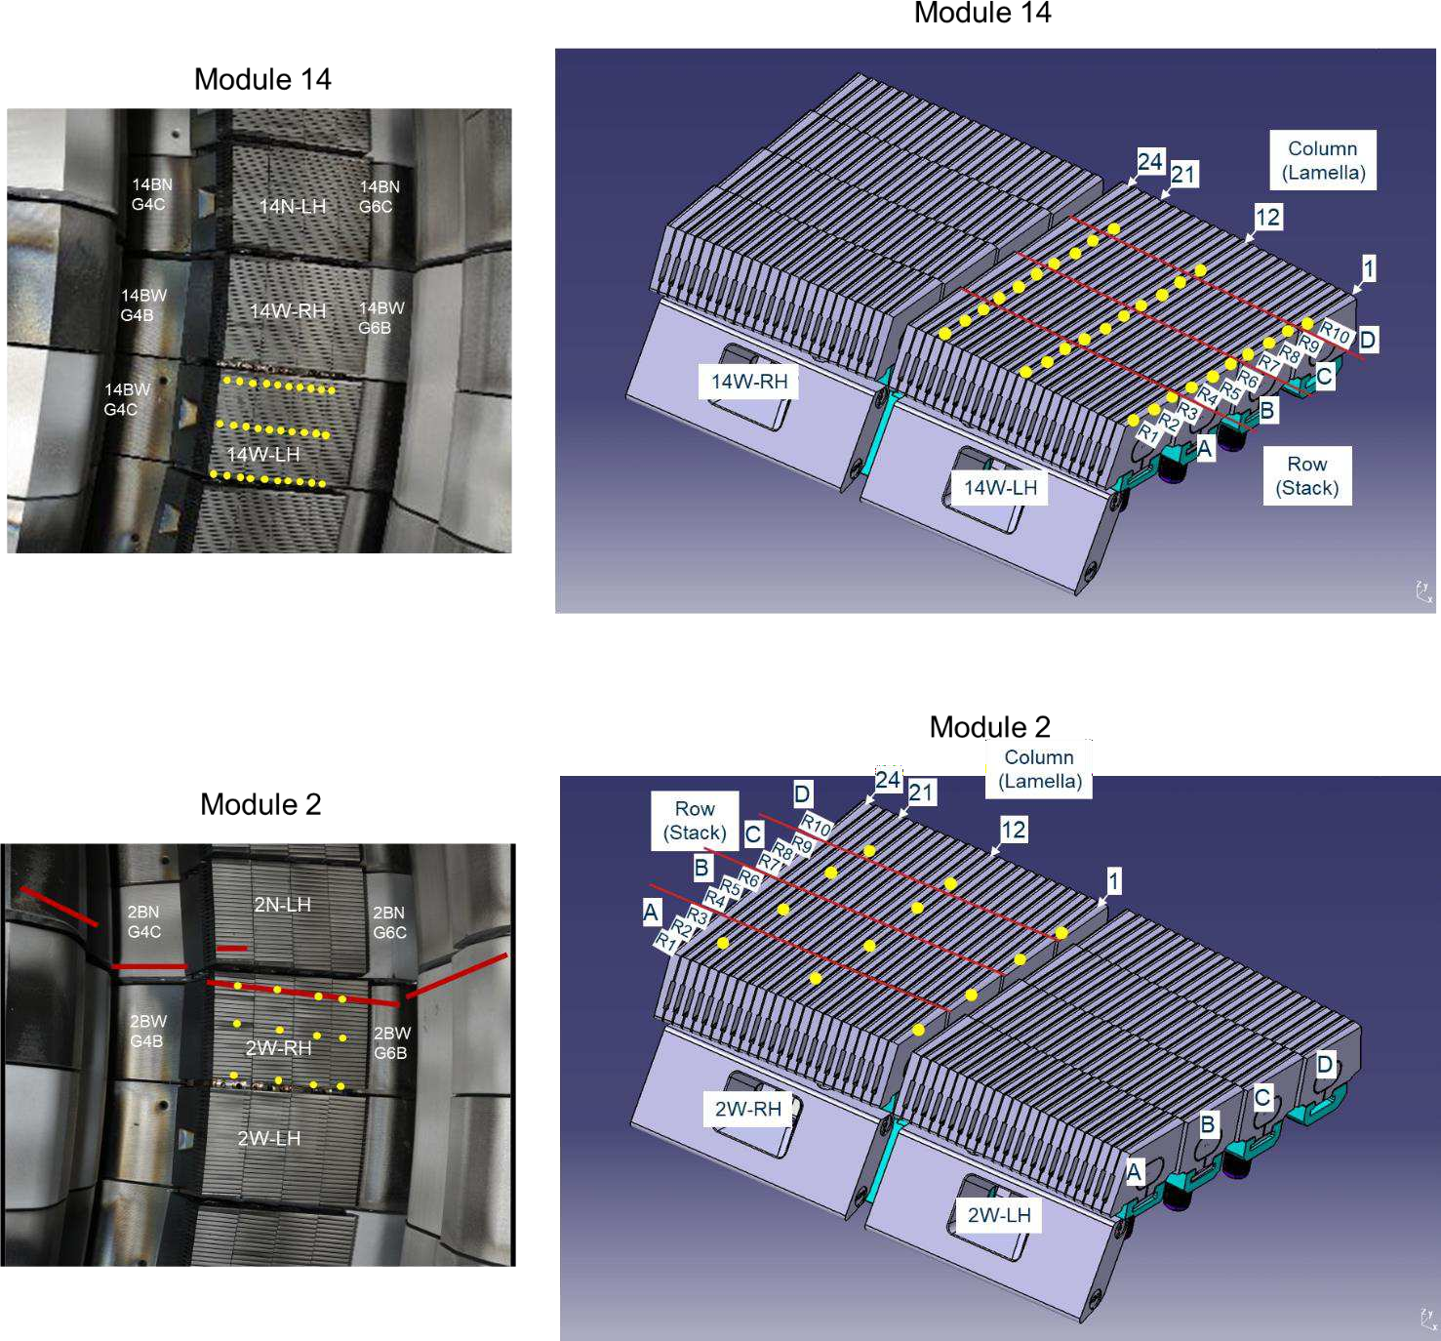
LIBS programme at JET, LBSRP Tiles
Tile ID | LIBS Detail | Number of Spots
LBSRP_14W | 3 Spots on: | 30
 | A1, B1, C1, A12, B12, C12,
 | A21, B21, C21
 | 1 spot on:
 | D1, D12, D21
LBSRP_2W | 1 Spot on: A1, B1, C1, D1, A12, B12, C12, D12, A21, B21, C21, D21 | 12
LBSRP_23W | 3 Spots on: A21, B21, C21 1 Spot on: D21 | 10
LBSRP_23N | 3 Spots on: A1, B1, C1, A12, B12, C12 1 Spot on: D1, D12 | 20
TOTAL |  | 72
Notes:
PD: Plasma Devices as in PEP listed
HHF: High Heat flux as in PEP listed
IBF: Ion beam Facility as in PEP listed
Other facilties as in PEP listed

Slide 17
LIBS programme at JET, LBSRP Tiles
Tile ID | LIBS Detail | Number of Spots
LBSRP_14W | 3 Spots on: | 30
 | A1, B1, C1, A12, B12, C12,
 | A21, B21, C21
 | 1 spot on:
 | D1, D12, D21
LBSRP_2W | 1 Spot on: A1, B1, C1, D1, A12, B12, C12, D12, A21, B21, C21, D21 | 12
LBSRP_23W | 3 Spots on: A21, B21, C21 1 Spot on: D21 | 10
LBSRP_23N | 3 Spots on: A1, B1, C1, A12, B12, C12 1 Spot on: D1, D12 | 20
TOTAL |  | 72
Notes:
PD: Plasma Devices as in PEP listed
HHF: High Heat flux as in PEP listed
IBF: Ion beam Facility as in PEP listed
Other facilties as in PEP listed

Slide 18
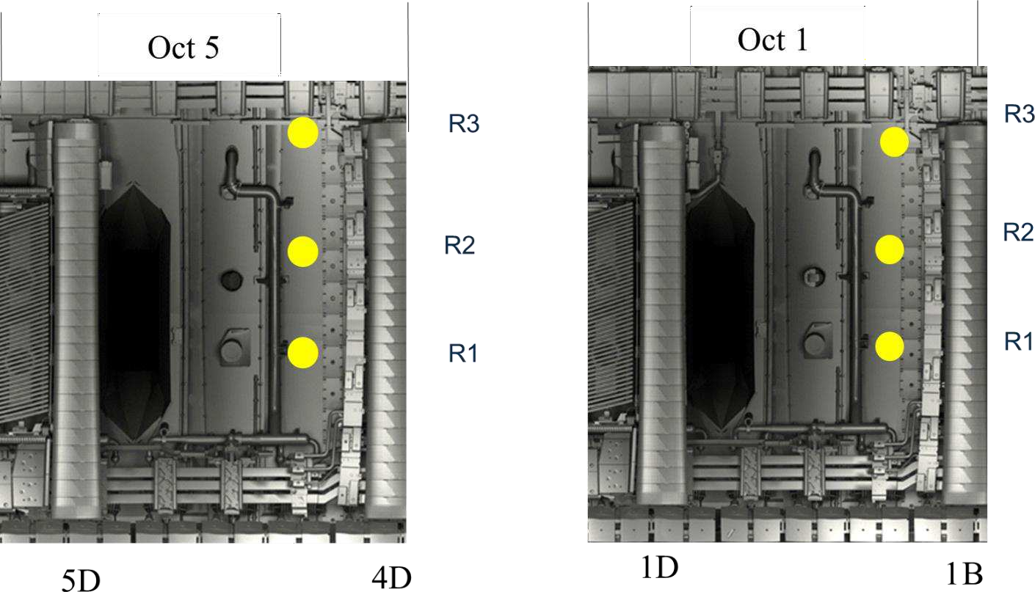
LIBS programme at JET, Vessel Wall
Location ID | LIBS Detail | Number of Spots
Vessel Wall Oct 1 | 3 rows, 1 column | 3
Vessel Wall Oct 5 | 3 rows, 1 column | 3
TOTAL |  | 6
Notes:
PD: Plasma Devices as in PEP listed
HHF: High Heat flux as in PEP listed
IBF: Ion beam Facility as in PEP listed
Other facilties as in PEP listed

Slide 19
LIBS programme at JET, summary
Location ID | LIBS Detail | Number of Spots
IWGL |  | 356
WPL |  | 364
IWP inner wall protection |  | 13
Base divertor carriers |  | 9
Inner divertor carriers |  | 42
HFGC tiles |  | 15
LBSRP tiles |  | 72
Outer divertor carriers |  | 30
Vessel wall |  | 6
TOTAL |  | 907
Notes:
PD: Plasma Devices as in PEP listed
HHF: High Heat flux as in PEP listed
IBF: Ion beam Facility as in PEP listed
Other facilties as in PEP listed

Slide 20
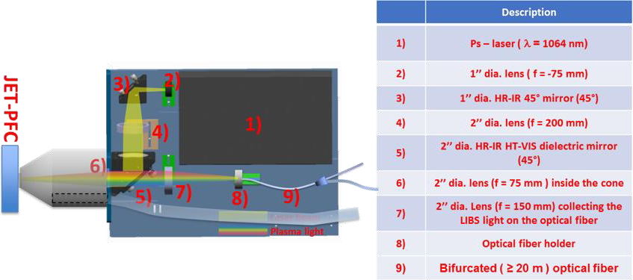
Aim and Benefits
The main aim of this project is to develop a compact LIBS tool to be mounted on the JET Remote Handling System that can access as many of the JET Vessel PFC as possible.
  Development of techniques for in- situ analysis of fusion vessel components,
  Develop our scientific understanding of fuel retention and contamination in PFC,
  Maximise the scientific benefits of the JET reactor during decommissioning,
  Development of techniques that minimise human exposure to the fusion environment.
https://doi.org/10.1016/j.sab.2023.106715
https://doi.org/10.1016/j.fusengdes.2020.111685

Slide 21
Completion of C39 baking studies
Tasks and questions to be addressed
Tritium concentration and thermal desorption spectra
In 2022 two sets of samples had been received from divertor tiles HFGC and 14ING1A.
Note that these tiles were exposed in ILW1-3
Tritium in these tiles is due to DD reactions
Sample was heated at 350 ℃ for 100h after which the system was purged and released tritium measured.
Baking was followed with TDS up to 1100℃
TDS was followed by full combustion (850ºC) for 14IWG1A samples
TDS
Baking
Main results
From baking experiments its can be seen that significant amount of T has remained in the sample after annealing at 350 ℃ and a small amount (~1%) also after TDS
Deliverable: PWIE.SPE.2.T002.D004
Status: completed
Facilities:
Human Resources: 6 PM
Involved RU: ISSP-UL
Linked WP or TSVV:
E. Pajuste et al. (ISSP-UL)
Notes:
PD: Plasma Devices as in PEP listed
HHF: High Heat flux as in PEP listed
IBF: Ion beam Facility as in PEP listed
Other facilties as in PEP listed

Slide 22
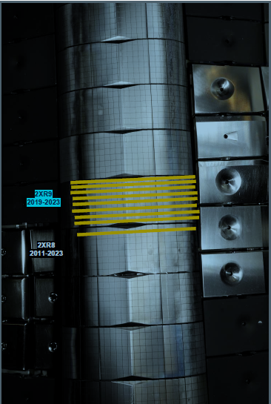
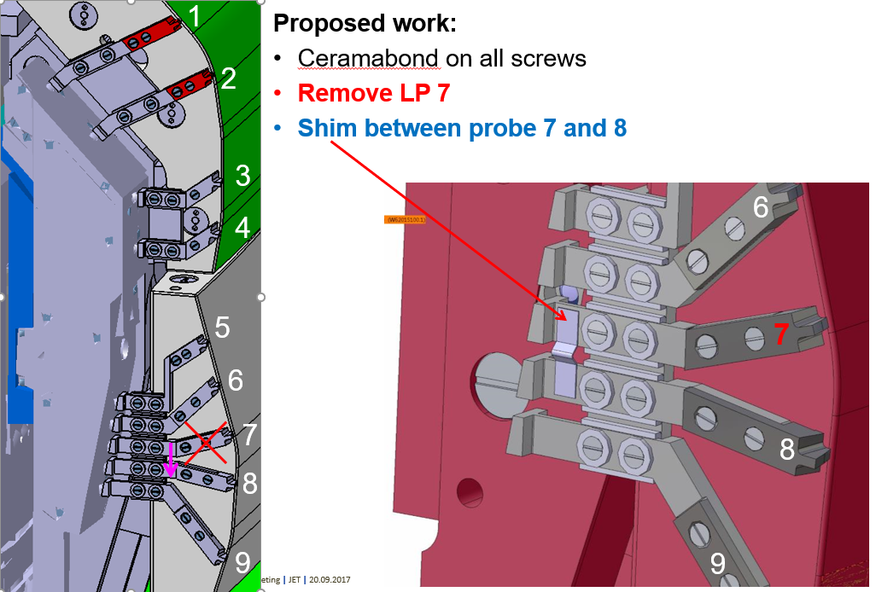
SPE analyses in 2024
2XR19(ILW3) and 2XR9 (ILW2+3):
  to compare with LIBS on 2XR19 and 2XR9 (2019-2023)
  erosion/deposition, fuel retention
  IBA done, TDS/FC ?
4D23 (ILW3) and 4D3 (ILW3):
  to compare with LIBS on 4D23 and 4D3 (2019-2023)
  IBA of 4D3 done, IBA, TDS of 4D23
Langmuir probes 16IN probes 5, 7,8, 9 (removed in 2015)
  Metallography at IPPLM
  IBA at VR done
2XR9

Slide 23
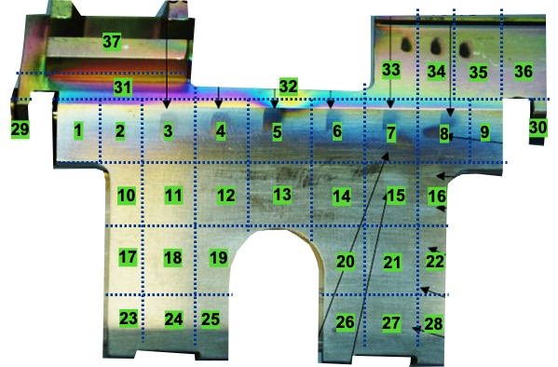
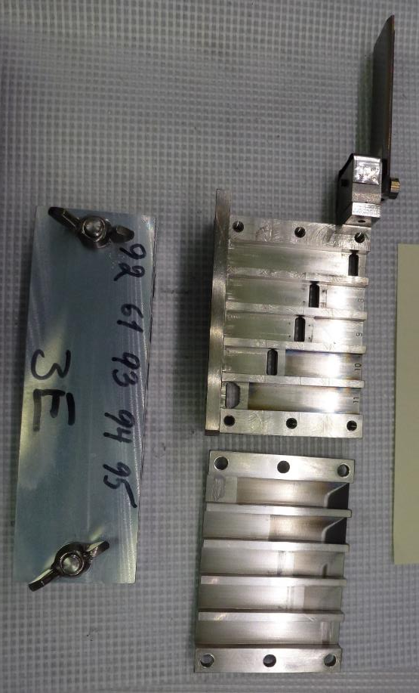
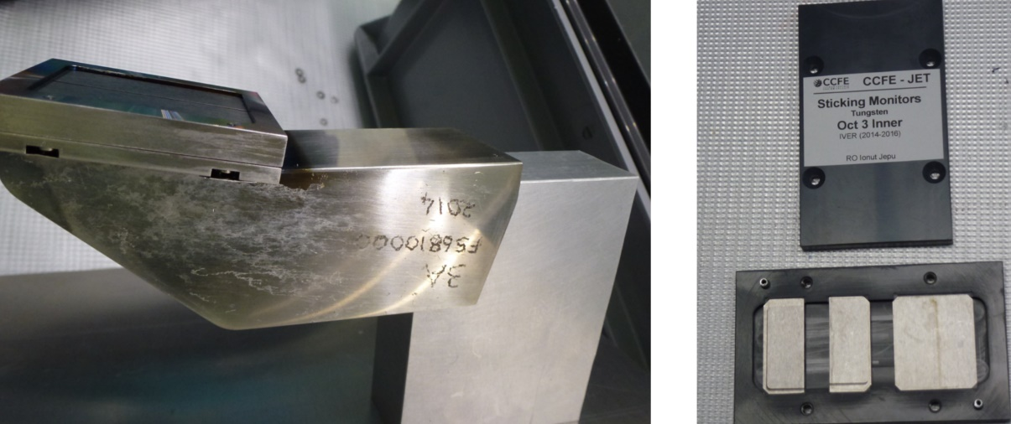
SPE analyses in 2024
Louvre clips (ILW3)
  Cutting completed at IAP
  Transport to remote areas
  Chemical structure of deposits
  Modelling of Be, W migration under SP D
Mirror cassettes
    Erosion/deposition in recessed areas
    Metal migration inside cassette
    3E (ILW1) for SPE
W sticky monitors and Si wafers of dust collectors
  Oct3 inner; Oct5 inner and 14W wedge available
  Si dust collectors analysed
W lamellae
Microstructure, fuel retention
Few from stack A, from stack C C01 and
from stack D D01
2XR9

Slide 24
Analysis plan 2024
CU (Comenius University)
        Participation in LIBS experiments at VTT and JET
    Data analysis of LIBS results (both VTT and JET experiment)
ENEA
  Participation in LIBS experiments at VTT and JET
FZJ
      Fuel retention studies using LID-QMS
  Completion of metallography and microstructure of W lamellae and Langmuir probes (16W)
  Completion of metallography and microstructure of Be castellations from IWGL tile with RE damage
  Participation in LIBS experiments at VTT and JET
IAP
    Cutting of limiter tiles and W lamellae
    TDS analysis of Be samples
    Louvre clips: chemical structure of co-deposits with XPS
    Fuel retention studies using GDOES

Slide 25
Analysis plan 2024
IPPLM (WUT,NCBJ)
        Nanoindentation of Langmuir probes
        FIB cross-sections to assess the grain size in individual zones of LPs
        Microstructure of W lamellae (stack A, C, D)
        Participation in LIBS experiments at VTT and JET
ISPP_UL
      Completion of fuel retention studies using FC, TDS (simulation of C39 baking cycle) and SEM
      Samples from W lamellae
  Louvre clips: chemical structure of co-deposits using FT-IR
  Participation in LIBS experiments at VTT and JET
IST
    Fuel retention studies using IBA (Be limiter samples, W lamellae)
    IBA analysis of mirror cassettes (tubes) for metal migration
    IBA analyses before and after TDS (for baking studies)?

Slide 26
Analysis plan 2024
UT
  Participation in LIBS experiments at VTT and JET
VR
      Fuel retention studies using HIERDA
      Analysis of W sticky monitors
      Analysis of mirror cassettes?
VTT
    Completion of fuel retention studies using SIMS (simulation of C39 baking cycle)
    Participation in LIBS experiments at VTT and JET
    Participation in TDS experiments jointly with UKAEA
    Decommissioning of SIMS and Be lab
    Commissioning of new Be lab
    New TOF-SIMS in 2024-25 (Iontof M6)

Slide 27
Analysis plan 2023
    UKAEA
    Fuel retention studies using TDS (simulation of C39 baking cycle, Be samples)
    Participation in LIBS experiments at VTT and JET
    Participation in IBA experiments jointly with IST?
    Microstructure of Langmuir probes (SEM, nanoindentation)
    Planning of removal of in-vessel components

Slide 28
Future actions
    Shipment of Be limiter tiles to IAP for cutting
        IBA (IST)
        Louvre-clip
        FT-IR (ISSP_UL)
        TDS, XPS (IAP)
        Shipment of samples to ISSP_UL (after XPS?)
        Mirror cassettes
        IBA analysis (IST, VR)
      Langmuir probes 16IN
        Analyses completed at VR
        Shipment to IPPLM
        W lamellae
          First IBA at IST
          Cutting at IAP
          Shipment to IPPLM

Slide 29
Future actions
          LIBS experiment at VTT, 1st campaign in Jan-Feb
          LIBS experiment at VTT, 2nd campaign in March?
          Analysis capabilities to analyse DTE 3 samples
            PMU will issue a letter (Feb-March)
            Please check your capabilities and license for handling radioactive materials
            Thematic meetings in smaller groups (publication plan)
                Planning of VTT and JET LIBS experiment (manning etc.), Feb-Apr
                Fuel retention (multiple vs. single campaign), Mar-Apr
                Baking experiments and T analyses, Apr-May
                Metallography of W components, Apr-May
            LIBS at JET in June-July
            Tile removal begins in August?
            First divertor samples available in early 2025

