Slide 1
WP PWIE: SPE Kick off Meeting 2024
Notes:
Please Indicate your subproject

Slide 2
IAP analysis plan for 2024
IAP
Cutting of limiter tiles and W lamellae
Samples to be shipped for analysis to FZJ, CCFE, HR, UoL and VTT, according to future instructions. Includes Louvre clips. (More of a coordinating activity)
TDS analysis of Be samples
Louvre clips: chemical structure of co-deposits with XPS
Fuel retention studies using GDOES and TDS
C. Porosnicu| WP PWIE SP E kick-off meeting

Slide 3
IAP analysis plan for 2024
IAP
Cutting of limiter tiles and W lamellae
Samples to be shipped for analysis to FZJ, CCFE, HR, UoL and VTT, according to future instructions. Includes Louvre clips. (More of a coordinating activity)
TDS analysis of Be samples
Louvre clips: chemical structure of co-deposits with XPS
Sample preparation for GDOES and TDS
Fuel retention studies using GDOES and TDS
C. Porosnicu| WP PWIE SP E kick-off meeting

Slide 4
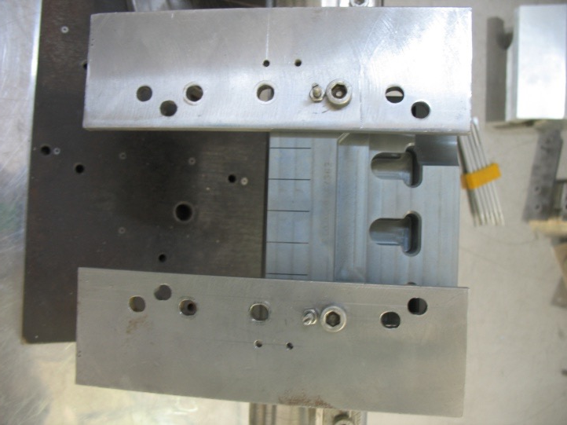
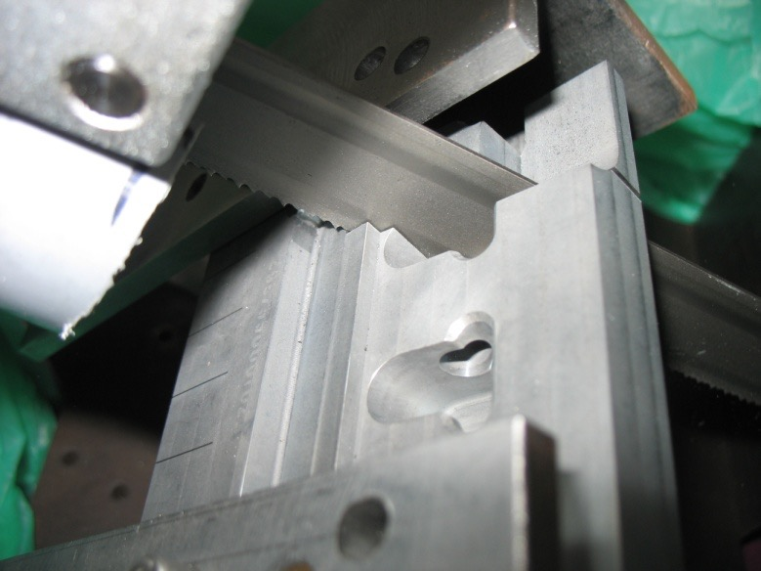
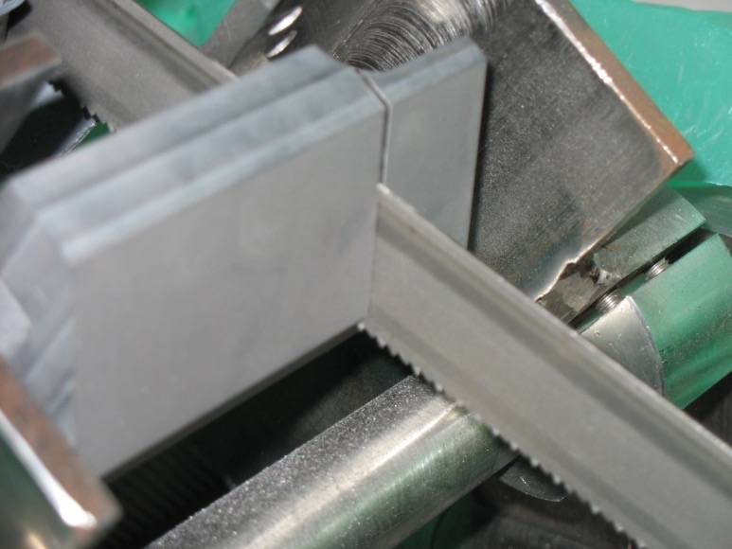
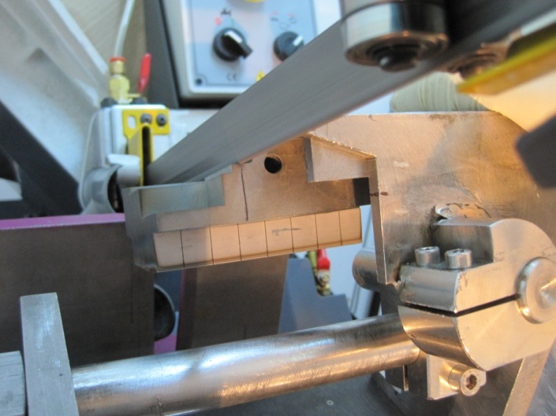
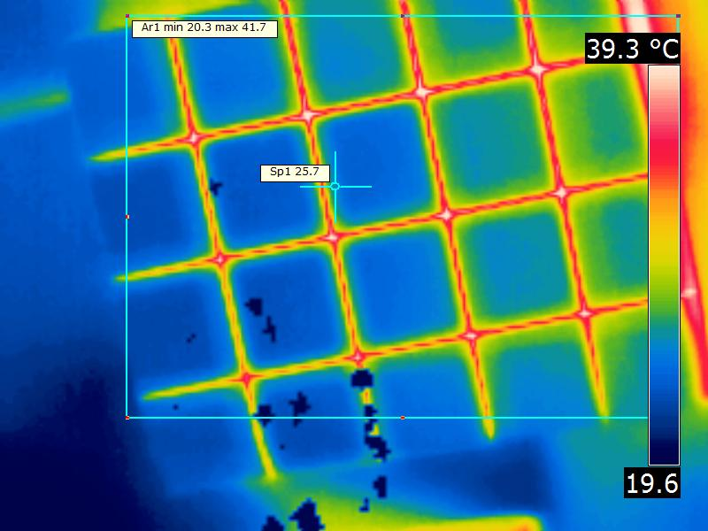
Rough cutting procedure
It is essential that no vibrations are present!
The cutting was performed in dry environment, using a carbide hardened band saw (made in USA) having 2300 mm in length and 19 mm width.
For temperature monitoring in real time a FLIR® E-Series Advanced Thermal Imaging Camera, (+/- 1 ºC ; 20-900 ºC) is used
During cutting the tile temperature did not exceed so far 48 ºC
Vibrations induce:
Blade damage
Equipment damage
Unprecise cutting
Thicker blade trace – loss of material and dust production!
HEAT!!
C. Porosnicu| WP PWIE SP E kick-off meeting

Slide 5
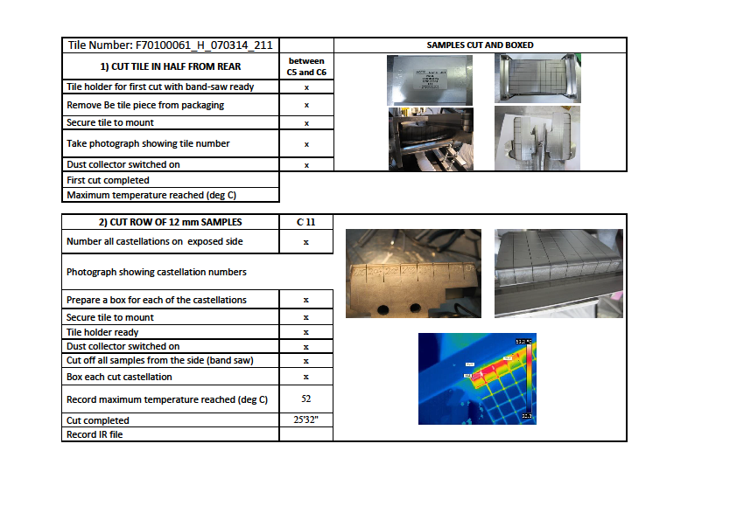
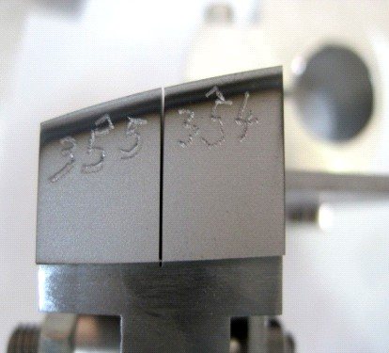
Cutting process recording document
Tracking system of the Be sample
C. Porosnicu| WP PWIE SP E kick-off meeting

Slide 6
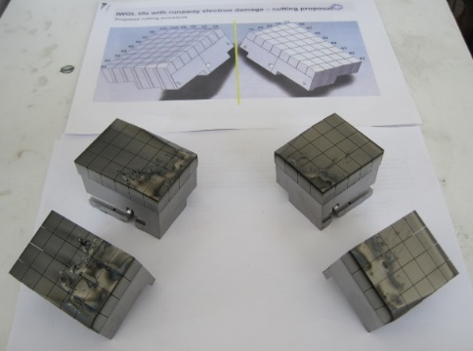
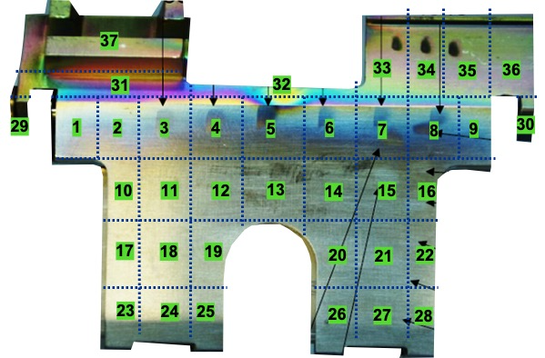
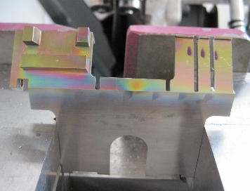
SPE.1: Coordination activity (IAP)
Louvre clips cutting and sectioning
Using the beryllium processing facility, complete cutting of IWGL tile 1XR18 with runaway electron damage was performed
Typical sample sizes: 10 mm x 10 mm x 10-12 mm or 10 mm x 10 mm x 2.5 mm
Microscopy measurements from top and side surfaces have been made for all the samples.
Cutting of Louvre CLips:
Cutting plan as agreed with CCFE
Primary and edge sectioning
Samples to be shipped for analysis to FZJ, CCFE, HR, UoL and VTT, according to future instructions
All 37 samples are packed
Ready to be shipped
Final sample extraction
Deliverable: PWIE.SPE.1.T001.D002
Status: Completed
Facilities: Hot cells at IAP
Human Resources: 2 PM
Involved RU: IAP and CCFE as a collaborator
Linked WP or TSVV: WPTE
Notes:
PD: Plasma Devices as in PEP listed
HHF: High Heat flux as in PEP listed
IBF: Ion beam Facility as in PEP listed
Other facilties as in PEP listed

Slide 7
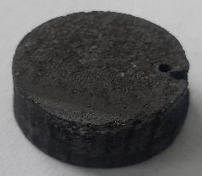
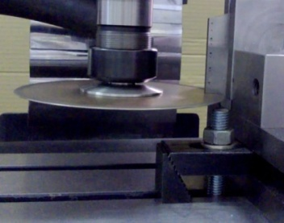
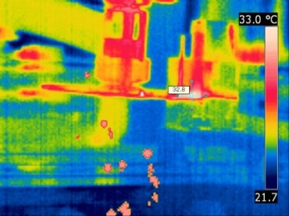
Lamellae cutting and sample preparation for TDS and GDOES
Cutting and processing of the sample
Cutting and processing of the samples was required prior to GDOES
Deuterium thermo-desorption spectra (TDS) for the designated samples
Initial TDS GDOES
Special cutting discs containing more than 21% diamond powder embedded in a copper alloy were used;
Lamella temperature during cutting - monitored: must not exceed 70ºC
Diamond milling disc in action
Sample temperature monitored by IRcamera
C. Porosnicu| WP PWIE SP E kick-off meeting

Slide 8
SP E.2 Comparison of hydrogenic retention quantification by different techniques and fuel removal assessment: IAP
TDS was performed on the remaining samples, after GDOES.
We took into account only the non sputtered part during the GDOES measuring process.
TDS was performed from room temperature to 1050ºC with a 10ºC/min ramp.
One interesting fact in the TDS measurements is the total release done until the maximum temperature reach for most of the samples (11 of 14)
Several desorbtion peaks are present for the samples from all tiles.
High intensity peaks are present at 325-375ºC, followed by shoulders for some samples at temperatures between 525 and 800ºC
Tile 6
Tile 4
Tile 7
Tile 8
Since GDOES demonstrated that D is present in Be deposits but also in W/Mo coatings it is difficult to identify with precision the retention mechanism
C. Porosnicu| WP PWIE SP E kick-off meeting

Slide 9
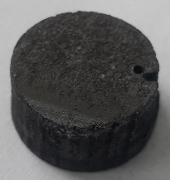
Post-mortem analysis of PFC and other objects in JET: IAP
Initial TDS GDOES
C. Porosnicu| WP PWIE SP E kick-off meeting

Slide 10
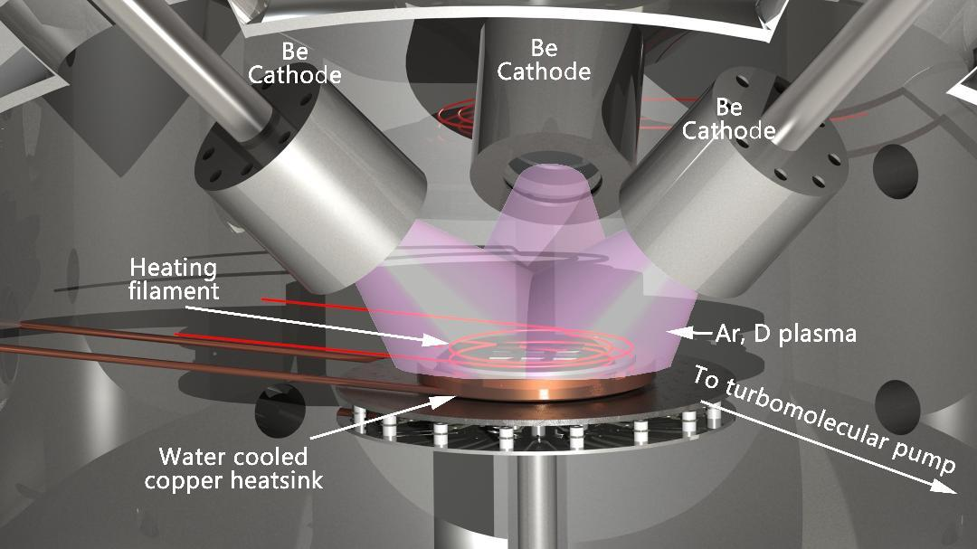
Be samples support
Be samples available for LIBS experiments at VTT
Additional samples can be prepared LIBS experiments at VTT
Deposition | Substrate | Sample size (mm) | Gas | Thickness (um) | Pieces
Be+H(20%), Bias -150V, 5um, W 4_5 | W | 5*5 | H 20% | 5 | 5
Be+D (1%), 10 um, (10*10) Si_1_1 | Si | 10*10 | D 1% | 10 | 2
Be+D (5%), 10 um, W_2_2 | W | 12*15 | D 5% | 10 | 1
Be+D (5%), 10 um, Si 1 | Si | 12*15 | D 5% | 10 | 1
Be+D(5%), 5um, Si (Sus) 1_1 | Si | 12*15 | D 5% | 5 | 3
Be+D (5%), 20 um, W_2_2 | W | 12*15 | D 5% | 20 | 1
Be+D (5%), 20 um, Si 1 | Si | 12*15 | D 5% | 20 | 1
Be+D(5%), 5um, Si 1_1 | Si | 12*15 | D 5% | 5 | 4
Be+D (5%), 5um, (12*15) Si_2_5 | Si | 12*15 | D 5% | 5 | 2
Be+D(10%). 5um, Si 2_4 | Si | 12*15 | D 10% | 5 | 1
Be (rough) + D (10%), 5 um, W 2_2 | W | 12*15 | D 10% | 5 | 1
Be+D (10at%), 10 um, Si 1 | Si | 12*15 | D 10% | 10 | 3
Be+D (10%), 1 um, (10*10) Si 1_1 | Si | 10*10 | D 10% | 1 | 2
Be+D (10%), 10 um, (10*10) Si 1_1 | Si | 10*10 | D 10% | 10 | 2
Be+D (10at%), 10 um, (12*15) Si 3 | Si | 12*15 | D 10% | 10 | 1
Be+D (10at%), 10 um, Si 2 | Si | 12*15 | D 10% | 10 | 1
Be+D (10%), 5um, (12*15) Si_2_12 | Si | 12*15 | D 10% | 5 | 1
Be+D (10%), 10 um, Si 3 | Si | 12*15 | D 10% | 10 | 1
Be+D(20%), Bias -150V, 5um, W 5_7 | W | 5*5 | D 20% | 5 | 2
Schematic description of the coating system used for Be-D/Be-H (4:1 at ratio) layer deposition
C. Porosnicu| WP PWIE SP E kick-off meeting

