Slide 1
IST activities in 2024: IBA analysis of JET PFCs – plans
WP PWIE SP E: Kick-off meeting, 23th January, 2024
Norberto Catarino, Rui Silva, Eduardo Alves

Slide 2
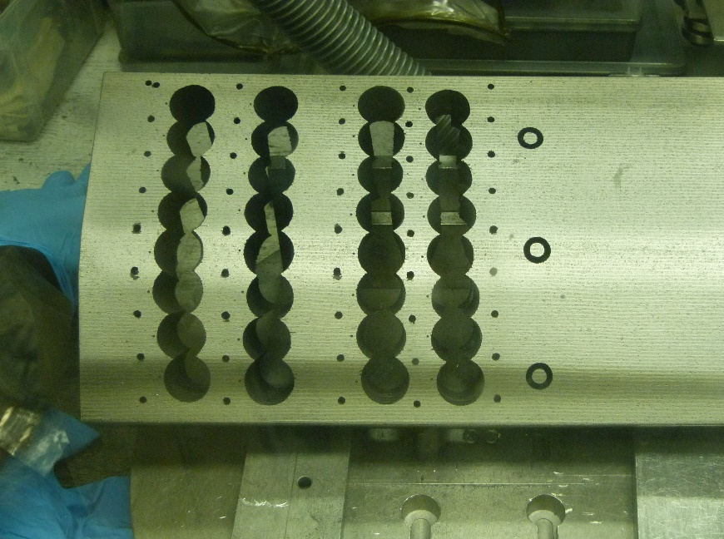
Pending analyses : 2ON G7A (2013-2016)
2
8
8b
8c
7a
7b
7c
7d
2ONG7A - 8b
6
6c
5a
5b
5c
2ONG7A - 7b
4
4c
4d
3a
3b
3c
Be
2
2c
2ONG7A - 5b
1a
1c
1d
1b
2ONG7A - 3b
NCSRD
CCFE
VTT
IST
IAP
2ONG7A - 1b
+ 2ON G8B (2013-2016) + 14BN G4A (2013-2016)

Slide 3
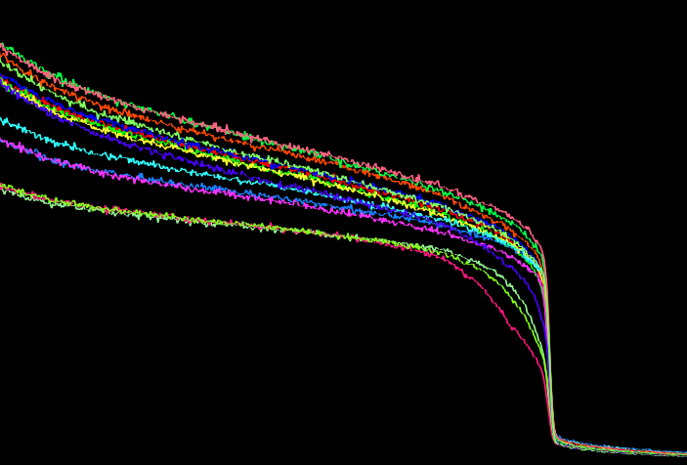
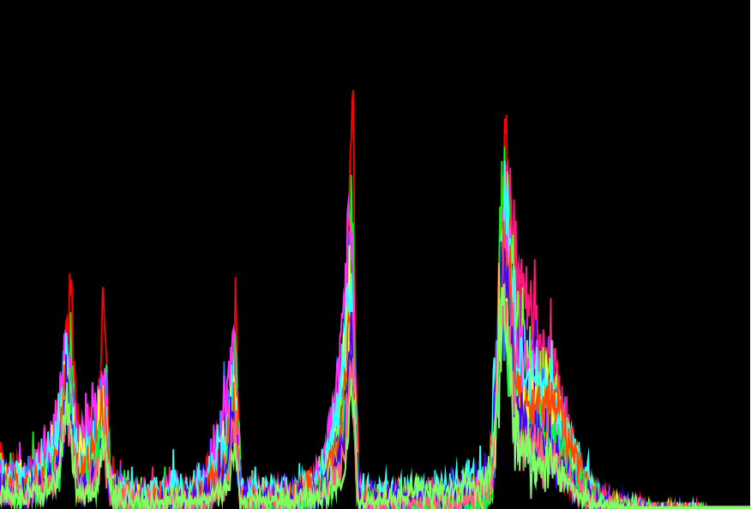
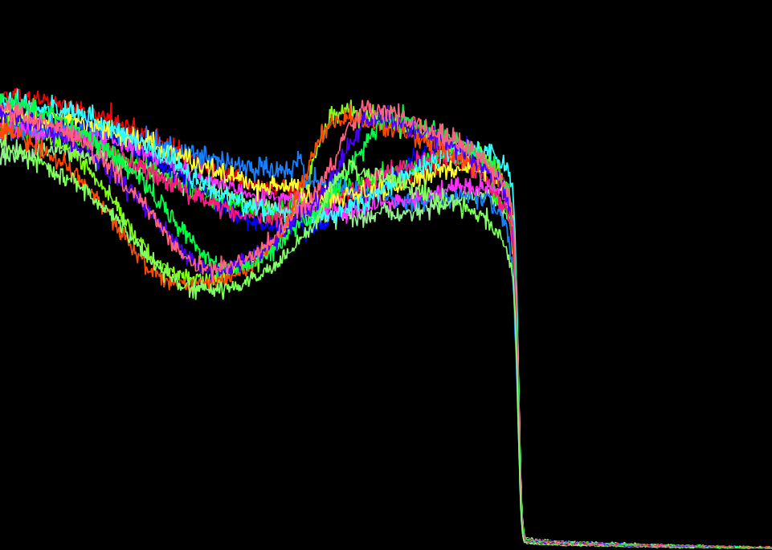
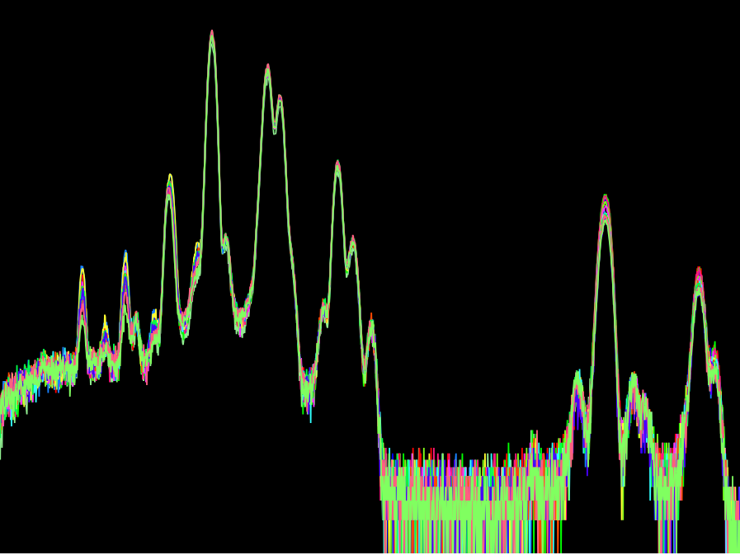
Pending analyses : 2ON G7A (2013-2016)
³He⁺ ; 2,3 MeV
2
RBS
NRA
2ONG7A - 8b
<- 8b
1b ->
2ONG7A - 7b
Be
³He⁺ ; 2,3 MeV
2ONG7A - 5b
EBS
PIXE
2ONG7A - 3b
Erosion
<- 1b
<- 8b
2ONG7A - 1b

Slide 4
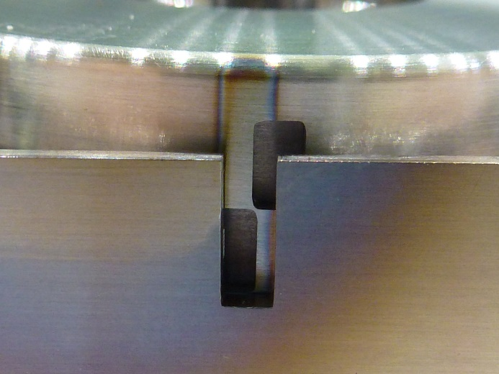
RC’s 2015-2016 ILW3 (Silicon collectors)
Divertor
◧ ◨ ☒ 2IN
◧ ◨ ☒ 12W (12W-wedge RC – as received – both slits were “opened” )
◧ ◨ ☐ 2OW (Broken pieces, not assembled)
ILW 1 2 3
2IN
12W
2OW

Slide 5
RC’s 2015-2016 ILW3 (Silicon collectors)
D(³He,p)⁴He, 2.3 MeV
⁹Be(³He,p₀)¹¹B, 2.3 MeV
¹²C(³He,p₁)¹⁴N, 2.3 MeV
The spectra are not analyzed because there is no LP data on tile 4 in ILW-3.

Slide 6
RC’s 2015-2016 ILW3 (Silicon collectors)
RTI - Reflectance Transformation Imaging

Slide 7
2024 Plans
IST
Fuel retention studies using IBA (Be limiter samples)
IBA analyses before and after TDS (for baking studies)
IBA analysis of mirror cassettes (tubes) for metal migration
SP E.2
Characterisation of divertor tiles 0 and 1 - Before and after LID-QMS ?
SP E.3
characterize Be limiter tiles - 2XR19(ILW3) and 2XR9 (ILW2+3)
Ion beam analysis of JET plasma facing and diagnostic components - mirror cassettes (tubes)
2 PM | 2 day of Accelerator
4 PM | 5 days of Accelerator

