Slide 1

VR SPE kick-off meeting 2024
Per Petersson

Slide 2
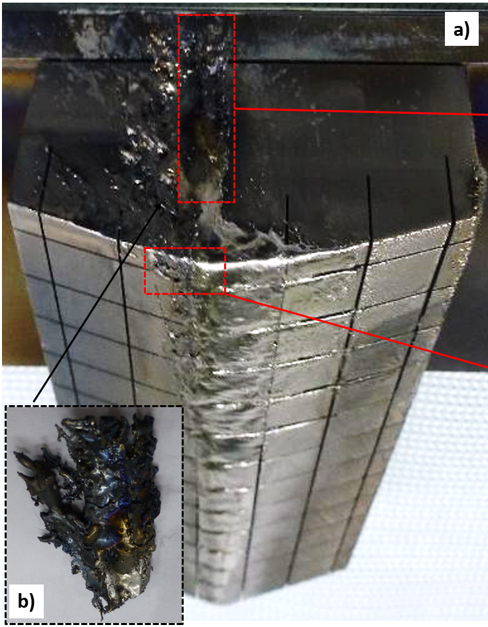
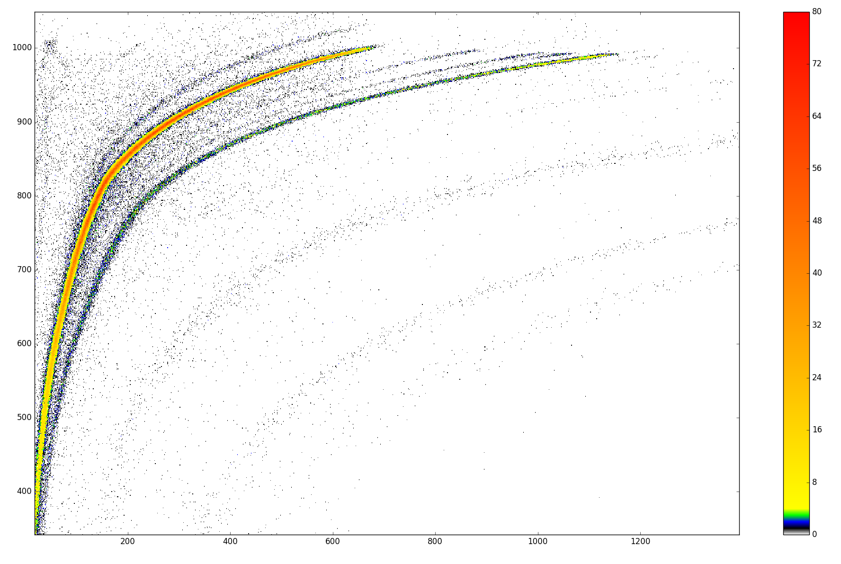
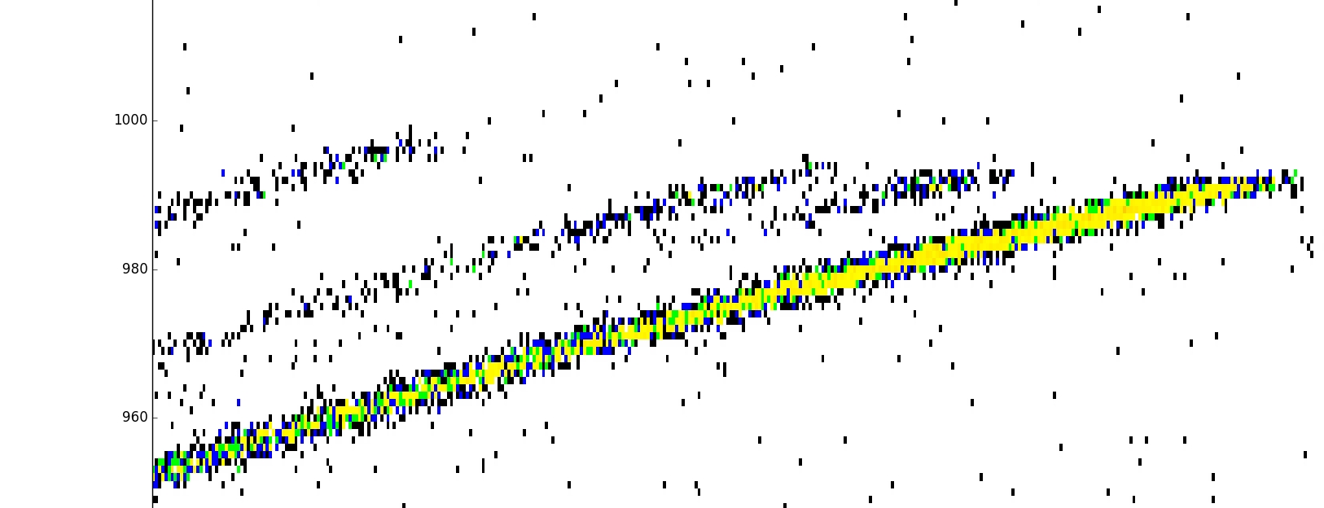
Time of Flight Elastic Recoil Detection Analyisis
ToF ERDA on Be flake from the dump plate
Further analysis of components by ToF-ERDA.
Keeping track of ¹⁵N and ¹⁸O
Combination with NRA for ¹⁸O and D
Less sensitivity for roughness
Review of existing data sets to gather information about ¹⁵N and ¹⁸O
Keeping track of where they has been found and where it has not been found
Possibility for µ-NRA for spots etc.
1000
800
600
400
D
⁹Be
¹²C
¹⁴N
¹⁵N
¹⁶O
Inconel family
¹⁵N only on very surface
¹²C
¹⁴N
¹⁶O
I (scattered beam)
¹⁵N
ToF channel
W
0 400 800 1200
Energy channel

Slide 3
Mirrors as deposition monitors
Aim: Assess the impact of radiation damage on fuel retention (and reflectivity)
Very simple to remove
Mo mirrors irradiated with ⁹⁸Mo³⁺ at 1.6 MeV to 2 dpa and 20 dpa.
SRIM prediction: Quasi-uniform damage up to 0.3 µm
Should be studied both for fuel retention (NRA, ToF ERDA) and reflectivity
Has to be evaluated what can be done with respect to tritium and radiation
Reflectivity of pre-damaged mirrors
SRIM
10 mm
Total reflectivity (%)
Number (Å ion)
2 dpa
20 dpa
10 mm
0 0.2 0.4 0.6
Total reflectivity: 5-10% decrease at 20 dpa.
Diffuse reflectivity increased at 20 dpa: 0.2–3.0%
Depth (µm)

