Slide 1
4D and 5D tomography of fast ion velocity distribution function in stellarators and tokamaks
Dmitry Moseev on behalf of the team

Slide 2
Motivation and goals of the project
Importance of fast ions in fusion plasmas
Plasma heating
Drive and suppression of instabilities
Machine protection
Etc
Challenges:
Distribution function is non-Maxwellian, generally more or less arbitrary
Plasma is underdiagnosed for fast ions
Goal of the project:
Develop a new type of regularization that allows multi-dimensional reconstruction with few data
Develop tool(s) that would allow strategic placement of fast ion diagnostics

Slide 3
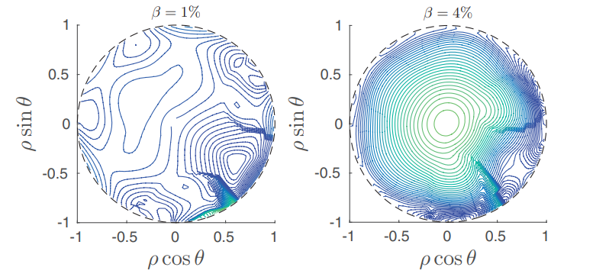
Changes in the project
Promised: Study of detectibility of FI confinement improvements in W7-X at high beta.
Refocused on COM tomography.
Reason: difficulty to populate orbits for which improvements of FI confinement are significant
J.M. Faustin et al 2016 Nucl. Fusion 56 092006

Slide 4
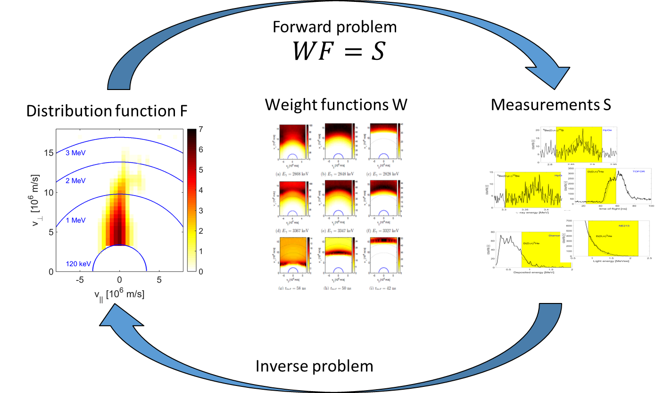
Weight functions

Slide 5
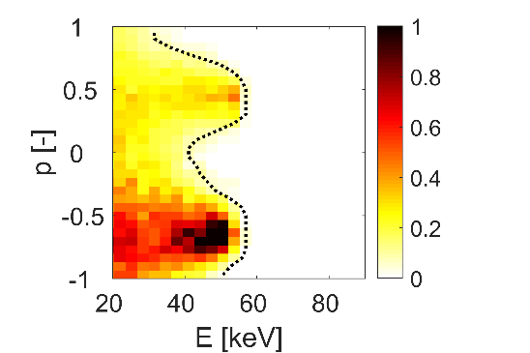
Idea of the new regularization
EAST distribution
$$fSD1$$
$$fSD2$$
$$fSD3$$
a₁×
a₂×
a₃×
$$f=\sum_{i}{a_{i}f_{SD,i}}$$
Expansion coefficient vector
$$S=WF$$
$$F=∑a_{i}f_{SDi}=F_{SD}A$$
$$S=WF=WF_{SD}A=W_{SD}A$$
Slowing-down basis matrix
Slowing-down weight matrix
B Madsen et al, PPCF 2020

Slide 6
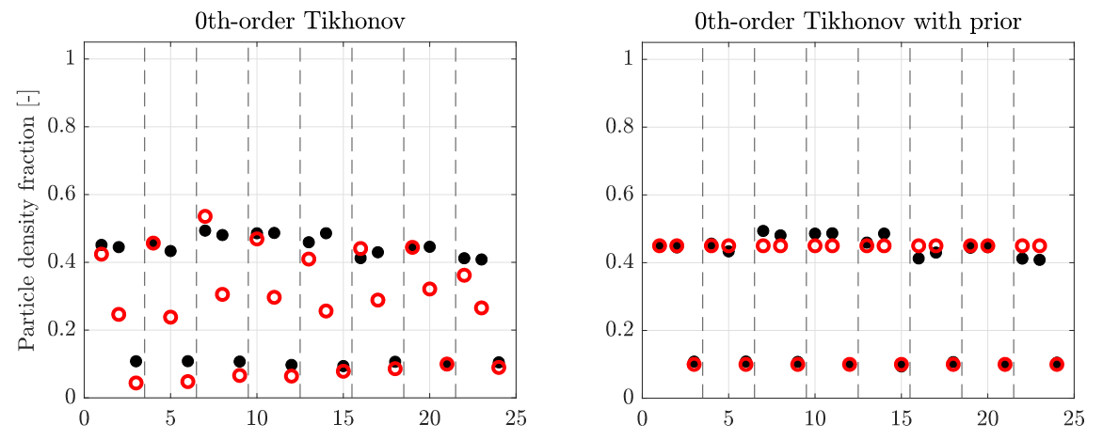
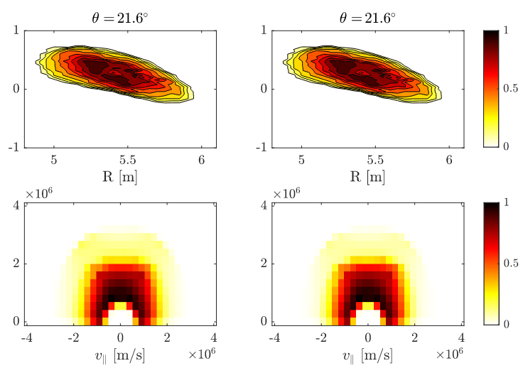
Reconstruction of the velocity distribution function in W7-X
TRUE RECONSTRUCTION
B.S. Schmidt et al 2023 Nucl. Fusion 63 076016

Slide 7
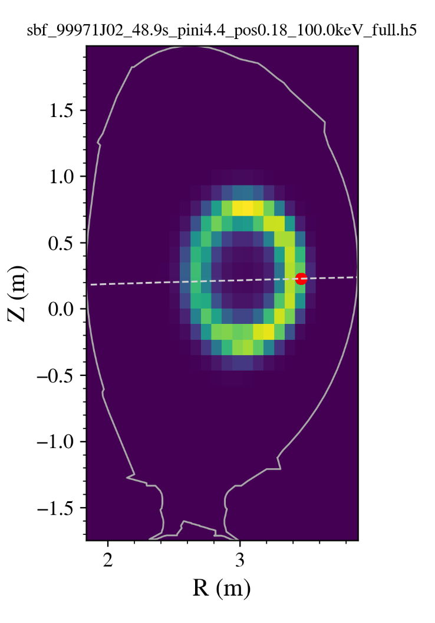
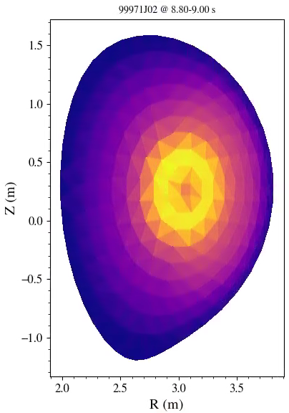
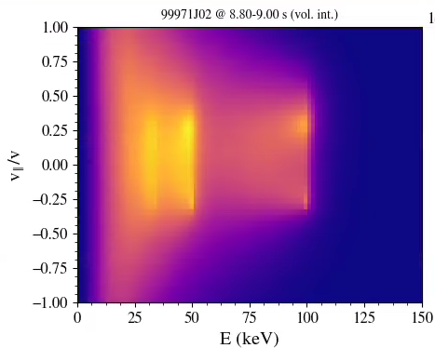
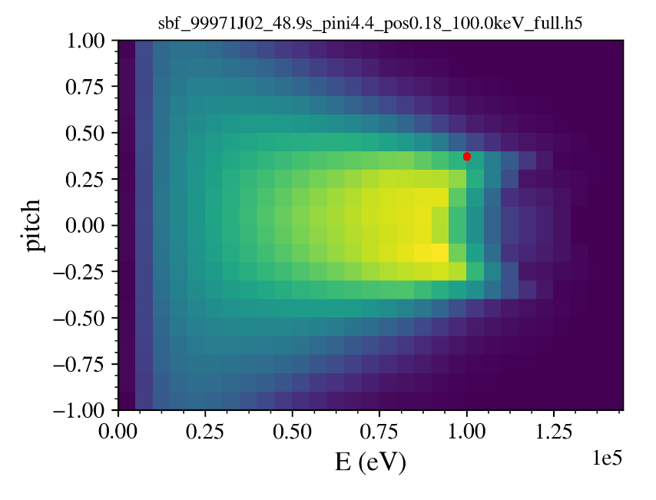
Reconstruction of FI distribution function in COM space
JET test case for synthetic reconstructions:
Slowing-down basis functions computed with ASCOT for 10 birth positions along the beamline
”Artificial” TRANSP simulation: plasma as in 99971 but only one PINI (providing simple ”true distribution” for first synthetic reconstructions)
First reconstructions look promising (M. Rud)
Next step: add second beamline (being done now 2024)
Example ASCOT slowing down basis function
Single-PINI TRANSP simulation
Deposition (E, pitch)
Deposition pos
Beamline

Slide 8
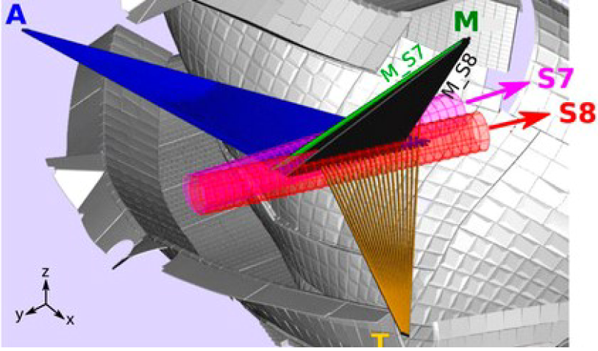
Improvement of the diagnostic coverage
O. Ford et al., RSI 91 (2020)

Slide 9
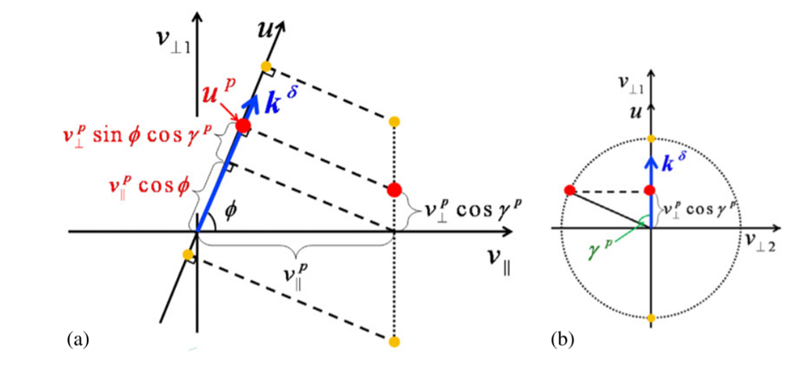
Improvement of the diagnostic coverage
M. Salewski et al, NF 2012

Slide 10
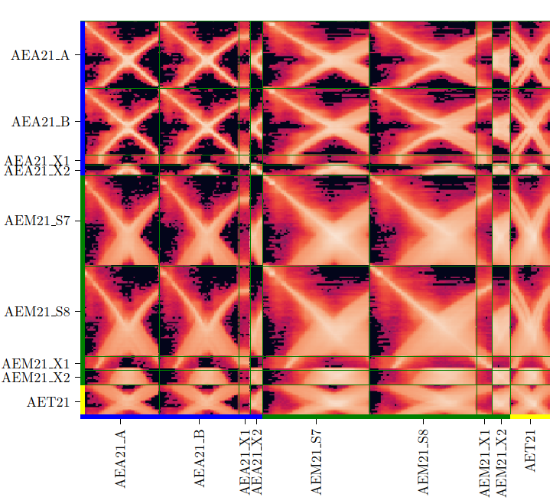
Improvement of the diagnostic coverage
Correlation between measurement volumes in W7-X FIDA system
J.E. Mencke et al., RSI 93, 123503 (2022)

Slide 11
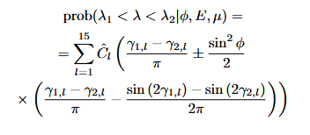
Improvement of the diagnostic coverage
Problem with this approach: very computationally extensive, needs Monte-Carlo modelling. Simplification is needed:
WF should be re-formulated in COM
Done for FIDA, CTS is on the way
WF in E-mu space can be computed for different measurement volumes and they become directly comparable.
The degree of redundancy of each additional FIDA channel can be estimated by computing $R=∫∫f_{ch1}f_{chN}dEdμ$. The low the value of R, the more additional information a new channel brings.

Slide 12
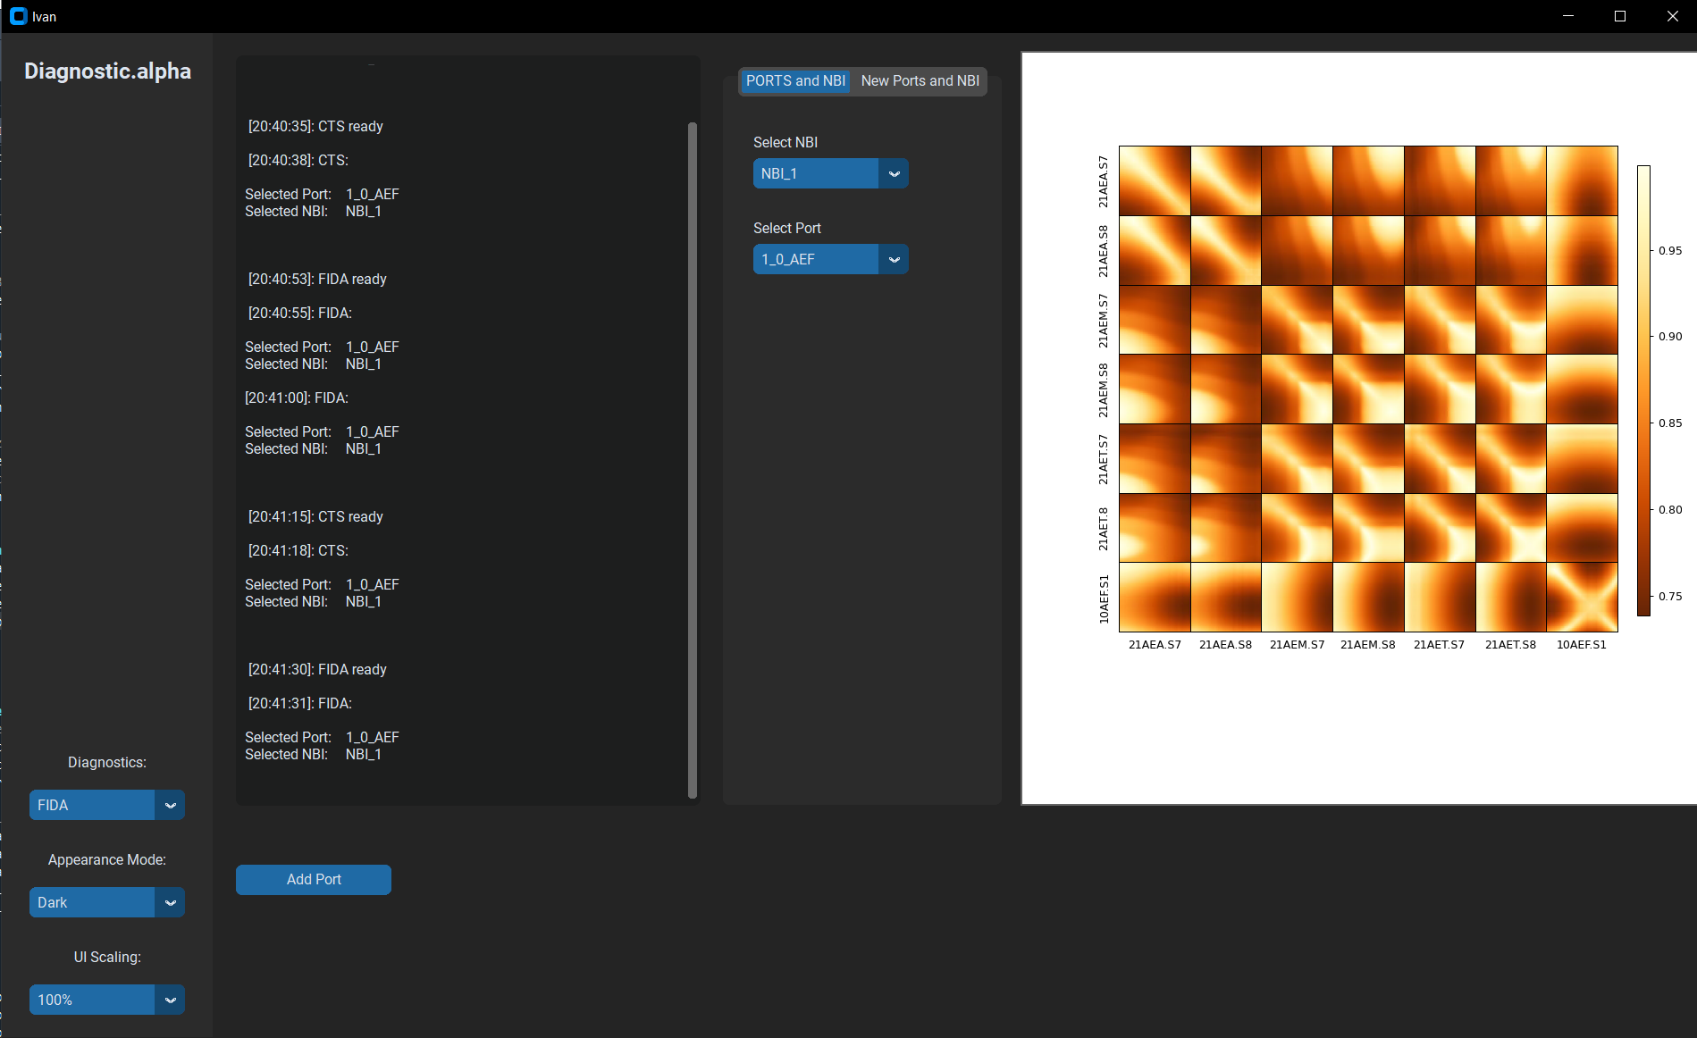
Improvement of the diagnostic coverage
Credit: I. Kuzmych, to be submitted to RSI

Slide 13
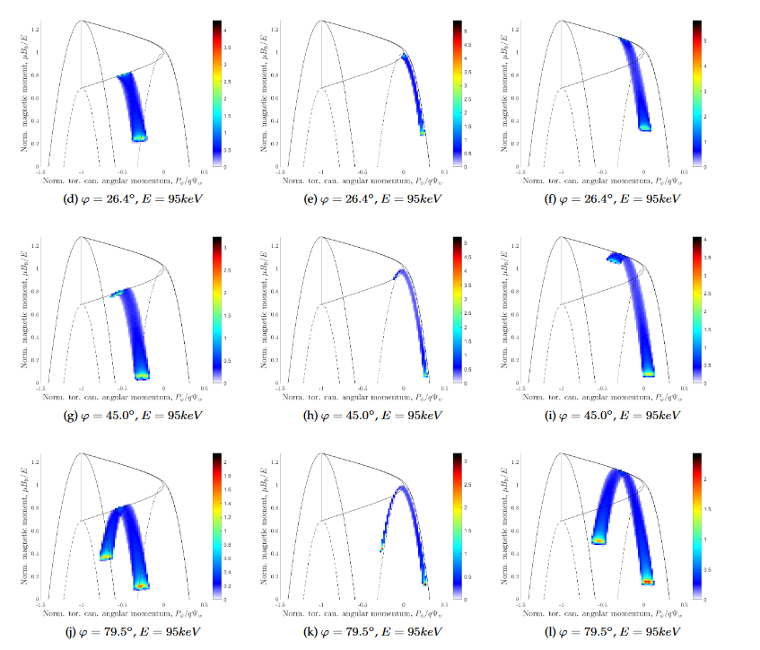
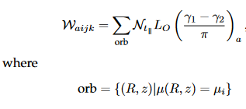
Wight functions in the COM space
M. Rud et al 2024 Nucl. Fusion 64 036007

Slide 14
Reconstruction of FI distribution function in COM space
M. Rud et al submitted to Nucl. Fusion

Slide 15
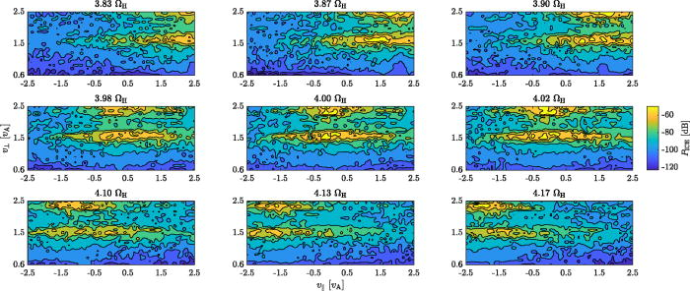
Reconstruction of FI distribution function in COM space
B.S. Schmidt et al., Phys. Plasmas 30, 092109 (2023)

Slide 16
Conclusions
Except for changes in the beta-study, everything runs according to the plan
JET tomography with slowing-down regularization is on the way (planned to be presented at EPS 2024)
COM-space tomography is a great improvement to the current techniques, currently working on a stellarator version
Diagnostic optimization can be done in E-mu space in stellarators and tokamaks with little computational effort
WF for ICE based on MCI is developed

