Slide 1
ML/AI methods in edge plasma physics
Development of machine learning methods and integration of surrogate model predictor schemes for plasma-exhaust and PWI in fusion
(ENR-MOD.01.FZJ - theory)
S. Wiesen (PI) & ENR Team
Feb 7th 2024
2023 annual report

Slide 2
Rationale of ENR
Enable and facilitate optimized and improved modelling that allows a more flexible integration of physics models in the light of extrapolations towards future fusion devices.
Demonstrate the applicability of Machine-Learning (ML) and Artificial Neural Network (ANN) methods in fusion with a special focus on plasma-exhaust (scrape-off layer and pedestal region) and PWI.
This ENR project elaborates on the conceptual basis for an improved model predictor scheme involving new methods and computational technologies based on ML/ANN for exploitation in fusion device design studies
How much of an algorithmic model can be transformed into an accurate ML based data model?
Include uncertainty quantification (UQ) to enable an efficient selection of the numerical data, i.e. its cardinality, on which the training must be based and how reduced models are efficiently and quantifiably calibrated
This ENR project aims at expanding and disseminating new expertise & knowledge in the field of ML/ANN into the fusion community → advice on best practices
S. Wiesen | ENR-MOD.01.FZJ – theory 2023 annual report | Zoom | Feb 7th 2024 | Page 2

Slide 3
Conferences 2023 & 2024 (selection)
ICDDPS4 2023
  Wiesen (invited): Data-driven models in fusion exhaust: methods and perspectives
  Dasbach: Development of surrogate models for tokamak exhaust
  Gillgren: Methods to investigate non-linearity of parameter dependencies in the pedestal models
  Kit: Latent dynamics on the pedestal representation learning
  Järvinen: Inferring machine independent latent features in pedestal representation learning
  Jurinec & Kit: Feature storage framework for ML workflows in fusion (collaboration with ACH-05)
  Clarte & Kit: Bayesian optimization for maximizing pedestal pressure height (collaboration with UH)
  Poels: Fast Divertor Plasma Simulation using Deep Learning-based Surrogate Modeling
IAEA-FEC 2023:
  Wiesen: Data-driven models in fusion exhaust: AI methods and perspectives (ENR review)
  Gillgren: Interpretable supervised learning methods for pedestal prediction
  Kit: Developing generative semi-supervised learning models for pedestal plasmas
  Järvinen: Bayesian methods for uncertainty quantification and parameter optimization in fusion energy applications
PSI2024
EPS2024
ICDDPS5 2024
  … and other national physics conferences
S. Wiesen | ENR-MOD.01.FZJ – theory 2023 annual report | Zoom | Feb 7th 2024 | Page 3

Slide 4
Publications 2023 & 2024 (selection)
First author | Initial | Title | Journal | Doc Type | Status | Pinboard
Poels | Y. R. J. | Fast Dynamic 1D Simulation of Divertor Plasmas with Neural PDE Surrogates | Nuclear Fusion, IOP Publishing, 63 (2023) 126012 | Paper | Published | 35206
Derks | G. L. | Multi-machine benchmark of the self-consistent 1D scrape-off layer model DIV1D from stagnation point to target with SOLPS-ITER | PPCF | Paper | Submitted | 36331
Kit | A. | Bayesian optimization of the JET pedestal pressure height | 4th International Conference on Data Driven Plasma Science (ICDDPS-4), Okinawa, Japan, 16th April 2023 | Paper | In Progress
Jurinec | F. | Data platform strategy for enabling large scale machine learning workflows | 4th International Conference on Data Driven Plasma Science (ICDDPS-4), Okinawa, Japan, 16th April 2023 | Paper | Submitted | 33421
Kit | A. | On learning latent dynamics of the AUG plasma state | 4th International Conference on Data Driven Plasma Science (ICDDPS-4), Okinawa, Japan, 16th April 2023 | Paper | Published | arXiv:2308.14556
Kit | A. | Supervised learning approaches to modeling pedestal density | PPCF | Paper | Published | 31230
Jaervinen | A.E. | A Bayesian Approach for Uncertainty Quantification and Data-efficient Optimization in Fusion Research | Nuclear Fusion | Paper | Submitted | 34104
Jaervinen | A.E. | Representation Learning Algorithms for Inferring Machine Independent Latent Features in Pedestals in JET and AUG | Physics of Plasmas | Paper | Submitted
Gillgren | A. | A fast neural network surrogate model for the eigenvalues of QuaLiKiz | Physics of Plasmas | Paper | Published | doi.org/10.1063/5.0174643
Dasbach | S. | Towards fast surrogate models for interpolation of tokamak edge plasmas | Nuclear Materials and Energy | Paper | Published | 30995
Wiesen | S. | Data-driven models in fusion exhaust: AI methods and perspectives, ENR Review paper | Nuclear Fusion | Paper | Submitted | 34084
Panera | A. | EuroPED-NN: Uncertainty aware surrogate model | Nuclear Fusion | Paper | Submitted | 36702
… and many other talks/posters/presnetations, c.f. report
S. Wiesen | ENR-MOD.01.FZJ – theory 2023 annual report | Zoom | Feb 7th 2024 | Page 4

Slide 5
Overview of sub-projects
SP1 Development of a surrogate model for power & particle exhaust
S. Dasbach (FZJ), S. Wiesen (FZJ/DIFFER)
SP2 Development/improvement of ML/ANN methods for training based on experimental data for pedestal physics
A. Jaervinen, A. Kit (VTT/U Helsinki),
A. Gillgren (VR/Chalmers)
A. Ho, A. Panera (DIFFER)
SP3 Model discovery for erosion yields through ML methods
M. Brenzke, D. Reiser (FZJ)
SP4 Towards time-dependent surrogate models for exhaust
Y. Poels, E. Westerhof, V. Menkovski, G. Derks (DIFFER)
S. Wiesen | ENR-MOD.01.FZJ – theory 2023 annual report | Zoom | Feb 7th 2024 | Page 5

Slide 6
SP1 Development of a surrogate model for power & particle exhaust
S. Wiesen | ENR-MOD.01.FZJ – theory 2023 annual report | Zoom | Feb 7th 2024 | Page 6

Slide 7
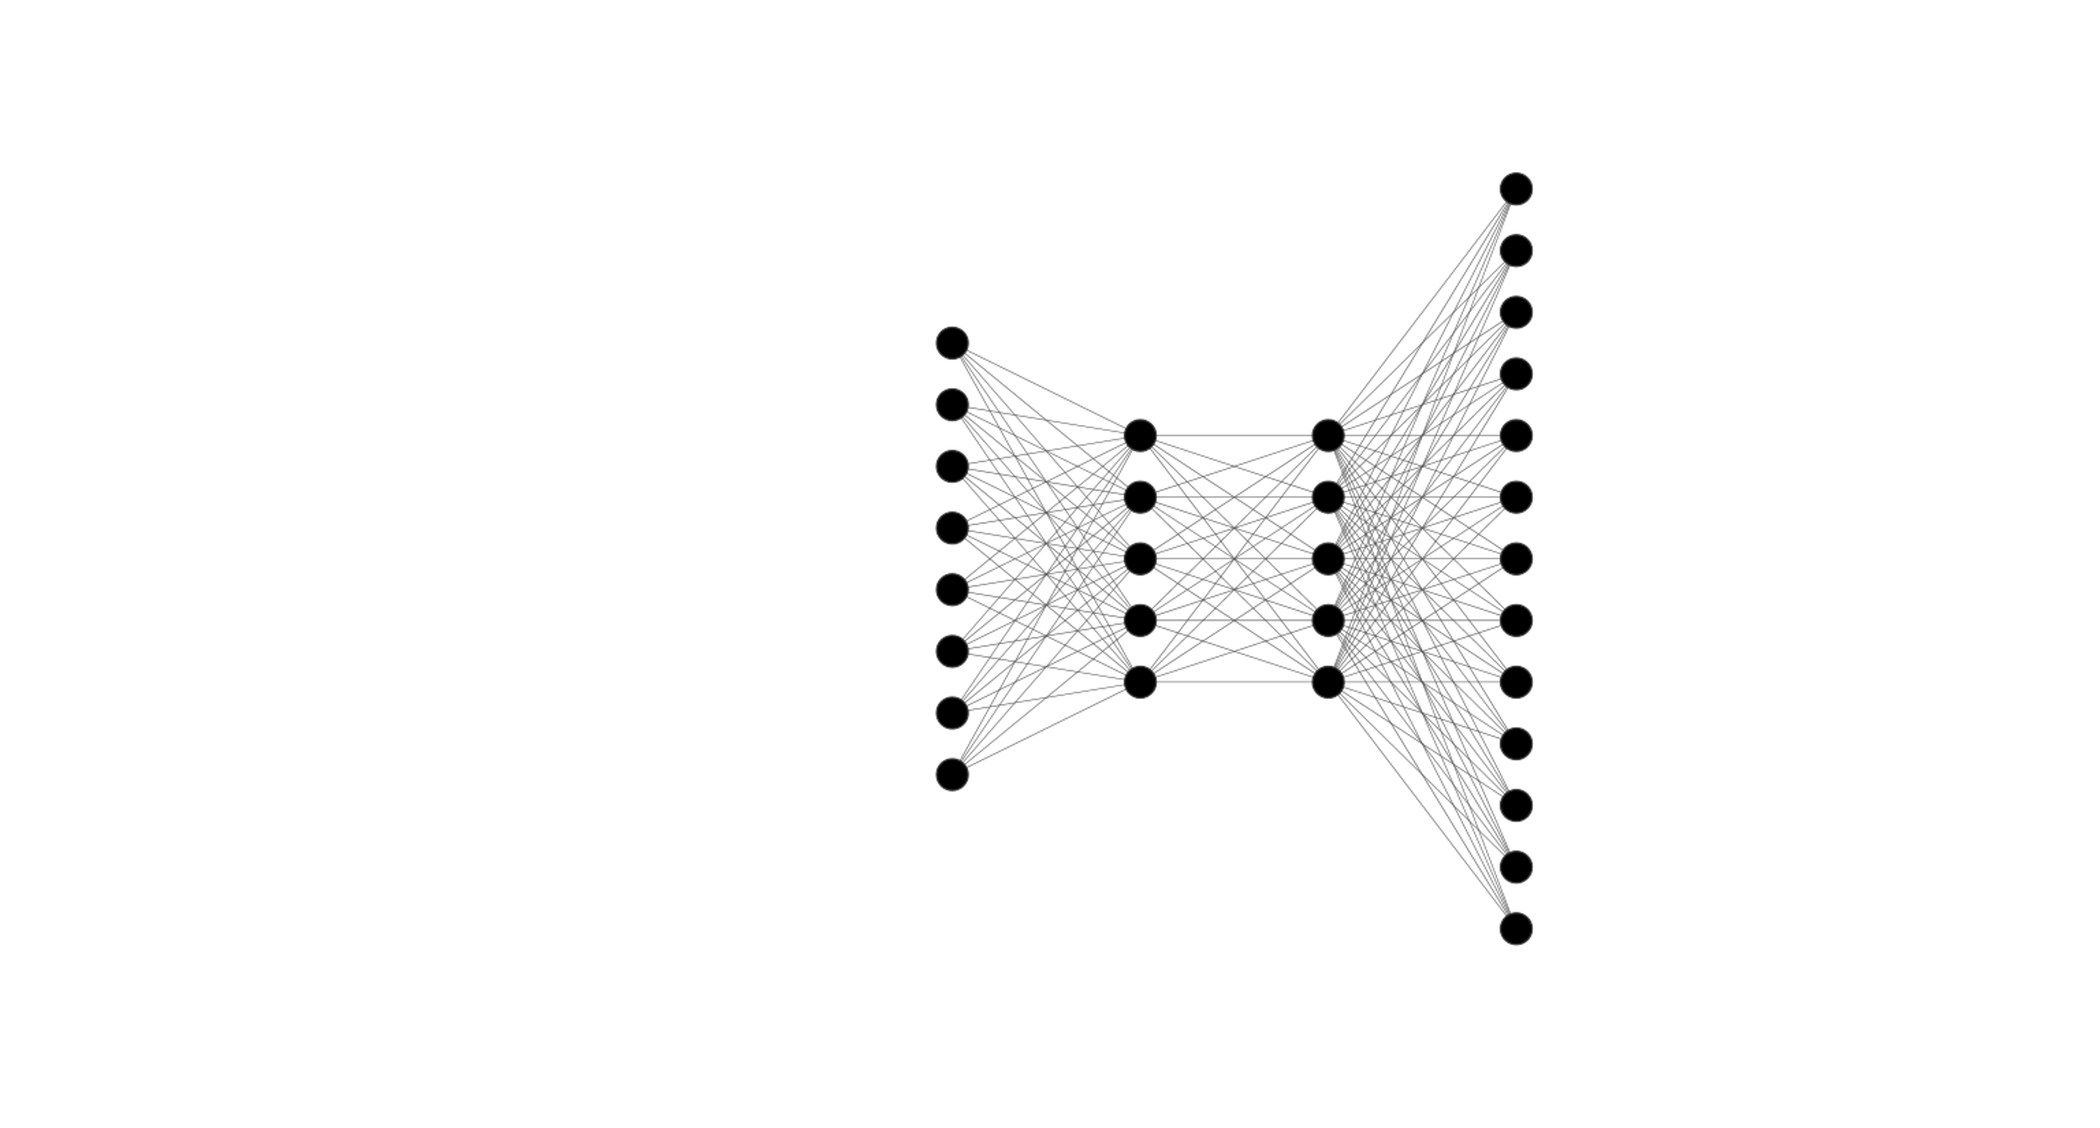
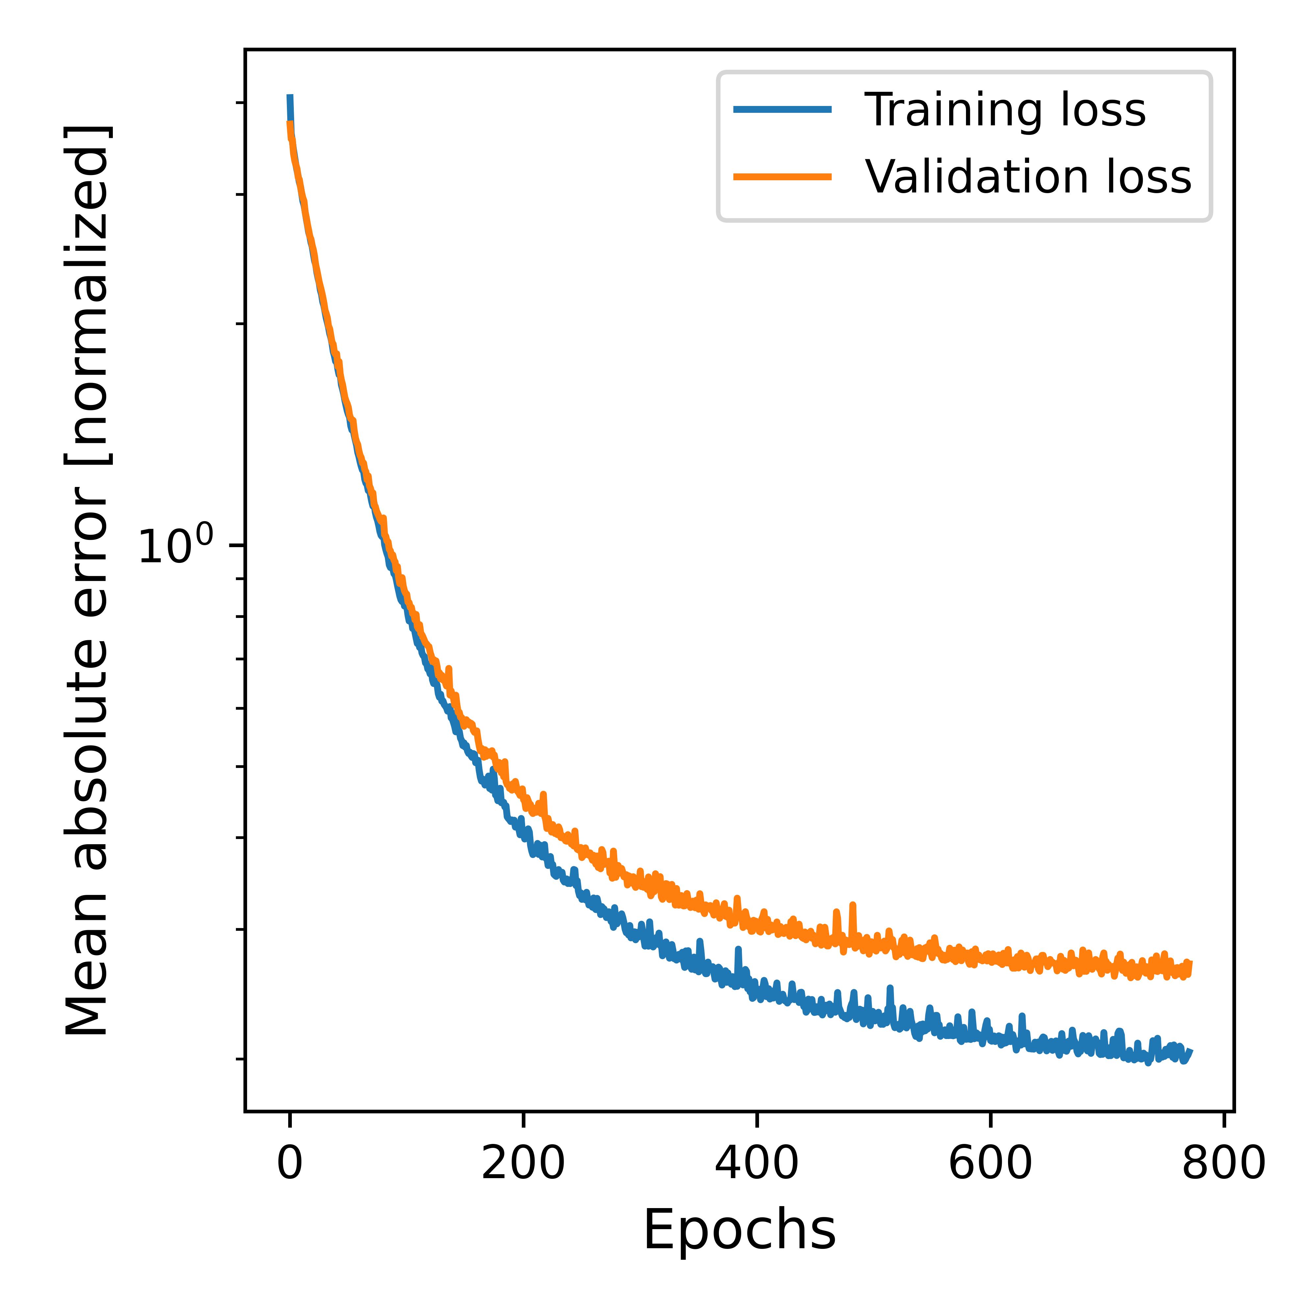
Neural Network Model
Te – cell 1
Te – cell 2
Te – cell 3
…
…
…
…
…
…
...
Te – cell 4894
Te – cell 4895
Te – cell 4896
Hyperparameter – Random Search
8 inputs
Hidden layers: [1,15]
Neurons per layer [100,1500]
Activation {relu,elu,selu}
Learning rate: [0.0001,0.005]
104x50 Te values output
Optimizer: Adam
Early Stopping Patience: 20 Epochs
Loss: Mean Absolute Error
L2 normalizer [0.00001,0.01]
Batch size [20,200]
Batch normalization [True, False]
Core input power
Core D+ Flux
D gas puff rate
N gas puff rate
Density transport coefficient
Major Radius
Toroidal magnetic field
Heat transport coefficient
Find best model architecture
Cross-validation (5-fold)
Final performance on test set as average of fold predictions
Seite 7

Slide 8
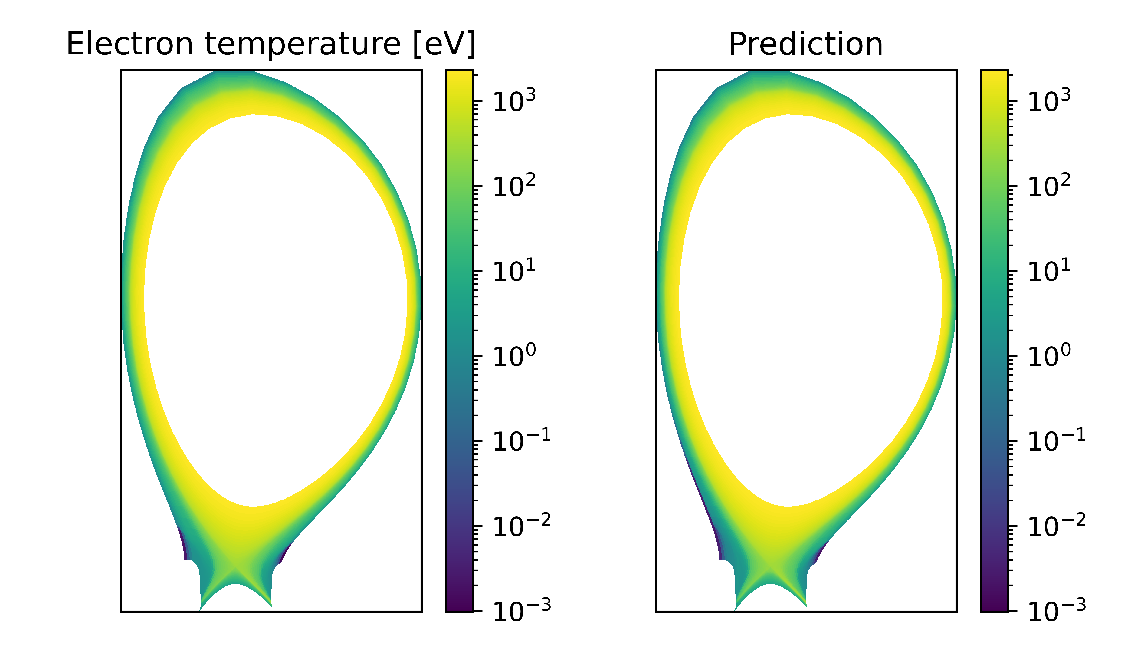
Neural Network - Performance
Median absolute errors: 3.5eV
Median relative errors: 7%
Median absolute errors: 1.0eV
Median relative errors: 13%
Seite 8

Slide 9
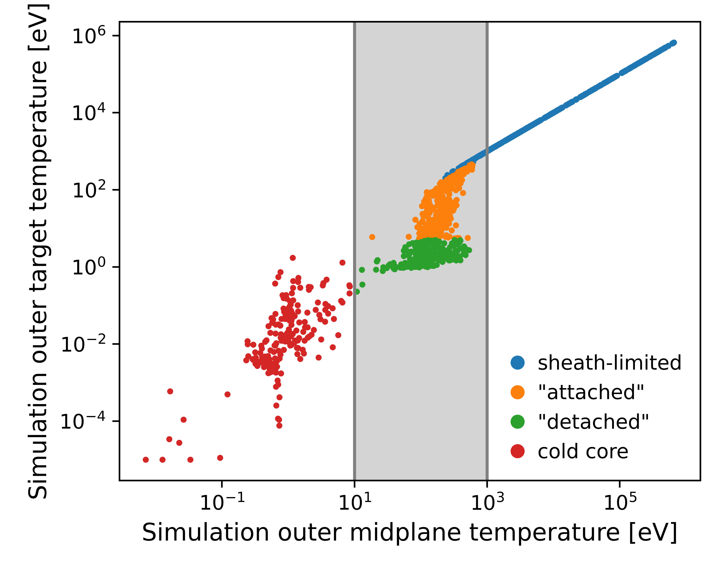
Neural Network – Across different regimes
Median test errors at outer target
100eV | 10%
0.9eV | 12%
0.2eV | 12%
0.02eV | 75%
Seite 9

Slide 10
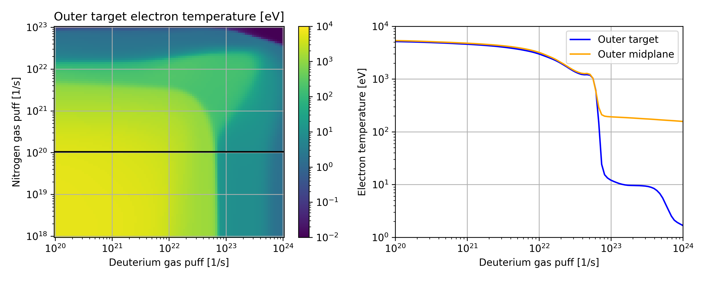
Applying the model to iter scenario
Fix parameters to ITER configuration
Heat transport 1.0 m²/s
Major Radius 6.2m
Toroidal magnetic field 5.3 T
Core input power 100 MW
Core D+ Influx 9.1e21 1/s
Density transport 0.3 m²/s
Scan gas puffs
N gas puff 1e18 - 1e23 1/s
D gas puff 1e20 - 1e24 1/s
100 steps each
Total: 100x100 =10.000 combinations
Network requires less than a minute
Seite 10

Slide 11
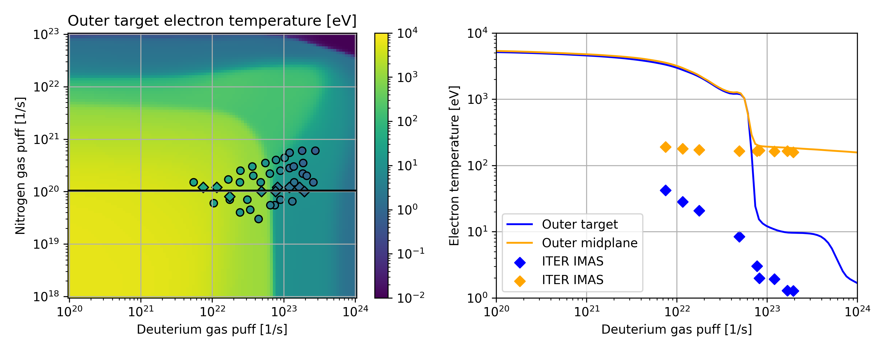
Applying the model to iter scenario
Fix parameters to ITER configuration
Heat transport 1.0 m²/s
Major Radius 6.2m
Toroidal magnetic field 5.3 T
Core input power 100 MW
Core D+ Influx 9.1e21 1/s
Density transport 0.3 m²/s
Scan gas puffs
N gas puff 1e18 - 1e23 1/s
D gas puff 1e20 - 1e24 1/s
100 steps each
Total: 100x100 =10.000 combinations
Network requires less than a minute
Deviations can have several sources
Different neutral model
Different geometry
Neon instead of Nitrogen
Helium ions
Different gaspuff/pump model
Median errors
Outer midplane: 29eV | 17%
Outer target: 16eV | 1000%
Seite 11

Slide 12
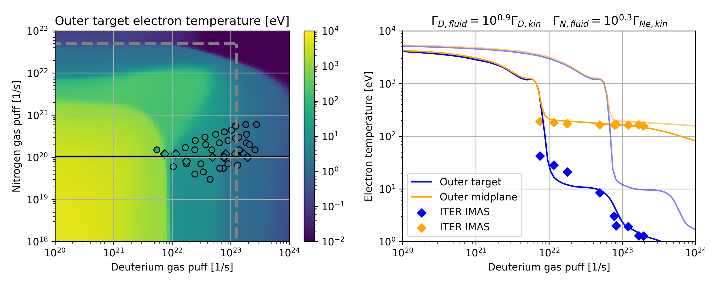
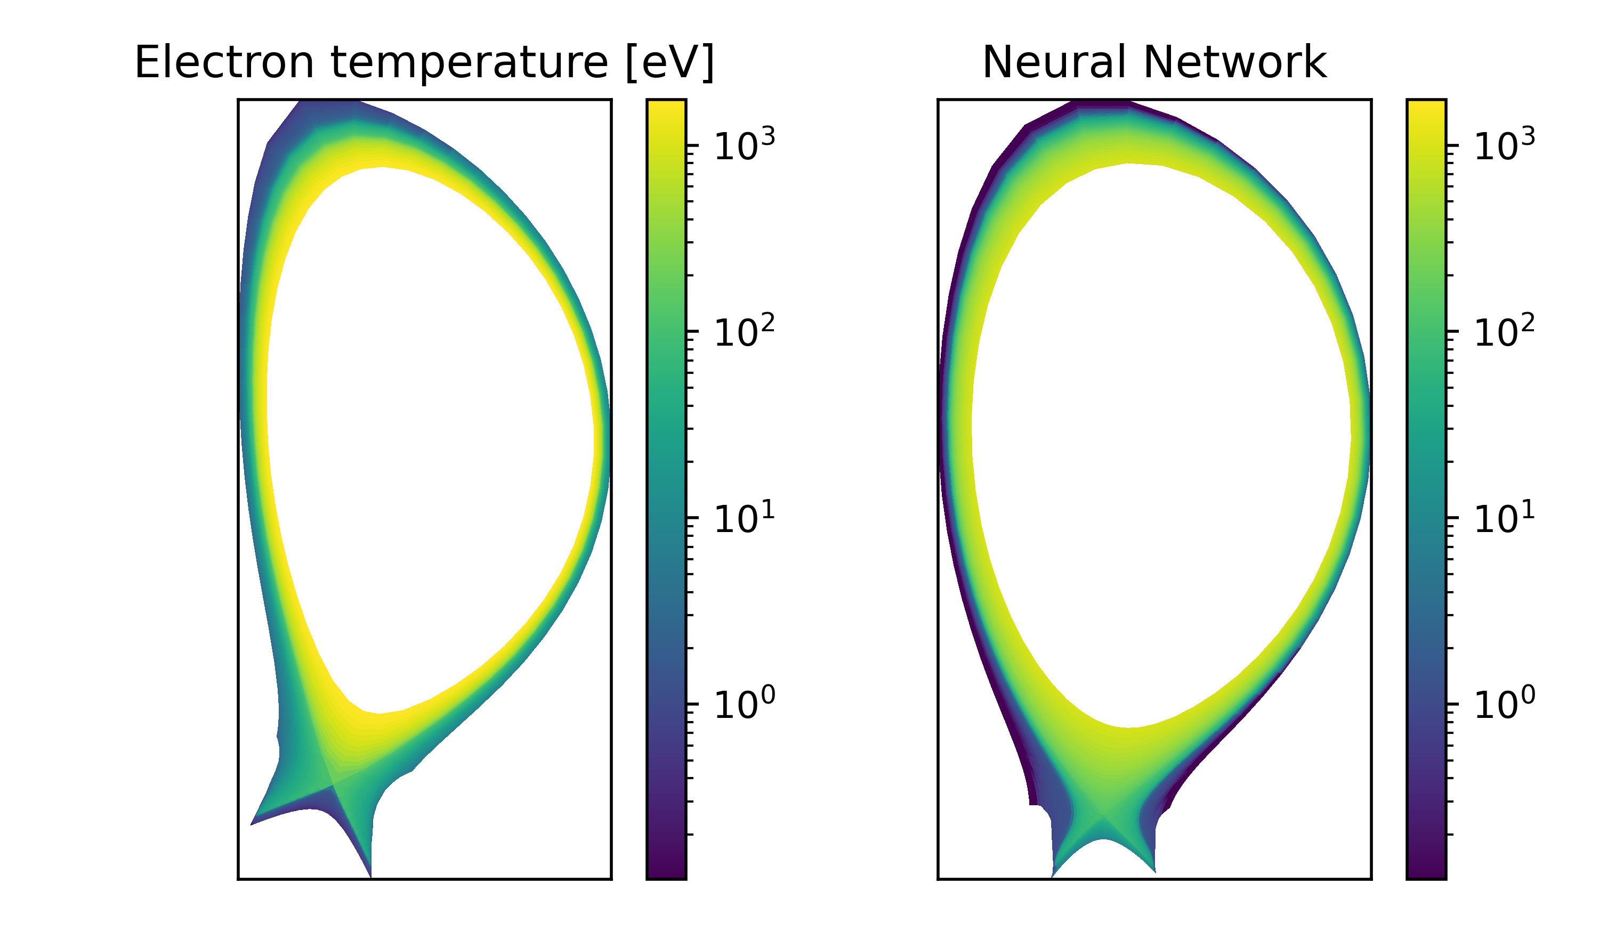
Applying the model to iter scenario
Fix parameters to ITER configuration
Heat transport 1.0 m²/s
Major Radius 6.2m
Toroidal magnetic field 5.3 T
Core input power 100 MW
Core D+ Influx 9.1e21 1/s
Density transport 0.3 m²/s
Scan gas puffs
N gas puff 1e18 - 1e23 1/s
D gas puff 1e20 - 1e24 1/s
100 steps each
Total: 100x100 =10.000 combinations
Network requires less than a minute
Scaling the gaspuff input to the network
Necessary shifting likely not consistent across different regimes
Network predictions remain on JET geometry
We can match only specific points
Median errors
Outer midplane: 13eV | 8%
Outer target: 0.8eV | 29%
Seite 12

Slide 13
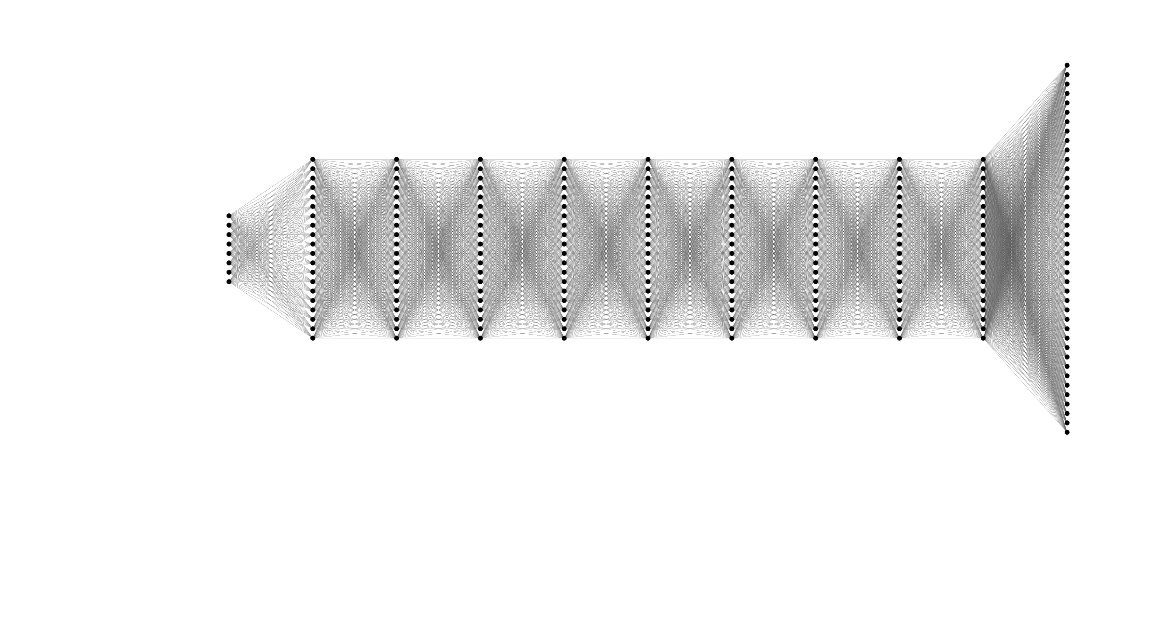
Transfer learning
Take existing model
Modify last layer to fit ITER geometry
Retrain only the last layer weights with ITER simulations
Seite 13

Slide 14
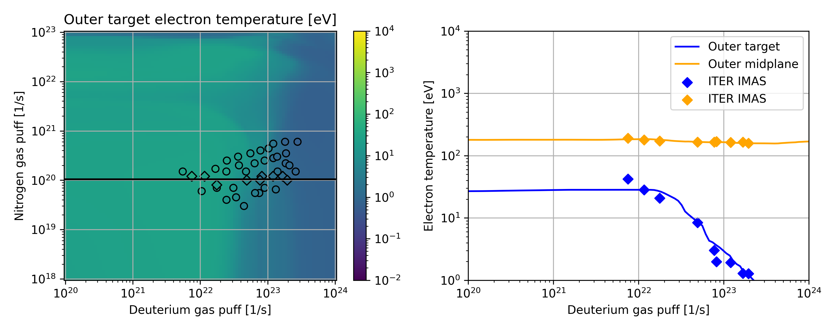
Transfer learning
Median errors
Outer midplane: 3eV | 1%
Outer target: 0.4eV | 15%
Seite 14

Slide 15
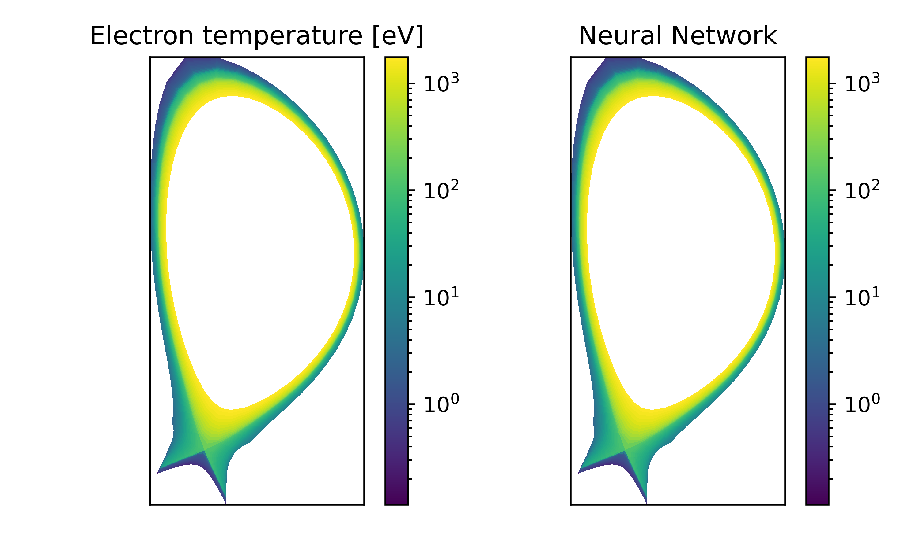
ITER performance on test set
Seite 15

Slide 16
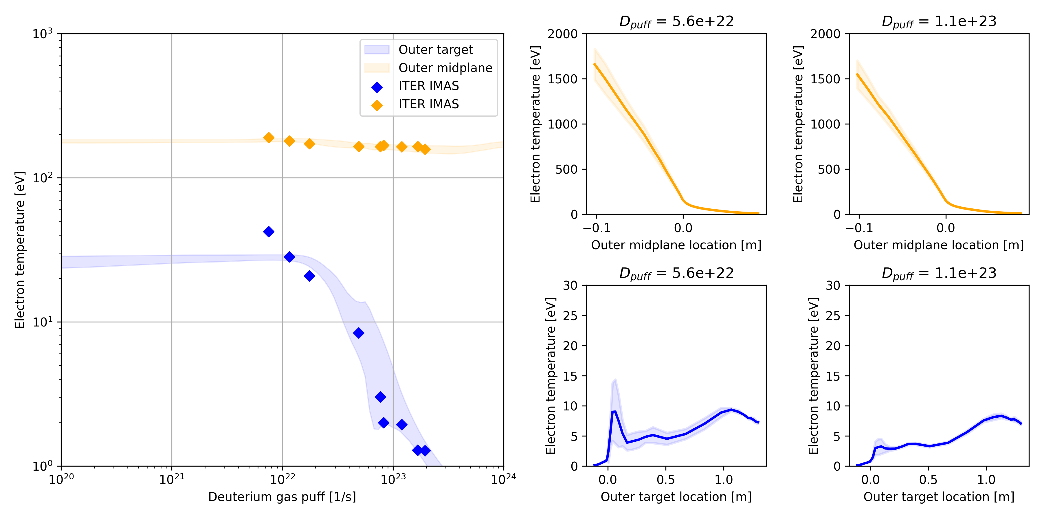
Transfer learning – transport uncertainty
ITER simulations have all same transport coefficients
Transfer learned model still allows for variations of the transport coefficients
To test this we sampled transport coefficients from normal distribution around ITER values
Seite 16

Slide 17
SP2 Development/improvement of ML/ANN methods for training based on experimental data for pedestal physics
S. Wiesen | ENR-MOD.01.FZJ – theory 2023 annual report | Zoom | Feb 7th 2024 | Page 17

Slide 18
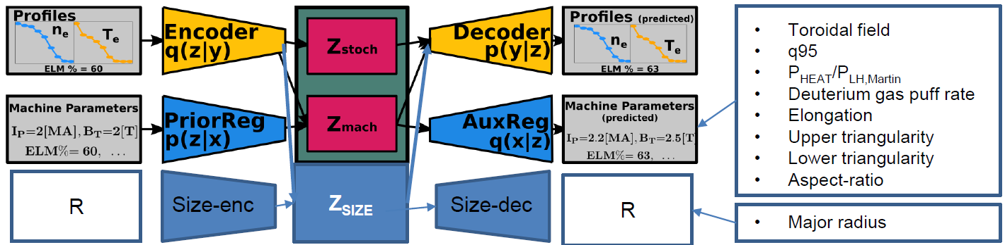
Learning machine independent latent features using JET and AUG databases
Investigations indicate that DIVA models have capability to learn empirically observed scalings with size (Greenwald density scaling).
A challenge with these models is to constrain the learning objectives such that a meaningful, distentangled representation is obtained.
DIVA with separate size regression, and CCVAE (separate latent space for each machine parameter) is considered:
S. Wiesen | ENR-MOD.01.FZJ – theory 2023 annual report | Zoom | Feb 7th 2024 | Page 18

Slide 19
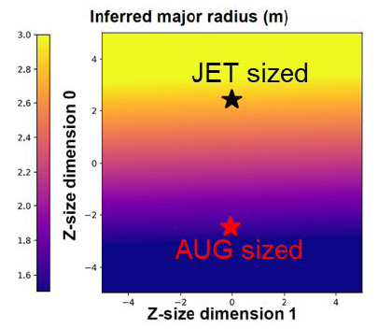
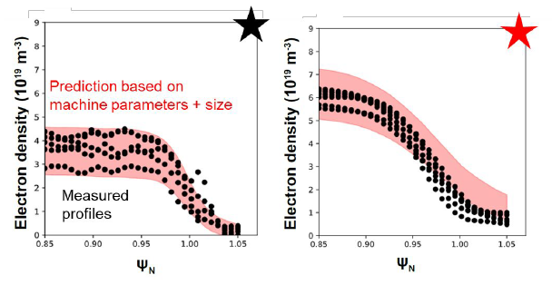
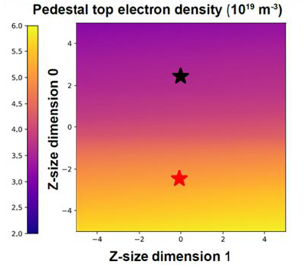
Learning machine independent latent features using JET and AUG databases
The algorithms do encode reduced density with device size which is qualitatively consistent with the empirical Greenwald density limit scaling:

Slide 20
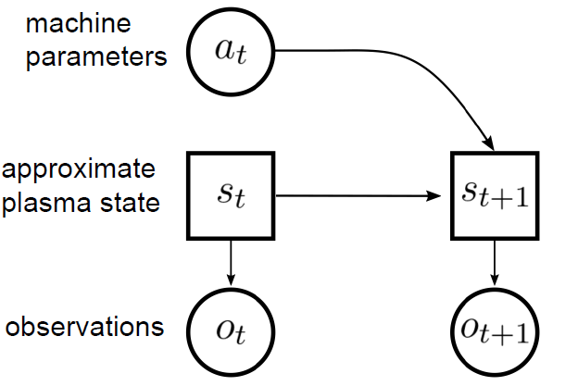
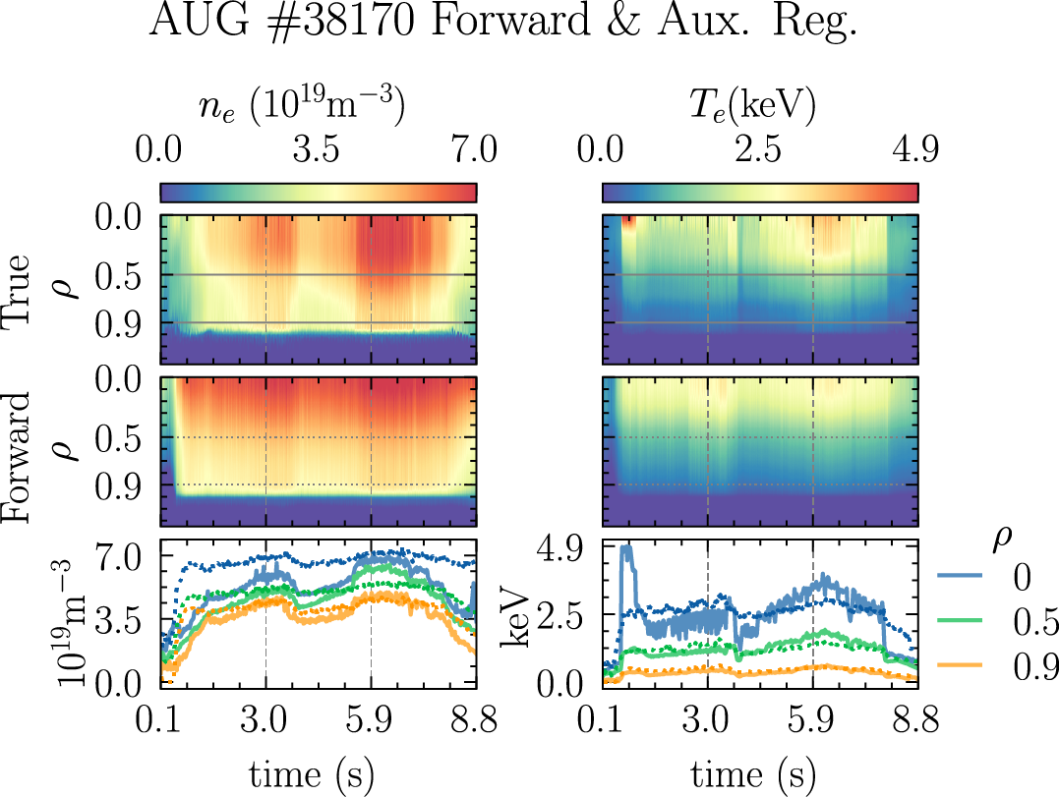

Learn a compressed (latent) state representation (forward model) for pedestal profiles
To approximate the plasma state, again a VAE is used and thus we learn
We assume these mappings are not deterministic→ we use a VAE as the observational model encoder: φ & decoder: π.
The trained observational model performs good lossy compression. The qualitative results show forward model can capture plasma dynamics of dominant transients (H-mode)
S. Wiesen | ENR-MOD.01.FZJ – theory 2023 annual report | Zoom | Feb 7th 2024 | Page 20

Slide 21
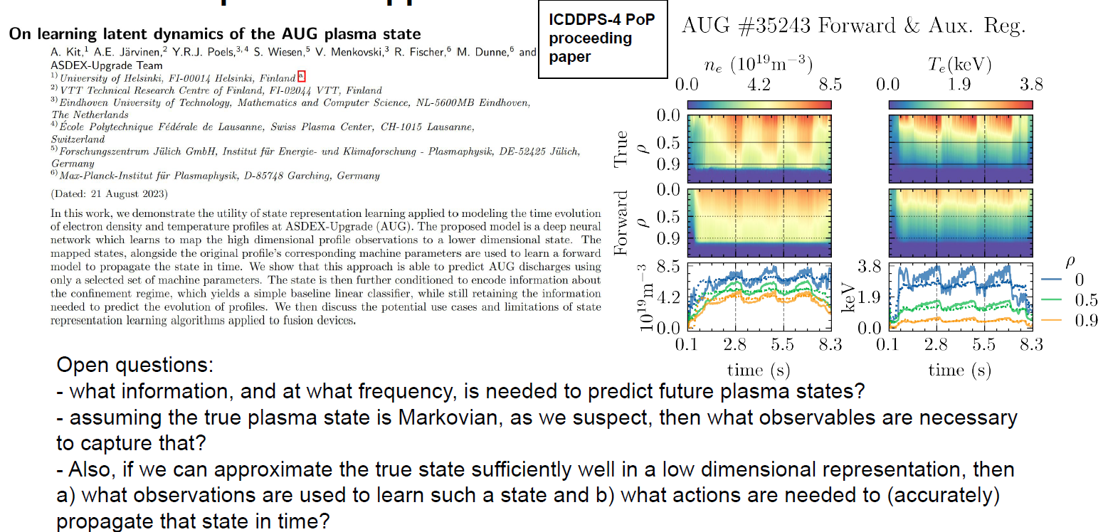
Learn a compressed (latent) state representation (forward model) for pedestal profiles

Slide 22
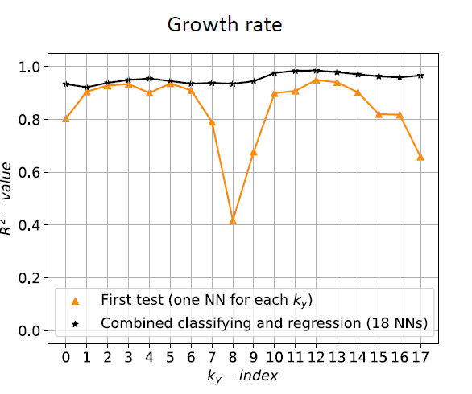
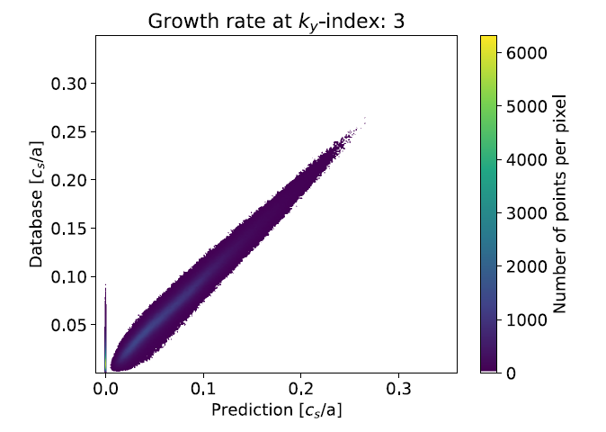
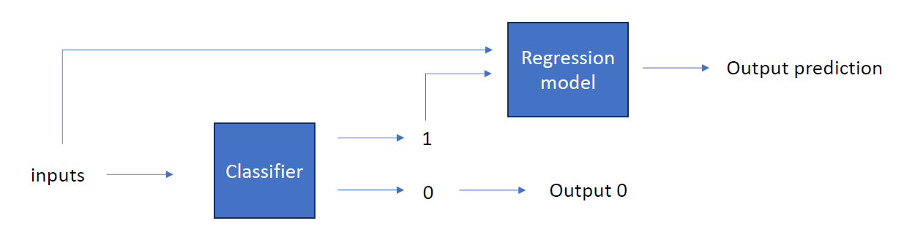
QuaLiKiz eigenvalue surrogate models
A surrogate model for QuaLiKiz named QLKNN exists that directly maps input parameters to fluxes (no explicit eigenvalue predictions) → QLKNN replicated the results of QuaLiKiz accurately.
However, the quasi-linear saturation rule is benchmarked to experimental data, and nonlinear GK simulations. QLKNN embeds the saturation rule that is used and therefore it is challenging to achieve high fidelity predictions for future machines where the saturation mechanism is not tested/verified.
The idea is to create a surrogate model for the eigenvalue calculations of QuaLiKiz that allows quick access to eigenvalues → enable flexibility regarding which saturation rule is applied together with the predicted eigenvalues to obtain the transport and also to enable a cross-machine model.
S. Wiesen | ENR-MOD.01.FZJ – theory 2023 annual report | Zoom | Feb 7th 2024 | Page 22

Slide 23
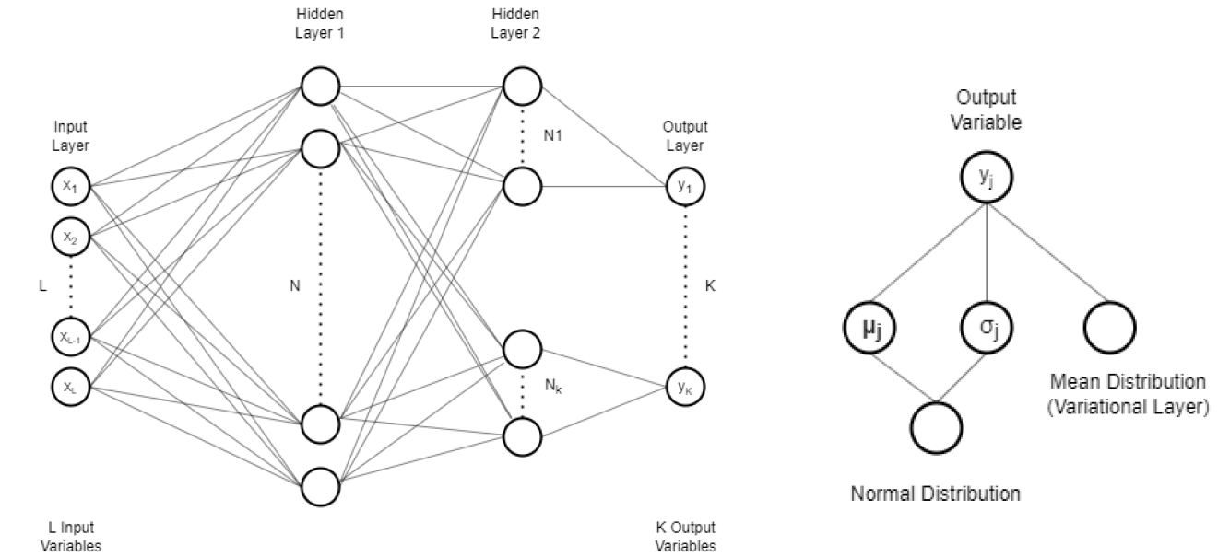
Uncertainty aware surrogate model: EuroPED-NN
Scatter of EuroPED database implies additional dependencies as evidenced by scatter around empirical sqrt ballooning limit [P.B. Snyder et al., NF 2009]. The ballooning limit relation did not account for potential resistive MHD effects.
The idea of this sub-task is to speed-up & simplify original models and also to sample data for experiments.
The surrogate model can be based on a Bayesian Neural Networks (BNN) that avoids overconfidence & allows to include previous knowledge of the system.

Slide 24
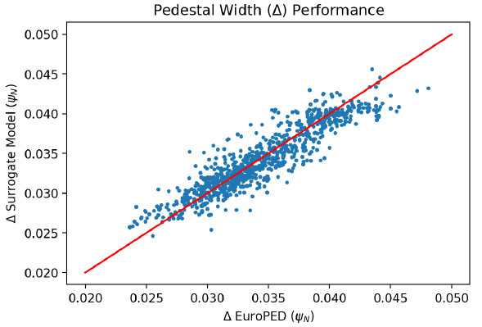
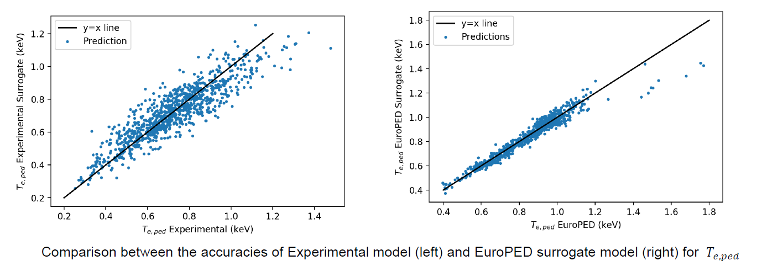
Uncertainty aware surrogate model: EuroPED-NN
A high accuracy is seen, especially in the prediction of Teped and neped but also for the pedestal width:
A next step is to add also experimental data in the BNN approach, first results seem to be promising:

Slide 25
SP4 Towards time-dependent surrogate models for exhaust
S. Wiesen | ENR-MOD.01.FZJ – theory 2023 annual report | Zoom | Feb 7th 2024 | Page 25

Slide 26
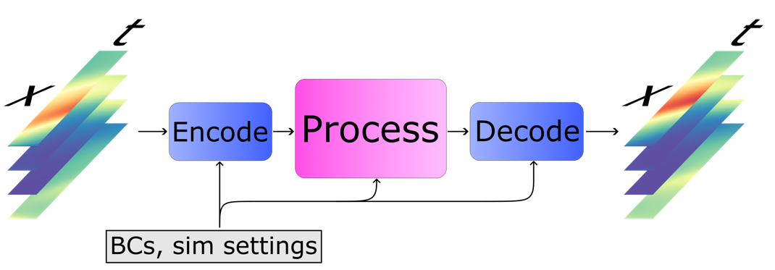
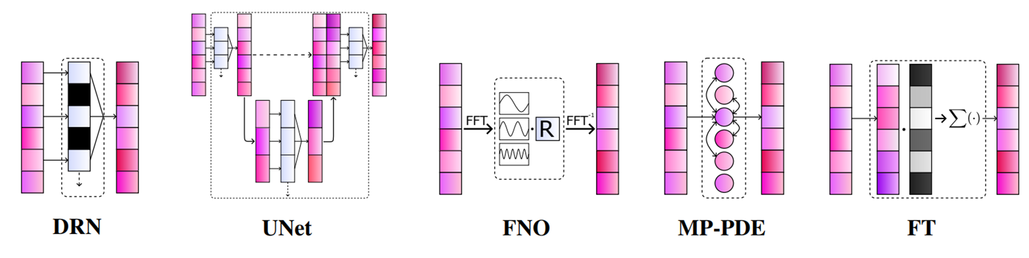
Towards time-dependent surrogate models for exhaust
Continuing from the first new, this sub-project worked a significant refinement of the data-driven approach to learn “neural PDE surrogates” from datasets of dynamic DIV1D SOL simulations.
S. Wiesen | ENR-MOD.01.FZJ – theory 2023 annual report | Zoom | Feb 7th 2024 | Page 26

Slide 27
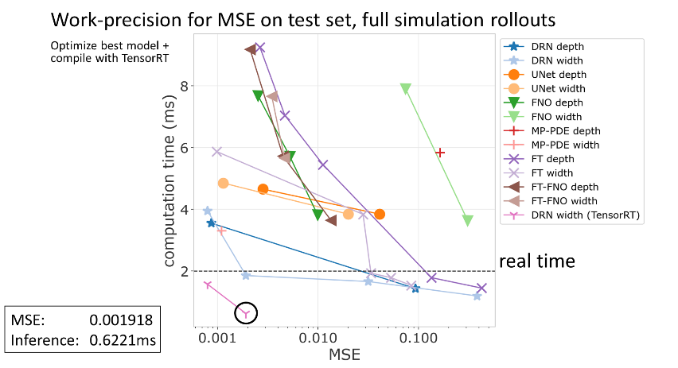
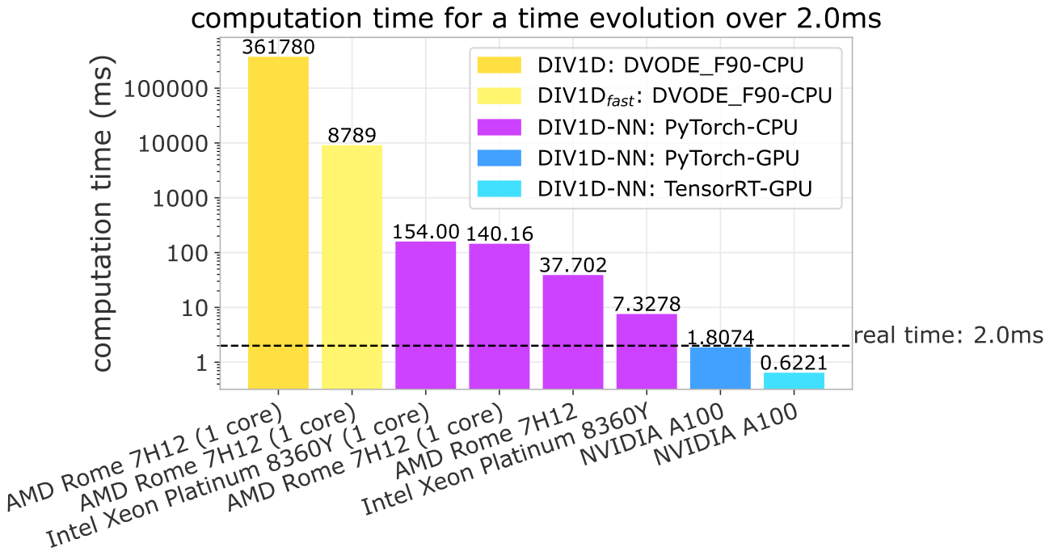
Towards time-dependent surrogate models for exhaust
This is an excellent result, demonstrating that DIV1D-NN can be faster than real-time predicting dynamic profiles.
S. Wiesen | ENR-MOD.01.FZJ – theory 2023 annual report | Zoom | Feb 7th 2024 | Page 27

Slide 28
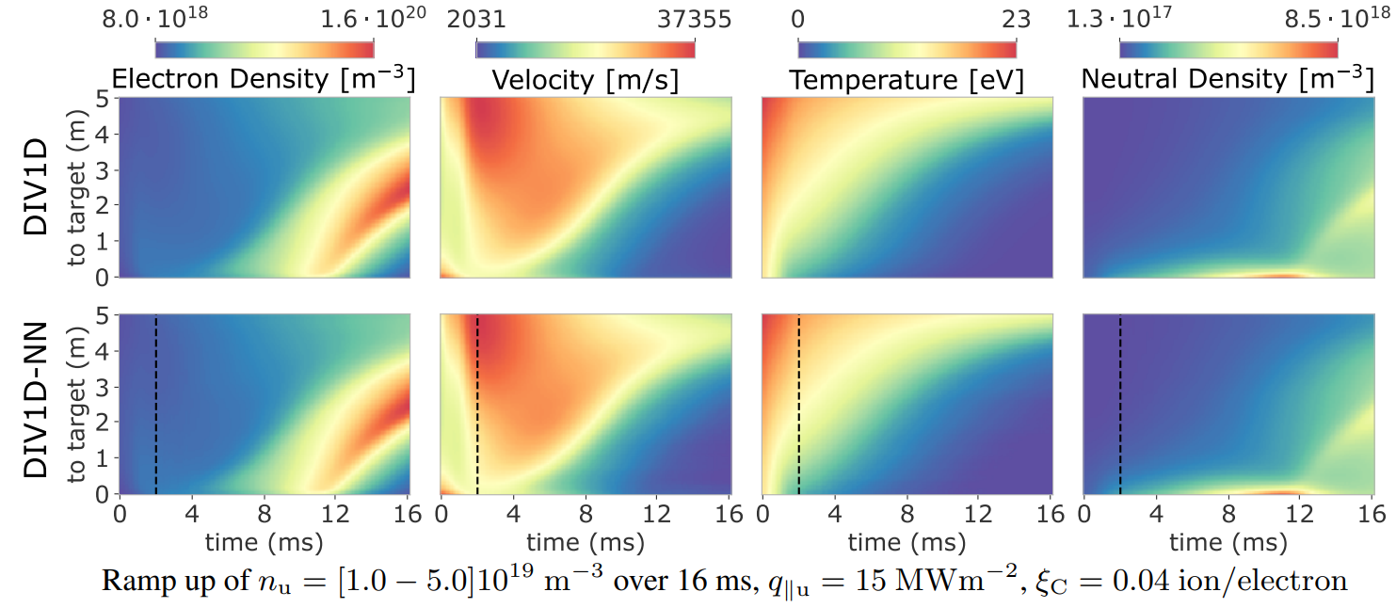
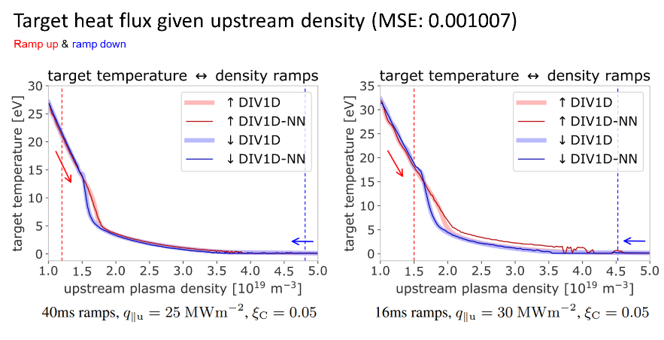
Towards time-dependent surrogate models for exhaust
An example of a slow density ramp for an unseen set of model parameters is as follows demonstrating DIV1D-NN robustness:
Hysteresis effects also captured!
S. Wiesen | ENR-MOD.01.FZJ – theory 2023 annual report | Zoom | Feb 7th 2024 | Page 28

Slide 29
SP3 Model discovery for erosion yields through ML methods
S. Wiesen | ENR-MOD.01.FZJ – theory 2023 annual report | Zoom | Feb 7th 2024 | Page 29

Slide 30
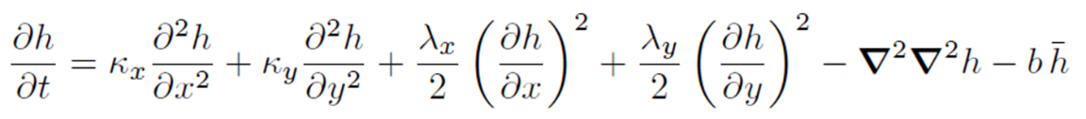
Model discovery for erosion yields through ML methods.
Work continued In 2023 on the model discovery of the dynamics of surfaces under bombardment of energetic ions.
The morphological changes can be described by means of the Kuramoto-Sivashinksy equation (KS) (continuum equation) which in a simplified form can be described as
The idea is to infer model parameters of KS type continuum equations from 2D surface height profile eroded under the action of ion beams. Different approaches to tested before (NNs, GAs, SVDs..).
NEW: we highlight the very promising single snapshot approach based on KS models employing an Eigenfeature analysis for the surface patterns, inspired face recognition (”Eigenface” analysis). To train, forward simulations of the KS model are conducted to provide typical patterns for a variety of model parameter combinations.
S. Wiesen | ENR-MOD.01.FZJ – theory 2023 annual report | Zoom | Feb 7th 2024 | Page 30

Slide 31
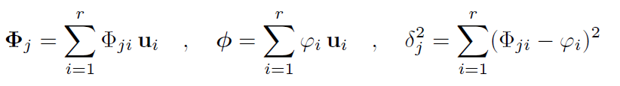
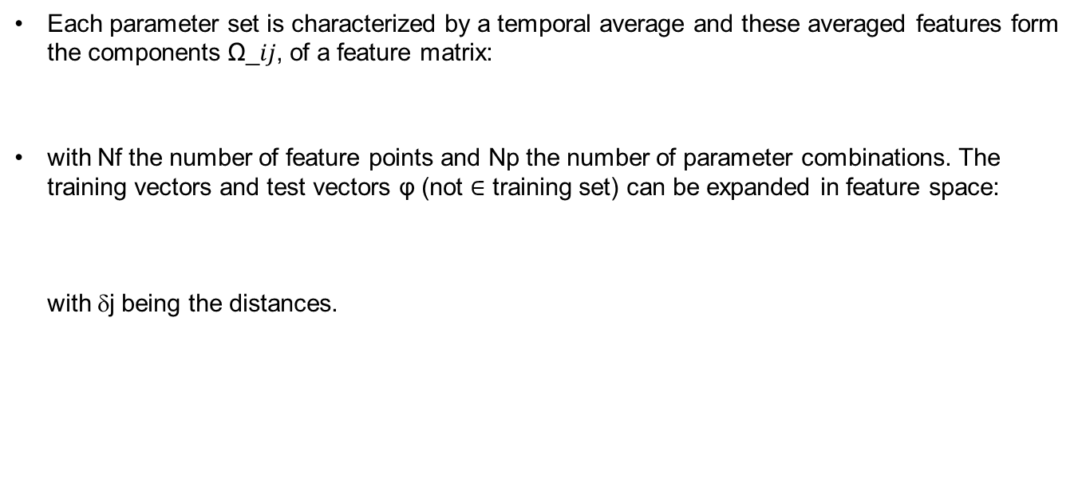
NEW: Face-recognition technique
Each parameter set is characterized by a temporal average and these averaged features form the components Ω_𝑖𝑗, of a feature matrix:
with Nf the number of feature points and Np the number of parameter combinations. The training vectors and test vectors φ (not $∈$ training set) can be expanded in feature space:
with δj being the distances.
S. Wiesen | ENR-MOD.01.FZJ – theory 2023 annual report | Zoom | Feb 7th 2024 | Page 31

Slide 32
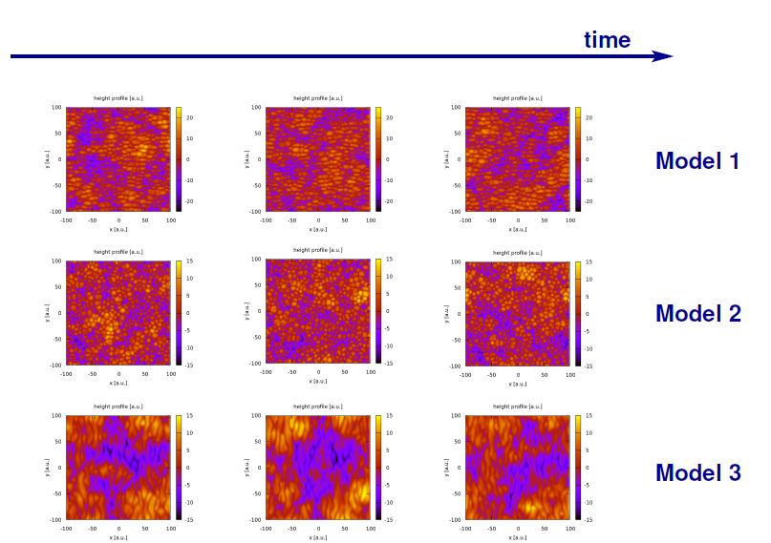
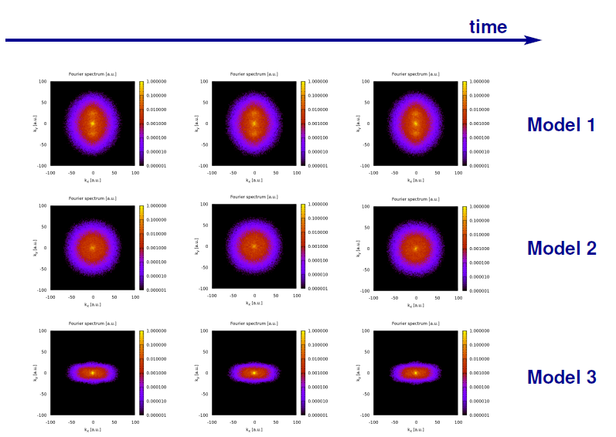
New Model setup
A time series of snapshots for each set of model
Parameters was prepared with the underlying KS model.
A Fourier-Component analysis (face-recognition) was executed. The similarity of snapshots is very obvious in Fourier space and always very close to temporal average
S. Wiesen | ENR-MOD.01.FZJ – theory 2023 annual report | Zoom | Feb 7th 2024 | Page 32

Slide 33
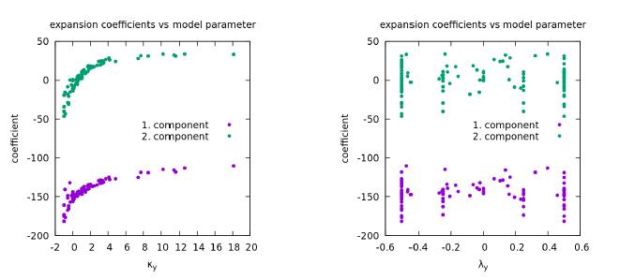
Results
Whereas linear components are very well represented (e.g. κ_{y}) by this approach, the non-linear ones (λ_{y}) are not:
This difficulty is very similar to what was found in the NN approach in 2022.
A sensitivity study is ongoing to address the non-linear term issue.
S. Wiesen | ENR-MOD.01.FZJ – theory 2023 annual report | Zoom | Feb 7th 2024 | Page 33

Slide 34
Plans beyond
S. Wiesen | ENR-MOD.01.FZJ – theory 2023 annual report | Zoom | Feb 7th 2024 | Page 34

Slide 35
Towards fast, high fidelity SOL-pedestal module for integrated plasma scenario prediction → Enabling plasma scenario digital twinning (not selected)
Submitter:
A. Jaervinen
S. Wiesen | ENR-MOD.01.FZJ – theory 2023 annual report | Zoom | Feb 7th 2024 | Page 35

Slide 36
Responding to new EF AI call
100 kEUR per proposal; limited until end 2025
Inside ENR group we decided to submit 2(3) stand-alone proposals:
(1) pedestal MHD
(2) SOL surrogates
(3) (representation learning proposal)
The prepared proposals will be formally competing for the same resources. We acknowledge that.
A foreseen UKAEA collaboration is in-kind
The proposals are clearly linked with EUROfusion WP needs and strongly support TSVV11
Recommendation letters from TSVV-11 PI & WPTE TFLs
S. Wiesen | ENR-MOD.01.FZJ – theory 2023 annual report | Zoom | Feb 7th 2024 | Page 36

Slide 37
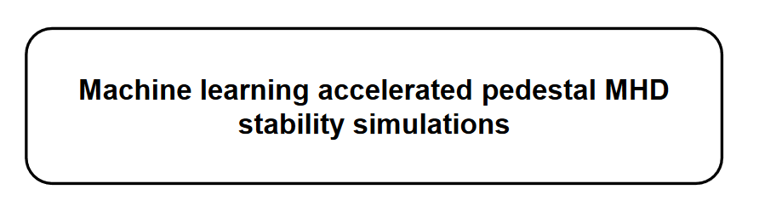
Proposal 1
S. Wiesen | ENR-MOD.01.FZJ – theory 2023 annual report | Zoom | Feb 7th 2024 | Page 37

Slide 38
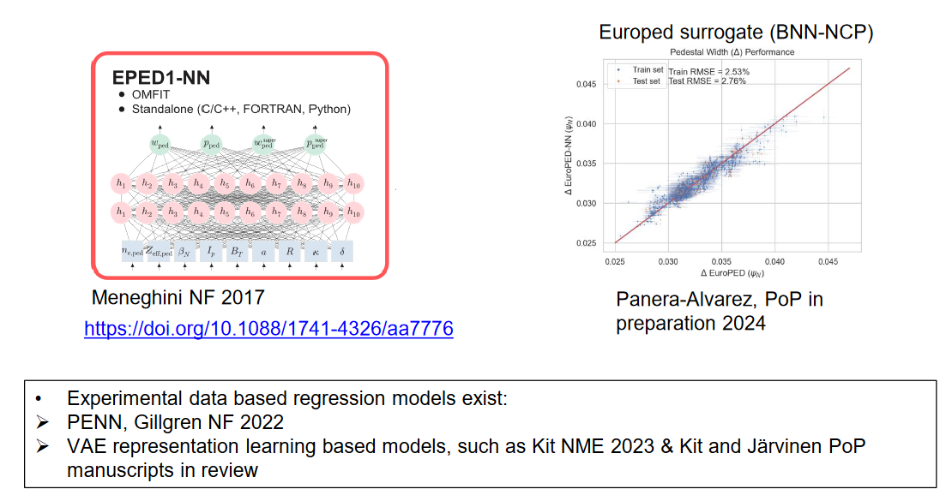
Previous research activities have built surrogates for EPED and Europed for pedestal top predictions (focus here on surrogating numerical models)

Slide 39
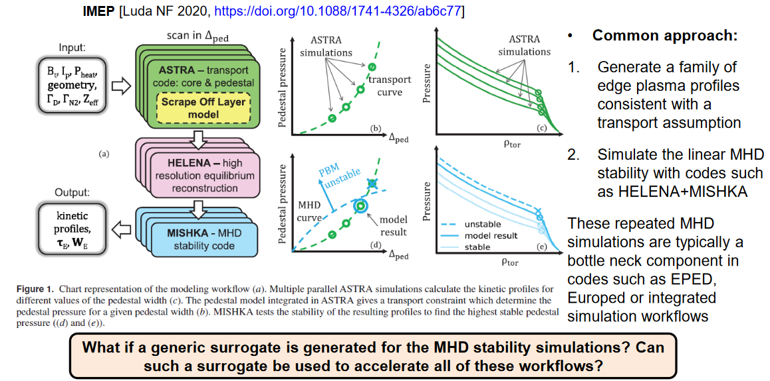
Repeated pedestal MHD stability simulations are a key component of many pedestal pressure prediction workflows

Slide 40
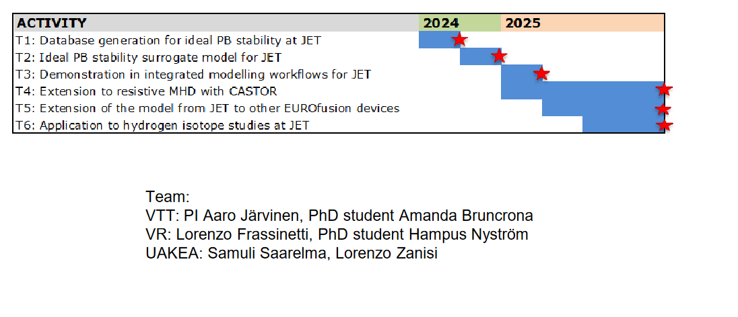
Draft plan & team of the proposal
S. Wiesen | ENR-MOD.01.FZJ – theory 2023 annual report | Zoom | Feb 7th 2024 | Page 40

Slide 41
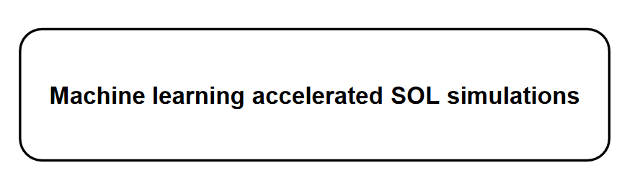
Proposal 2
S. Wiesen | ENR-MOD.01.FZJ – theory 2023 annual report | Zoom | Feb 7th 2024 | Page 41

Slide 42
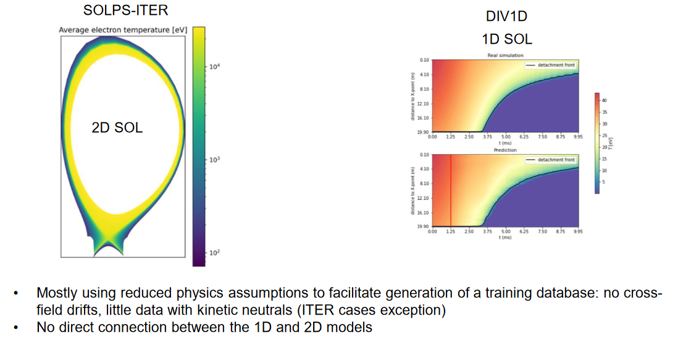
The present ENR project has explored methods to surrogate 2D and 1D SOL models
S. Wiesen | ENR-MOD.01.FZJ – theory 2023 annual report | Zoom | Feb 7th 2024 | Page 42

Slide 43
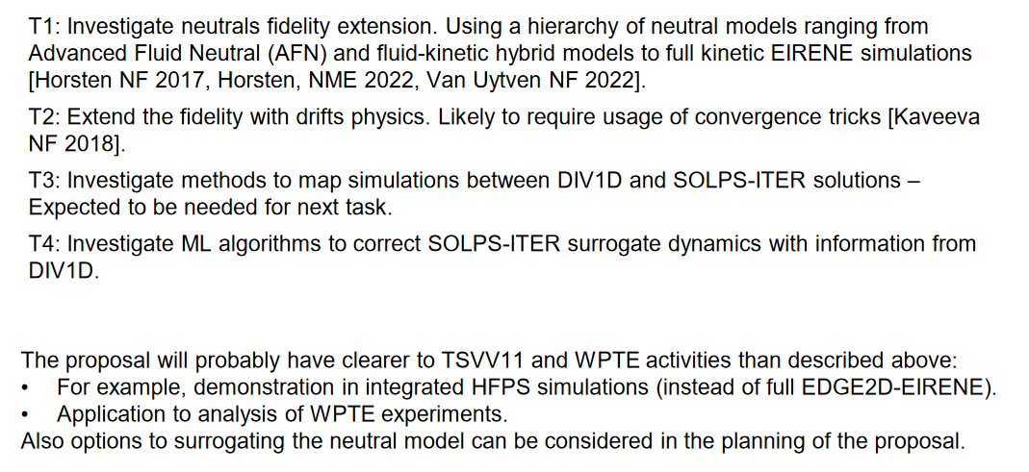
Topical areas based on the ENR proposal – To be updated as the proposal is being prepared
S. Wiesen | ENR-MOD.01.FZJ – theory 2023 annual report | Zoom | Feb 7th 2024 | Page 43

Slide 44
backup
S. Wiesen | ENR-MOD.01.FZJ – theory 2023 annual report | Zoom | Feb 7th 2024 | Page 44

Slide 45
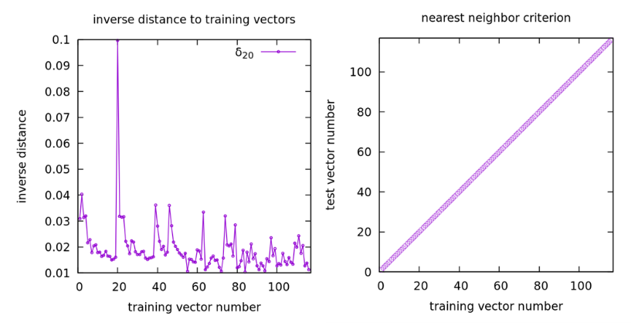
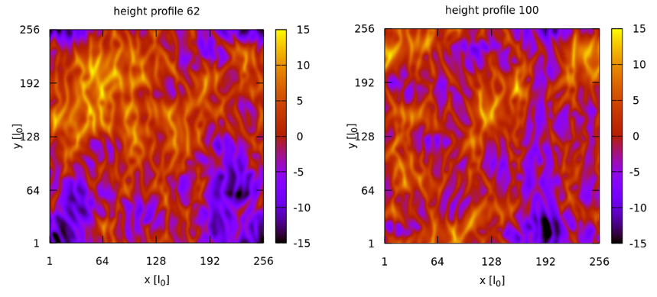

Results
The training data is a set of 116 time-averaged profiles of the features of surface height profiles, each obtained by averaging over 100 snapshots. All these snapshots look ”similar” but are actually very different when comparing point by point. We test, if the group, i. e. the model parameters, of a single snapshot taken from these time series can be identified by a simple nearest neighbor check, where we look for the training vector $Φ_{j}$ having the shortest distance $δ_{j}$.
S. Wiesen | ENR-MOD.01.FZJ – theory 2023 annual report | Zoom | Feb 7th 2024 | Page 45

Slide 46
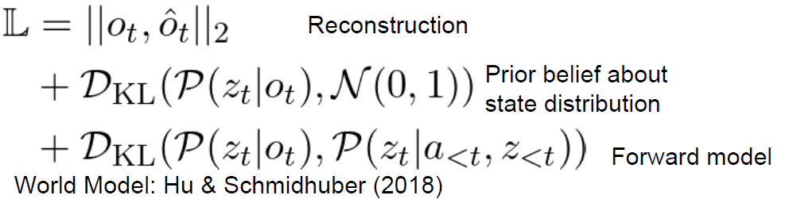
Learn a compressed (latent) state representation (forward model) for pedestal profiles
In 2022 quasi-static predictions could be made via the VAE approach, in this year, the work has been extended employ a forward model to predict future states using machine parameters:
Such compressed or lower dimensional state representations could be desirable for control, predictive inference, and interpretation. Ideally, such representations contain the essential aspects of the system. In practice, it is hard to enforce this. The overarching question we seek to address is: What constitutes the objective function that learns a useful state?
S. Wiesen | ENR-MOD.01.FZJ – theory 2023 annual report | Zoom | Feb 7th 2024 | Page 46

