Slide 1

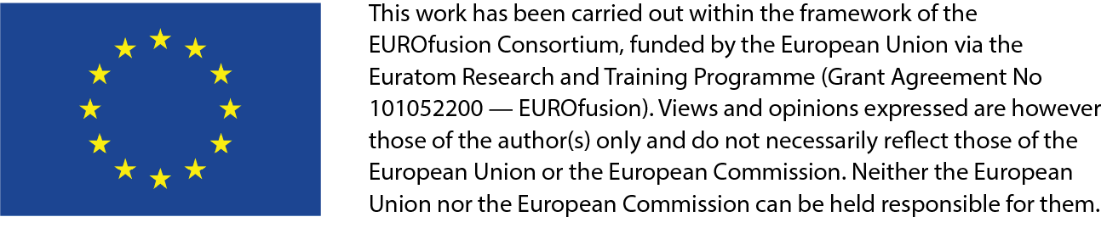
Energetic particle optimization of stellarator devices using near-axis magnetic fields
Rogerio Jorge
P. Rodrigues, J. Ferreira, A. Figueiredo, R. Coelho, D. Borba, P. Figueiredo

Slide 2
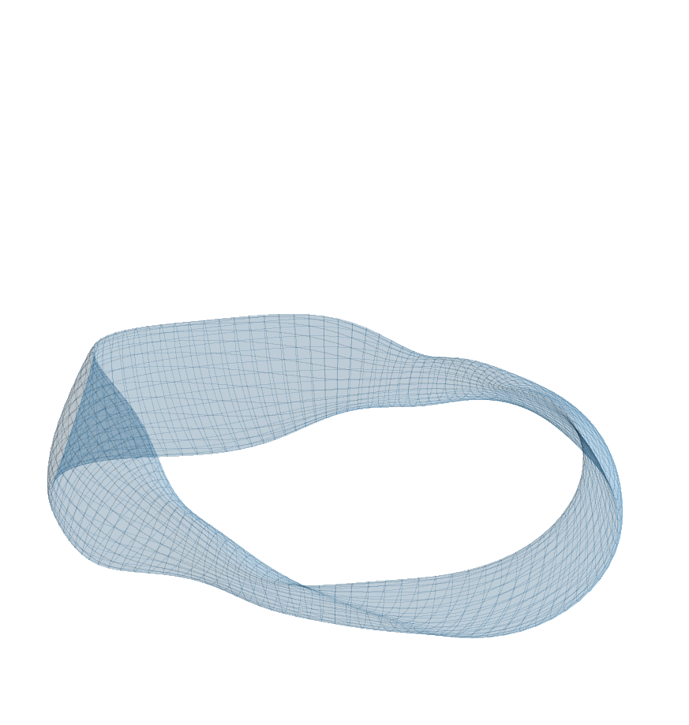
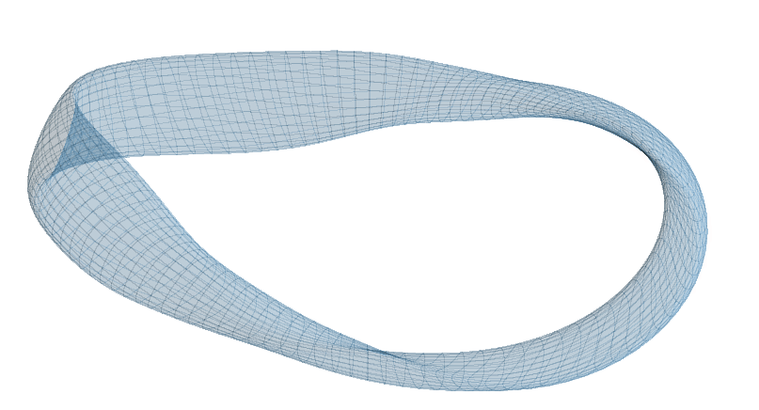
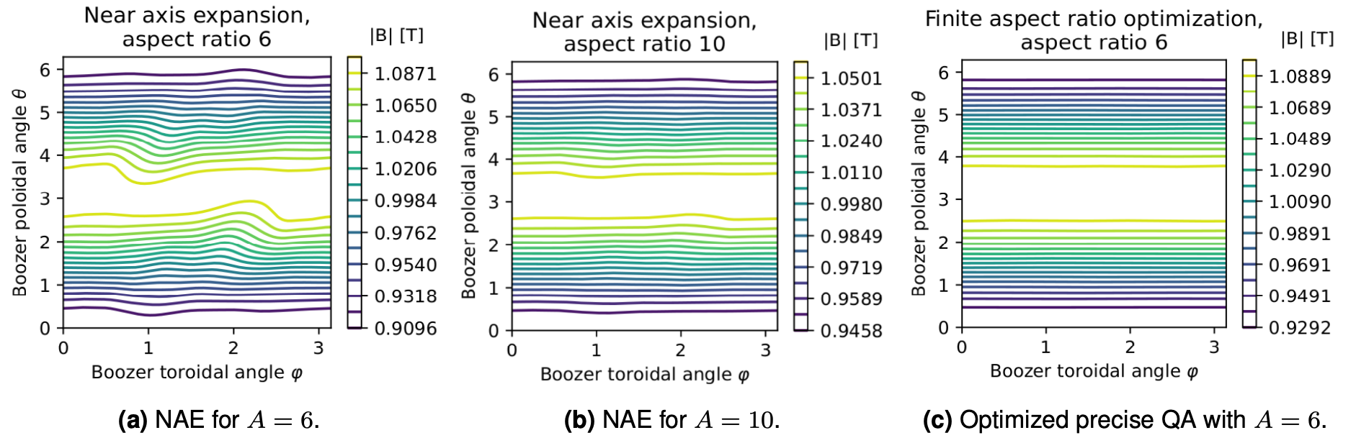
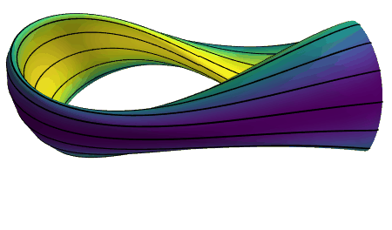
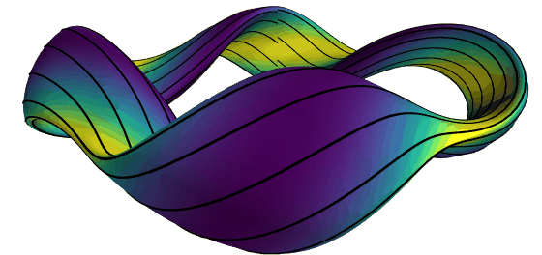
Motivation
How to guarantee alpha particle heating in stellarator reactors?
How to decrease first wall damage from unconfined particles?
- Particle confinement is usually considered the Achilles Heel of stellarators
- New proxies have changed this paradigm
- Analytical models (e.g., near-axis expansion) decrease degrees of freedom but have other tradeoffs
- The near-axis can also provide physical insight and guide future designs

Slide 3
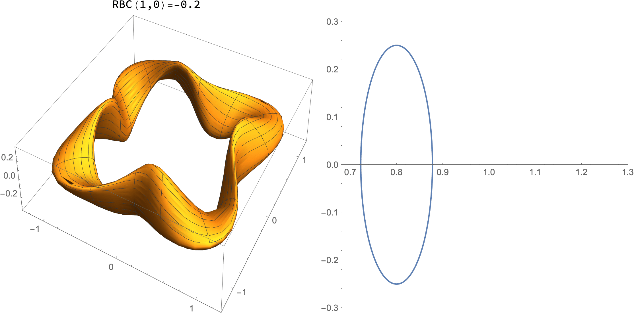
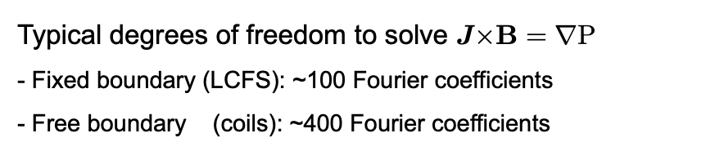
Goals
Obtain reactor relevant stellarator shapes in a reliable and efficient manner
Typical degrees of freedom to solve $J×B=∇P$
- Fixed boundary (LCFS): ~100 Fourier coefficients
- Free boundary (coils): ~400 Fourier coefficients
Near-axis (high aspect ratio) degrees of freedom
- Axis + 1st order + 2nd order: ~10 Fourier coefficients
Is this gain worth it?

Slide 4
Publications/Presentations
First Author | Initials | Title of work | Journal / Conference | Doc. Type | DOI or status of paper
Paulo Figueiredo | PF | Energetic Particle Tracing in Optimized Quasisymmetric Stellarator Equilibria | Journal of Plasma Physics | Paper | In revision, arXiv: 2311.07467
Rogerio Jorge | RJ | Single-Stage Stellarator Optimization: Combining Coils with Fixed Boundary Equilibria | Plasma Physics and Controlled Fusion | Paper | DOI: 10.1088/1361-6587/acd957
Rogerio Jorge | RJ | Direct Microstability Optimization of Stellarator Devices | Physical Review E | Paper | In revision, arXiv: 2301.09356
Paulo Figueiredo | PF | Direct Optimization for Enhanced Stellarator Design in Magnetic Confinement Fusion | Hidden Symmetries and Fusion Energy Annual Meeting 2023, March 23-24, Simons Foundation, New York City | Poster | N/A
Paulo Rodrigues | PR | gyronimo: an object-oriented library for gyromotion applications | 49th EPS Conference on Plasma Physics, July 2023, Bordeaux (Th-MCF23) | Poster | N/A
Rogerio Jorge | RJ | The direct construction of an exceptionally quasi-isodynamic stellarator | Joint Varenna-Lausanne International Workshop, September 2022, Italy | Invited Talk | N/A
Rogerio Jorge | RJ | Streamlined Stellarator Design: Single-Stage Optimization with Fixed Boundary Equilibria | 65th Annual Meeting of the APS Division of Plasma Physics, October 30–November 3, 2023; Denver, Colorado, USA | Invited Talk | N/A
Rogerio Jorge | RJ | Direct Optimization for Enhanced Stellarator Design in Magnetic Confinement Fusion | Hidden Symmetries and Fusion Energy Annual Meeting 2023, March 23-24, Simons Foundation, New York City | Invited Talk | N/A

Slide 5
EnR Task Specification
The project is divided into 5 different tasks (WP)
WP1 – Particle tracer code development (near-axis & full MHD)
WP2 – Combine particle tracer and stellarator optimization codes
WP3 – Optimized stellarator equilibria (QS, QI and General)
WP4 – Physics study of Nemov’s criterion
WP5 – Fast particle orbits in realistic magnetic fields
2022
2023
With the following goals
Create an open-source, user friendly, fully tested particle tracer (WP1, WP2)
Perform the first direct fast particle optimization of a stellarator (WP3)
Compare fast particle optimization with commonly used proxies (WP4)
Extend the optimization to stochastic magnetic fields (WP5)

Slide 6
EnR Task Specification
The project is divided into 5 different tasks (WP)
WP1 – Particle tracer code development (near-axis & full MHD)
WP2 – Combine particle tracer and stellarator optimization codes
WP3 – Optimized stellarator equilibria (QS, QI and General)
WP4 – Physics study of near-axis expansion and Nemov’s criterion
WP5 – Fast particle orbits in realistic magnetic fields
2022
2023
With the following goals
Create an open-source, user friendly, fully tested particle tracer (WP1, WP2)
Perform the first direct fast particle optimization of a stellarator (WP3)
Compare fast particle optimization with commonly used proxies (WP4)
Extend the optimization to stochastic magnetic fields (WP5)

Slide 7

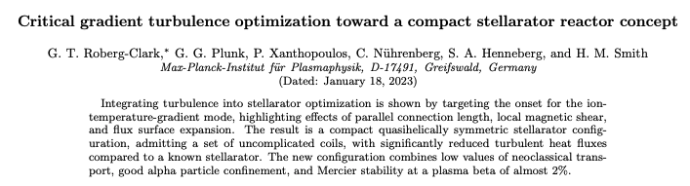
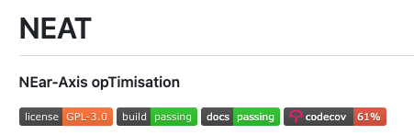
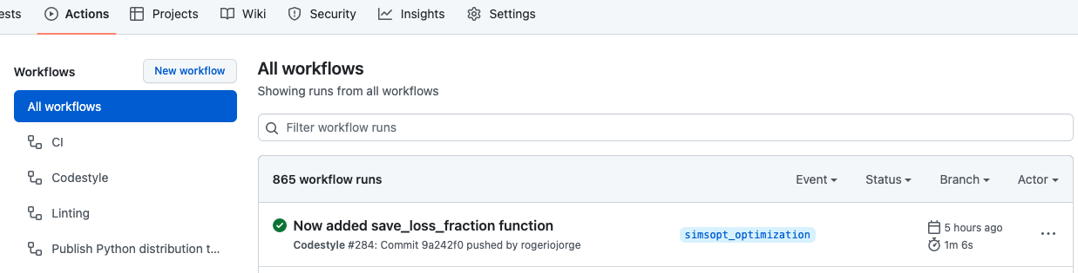


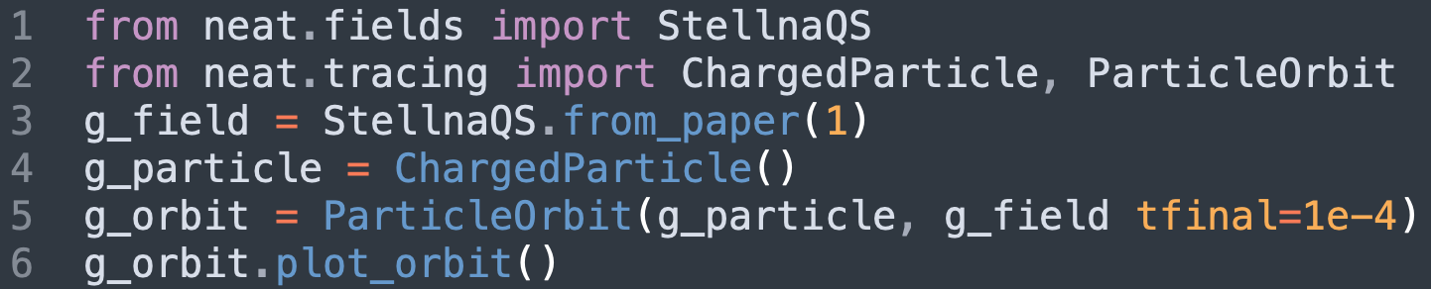

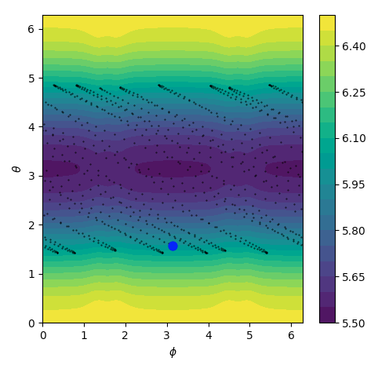

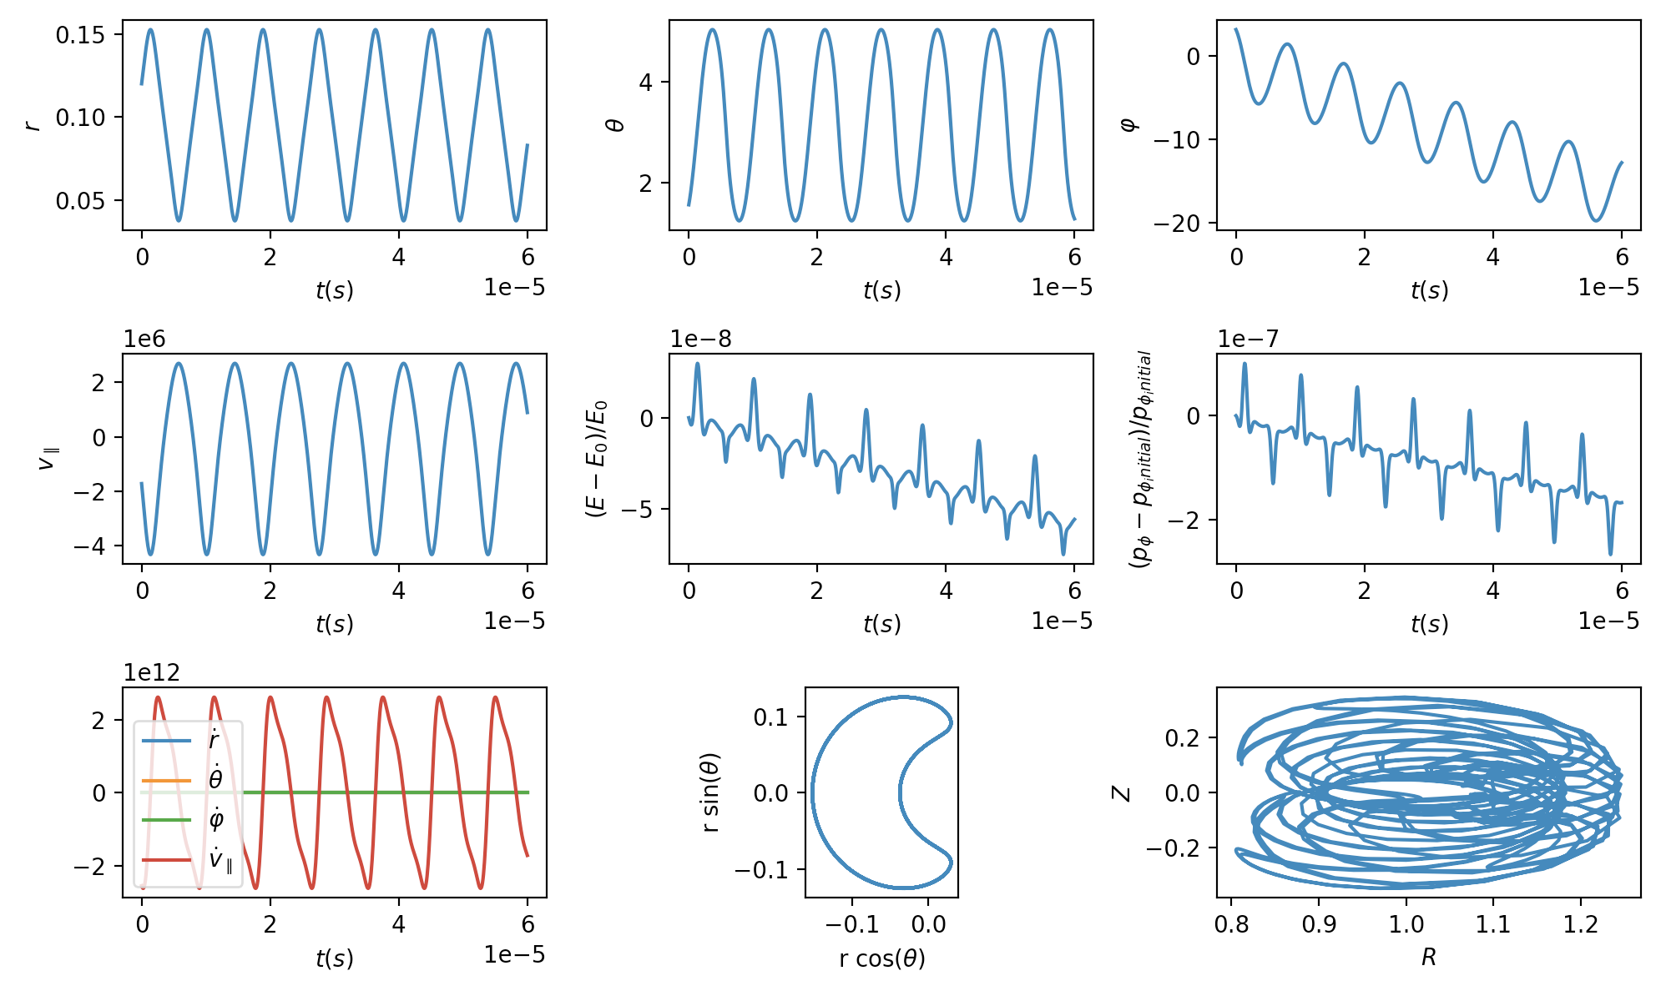
WP1
Development of the NEAT code
Near-Axis Geometry
Full MHD Geometry
Already being used by the stellarator optimization community
Open-source and automatic testing with GitHub actions
User-friendly example in near-axis geometry

Slide 8
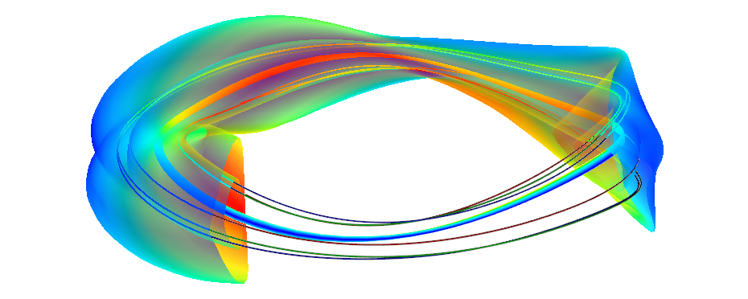
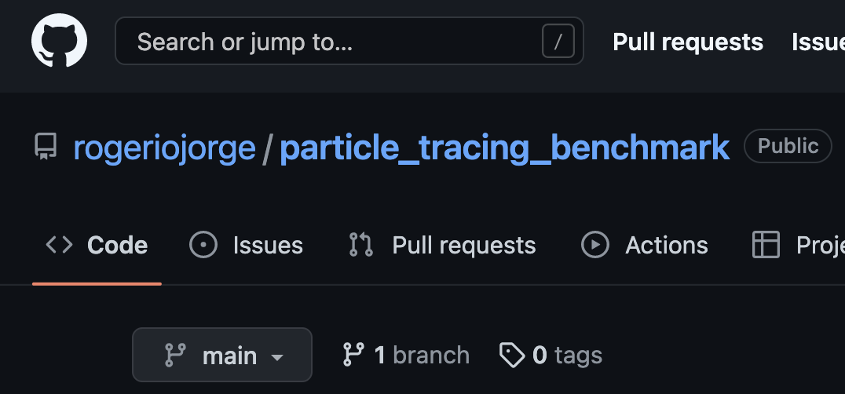
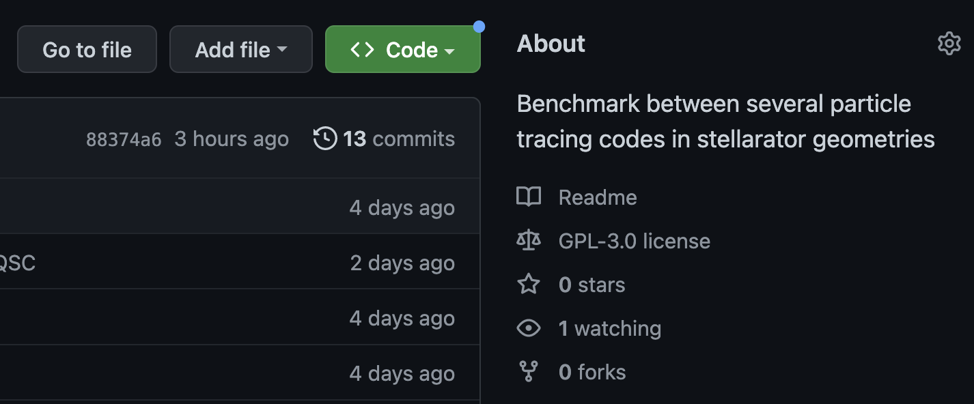
WP1
Characteristics of NEAT
Flexible geometries
VMEC output files
Near-axis analytical model
Near-axis quasisymmetry (exact/partial)
Dommaschk potentials (magnetic islands)
Multiple tracers
SIMPLE
gyronimo
SIMSOPT
BEAMS3D
Benchmark available on https://github.com/rogeriojorge/particle_tracing_benchmark
Particle in near-axis geometry
Plasma Boundary
Inner surface
SIMPLE (VMEC) particle tracer
Magnetic axis
Particle in VMEC geometry

Slide 9
EnR Task Specification
The project is divided into 5 different tasks (WP)
WP1 – Particle tracer code development (near-axis & full MHD)
WP2 – Combine particle tracer and stellarator optimization codes
WP3 – Optimized stellarator equilibria (QS, QI and General)
WP4 – Physics study of near-axis expansion and Nemov’s criterion
WP5 – Fast particle orbits in realistic magnetic fields
2022
2023
With the following goals
Create an open-source, user friendly, fully tested particle tracer (WP1, WP2)
Perform the first direct fast particle optimization of a stellarator (WP3)
Compare fast particle optimization with commonly used proxies (WP4)
Extend the optimization to stochastic magnetic fields (WP5)

Slide 10
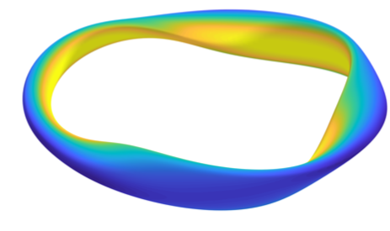
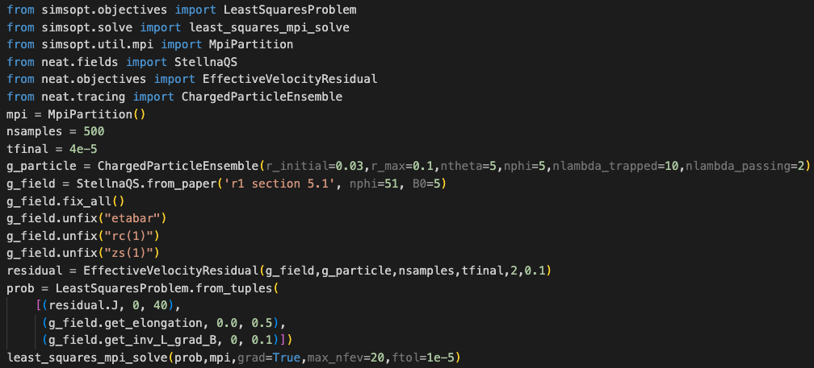
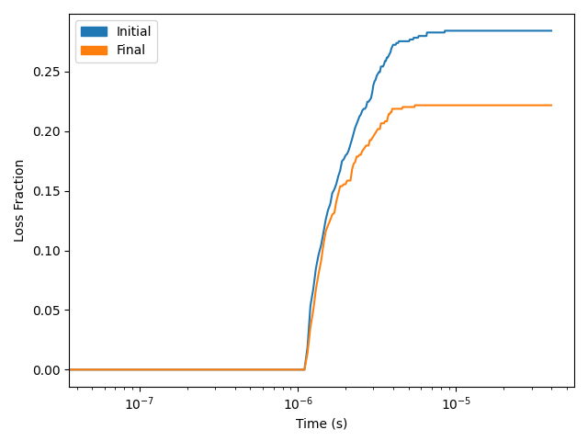
WP2 – Combine particle tracer and stellarator optimization codes
2. Integration with stellarator optimization frameworks (WP2)
scipy.optimize.minimize or SIMSOPT – near-axis
SIMSOPT - full MHD
DESC - full MHD (finalizing)
User-friendly example in near-axis geometry
Reduction in loss of alpha particles
Choose particle ensemble
Choose geometry
Choose degrees of freedom
Choose objective function
Optimize

Slide 11
EnR Task Specification
The project is divided into 5 different tasks (WP)
WP1 – Particle tracer code development (near-axis & full MHD)
WP2 – Combine particle tracer and stellarator optimization codes
WP3 – Optimized stellarator equilibria (QS, QI and General)
WP4 – Physics study of near-axis expansion and Nemov’s criterion
WP5 – Fast particle orbits in realistic magnetic fields
2022
2023
With the following goals
Create an open-source, user friendly, fully tested particle tracer (WP1, WP2)
Perform the first direct fast particle optimization of a stellarator (WP3)
Compare fast particle optimization with commonly used proxies (WP4)
Extend the optimization to stochastic magnetic fields (WP5)

Slide 12
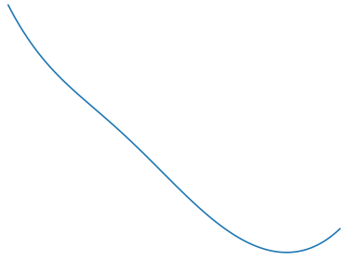
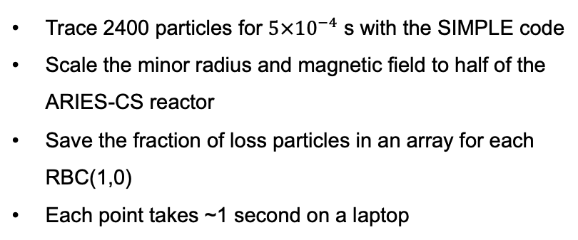
WP3 – Optimized stellarator equilibria
3. Optimized stellarator configurations (WP3)
Obtained Near-Axis Optimizations (previous slide)
Obtained full MHD Optimizations
Minimal benchmark problem
Local minimization methods not able to find the global minimum
Trace 2400 particles for $5×{10}^{−4}$ s with the SIMPLE code
Scale the minor radius and magnetic field to half of the ARIES-CS reactor
Save the fraction of loss particles in an array for each RBC(1,0)
Each point takes ~1 second on a laptop
Choose particle ensemble
Choose geometry
Quasisymmetry
Choose degrees of freedom
Choose objective function
Optimize

Slide 13
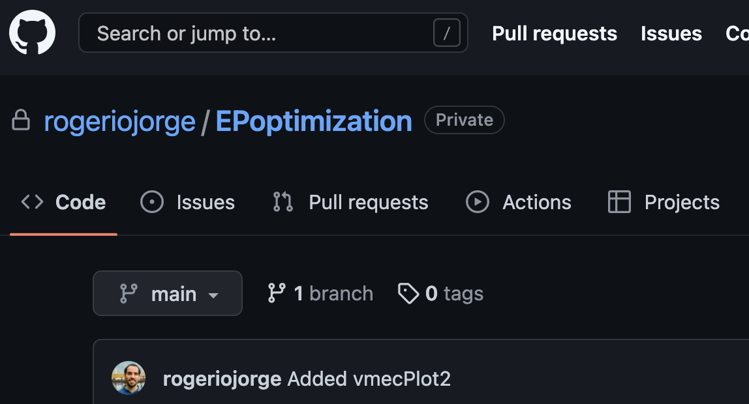
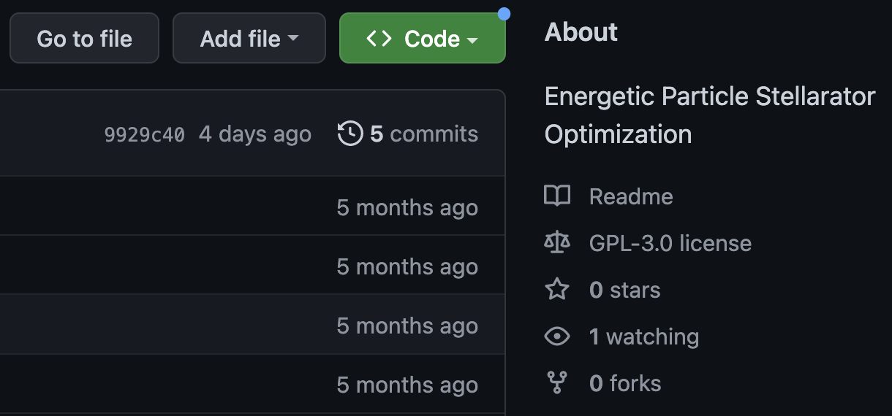

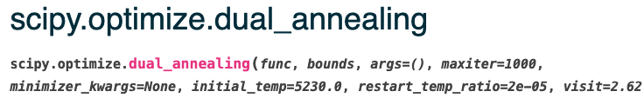
WP3 – Optimized stellarator equilibria
Scripts available on https://github.com/rogeriojorge/EPoptimization
3. Optimized stellarator configurations (WP3)
Obtained Near-Axis Optimizations (previous slide)
Obtained full MHD Optimizations
Stochastic optimization – generalized dual annealing
Optimization
Choose geometry
The optimizer found a quasi-isodynamic stellarator
Choose degrees of freedom
Optimized solution
(2.5% losses)
Number of iterations
Found a robust solution
Choose objective function
Initial condition (100% losses)
Optimize

Slide 14
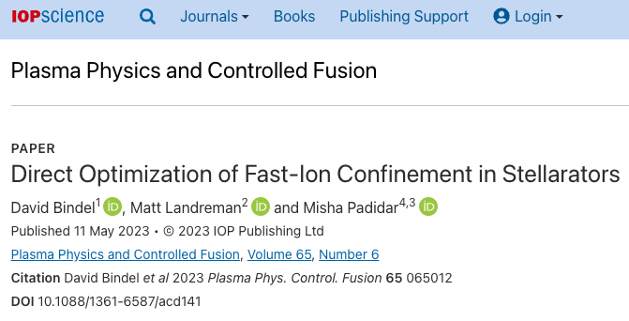
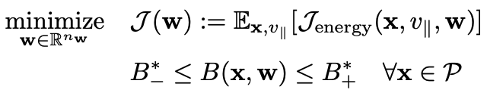
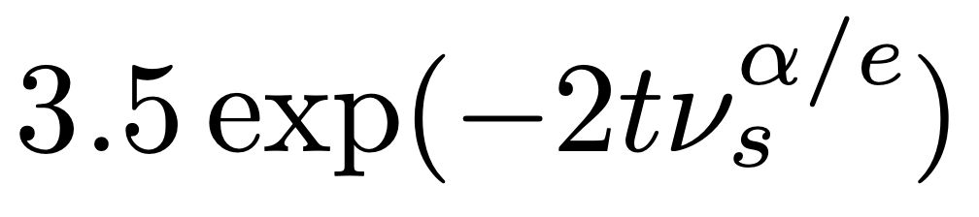

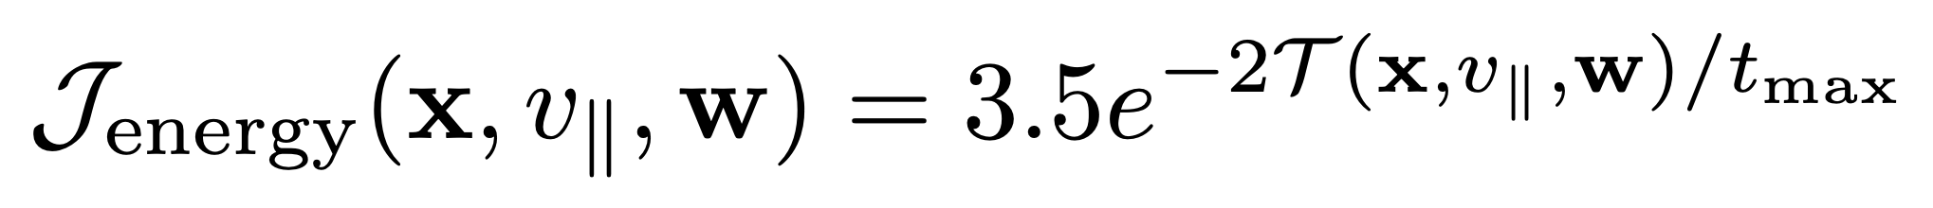
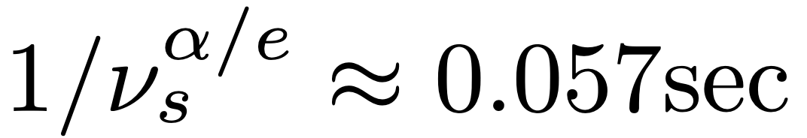
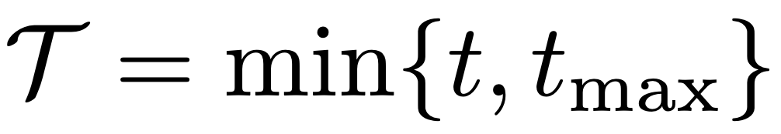
WP3 – Optimized stellarator equilibria
Similar study published in 2023
Restrict mirror ratio
Radial birth distribution of particles
Particles uniformly distributed over flux surfaces
Choose geometry
Obtained using a fit to 200 000 tracings
Particle tracing simulations with collisions using the ANTS code
Energy loss model
Choose objective function
Optimize

Slide 15
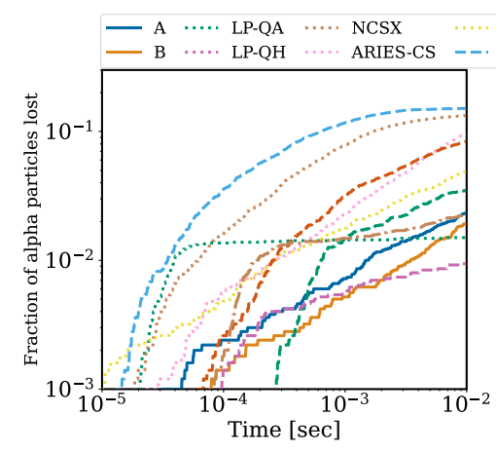
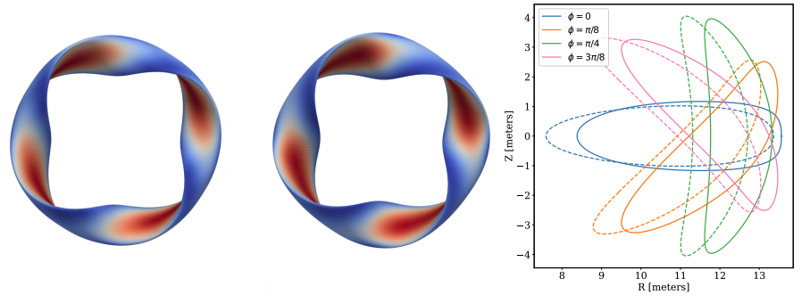
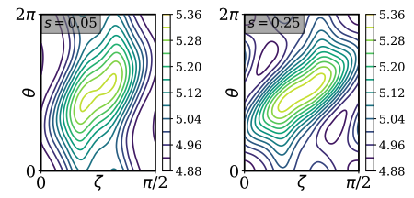
WP3 – Optimized stellarator equilibria
Similar study published in 2023
Restrict mirror ratio
Resulting stellarators far from omnigenity
Choose geometry
Choose objective function
Optimize

Slide 16
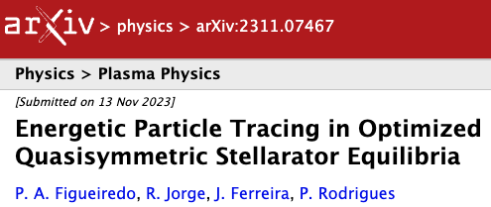
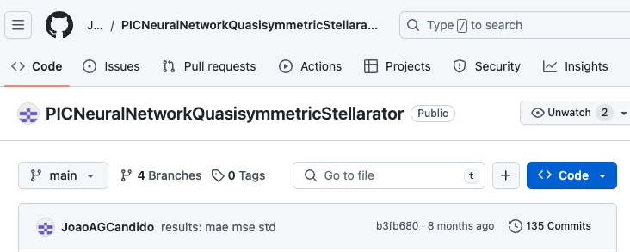
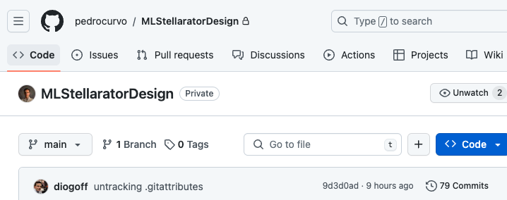
WP3 – Optimized stellarator equilibria
Focus on the near-axis expansion
Viability of near-axis solutions as good initial conditions for full MHD designs
P. A. Figueiredo et al, submitted to JPP
Near-axis database and machine learning model
J. Candido, Undergraduate Thesis (2022/2023)
P. Curvo, Undergraduate Thesis (2023/2024)

Slide 17
WP3 – Optimized stellarator equilibria
Focus on the near-axis expansion
Viability of near-axis solutions as good initial conditions for full MHD designs
P. A. Figueiredo et al, submitted to JPP
Create near-axis plasma boundaries and export them to VMEC.
Compare (R, Z) values of a near-axis vs. VMEC point
Choose geometry
Choose degrees of freedom
Choose objective function
Optimize

Slide 18
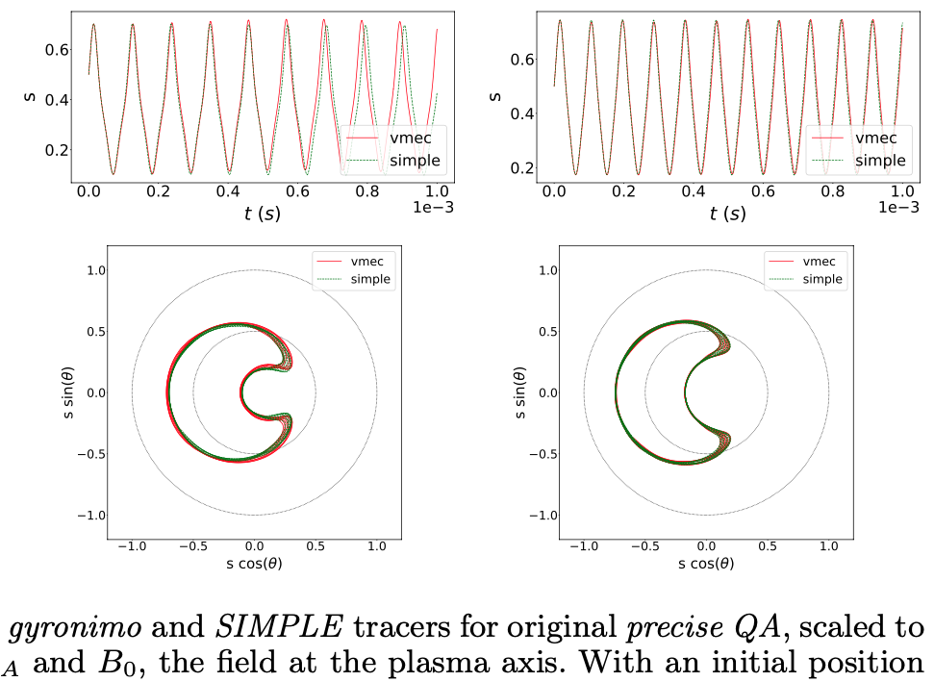
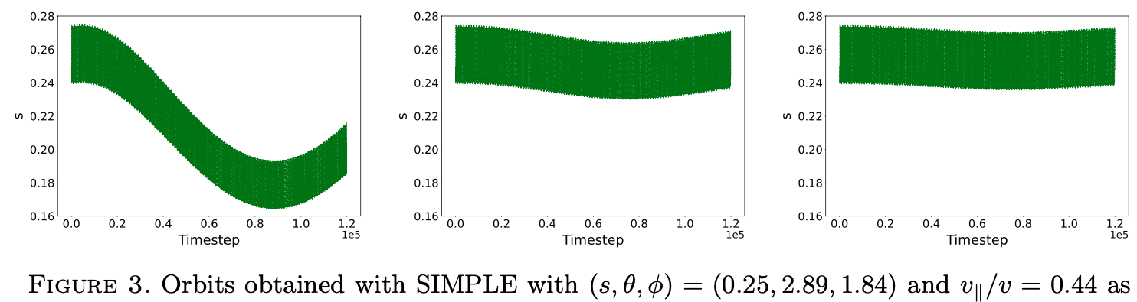
WP3 – Optimized stellarator equilibria
Focus on the near-axis expansion
Viability of near-axis solutions as good initial conditions for full MHD designs
P. A. Figueiredo et al, submitted to JPP
Use NEAT to benchmark codes

Slide 19
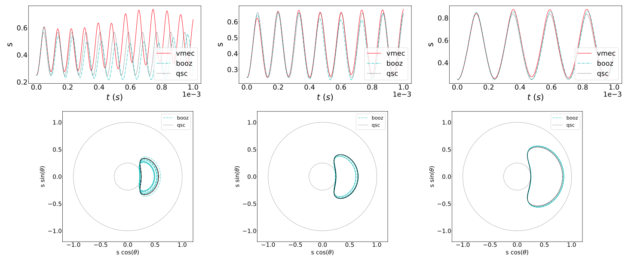
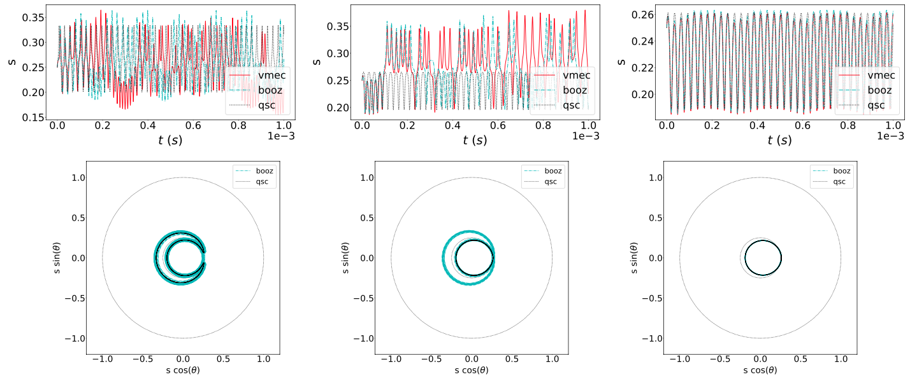
WP3 – Optimized stellarator equilibria
Focus on the near-axis expansion
Viability of near-axis solutions as good initial conditions for full MHD designs
P. A. Figueiredo et al, submitted to JPP
Use NEAT to benchmark codes
Compare near-axis vs. full MHD orbits
Quasi-Axisymmetry
Quasi-Helical Symmetry

Slide 20
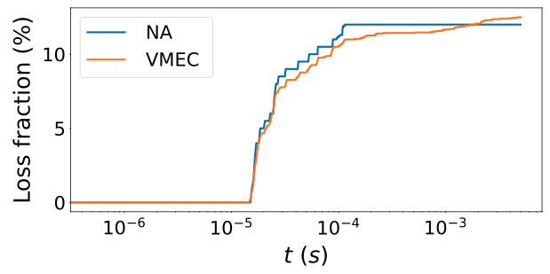
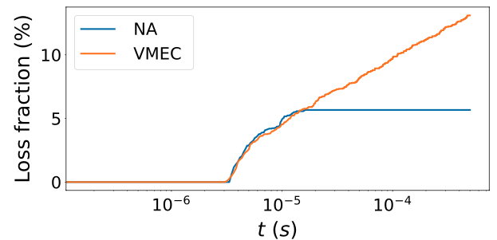
WP3 – Optimized stellarator equilibria
Focus on the near-axis expansion
Viability of near-axis solutions as good initial conditions for full MHD designs
P. A. Figueiredo et al, submitted to JPP
Use NEAT to benchmark codes
Compare near-axis vs. full MHD orbits
Compare near-axis vs full MHD loss fractions
Quasi-Axisymmetry
Quasi-Helical Symmetry

Slide 21
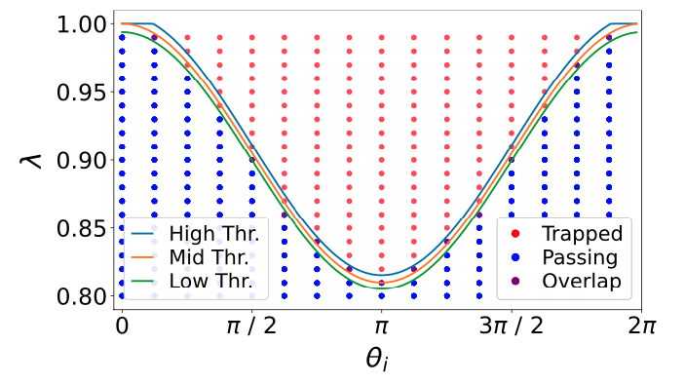
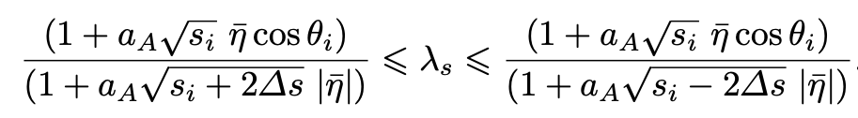
WP3 – Optimized stellarator equilibria
Focus on the near-axis expansion
Viability of near-axis solutions as good initial conditions for full MHD designs
P. A. Figueiredo et al, submitted to JPP
Use NEAT to benchmark codes
Compare near-axis vs. full MHD orbits
Compare near-axis vs full MHD loss fractions
Obtain analytical formulas for the trapped-passing boundary and banana width using near-axis expansion

Slide 22
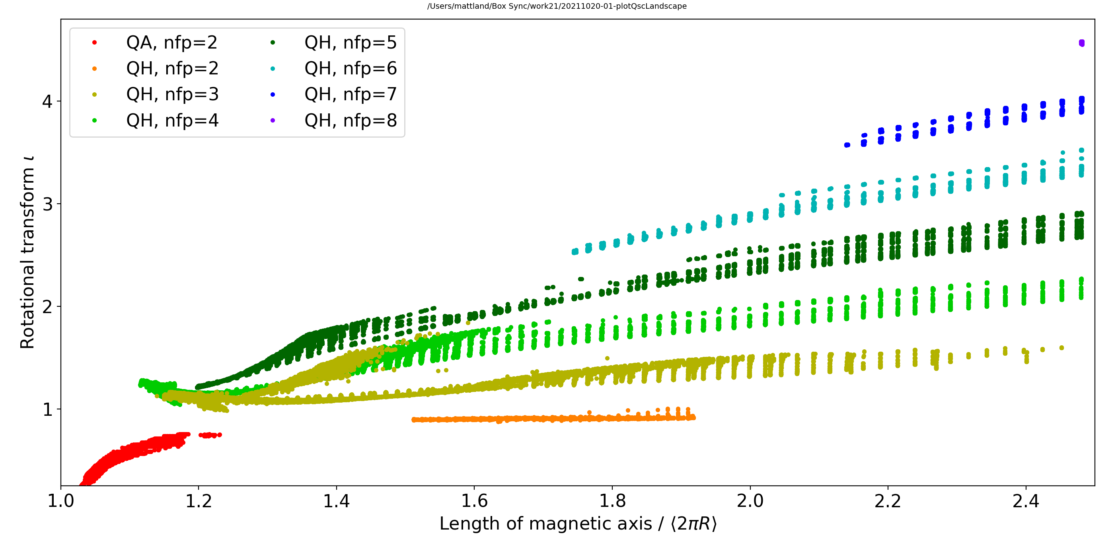
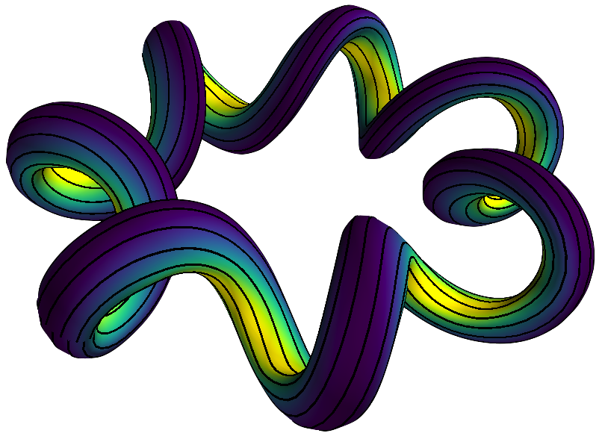
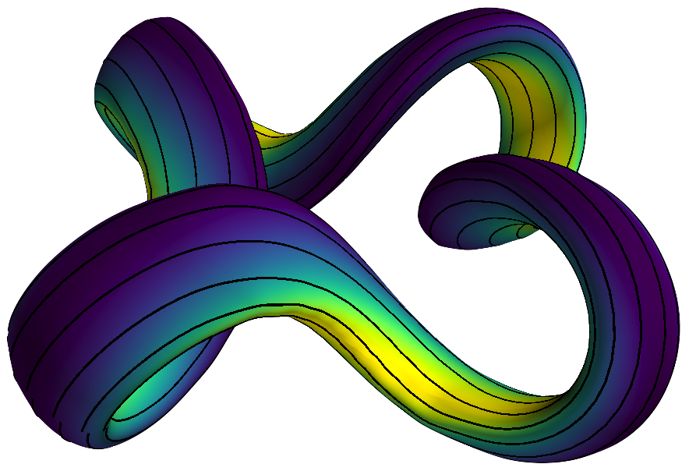
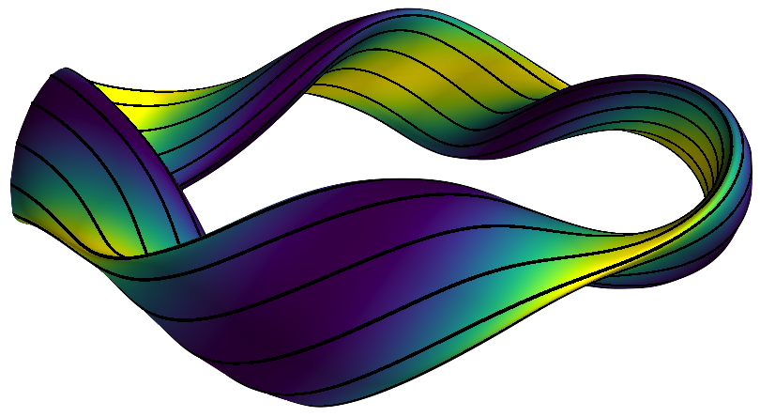
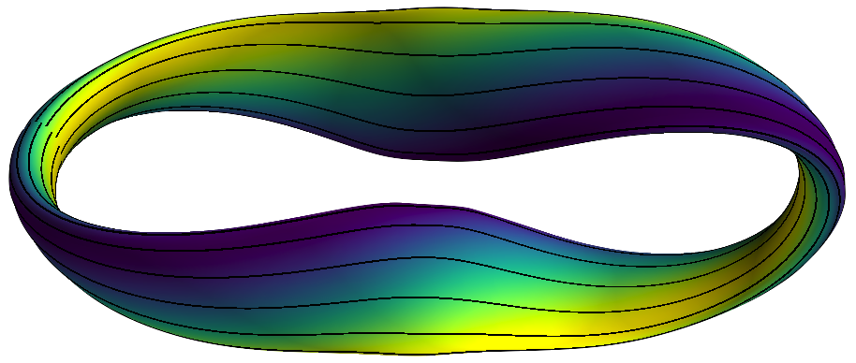

WP3 – Optimized stellarator equilibria
Focus on the near-axis expansion
Near-axis database and machine learning model
J. Candido, Undergraduate Thesis (2022/2023)
P. Curvo, Undergraduate Thesis (2023/2024)
M. Landreman, Journal of Plasma Physics, Volume 88, Issue 6, December 2022, 905880616
Create a near-axis database similar to

Slide 23


WP3 – Optimized stellarator equilibria
Focus on the near-axis expansion
Near-axis database and machine learning model
J. Candido, Undergraduate Thesis (2022/2023)
P. Curvo, Undergraduate Thesis (2023/2024)
M. Landreman, Journal of Plasma Physics, Volume 88, Issue 6, December 2022, 905880616
Create a near-axis database similar to
Experiment with data-reduction and clustering methods (e.g., find division between QA and QH)

Slide 24


WP3 – Optimized stellarator equilibria
Focus on the near-axis expansion
Near-axis database and machine learning model
J. Candido, Undergraduate Thesis (2022/2023)
P. Curvo, Undergraduate Thesis (2023/2024)
M. Landreman, Journal of Plasma Physics, Volume 88, Issue 6, December 2022, 905880616
Create a near-axis database similar to
Experiment with data-reduction and clustering methods (e.g., find division between QA and QH)
Train neural network to reproduce forward and inverse solutions
alpha = 7.91e- 05, batch_size = 87, hidden_layer_sizes = [45, 45, 45, 45], learning_rate_init = 9.3 × 10⁻⁴
Forward model (easy to reproduce)
Inverse model (hard to reproduce)
“Given an elongation, $ι$ and elongation, what are its near-axis parameters?”
Linear Regressor
Polynomial Regressor
Neural Network

Slide 25
EnR Task Specification
The project is divided into 5 different tasks (WP)
WP1 – Particle tracer code development (near-axis & full MHD)
WP2 – Combine particle tracer and stellarator optimization codes
WP3 – Optimized stellarator equilibria (QS, QI and General)
WP4 – Physics study of near-axis expansion and Nemov’s criterion
WP5 – Fast particle orbits in realistic magnetic fields
2022
2023
With the following goals
Create an open-source, user friendly, fully tested particle tracer (WP1, WP2)
Perform the first direct fast particle optimization of a stellarator (WP3)
Compare fast particle optimization with commonly used proxies (WP4)
Extend the optimization to stochastic magnetic fields (WP5)

Slide 26




Physics study of Nemov’s criterion
Nemov $Γ_{c}$ - minimize radial drift of trapped orbits
V_{r} - bounce average radial drift $∂J/∂α$
V_{𝜽} - bounce average poloidal drift $∂J/∂α$
$J=$ $\int_{bounce}{\sqrt{1−\frac{\left|B\right|}{b^{′}}}dl}$ - adiabatic invariant
Calculate $J$ at each surface and normalized magnetic moment b’=1/$λ$ by bounce averaging
Higher resolution and longer field lines create discontinuities between wells leading to noise
Many turning points on unoptimized stellarators make calculation very complex
Calculation of $Γ_{c}$ implemented but noise hinders optimization efforts
(R. Coelho, J. Rodrigues)

Slide 27
EnR Task Specification
The project is divided into 5 different tasks (WP)
WP1 – Particle tracer code development (near-axis & full MHD)
WP2 – Combine particle tracer and stellarator optimization codes
WP3 – Optimized stellarator equilibria (QS, QI and General)
WP4 – Physics study of near-axis expansion and Nemov’s criterion
WP5 – Fast particle orbits in realistic magnetic fields
2022
2023
With the following goals
Create an open-source, user friendly, fully tested particle tracer (WP1, WP2)
Perform the first direct fast particle optimization of a stellarator (WP3)
Compare fast particle optimization with commonly used proxies (WP4)
Extend the optimization to stochastic magnetic fields (WP5)

Slide 28




WP5 – Fast particle orbits in realistic magnetic fields
Implementation of particle tracing on DESC (collaboration with PPPL)
Summer 2023 visit of João Biu to Princeton
Particle tracing now implemented in DESC
DESC uses automatic differentiation
Study of direct particle tracing using automatic differentiation underway
Starting Equilibrium
Optimized Equilibrium
Particle drifting from flux surface ψ
Particle confined in flux surface ψ

Slide 29

WP5 – Fast particle orbits in realistic magnetic fields
Implementation of particle tracing on DESC (collaboration with PPPL)
Added particle tracing in Biot-Savart fields from coils
Coil optimization with complex vacuum fields currently underway
Integration with NEAT framework currently underway
Trapped particle orbit in HSX-like coils

Slide 30






WP5 – Fast particle orbits in realistic magnetic fields
Dommaschk potentials (analytical B field in NEAT)
M. Pereira, Undergraduate Thesis (2022/2023)
Passing particles traced in such a field
Poincaré plot of Dommaschk magnetic field
Analysis of trapped trajectories currently underway

Slide 31
End
Choose geometry
Choose degrees of freedom
Choose objective function
Optimize

