Slide 1





AMU/CEA 2023 Report
& 2024 work
Y. Marandet, P. Genesio

Slide 2
Parallelization of the rate coefficient calculation
in preparation for the use of CRM models, needed to reduce « overhead » time (preparation of MC calculation in the main loop)
2023 : debugging and testing, progress slow (working on reorganisation of tasks)
branch parallel_ColRad_WIP
next steps
Decide on control switches for the user (based on scalings, …)
Merge into EIRENE unified
OpenMP layer for ‘consistency’ with the MC loop (on low level loops)

Slide 3
Interface to TSVV3
Major upgrade of SOLEDGE3X interface in 2023 (styx2.0; N. Rivals)
‘decouple’ interface from EIRENE and move to MsV
Improvement of neutral models in SOLEDGE3X ongoing (following TSSV5 work by Horsten et al., PhD V. Quadri, invited@PET 2023)
V. Quadri, P. Tamain, Y. Marandet et al., Contrib. Plasma. Phys. 2024
Reintegration of hybrid models making use of TSVV5 work, and 1 publication foreseen concluding M. Valentinuzzi’s work (exploiting N. Rivals’ ITER simulations and enabling further computing time improvements)
Intership started early 2024

Slide 4
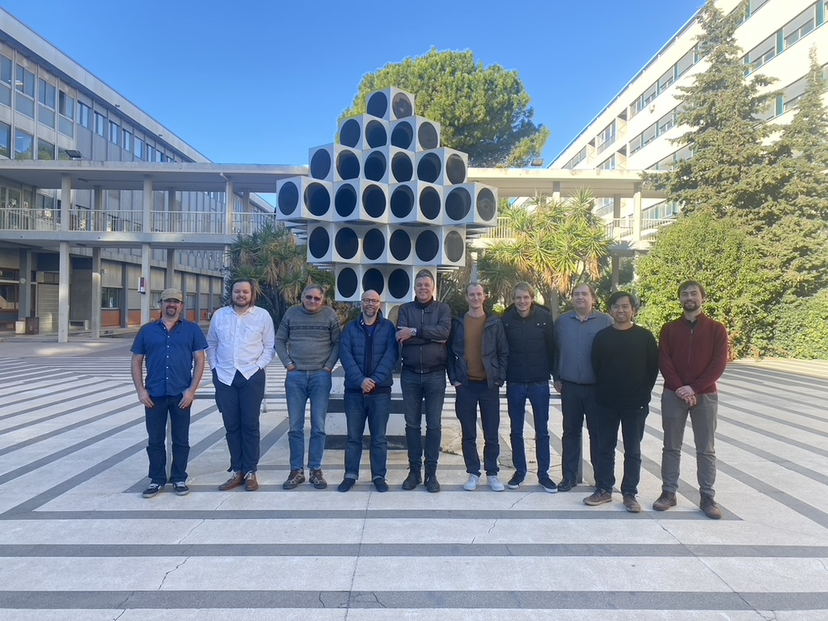
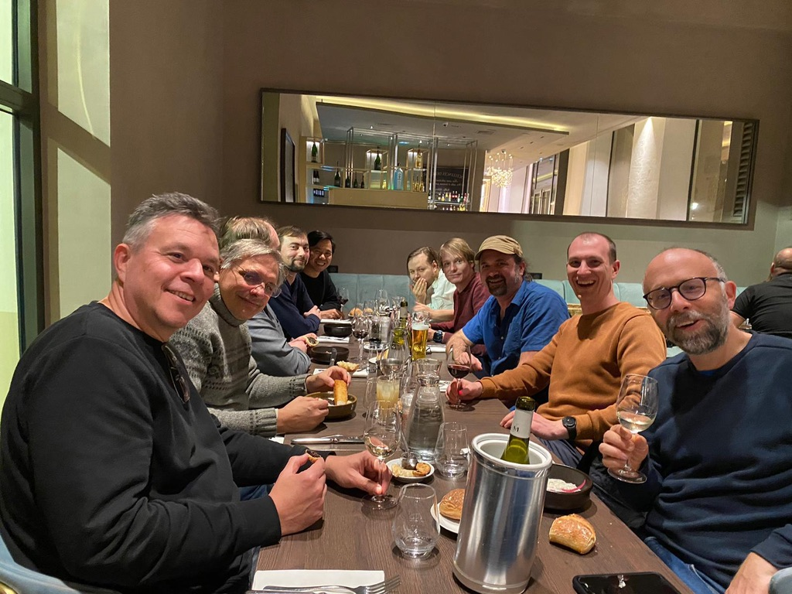
Organization of the 2023 code camp

Slide 5
TBD 2024
Contributions to EIRENE refactoring
Fix issues identified in the parallelisation
Make sure CRM parallelisation is merged to the develop branch
Revise folneut along the lines proposed (case select) starting from the EIRENE_unified branch (timing w.r.t. free format conversion ?)
Extend to folion, …

