Slide 1
TSVV Task 5: “Neutral Gas Dynamics in the Edge” 12.09.2023
Mid-term review for E-TASC SB
D. Borodin et al.

Slide 2
TSVV-5: Neutral Gas Dynamics in the Edge
Main simulation tool:
EIRENE code (and EIRENE-CFD packages) http://www.eirene.de/
We aim to transform it to IM- and HPC-ready neutral gas module (EIRENE-NGM) suitable for simulations on ITER and DEMO scale with large focus on (semi)detached divertor plasmas
FP-9 deliverables:
Neutral gas code that allows for an efficient use of HPC resources (towards exascale systems and/or HPC booster techniques) through suitable parallelization methods.
Revised and extended physics basis for the neutral gas model. Further development of the underlying collision-radiative model towards the full vibrational resolution for all hydrogen isotopes and specific impurities for seeding.
Improved (in contents and structure) Atomic and Molecular database for volumetric and surface processes. Database access through generalized interfaces to, e.g., atomic, molecular, nuclear and surface (AMNS) physics data.
Interfaces and boundary conditions necessary for future applications; modularization of the neutral gas code to facilitate coupling to computation fluid dynamics (CFD) codes (2D or 3D codes, turbulence codes, time-dependent) and possibly also to gyro-kinetic/gyrofluid plasma codes.
Strategy towards a validated predictive capability for integrated fusion reactor modelling for (semi-)detached divertor plasmas. Liaison with TSVV Tasks 3 and 4.
Neutral gas code that allows for an efficient use of HPC resources (towards exascale systems and/or HPC booster techniques) through suitable parallelization methods.
Revised and extended physics basis for the neutral gas model. Further development of the underlying collision-radiative model towards the full vibrational resolution for all hydrogen isotopes and specific impurities for seeding.
Improved (in contents and structure) Atomic and Molecular database for volumetric and surface processes. Database access through generalized interfaces to, e.g., atomic, molecular, nuclear and surface (AMNS) physics data.
Interfaces and boundary conditions necessary for future applications; modularization of the neutral gas code to facilitate coupling to computation fluid dynamics (CFD) codes (2D or 3D codes, turbulence codes, time-dependent) and possibly also to gyro-kinetic/gyrofluid plasma codes.
Strategy towards a validated predictive capability for integrated fusion reactor modelling for (semi-)detached divertor plasmas. Liaison with TSVV Tasks 3 and 4.
Code performance, parallelization, refactoring, domain decomposition, I/O for HPC, …
Fluid-kinetic hybridisation (FKH) and improved CRMs
physics
Improved AMNS data, both in structure/physics and content
EIRENE as NGM – restructuring, interfaces to other codes, time-dependent runs, kinetic ions
Validation with experiments and test of predictive capabilities for ITER and DEMO

Slide 3
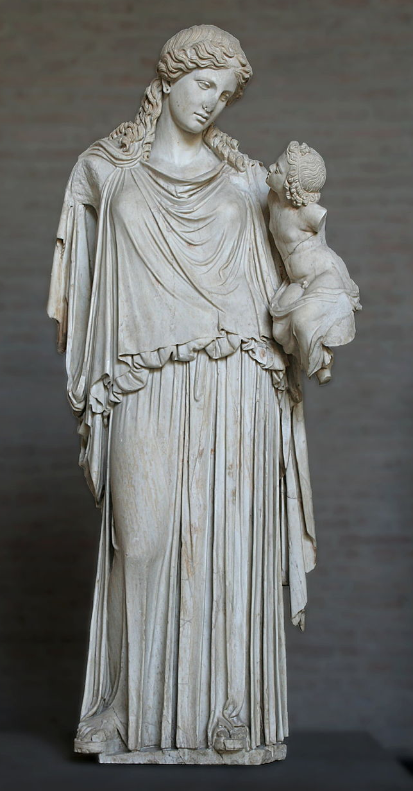
EIRENE-NGM-DEVELOPERS (TSVV-5)
D.V. BORODIN, F. Cianfrani, S. Wiesen, D. Harting, P.Börner, B.Küppers
Forschungszentrum Jülich, Institut für Energie- und Klimaforschung – Plasmaphysik, Germany
W. DEKEYSER, S. CARLI, M. BLOMMAERT, N. HORSTEN, W. VAN UYTVEN, M. BAELMANS
KU Leuven, Department of Mechanical Engineering, Belgium
B. MORTIER, G. SAMAEY, E. LOEVBACK (with ACH-MPG)
KU Leuven, Department of Computer Science, Belgium
Y. Marandet, P. Genesio
Aix-Marseille Univ., France
H. Bufferand
CEA, IRFM, France
E. WESTERHOF, J.G. MUNOZ, P.W. GROEN
DIFFER - Dutch Institute for Fundamental Energy Research,
Eindhoven, the Netherlands
M. GROTH, A. HOLM , A.CHanDRA
Department of Applied Physics, Aalto University,
Espoo, Finland
ACH-VTT:
O.LaPPI
F. Granberg J. Åström
ACH-IPPLM:
D.Yadykin
Yu.Yakovenko
ACH-MPG:
H.LEGGate
Eirene with the infant Ploutos
ITER Organisation:
X.Bonnin

Slide 4
TSVV-5: IMS WP for 2021
A dedicated event similar to a code camp for a short circle of the involved developers is necessary to start over with the code leaning. The concerting including selection of particular coding techniques, code reorganization schemes etc will begin already by the preparation of this event and will continue after it with application to a single case to be selected.
The structured list of the "portfolio" cases is already developed as a draft to be reviewed and finalized by the task members during the year. We expect the ACH D to provide assistance in organising the commonly accessible and linkable to HPC resources catalogue of the simulations (e.g. EUDAT-based).
The FEM FW model should be coded and tested by first application to a selected MAGNUM-PSI experiment.
Also establishing the work on the CRM improvement and FKH is expected: definition of the related simulation cases, incorporating new data formats and parameters for CRMs, agreeing on “test bed” cases for FKH approaches etc. This needs status review at regular task meetings.
Assessment of fundamental data (cross-sections and rates) in AMJUEL (AMJUEL, HYDHEL, H2VIBR) against fundamental data used by and derived from other CRMs (e.g., YACORA) using slab models will take place. Development/exploitation of CRM post-processing tools for comparison to JET and MAGNUM-PSI experimental data (e.g., Fulcher band measurements). Assessment of availability of fundamental data for hydrogen isotopes and compare cross-sections and rates.
Code Camp 2021
TSVV-5 requirements and focus group are clear . . .
Ploutos web-based tool

Slide 5
TSVV-5: IMS WP for 2022
Theory/algorithmic development work on FKH combined with application to verification (mostly slab) cases: generalization AFN model for drifts and n-n collisions; Overview and assessment of techniques to reduce bias, cancellation and modelling errors; etc.
Coding and data management effort on CRMs: new molecular data formats (e.g. ADAS “mdf”) and recent RMPS or CCC data including for various H/D/T isotopes; move on using the IMAS; compile ITER/DEMO-relevant data. A contact with data providing groups for instance through the framework provided by the IAEA A&M data unit (GNAMPP).
Code reorganisation: test correctness of the “starter-core” modular EIRENE-NGM version for various geometries. Continue applying the modulated version to further CI and “portfolio” cases, provide necessary bug fixes and code generalisations.
Start over with HPC-related optimisation for the core (load balancing schemes, domain decomposition etc). Some ACH support is expected in particular for HPC code-performance optimisation.
Execute SOLPS-ITER with vibrationally excited hydrogen molecules for and assess their impact on the state of the divertor plasma (JET L-mode). Assess impact of hydrogen isotopes on state of divertor plasma. Utilise CRM post-processors to predict spectroscopic signature of molecules (Fulcher band), for hydrogen, deuterium and tritium.
Assess state of photon tracing model in current EIRENE version, reactivate photon tracing model in standalone EIRENE simulations, execute simple test runs (slab) and actual tokamak geometries (JET).
Goals redefined
EIRON
toy-model

Slide 6
SB Reaction on Mid-term report
“TSVV-05 is well on track to meeting its goals. The project has achieved good integration between the efforts at FZJ, KUL, AMU/CEA, DIFFER, and Aalto. The SB is pleased . . .”
The SB endorses the choice of TSVV-05 to concentrate the CRM developments on an otherwise much simplified stand-alone code, PLOUTOS (successor to HydKin).
Another stand-alone simplified code EIRON was developed in the TSVV for testing CPU loading and domain decomposition approaches and the SB appreciates the need for this.
The SB recommends to the TSVV-05 team to specify in their next report (expected in January 2024) in more detail with respect to physics content and code structure their priorities towards a EUROfusion standard EIRENE-NGM. The SB strongly endorses the objective to develop and release such a high quality standard NGM for the EUROfusion community, even as this standardised module will undergo further development in the physics areas of FKH, CRM, and radiation transport.
With respect to the physics developments the SB recommends further validation activities assessing the importance of these effects as seen in the EIRENE implementation. Data for validation may come from tokamaks through collaboration with TSVV-04, TSVV-06, and TSVV-07, and also from PSI-2, in additional to data from MAGNUM-PSI already used in the project.

Slide 7
Unfinished technical tasks
EPL: good acceptance in the community, lots of registered BDs and institutions.
ITER is still not officially in agreement.
SimDB (based on UAL): IT group in FZJ contacted, issue ticket raised – processing ongoing.
AMNS discussion (D.Coster, TSVVs 7, 3, 11, … ) – endorsed by other TSVVs, but still not scheduled.
MsV release: still stumbling…

Slide 8
Thanks for the attention!

