Slide 1
SPX.1 D002 Planning 2024 OES results H/H₂, ne, Te and 2D distribution in JULE-PSI . VIS molecular and atomic spectroscopy in PSI-2 under ionising and recombining plasmas (FZJ)
M. Reinhart, R. Rayaprolu, G. Sergienko

Slide 2
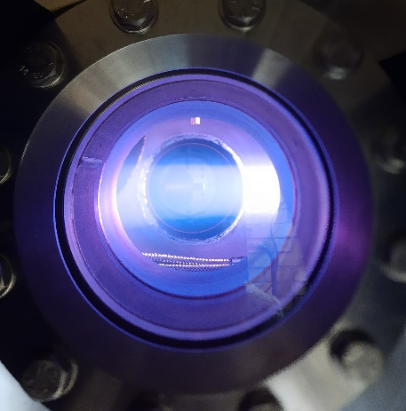
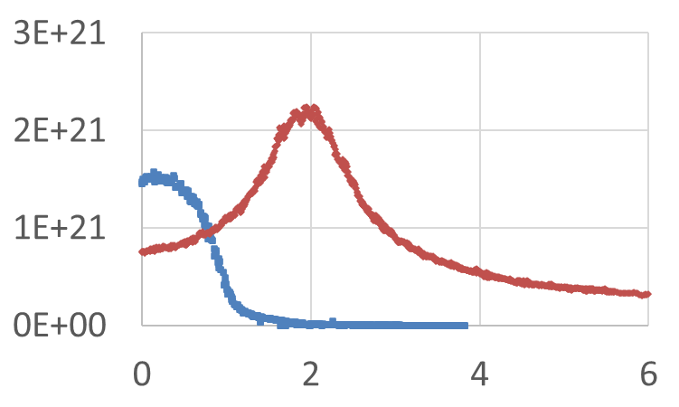
OES results H/H₂, ne, Te and 2D distribution in JULE-PSI
Status:
Langmuir Probe, Optical Emission Spectroscopy and Hyperspectral Camera available and running
Results for Neon and Argon Plasma available
No permission yet for hydrogen operation in the building/hall
OES results H/H₂, ne, Te and 2D distribution in JULE-PSI
JULE-PSI
PSI-2
Available/ready
Not ready
Ion flux [m⁻²s⁻¹] vs plasma
radius [cm]

Slide 3
OES results H/H₂, ne, Te and 2D distribution in JULE-PSI
Plans for 2024:
Installation of new plasma source with improved cooling for steady-state operation: Ongoing
Acquiring permission for hydrogen operation: Ongoing
H/H2 results: only after permission
Achieving deliverable depends on Acquiring permission for hydrogen operation. If hydrogen operation not possible until the end of the year, resources need to be redistributed to other tasks in WPPWIE.
Forseen resources:
Human resources: 2 PM
JULE-PSI operation: 5 days
JULE-PSI
PSI-2
Ion flux [m⁻²s⁻¹] vs plasma
radius [cm]

Slide 4
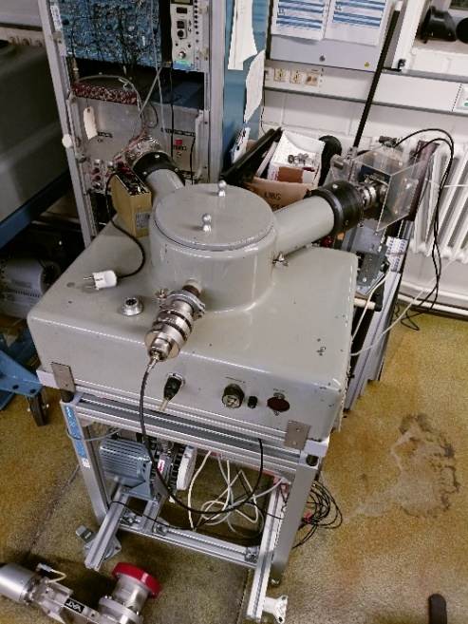
VUV passive spectroscopy on H/H₂ and isotopes in MAGNUM-PSI/UPP/PSI-2
Status:
Seya-Namioka Vacuum Monochromator with 500 mm focal length available but not running and not installed at PSI-2
Plans for 2024:
Test operation outside of PSI-2: Ongoing
Installation of VUV Spectrometer at PSI-2: In planning
Results on H/H2 and isotopes: Only after installation
Achieving deliverable depends on installation at PSI-2. If installation not possible until the end of the year, resources need to be redistributed to other tasks in WPPWIE.
Forseen resources: Human resources: 2 PM, PSI-2 operation: 10 days (shared with VIS spectroscopy)

Slide 5
VIS molecular and atomic spectroscopy in PSI-2 under ionising and recombining plasmas (FZJ)
Status:
Acton Spectrograph 750nm + Newton EMCCD camera (1600x400 px) available for 2D measurements (radial resolution)
Recombining plasmas available at PSI-2 by gas-puffing in the exposition zone
Similar studies have already been done/started 12 years ago (A. Pospieszczyk, U. Fantz, M. Reinhart, et al. „Spectroscopic characterisation of the PSI-2 plasma in the ionising and recombining state”):
Plans for 2024:
After input on requested spectral lines (370-1200 nm), everything is ready and availablefor experiments at PSI-2
Forseen resources: Human resources: 2 PM, PSI-2 operation: 10 days (shared with VUV spectroscopy)
Spectra of the Balmer series at a neutral pressure of 1.3 ∙ 10⁻² mbar
A. Pospieszczyk et al. / Journal of Nuclear Materials 438 (2013) S1249–S1252

