Slide 1
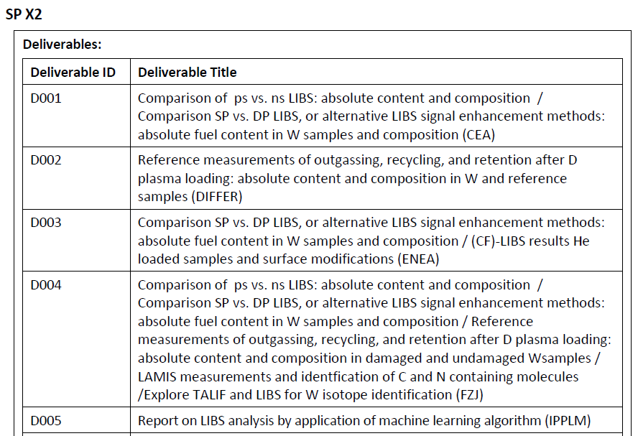
WPPWIE – SPX 2 – Optimization of laser based surface analysis diagnostics
Arnaud Bultel ‡, Aurélien Favre, Vincent Morel
CORIA, UMR 6614, CNRS-Normandie Université-INSA de Rouen, 76801 St-Etienne du Rouvray cedex, France
‡arnaud.bultel@coria.fr
Stéphane Vartanian, Elodie Bernard
IRFM, CEA Cadarache, 13108 Saint-Paul-lèz-Durance, France

Slide 2
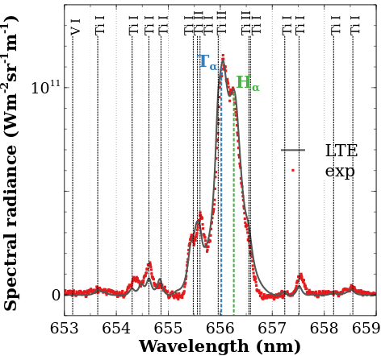
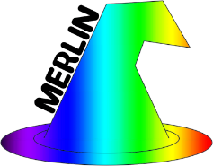
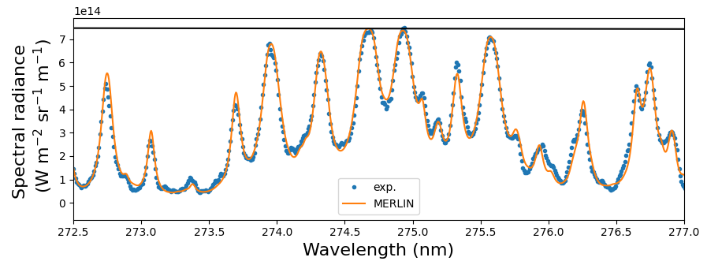
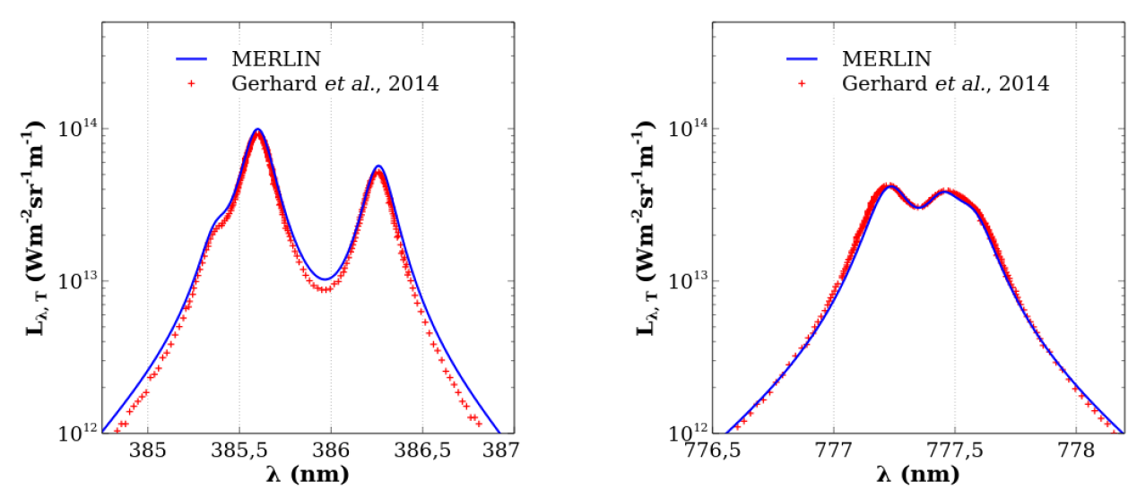
1 – MERLIN
Resolution of the Radiative Transfer Equation
Includes atoms, ions (II, III)
Requests to main spectroscopic database (NIST, ALL, Kurucz, Quinet-Mons…) for $E_{k}$, $g_{k}$, $A_{ki}$
Local Thermodynamic Equilibrium (1 or several layers), composition derived from a validated software
Takes into account Doppler broadenings, Stark broadening and shifts
(very complex) spectra in many situations
Synthetic spectra calculation validated
Main tool for CF-LIBS
Ar-Pd-Ti-Si-H-T plasma
Ar-Si-O plasma
Ar-Fe-Cr-Cu-W-Na-Mn-V plasma

Slide 3
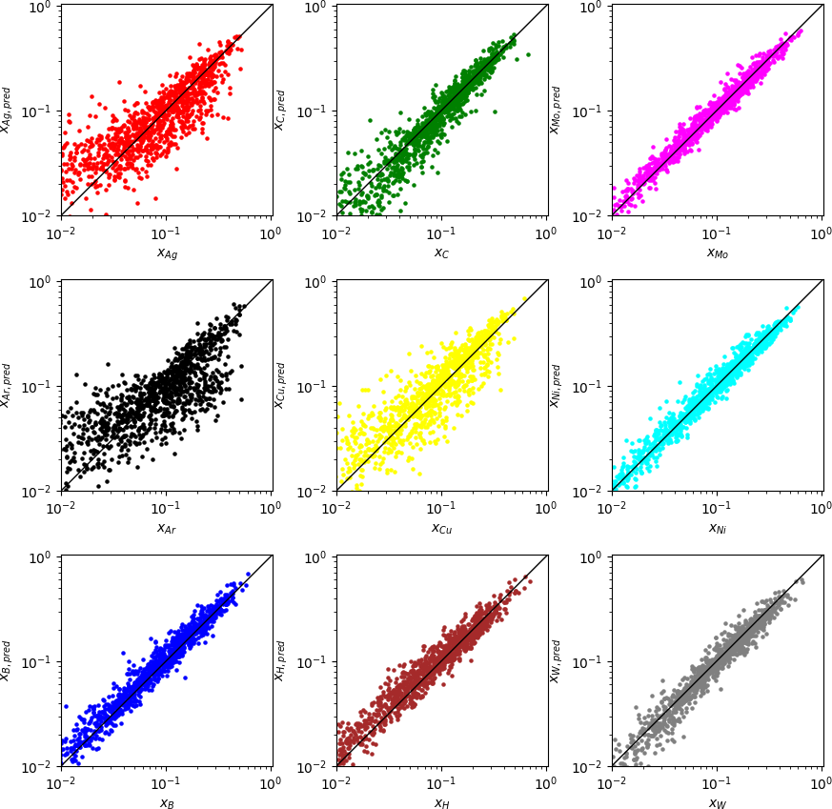
2 – MERLIN in Deep Learning
Training of a neural network
Species (up to 9) in different concentrations with various $\left(n_{e}, T, L_{p}\right)$ values
Implementation of a convolutional network
Good prediction at some % in mole fraction
Results in ~ 20 ms
Can work in real time (10 Hz laser source) to give the composition, $n_{e}$ and $T$
Ar-Ag-C-Mo-Cu-Ni-B-H-W plasma (9 species, WEST campaign)

Slide 4
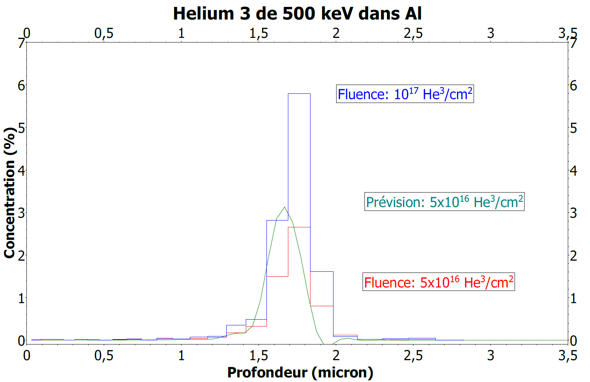
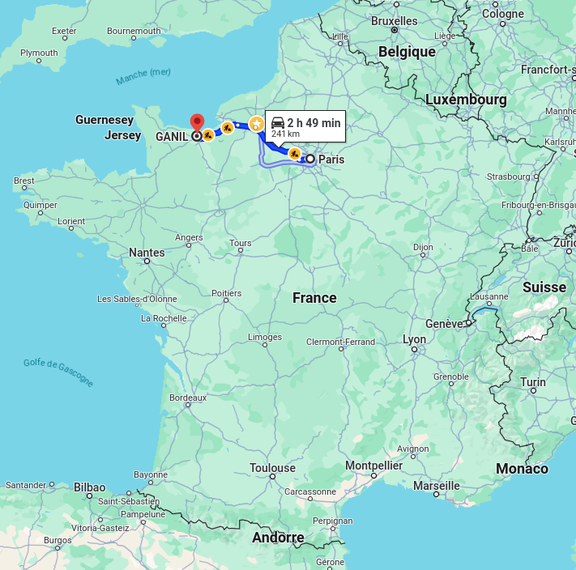
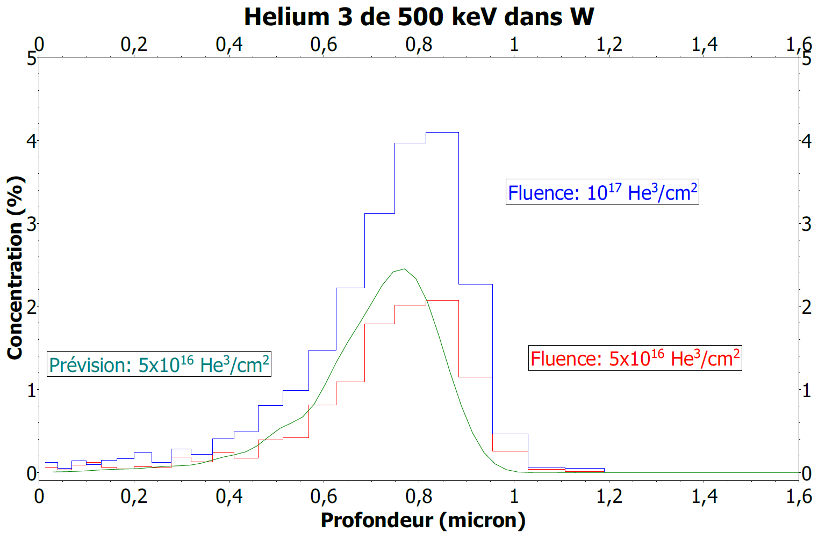
3 – CF-LIBS
He³: product of T disintegration
Preparation of He³ implanted samples (Al and W by ionic beam)
Profiles with a maximum able to allow the verification of the depth
Other Al and W samples also implanted with D
Same characteristics: profiles with a maximum

Slide 5
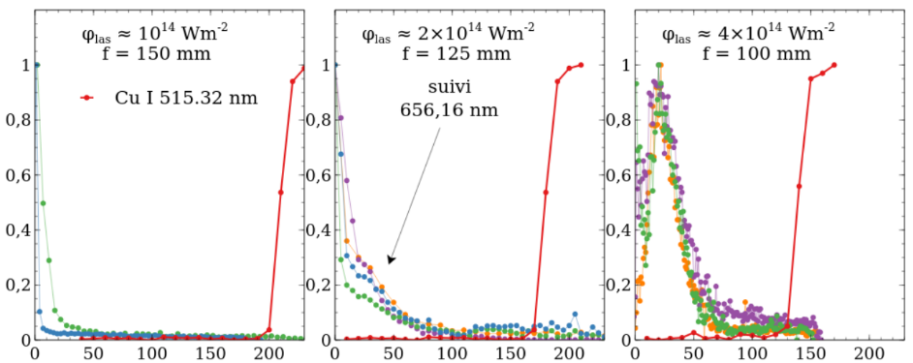
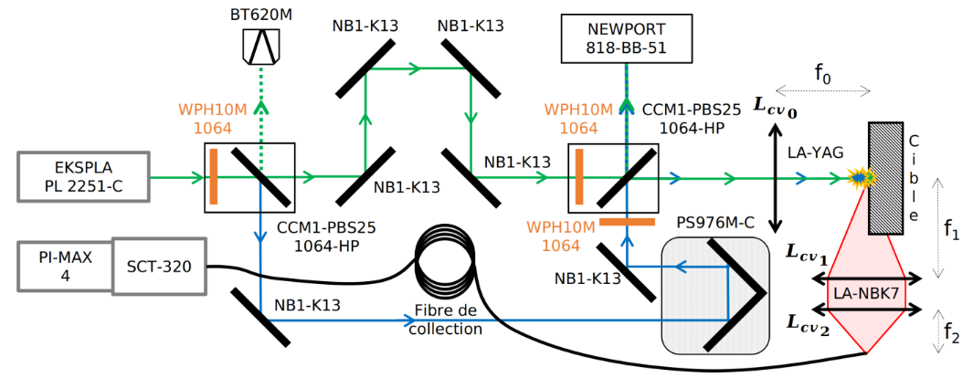
3 – CF-LIBS
Comparison ns-ps (SP) CF-LIBS
Comparison SP-DP ps and ns CF-LIBS
Normalized spectral radiance
Shot number
Shot number
Shot number
Schematic view of the ps-ps axial Double Pulse experimental device.
Al sample [thickness $\left(300±30\right)μm$ containing D at $\sim 5 μm$] placed on a Cu plate
Ns laser source (Nd:YAG 532 nm, 6 ns, 50 mJ)
Same type of measurements on GANIL new samples with
ns laser source (Nd:YAG 1064 nm, 6 ns, 100 mJ)
ps laser source (Nd:YAG 1064 nm, 30 ps, 100 mJ)
Rebuilding of the spectra by MERLIN
Current configuration
ps laser source (Nd:YAG 1064 nm, 30 ps, 100 mJ)
Adaptation to ns-ns configuration
ns laser source (Nd:YAG 1064 nm, 6 ns, 100 mJ)
Measurements on GANIL new samples
Rebuilding of the spectra by MERLIN

