Slide 1
FZJ plan for 2024
Comparison of ps vs. ns LIBS: absolute content and composition
Comparison SP vs. DP LIBS, or alternative LIBS signal enhancement methods: absolute fuel content in W samples and composition
Reference measurements of outgassing, recycling, and retention after D plasma loading: absolute content and composition in damaged and undamaged W samples
LAMIS measurements and identification of C and N containing molecules
Explore TALIF and LIBS for W isotope identification (FZJ)

Slide 2
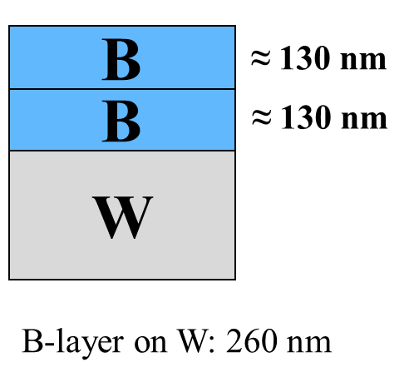
Comparison of ps vs. ns LIBS: absolute content and composition
The measurement of boron film on W by ps-LIBS (λ=355nm, 35 ps) in vacuum pressure 3 10⁻⁵ Pa
Optimized spectral acquisition parameters:
gate delay 30 ns , gate width 1000 ns
Average ablation rate 66.98 ± 0.29 nm/pulse
Depth resolution of boron layer: ps-LIBS is better than ns-LIBS

Slide 3
Absolute fuel content in W samples and composition
The measurement of hydrogen in W target by ps-LIBS (λ=1066nm, 35 ps) in Ar atmospheric pressure with JET like LIBS set-up.
Littrow spectrometer commissioning for JET Remote Arm LIBS.
Long gate delay (> 4μs) required for Hα and Dα discrimination.

