Slide 1
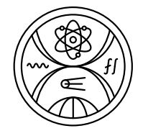
SP X: KoM - plans for 2024
STAFF: Pavel Veis, Pavol Ďurina, Tomáš Roch, Michal Stano, Matej Veis
Post docs: Sahithya Atikukke, Dhanada Sukumaran, Ivan Urbina
PhD. st.: Shweta Soni, Jairo Peralta, Pavitra G. Bhat,
Sanath Shetty, Vaishnavi Sudhakaran (CU Bratislava team)
Notes:
Please Indicate your subproject

Slide 2
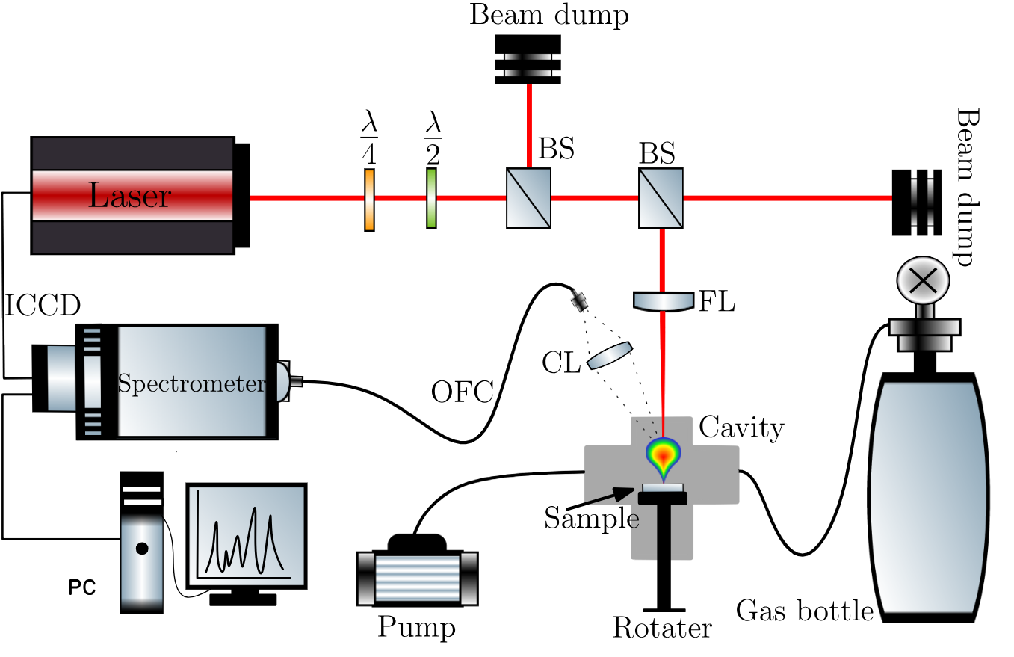
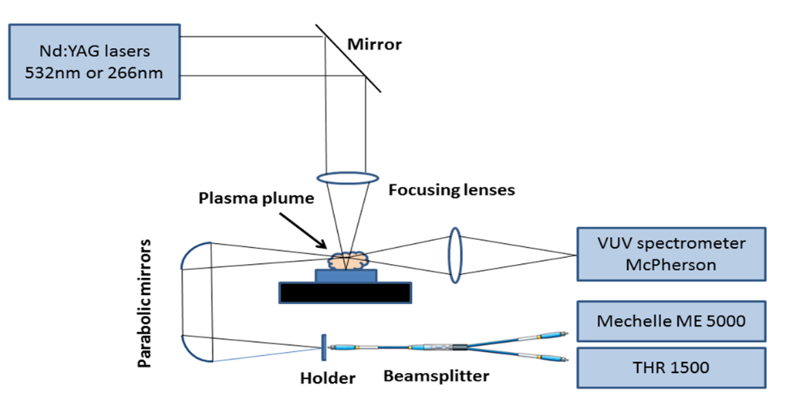
LIBS experimental setups
1) Picosecond LIBS setup at MUNI, Brno, CZ
Nd:YAG laser (Brilliant B, Quantel)
Mechelle M5000 spectrometer
Andor iStar 340 T ICCD camera
2) Comenius University, Bratislava, Slovakia
new LIBS cartography ATOMtrace system
ns OPO laser
ns/ps Nd:YAG
Detection of light elements
(H, N, O, Be, B, C, Sn …) LIBS
Broadband spectra
LIBS, CF LIBS
T_{e}, n_{e}
Molecular spectra
T_{rot}, T_{vib}
x-y-z translation stage
1. Trace element detection in complicated matrixes(Mo, W, Fe...)
2. Spectral lines profiles: Stark broadening => n_{e}
Stark and isotopic shifts, D/H ratio
AtomTrace chamber

Slide 3
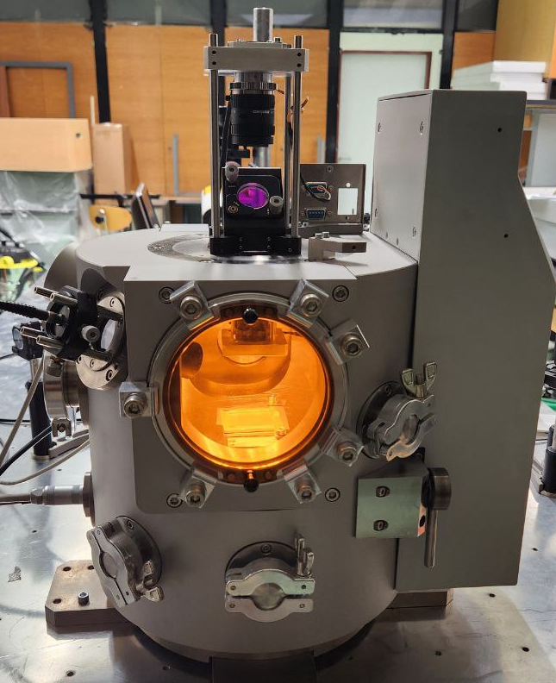
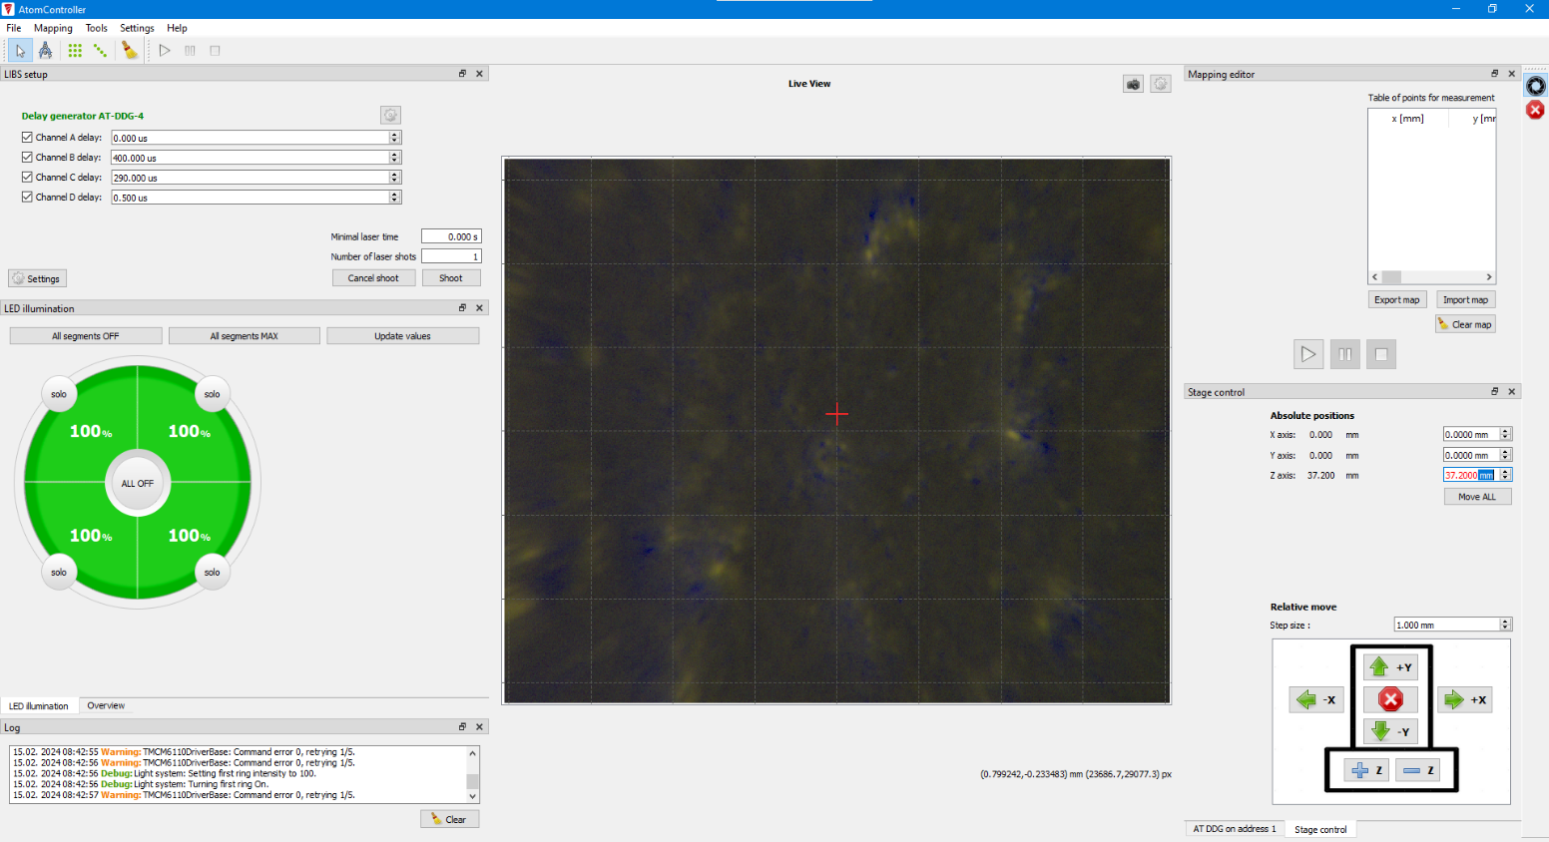
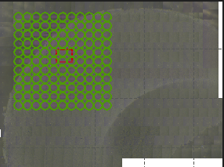
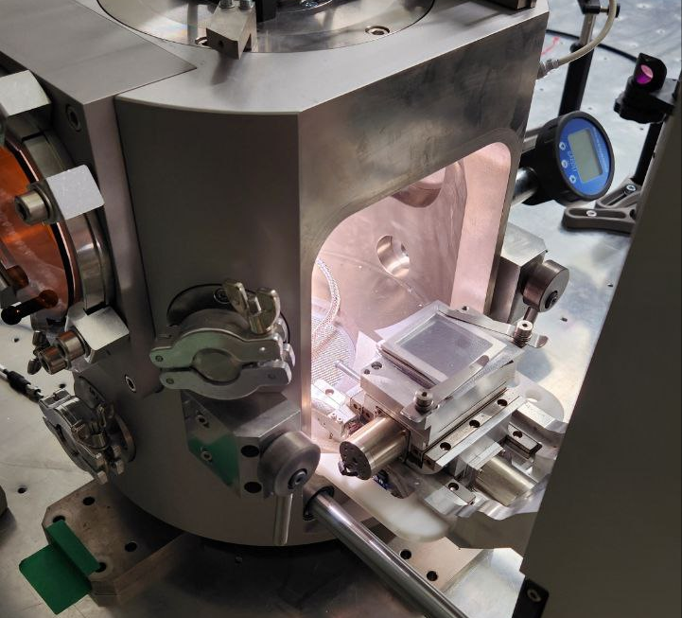
LIBS AtomTrace cartography setup
Cartography is done by performing a raster scan over the sample.
The AtomController software facilitates the control between the computer and the chamber.
The depth of the ablated craters is then studied using confocal microscopy.

Slide 4
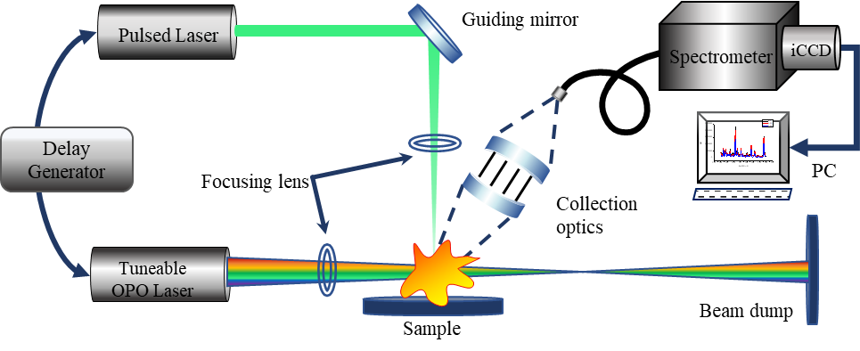
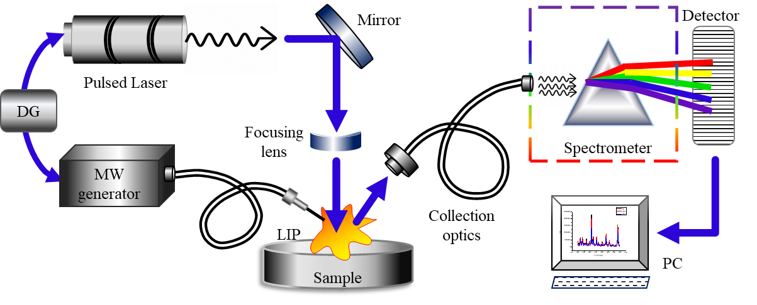
LIBS enhancement approaches
Double pulse LIBS
Laser-induced fluorescence assisted LIBS
Vacuum UV LIBS
Microwave enhanced LIBS
Spark assisted LIBS
Magnetic confined LIBS
Nd:YAG
Dichroic mirror
Optical fiber
Focusing lens
iCCD
Mechelle
Quartz window
PC
PC
Gas outlet
McPherson
iCCD
Gas inlet
Vacuum Chamber
Sample holder
XY Translation

Slide 5
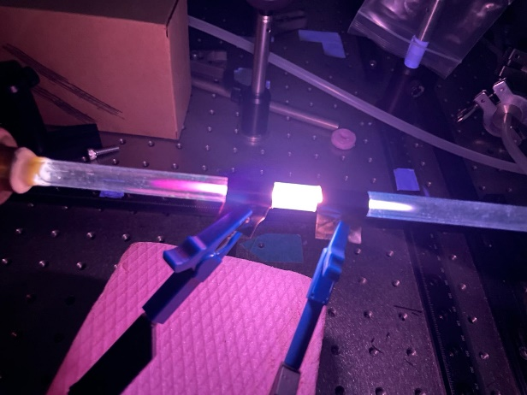
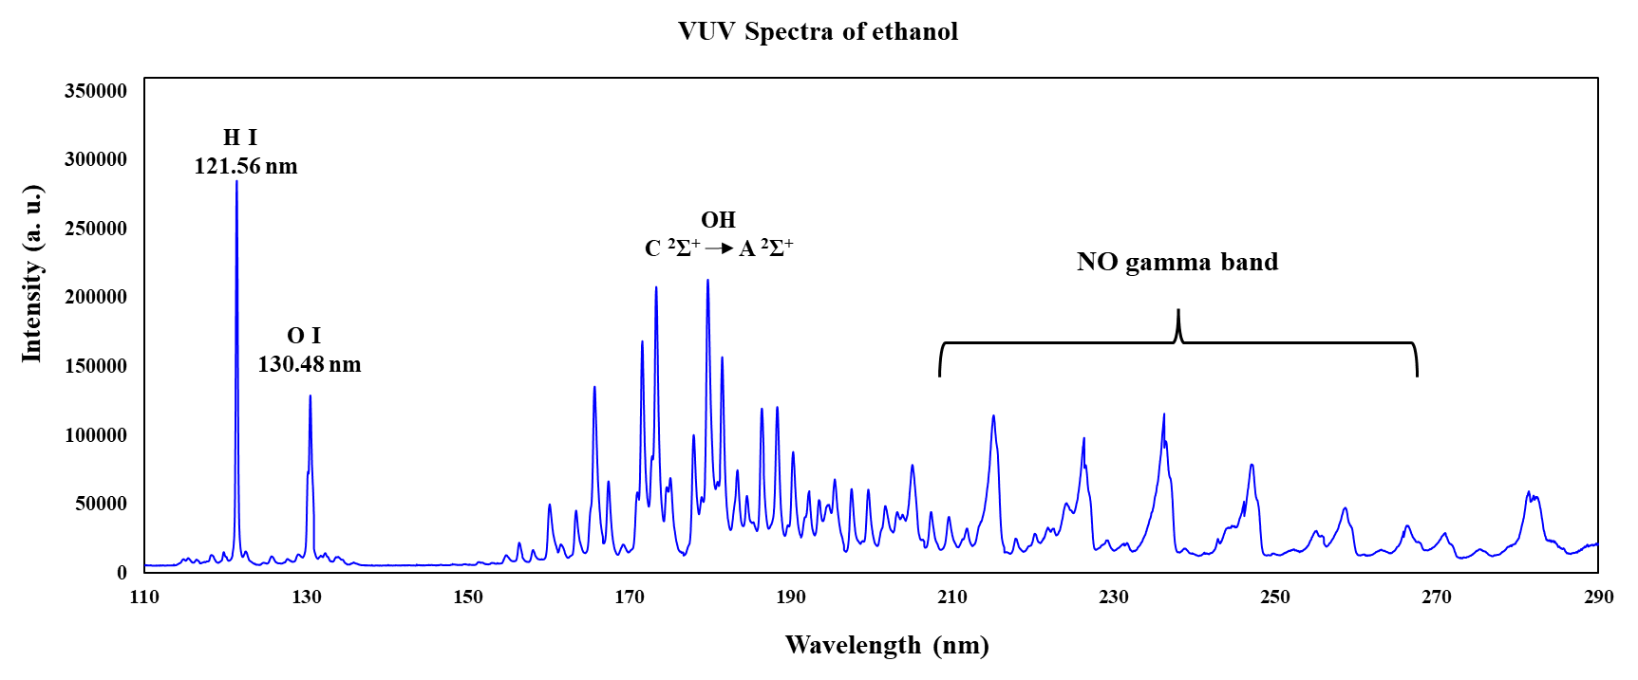
Vacuum UV LIBS

Slide 6
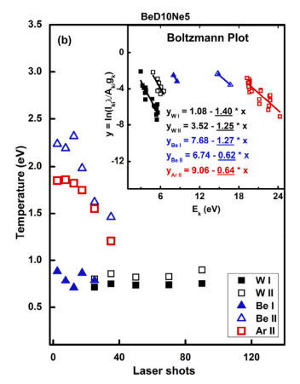
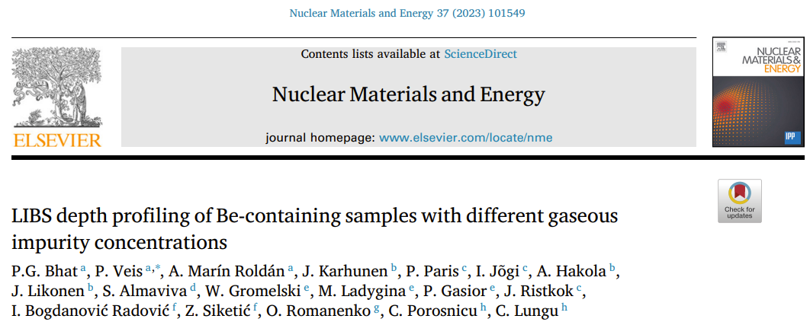
Work done in 2023 and plans for 2024
Work done in 2023 and continuation in 2024
  Campaign of LIBS measurements in VTT in May 2022
  Analysing LIBS results from last Be-coating samples with gas impurities
  and CuBe sample - ps/ ns regimes comparison, depth profiling
Notes:
This presentation has the follow principal points:
The motivation for performing this work. What is the problem for measuring light elements?
A very brief explanation of what LIBS and CF-LIBS are.
The main advantages of the simulatneous use of VUV and UV-NIR ranges
The experimental setup employed in this work.
The main results.
And finally, some conclusions.

Slide 7
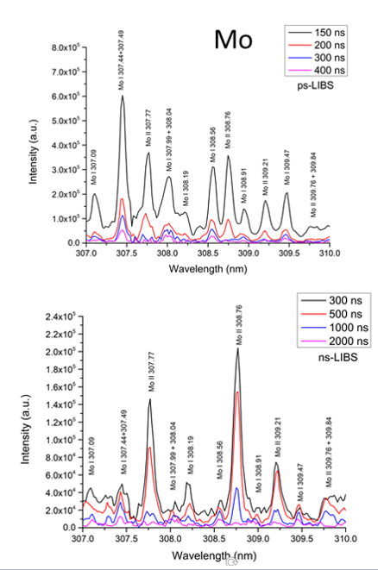
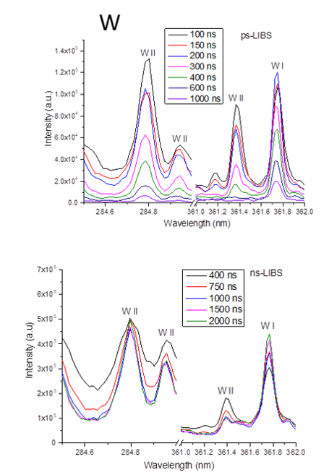
Comparison ns/ps LIBS measurements
W and Mo as substrates
Regime | Mo | W
ps | 85 ±13 nm/pulse | 55 ±11 nm/pulse
ns | 318 ±63 nm/pulse | 207 ±42 nm/pulse
ps
ns
A. M. Roldán et. al., Fusion Engineering and Design 172 (2021) 112898.
Notes:
This presentation is composed by 7 parts. First, the introduction, where I would talk about the motivation and paleoclimatic proxies. Parts 2 to 6 are related to the analysis of all these proxies by laser spectrocopy, being separated in analysis of speleothems by LIBS, the evaluation of the LIBS technique, the anbalysis of other tan speleothems proxies by LIBS, and finally, imaging by LIBS. The last and final part will be the conclusions.

Slide 8
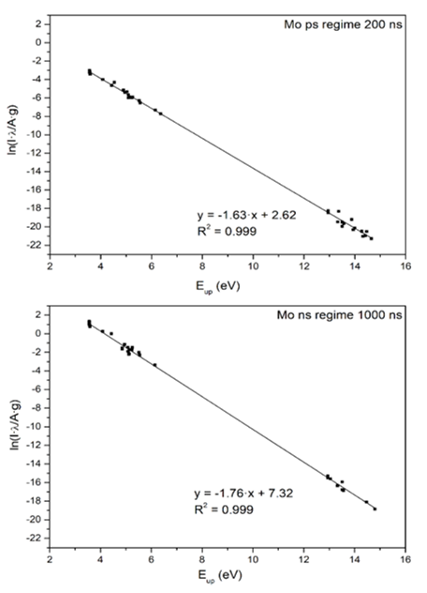
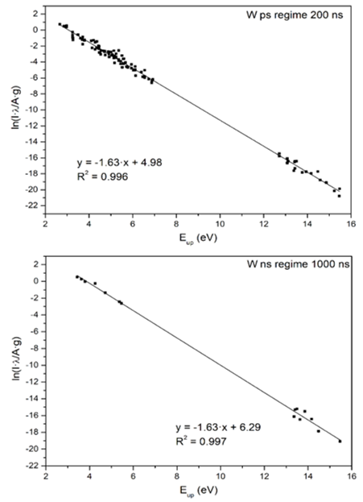
Comparison ns/ps LIBS measurements
W and Mo as substrates
Regime | Mo | W
ps | 85 ±13 nm/pulse | 55 ±11 nm/pulse
ns | 318 ±63 nm/pulse | 207 ±42 nm/pulse
ps
ns
A. M. Roldán et al., Fusion Engineering and Design 172 (2021) 112898.
Notes:
This presentation is composed by 7 parts. First, the introduction, where I would talk about the motivation and paleoclimatic proxies. Parts 2 to 6 are related to the analysis of all these proxies by laser spectrocopy, being separated in analysis of speleothems by LIBS, the evaluation of the LIBS technique, the anbalysis of other tan speleothems proxies by LIBS, and finally, imaging by LIBS. The last and final part will be the conclusions.

Slide 9
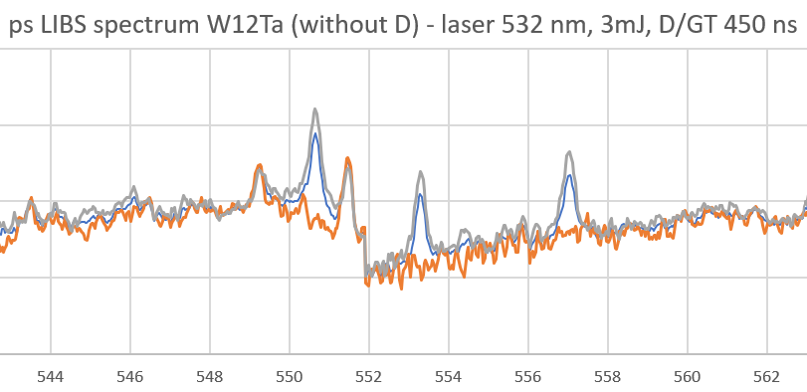
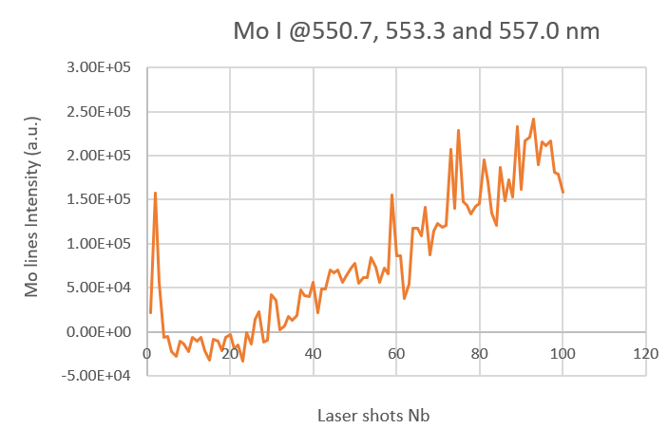
ps LIBS measurements on WTa w and wo D
ps LIBS regime
Has shorter lifetime
W and Mo as substrates
Notes:
This presentation is composed by 7 parts. First, the introduction, where I would talk about the motivation and paleoclimatic proxies. Parts 2 to 6 are related to the analysis of all these proxies by laser spectrocopy, being separated in analysis of speleothems by LIBS, the evaluation of the LIBS technique, the anbalysis of other tan speleothems proxies by LIBS, and finally, imaging by LIBS. The last and final part will be the conclusions.

Slide 10
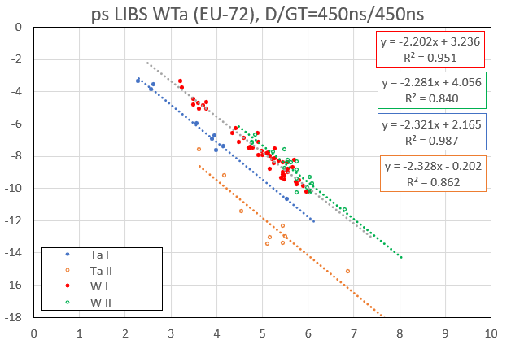
ps LIBS measurements on WTa w and wo D
Promising CF LIBS results on Wx%Ta samples wo D.
Next ps LIBS measurements
on Wx%Ta samples w D.
W and Mo as substrates
Notes:
This presentation is composed by 7 parts. First, the introduction, where I would talk about the motivation and paleoclimatic proxies. Parts 2 to 6 are related to the analysis of all these proxies by laser spectrocopy, being separated in analysis of speleothems by LIBS, the evaluation of the LIBS technique, the anbalysis of other tan speleothems proxies by LIBS, and finally, imaging by LIBS. The last and final part will be the conclusions.

Slide 11
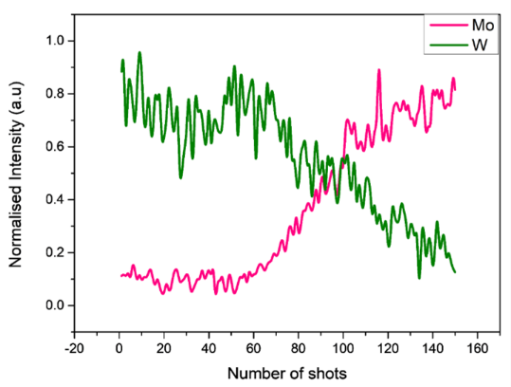
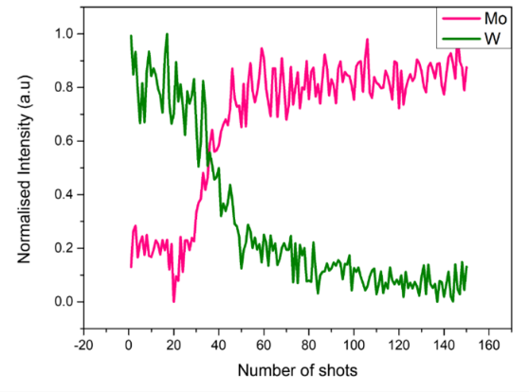
Resonant LIBS Analysis of WTa/Mo samples
R-Ablation @ 255.135 nm (W I)
Energy- 2 mJ m, air atm. press..
Ablation rate- 90 nm/pulse
Layer thickness- 7.7 μm
Depth profile at resonant excitation
NR- Ablation @ 222.75 nm
(out of W I-II, Ta I-II)
Energy- 2 mJ m, air atm. press..
Ablation rate- 250 nm/pulse
Layer thickness- 6.2 μm
Depth profile via GDOES – 7 μm
Depth profile at off-resonance

Slide 12
Plans for 2024
Plans for 2024
  Comparison ps / ns CF and depth profile LIBS measurements of relevant samples (e.g. WTa, CuBe) with and without D
  (different exp. conditions: laser wavelength, fluence, iCCD camera delay and gate time, gas , pressure)
  - Goal: pre-study for ps LIBS RH system campaign
  - in collaboration with P. Dvorak (Brno, CR) and E. Grigore groups
  - first results will be presented at Nordic LIBS conference at Tampere in March 2024.
  Participation on ps LIBS RH system campaign in JET and data treatment for quantitative analysis
  Resonant/off-resonance CF and depth profile LIBS measurements of relevant samples
  (different exp. conditions: laser wavelength, fluence, iCCD camera delay and gate time, gas , pressure)
  - Goal: enhancement of LIBS spectrum and increasing of depth resolution.
  Top flat beam profile CF and depth profile LIBS measurements – first test and application on relevant samples (Magnum PSI loaded samples,…)
  Confocal microscopy for evaluation of ablated matter and ablation rate
  Cartography LIBS system for depth profile and X-Y mapping of fusion relevant samples
  Vacuum UV OES
  - Goal: for light element depth profile LIBSE analysis (Boron,….)
Notes:
This presentation has the follow principal points:
The motivation for performing this work. What is the problem for measuring light elements?
A very brief explanation of what LIBS and CF-LIBS are.
The main advantages of the simulatneous use of VUV and UV-NIR ranges
The experimental setup employed in this work.
The main results.
And finally, some conclusions.

