Slide 1
SP-X.2: Optimization of laser-based surface analysis diagnostics
Indrek Jõgi
University of Tartu

Slide 2
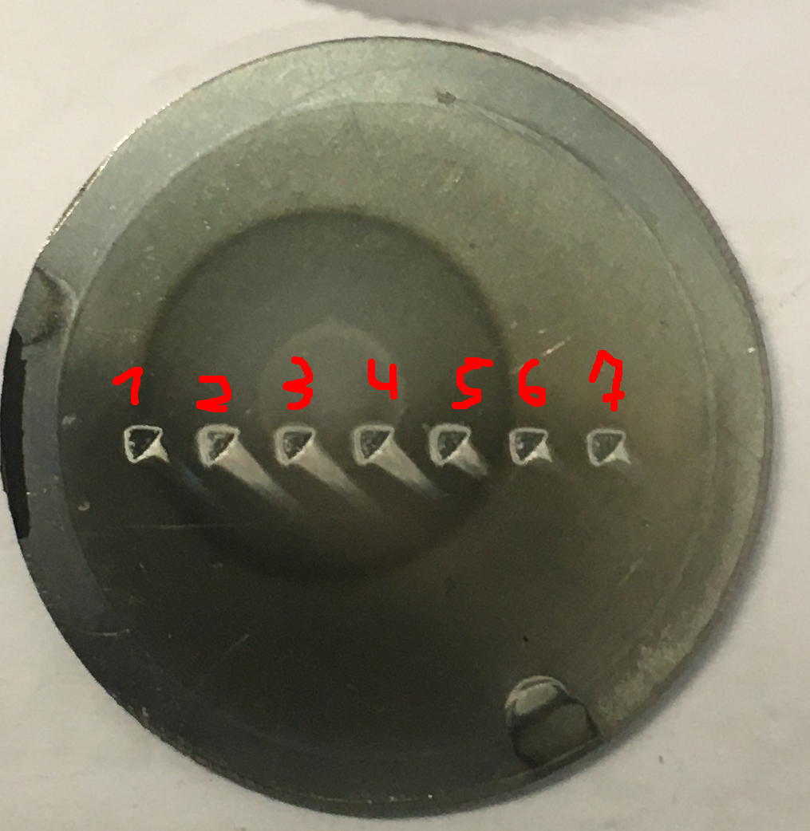
Tasks and deliverables 2024
1. Analysis of B containing coatings and/or W coatings with (CF)-LIBS: absolute content and composition
2024: Analysis of WEST samples.
Deposited B containing coatings?
2. CF)-LIBS results He loaded samples and surface modifications
2024: Analysis of He in Magnum-PSI loaded samples and deposited coatings with He.
(publication of VTT and DIFFER campaign results)
1 μm c-W
LIBS
ToF-ERDA
Edge 16·10¹⁵ at/cm²
Center 250·10¹⁵ at/cm²

Slide 3
Tasks and deliverables 2024
3. Reference measurements of outgassing, recycling, and retention after D plasma loading: absolute content and composition in W and reference samples
2024: Analysis of D in Magnum-PSI loaded coatings (publication of results)
1 μm c-W D₂-N₂
5 μm c-W D₂-N₂
1 μm c-W
5 μm c-W
Depth profiles of D, W and Mo
D spatial distribution on coating
4. (CF-)LIBS on Be containing coatings with different type of fuel content
2024: participation in LIBS JET campaign and preliminary tests in VTT.
(publication of previous VTT campaign results)

Slide 4
H isotope detection at different pressures
H and Mo intensity as the function of distance from target at 1 μs
Ar
N₂
Intensity vs FWHM at different pressures in Ar and N₂

