Slide 1
PRD-9.INT.01-T011 Numerical evaluation of LM-CPS performance in COMPASS-U
I. Ivanova-Stanik et al.
Institute of Plasma Physics and Laser Microfusion, Poland

Slide 2
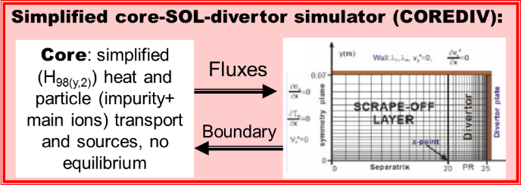
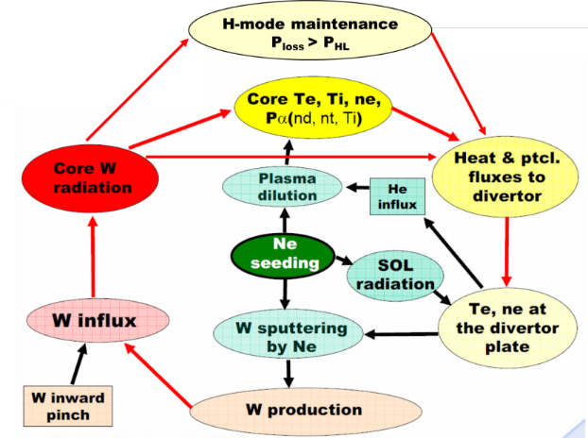
COREDIV code: pros and cons
Advantages:
Self-consistent modeling core and SOL: Important for simulation of the impurity with high atomic number: W, Ni, Ar, Kr
Included atomic processes: ionization, recombination, excitation, charge exchange
Solved each ionization stage of the impurities
Intrinsic and seeded impurities – gas puff at different positions
LM implemented
Faster code: 1case - 12h

Slide 3
COREDIV code: pros and cons
Disadvantages:
Anomalous transport described by simple model:
τ_{E} from experimental
ELMy H-mode scaling
C_{e} – adjusted iteratively to
keep prescribed confinement
Equations for plasma rotation and plasma current neglected → j(r) – given input function, (no evolution of magnetic field)
Position of the pedestal as a input parameter
Slab geometry for the SOL
Non included private region
Drifts neglected
Analytical model for neutrals accounts for plasma recycling and impurity sputtering → detachment can not be modeled correctly.
Only thermal neutron
Irena Ivanova-Stanik| M21-02 Meeting |22.06.2022 | Page 3

Slide 4
Idea
METIS
(1D)
COREDIV
HeatMD
Evap.+sputt.
FiESTA
Magn equil.
COMPARISON
ERO 2.0
Evap.+sputt.
SOLPS ITER
2D (SOL+EDGE)
Experiment
Benchmarkt
TECXY
2D (SOL+EDGE)

Slide 5
Aim and input data
The simulation are prepared for COMPAS scenerio 3210.
We assuming:
n_{e}^{sep} = 0.35<n_{e}>_{vol}
H₉₈ = 0.815
R^{recyc}_{Li,Sn} = 0.1
D_{SOL} = 0.5 m²/s, D_{SOL} = 0.3 m²/s
W divertor
PARAMETERS | A (#3210)
Toroidal radius: R [m] | 0.9
Plama radius: a [m] | 0.27
Plasma currents: I_{p} [MA] | 0.8
Toroidal Mag. Field: B_{T} [T] | 2.5
Elongation | 1.7
Electon density: <n_{e}>_{vo}l[x10²⁰m⁻³] | 1.125
Auxiliary heating: P_{aux}[MW] | 2.0
Choice of impurities
Self - consistent simulations with 3 impurities:
C – fixed source at midplane, chosen to fit Z_{eff} (Z_{eff} = 1.3)
Li, Sn - fixed source at divertor plate
W – from sputtering (all ions)
The radiation and Z_{EFF} levels fitted simultaneously
Aim: Answer the questions:
How much is limit of the impurities?
What is temperature of the divertor plate?
What is the difference between Li and Sn?

Slide 6
COREDIV simulation
Comparison on the profile with results from Metis: F. Jaulmes et al 2021, Nucl. Fusion 61 046012
radiation fraction go to 75%-80%
Higher D_{SOL} go to higher SOL radiation (effect by C radiation)
Lower tungsten concentration (C_{W}) < 4×10⁻⁶
Diffusion for case 3210 have small influence of the limit of the gas puff level
Temperature of the plate (T_{e}^{PLATE}) is lower: about 5eV for case with Sn and 5-11 eV for Li. W is produced mainly by C
No problem to work in H-mode (P^{SOL} > P_{LH})
Sn have no influence on the pedestal (the maximum of the radiation is for a/r between 0.4 and 0.8

Slide 7
COREDIV&HeatLMD
prompt redeposition f_{promt} | 0 | 0.9
1.0 mm CPS on 4 mm copper cooling pipe HeatLMD (sputtered+vaporized) water pipe + sputtering + evaporation = 160 [MW/m2] equilibrium strike point surface temperature [ºC] COREDIV concentration | Li 3.0 ×10²² [1/s] 15 + 45 + 100 900 10 | Sn 3.0 ×10¹⁹ [1/s] 45 + 15 + 100 1900 Rad. collapse
0.25 mm CPS on 2 mm copper cooling pipe HeatLMD (sputtered+vaporized) water pipe + sputtering + evaporation = 160 [MW/m2] equilibrium strike point surface temperature [ºC] COREDIV concentration | LiSn 1.5 ×1022 [1/s] 70 + 30 + 60 1000 9 | Sn 3.0 ×10¹⁸ [1/s] 130 + 15 + 15 1700 10⁻⁴
Results from COREDIV and HeatLMD codes for the inclined target from in thermal equilibrium with ELMy H-mode attached plasma

Slide 8
COREDIV simulation
Name of presenter | Conference | Venue | Date | Page 8
Plasma parameters versus Γ _{li} : (a) W concentration,, (b) electron temperature (T_{e}^{PLATE}) and density (n_{e}^{PLATE})to plate, to SOL (P^{SOL}) (c) Sn and Li concertation and d) Sn radiation in core (left) and Li density on the separatrix (left).
Plasma parameters versus Γ _{Sn} : (a) W concentration,, (b) electron temperature (T_{e}^{PLATE}) and density (n_{e}^{PLATE})to plate, to SOL (P^{SOL}) (c) Sn and Li concertation and d) Sn radiation in core (left) and Li density on the separatrix (left).

Slide 9
Prompt redeposition – classical formula
The fraction of not promptly redeposited Li (left) and Sn (right) ions escaping from divertor plate as a function of temperature in 1.5 T (dot line) and 2.5 T (straight line) magnetic field for different electron densities

Slide 10
Prompt redeposition – Tskhakaya formula
Tskhakaya D. et al., Modelling of tungsten redeposition coefficient, J. Nucl.Mater. 463 (2015) 624–628.

Slide 11
CONCLUSIONS:
The COREDIV code has been used to perform self-consistent core-edge simulations of case with Sn and Li puff.
Tungsten is produced only due to carbon +self-sputtering.
Preliminary COREDIV predicts core concentration about 10-11% Li (depend by radial diffusion in SOL region) for 0.025% for Sn.
For the case with Sn, 60% from radiation is from Sn
The Li and Sn have small influence on the W.
Prompt re-deposition for Li is about 10% and strongly depend by magnetic field, but for Sn is higher and go to 90% and influence of the magnetic field is smaller.
For attached 2 MW H-mode and target inclined against the magnetic field reaching thus 160 MW/m², we conclude necessity of backside cooling of the LMD target because just inertial cooling yields radiative collapse.
However, a thin target with just 2 mm thickness yields to acceptably low Sn release even for so high heat flux.

Slide 12
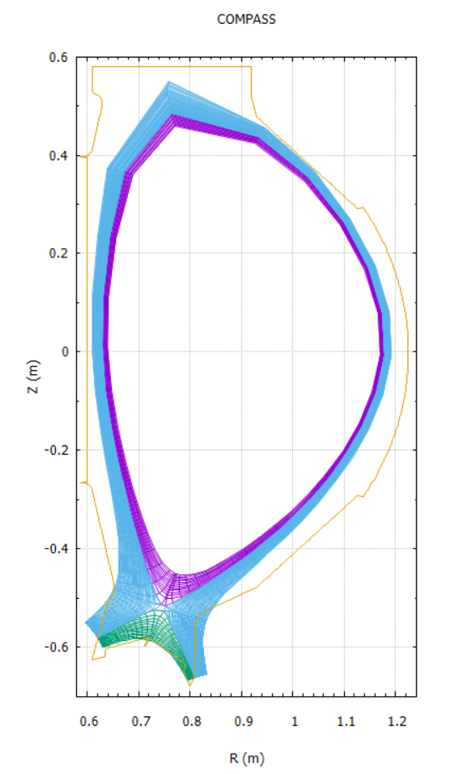
Simulation with TECXY code
Analysis for scenario 24300 (B_{T}=4.25T, I_{p} =1.3MA, q₉₅=3.7, k=1.8, P_{NBI}=2.7 MW, P_{ECRH}=1MW)
Based on the mesh SOLPS-ITER, generation mesh for TEXCY (by I. Borodkina)
Mesh for TECXY is prepared
Start to simulation
TECXY mesh

Slide 13
Plans for 2024
Continue simulation with COREDIV and TECXY for COMPASS-U scenarios with high heating power
Simulation with COREDIV for scenario with higher auxiliary power (24300)
Testing code CORTECXY – core plasma from COREDIV+SOL from TECXY (realistic geometry).
Results will be reported on:
26th International Conference on Plasma Surface Interaction in Controlled Fusion Devices (PSI-26), Marseille, France.
S. Lucas et al., Preliminary ERO2.0 Li, Sn and W erosion and transport simulations for the COMPASS Upgrade tokamak
J. Horacek et al.,Towards an innovative plasma-facing component sustaining unmitigated ELMs and 60 MW/m² steady-state
33rd Symposium on Fusion Technology (SOFT2024), Dublin, Ireland
I. Ivanova-Stanik et al.,..
Varenna-Lausanne Theory of Fusion Plasmas, September 2024
J. Horacek et al., Coupled simulations of liquid metal divertor

