Slide 1
Thursday 7th February
UKAEA 2023 Contribution for WPLMD and Future Plans
M. Bastar, A. Barth, D. Horsley and IPP.CR Colleagues

Slide 2
Task Objectives
The development of liquid-metal plasma-facing surfaces provides potential for a liquid surface that self-arranges to eliminate hot-spots or edges and is self-healing under high-power excursions.
Work in FP9 therefore aims to develop both the plasma-facing surface design and manufacturing concept, and the whole divertor-module concept to a state where it is a potential option for DEMO. This includes development of concepts that could be tested on COMPASS-U.
COMPASS-U will be available from ~2027 for LMD testing. Based on the generated understanding from liquid metal testing procedures elsewhere in the work package, prototype testing is anticipated through module insertion into the divertor and enable full designs for COMPASS-U by the end of the programme.
Deliverables on this task are created to aid the realisation of an LMD target for COMPASS-U from defining design requirements through to manufacture and test support.

Slide 3
AWP23 Deliverable Specification
Determine Research Objectives for LM-CPS Divertor Components in COMPASS-U.
Prioritisation of needs / requirements / outcomes.
Links to DEMO decision points and alignment with overall EUROfusion verification and validation (V&V) strategy. Gaps / uncertainties being addressed .
Test success criteria, model development & validation requirements .
Collect Stakeholder Requirements and Derive System Requirements for LM-CPS Divertor Tile.
Stakeholder requirements informed by research objectives.
Workshop amongst WPPRD-LMD community to ensure objectives and constraints are satisfied.
Conceptual Design of COMPASS-U LM-CPS Divertor Tile Based on DEMO Technology.
Design work to conform to requirements
Feedback from workshop to be incorporated into AWP24 design work.

Slide 4
AWP23 Deliverable Specification
Deliverable Status: 90% Complete.
Revisions to be made to documents that incorporate comments captured in recent workshop. Upload to IDM will complete the deliverable.

Slide 5
Research Objectives
The purpose of the experiment will be to demonstrate the LMD technology and identify a pathway for extrapolation for a DEMO reactor. Prioritisation of experimental features are as follows:
Demonstrate component can mechanically withstand multiple shots, replenish erosion sufficiently to maintain thermal performance over lifetime, operate within the tolerable limits of a core plasma.
Determine where eroded material from the target is transported and deposited within the reactor. Potential for pre-testing in ASDEX for tile commissioning/testing.
Liquid metal resupply system for prolonged campaigns. Control of plasma incidence angle at strike point for manipulation on heat fluxes/temperatures. Divertor target erosion transport SOLPS model validation.
Active cooling of target. Steady state operation. Understanding of MHD flows within the CPS.
Where i – must have, ii – should have, iii – could have, iv – won't have.

Slide 6
Stakeholder Requirements
Using the Research Outcomes, stakeholder requirements are derived and these in turn are used to define System Requirements for the component design.
To demonstrate the LMD technology in COMPASS-U plasma in the form of a tile and extrapolate to entire Divertor region.
Gain insight on how this can be extrapolated to a DEMO fusion reactor.
To demonstrate performance characteristics such as lifetime survival, no significant influence on core plasma performance and performing core functions (liquid metal replenishment)
Capture the liquid metal transport throughout the tokamak. Identify where the liquid metal gets deposited and its contribution to the core. Define any unexpected effects for higher levels of erosion.
Identify open issues and technology gaps that cannot be solved in COMPASS-U, needed for successful implementation in a DEMO reactor.
Validate current core modelling techniques.
Outcome, Stakeholder and System Requirements to be finalised and uploaded to IDM

Slide 7
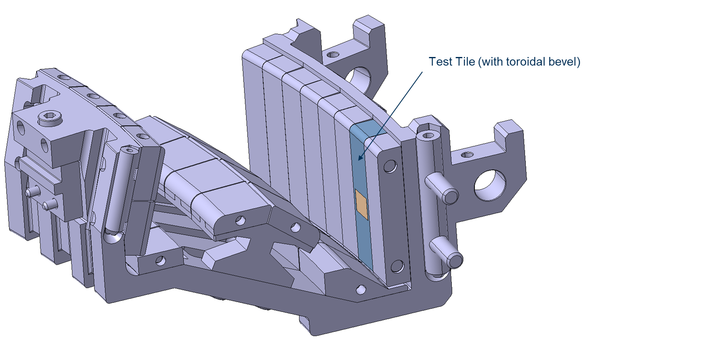
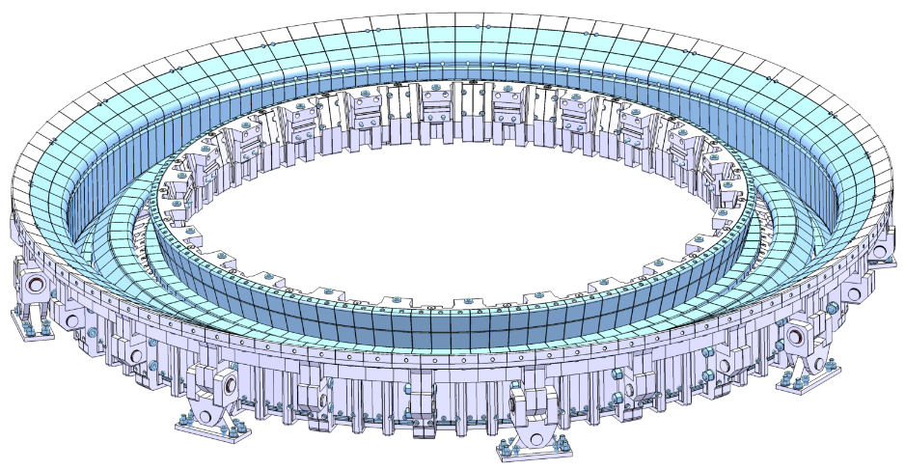
Divertor Configuration and Tile Location in COMPASS-U
Divertor ring made of 24 cassettes

Slide 8
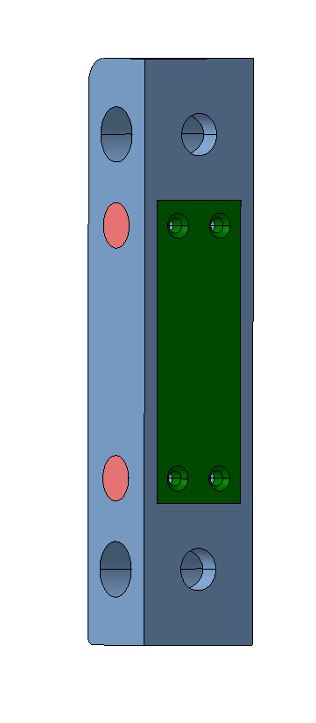
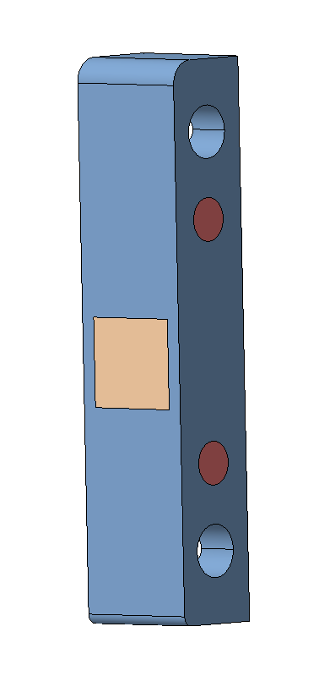
Tile dimensions
Back view
Front view
20mm
Inserts
75mm
116mm
Lid
CPS
26mm

Slide 9
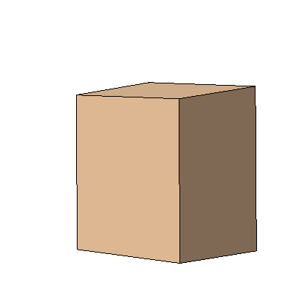
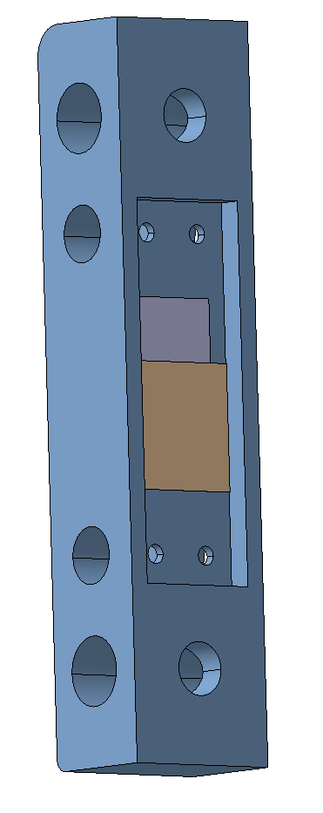
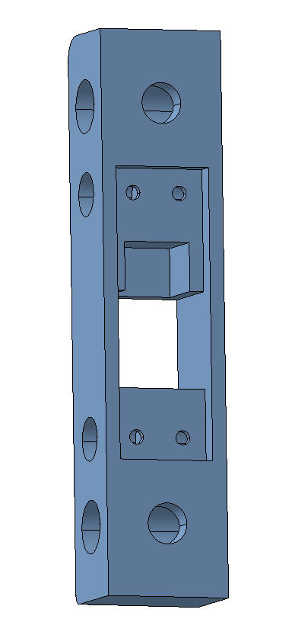
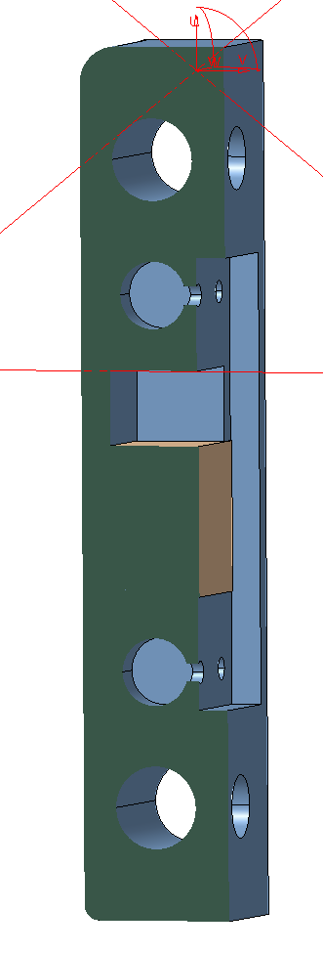
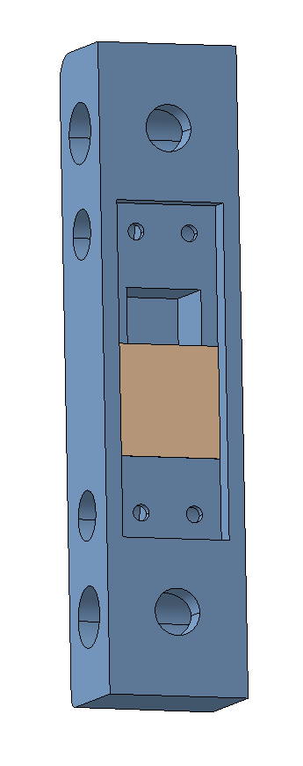
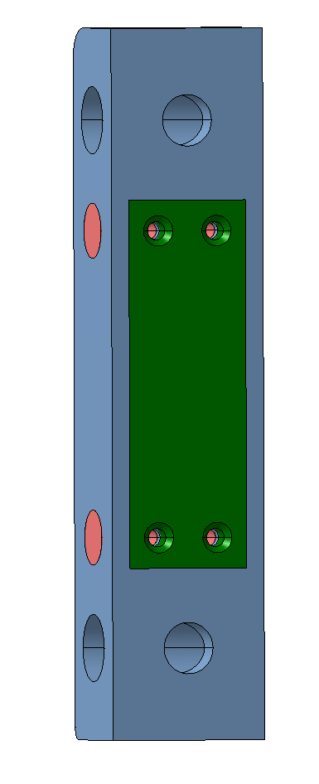
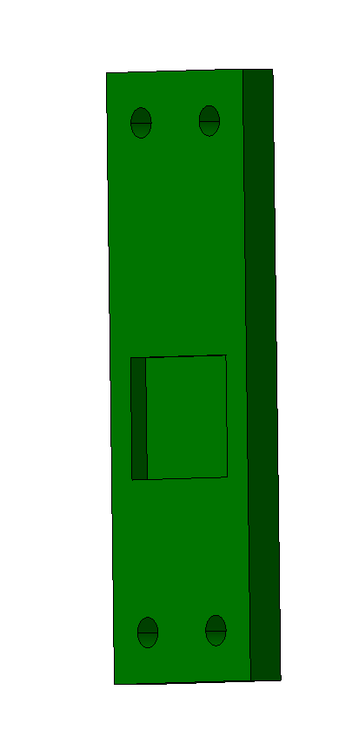
Assembly
CPS Part (Probably 3D printed)
Filling with liquid tin and let it solidify
Surfaces at 5° degree angle
4xM3 countersunk bolts
Section
CNC milled tungsten case
Bolt the lid
Room for heating cartridge
Reservoir for liquid tin
Lid
Small interference with the lid and with the angle of the surfaces at CPS will create pressure at the top a bottom plane to prevent leakage of tin

Slide 10
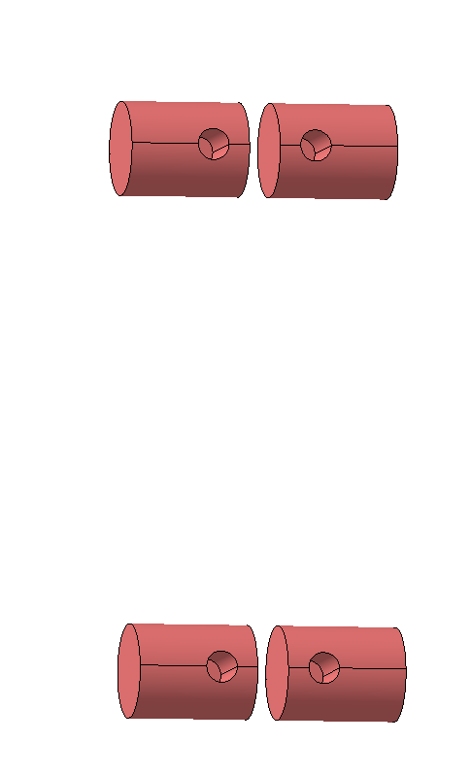
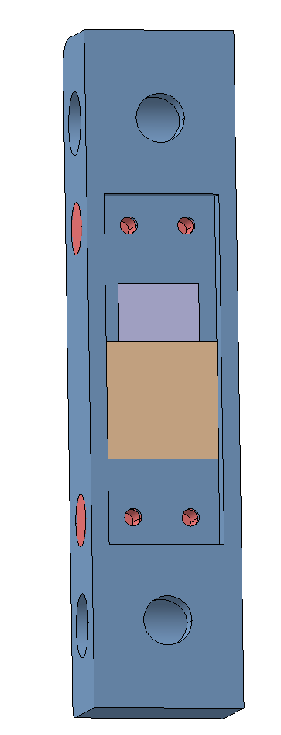
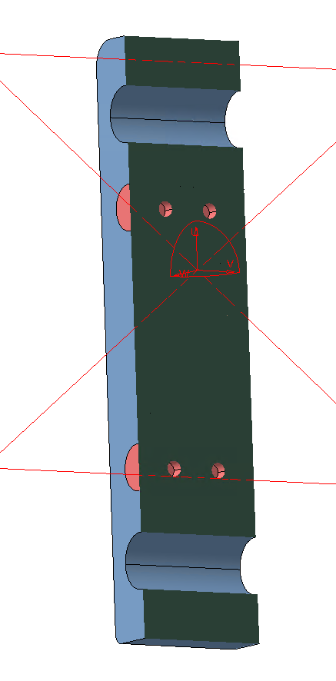
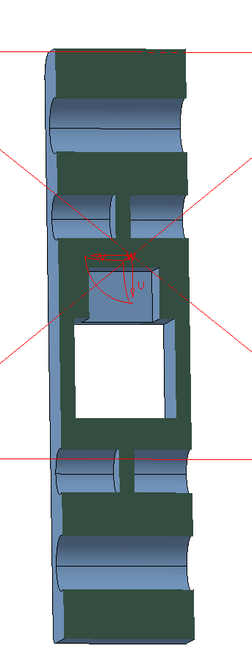
Assembly
Tie bars
12 g of tin
1.7cm3
3mm wall

Slide 11
Inputs Required for Determining Design and Compatibility with Diagnostics
Level of extrapolation required? - How close will test conditions on this facility be representative of DEMO operating conditions?
Design Data Requirement. - Is the aim of the test to provide data that is directly usable in design (e.g., nuclear data)? If so what accuracy and statistics (i.e., repeated tests) is required and why?
Design Data Requirement. - If the data is to support a model needed to enable design decisions or substantiation, where is that model described and what are the requirements on data?
Stakeholders - Who else will use the data/models from these experiments? Should they be involved with the experimental activities?

Slide 12
Conclusions
Priority research objectives based around LM compatibility with plasma (and transport), LM/CPS selection combination and engineering performance (manufacturing/integrity).
A series of requirements documents have been created capturing inputs from WPPRD-LMD, COMPASS-U, DEMO and Design Teams. Updates to these documents following a workshop will be completed as part of AWP24 deliverable.
A first iteration of a concept design has been produced. Feedback received has resulted in updated requirements. New design features to be incorporated in the AWP24 design work.
An operational sequence is to be produced to better define the boundary conditions for upcoming analysis in AWP24.

Slide 13
Future Activities
The work conducted in 2023 has produced an initial concept design that has informed Research Objectives, System Requirements and Functional Requirements.
The work envisaged for 2024 will aim to progress the design to a detailed stage and a route to manufacture identified. The technical specification for the deliverable includes:
Create operational states specification compatible with COMPASS-U.
Finalise concept design including required heaters, liquid metal reservoir and mounting arrangement.
Perform thermal and structural analysis and ensure compatibility with operational cycle

