Slide 1
CIEMAT: LMD 2023 review/2024 kick-off
E. Oyarzabal, A. de Castro, D. Alegre, D. Tafalla, F. Tabares and the OLMAT team.
Fusion National Laboratory. CIEMAT. Madrid. Spain

Slide 2
OLMAT 2023
Vapor shielding and evaporative plume characterization with Langmuir probe (February and November, 8 days).
Exposure of Sn wetted W CPS to NBI:
2 Targets like the one exposed to AUG with and without lateral wall exposed (March, 4 days)
Exposure of different Sn wetted W CPS to laser only (July, 5 days) and simultaneous NBI+CW laser pulses (December, 4 days)
NBI
CW laser
OLMAT studies for LMD 2023:
Study mechanisms of wetting and drop production in CPS structures
Evaluate thermal sputtering and vapor shielding of liquid metals in OLMAT
Influence of ELM-like loads in OLMAT loading studies
E. Oyarzabal LMD 2023 review/2024 kick-off 8th of February Slide 1/12

Slide 3
2023: Laboratory experiments on Sn and W CPS wetting
Problems with the current CIEMAT wetting system:
Conventional vacuum oven (200mTorr during wetting process) at 1150 ⁰C.
Oxidation due to high vacuum pressure.
Bending of the meshes due to the high temperature required.
Improved “wetting” system:
Wet with H₂ flowing at 110mTorr with a filament of W producing hydrogen radicals.
Wetting temperature around 450 ⁰C.
This system allows as well for future “wetting” studies in hydrogen atmospheres and studies on bubble formation and particle ejection (droplets observed in the surrounding of the Sn drop) .
E. Oyarzabal LMD 2023 review/2024 kick-off 8th of February Slide 2/12
Notes:
For conductive heat losses, characteristic of the CPS
solution, a maximum T gradient is sought. This implies high evaporation rates. Here we show the flux of lithium and tin from 3 different LM options. The temperature limits corresponding to a1% of the plasma particle flow for Li are shown. A much smaller limit applies to Sn due to its higher Z. No other sources of impurity are considered here. Thus, high impurity screening and low transport to the core are required. Both depend on the ionization mean free path of the LM atom. In addition, the kinetic energy of the species provides information about the release mechanism. Other issues have to be fulfilled

Slide 4
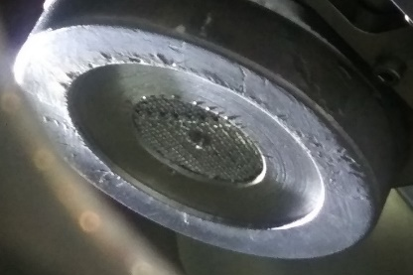
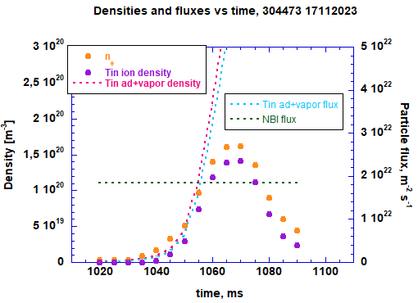
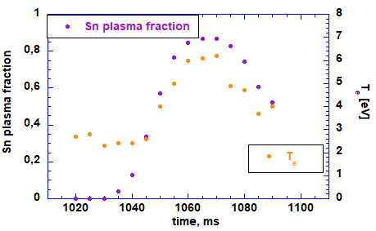
2023: Vapor shielding and plasma characterization: Embedded Langmuir probe (February)
W felt filled with Sn (provided by ENEA) with pore size 400 microns. 1st LP configuration (d=0,75 mm)
Operation with target tilted 45⁰ (protection of NBI against massive Sn vaporization)
Successful operation and LP measurements even at largest power densities
NBI 60 MW/m² 100 ms pulse
Densities and fluxes vs time Sn fraction and Te vs time
Vapor shielding
Analysis averaging 25 I-V curves within 4 ms.
Non conventional LP analysis: Evolution of H₂/Sn ratio in plasma, thermionic emission, plume expansion.
Further experiments carried out in December 2023 campaign (thicker W LP tip) attempting to minimize thermionic effect on measures
Thermal response measured by IR pyrometry in two consecutive shots (posterior and equal in heat flux to 304470) starting at same T₀. Identical T_{rise} evolution rules out the possible effect of window metallization on T_{target} damping. This thermal shielding is reached when vapor fluxes overpasses incoming particle flux
E. Oyarzabal LMD 2023 review/2024 kick-off 8th of February Slide 3/12

Slide 5
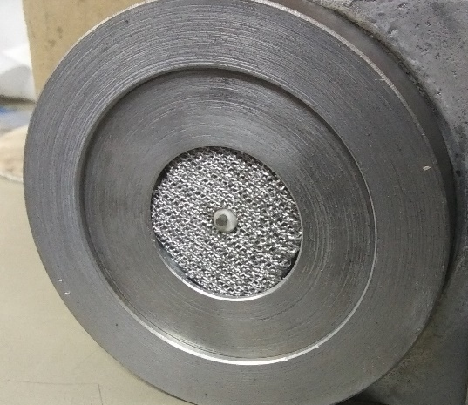
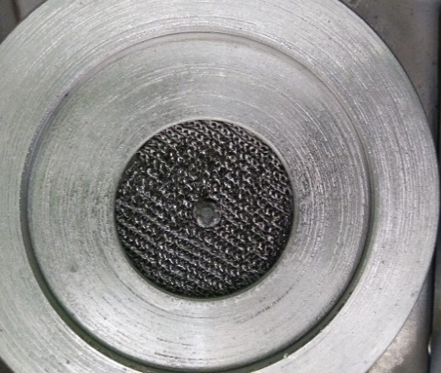
2023: Vapor shielding and plasma characterization: Embedded Langmuir probe (December)
Pre-exposure photo
W felt filled with Sn (provided by ENEA) with pore size 400 microns with upgraded LP configuration (d=2 mm):
Successful operation and LP measurements even at largest power densities
Employment of Sn II line filters to infer evolution of Sn+ ion population
Comparative shots at similar injected power with H⁰ and H⁰+H⁺ beams (average particle energy around 21 keV)
Previous experiments to characterize plasma clouds generated over a TZM target with equal LP configuration.
Characterization of hydrogen plasma cloud for Sn-H cloud benchmarking
Ongoing analysis:
Analysis of I-V characteristics and spectroscopic characterization is ongoing. Focused spectroscopy measures may infer spatial differences within the cloud.
Determination of plasma cloud parameters and radiative characteristics.
Investigate possible differences in Sn ion populations induced by varying primary beam.
Significant damage and dry-out on felt surface, induced by large number of high power pulses, to be investigated by material analyses.
Post-exposure
E. Oyarzabal LMD 2023 review/2024 kick-off 8th of February Slide 4/12

Slide 6
2023: AUG with and w/o lateral wall exposed to NBI
706KW (58MW/m²) 100ms Sn filter
Similar results for both targets → Similar temperature increment with NBI pulses.
No drop or Sn spilling up to the highest heat fluxes (56+15MW/M2) → Both targets underfilled around 20% of porous volume.
Droplet ejection observed in Magnum→ No bubble formation in OLMAT due to short pulse duration (no H₂ saturation).
W/o wall
With wall
E. Oyarzabal LMD 2023 review/2024 kick-off 8th of February Slide 5/12
Notes:
For conductive heat losses, characteristic of the CPS
solution, a maximum T gradient is sought. This implies high evaporation rates. Here we show the flux of lithium and tin from 3 different LM options. The temperature limits corresponding to a1% of the plasma particle flow for Li are shown. A much smaller limit applies to Sn due to its higher Z. No other sources of impurity are considered here. Thus, high impurity screening and low transport to the core are required. Both depend on the ionization mean free path of the LM atom. In addition, the kinetic energy of the species provides information about the release mechanism. Other issues have to be fulfilled

Slide 7
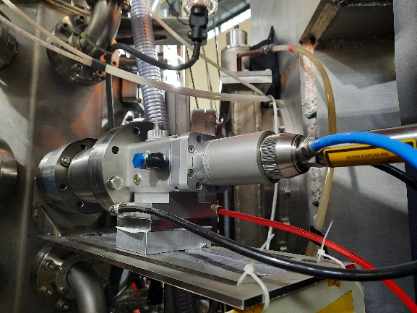
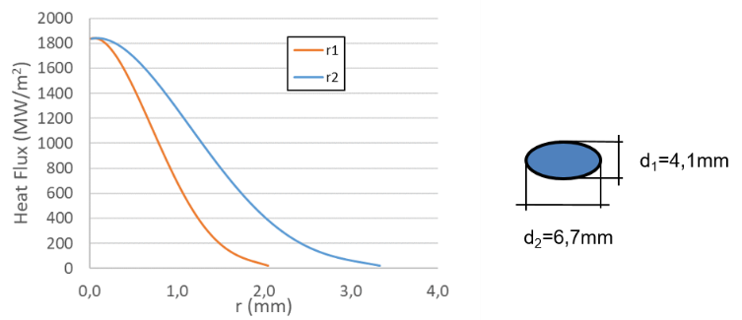
2023: Exposure of Sn wetted W CPS to high energy CW laser pulses
Power: 930 W continuous; 9300 W pulsed.
Pulses: 0.2-10 ms; 90 J energy; 10-2000 Hz
Continuous mode:
ITER (or DEMO) steady state: 10 MW/m² in 33 mm² area.
Slow transients: 20-70 MW/m² in 17-4 mm² area.
Pulsed mode:
Mitigated ELMs:
20 MW/m² for 0.5 ms in 130 mm² area. 2000 Hz. Disruptions or large ELMs:
0.15-6.5 GW/m² for 2 ms in 17-0.5 mm² area.
Laser Heat flux Gaussian profile at target position at maximum pulsed laser power (9300 W):
Ellipsoidal spot due to 52 degrees lateral incidence angle
July: Laser only experiments (6,7mmx4,1mm)
November: Laser + NBI experiments: Flat top lens (3,4mmx2,1mm)
We use Heat Flux mean values due to complications with laser beam
characterization (underestimated values).
Laser only experiments
The heat flux to the target is obtained using an absorbance of 40 % for the case of W and 23% for the case of Sn , and a window absorbance of 10 %.
E. Oyarzabal LMD 2023 review/2024 kick-off 8th of February Slide 6/12
Notes:
For conductive heat losses, characteristic of the CPS
solution, a maximum T gradient is sought. This implies high evaporation rates. Here we show the flux of lithium and tin from 3 different LM options. The temperature limits corresponding to a1% of the plasma particle flow for Li are shown. A much smaller limit applies to Sn due to its higher Z. No other sources of impurity are considered here. Thus, high impurity screening and low transport to the core are required. Both depend on the ionization mean free path of the LM atom. In addition, the kinetic energy of the species provides information about the release mechanism. Other issues have to be fulfilled

Slide 8
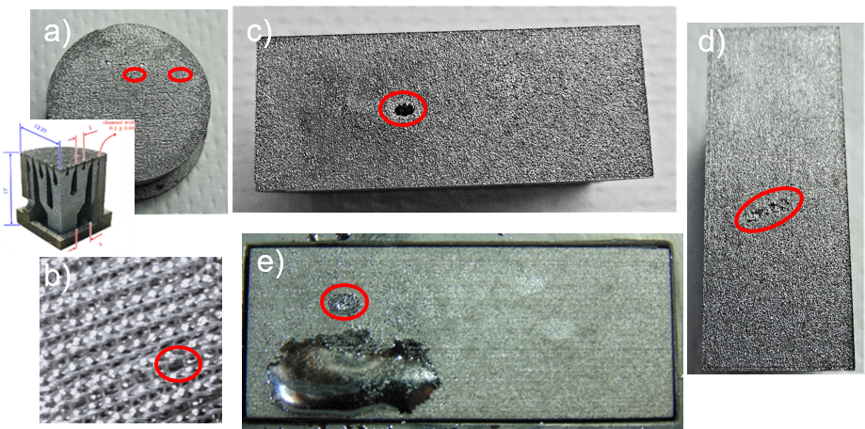
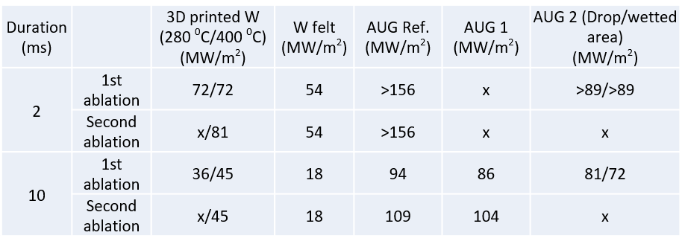
2023: Exposure of Sn wetted W CPS to high energy CW laser pulses
Exposed targets:
a) Sn wetted 3D printed W target: internal deposit and 100 mm pore size in the surface (3D printed W).
b) W felt from ENEA with 400 mm pore size (W felt).
c, d and e) AUG W with different filling degrees: c) reference with no Sn (AUG Ref.) d) 20% filling and after exposure to Magnum and OLMAT pulses (AUG 1) and e) after wetting at CIEMAT (AUG 2).
Ablation experiments:
Evaporation plume before ablation observed only for the AUG Ref target.
Higher energy of the laser necessary to have a second ablation in some cases, indicating that a higher heat flux is needed for the ablation of an already ablated area→ effect of loose particles or oxidized surface in first ablation.
Maximum in-situ ablation heat fluxes observed for AUG Ref. and AUG 1 where a pure W surface is exposed to the laser. Lower heat flux needed to produce the ablation of the Sn wetted W surfaces.
Higher heat flux needed for Sn drop ablation than Sn wetted area ablation (better thermal conductivity inside the drop?)
Table 1. Values of the mean heat flux absorbed by the targets at which ablation is observed.
E. Oyarzabal LMD 2023 review/2024 kick-off 8th of February Slide 7/12
Notes:
For conductive heat losses, characteristic of the CPS
solution, a maximum T gradient is sought. This implies high evaporation rates. Here we show the flux of lithium and tin from 3 different LM options. The temperature limits corresponding to a1% of the plasma particle flow for Li are shown. A much smaller limit applies to Sn due to its higher Z. No other sources of impurity are considered here. Thus, high impurity screening and low transport to the core are required. Both depend on the ionization mean free path of the LM atom. In addition, the kinetic energy of the species provides information about the release mechanism. Other issues have to be fulfilled

Slide 9
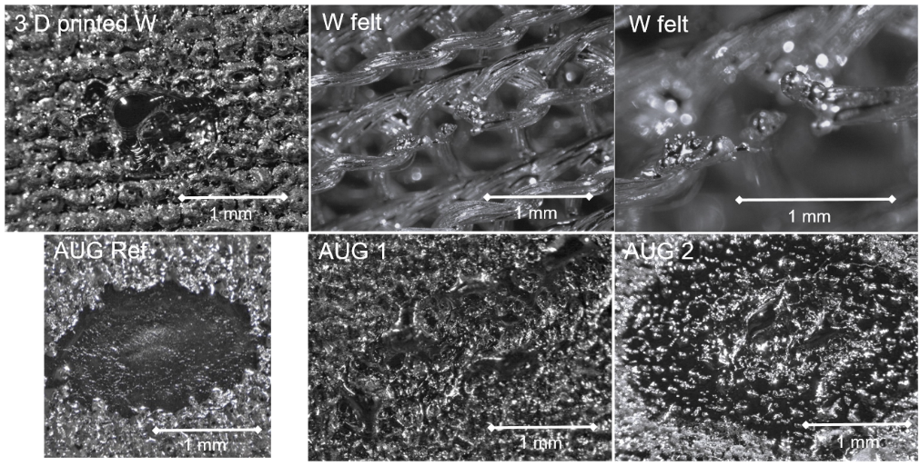
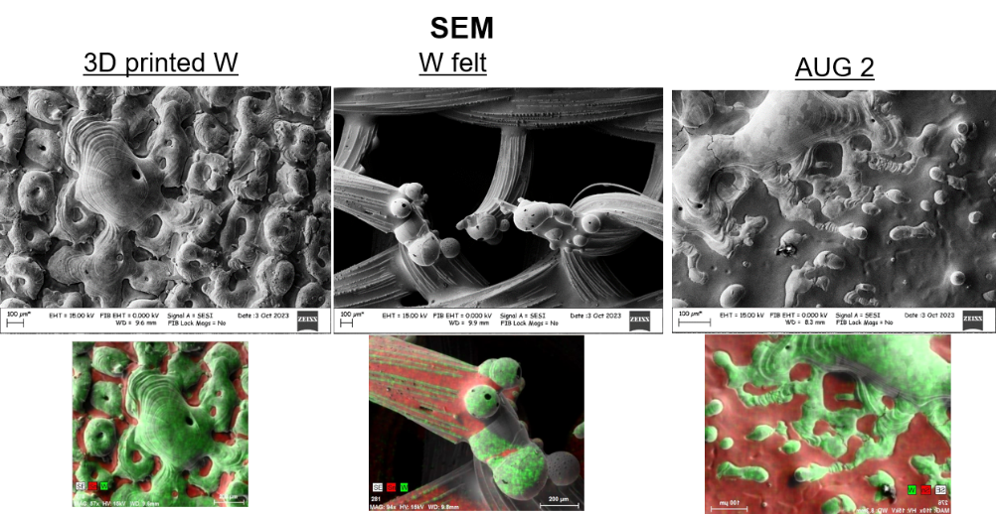
2023: Exposure of Sn wetted W CPS to high energy CW laser pulses
Crater characterization:
Targets with some Sn content present craters with molten W surrounding the center of the crater (not observed in the AUG Ref.)
In W felt the ablation produces the destruction of the Sn wetted W wires.
Elongated shape of the crater in AUG 1 due to simultaneous NBI and laser pulses and target displacement observed during the NBI pulses.
Clear difference between the AUG Ref. and the AUG 1 → Even when there is no Sn on the surface, the Sn content in the bulk of the W CPS has an effect in the ablation dynamics.
AUG 2
3D printed W
W felt
AUG Ref.
AUG 1
AUG 2
Fast camera images of the ablation for the 10 ms pulses..
E. Oyarzabal LMD 2023 review/2024 kick-off 8th of February Slide 8/12
Notes:
For conductive heat losses, characteristic of the CPS
solution, a maximum T gradient is sought. This implies high evaporation rates. Here we show the flux of lithium and tin from 3 different LM options. The temperature limits corresponding to a1% of the plasma particle flow for Li are shown. A much smaller limit applies to Sn due to its higher Z. No other sources of impurity are considered here. Thus, high impurity screening and low transport to the core are required. Both depend on the ionization mean free path of the LM atom. In addition, the kinetic energy of the species provides information about the release mechanism. Other issues have to be fulfilled

Slide 10
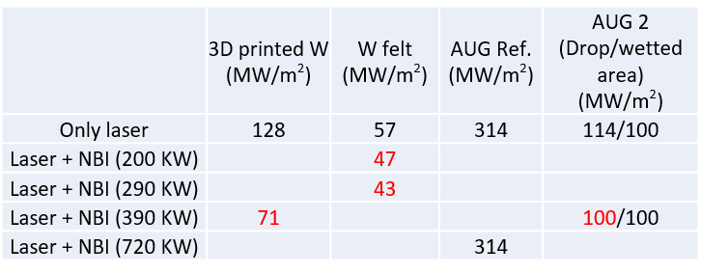
2023: Exposure of Sn wetted W CPS to NBI and high energy CW laser pulses (Ongoing analysis)
Ablation experiments:
Ablation on set at increasing NBI powers and ablation at highest laser energy (2ms pulses): Study of the crater formation (optical and SEM), particle ejection dynamics from fast camera recordings and optical spectroscopy:
As before highest ablation mean heat flux for W Ref. and lowest for W felt.
Small decrease of ablation heat flux for increasing NBI power in some cases.
Higher heat flux needed for Sn drop ablation than Sn wetted area ablation as before.
No noticeable effect of crater damage in surface temperature inhomogeneities or particle ejection dynamics during final only NBI exposure of the ablated targets (except for a brighter point at center in the 3D printed W target).
Study of particle ejection from fast camera recordings underway.
Optical spectroscopy results to be analyzed.
SEM analysis of exposed targets to be performed.
Values of the mean heat flux absorbed by the targets at which ablation is observed.
NBI 490 KW
NBI 390 KW
E. Oyarzabal LMD 2023 review/2024 kick-off 8th of February Slide 9/12
Notes:
For conductive heat losses, characteristic of the CPS
solution, a maximum T gradient is sought. This implies high evaporation rates. Here we show the flux of lithium and tin from 3 different LM options. The temperature limits corresponding to a1% of the plasma particle flow for Li are shown. A much smaller limit applies to Sn due to its higher Z. No other sources of impurity are considered here. Thus, high impurity screening and low transport to the core are required. Both depend on the ionization mean free path of the LM atom. In addition, the kinetic energy of the species provides information about the release mechanism. Other issues have to be fulfilled

Slide 11
2023: Exposure of Sn wetted W CPS to NBI and high energy CW laser pulses (Ongoing analysis)
Targets with some Sn content present craters with molten W surrounding the center of the crater as before.
No apparent effect on crater morphology with and without NBI exposure → SEM analysis needed to see Sn and W coverage.
Table 1. Values of the mean heat flux absorbed by the targets at which ablation is observed.
Laser
Laser + NBI
E. Oyarzabal LMD 2023 review/2024 kick-off 8th of February Slide 10/12
Notes:
For conductive heat losses, characteristic of the CPS
solution, a maximum T gradient is sought. This implies high evaporation rates. Here we show the flux of lithium and tin from 3 different LM options. The temperature limits corresponding to a1% of the plasma particle flow for Li are shown. A much smaller limit applies to Sn due to its higher Z. No other sources of impurity are considered here. Thus, high impurity screening and low transport to the core are required. Both depend on the ionization mean free path of the LM atom. In addition, the kinetic energy of the species provides information about the release mechanism. Other issues have to be fulfilled

Slide 12
Plans for 2024
Exposure of liquid Sn targets to NBI pulses, laser pulses and NBI+laser pulses:
New targets that may be manufactured by Eurofusion collaborators.
Exposure of the 21mm x 25 mmx 45 mm SnLi module from COMPASS:
For NBI exposure it has to be taken into account that in OLMAT
we do not reach the H₂ supersaturation, so it is not possible to observe
its effect.
W CPS targets manufactured by CIEMAT in collaboration with AENIUM by
additive manufacturing.
Variable in depth porosity to study the effect in droplet formation in the surface.
Variable geometry to study the effect in droplet formation in the surface.
Study of the effect of different wetting techniques (HIP assisted, with pre-percolated Sn, with Hydrogen radicals)
E. Oyarzabal LMD 2023 review/2024 kick-off 8th of February Slide 11/12
Notes:
For conductive heat losses, characteristic of the CPS
solution, a maximum T gradient is sought. This implies high evaporation rates. Here we show the flux of lithium and tin from 3 different LM options. The temperature limits corresponding to a1% of the plasma particle flow for Li are shown. A much smaller limit applies to Sn due to its higher Z. No other sources of impurity are considered here. Thus, high impurity screening and low transport to the core are required. Both depend on the ionization mean free path of the LM atom. In addition, the kinetic energy of the species provides information about the release mechanism. Other issues have to be fulfilled

Slide 13
Plans for 2024
Continuing the vapor shielding experiments with the new targets:
Rate of collisional processes (ionization) between gas atoms and energetic particles peaks at keV range energies→ Relevant case when compared to Intra-ELM phase ion energies →How ELMs and/or energetic particles may affect radiative characteristics of LM clouds in detached-like state?
Collaboration has started with theory group (UAM) to study basic atomic processes at keV range energies (Sn⁰+H⁰, Sn⁰+H⁺ …)
Exposure of a hybrid flowing-CPS liquid Li element (collaboration with Center for Plasma Material Interactions, Illinois) to OLMAT CW laser pulses.
Exposure of Li and SnLi wetted W CPS to CW laser to compare with Sn results.
Bubble formation and droplet ejection studies in the laboratory with exposure to hydrogen radicals:
Study of the effect of variable in depth porosity.
Study of the effect of filling degree.
Attempt to optimize the design so the bubble formation due to supersaturation with H₂ does not happen in the exposed surface to avoid the problems of particle ejection.
E. Oyarzabal LMD 2023 review/2024 kick-off 8th of February Slide 12/12
Notes:
For conductive heat losses, characteristic of the CPS
solution, a maximum T gradient is sought. This implies high evaporation rates. Here we show the flux of lithium and tin from 3 different LM options. The temperature limits corresponding to a1% of the plasma particle flow for Li are shown. A much smaller limit applies to Sn due to its higher Z. No other sources of impurity are considered here. Thus, high impurity screening and low transport to the core are required. Both depend on the ionization mean free path of the LM atom. In addition, the kinetic energy of the species provides information about the release mechanism. Other issues have to be fulfilled

Slide 14
Thank you!
Notes:
For conductive heat losses, characteristic of the CPS
solution, a maximum T gradient is sought. This implies high evaporation rates. Here we show the flux of lithium and tin from 3 different LM options. The temperature limits corresponding to a1% of the plasma particle flow for Li are shown. A much smaller limit applies to Sn due to its higher Z. No other sources of impurity are considered here. Thus, high impurity screening and low transport to the core are required. Both depend on the ionization mean free path of the LM atom. In addition, the kinetic energy of the species provides information about the release mechanism. Other issues have to be fulfilled

