Slide 1
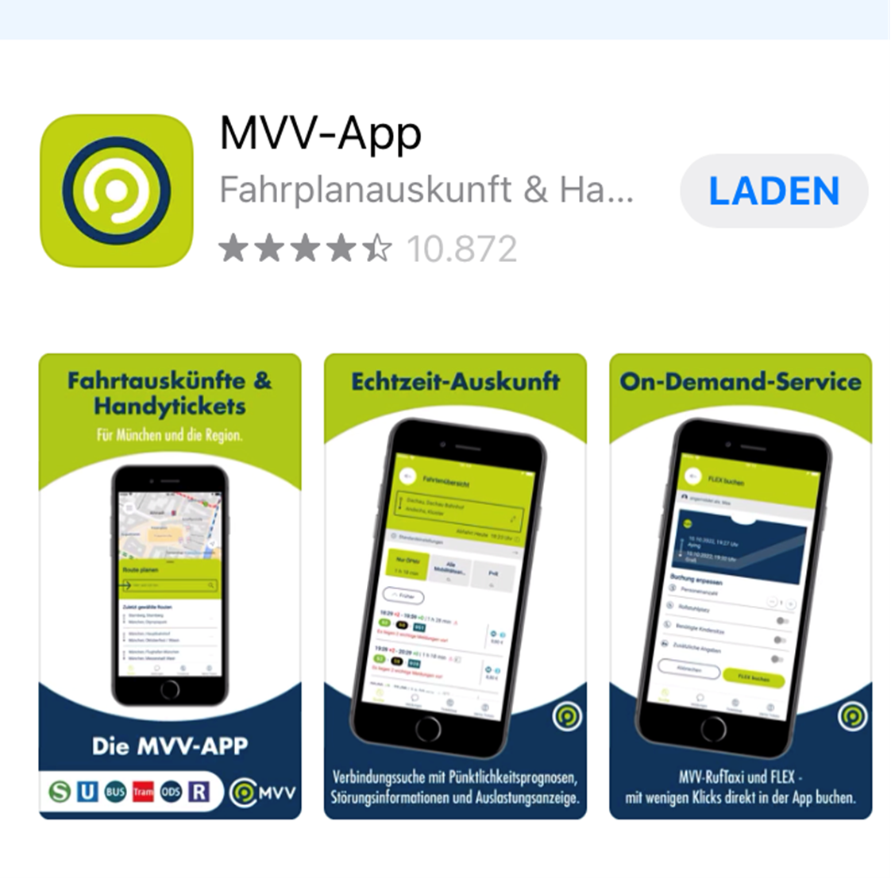
Single Day Ticket: 3 zones (9,50€)
Group Day Ticket for up to 5 people: 3 zones (19,20)
this is how it looks in Apple-Store →

