Slide 1
Perspective of the Plasma Science for ITER, DEMO and stellarators department
EUROfusion E-TASC General Meeting
Marco Wischmeier and Sara Moradi for the Plasma Science Department with contributions from PLs and TFLs
11th of November 2024

Slide 2
Objectives of the Plasma Science Department
Address physics gaps for ITER with the priority on the ITER re-baselining
Support the DEMO physics programme
Identification of physics gaps towards a stellarator-based reactor
Increase focus on interpretative modelling
Aiming at addressing uncertainty qualification for interpretative modelling & in extrapolations for ITER and DEMO
Organized in 4 Work Packages:
Tokamak Exploitation (WP TE, N. Vianello, E. Tsitrone), Plasma Wall Interaction & Exhaust (WP PWIE, S. Brezinsek), W7-X Exploitation (WP W7-X, M. Jakubowski) and JT-60SA Enhancements & Commissioning (WP SA, C. Sozzi) & hosting WP PrIO (X. Litaudon) until end 2024

Slide 3
Open questions for ITER & DEMO
ITER & DEMO essential objectives for EUROfusion
Increased integration between engineering & physics to address high priority topics:
Alternative to type I ELM scenarios – aka ELM free or small ELM scenarios
ITER ELM mitigation methods (RMP ELM mitigation, pellet ELM pacing) validation for DEMO
Develop theoretical & empirical predictive capability for the pedestal top with all relevant ELM mitigation methods and ELM-free regimes
W transport and screening
High dissipative solution for PFC protection
Divertor reattachment: characterize relevant timescales
First wall and divertor erosion – large uncertainty on first wall, nearly no information for alternative to type I scenarios for DEMO
Dynamic phases: ramps up and down, PFC protection in presence of H&CD actuators
High-beta advanced or hybrid scenarios under DEMO – focus on ideal and non-ideal MHD stability (i.e. beta- limit, RWM, NTMs et cetera)
The established link between DCT & Plasma Science had a major impact on final JET 2022/23 experimental programme (e.g. QCE, X-point radiator, magnetic flux pumping) & continues to guide experiments on ASDEX Upgrade, MAST-U, TCV and WEST

Slide 4
The role of Subjective Scientific Readiness Levels
Level | Criteria
Emerging | Little or no understanding yet on WP TE devices
Exploratory | Physical process is assessed on WP TE devices, transposing to ITER or DEMO is uncertain
Judgemental | Controlling physical processes has been assessed on WP TE devices, but extrapolation to ITER/DEMO requires scalable parameters and further investigation
Mature - needs underpinning | Good understanding of controlling physical processes on WP TE devices, but major uncertainty in view of transposing ITER/DEMO
Mature - needs support | A good understanding has been achieved on WP TE devices, further research exploring ITER or DEMO relevant parameters
Established | Understanding is well developed and can be applied to ITER or DEMO
Definition established within WP TE in 2021 and monitored since then, to be extended to PWIE end of 2024 and W7-X in 2026/2027 (towards stellarator DEMO physics gaps)

Slide 5
Status and Changes in SSRLs for 2023
Level | Emerging | Exploratory | Judgemental | Mature-needs underpinning | Mature-needs support | Established
RT | Title | D1 | D2 | D3 | D4 | D5 | D6 | D7
RT22-01 | Core-Edge-SOL integrated H-mode scenario compatible with exhaust constraints in support of ITER | X |  | X |  | X | X | X
RT22-02 | Physics understanding of alternatives to Type-I ELM regime |  |  | X |  |  | X
RT22_03 | Strategies for disruption and run-away mitigation |  | X |  |  |  | X
RT22_04 | Physics-based machine generic systems for an integrated control of plasma discharge | X |  | X |  | X
RT22-05 | Physics of divertor detachment and its control for ITER, DEMO and HELIAS operation |  | X |  |  |  | X
RT22-06 | Preparation of efficient Plasma Facing Components (PFC) operation for ITER, DEMO and HELIAS |  | X |  | X | X
RT22-07 | Physics understanding of alternative divertor configurations as risk mitigation for DEMO | X |  |  | X
RT22-08 | Physics and operational basis for high beta long pulse scenarios
RT22-09 | Physics understanding of energetics particles confinement and their interplay with thermal plasma |  |  |  |  | X
DX: Numerator of deliverable or scientific objective
“X” marks a scientific objective of an RT with a change of the SSRL in 2023 compared to 2022 based on the level 3 reporting

Slide 6
Need for systematic SSRL & uncertainty quantification
Uncertainty quantification in interpretative modelling is essential
Aim to train modellers on best practices to achieve uncertainty quantification
Assist the modelling community with required tools to apply these on a regular and systematic basis
Pre-requisite to extrapolate to ITER & for DEMO to determine margins for design

Slide 7
TSVVs: Requirements for validation & verification
The physics cases for validation should happen in coordination between EUROfusion needs and interaction with internal programs
EUROfusion provides both a platform of devices (tokamaks, stellarators, linear devices) & computational support
EUROfusion will prioritize experimental proposals for code validation across devices – but we need the requests – even an L-mode will have high priority if needed!
Code validation proposals inside EUROfusion are NOT connected to high demand on reporting as might be believed – the reporting is done through RT and/or Sub projects in the various work packages, not necessarily by the individual proponent
The preparation of experiments for code validation will also sharpen the dialogue on requirements for success and for what might already be available beyond what Thrusts could possibly provide

Slide 8
Feedback from PSD – it works well!
WPPWIE Sub Projects & TSVV-5, TSVV-6, TSVV-7 (common meetings, interaction, plasma backgrounds, atomic data, code camps, moderate flexibility towards addressing full W-ITER) – personal involvement in both WPs
Scientific achievements of TSVVs 12 & 13 so far considered outstanding: new promising configurations and benchmarked gyrokinetic codes for stellarators
TSVV-5, TSVV-6, and TSVV-7 provide code packages, which need still development in the next years, modules existing and being used, modular approach beneficial to merge codes to new suites
EUROfusion should ensure that operational tools, broadly defined to include methods, codes and procedures are ready before ITER application (tested, validated and reliable)
WP PrIO providing Multi-machine databases (Disruption, Pedestal, Confinement, IR images and soon L-H transition)
TSVV 13: Systematic simulation electromagnetic & Multiscale stellarator turbulence, Advanced multispecies simulations, Predictions of heavy impurity transport for design of metallic wall

Slide 9
Feedback from PSD – additional features are needed
WP TE thrusts not always helping as expected – should it be merely as communication channel?
e.g. Validation plan needs to be specified for TSVVs across WPs with a schedule
Status and evolution of TSVV11 (integrated modelling) crucial for PSD programme across various WPs and as basis for extrapolations in regimes relevant to ITER/DEMO – currently a bit unclear
PWI-Plasma coupling (iterative loop with plasma cooling) – missing temporal evolution
Time-resolved simulations (slow and fast transients, catch turbulence aspects) – missing features
TSVV 12 (Stellarator optimization): Optimization of divertor (here in general role of drifts and control of power and particle exhaust), edge transport, role of core electromagnetic turbulence; Exploration of novel concepts – missing features

Slide 10
Feedback from PSD – Programmatic considerations
How do the PIs decide on verification datasets – A dialogue between WPs and PIs is needed to identify show cases
E-TASC SB to provide long-term recommendations on prioritizations (long term i.e. beyond 2025/2027)
Missing code developments in area of technology and with strong links to physics – high/low TRL/SRL or subsystems (e.g. NBI injector, Breeding blanket dynamics, Fuel system, ECRH developments) – could be new TSVVs?
Need for research and activities in system engineering and model-based system engineering in view of the complexity of the ITER/DEMO design activities as well as plasma/system control needs – different from Process codes (TSVV14)

Slide 11
TSVV integration & dissemination
Expectation management needs to be corrected – WP-TSVVs-ETASC-Community
TSVVs are providing excellent progress on code development
Thrusts are addressing the links to WPs but could be better
A need to provide a timeline when codes are mature & can be expected ready for deployment (e.g. code’s dependence on system size TCV vs JET/JT-60SA vs ITER/DEMO)
Dissemination & training – roles of WPs/PIs and the question of availability of human resources
Accelerate dissemination:
The horizon for the operation of ITER is 10ys, the horizon for the finalization of the design of DEMO and begining of DEMO construction is 10-15ys
The timing for the dissemination of codes is critical for these to be applied and tested through interpretative modelling for influence on preparation of the operation & design

Slide 12
Where are we …?
Artificial intelligence & Machine Learning:
How does the E-TASC SB foresee the oversight and evolution of the AI projects – data curation & availability?
Assess the outcome and value of the existing AI/ML projects prior to start of new activities on AI/ML
Status of TSVV 15 (Pulse Design Simulator) –
Is there a requirement for interaction with Work Packages and if yes to which extent and when?
What are the desired and expected outcomes for ITER?
Data Management Plan progress?
Fair for Fusion is an important element for the community,
IMASification of JET, AUG, …
Access for users

Slide 13
PSD proposal for extending TSVV application & dissemination
TSVVs are communities of mainly developers with limited resources on application & specific validation tasks to address WP objectives.
We believe that a way forward is to expand the TSVVs application/dissemination sides by adjusting their available resources, as the TSVVs are in a better position to provide the training and additional support needed to expand their user community.
The resources should sit within each TSVV while the plans for what should be done is defined through a dialogue with WPs:
A joint shopping list of projects both on validations & code developments i.e. additional features to address WP needs: PI & WPs make the proposed list & PSD-DSD & E-TASC SB review and recommend the priorities & financing
2-3 people each person @ roughly 0.5 ppy/year, (not much less)
Provide tangible results by the end of 2025 & a perspective for 2026/2027
An enhancement of the TSVV with a targeted application to WP needs, no additional reporting
To boost community of users

Slide 14
Evolutions on JT-60SA
To ensure alignment of scientific exploitation of JT-60SA with priorities & objectives of EUROfusion programme - (modelling activities to prepare) exploitation under WP TE
Re-prioritize scientific objectives for C phase assuming only inertially cooled C wall
Define scientific priorities for W wall
Define possible scenarios in W wall & their impact on additional requirements e.g. ECRH heating, diagnostics, W divertor & W first wall on JT-60SA, …
WP SA leader C. Sozzi to provide overall coordination platform across various WP involved (WP DIV, WP PWIE, WP SA, WP TE)
Initiated discussions at various levels with F4E, QST, ITER:
Promote early transition to W → aim is to secure start of JT-60SA operation with W wall > 1 year before ITER operation
Provide a structure to participate to device operation, promote information exchange between scientific teams and machine operation, establish procedures/platforms for data validation → part of transition from initial integrated commissioning to scientific exploitation expected to start late 2026

Slide 15
New activities in PSD for 2025
ITER:
Initiating documentation of activities across all WPs towards ITER starting with ITER modelling; to extend in 2025 towards experimental activities & their relationship with ITER re-baselined Research Plan
JT-60SA:
fast track Transition to W Activly cooled divertor & W wall
Stellarators:
Launching activity to identify Stellarator DEMO physics gaps and produce document by end 2025 ➔ assist prioritization of EUROFusion programme on exploiting stellarator line
Burning plasma Experimental Superconducting Tokamak (BEST) under construction in China: Produce 1st version of joint Research Plan for BEST by end of 2025:
Aim to identify if & to which extent EUROfusion could/should embark on a joint scientific exploitation of BEST

Slide 16
Slides with additional information by WPs to guide discussions

Slide 17
TSVV 1 – TSVV2 - TSVV 5 – TSVV 11 – individual codes inside various TSVVs - WP PWTE

Slide 18
WPTE modelling needs across multiple RTs
Gyrokinetic pedestal transport:
Addressing the role of mid-Z impurities (RT01, RT05) in setting the pedestal and edge transport → TSVV1
Check transition of dominant instabilities moving from ballooning limited pedestal/peeling limited pedestal (RT01) → TSVV1
Triangularity effect on pedestal transport modification (QCE/NT) → TSVV1, TSVV2
High-Z impurity transport for W screening: Neoclassical approach not sufficient need to tackle it with high-fidelity code → TSVV1, TSVV06. Clear missing link with the TE work-package
L-H transition and radial electric field: already within the radar of TSVV1 (dependence on field direction, current/density scaling). Urgent need to validate the proposed new ITPA scaling for metallic device
Boundary plasma modelling:
High-fidelity turbulence fluid code application to WPTE so far limited (example in RT05 and TCV-X23)
Increase the user base (GRILLIX/SOLEDGE3X/GBS/GENE-X) and apply to H-mode: needed for RT01 and RT02 to guide the assessment on far SOL and inform erosion codes, for RT05 for XPR transport (strongly filamentary in the SOL). Scalability/readiness towards H-mode, high-density, impurity seeded
Development in Neutral Gas Dynamics (TSVV-05): uncertain dissemination of last results among Boundary modellers in within WPTE

Slide 19
WPTE modelling needs across multiple RTs
Integrated modelling:
Large effort devoted in present WPTE program: RT01, RT05, RT08 to some extent RT02, RT09. Strengthening the link between TE modellers/TSVV11 and ensuring good practice usage/improved tools
Cross-dissemination of the results happening so far on a voluntary basis
Integrated modelling of MHD transients:
JOREK modelling of ELM modification due to seeding (RT01 and RT05) up to ELM suppression. Limited resource available within WPTE
MHD resistive pedestal stability (RT01, RT05, RT02)
Core GK transport (reduced and high-fidelity codes):
Core transport modification as a consequence of elevated q-profile, modification of ExB velocity and ITB (RT08) or Negative Triangularity (RT02)
Energetic particles
Requires high accuracy plasma equilibria, high fidelity FI distribution functions for stability calculations (integrated modelling codes), GK simulations for interpretation of turbulence and zonal flow effects.
Synthetic diagnostics/diagnostic simulation for comparison to experiments (RT09)

Slide 20
General consideration
The physics cases for validation should happen within EUROfusion and not based on personal knowledge/interaction with internal program
Clear need to increase user’s basis for specific codes: GK, advanced turbulence codes (GRILLIX is a clear example), JOREK as well as to disseminate good practice
Regular feedback on advancement of codes: Thrust not always working as expected, other mechanisms to be considered/proposed?
TSVV PIs are strongly encouraged to actively participate to TFM meeting, at least at the review/GPM
Some of the RTs are promoting modelling specific meeting at the working level. Expert from TSVVs will be extremely appreciated as participants
Code dissemination and training needed

Slide 21
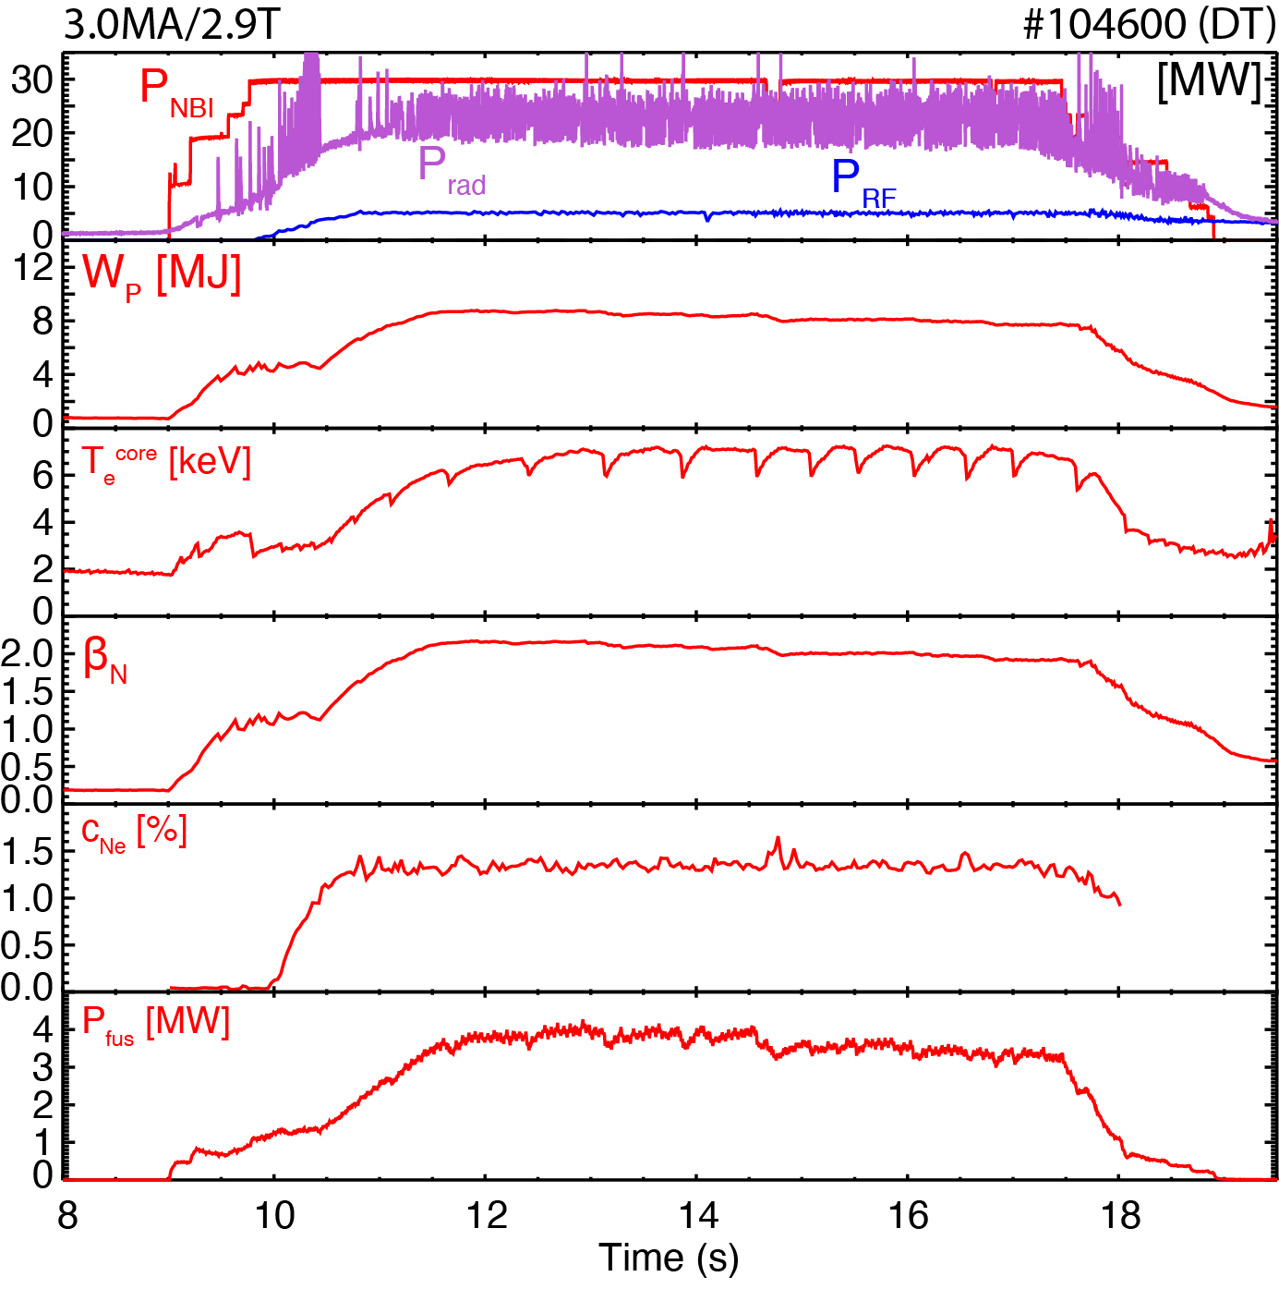
RT01: High performance Plasmas compatible with Exhaust Solution
WPTE Topic:
At full performances ITER operation requires high confinement scenarios with heat load withstanding capabilities
The chosen strategy achieved via a combination of high gas throughput (high divertor neutral pressure) and extrinsic impurity seeding
A core-edge integrated scenario with ITER like established in DD and DT with current ranging from 2.5 to 3.2
Modelling need:
Pedestal GK to check impurity effects (partially secured within WPTE) → extended to DT
Integrated transport: on-going within WPTE (Jintrac/COCONUT) to check consistency with TSVV11
Advanced edge turbulence: GRILLIX/TOKAM3X/GENE-X to understand edge and SOL transport. So far Missing
W transport (no signature of W accumulation in these scenario).
Erosion

Slide 22
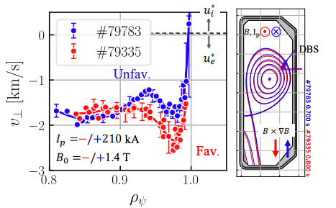
RT01- Linking Edge Flows to the Magnetic Geometry Asymmetry in Tokamaks
WPTE Topic:
Multi-machine (WEST/TCV) investigation of edge flows in favorable/unfavorable ion 𝐵 × ∇𝐵 drift direction
Deeper Er observed in favorable configuration in both devices
On WEST Clear deepening of 𝐸𝑟 with 𝐼𝑝 in Unfav. (not only Ohmic) discharges
Modelling need:
GK including Er evolution
Advanced fluid/turbulence code
Nevertheless opposite trend observed for unfavorable Er profile modification with Ip
Work in progress for addressing the modification with linear/non-linear GK modelling
Courtesy from S. Rienäcker, L. Vermare, P. Hennequin

Slide 23
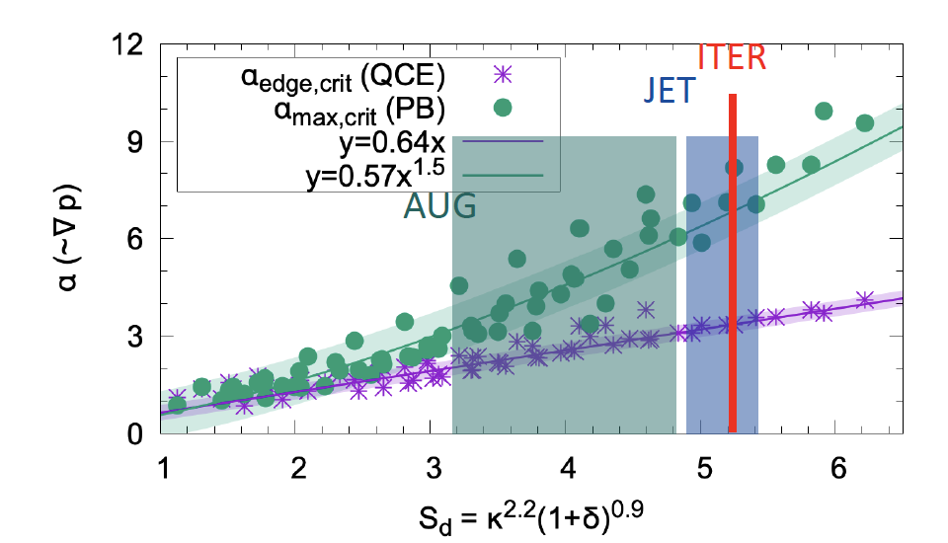
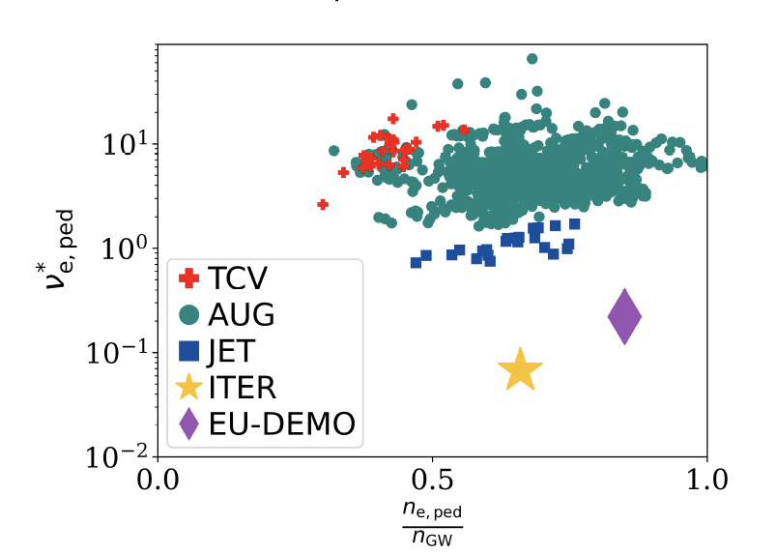
RT02: Quasi-Continuous Exhaust (QCE) regime
WPTE Topic:
QCE is a promising alternative to type-I regime
QCE robustly established in AUG, JET & TCV
﻿G.F. Harrer et al 2018 Nucl. Fusion 58 112001
M. Faitsch et al, sub. to NF
B. Labit et al 2019 Nucl. Fusion 59 086020
Exists at wide range of P_{sep}, reasonable normalised confinement, at relevant q₉₅ (<= 4)
Pedestal top ν* lower in larger machine, as expected -> projects towards ITER
Critical α_{MHD} for threshold combined with α_{t} broadening for n_{e,sep,crit}
Projection to ITER (or other large devices) very favourable!
Modelling need:
SOLPS-ITER + ERO 2.0 for proper evaluation of erosion
Ideal and resistive MHD both linear and non-linear (JOREK)
Advanced fluid codes as GRILLIX/SOLEDGE3X/GBS
M. Faitsch – AAPPS-DPP 2024

Slide 24
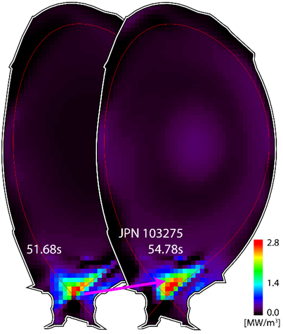
RT05: The X-Point Radiator XPR: a power exhaust solution in view of DEMO
WPTE Topic:
XPR is a Stable scenario, controllable in real time
Exists in cabon or metallic machines (TCV, AUG, WEST…)
Exists with various impurities (N₂, Neon, Argon, Krypton)
Features full detachment and highest radiated power fraction
Can provide ELM suppression
The XPR is a region of high radiation with low temperature (1-2 eV), high density inside the confined plasma at/above the X-point
WEST
ASDEX Upgrade
JET
Modelling needs:
Already on-going effort for code validaiton in high-density (TCV-X23)
Ideal and resistive MHD both linear and non-linear (JOREK)
Advanced turbulent codes for edge/SOL transport
GK pedestal simulations addressing the role of single and multiple impurities
Integrated modelling (JINTRAC/COCONUT)

Slide 25
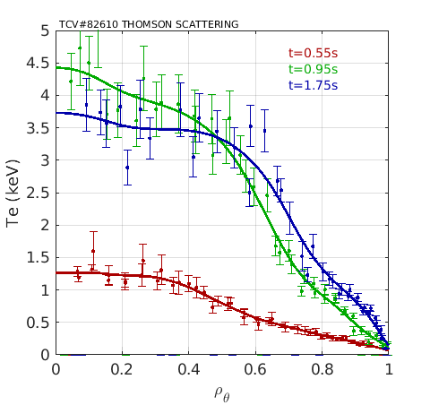
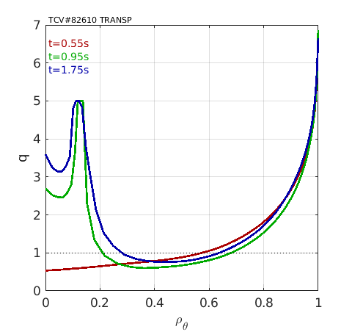
RT08: Non-Inductive Operation at high 𝞫
TCV
Steady-state fully non-inductive Double transport barrier (DTB) achieved with combination of on/off-axis heating and current drive (both co/cntr-Ip) ECRH and NBI
Modelling needs:
Integrated transport modelling
GK core modelling to infer variation of core-turbulence in presence of DTB
S. Coda, C. Piron, F. Auriemma, A. Bock

Slide 26
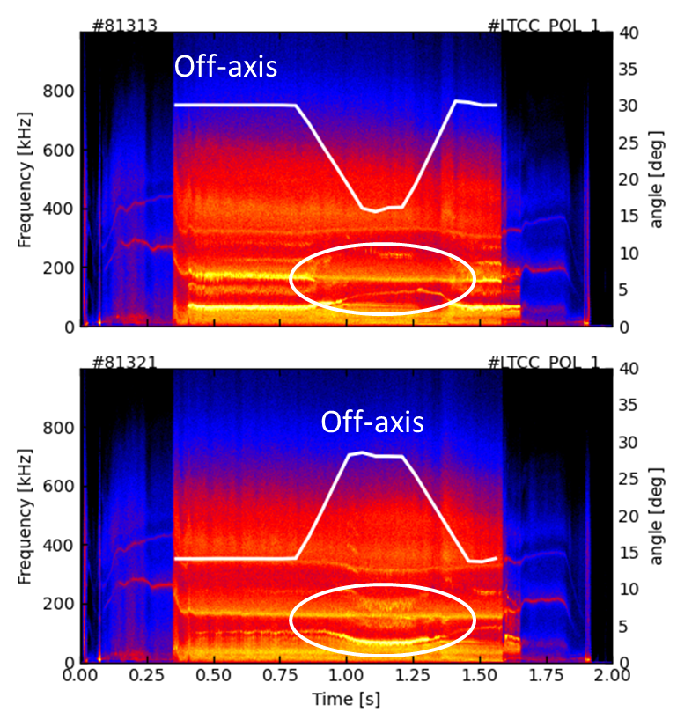
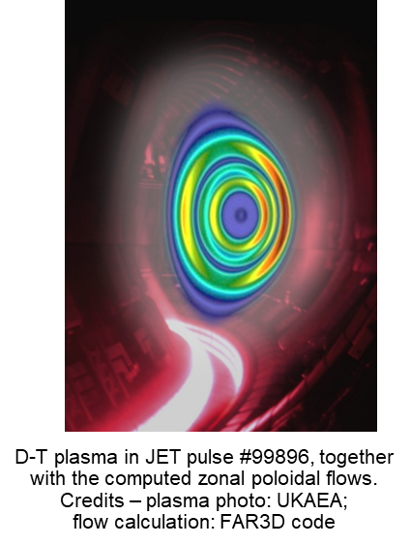
RT09: Energetic Particles
Plasma equilibrium and stability modelling of Alfvenic eigenmodes (e.g. HELENA+CSCAS) For interpretation of e.g. AE suppression by ECRH (see illustration)
High accuracy plasma equilbria for correct q-profile
Uncertainty assessments of key plasmas – intensive activity in terms of effort/computational time
Integrated modelling required to produce accurate FI distribution functions (e.g. TRANSP + ASCOT)
High fidelity FI DFn requires running e.g. ASCOT on Marconi cluster with large number of marker particles for good resolution in energy/pitch-angle space
ELM-TAE interaction (e.g. MEGA)
Synthetic diagnostics/ diagnostic analysis techniques
FIDASIM, FILDSIM, FILD tomography, DRESS, NPA/INPA/SSNPA, CTS
GK + Global gyrofluid simulations – e.g. CGYRO + FAR3D (see illustration)

Slide 27
TSVV 5 - TSVV 6 - TSVV 7 - WP PWIE

Slide 28
General WPPWIE view on TSVVs
Good direct interaction between WPPWIE Sub Project and TSVV-5, TSVV-6, TSVV-7 members
WPPWIE provides input in atomic and molecular data, plasma backgrounds, reference experiments in
linear devices, post-mortem analysis from tokamaks and stellarators to benchmark, complementary
simulations, validation of code packages in laboratory experiments, etc.
Overall coordination via PI, WPL and experts in Thrust including WPTE and WPW7X
Interaction benefits from personal involved in both packages. common meetings, code camps etc.
Moderate flexibility within the given scope of the TSVVs exist to address actual new questions (full-W ITER)
TSVV-5, TSVV-6, and TSVV-7 provides code packages, which need still development in the next years,
BUT parts and modules are already:
- usable for predictive modelling for full-metallic devices within EUROfusion portfolio or beyond
- usable for interpretative modelling of plasma-edge, plasma-wall interaction and exhaust as benchmark
Modular code development (e.g. CRM, grids) will permit to merge codes to new suites (e.g. EIRENE-ERO2.0)
Main missing points from WPPWIE perspective
real PWI-Plasma coupling (iterative loop with plasma cooling)
time-resolved simulations (catch turbulence aspects)
plasma conditions at recessed areas
Notes:
Oben „allgemeine Aussage über Status“
Unten „zukunft“

Slide 29
WPPWIE view on TSVV-5 and TSVV-6
TSVV-5: : Neutral Gas Dynamics in the Edge
Code development supports multiple plasma boundary simulations used in WPPWIE
Experiments in linear devices executed and comparison with SOLPS-ITER simulations including EIRENE
as well as atomic and molecular data and CRM within EIRENE at “cold” plasmas ongoing
A &M data and CRMs for D needs to be benchmarked vs. experiments with rovibrational resolution (MAR etc.)
A &M data and CRMs for different hydrogen isotopes required (DT plasma simulations etc.)
Energetic and angular resolved charge-exchange distribution functions as standard output for PWI codes
TSVV-6: : Impurity Sources, Transport, and Screening
Development and benchmarks of SOLEDGE3X vs. WEST plasmas regarding W source, transport and screening
Benchmark of Wendelstein7-X plasmas and transport with ¹³C marker using EMC3-EIRENE-ERO2.0 suite
Comparison of SOLEDGE3X-ERO2.0 vs. EMC3-EIRENE-ERO2.0 and benchmark vs. full-W device experiment
Predictive simulations of full-W ITER plasmas with RMP (including EIRENE Trace Ion Module benchmark)
Transfer to integrated modelling workflow and inclusion of pedestal as source of energetic neutrals causing W erosion at first wall
Notes:
Unten „Grün“ wo gab es wichtigen input zu PWIE
„Schwarz“ was man sich wünscht von PWIE für die Zukunft

Slide 30
WPPWIE view on TSVV-7
TSVV-7: : Plasma-Wall Interaction in DEMO
Workflow for PWIE established for reference H-mode SOLPS-ITER plasma with Ar seeding: extrapolation of
net W erosion of first wall and fuel retention in PFCs for DEMO and transients (code-suite for metallic devices)
Support of melt-layer motion code development, benchmark experiments, analysis and interpretation
Benchmark of code-suite versus new full-W device experiment/samples (e.g. AUG with semi-detached divertor)
Predictive simulations with mixed plasma species: isotope effects in plasma, at the interface, and in the material
Expanding code development towards RE-beam impact, damage and associated W erosion (link to TSVV-9)
Dust transport in steady-state conditions: coupling of Migraine and ERO2.0 to mimic transport to remote areas
Notes:
„Grün“ wo gab es wichtigen input zu PWIE
„Schwarz“ was man sich wünscht von PWIE für die Zukunft

Slide 31
TSVV 11 - WP PrIO

Slide 32
Work-Package ‘Preparation of ITER Operation’ (PrIO)
In the context of the ITER revised baseline with the aim of achieving Q=10 as soon as possible, EUROfusion should ensure that operational tools, broadly defined to include methods, codes and procedures are ready before ITER application (tested, validated and reliable)
Sub-project SP-2 “Preparation of ITER first experimental campaigns “
Multi-machine databases (Disruption, Pedestal, Confinement, IR images and soon L-H transition) and AI/ML projects
ITER Synthetic diagnostics, Integrated Data Analysis and Operational tools
Outlook “ ITER Operational Scenario modelling with the new W-Wall based on the EU experimental results”
Sub-project SP-3 “Plant systems and plasma operation”
Outlook: integrate the pulse design tools with the ITER synthetic diagnostics + Wall protection ?
Sub-project SP-4 “ITER Neutral Beam test Facility and R&D for the ITER Neutral Beam”
Outlook: new TSVV on fully integrated NB Injector simulations ?
Sub-project SP-5 “Neutronics, Nuclear waste and Safety”
Integration of plasma transport code (neutron emission) with Monte-Carlo radiation transport codes for ITER nuclear analysis
Development and validation of multi-physics modeling tools coupling neutronics activation and fluid-dynamics
Outlook : Support the EU neutronics code development, open source and standardization

Slide 33
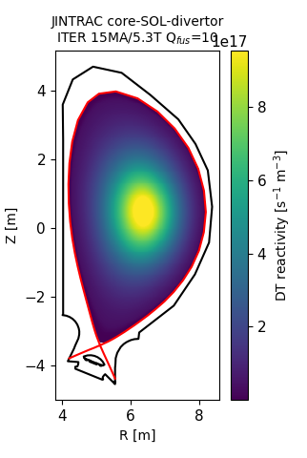
Integration of plasma transport code with Monte-Carlo radiation transport codes for ITER nuclear analysis
Advanced computational workflow comprises plasma transport (JINTRAC), fast ion transport (ASCOT), neutron spectrum calculations (DRESS), and MCNP neutron transport code :
Validation on JET and application to ITER (in 2025 and beyond)
ITER 15MA baseline Q_{fus}=10 scenario
Adaptation of the neutronics calculations + synthetic diagnostics for ITER in the context of the revised ITER research plan
demonstration of JINTRAC-DRESS-MCNP workflow compatible with IMAS
application to neutron synthetic diagnostics studies
Total neutron emissivity
[Ž. Štancar et al 2021 Nucl. Fusion 61 126030]

Slide 34
ACH/TSVV LINKS
PrIO Sub-project | PrIO ACTIVITY | NEEDS from ACH | TSVV link | DMP link
SP-2 “Preparation of ITER first experimental campaigns | Multi-machine databases : Disruption, Pedestal, Confinement, IR images and upcoming L-H transition AI/ML projects | Support for deployment on the EUROfusion Gateway and release of user interface Support to adaptation to latest IMAS DD Support for AI/ML database exploitation | Outlook: ITER Operational Scenario modelling with the new W-Wall based on the EU experimental results | Provision of data
 | ITER synthetic diagnostics (FILD, FOCS, IR, magnetics, bolometer, radial neutron camera, gamma ray spectrometer) Integrated Data Analysis Operational tools (breakdown workflow) | Support adaptation to IMAS standardization, open source | Data for/from synthetic diagnostics | Data for validation
SP-3 “Plant systems and plasma operation” |  |  | Strengthen the link with TSVV15 Pulse Design Tool Integrate the pulse design tools with the synthetic diagnostics for ITER + Wall protection ?
SP-4 “ITER Neutral Beam Test Facility and R&D for the ITER Neutral Beam” |  | Support to NBTF simulations (HPC) | Outlook: new TSVV on fully integrated NB Injector simulations ?
SP-5 “Neutronics, Nuclear waste and Safety” | validation of multi-physics modeling tools coupling neutronics activation and fluid-dynamics | Support for ITER neutronics simulations (HPC) Support adaptation to IMAS, open source and standardization | TSVV 10 (ASCOT/ATEP) TSVV11
| PrIO X Litaudon & G Falchetto | E-TASC meeting| Garching 11-15 Nov. 2024

Slide 35
TSVV 12 – TSVV 13 - WP W7-X

Slide 36
Thrust 4: Stellarators. Interface between WPW7X and TSVVs 12 & 13
TSVV 12, Stellarator Optimization; TSVV 13, Stellarator Turbulence Simulation
Scientific achievements of TSVVs 12 & 13 so far are outstanding.
TSVV 12: Before 2021, no magnetic configuration was known with the potential to be the basis of a stellarator reactor design. Now, there are several good candidates.
TSVV13: Europe now has several stellarator gyrokinetic codes that have been benchmarked and are being validated against current experiments. Application of these codes has greatly advanced our understanding of electrostatic turbulence.
Codes developed under TSVVs 12 & 13 are of high relevance for WPW7X.
The topics of TSVVs 12 & 13 will still be of high priority in the following years, with key subtopics to be addressed and key questions to be answered.
An informed decision on building a stellarator reactor needs those answers.
Tools to answer those questions developed in TSVVs and validated in WPW7X.
Notes:
Códigos de alta fidelidad para el transporte en el borde del plasma.

Slide 37
Thrust 4: Stellarators. Interface between WPW7X and TSVVs 12 & 13
TSVV 12, Stellarator Optimization; TSVV 13, Stellarator Turbulence Simulation
Key subtopics and key questions after 2025 and after 2027.
TSVV 12
Optimization of
divertor,
edge transport,
core electromagnetic turbulence.
Exploration of novel concepts; e. g. piecewise omnigeneity.
TSVV 13
Systematic simulation electromagnetic turbulence.
Multiscale simulations of stellarator turbulence.
Advanced multispecies simulations.
Predictions of heavy impurity transport for design of metallic wall.
Notes:
Códigos de alta fidelidad para el transporte en el borde del plasma.

Slide 38
Thrust 4: Stellarators. Interface between WPW7X and TSVVs 12 & 13
TSVV 12, Stellarator Optimization; TSVV 13, Stellarator Turbulence Simulation
Physics of divertor detachment and its control. Add drifts in island divertor to existing codes e.g. EMC3
Physics of high-performance scenarios. Gyrokinetic simulations for a unified understanding of the different high-performance scenarios
Electromagnetic turbulence. Assess the importance of electromagnetic fluctuations for turbulent transport as a function of beta
Impact of impurities on bulk turbulence. Validation of theoretical predictions
Zonal flow characterization. Extend validation of zonal-flow simulations in scenarios beyond standard ECRH plasmas
Fast ions.
Simulations of fast ion distribution and power losses for NBI discharges
Modelling of the interaction of fast ions and Alfvénic modes
Notes:
Códigos de alta fidelidad para el transporte en el borde del plasma.

Slide 39
WP SA

Slide 40
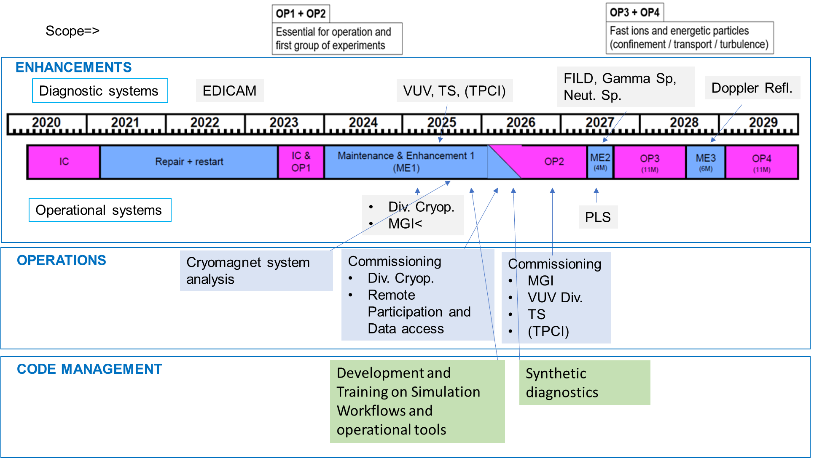
2025-2027: WPSA perspective
WPSA supports the scientific exploitation of JT-60SA providing expertise for enhancements and commissioning
Within WPSA scope are:
scientific support to the preparation of machine upgrades,
their installation and commissioning,
development of synthetic diagnostics and operation oriented (control room) tools
In the perspective of the next 3 years (2025-2027) there are several EU-led or EU-significantly-participated subsystems going into operation
FOR ME1-OP2
Divertor cryopumps
Massive Gas Injection
Error Field Correction coils
Thomson Scattering
VUV (and visible) spectroscopy and several other diagnostics
Tangential Phase Contrast Imaging (tbc)
Plasma control system with in-vessel coils and stabilizing plate
ECRF plant
NNBI plant
Inertially cooled C divertor
and ME2-OP3 (under development/review/approval)
Neutron and Gamma spectrometry
Fast Ion Losses Detector
Pellet (fueling and pacing) Launching System
Doppler Reflectometry system
Time plan
under BA approval
Transition to full W wall under consideration
Development of Operation oriented tools
Modeling and analysis of the Cryomagnetic system
Plasma Magnetic control
Breakdown simulator (w/ and w/o ECRH)
Discharge simulator
Tools for data access, visualization, control room analysis (e.g. MHD analysis, tomography), synthetic diagnostics
Neutronics analysis (for design purposes)

Slide 41
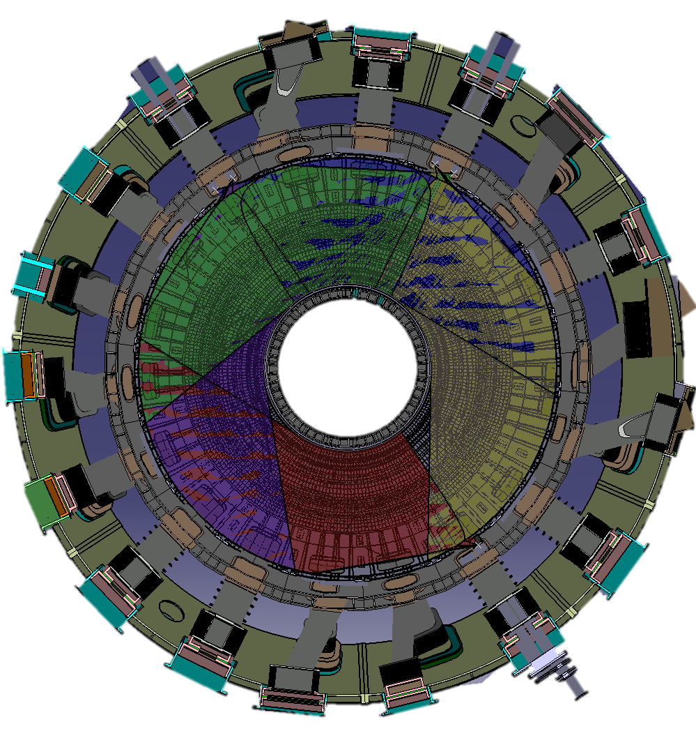
Diagnostics for OP2 (∼2026)
EDICAM
Visible cameras
Neutron monitor
Bolometer
+TPCI P1-P8=> tbc
ME1 for OP2 or ME2 for OP3
Vis. Cameras
IR camera (Div)
FILD
Bolometer
MSE
P16
P17
P18
In ME2 for OP3=>
(tbc)
P15
P1
Z_{eff} monitor/vis. spectroscopy
Thomson scattering
P14
SX array
Penning gauge
CAM
CAM
EDICAM
P2
Thomson scattering
CXRS(Toroidal)
LP(U)
P12
Div. VUV spectrometer
P4
D_{α} array
CO₂, YAG laser, Z_{eff}
LP(L)
ECE
P11
P5
CXRS(Toroidal)
FIDA
P10
VUV spectrometer
Neutron monitor/profile
X-ray imaging crystal
spectrometer
CXRS(Poloidal)
Visible & IR cameras
Neutron monitor
Divertor visible spectrometer
P9
P6
TESPEL
P8
P7
Z_{eff} monitor/Vis spec.
Penning gauge/QMS(only in IC)
CO₂ interferometer/polarimeter
CXRS(Poloidal)
In operation in IC
41

Slide 42
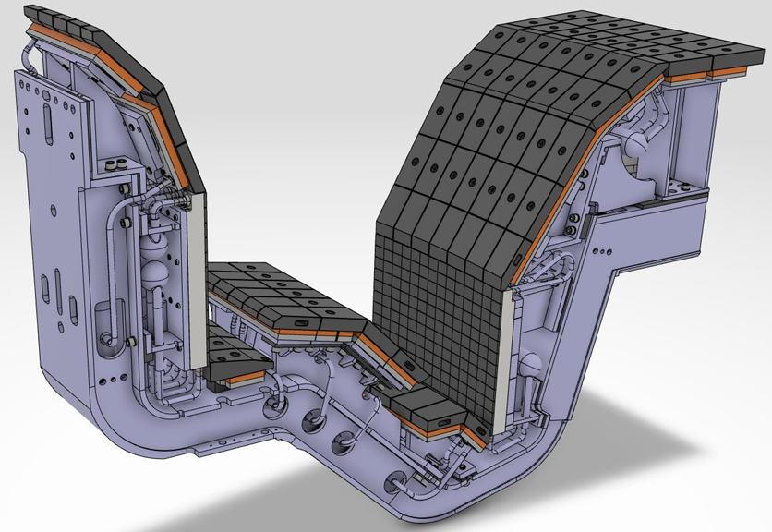
EUROfusion support to the transition of JT-60SA to full W wall
Among the WPSA objectives there is also the coordination of the EU contribution to the transition to W divertor and wall.
This might include several lines of work and collection of information of activities performed in other EuroFusion WPs
Definition of the scientific priorities for the C phase and for the W phase and W-related preparation experiments in the C phase of JT-60SA (WPTE)
Core and impurity transport (WPTE)
Modeling of heat load on PFCs (WPTE)
Modeling for PFCs shape optimization (WPPWIE)
Test of PFCs (WPPWIE)
Development and qualification of PFCs (WPDIV)
Diagnostics upgrade for W monitoring, wall and divertor protection
Upgrade of the heating systems
Upgrade of the protection system
Review of the wall cleaning systems and procedures
Review of the gas injection system

Slide 43
Expected/desired interaction with E-TASCs / TSVVs
 | Input from WPSA/JT-60SA | Expected output to WPSA/JT-60SA | comment
TSVV01: Physics of the L-H Transition and Pedestals | Dedicated diagnostics will provide data (TPCI, DR) | Support to diagnostic data validation/interpretation | WPSA is primarily involved in the diagnostics/technical aspects and in the validation of the data during commissioning and first operation. Scientific exploitation with the JT-60SA Experiment Team/WPTE
TSVV02: Physics Properties of Strongly Shaped Configurations | Dedicated diagnostics (FILD) will provide data for effect of shaping on fast ion confinement | Support to diagnostic data validation/interpretation
TSVV03: EU boundary plasma modelling towards reactor relevant simulations | Data from edge diagnostics (tbc) | Synthetic (edge) diagnostics for heat exhaust prediction – support in design and later validation. Support to diagnostic data validation/interpretation (impurities and turbulence in SOL and edge)
TSVV06: Impurity Sources, Transport, and Screening | W-PFCs specification (via WPDIV, F4E) | Modelling W from the source to the core | Coordination of the EU contribution to the transition to W (other WPs primarily acting)
TSVV07: Plasma-Wall Interaction in DEMO | W-PFCs specifications (via WPDIV, F4E) | Modelling of full-W PWI in full-W devices: transients and steady-state
TSVV08: Integrated Modelling of Transient MHD Events | MGI experiments data | JOREK support for designing the operation of the MGI
TSVV09: Dynamics of Runaway Electrons in Tokamak Disruptions | Data from diagnostics (EDICAM-Neutron monitor/Gamma spectrometer) | Input for the expected runaway energy distribution. Support to diagnostic data validation/interpretation | WPSA is primarily involved in the diagnostics/technical aspects and in the validation of the data during commissioning and first operation. Scientific exploitation with the JT-60SA Experiment Team/WPTE
TSVV10: Physics of Burning Plasmas | Energetic particle data from diagnostics (FILD) for validation of the workflow | Support for diagnostic data validation/interpretation
TSVV15 Pulse Design Tool | Data for code validation. At a suitable time integration of the tools developed in WPSA | Application to JT-60SA

