Slide 1
DEMO Central Team Perspective
EUROfusion ETASC General Meeting, Garching, 11.11.2024
^{1,2}H. Zohm, ^{1,3}C. Bourdelle, ^{1,4}M. Coleman, ^{1,5}F. Maviglia, ^{1,2}M. Siccinio, ^{1,6}S. Wiesen
¹DEMO Central Team
²MPI für Plasmaphysik, Germany
³CEA Cadarache, France
⁴UKAEA Culham, United Kingdom
⁵ENEA Frascati, Italy
⁶DIFFER Eindhoven, the Netherlands

Slide 2
DEMO constraints different from present day devices and even ITER
Inductive current fraction small enough for long pulse (> 2 hrs) or even steady state
β high enough to approach sufficient bootstrap fraction
external current drive power small enough for Q_{CD} = P_{fus}/P_{CD} ≥ 30
Confinement compensating for reduced current to achieve high β_{pol}
transport in the reactor-grade regime: 1/ρ* ≥ 300 (local) and ν* ≤ 0.01 (collisionless)
density as high as possible: n/n_{GW} ≥ 1.2, n_{ped}/n_{GW} > 0.85
Compatibility with exhaust requirement
n_{sep}/n_{GW} ≥ 0.4, f_{rad,core} ≥ 60 %, but pedestal top collisionless
no (large) ELMs
Controllability under DEMO boundary conditions
limited set of sensors and actuators (H&CD@ Q > 30, ECCD only (?), diagnostics…)
Moving beyond present experimental capabilities puts strong emphasis on theory and modelling!

Slide 3
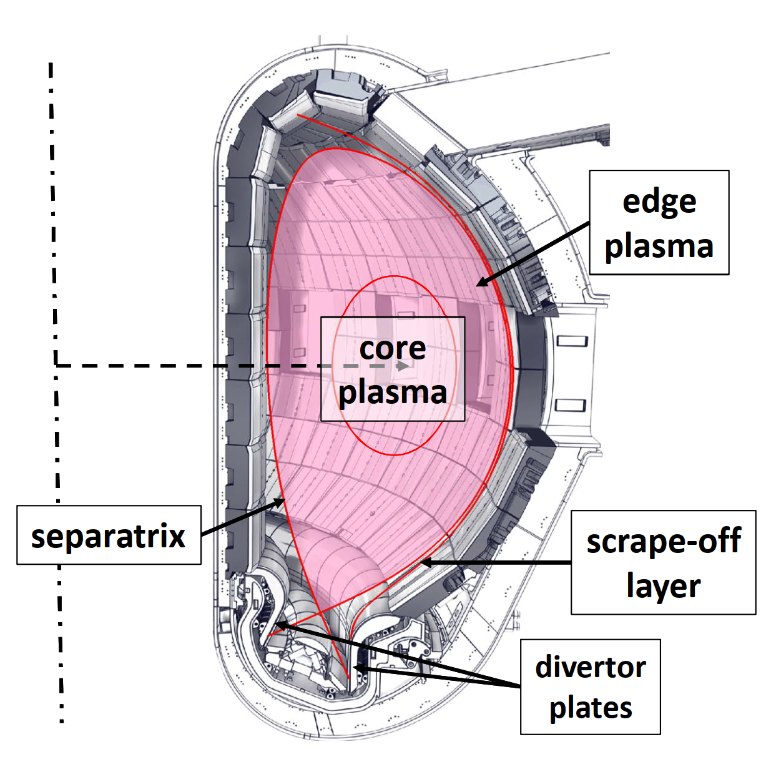
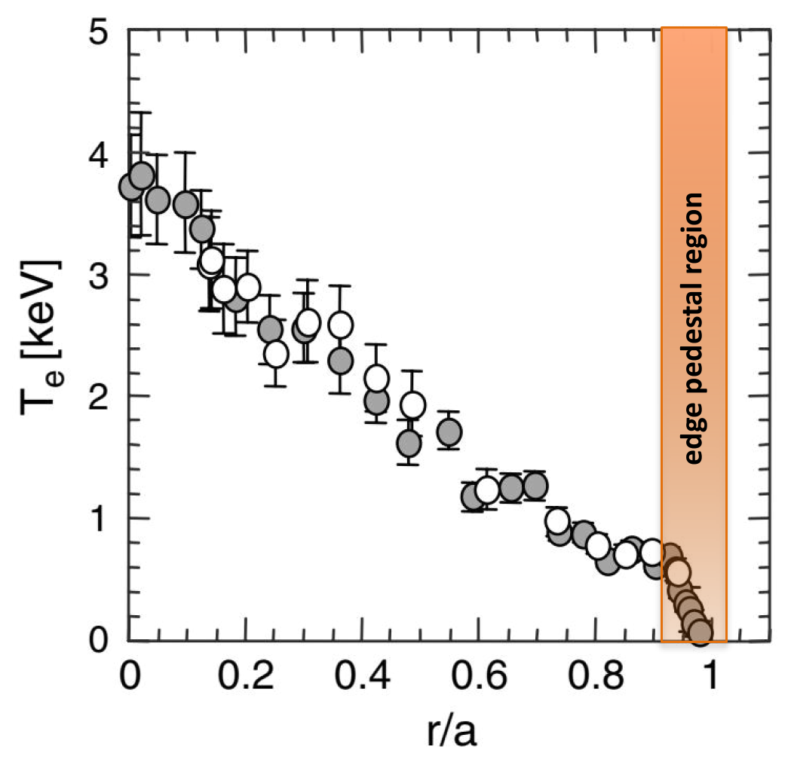
Elements of the DEMO plasma scenario
JT-60U, H. Urano et al.
Nucl. Fusion 2008
Assumption: plasma scenario broken down into 3 parts (non-linearly coupled)
core: closed flux surfaces - burning plasma (T_{i} ≈ T_{e} ≈ 30 keV, 2 x n_{D} ≈ 2 x n_{T} ≈ n_{e} ≈ 10²⁰ m⁻³)
scrape-off-layer / divertor: plasma flows along ‚open‘ field lines to divertor (T_{e} = 5 eV)
edge: connects core and scrape-off-layer (closed flux surfaces, but different physics)

Slide 4
Proposed integrated plasma scenario difficult to validate
What is a ‚credible element‘ for a DEMO physics scenario?
Experimentally validated in at least 2 devices of different size / magnetic field…
A (maybe just ‚working‘) model exists that allows extrapolation
Proposed scenario consists of three elements that have been demonstrated individually
hybrid core with q-profile clamped by flux pumping
QCE pedestal at high n_{sep}/n_{GW} (backup: RMP suppression of ELMs)
detached radiative divertor in combination with substantial core radiation
Very difficult to integrate all three elements in present day devices
hybrid core needs low density for low ν* – contradicts QCE and radiative exhaust
RMP ELM suppression so far only at low density – contadicts radiative exhaust
predictive modeling capability will be essential to integrate the elements!
In the following, I will describe these elements and the challenges we still have

Slide 5
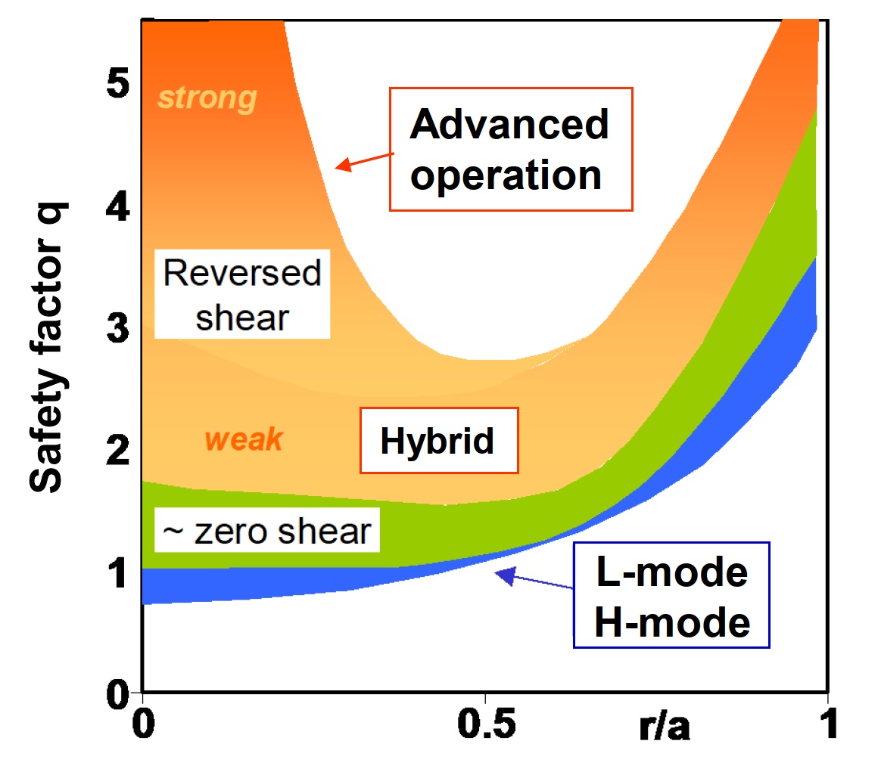
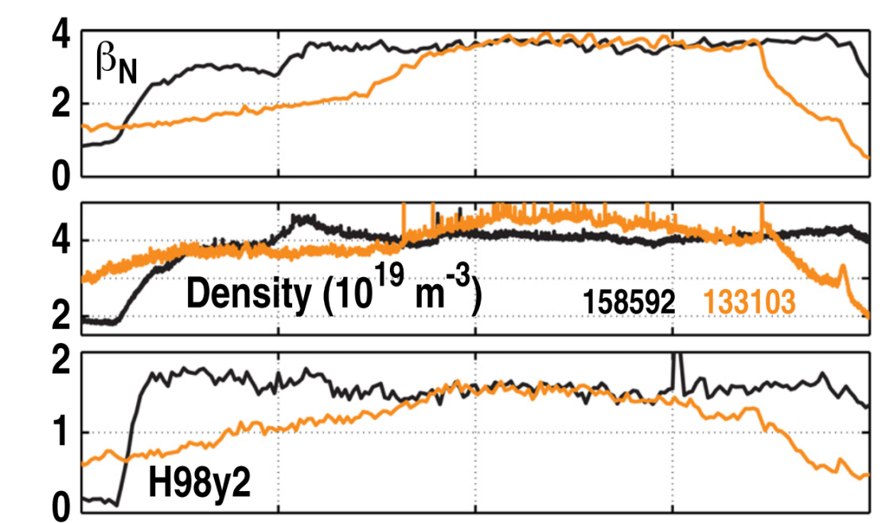
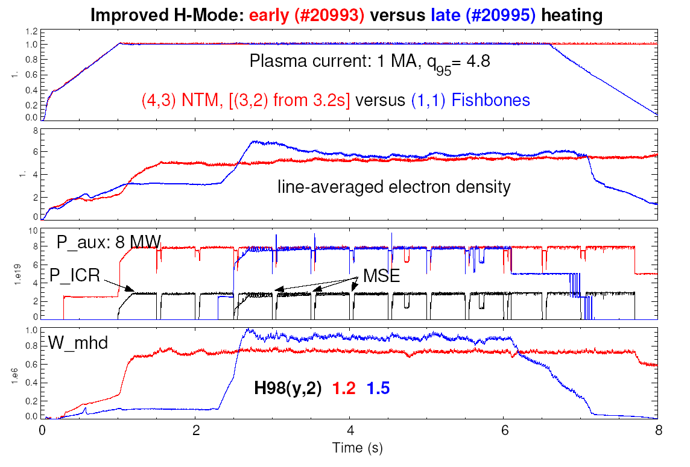
Search for optimum core scenario: hybrid versus ITB scenario
DIII-D: F. Turco,
Phys. Plasmas 2015
AUG: J. Stober et al.,
Nucl. Fusion 2007
‚Hybrid‘ scenario with core q(r) ‚clamped‘ at 1
higher current – better absolute performance
higher no-wall β-limit, lower bootstrap fraction
good confinement (e-m/fast & particle stabilisation)
q(0)-clamping by ‚dynamo‘ – efficient CD possible

Slide 6
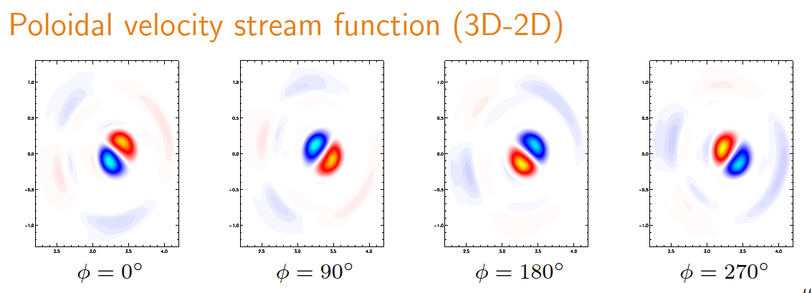
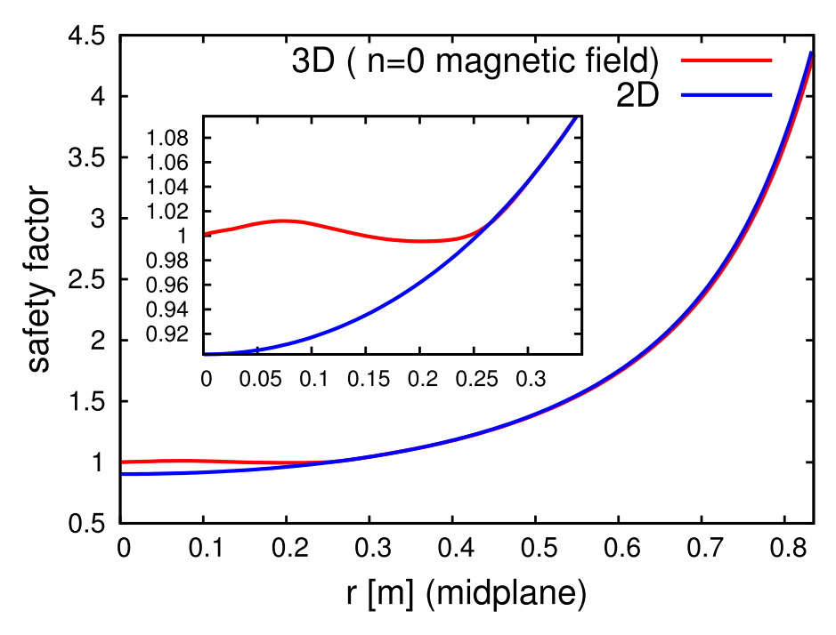
Towards an understanding of the q-profile clamping
MD3D-C1 nonlinear MHD code:
(1,1) quasi-interchange flow pattern creates (0,0) E-field
poloidal flux is moved from the centre to q > 1
stationary state with continuous flux redistribution (‚dynamo‘)
Possibility of central CD without sawteeth!
Ongoing: JOREK simulations validated against experimental results from AUG (and JET)
Next step: reduced model for integrated modeling
I. Krebs et al.,
Phys. Plasmas 2017

Slide 7
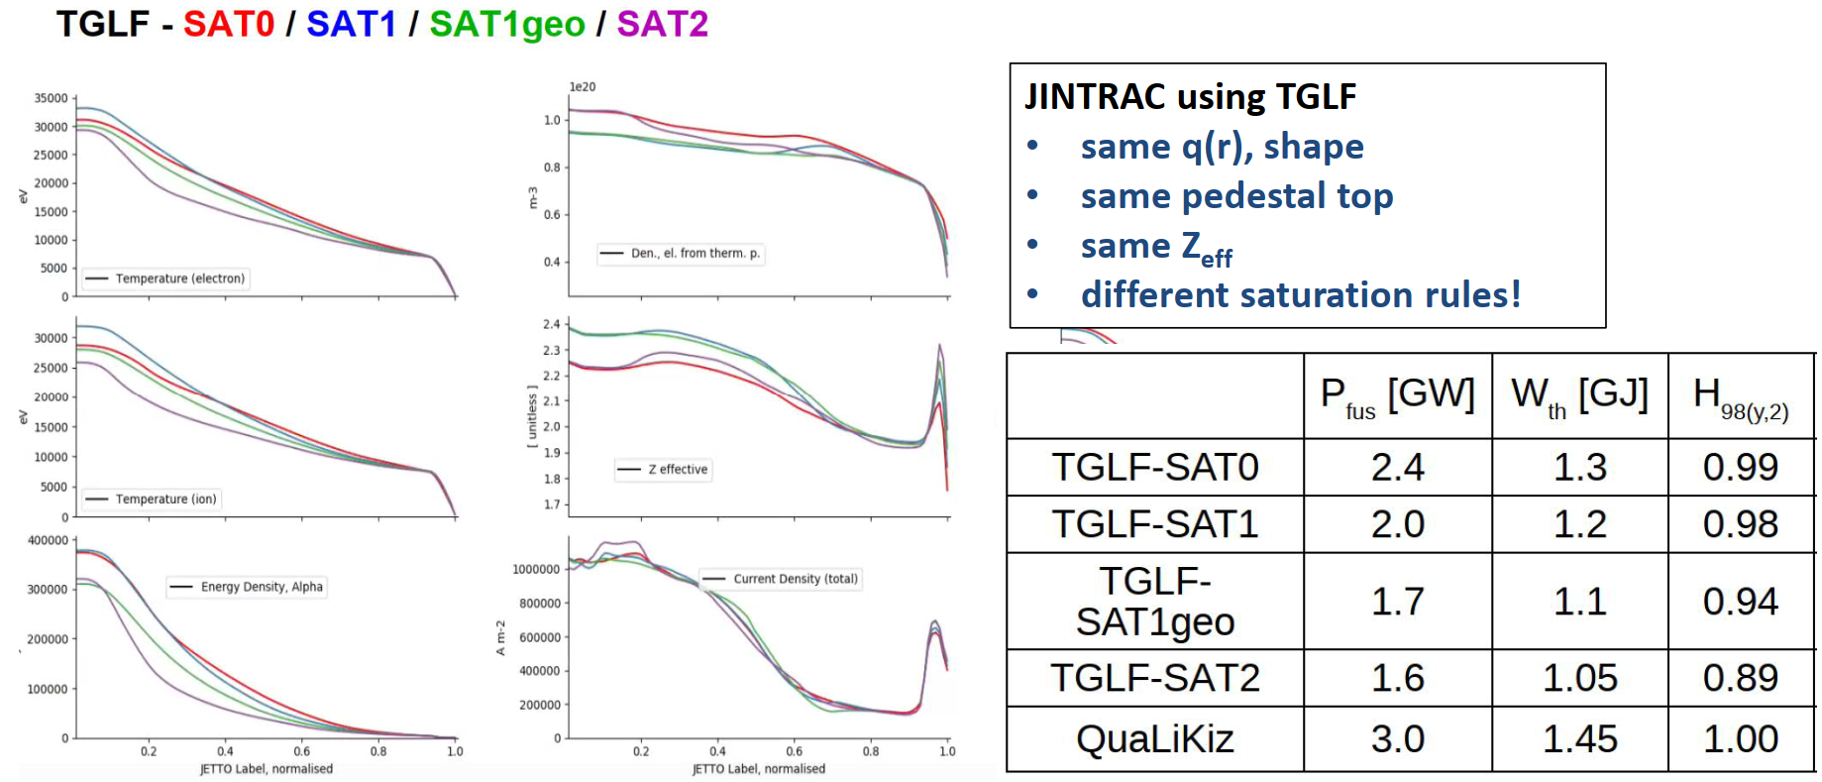
Core turbulent transport will be different in burning plasmas
Tools benchmarked against present day experiments, but expect major differences in ITER/DEMO
the fast particle poulation will interact with turbulence (dilution, orbits, three wave coupling)
need a better understanding, especially of the nonlinear e-m and fast particle driven mode effects
Such an activity is advocated by C. Bourdelle et al., also with the ultimate aim of a reduced model
N.B.: we have so far not treated fast particles in a consistent manner and aim to strengthen our efforts

Slide 8
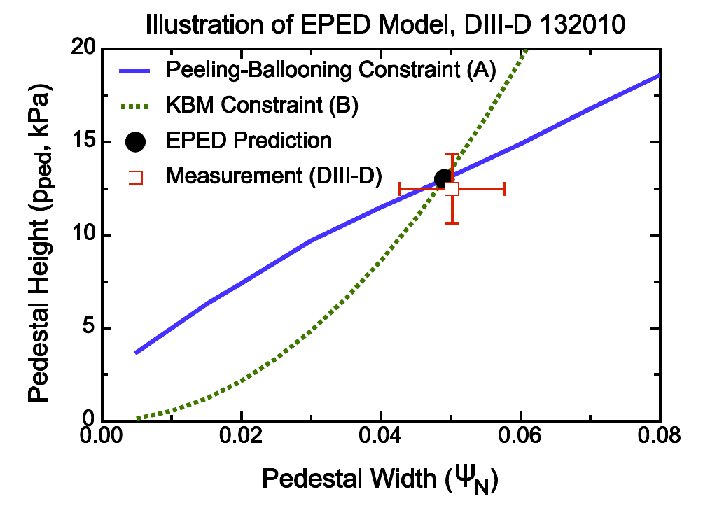
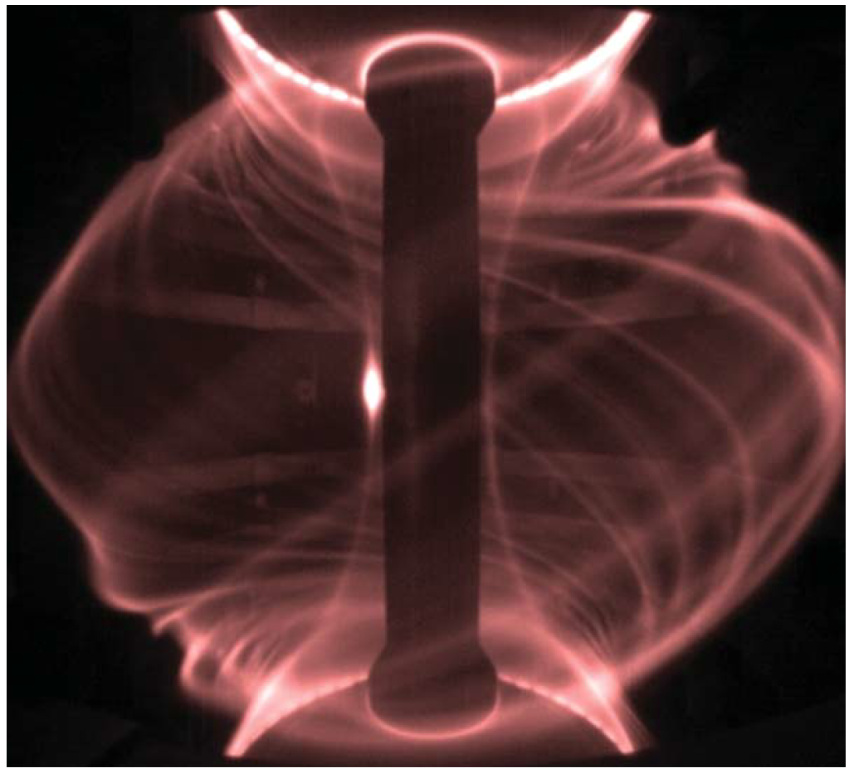
The plasma edge pedestal in DEMO
(but why?)
P. Snyder et al., Nucl Fusion 2009
A. Kirk et al., PPCF 2005
Due to the stiff core profiles, edge pedestal substantially increases plasma performance
pedestal understood as combination of MHD stability and transport constraints
pulsed type I ELM heat loads unacceptable for DEMO – need to limit pedestal height
MHD part seems well understood (?), transport part is still heuristic, need better models!

Slide 9
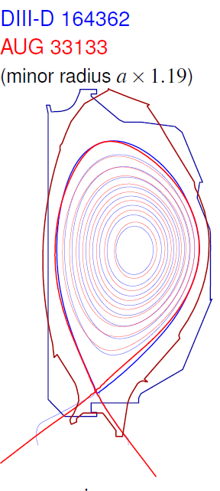
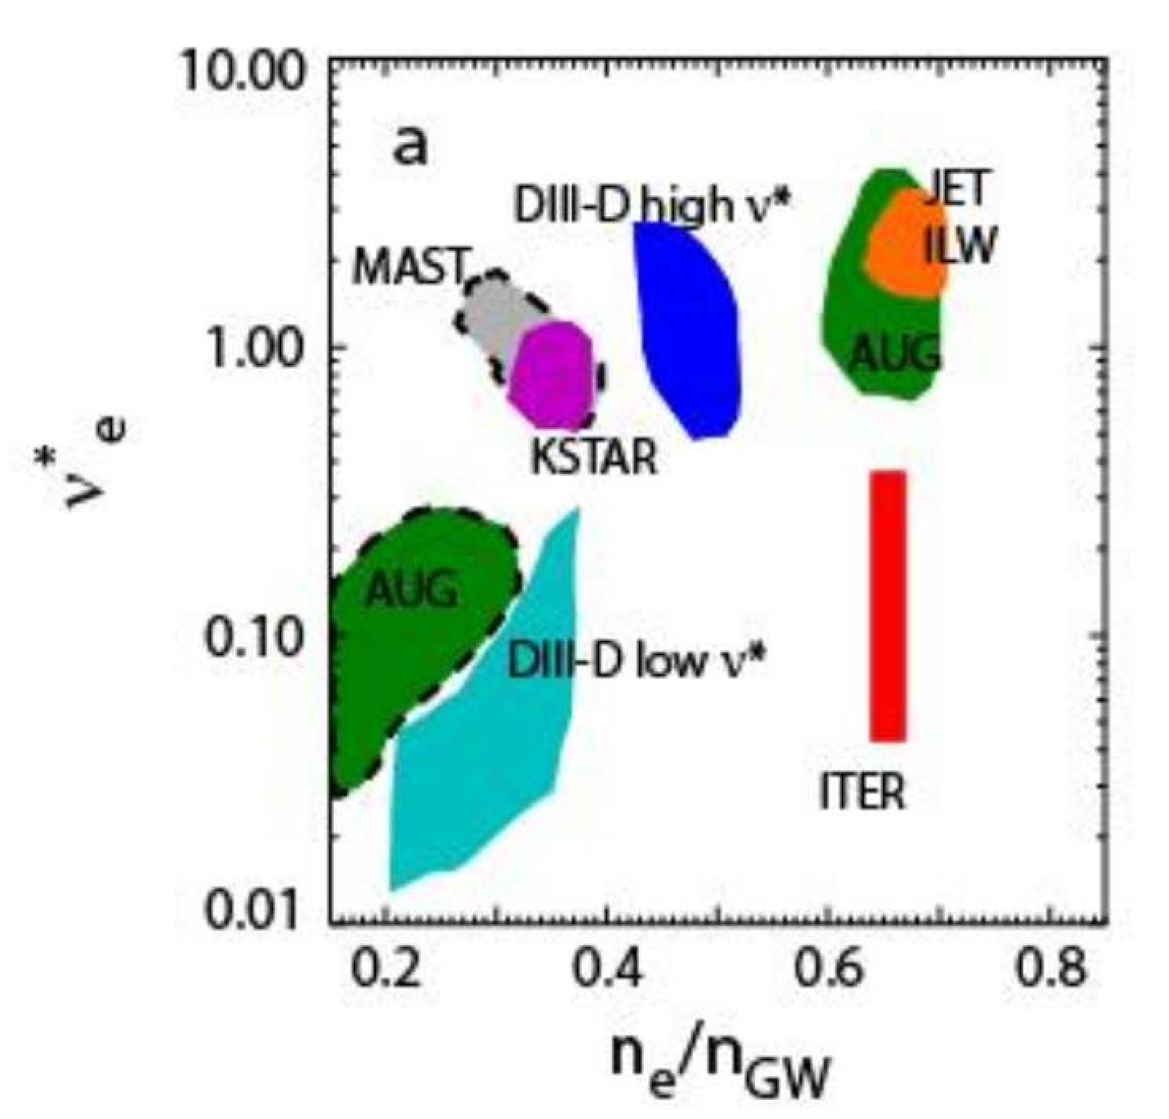
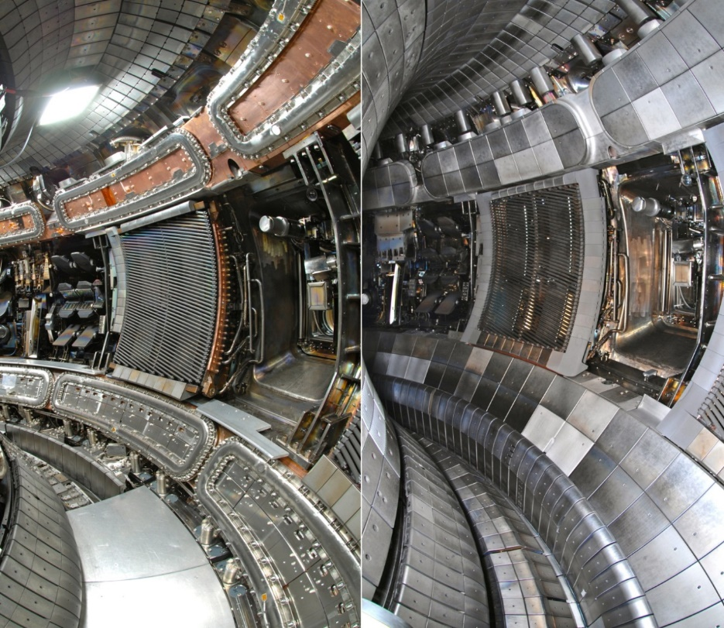
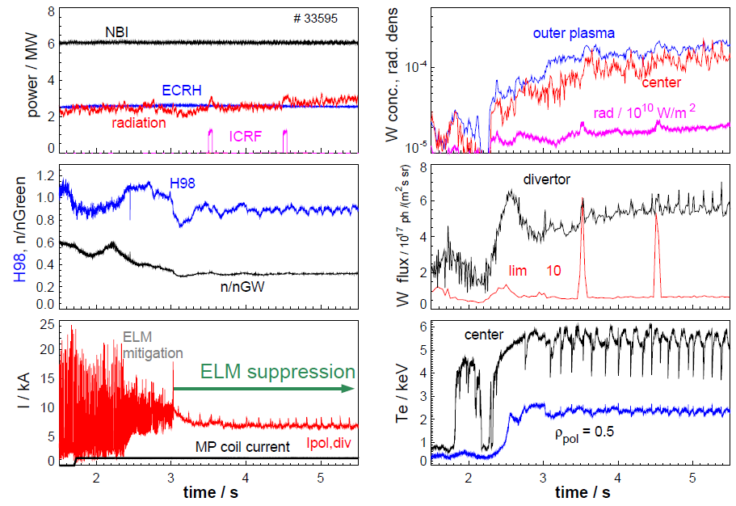
Conventional solution: ELM mitigation/suppression
W. Suttrop et al., Nucl. Fusion 2018
A. Kirk et al., Nucl. Fusion 2013
ITER aims at mitigating/suppressing ELMs by Resonant Magnetic Perturbations
perturbation mainly reduces density pedestal (additional turbulent trasnport)
emerging physics understanding through expt. and theory (worldwide collaboration)
present operational space for full suppression not overlapping with ITER/DEMO

Slide 10
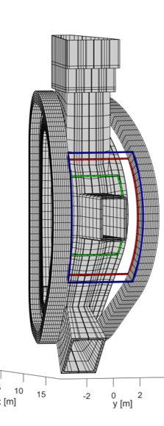
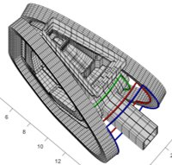
3-D coils in DEMO
DEMO needs dedicated coil set to correct field errors, also to be used for
3-D ELM suppression
manipulation of locked tearing modes
tailoring of edge profiles
Work builds on recent findings
need to include plasma response
need to evaluate impact on exhaust
Different from ITER, we can design these coils with all applications in mind
first set has been laid out that could fulfil these functions
To do: evaluate impact of non-resonant components on NTV (more than one row needed?)
Related: effect of field ripple on plasma performance is not understood at all…
3 different incarnations
of 3-D coils on DEMO

Slide 11
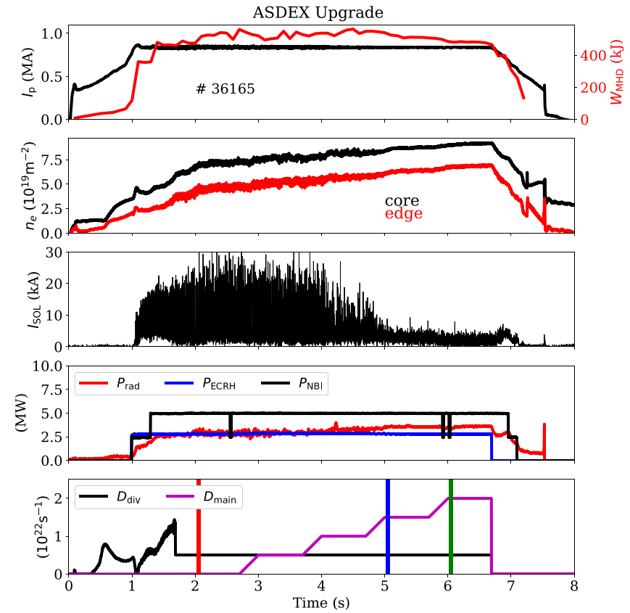
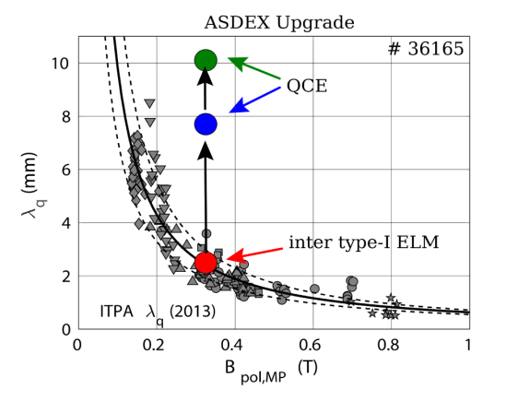
A variety of H-mode scenarios w/o ELMs exists (QH, I, EDA, QCE…)
M. Faitsch, Nucl. Mat. Energy 2021
Promising scenario without external actuators and compatible with DEMO exhaust: QCE
at high δ, ELMs ⇒ frequent filamentary bursts (‚quasi continuous exhaust‘) with broad λ_{q}
regime exists at n_{sep} = 0.4 n_{GW}, n_{ped}=0.8 n_{GW}, with H₉₈ = 0.9-1.0, (but high pedestal top ν*)
model based on high-n ballooning stability @ pedestal foot ⇒ extrapolation to DEMO?

Slide 12
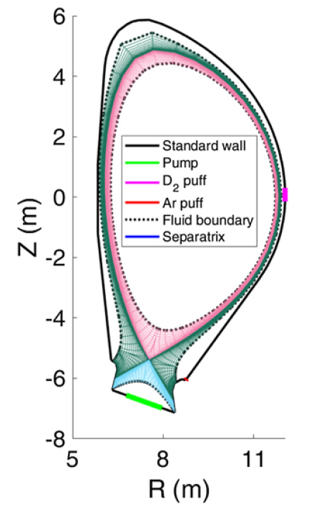
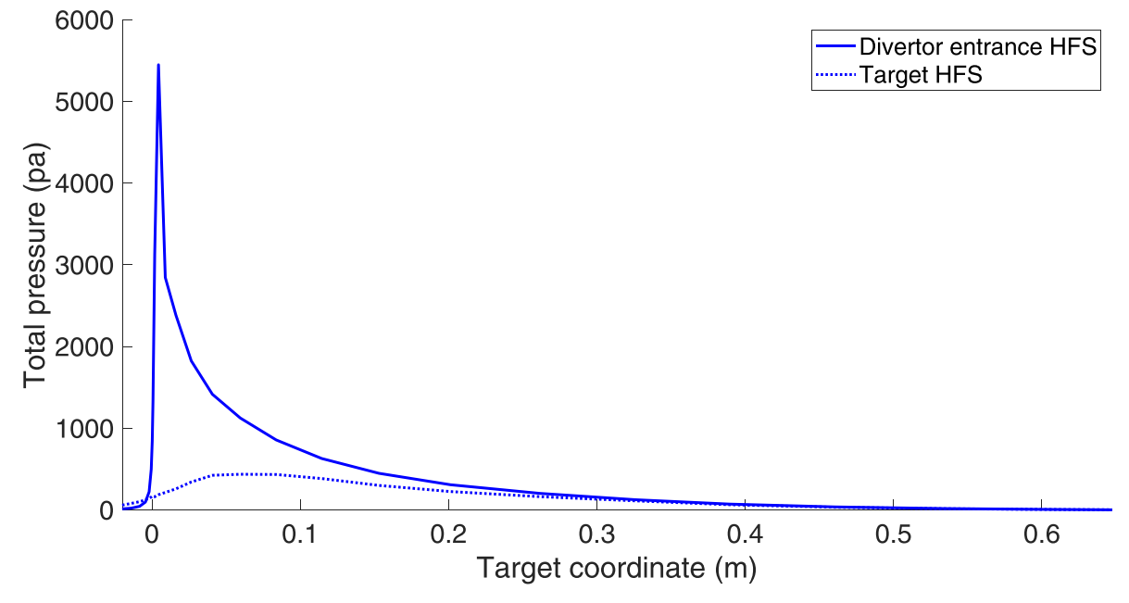
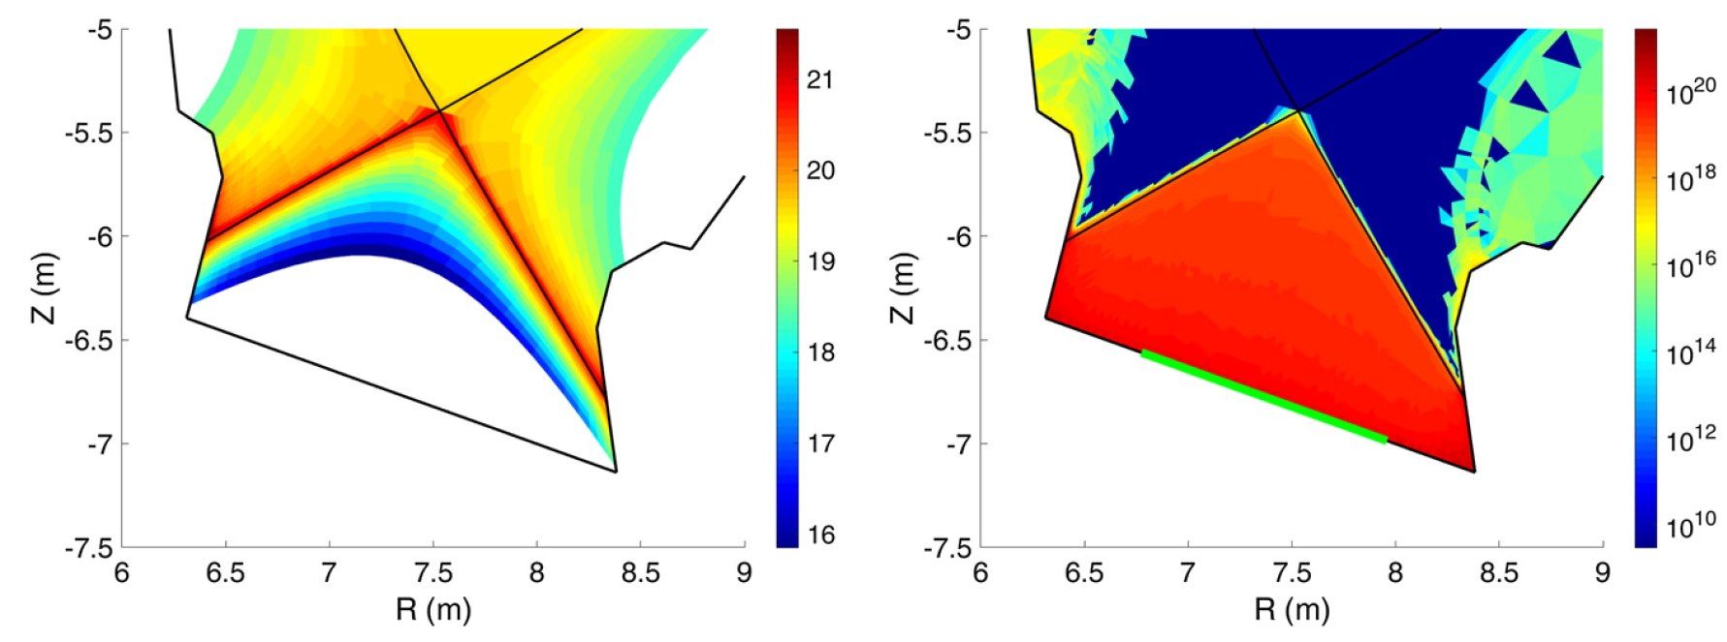
SOLPS-ITER detached divertor solution for the reference case
Electron density
Neutral density
Possible to transform P_{sep} = 150 MW (=1.2 P_{LH}) to q_{target,max} = 2 MW/m²
implies 67% of core radiaton (very different from ITER) – link to core plasma
not including transients – need time dependent modeling (e.g. ELM buffering, reattachment dynamics) -> reduced models needed
need to clarify extrapolability of X-point radiator and, as a consequence, compact divertors
F. Subba et al.,
Nucl. Fusion 2021

Slide 13
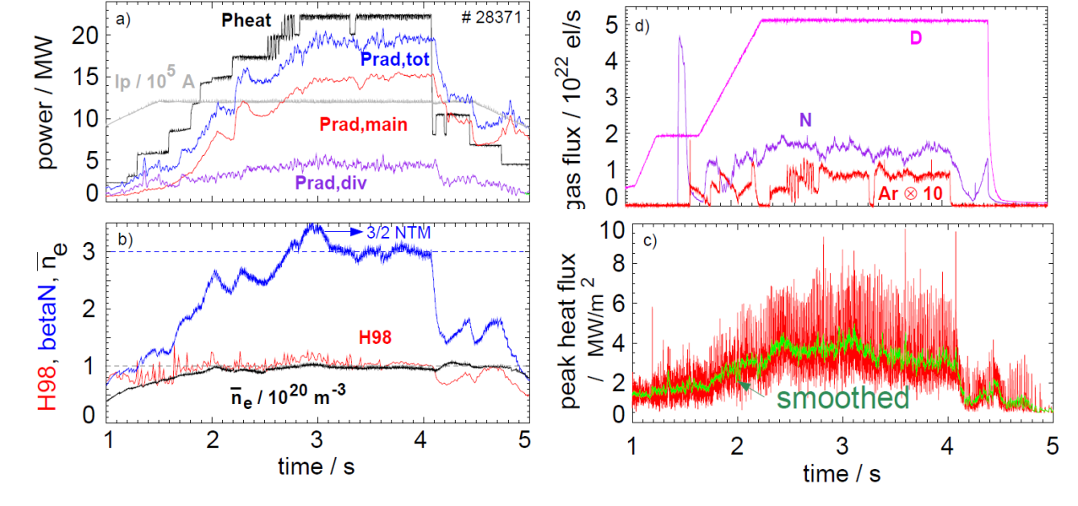
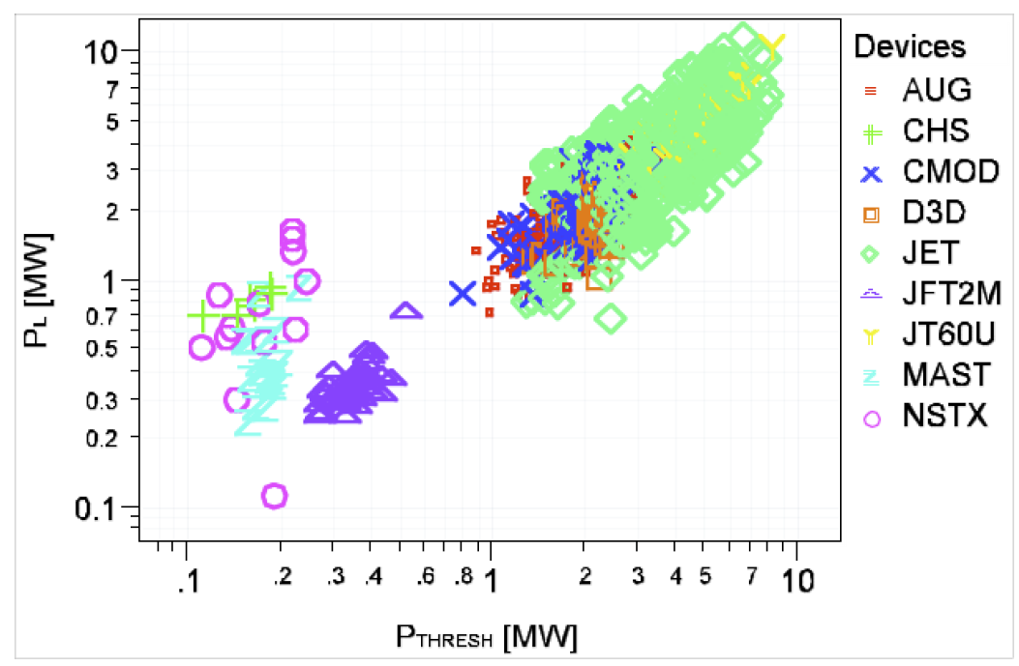
Different from ITER, DEMO will need substantial core radiation
A. Kallenbach et al.,Nucl. Fusion (2013)
Y. Martin et al., J. Phys. Conf. (2008)
Heat flux across the separatrix only manageable if P_{sep} is close to P_{LH,Martin}
Calls for studies of plasmas with high core radiation fraction
Strong emphasis on L-H threshold power prediction, albeit for different reasons than ITER
A better understanding of the L-H threshold power is crucial for safe operation of DEMO!

Slide 14
The way forward
We will consolidate the scenario choice by further research within the EU (and worldwide) programme
experiments on present and future devices will shed light on extrapolability
further development of predictive models for the individual elements
progress in understanding underlying physics should lead to improved reduced models to be used in integrated plasma scenario modelling combining core, edge and exhaust
Related: control of the integrated scenario will have to be demonstrated
all three elements interact nonlinearly – integrated control needed
DEMO will have sparse sensors and actuators (present experiments much better)
Need new control strategies and time dependent modelling of them ⇒ ‚flight simulator‘ (new TSVV)
We clearly need to intensify our interaction with you (the ETASC community)
establisihed for experiments (‚FSD-FTD meeting‘), with sporadic theoretician appearances
need to establish such a forum for theory as well (combined or separate? case by case decision? who?)
Note: for us this is a two-way process – learning from the community but also guiding the research

