Slide 1

Status of the US Theory & Simulation Program
Michael Halfmoon
Program Manager, Fusion Energy Sciences, US DOE Office of Science
Energy.gov/science
Notes:
Template Instructions: Please insert your name and title. You can also pull in information from the event you are attending. Each slide is made so you can easily add to it. The footer at the bottom of the slide does not change. If you would like to use a more specific URL to your particular program or division, please include it in the body of the slide.
If you would like the date or slide numbers on your slides: Go to View > Normal.
Go to Insert > Slide Number.
Select Slide Number and/or date.
To add or remove the slide number from just the title page, clear or select Don't show on title slide.
Select Apply to all or Apply.
Consider putting a picture of yourself or your team on the opening slide.

Slide 2
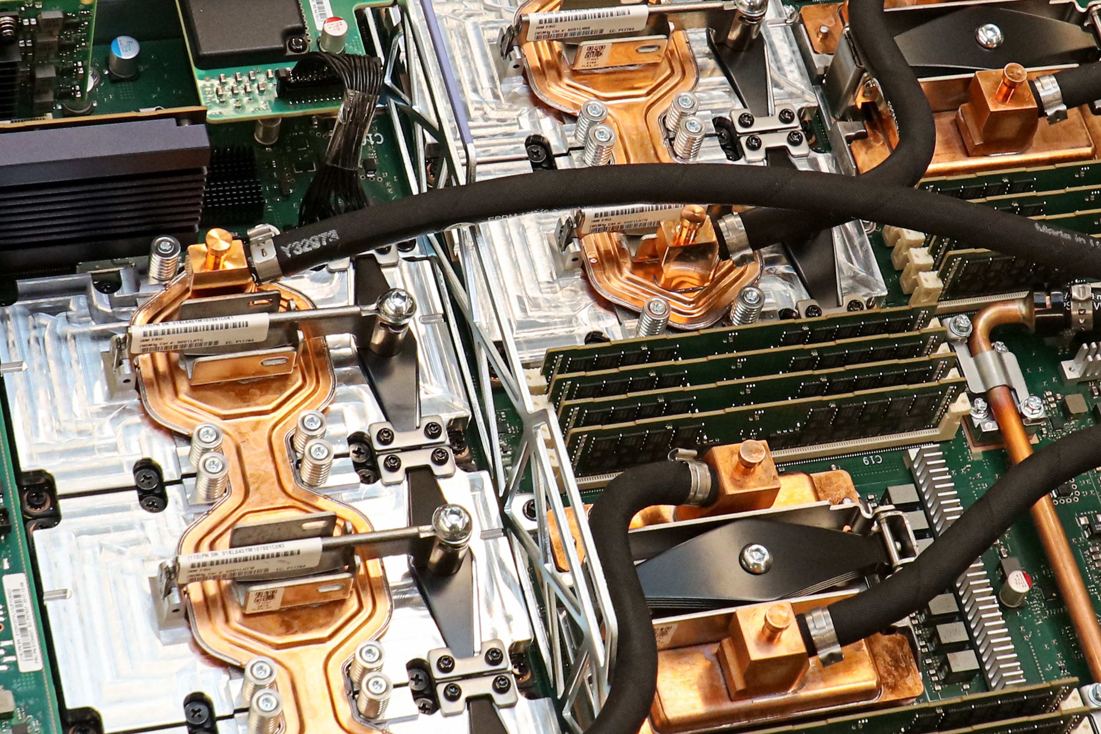

Theory
The base theory program focuses on advancing the scientific understand of the physical processes in magnetically confined plasmas. This research ranges from foundational analytic theory to large-scale HPC efforts.
Fusion Energy R&D Centers: Advanced Simulation for Design/Optimization
The Advanced Simulation Center is aimed at the development of high-fidelity simulation tools focused on mission-critical topical areas for fusion pilot plants.
Advanced Computing
The Advanced Computing program is aimed at continuing support for FES relevant efforts from the Exascale Computing Project and assisting in data infrastructure needs for large-scale computing.
SciDAC
SciDAC is aimed at accelerating scientific discovery by capitalizing on SC investments in leadership-class computing systems. Recently expanded to cover WFM efforts and non-Tokamak MFE and IFE configurations. Collaborative effort with ASCR.
Notes:
Add Advanced Computing description

Slide 3
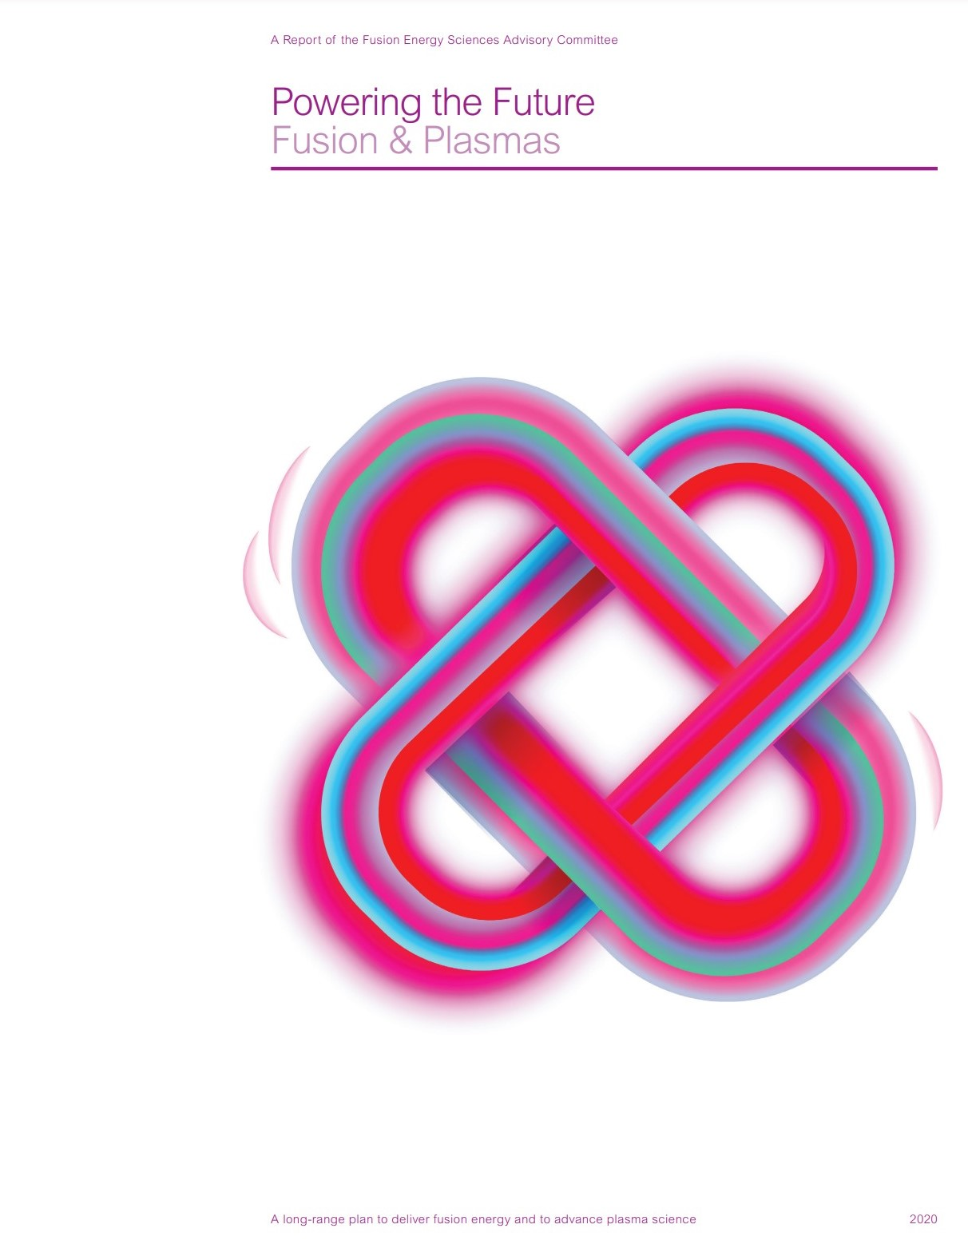
Priorities and Drivers - 1
The Community Planning Process (CPP) report that informed the FESAC Long-Range Plan recommended:
  Develop and utilize a hierarchy of validated models for predictive integrated modeling, by continuing the partnership between FES and ASCR, expanding capacity computing infrastructure, and utilizing advances in computational architecture and capability.
It also stated:
  Develop physically rigorous and computationally robust model integration methods to enable predictive whole-facility modeling and optimization of FPP concepts.

Slide 4
Priorities and Drivers - 2
The FESAC Long-Range Plan under cross-cutting recommendations emphasized the importance of fundamental theory as well as our partnership with ASCR:
  Fundamental theoretical research, separate from computation, remains essential for developing new models, insights, and innovations in topics across plasma and fusion science and technology. Foundational theory work also enables the FES community to continue to take advantage of and expand advanced scientific computing and the tools that can further improve our fundamental understanding and predictive modeling capabilities, including new methods in machine learning (ML), artificial intelligence (AI), and quantum information science (QIS). This work is also essential for fusion and plasma research to take full advantage of US investments in exascale computing. All of these investments in theory and computation are vital to the continued development of variously complex validated models, including integrated modeling capabilities, an area in which, historically, the US has shown strength and leadership. A continued close partnership between FES and the Advanced Scientific Computing Research (ASCR) program is therefore essential to realizing these opportunities and to sustaining investment in computational user facilities and capacity computing resources.

Slide 5
Congressional Language
The FY 2023 Enacted Budget specified:
  The agreement provides not less than $45,000,000 for Theory & Simulation
The FY 2024 House Mark stated:
  “Within fusion energy research, the Department is encouraged to prioritize high-performance computation activities.”
The CHIPS & Science authorization language calls for the establishment of a “High-Performance Computation Collaborative Research Program”:
  The Secretary shall carry out a program to conduct and support collaborative research, development, and demonstration of fusion energy technologies, through high-performance computation modeling and simulation techniques, in order:
      To support fundamental research in plasmas and matter at very high temperatures and densities;
      to inform the development of a broad range of fusion energy systems; and
      to facilitate the translation of research results in fusion energy science to industry
It also calls for the establishment of a High-Performance Computing for Fusion Innovation Center
Notes:
Double check 2024 Proposed Budget quote.

Slide 6
Budget History

Slide 7
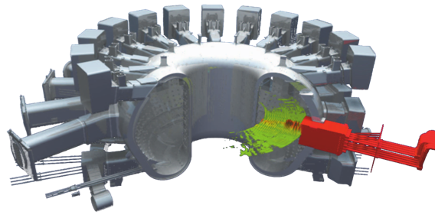
FOA History
Prior to FY21, the FES Theory program issued an annual Theory and Simulation FOA.
For the past three years, the Theory program has relied on the Open FOA to select and renew awards.
  The Theory program supports ~40 grants to universities and private industry as well as theory efforts at four DOE national laboratories (LANL, LLNL, ORNL, PPPL)
SciDAC selections have been made for FY 2023.
  Twelve awards were selected, four led by universities, one led by a private company, and seven led by national laboratories.
  This FOA includes topical areas beyond tokamaks, opening the call to IFE, stellarators, and even alternative concepts.
Multiscale simulation of gyrokinetic turbulence. (SciDAC-5)
Simulation of RF heating. (SciDAC-4)

Slide 8
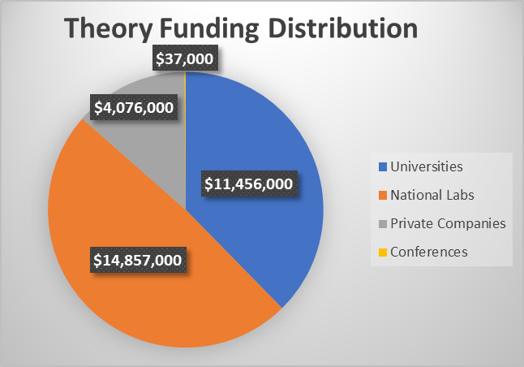

Slide 9
Program Element Coordination- SciDAC 5 Partnerships
Awarded Partnerships are:
  WFM modeling and code-coupling efforts. (Churchill/Collins)
  Stellarator optimization and design. (Bhattacharjee)
  Advancements in multiscale gyrokinetic simulations. (Belli)
  Plasma materials interactions studies at the atomic level. (Marian)
  Breeding blanket technology simulations and interactions. (Smolentsev)
  AI/ML applications to turbulence and transport surrogate models. (Holland)
  Kinetic modeling of IFE implosions. (Vay)
  Core-edge integration of gyrokinetic simulations. (Parra)
  Boundary simulations of ELMs. (Xu)
  Exploration of ELM-free regimes. (Ebrahimi)
  RF simulations with materials interactions. (Bonoli)
Award Demographics
Number of awards |  | 12
Overall success rate |  | 34%
Female lead PIs | 3 | 25%
Early career | 1 | 8%
University-led | 4 | 33%
Lab-led | 7 | 59%
Industry-led | 1 | 8%

Slide 10
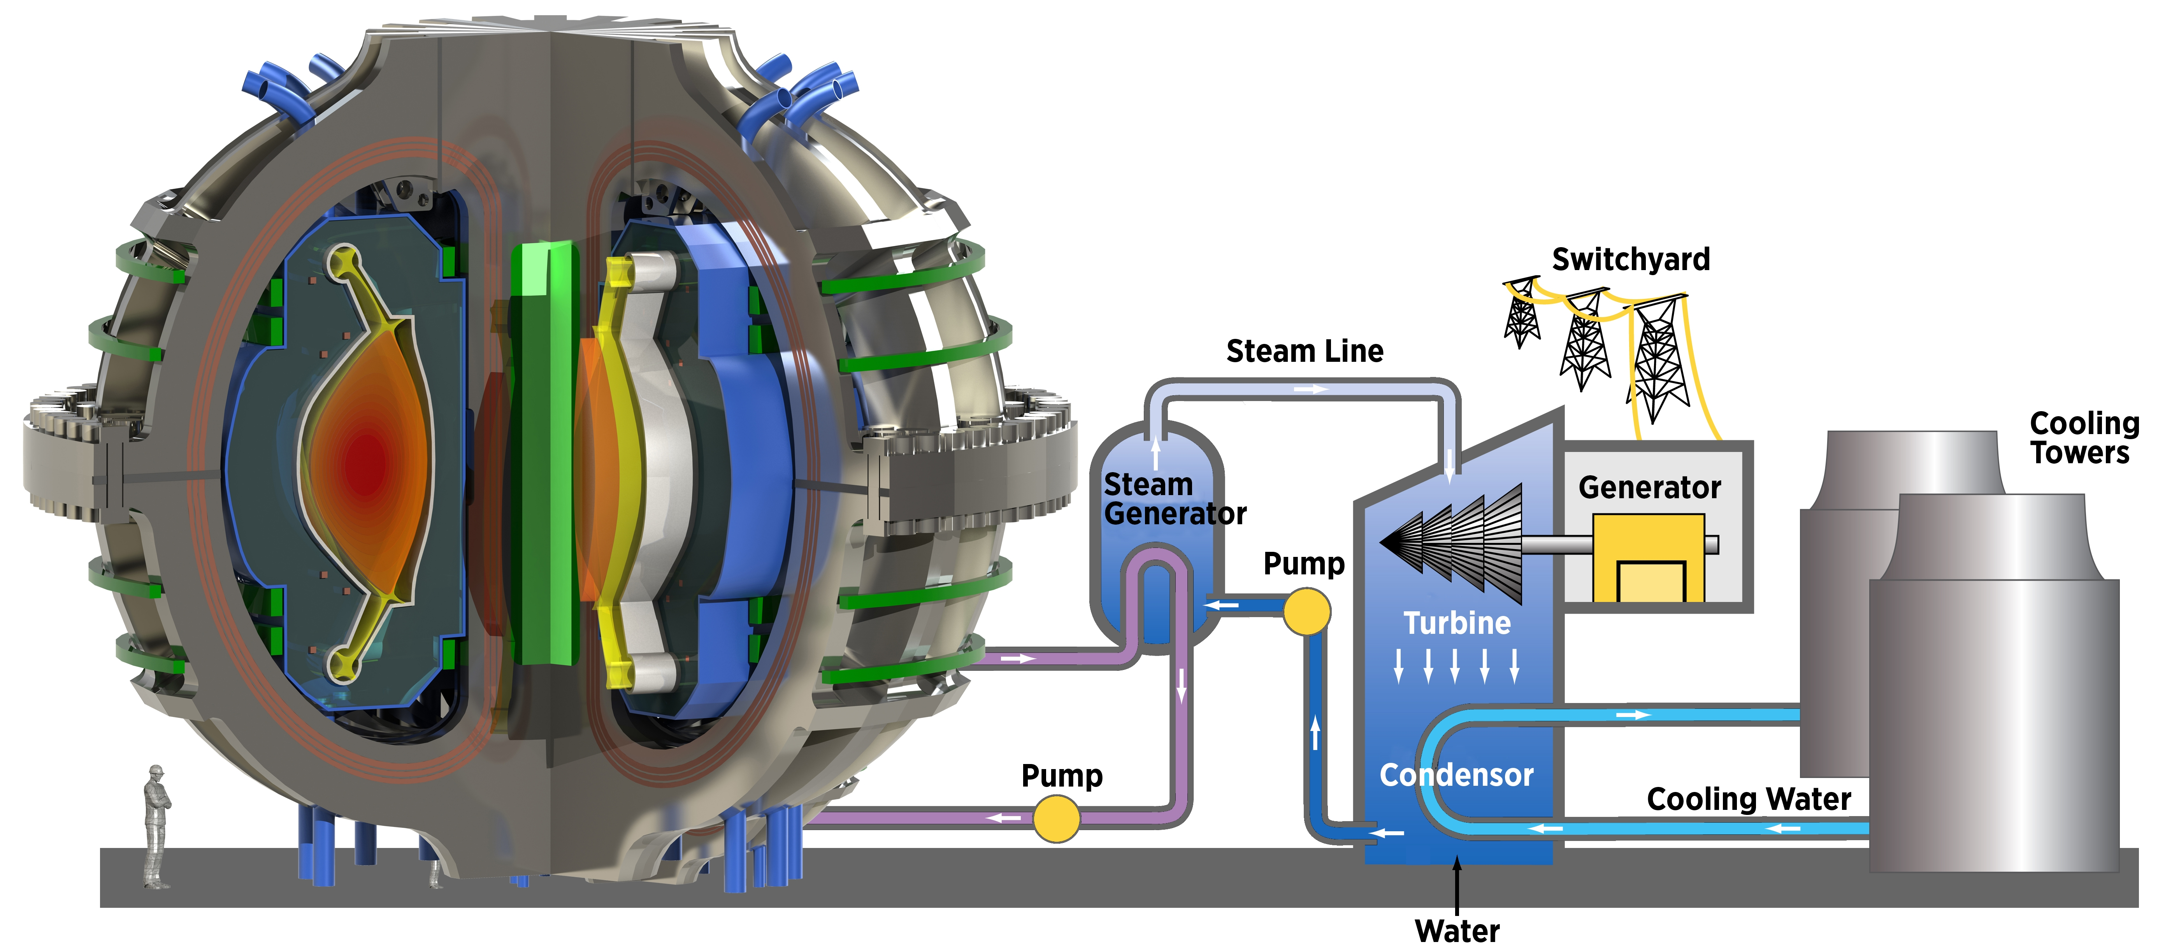
Program Element Coordination: R&D FIRE Centers- Advanced Simulation for Design/Optimization
The Advanced Simulation Centers aim to support high-fidelity code development in application to fusion pilot plants.
Goals:
  Leveraging investments in HPC codes and exascale infrastructure.
  Advancing integrative engineering techniques.
Open to coordination with SciDAC Partnerships: Implementation of Advanced Simulation codes in SciDAC frameworks, benchmarking efforts, etc.
Fusion pilot plant concept

Slide 11
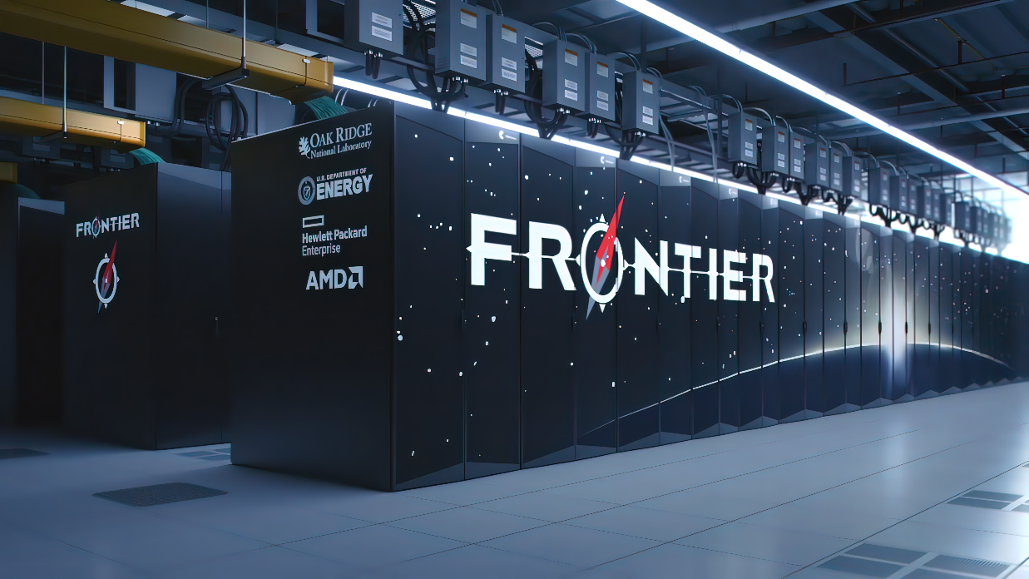
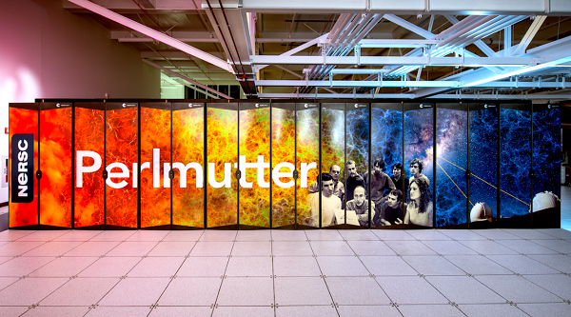
Program Element Coordination:
Computing Facilities
The Theory and Simulation Program coordinates extensively with ASCR, primarily through SciDAC, and additionally via the computational resource awards granted by the ASCR Leadership Computing Challenge (ALCC) and Innovative and Novel Computational Impact on Theory and Experiment (INCITE) programs.
  In 2023, five projects via ALCC and seven projects via INCITE were awarded time on Theta, Polaris, Summit, Frontier, Perlmutter, and Cori.
Within FES, the Theory program coordinates activities with the other program elements; several theory grants have been co-funded with other programs (e.g., stellarator, DIII-D, AI/ML, Materials, etc.)
The Theory Program also manages the FES NERSC resources, working closely with ASCR.
  For 2023, 99 projects were awarded time on Perlmutter, with a combined total of ~2M CPU hours and ~1M GPU hours.

Slide 12
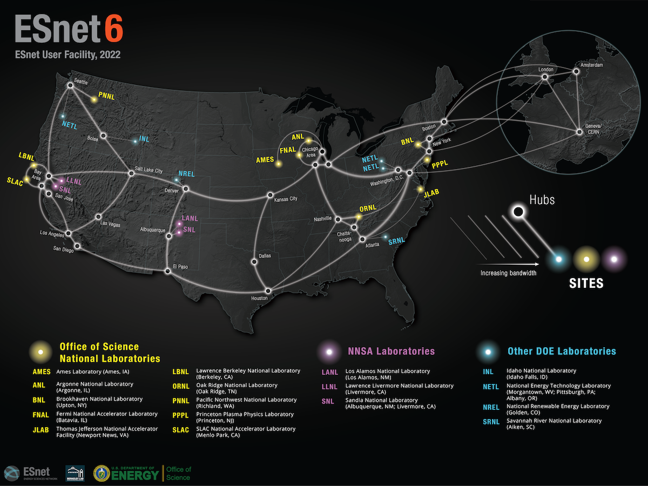
Program Element Coordination: Integrated Research Infrastructure
IRI combines DOE User Facilities with high-capacity computing to streamline data analysis.
  Efforts currently exist at DIII-D to leverage NERSC resources for real-time discharge analysis.
  Future facilities (in particular, ITER) will require massive data transfers, and the tools needed for this must be put into place well before operation.
  Opportunity for enhanced collaboration between theory and experiment.
  Will fundamentally shift the way theory interacts- real-time analysis with HPC resources is not the common workflow.
  Can leverage computational algorithms developed under FES SciDAC Partnerships. (Data streaming research at ORNL)

Slide 13
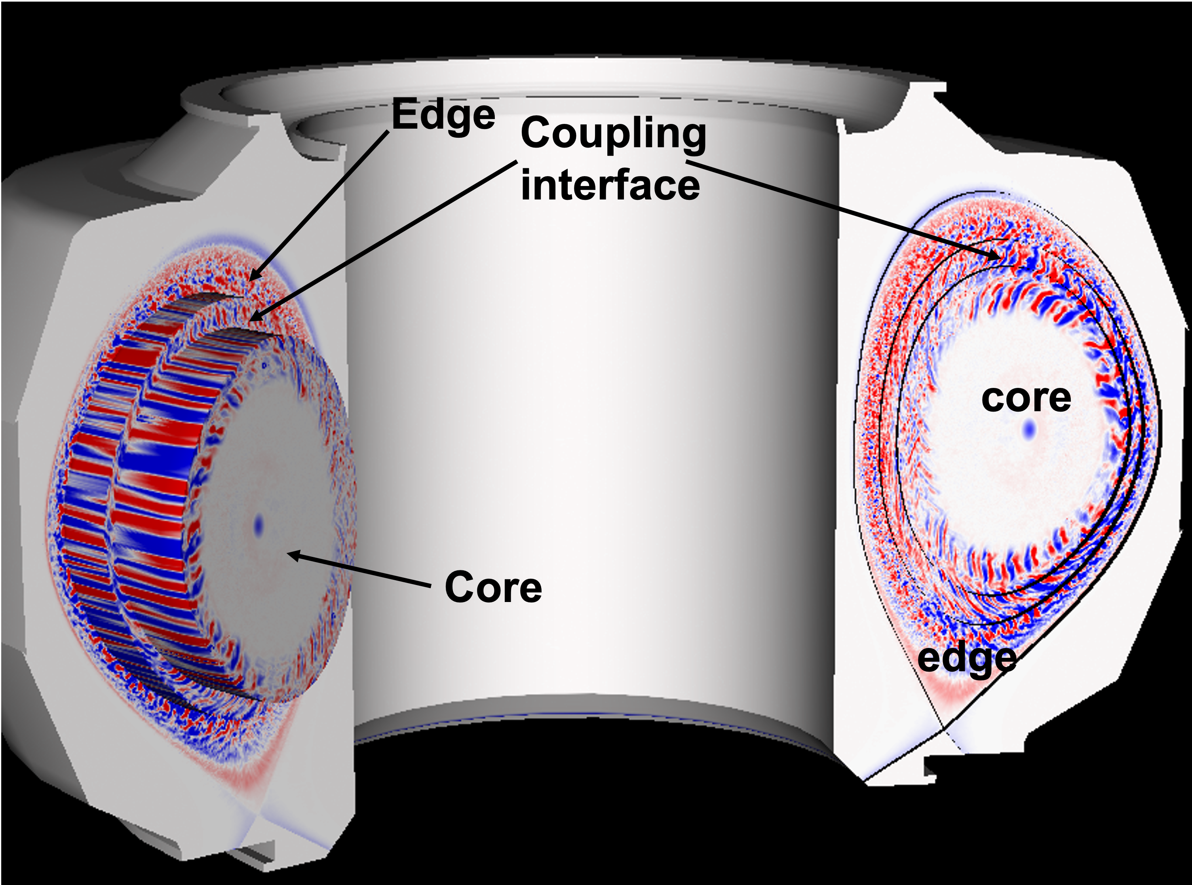
Program Element Coordination: Exascale Computing
Past partnership with ASCR’s Exascale Computing Project (ECP) has produced significant research results:
WDMApp: Core-edge coupling of GENE, GEM, and XGC gyrokinetic codes.
  It is a waste of exascale resources to run slow-growing core modes on the same grid, with the same timestep, and code as the edge.
    The solution is to break the regions into pieces, with each piece accounting for separate physics regimes.
    Will be continued focus in a SciDAC-5 partnership. (Parra)
  WarpX: PIC code modeling laser acceleration of plasmas.
    Used state-of-the-art meshing algorithm, AMReX, to model relativistic charged particle dynamics
    Will be the subject of a SciDAC-5 Parntership. (Vay)
  EXAALT: Modeling of interatomic potentials, used for predictions of ITER first wall.
    Modeling of nanostructure fuzz with molecular dynamics solvers.
  With the ECP ending, there is interest in integrating FES-relevant ECP projects in our core research.
Diagram of WDMApp gyrokinetic simulation

Slide 14
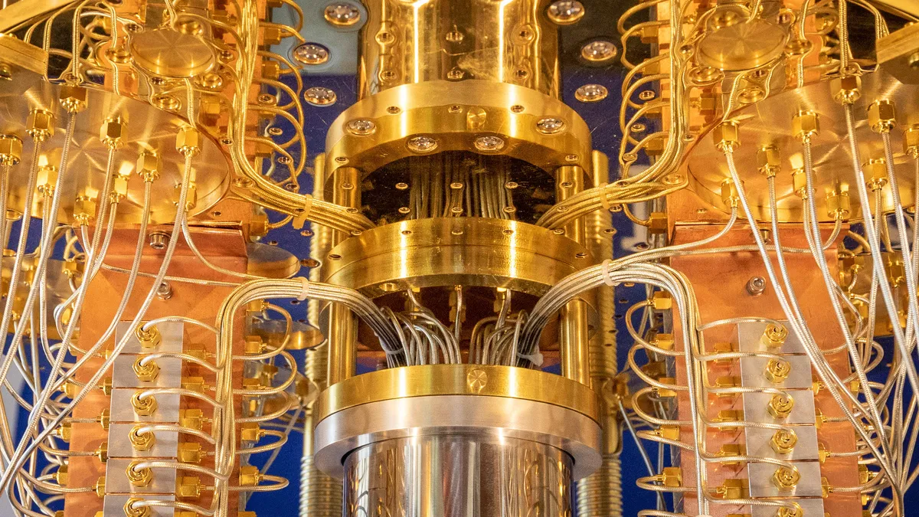
Program Collaboration: AI/ML & QIS
Artificial Intelligence and Machine Learning will be integral to research efforts within the Theory and Simulation program.
  The burgeoning field has made significant advances in constructing reduced models from large databases of high-fidelity simulations.
  AI/ML can ease the burden of runtime on supercomputing facilities through advanced interpolation efforts.
  Three base theory grants, one Theory ECRP, and nearly all SciDAC awards focus on or at least utilize AI/ML.
Quantum Computing technology intends to revolutionize large-scale computing beyond exascale capabilities.
  Simulations of gyrokinetic microturbulence are currently serving as a test case for QIS computing efforts.
IBM quantum computer

Slide 15
Program Collaboration: Materials and Fusion Nuclear Science
Simulations of Materials and Fusion Nuclear Science are the focus of two recently awarded SciDAC Partnerships (Smolentsev and Marian).
  High-fidelity simulations of plasma-facing materials have been constrained by computational capabilities, but the advent of exascale computing have opened the door to new possibilities within the field.
  Modeling of liquid metal blankets in the presence of plasma events such as disruptions will accelerate the SciDAC mission of a Whole Facility Model.
Meshing of liquid Lithium divertor

Slide 16
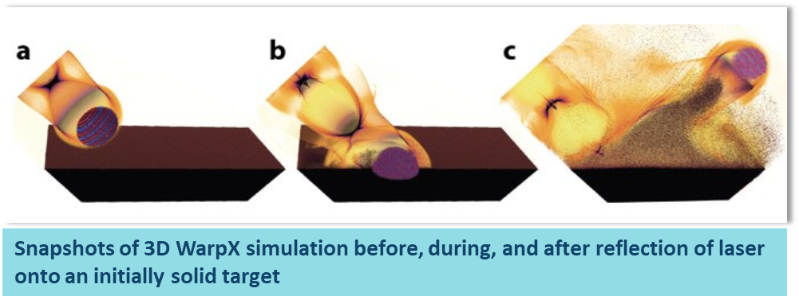
Program Collaboration: HEDLP & IFE
The recent results at NIF have brought significant attention to IFE research as a possible path towards fusion energy.
  The Theory and Simulation program has awarded one SciDAC Partnership to the LBNL team working on the WarpX code to model the kinetics of laser-target interactions.
  Simulation studies funded under the HEDLP and IFE programs have received NERSC ERCAP and competitive ALCC awards for supercomputer resources.

Slide 17
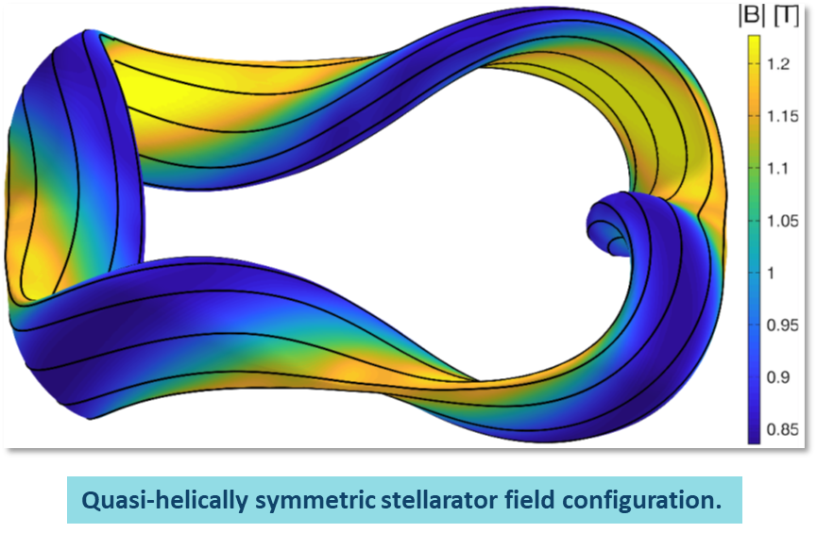
Program Collaboration: Stellarators and General Plasma Science
Stellarator research is the primary focus of multiple efforts under both the Base Theory program, as well as two current SciDAC awards.
  The University of Maryland Stellarator theory team is funded jointly by the FES Theory and Stellarator programs.
General Plasma Science is currently supported by the Theory program through allocations of NERSC supercomputer time.
  Future projects at PPPL supported under their base Theory grant may seek support under the General Plasma Science program.

Slide 18
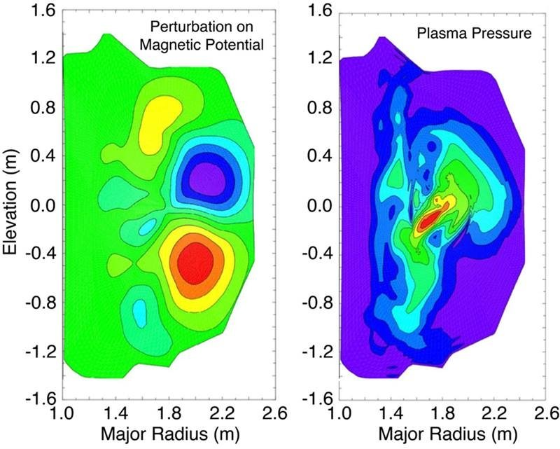
Program Collaboration: Spherical, Long Pulse, and Advanced Tokamaks
Verification and Validation efforts are integral to the operation of HPC codes as well as experimental design.
  Current SciDAC portfolio has plans for extensive coordination with DIII-D, MAST-U, and W7-X.
  Efforts are built primarily around data-sharing and synthetic diagnostic development.
  Future research work should formalize these efforts, with clear milestones and agreements.
Model of RWTM driving thermal quench on DIII-D

Slide 19
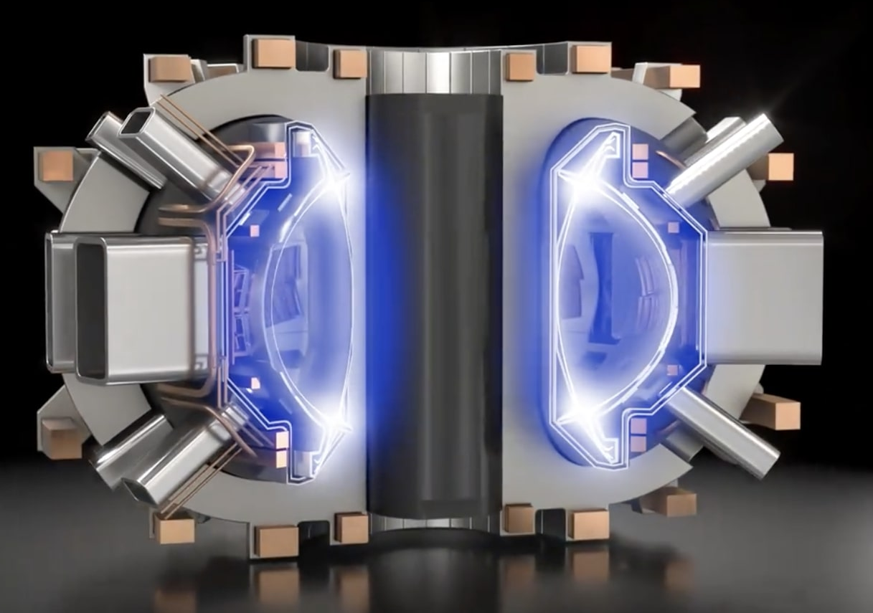
Program Collaboration: Milestone Program and Outreach
Collaboration with Milestone efforts:
  The FES SciDAC-5 Partnerships are encouraged to collaborate with recipients of Milestone Awards.
  Access to the predictive modeling and simulation capabilities of SciDAC Partnerships will help accelerate the development of a fusion pilot plant.
  Milestone teams have inquired about NERSC opportunities for computational time.
Building up smaller programs:
  The Theory & Simulation Program has the unique feature of lacking the requirement for on-site equipment to perform scientific research.
  This can allow for a presence at smaller institutions, in collaboration with larger universities and national laboratories.
  The Advanced Computing program element can provide a possible avenue for leading institutions to coordinate efforts and share infrastructure with other universities.
    PPPL is currently allowing access to their clusters (Stellar and Traverse) from outside institutions as a first step.
3D model of SPARC.

Slide 20
Diversity, Equity, Inclusion, and Accessibility
DEIA has been a challenge for the Theory program; women and minorities are significantly underrepresented (at least as lead PIs)
  FES SciDAC-5 has seen the most diverse pool of applicants and awardees in the program’s history.
Plans for improving DEIA:
  Promote collaborative opportunities between large institutions and MSIs/HBCUs.
  Promote programs at universities that offer student training free of charge, e.g., MIT’s Computational Physics School for Fusion Research (CPS-FR).
SciDAC-5 Awardee Demographics
Female leads PI’s | 3
Female co-PI’s | 11
Hispanic lead PI’s | 2
Hispanic co-PI’s | 3

Slide 21
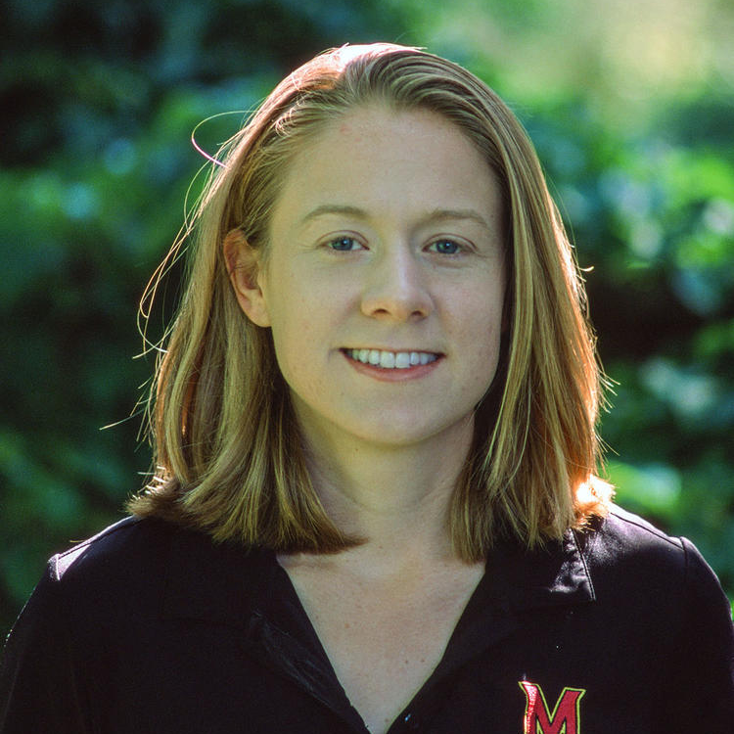
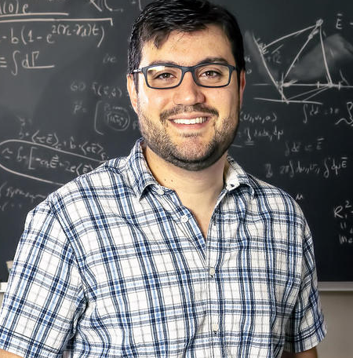
Early Career Research Program
The DOE Early Career Program mission is developing the next generation of STEM leaders to solidify America’s role as the driver of science and innovation around the world.
  In FY23 the FES Theory and Simulation program received 11 applications for the ECRP and awarded two.
  Elizabeth Paul is a leading researcher in the field of stellarator optimization with a tenure track position at Columbia University.
  Vinicius Duarte is a leader in the field of energetic particle instabilities and reduced modeling efforts with a staff research position at PPPL.
Dr. Elizabeth Paul
Dr. Vinicius Duarte

Slide 22
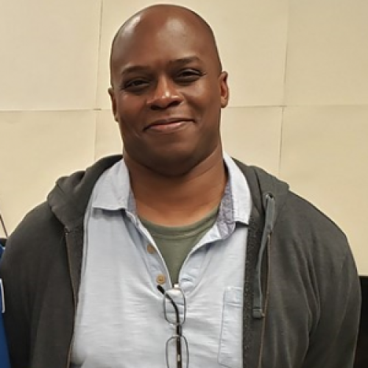
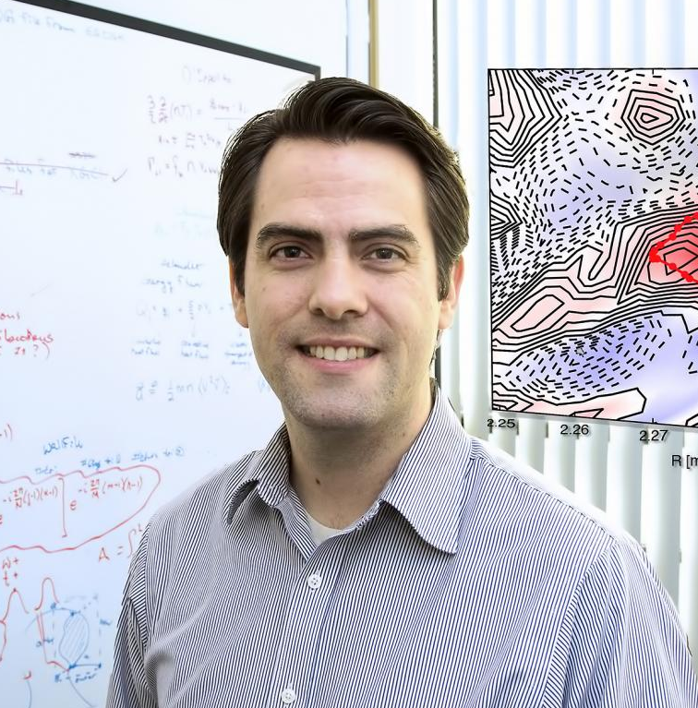
Funding for Accelerated, Inclusive Research (FAIR)
Building research capacity, infrastructure, and expertise at historically underrepresented institutions.
Includes minority serving institutions (MSIs) and emerging research institutions (ERIs).
Supporting mutually beneficial relationships between MSIs and ERIs with partnering institutions.
Theory has awarded one FAIR proposal for FY23
  PI Marcus Alfred (Howard University)
  Collaborator Michael Churchill (PPPL)
  Focused on AI/ML efforts for solving edge transport in tokamaks.
Dr. Marcus Alfred
Dr. Michael Churchill

Slide 23
Theory & Simulation: The Next Five Years
Advancements in computing open the door for paradigm-shifting degrees of simulation fidelity.
  ECP projects have successfully achieved high levels of computational optimization on FRONTIER. (FOM > 50 for WDMApp)
  QIS, though in its relative infancy, is already being utilized for complex MFE plasma simulations.
  The Theory & Simulation program should leverage these tools.
Whole Facility Modeling efforts in SciDAC hope to guide FPP device design.
  Several SciDAC Partnerships intend to focus their efforts on operational scenarios relevant to devices within the Milestone Program, while expanding the scope of code-coupling efforts.
  Stellarator projects focus on the optimization of coil configurations to minimize deleterious instabilities and maximize confinement.
“Big Data” resources can be utilized by researchers to accelerate modeling and simulation.
  Reduced Ordered Models in conjunction with AI/ML can offer new insights in the physics of plasma phenomena.
  The output data from high-fidelity whole facility models can offer predictive analysis before a device has finished construction.
Theory and Simulation is responsible for filling program gaps.
  Theory & Simulation research can work from first-principles to flesh out experimentally observed diagnostic results.
    Theory aims to answer the “Why?” to novel experimental results.
  Coordination with experimental programs will be key to the success of both Theory and Experiment.
  Relationship is highly symbiotic: Theory depends on high-quality experimental data and Experiments depend on high-fidelity predictions to define new operational parameters.
Support up-and-coming research programs
  Awards under the FAIR FOA and single-investigator awards under the Theory program can take advantage of HPC infrastructure with an internet connection alone.

