Slide 1
Implementation and status of the EUROfusion Data Management plan
16th IMEG meeting
Pär Strand, Chalmers
M. K. Owsiak, A. Filipczak, B. Pogodziński, K. Niżnik, P. Grabowski, N. Cummings, S. de Witt, A. Parker, J. Hollocombe, T. Farmer, G. Szepesi , J.-F. Artaud, L. Fleury, F. Imbeaux, P. Maini, J. Morales, R. Coelho, D. Borba, P. Strand, D. Yadykin, D. P. Coster, L. Kripner, J. Decker, L.Simons, C. Yildiz

Slide 2
FAIR based Implementation of the Data Managment Project
FAIR - Findable, Accessible, Interoperable, Reusable
Goals:
Long term goal is to provide FAIR based access to EUROfusion based modelling and experimental data using IMAS as interoperable basis with addition of searchable formats.
The Implementation of the EUROfusion Data management plan follows the Blueprint architecture developed by Fair4fusion project. Initially, it promotes access to searchable metadata (waveforms) and data access to a subset of data from EUROfusion discharges on the European devices through IMAS structured data. It should provide FAIR based access to EUROfusion experimental and modelling data.
The activity separates into core services providing the infrastructure platform and user interfaces/authentication (PSNC) and sites (AUG, TCV, WEST, COMPASS/-U, JET, [MAST/-U]).

Slide 3
EUROfusion Data management Plan – staged approach
The data management plan defines 4 scenarios/stages of increasing ambition. Not yet fully supported!
Scenario A: making metadata only available and searchable using IMAS data subsets for interoperable definitions of quantities [F,(I)].
Scenario B: adds to Scenario A by allowing a subset of the data to be accessed using common tools (UDA). Facilities are responsible for the access level and qualification of data through the data mappings [F,A,I,(R)].
Scenario C: builds on the previous stages and allows for enhanced data provenance and referencing through PID’s [F,A,I,R].
Scenario D: adds a lightweight layer for open access to non-embargoed metadata and where allowed by the facilities also data access for export in human readable formats (CSV files) [F,A,I,R] and open. Defer.
Going into production on the new GW Q1 2025 (?)
Prototype/demo available for testing review now!
Prototype! Start implement! Original scope extended due to additional funding. Continued focus in 2025. User requirements and needs!
Defer. Resource restricted but important. LTDSF with PID support in the pipeline open up future possibilites

Slide 4
Status
Core services at PSNC/Gateway and participating sites (AUG, COMPASS, MAST/MAST-U, TCV, WEST and JET (JDC - 2024):
  Demonstrated remote data access through IMAS based tools and protocols (UDA client server solution)
  Security layer in UDA has been delivered, migration towards JSON plugin for simplified data mappings started on several sites
Population of Metadata data catalog ready for production use, awaiting new Gateway hardware.
  Demonstrated at SOFT 2024 (”scenario A”)
  Need to define a recommended list of signals from experiments based on user needs → parallell session this afternoon/tomorrow!
Imasification of Machine data → more resources and ability to move faster on data access for users and their use cases available, but
    Hampered by availability of expertise – funding exists but implementation slowed down by availability of diagnosticians etc.
    Some variation in enthusiasm from the experimental sites…?
    Should build a set of use cases with clear requirements → Parallel session this afternoon /thursday
Demonstrated ability to provide data access for user driven application needs, by running a predictive transport code (ETS) for AUG, WEST, [TCV] and ITER on DMP provided data and access tools. (”scenario B”)
  Expanded use requires Authentication and Authorisation technology to be further established at all sites
  slow integration with EUROfusion LDAP approval/implementation of site policies delayed as knockon effect
  Reponsibility/willingness/ability to provide higher level data (core profiles etc) varies between sites – need an harmonized approach. – discussion in parallel sessions

Slide 5
Intermediate Summary
Longer term vision: A one stop facility for researching, accessing, processing, analysing, and sharing experimental and modelling data.
Technology backend (almost) ready for full deployment
  Still need to provide authorisation layer beyond whitelisting on sites
Now time to start population data and expand data mappings (site activitites!)
  Recommendations on minimum data requirements
    Standard data for metadata ”waveforms”
    Data mappings / data sets for TSVV data validation -
    How to manage ”processed data” – core _profiles etc at scale? Who is responsible?
Reasonable progress in the 1+ year of activity
  Still some struggles with red tape and prioritisation at different sites
  Some concerns on longevity and support of some infrastructure components
Next step: Develop the technology to integrate modelling data through SimDB as a site(facility) of its own. Closing the loop from data – modelling - new data all available in an integrated structure.

Slide 6
Background for the Discussions

Slide 7
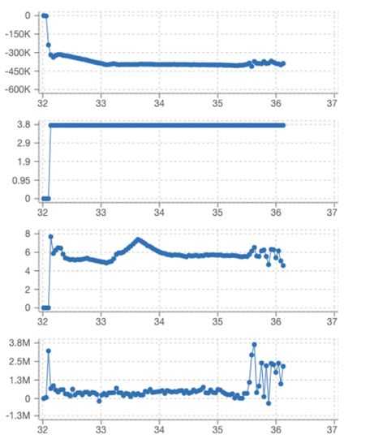
Approach to the ”Scenarios”
Scenario A: ”Metadata” made available from the fusion devices
  Metadata is context dependent – someones metadata is someone else’s data and viceversa:
  Our definition: ”metadata is the waveforms needed for a researcher to not only know that a shot was performed but also to assess the shot for insights and future use”.
  Also planned as front end for EUROfusion databases on pedestal, disruption, etc
  Core services delivered and supported by PSNC – provides a front end
  dashboard providing search option and graphical interfaces
  Sites provide summary waveforms - (down)sampled to a single time
  array /discharge which are harvested by core services
  Provided in IDS format mainly through ”ids_summary”, dataset_description
Prototyped and ready for larger scale use
  Waiting for new hardware (EF/gateway) to be made available → Q1 2025.
  Performance tuning and production release.
  What are the data /standard searches that users are expecting?
  Demonstrator Dashboard https://dmp.eufus.psnc.pl/dashboard/

Slide 8





Dashboard/Metadata server
Experimental sites
Findable – searchable interface to multidevice data
Metadata ingestions (“EUROfusion” data)
Notification from experiment
Pull from Core Site
IMAS formatted data from Experiments sites
SQL database on core services
User
Interoperable – common data specification – ontology - IMAS

Slide 9
Approach to the ”Scenarios” – cont’d
Scenario B: Allow for access to higher (1d, 2d,…) dimensionality data for use with common modelling tools.
  Need to limit data access to data actually used, based on use cases.
    Use cases → data needed to be available to run a particular code or a ”type” of codes.
    Need to avoid open ended data mapping requests and provide a clear pathway for validating data mappings.
  Ex of Use cases in the EUROfusion environment:
    Equilibrium and MHD stability
    Predictive transport modelling (TSVV-11, TSVV-15),
    Turbulence modelling (TSVV-1) - similar data needs as TSVV-11 (subset)
    Energetic particle workflows (TSVV-10) – as above but a further need for distribution IDS.
    Stellarators ? IMAS compatibility?
  Aim of the paralellel session: initial feedback, contact points and a process for delivering the data mappings as needed for users and all TSVVs.

Slide 10

Dashboard/Metadata server
Experimental sites
DMZ
Internal
Authorized data access
Data Accessible through remote call (UDA)
Two schools for providing data to DMZ area:
Standalone IMAS data service updated on need/request
Dynamic mapping with firewall passthrough
Authenticated User

Slide 11
Approach to the ”Scenarios” – cont’d
Scenario B: Allow for access to higher (1d, 2d,…) dimensionality data for use with common modelling tools.
  The use cases have the benefit of having mature codes and expert code users involved, with codes that are or are in the process of beign fully IMASified.
  A lot of existing work from the EUROfusion WP CD activity can be (at least partially) reused.
  A drawback is that some use cases need to have ”processed data” - core_profiles and/or core_sources etc.
    Typically not generated in experiments automatic pipelines. How to scale beyond ”data on request”?
    Consider moving more postprocessing to the user end (e.g., IMAS based IDA systems)
      Issues with data qualification and provenance trails.
      Different tools art different sites! Consistency issues
        Discussion and strategy needed – paralllel sessions
  Data mappings effort ongoing that are now started to be tested -
  Data access is through remote access with UDA/AL5 tools with (in the longer term) AAI control.

Slide 12
Experimental sites
Dashboard/Metadata server
Catalogued Simulations
Persistent identifiers
DMZ
Internal
Authorized data access
Closing the loop:
Reusing data providing
simulations on equal footing
with experiments
LTDSF / SimDB
Authenticated User

Slide 13
Summary
Implementation of the EUROfusion Data management plan is well underway
Several sites: AUG, TCV, WEST, JET, MAST(-U), COMPASS(-U), different stages of dev.
Scenario A: “wave form metadata” mostly ready.
  AUG (1150shot), TCV (~6000 shots) and WEST (1400 shots) ready to scale up to more complete coverage (including automatic updates of new discharges)
  Held back by need to move to new Gateway platform for production → Q1 2025
Scenario B: > 0D data for simulations
  Benefits from previous work and existing routine(Trview, tcv2ids,…) and machine descriptions from WP CD
  Ready for first test for users and use cases
  Need completed AAI implementation before it can move to broader production
  Issues on some site to support data mapping developments
Hardening infrastructure towards production
Aim of parallel sessions is to provide a structured approach to support TSVV use cases
  Provide data sets for validation, identify TSVV contacts and specific requirements
  Explore pathways to massive data validation efforts a ala TSVV11

Slide 15
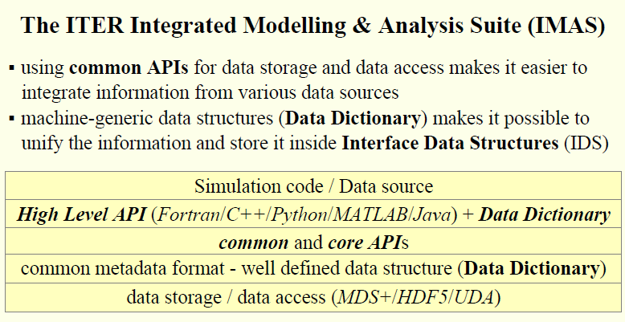
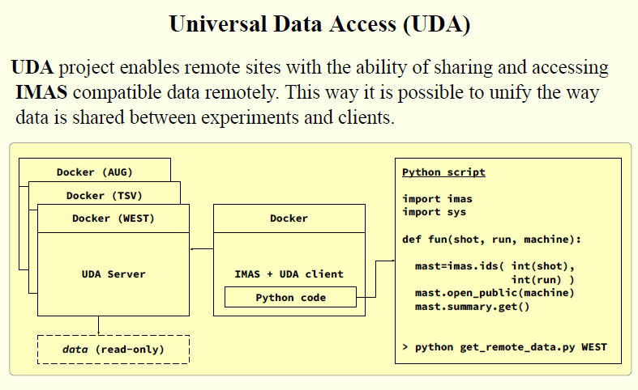
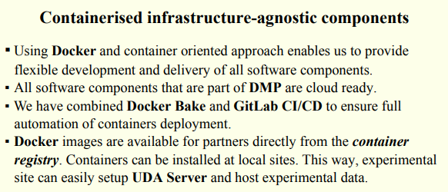
Core services – amalgation of EUROfusion and ITER software components
SOFT poster:
“Gathering and exposing experimental meta data through a dedicated catalog System”, M. Owsiak et al

Slide 16
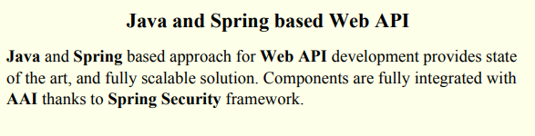
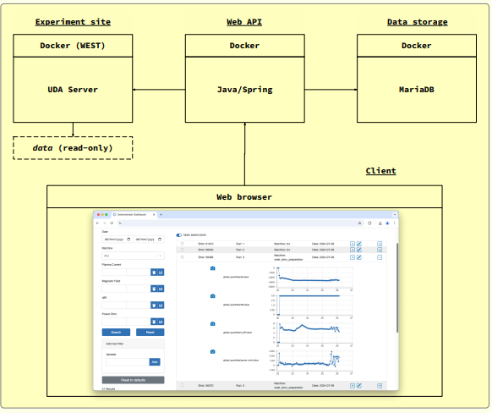
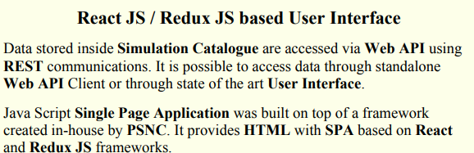
User interfaces
Demonstration planned at the SOFT conference.
Additional tools have been developed
for the data ingestion services

Slide 17
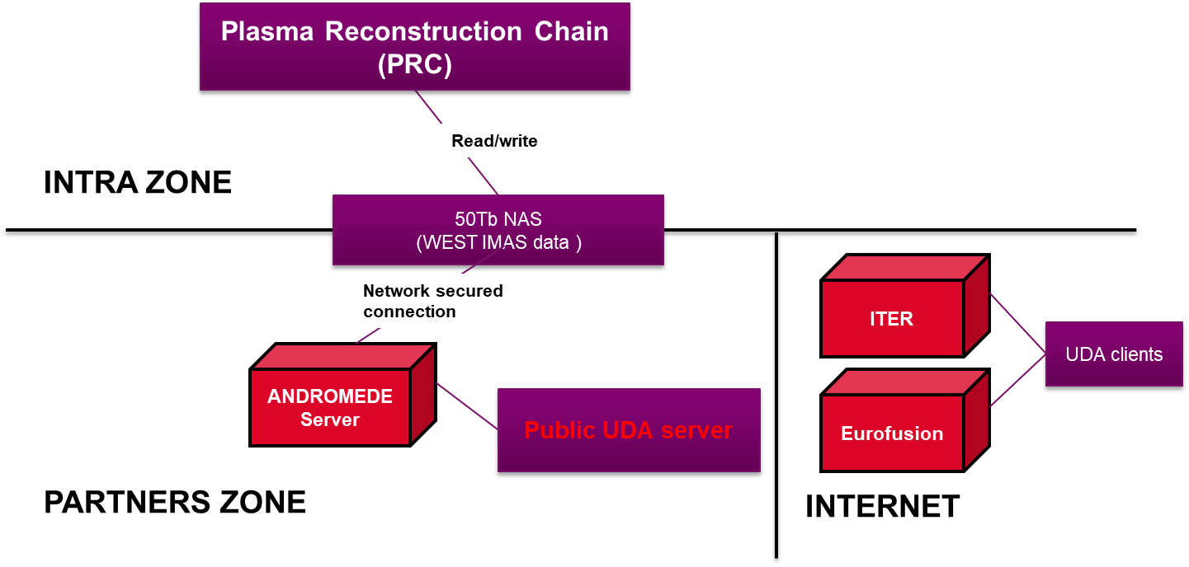
Providing WEST data
WEST pulse files produced by PRC components
WEST data sharing:
    UDA connections allowed from: ITER, Gateway and PSNC
    Using IP filtering, no authentication
2 IMAS databases are available:
  One containing diagnostics processed data
  One including METIS interpretive simulations carried out systematically for each pulse

