Slide 1
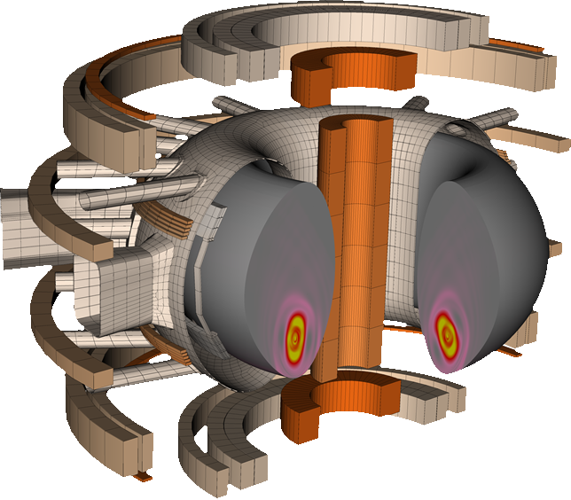
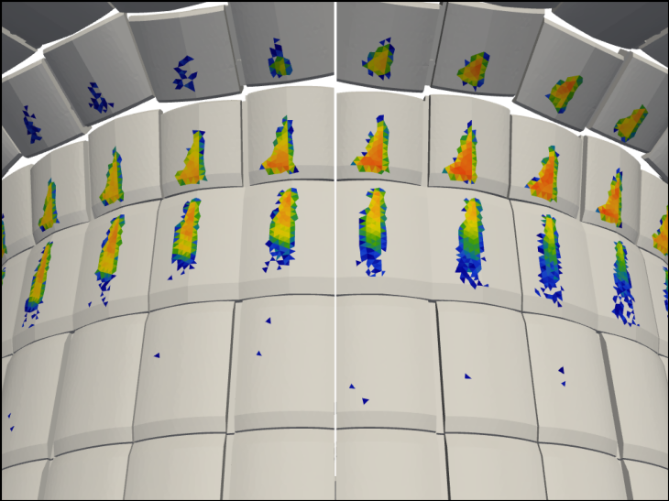
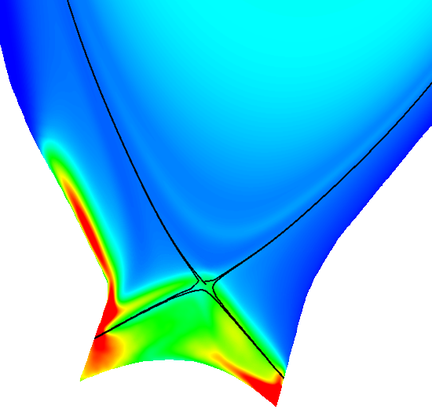
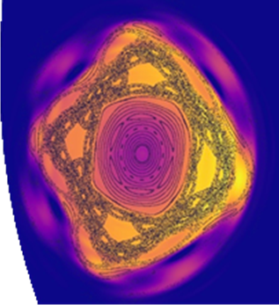
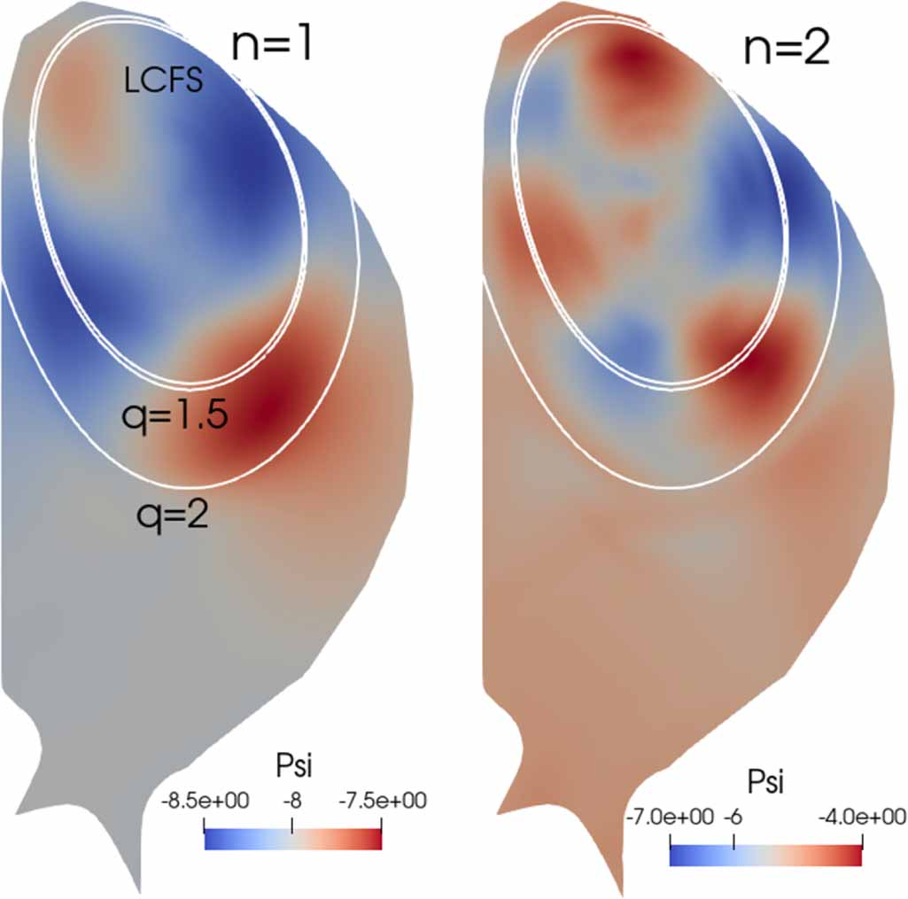
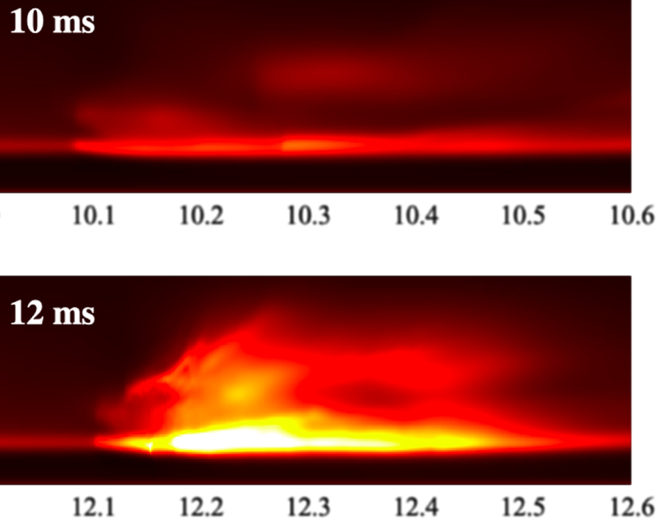
Quick overview of the JOREK code community
E-TASC General Meeting 2024
Matthias Hoelzl
Max Planck Institute for Plasma Physics

Slide 2
Historic overview
JOREK started around 2005 by Guido Huijsmans at CEA
After ~2010 a true community began to grow, supported by EnR projects and later TSVV
While the code initially aimed at pedestal physics only, it now addresses:
Pedestal including ELMs, small-ELM, ELM-free, RMPs, pellets
Disruptions including natural disruptions, SPI, VDEs, REs
Core including sawtooth control and EPs
Stellarator MHD including soft beta limits, ECCD crashes, etc.
Exhaust / divertor / SOL
Electrostatic ITG & TEM turbulence
The code has grown into an extended MHD and full-f PiC hybrid fluid-kinetic code (3D full domain)
Coupling to JOREK and CARIDDI_J allows to capture electromagnetic interactions with the wall
Initially there was only a poorly working SVN based version control
We moved the code to ITER Bitbucket (next slide)
We established a code Wiki, public website, mailing lists etc.
Now a large community, highly international, far beyond Europe
240 registered users on our Wiki
At the last annual meeting we had 61 participants, half in person

Slide 3
Historic overview
JOREK started around 2005 by Guido Huijsmans at CEA
After ~2010 a true community began to grow, supported by EnR projects and later TSVV
While the code initially aimed at pedestal physics only, it now addresses:
Pedestal including ELMs, small-ELM, ELM-free, RMPs, pellets
Disruptions including natural disruptions, SPI, VDEs, REs
Core including sawtooth control and EPs
Stellarator MHD including soft beta limits, ECCD crashes, etc.
Exhaust / divertor / SOL
Electrostatic ITG & TEM turbulence
The code has grown into an extended MHD and full-f PiC hybrid fluid-kinetic code (3D full domain)
Coupling to JOREK and CARIDDI_J allows to capture electromagnetic interactions with the wall
Initially there was only a poorly working SVN based version control
We moved the code to ITER Bitbucket (next slide)
We established a code Wiki, public website, mailing lists etc.
Now a large community, highly international, far beyond Europe
240 registered users on our Wiki
At the last annual meeting we had 61 participants, half in person
JOREK is all about the self-consistent interaction of such processes in 3D

Slide 4
Historic overview
JOREK started around 2005 by Guido Huijsmans at CEA
After ~2010 a true community began to grow, supported by EnR projects and later TSVV
While the code initially aimed at pedestal physics only, it now addresses:
Pedestal including ELMs, small-ELM, ELM-free, RMPs, pellets
Disruptions including natural disruptions, SPI, VDEs, REs
Core including sawtooth control and EPs
Stellarator MHD including soft beta limits, ECCD crashes, etc.
Exhaust / divertor / SOL
Electrostatic ITG & TEM turbulence
The code has grown into an extended MHD and full-f PiC hybrid fluid-kinetic code (3D full domain)
Coupling to JOREK and CARIDDI_J allows to capture electromagnetic interactions with the wall
Initially there was only a poorly working SVN based version control
We moved the code to ITER Bitbucket (next slide)
We established a code Wiki, public website, mailing lists etc.
Now a large community, highly international, far beyond Europe, numerous collaborations
240 registered users on our Wiki
At the last annual meeting we had 61 participants, half in person
JOREK is all about the self-consistent interaction of such processes in 3D

Slide 5
Code development based on ITER Bitbucket / International
The code is hosted on the ITER Bitbucket system
The STARWALL and CARIDDI_J codes coupled to JOREK are also hosted at ITER
Access requires an ITER account, but we have an easy solution in place to get it where needed
Aim: A single code version for the whole community and for all applications
Many automatic regression tests in place
Code reviewing before merging into the main branch
Regular tags for release versions including release notes to the mailing list
Core developers team meets before each release
Continuous ACH support with coding/HPC/numerics expertise helps a lot
Challenge of keeping the code clean, stable, maintainable in spite of the flexibility
Challenge of finding the time for development coordination, getting things merged
Challenge of finding time for code refactoring

Slide 6
Code development based on ITER Bitbucket / International
The code is hosted on the ITER Bitbucket system
The STARWALL and CARIDDI_J codes coupled to JOREK are also hosted at ITER
Access requires an ITER account, but we have an easy solution in place to get it where needed
Aim: A single code version for the whole community and for all applications
Many automatic regression tests in place
Code reviewing before merging into the main branch
Regular tags for release versions including release notes to the mailing list
Core developers team meets before each release
Continuous ACH support with coding/HPC/numerics expertise helps a lot
Challenge of keeping the code clean, stable, maintainable in spite of the flexibility
Challenge of finding the time for development coordination, getting things merged
Challenge of finding time for code refactoring

Slide 7
Code License and Dissemination
JOREK has its own code license created with CEA and IPP legal departments years ago
Available upon request to the code owners (the main hubs)
Cannot be forked or renamed
New developments must be shared with the community via the git repository
“Publication rules” apply
references for JOREK and for key developments that are used in the work
“JOREK Team” as co-author
should inform the community before submission
Code Wiki has instructions for running on various platforms
Helpdesk mailing list
Experimenting with other solutions, which cannot stop at EUROfusion boundaries!
Tutorials available for getting started with the most basic things (but need updates)

Slide 8
Training / Finding new users
JOREK is a high fidelity code that takes time for becoming productive
Tutorials and interfaces to eqdsk, IMAS, etc. simplify the start a bit
We had one dedicated training event in the past. We invested a lot of energy. Nevertheless, only a small fraction of the trainees remained active in the community.
Instead, we now train master students, PhDs, and postdocs all the time.
Co-funded PhD/PD projects with ITER or DEMO also work very well.
Training is by far most effective if the trainee
invests nearly full-time in the beginning, thus student/PhD/PD
has a strong intrinsic interest in the subject
physically stays at one of the main hubs at least for a while
has concrete contact persons to move from basics to scientific production

Slide 9
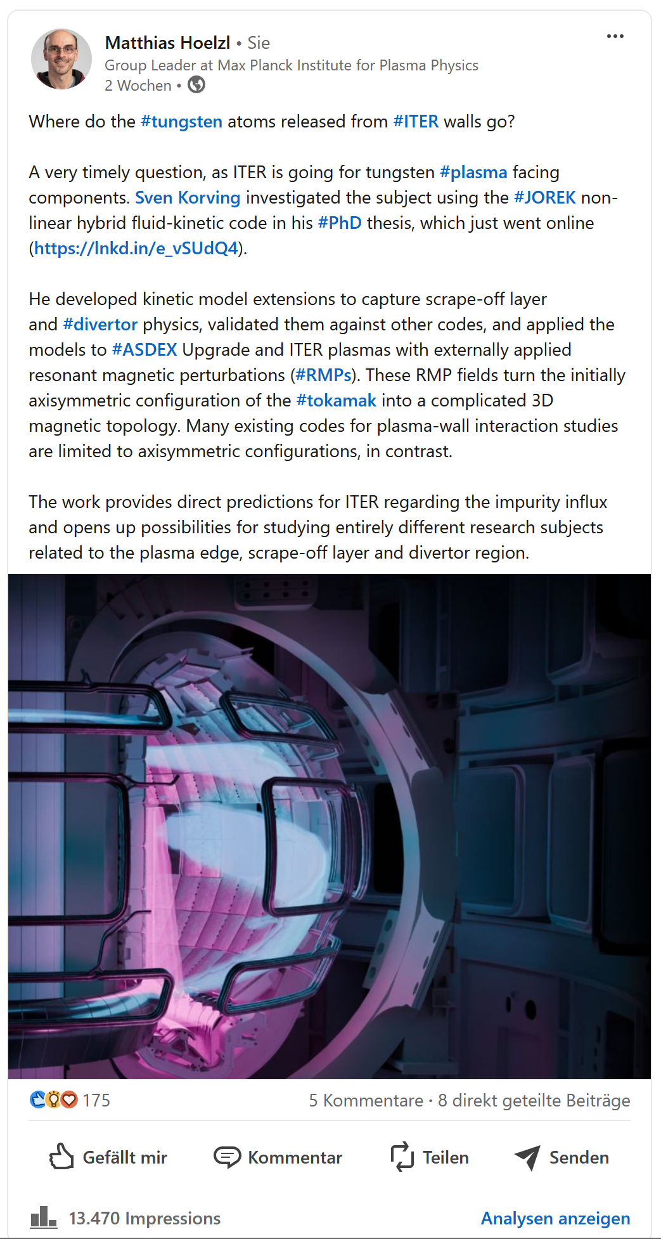
Outreach
Comprehensive overview article for JOREK covering numerics, models, verification, validation and applications Nuclear Fusion 61, 065001 (2021)
IAEA proceedings with all recent developments (following the example of the experiments); will keep doing this in the future Nuclear Fusion 64, 112016 (2024)
We actively inform the community via LinkedIn e.g. about new articles or PhD thesis and reach quite a broad audience this way

