Slide 1
Training on HFPS Jan 2023
preparation, call for participation, with Denis support
Reviewed with WPTE, participation selection
Reply to all
Announcement of part open to all EUROfusion
Training
Follow up

Slide 2
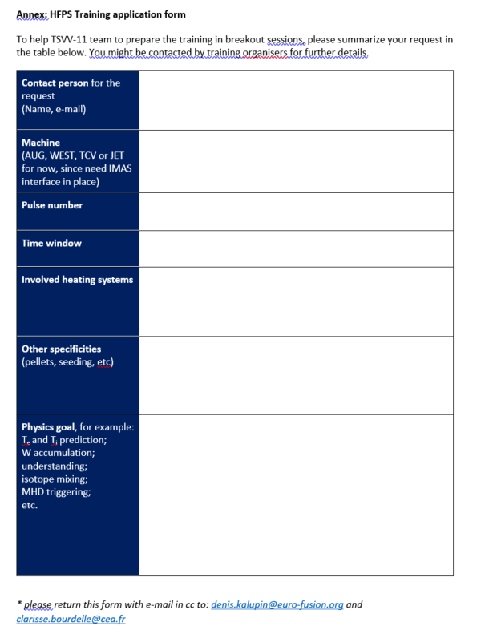

Slide 3
Training on HFPS Jan 2023
preparation, call for participation, with Denis support
Reviewed with WPTE, participation selection
Reply to all
Announcement of part open to all EUROfusion
Training
Follow up

Slide 4
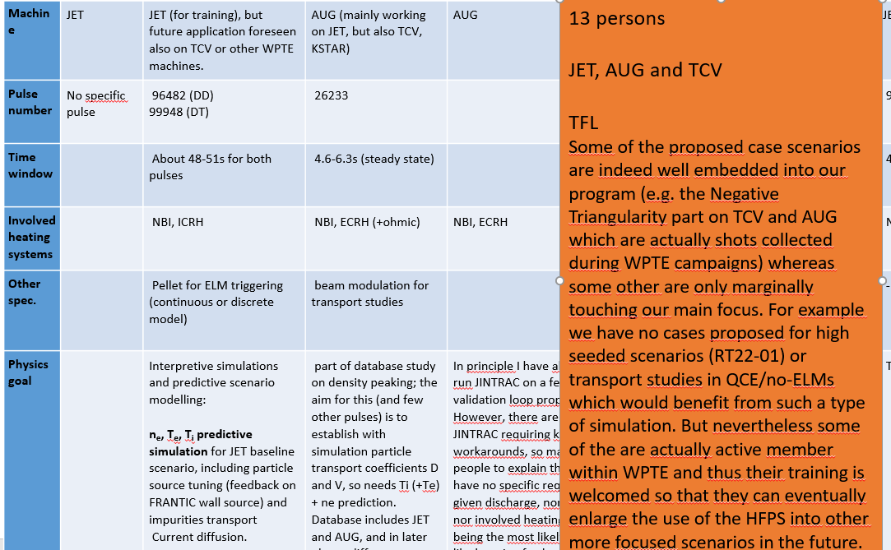
18 replies, 13 persons selected
4 trainees on AUG cases, 8 on JET cases and 1 on TCV case (WEST dealt with in house)

Slide 5
Training on HFPS Jan 2023
preparation, call for participation, with Denis support
Reviewed with WPTE, participation selection
Reply to all
Announcement of part open to all EUROfusion
Training
Follow up

Slide 6
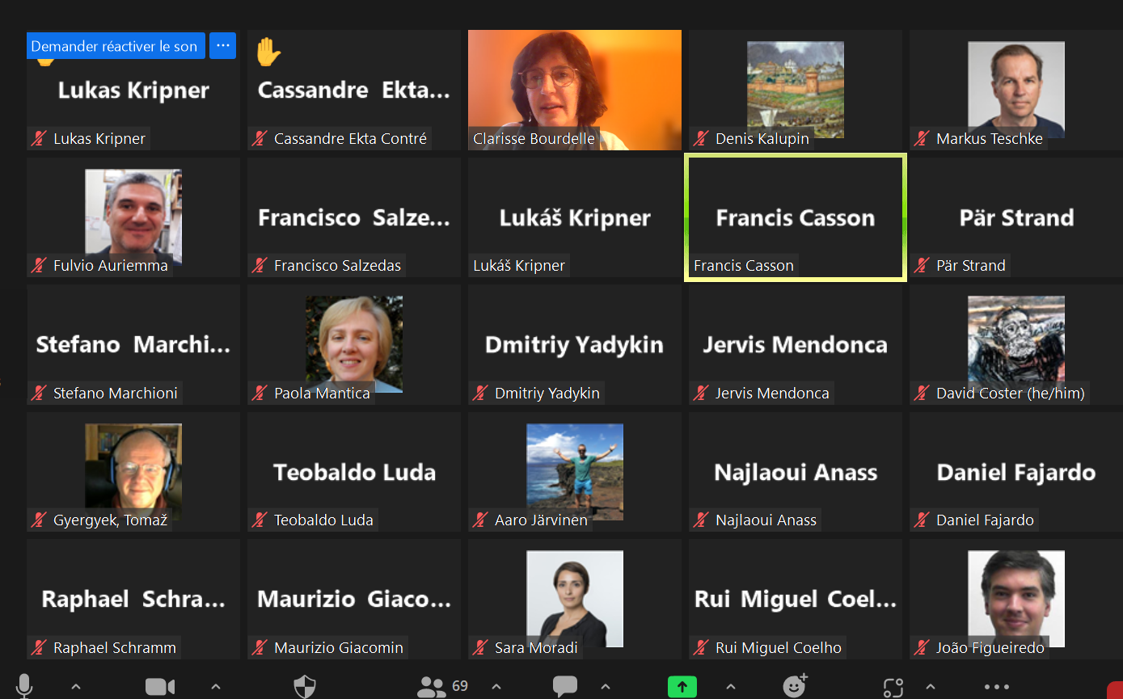
Wed. Jan. 25th 10.30-12.30 CET | General introduction and overview (open to all, no registration needed): · Recent achievements of integrated modelling · What is the High Fidelity Pulse Simulator?
69 participants to the 1st part
Slides available on the TSVV11 wikipage

Slide 7
2nd part started with a ‘how to’ on HFPS on the Gateway by Francis
Then all participants started their cases, and expert HFPS users were available to help
We had 4 cases on AUG that got stuck on the IMAS data preparation due to firewall issues between Garching and the Gateway, even today not solved, Giovanni sends data through e-mail to Francis for our benchmark case!
We used breakout rooms for one to one support, sharing screen etc. Very efficient and friendly despite using zoom
Wed. Jan. 25th 14.30-17.30 CET | 2.30 CET: all, Intro/demo interpretative case: F. Casson Breakout rooms as needed (ref. supervisor see table below) 5 pm CET: all, update on progresses/issues
Thur. Jan. 26th 9.30-12.30 CET | 9.30 CET: all, intro/demo predictive case with QLKNN Breakout rooms as needed (ref. supervisor see table below) 12.00 CET: all, update on progresses/issues

Slide 8
Training on HFPS Jan 2023
preparation, call for participation, with Denis support
Reviewed with WPTE, participation selection
Reply to all
Announcement of part open to all EUROfusion
Training
Follow up

Slide 9
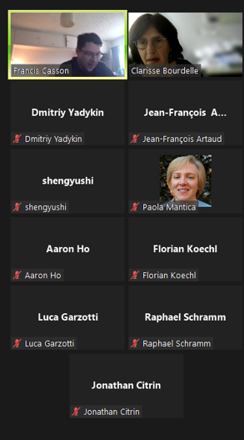
We had a follow up meeting ‘hands on’ March 3rd via zoom
The idea was to have them every 2 months or so, but actually the active new users were very few… And we just had a favorite contact person to be more flexible
We had the idea to invite the most active participants to our I person meeting in Eindhoven, March 2023
(thanks to NL eScience center project with DIFFER that included a lot of money for meetings)

Slide 10
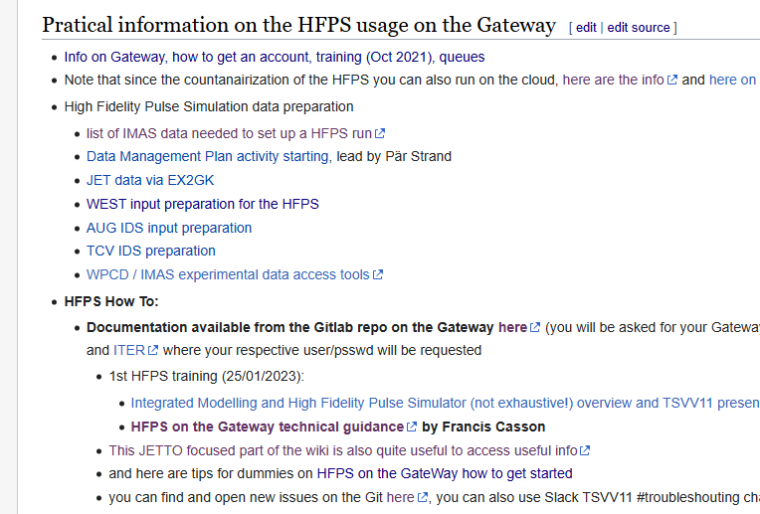
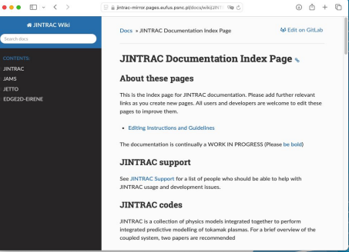
Now, what is still on-going, since new users show up regularly:
- We have very complete TSVV11 wikipage, and HFPS wikipages

Slide 11
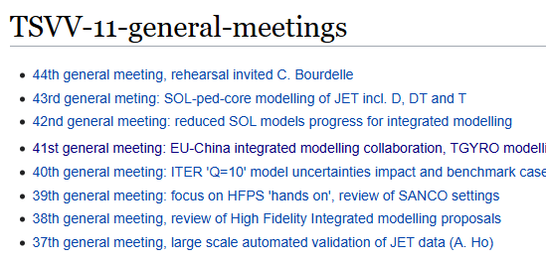
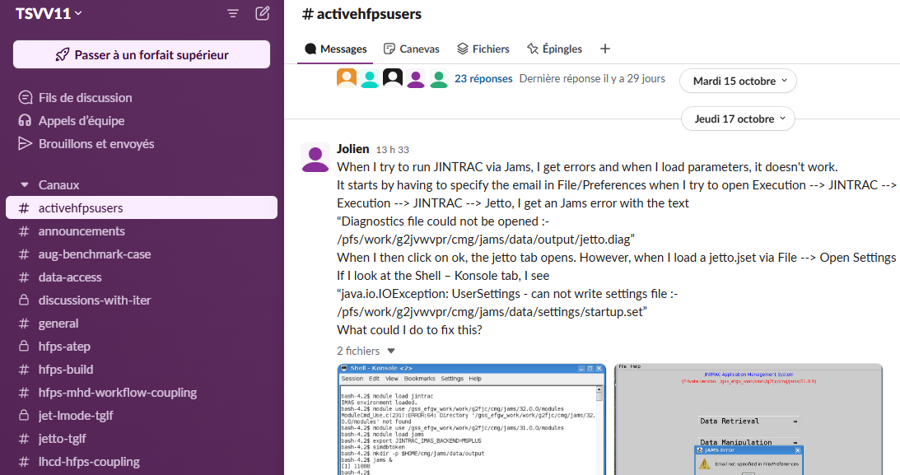
As well as TSVV11 dedicated to specific modules: technical and physics. So that we improve the HFPS wikipage on these modules
And a dedicated slack channel on which we have immediate support
Any new users is guided to
the wiki (TSVV11 and HFPS)
slack in particular #activehfpsusers
our regular TSVV11 meetings + in person (but here not necessarly in TSVV11 so back to need for flexible travel fond)

Slide 12
Fresh from Yesterday, proposal I just made to Marco Wischmeier / Sara Moradi, will be discussed next week
TSVV11 goal is to develop integrated modelling framework, extend features on physics driven question.
Interface with WPTE most welcome to support validation of experiments, even predict first approaches
Extension of integrated modelers needed
Proposed plan:
Modelling sessions targeted on physics topics twice a year coordinated by an SC and open to EF members having either already addressed the topic with integrated modelling tools or willing to learn on a precise plasma discharge.
The session would be aiming at 1/ improve the physics taken on-board integrated modelling thanks to ‘control room’ like multiple experts on-site in one room 2/ train new users motivated by the topic of the session.
Possible topics could be:
Ip ramp up modelling (existing:TCV, AUG, JET, WEST etc future: DTT, DEMO, ITER, JT60-SA)
A lot of work is existing, but using different model fidelity levels, but recently physics based models up to the LCFS have been used self-consistently with impurities and also with MHD stability checks. So worth exchanging on the various levels.
Obvious link with ITER needs at the moment when including W as well
High beta plasma modelling (usually combined with presence of fast ions) JET hybrids in D and DT, JET in preparation of JT60-SA, AUG, and to come JT60-SA, BEST, ITER, DEMO
A lot of integrated modelling as been done using TGLF or QuaLiKiz + ad-hoc fix to mimic the fast ion stabilization. Stand alone verification has also been done to guide of TGLF settings to be used. As well as non-linear flux matching modelling using GENE-Tango.
Obvious link with burning plasma challenge (ITER, DEMO)
W radiation collapse modelling and actuators. JET, AUG, WEST and preparation of ITER, VNS, DEMO
Radiation collapse have been modelled thanks to turbulent+neoclassical W transport etc on JET, AUG and WEST. Successfully. The same settings could be applied to more discharges? Or used further to optimize operation. And also to model the VNS, and ITER etc
Link with VNS, ITER etc

