Slide 1
Perspectives for utilization of AI/ML
Fredric Granberg
And ACH-VTT Team

Slide 2
AI/ML in fusion research
The aim is to raise the question about how to treat AI/ML in the fusion community
I do not advocate for or against, neither am I an expert, and probably I will contradict myself
What do we need, or do we even need any discussion about this?
Wild west?
Guidelines?
At the moment ”all proposals” needs to include aspects of AI/ML
Can be trivial

Slide 3
Some examples on success stories
AI/ML/NN fast surrogate models to heavy simulations/or combinatorial problems
Speep-up simulations
Utilize accuracy of more precice models at larger scale
AI based algorithms for efficient sampling of paramater space
Can reduce human time for sampling, and be better than a grid
LLMs for language/spell checking / document searching
Good starting point for non-native speakers

Slide 4
Common things
All of these can be validated or at least checked with a ”accurate” model
If a strange result arises, it can be checked with a existing model/human
Many current AI/ML papers are good models with small validation errors, but no new physics nor insights

Slide 5
Problems
Error estimate is not existing in many of these models
It can be included in to the models, to have an estimate of the certainty of a point
Not bullet-proof, but a good start, which can be improved
Example:
A NN estimate of X was generated by training of experimental X by choosing some parameters they thought will affect X.
A nice evolution was extrapolated, but no possibility to get an error estimate, neither can it be validated (within many years/decades)

Slide 6
What should we do?
Anything goes, as long as it is AI/ML?
Guidelines?
”Standard EUROfusion AI methods/software”?

Slide 7
ACH-VTT
We have had very little AI/ML related tasks
I think it can be counted on one hand in the whole E-TASC period from beginning
Maybe still in its infancy, so no need for support?
Examples this far
Anomaly detection for simulations
Bayesian optimization
Fast surrogate models for heavy codes

Slide 8
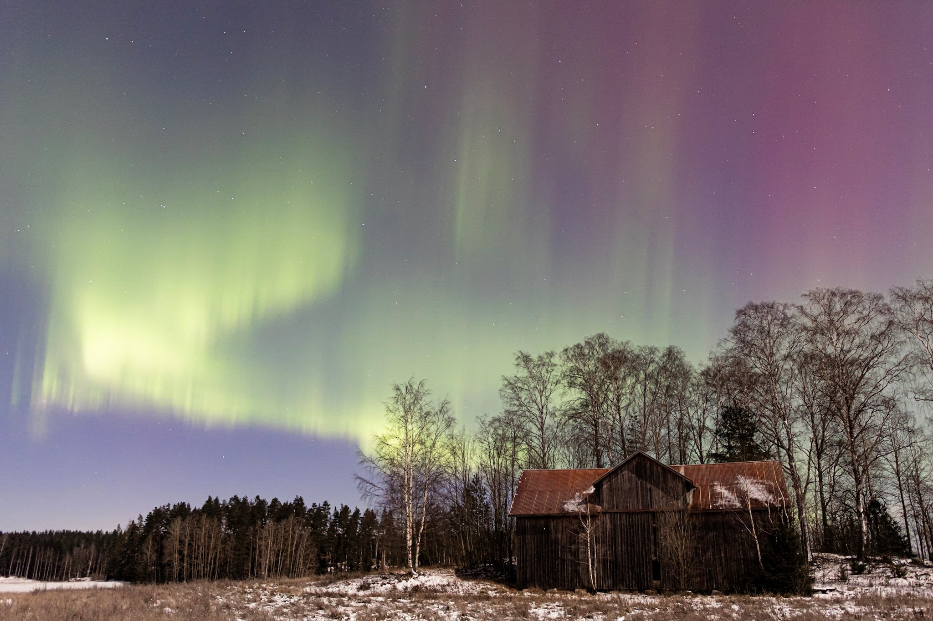
THANK YOU FOR YOUR ATTENTION Happy to discuss this further during brea

