Slide 1
burning plasma means: high beta + EP, which means interplay KBM, AE modes, turbulence and EP distribution [Falessi, Zonca et al]

Slide 2
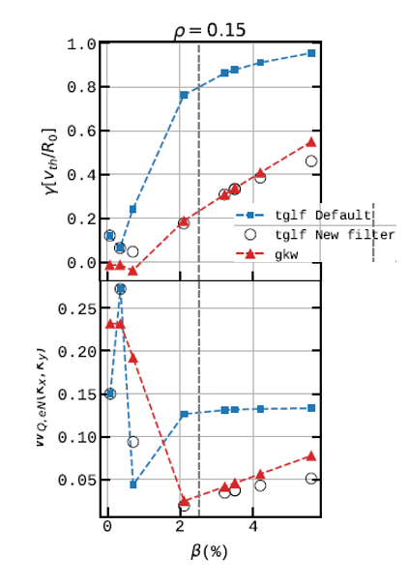
not accessible to reduced models, although TGLFsat2 stand alone not too bad for KBM in JET rho=0.15 75225 [Najlaoui's work see EUROfusion pinboard]

Slide 3
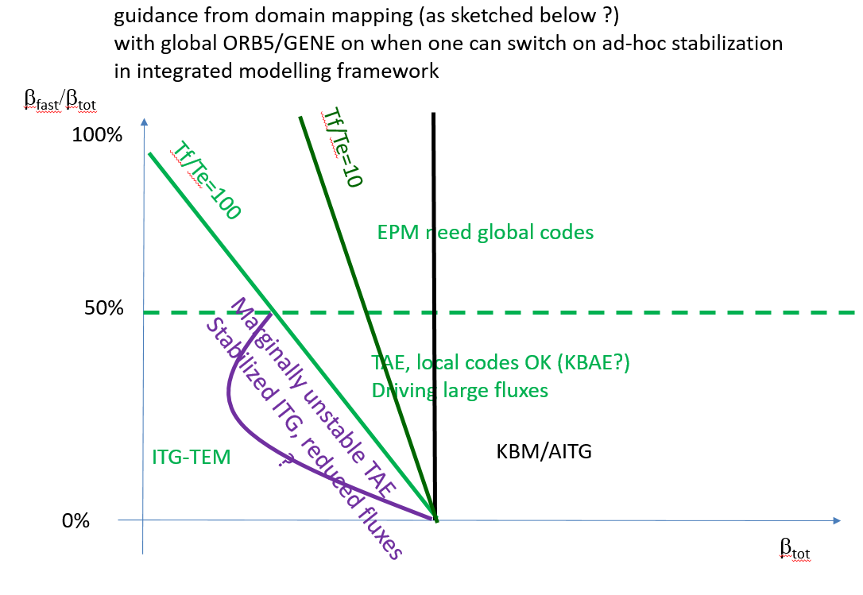
global el-mag GK models needed ORB5, GENE to understand more globally :
- where de/stabilizing interplay exists between TAE, fishbones, KBM/aITG
- where in such map(s) long lived zonal e.m. fields and PSZS are crucial for the saturation?
- Role of : β_{tot}, β_{fast}/β_{tot}, T_{fast}/T_{e}, s etc

Slide 4
Flux matching for ITER 15 MA using GENE-Tango w/o EP alphas ‘only’ Pfus (talk Di Siena last week)
- existing reduced models even w/o fast alphas not agreeing with GENE-Tango

Slide 5
note of Pfus vs time modeled using int. modelling, since Pfus depends on T0^2n0^2, a zoo of results possible with available (not verified) reduced models (below ITER 15 MA). so real and strong need for physics based to prepare operational domain and control schemes on Pfus and Psep in ITER Q>5 and beyond.

Slide 6
Methodology for coupling of ATEP to transport codes:
Embed the present ATEP WF (see scheme below) into comprehensive transport codes on various levels:
-broadened heating profile
-diffusion coefficient
-moments of EP distribution function
-EP distribution itself
-zonal fields generated by EP-driven modes
- develop methodology to couple to reduced models e.g. TGLF (difficulty: global/local; spectral shift rules for e.m. modes due to ExB shearing). ZF data available in MHD linear IDS, see slide below

Slide 7
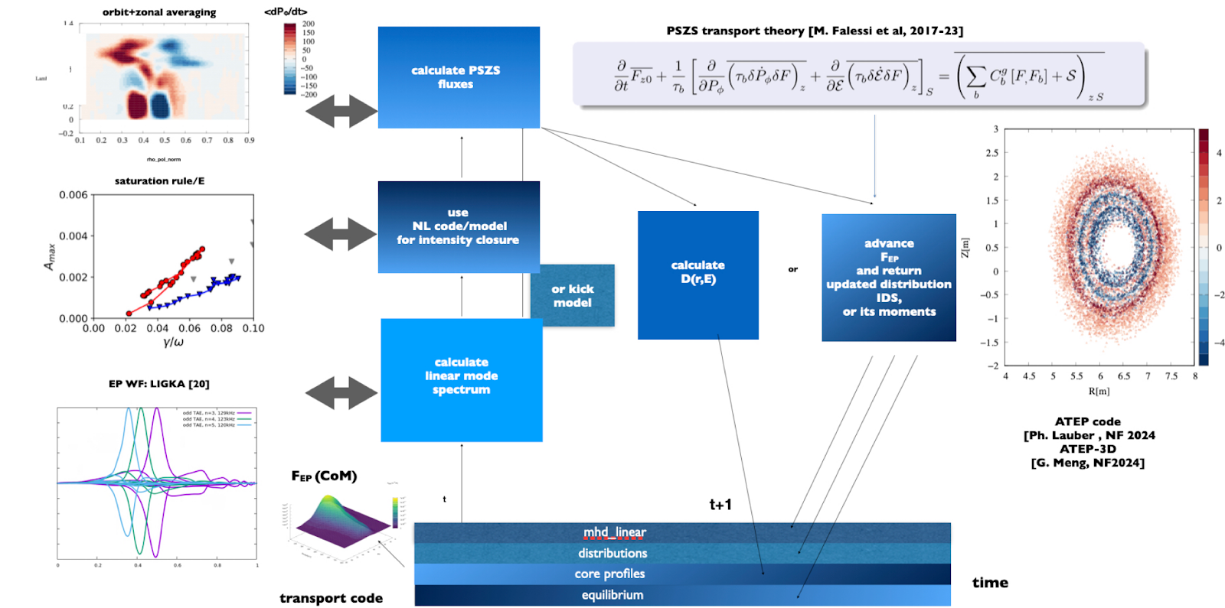

Slide 8
