Slide 1
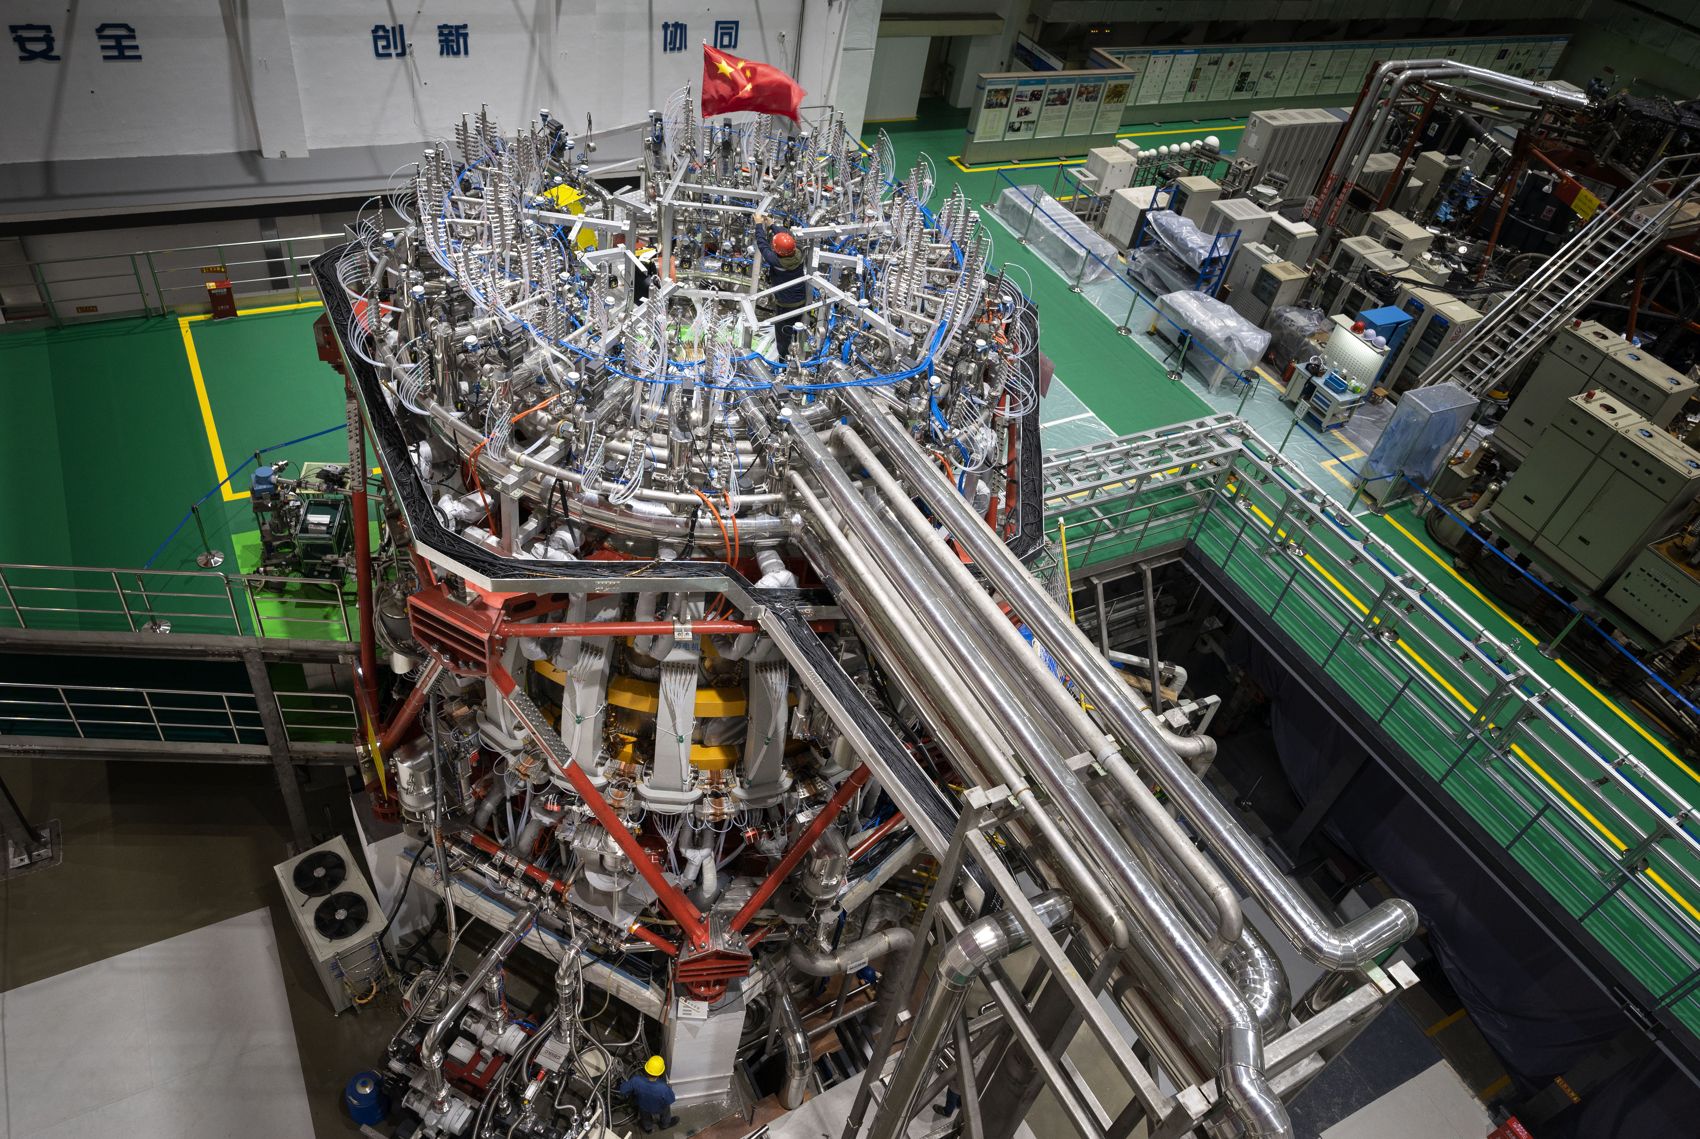

Overview of HL-3
Lijun CAI
on behalf of HL-3 Team
Southwestern Institute of Physics, CNNC
Karlsruhe, Germany，Mar.19，2024

Slide 2

01
Introduction of HL-3 Tokamak
02
HL-3 upgrades
03
Recent milestones and experiments
CONTENTS
04
DT operation plan
05
Summary and outlook

Slide 3


01
Introduction of HL-3 Tokamak

Slide 4
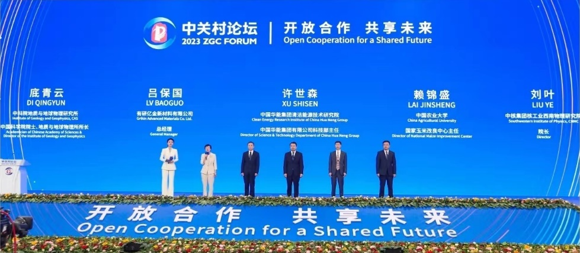
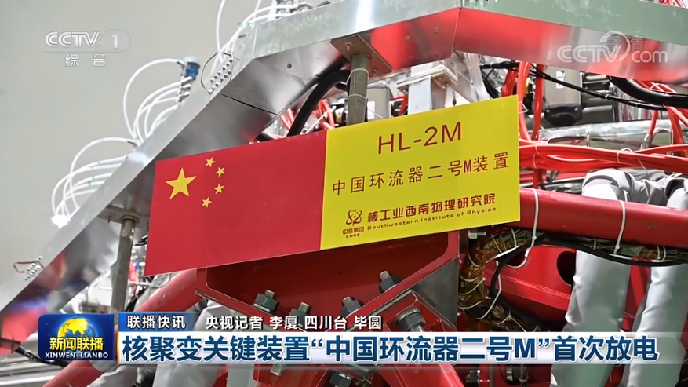
HL-2M renamed as HL-3
HL-3 tokamak (known as HL-2M before) constructed in Chengdu, 2020
HL-3 was officially named at the ZGC Forum in Beijing in May, 2023
Mar, 2019 | Tokamak assembly began
Oct, 2020 | Assembly complete
Dec, 2020 | First plasma
Mar, 2021 | Project passed the Acceptance Test
Notes:
HL-3创新成果入选2023年中关村论坛成果发布会“20大重大成果”

Slide 5
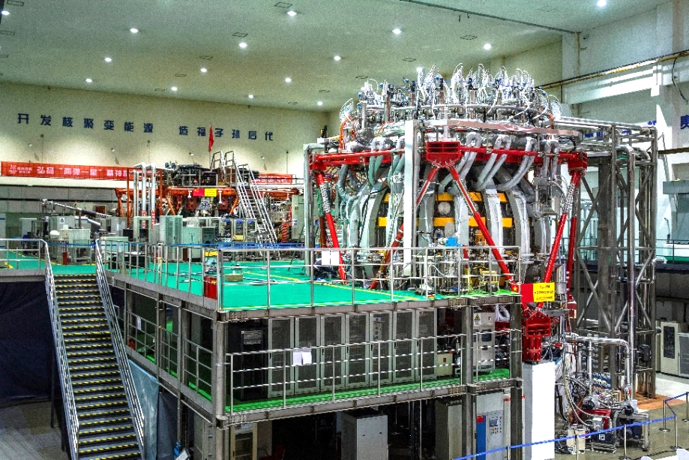
Parameters of HL-3
Main parameters | HL-3 | HL-2A
Major radius, R | 1.78m | 1.65m
Minor radius, a | 0.65m | 0.4m
Aspect ratio | 2.8 | 4.1
Plasma current, I_{p} | 3 MA | 0.45MA
Toroidal magnetic field, Bt | 3 T | 2.8T
Elongation | >1.8 | <1.3
Plasma Volume
Plasma Current
Ion Temperature
n × T_{i} × τ_{E}
~40 m³
3 MA
150 million degree
~10²¹ m⁻³·keV·s

Slide 6
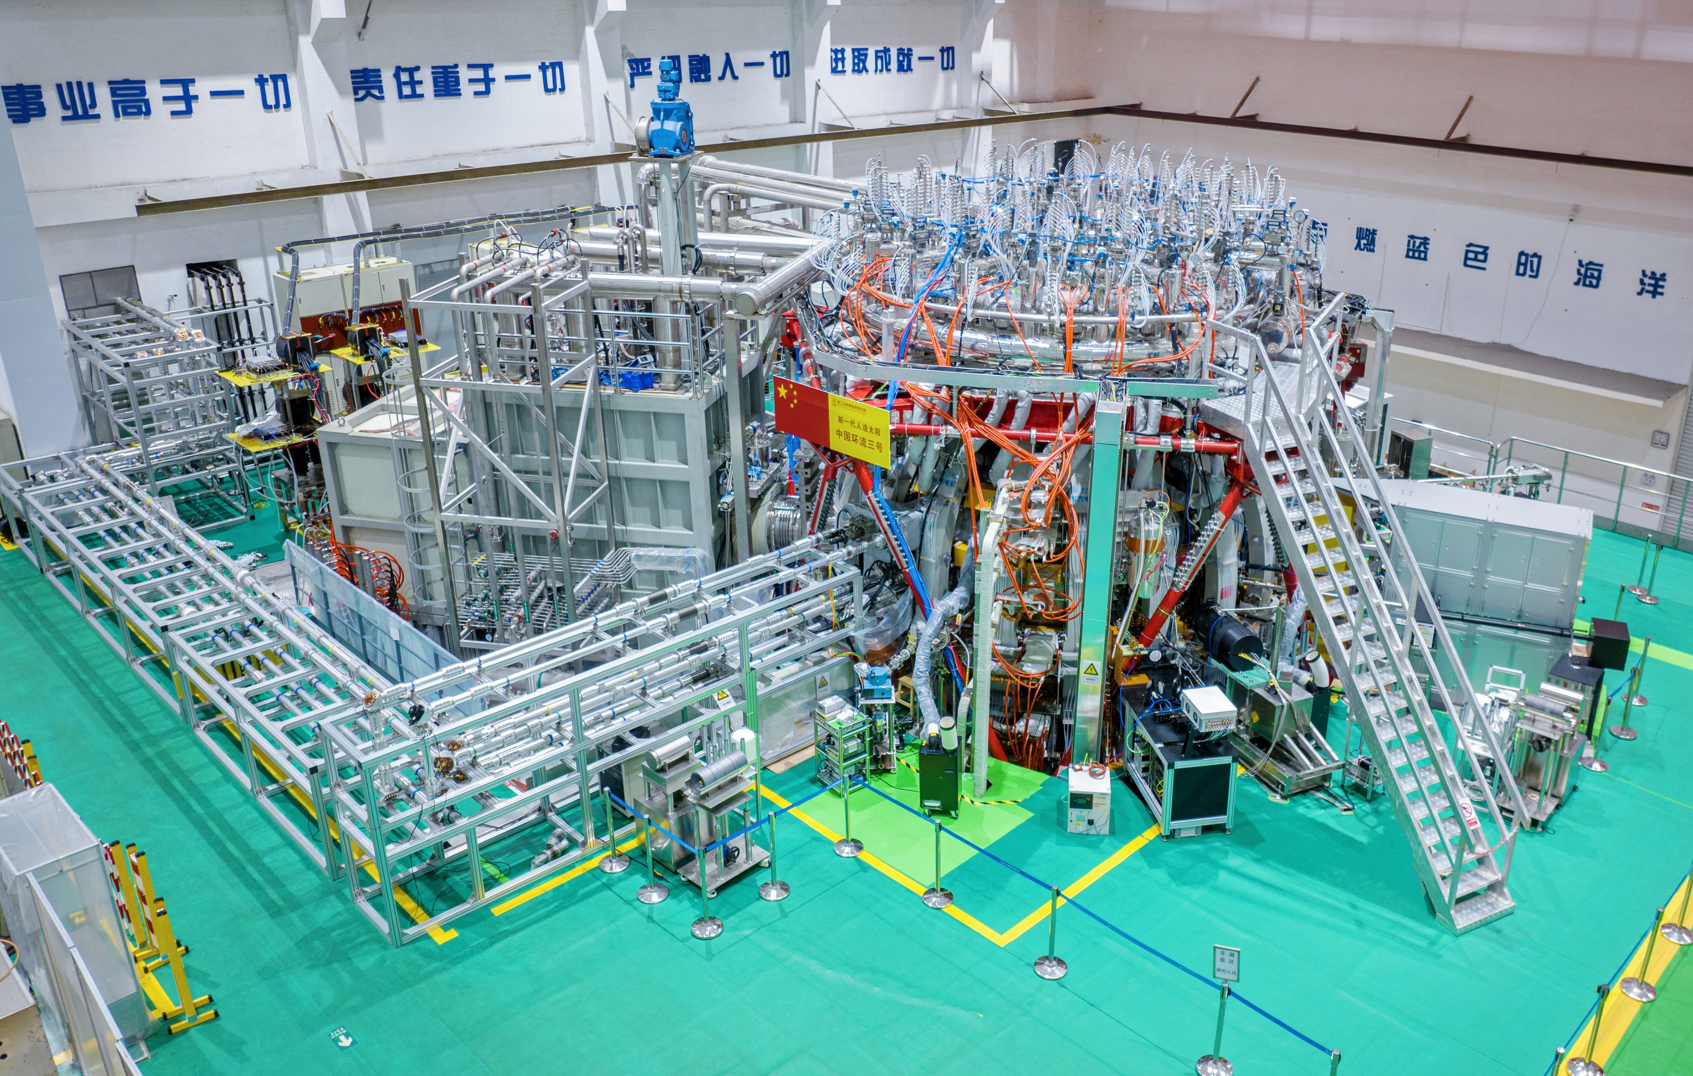
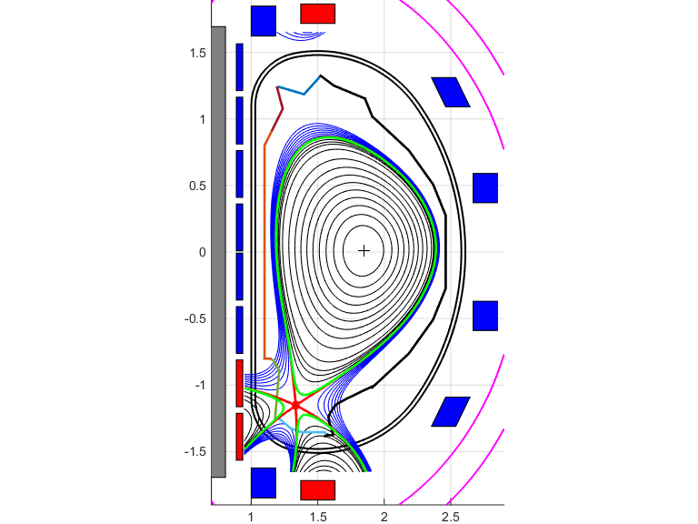
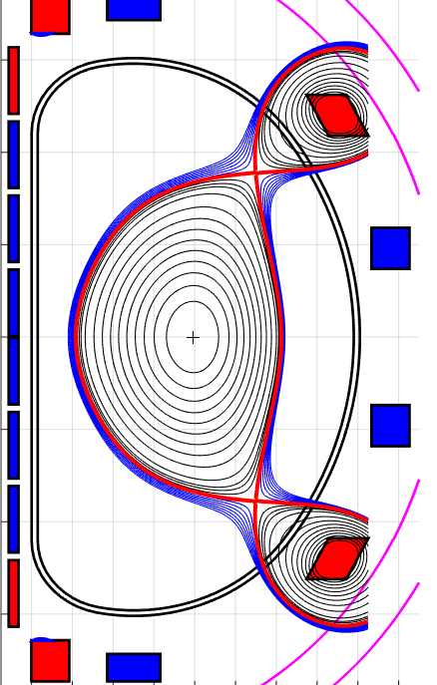
Mission of HL-3
Addressing critical physics and technology issues for ITER & fusion reactors
ITER-related scenarios, such as baseline H-mode, hybrid & steady state; high-performance operation regimes toward fusion reactors, such as β_{N} >3, high density with Greenwald fraction >1, etc.
ITER-related key plasma physics and technologies, including EP / VDE / NTM / ELM control, disruption alerting & mitigation, etc.
Advanced divertor configuration concept and physics，test and validation of high heat flux PFCs.
D-T fusion experiments to explore burning plasma physics and technologies.

Slide 7
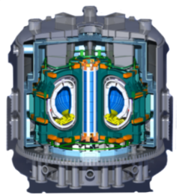
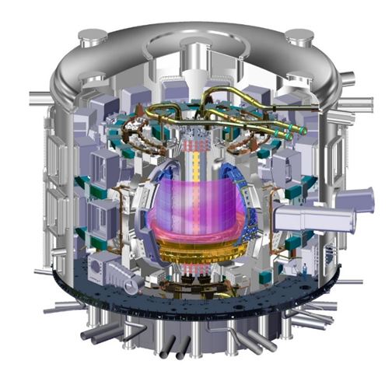
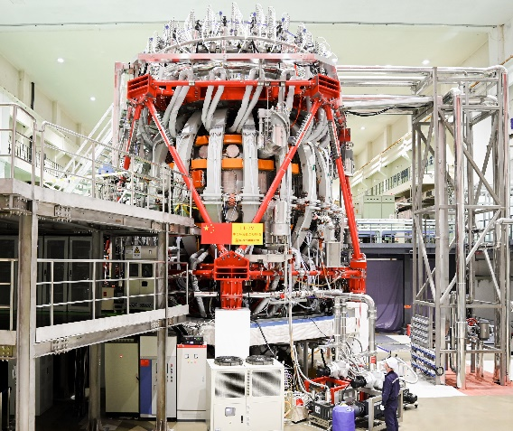
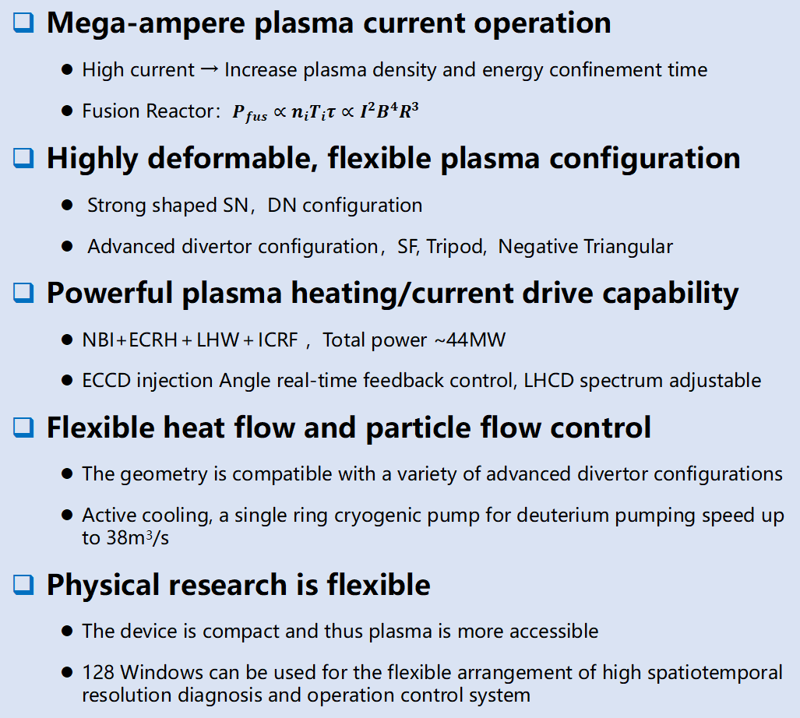
Characteristics of HL-3
Mega-ampere plasma current operation
  High current → Increase plasma density and energy confinement time
  Fusion Reactor：$P_{fus}$ $∝n_{i}T_{i}τ∝I^{2}B^{4}R^{3}$
Highly deformable, flexible plasma configuration
  Strong shaped SN，DN configuration
  Advanced divertor configuration，SF, Tripod, Negative Triangular
Powerful plasma heating/current drive capability
  NBI+ECRH＋LHW＋ICRF ，Total power ~44MW
  ECCD injection Angle real-time feedback control, LHCD spectrum adjustable
Flexible heat flow and particle flow control
  The geometry is compatible with a variety of advanced divertor configurations
  Active cooling, a single ring cryogenic pump for deuterium pumping speed up to 38m³/s
Physical research is flexible
  The device is compact and thus plasma is more accessible
  128 Windows can be used for the flexible arrangement of high spatiotemporal resolution diagnosis and operation control system
Fusion Reactor
ITER
Support fusion reactor design and construction
Support ITER
HL-3

Slide 8
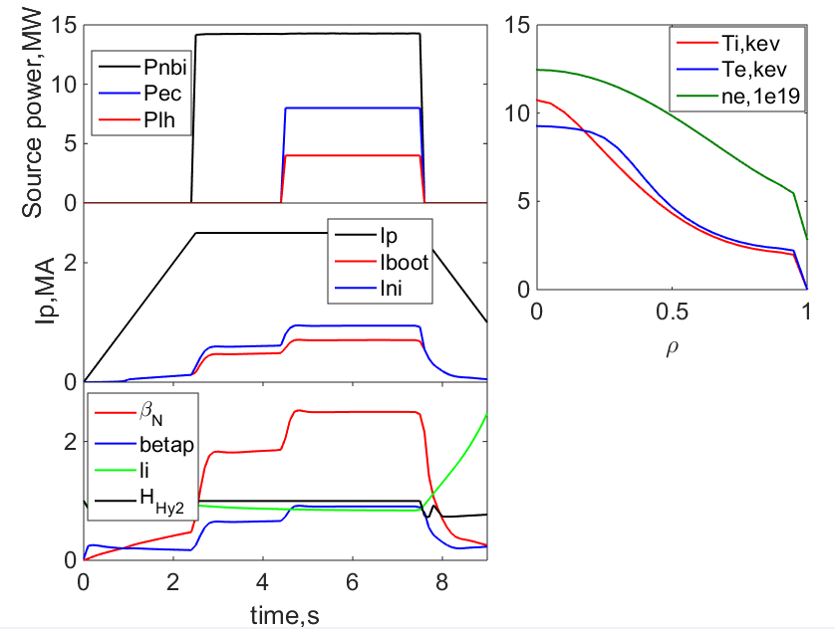
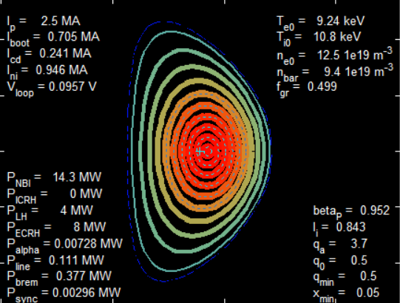
Scenario of high parameter plasma
T_{i0} >10keV, at f_{G}=0.5 (linear density 9.4×10¹⁹ m⁻³)
The fusion triple product can reach the order of 10²⁰ m⁻³skeV
β_{N} ~ 3
Ip(MA)/ B_{t}(T) | 2.5/2.2 | 2.5/2.2 | 2.5/2.2
κ/δ | 1.8/0.5 | 1.8/0.5 | 1.8/0.5
a/R(m) | 0.65/1.78 | 0.65/1.78 | 0.65/1.78
f_{G} | 0.6 | 0.6 | 0.5
P_{NBI}/P_{EC}/P_{LH} | 15 /8 /2 | 15 /8 /4 | 15 /8 /4
X_{EC}/X_{LH} | 0.3 /0.7 | 0.3 /0.7 | 0.3 /0.7
q₉₅ | 3 | 3 | 3
β_{p} | 0.98 | 1.00 | 0.95
β_{N} /4li | 2.8 /3.6 | 2.9 /3.5 | 2.8 /3.4
f_{BS} /f_{ni} | 0.26 /0.32 | 0.28 /0.35 | 0.28 /0.37
Te0/Ti0 (keV) | 8.5/9.2 | 8.7 /9.4 | 9.2 /11
Teped/Tiped (keV) | 1.5 /1.4 | 1.6 /1.5 | 2.2 /2
neped/nesep (1e19) | 7.3 /4.1 | 7.3 /4.1 | 5.4 /2.9
W_{th} (MJ) | 3.3 | 3.5 | 3.3
H₉₈(y,2) | 1 | 1 | 1
n(0)τT_{i}(0) (1e19m⁻³skeV) | 18.0 | 18.4 | 17.2
Plasma parameter evolution and flat-top temperature density profile (Ip=2.5MA,Bt=2.2T,Paux=27mw, f_{G}=0.5)

Slide 9
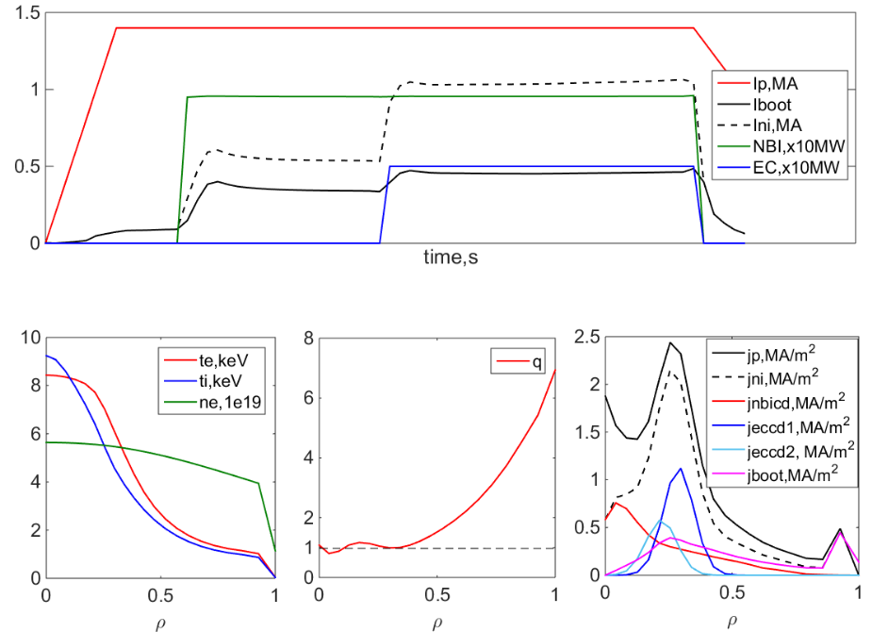
Hybrid scenario with MA plasma current
f_{G}~0.5 , NBI+ECRH&CD+ LHCD，Ip=1.0~1.4MA , Hybrid scenario
f_{BS} : 30%~45%,f_{ni} :70%~90%, β_{N} ~2.5, H₉₈(y,2)~1.1
Ip(MA)/ Bt(T) | 1.4/2.2 | 1.0/2.0 | 1.0/2.0
κ/δ | 1.8/0.5 | 1.8/0.5 | 1.8/0.5
a/R(m) | 0.65/1.78 | 0.65/1.78 | 0.65/1.78
fG | 0.47 | 0.5 | 0.5
PNBI/PEC1/PLH (PEC2) | 10 /5 /(2) | 6 /7 /(1) | 6 /6 /3
XEC/XLH | 0.34 /(0.28) | 0.4 /(0.2) | 0.3 /0.7
q95 | 5.5 | 4.8 | 4.7
q0 / qmin | 1.10 /0.80 | 1.10 /1.00 | 0.93 / 0.88
βp | 1.3 | 1.7 | 1.6
βN /4li | 2.3 /3.8 | 2.5 /3.9 | 2.4 /3.4
fBS /fni | 0.33 /0.76 | 0.40 /0.86 | 0.41 /0.89
Te0/Ti0 (keV) | 8.4/9.2 | 6.7 /6.1 | 6.5 /5.8
Teped/Tiped (keV) | 1.0 /0.87 | 1.2 /0.86 | 1.3 /0.89
neped/nesep (1e19) | 3.9 /1.1 | 2.7 /1.1 | 2.5 /1.3
Wth (MJ) | 1.3 | 0.85 | 0.82
H98(y,2) | 1.05 | 1.1 | 1.03
Ip=1.4MA, The heating and current waveforms
Plasma temperature, density, safety factor and current profile

Slide 10
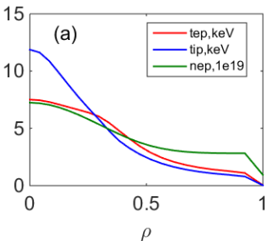
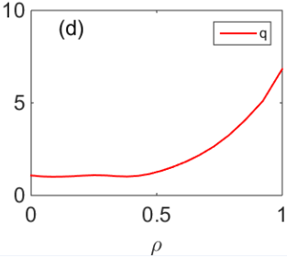
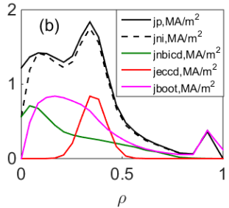
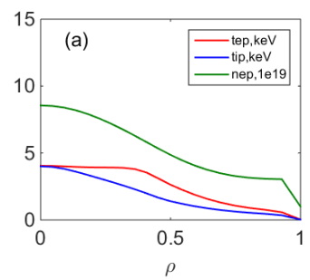
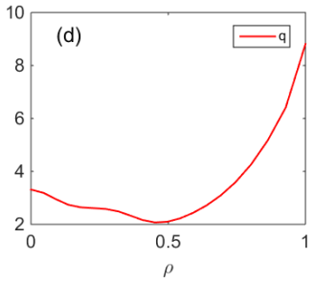
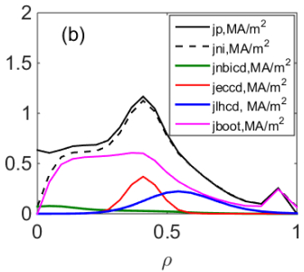
Full non-inductive with MA plasma current
Reversed magnetic shear profile features
f_{BS}>50% ，f_{ni} ~100%，H₉₈(y,2)~1.3.
Ip(MA)/ B_{t}(T) | 1.2/1.7 | 1.0/1.85
κ/δ | 1.8/0.5 | 1.8/0.5
a/R(m) | 0.65/1.78 | 0.65/1.78
f_{G} | 0.5 | 0.73
P_{NBI}/P_{EC1}/P_{LH} | 10 /5.5 /- | 1.5 /3.5 /4
X_{EC}/X_{LH} | 0.42 /- | 0.45 /0.6
q₉₅ | 5.1 | 4.8
q₀ / q_{min} | 1.0 /1.0 | 1.10 /1.00
β_{p} | 1.8 | 1.9
β_{N} /4li | 3.4 /4.0 | 2.3 /3.2
f_{BS} /f_{ni} | 0.55 /1.00 | 0.63 /1.00
Te0/Ti0 (keV) | 7.5/12.0 | 4.0 /4.0
Teped/Tiped (keV) | 1.1 /0.79 | 0.57 /0.35
neped/nesep (1e19) | 2.9 /0.93 | 3.0 /1.0
W_{th} (MJ) | 1.3 | 0.95
H₉₈(y,2) | 1.29 | 1.32
Flat magnetic shear
Diamagnetic shear

Slide 11
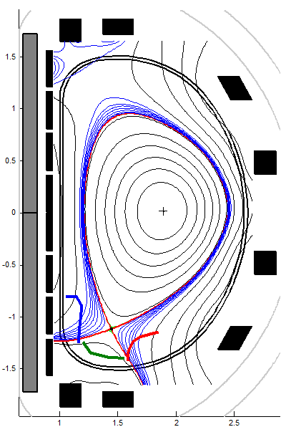
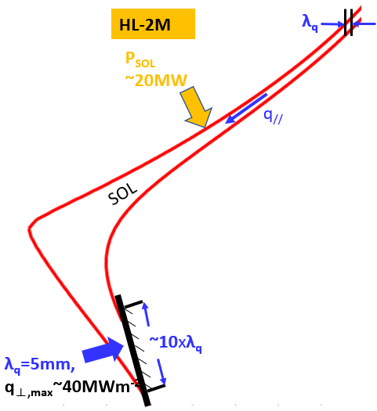
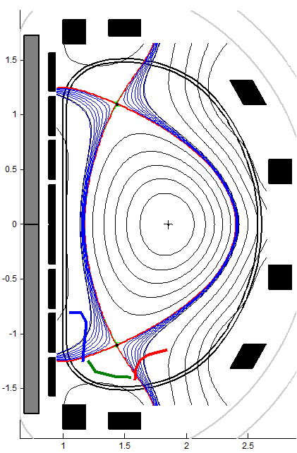
Advanced divertor configuration
Snowflake minus
Heat flow width λ_{q} : 1~10mm
In SN divertor, deposited target plate heat load >14MW/m²
Multiple advanced divertor configuration discharges, with MA Plasma Ip
Standard snowflake
Snowflake Plus
雪花右减
Conventional single null divertor configuration
Tripod
Double null
Negative triangular

Slide 12


HL-3 Research Plan
—— Key Facility for Fusion Science
IV. Extended Research
  Triple product ＞10²⁰m⁻³·keV·s
  Fusion reactor grade plasma operation and physics research
  Fusion reactor related integration scheme verification
  Fusion reactor related critical components/diagnostic tests
We are here now
III. Integrated research
  I_{p} ≥ 2 MA
  T_{i} ~ 10keV
  Advanced scenario
  Heat/particle control
  Configuration control
II. Initial research
  Ip ≥ 1 MA
  H mode discharge
  Advanced divertor control
I. First plasma
  2020.12.04 first plasma
  Limiter/divertor configuration
2020
2025
2030

Slide 13
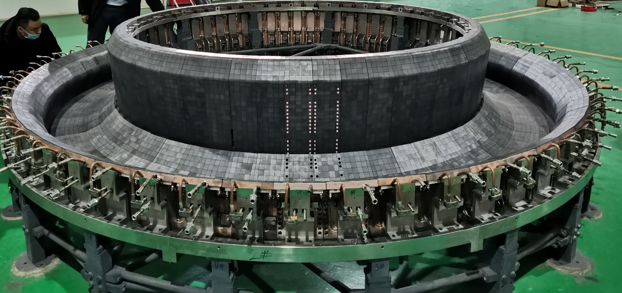
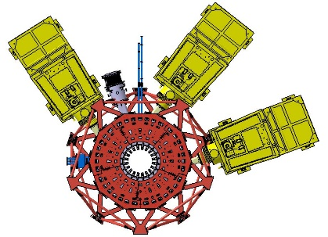
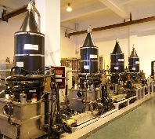
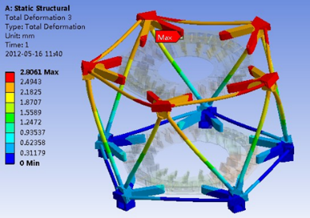
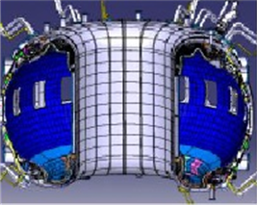
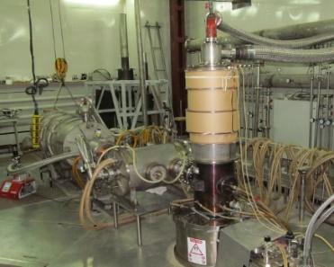
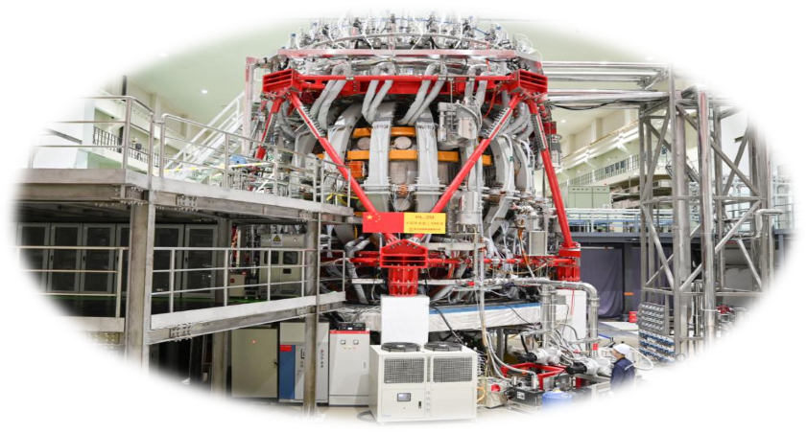
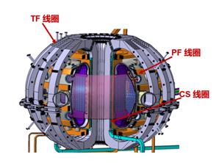
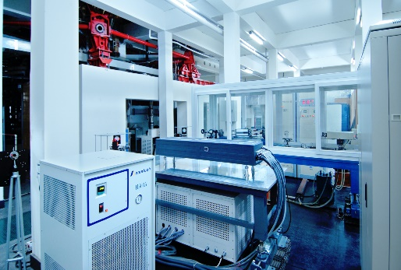
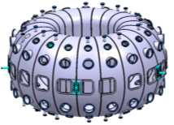
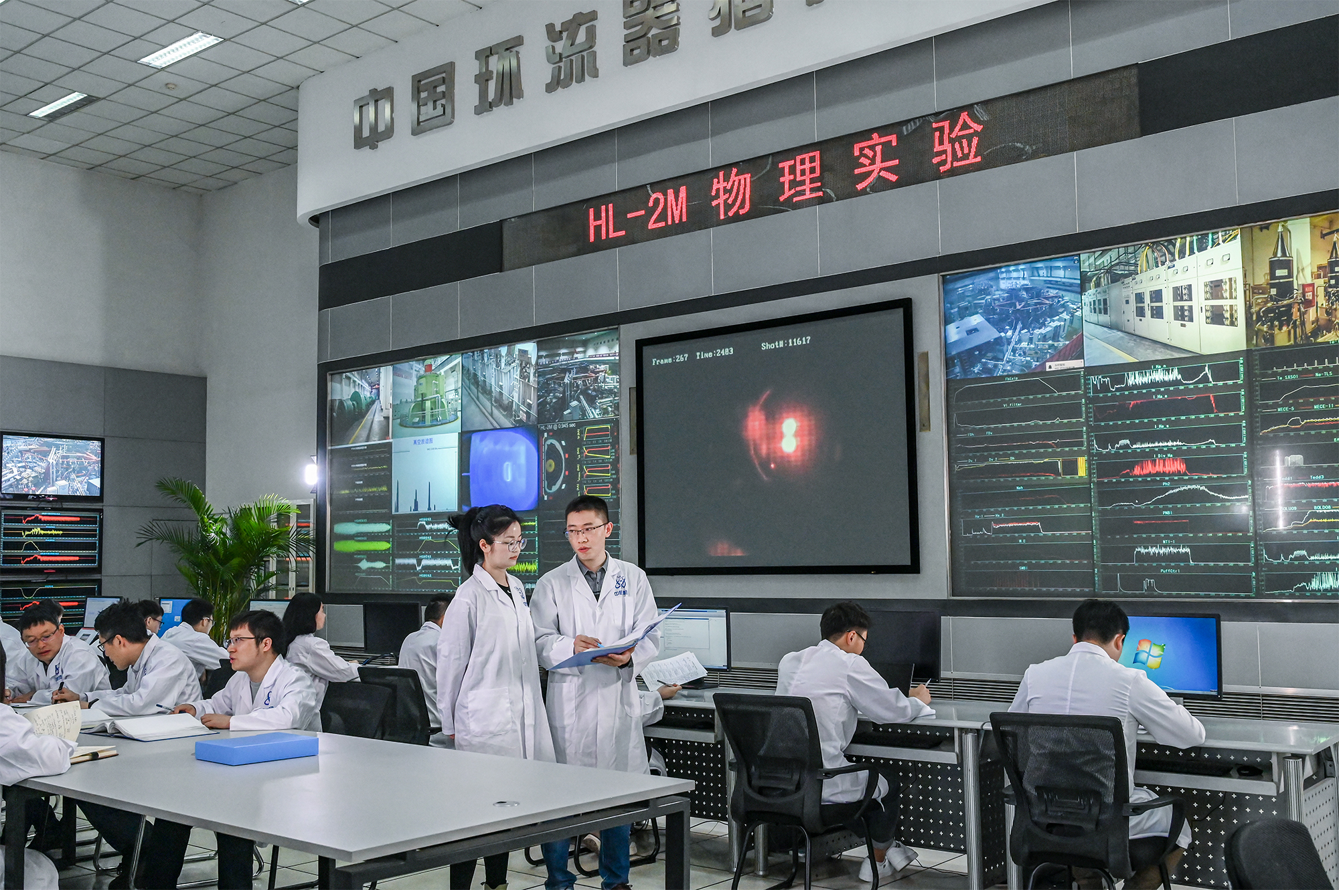
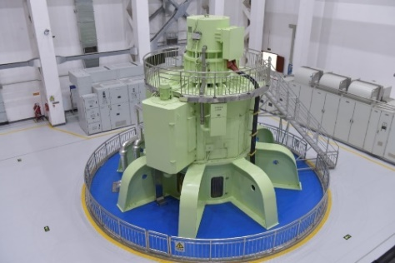
HL-3 device and auxiliary systems
Divertor
Heating System
Machine Support
First Wall
CS, TF and PF coils
Divertor
Diagnostics
Vacuum chamber
Central control room
Power Supply

Slide 14
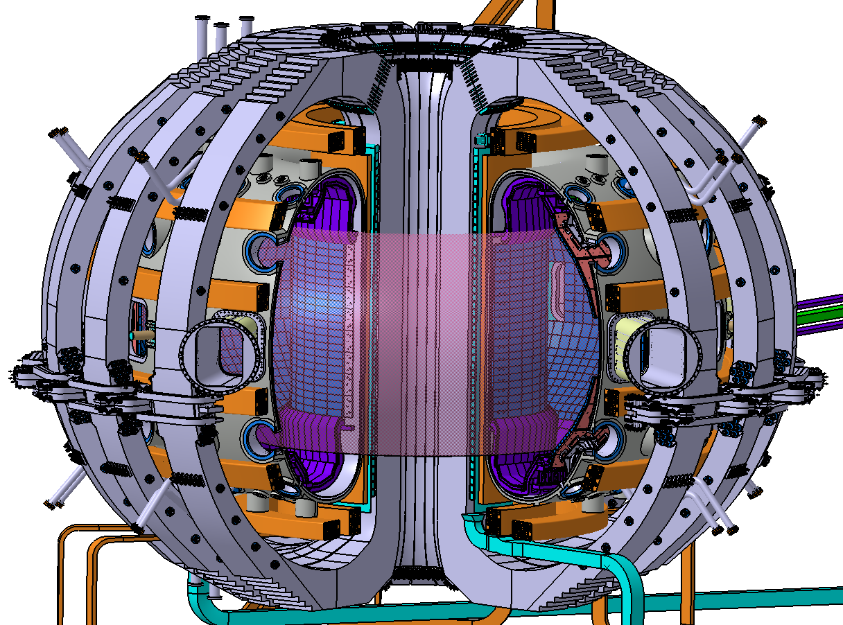
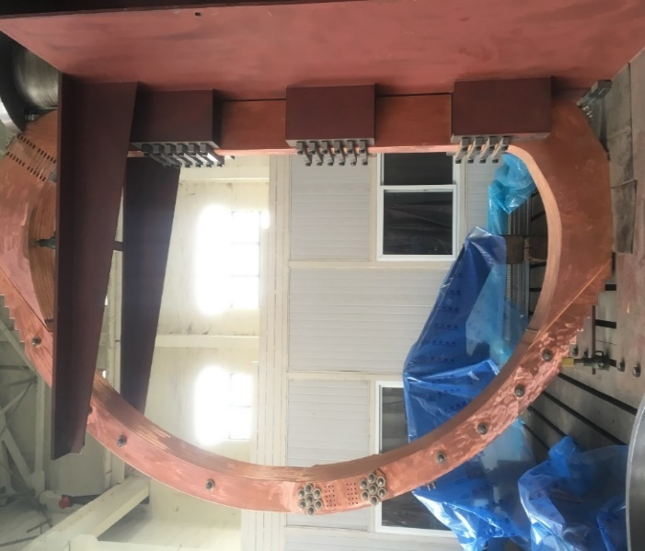
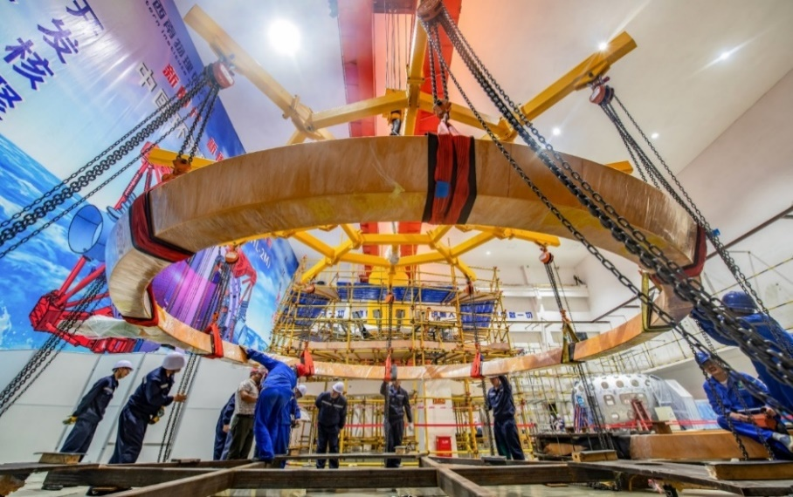
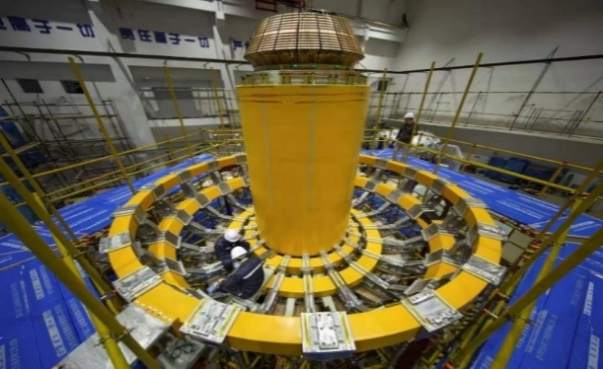
Magnet system
TF coils
20-piece (140turns) detachable D-shaped toroidal field (TF) coil (190kA/turn).
PF coils
16-piece integrated and built-in poloidal field (PF) coil (14.5~40 kA/turn)
外弧段
中心段
5.1m
2.97 m
CS coils
A/B dual sets of built-in ohmic solenoid (CS) coils (220 kA)
Adopting a topology structure where the TF coils are detachable and the PF coils are integrated within the TF coils
Improving the coupling efficiency between the magnets and plasma, enhancing the capability of physical research

Slide 15
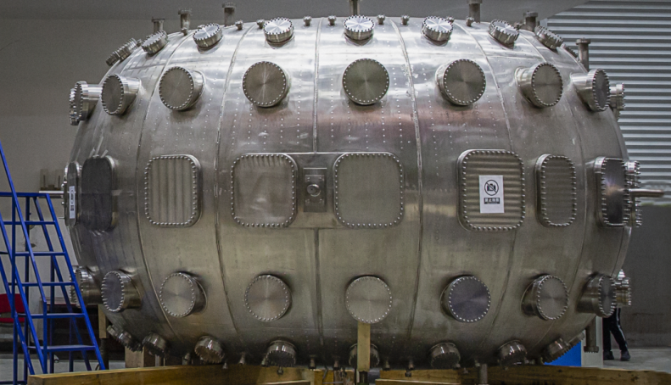
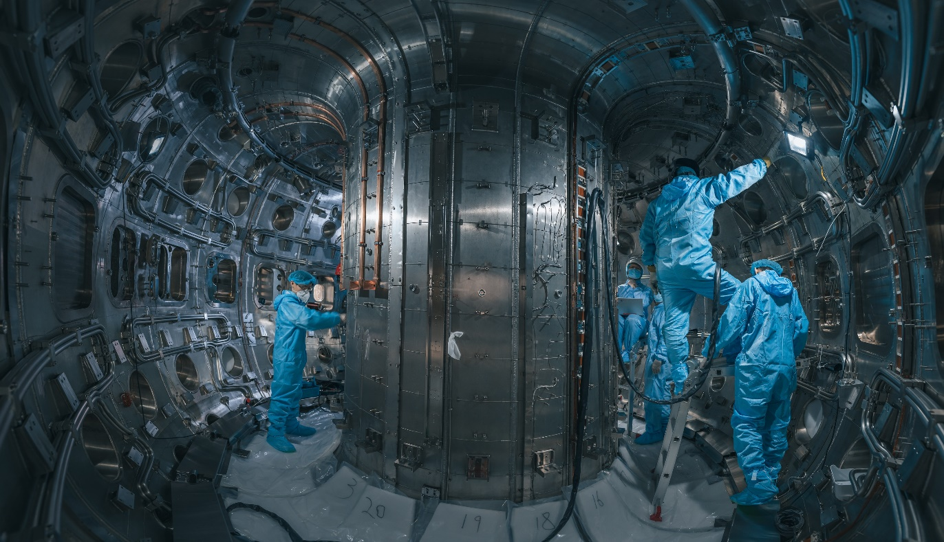
Vacuum vessel
Vacuum vessel: D-shaped cross-section double-thin-walled structure with 20 sectors. Material: Inconel625 (high nickel alloy).
Precision manufacturing technologies: difficulty of forming, high design precision, complex structure and welding deformation control.
Main vessel: Height ~3.2m，Dia. ~ 5.2 m；
Volume：42m³
Shell thickness（5.4mm），No. of Ports:128
Baking Tem.(with hot nitrogen)：300℃
Limited Vacuum：3×10⁻⁶Pa

Slide 16
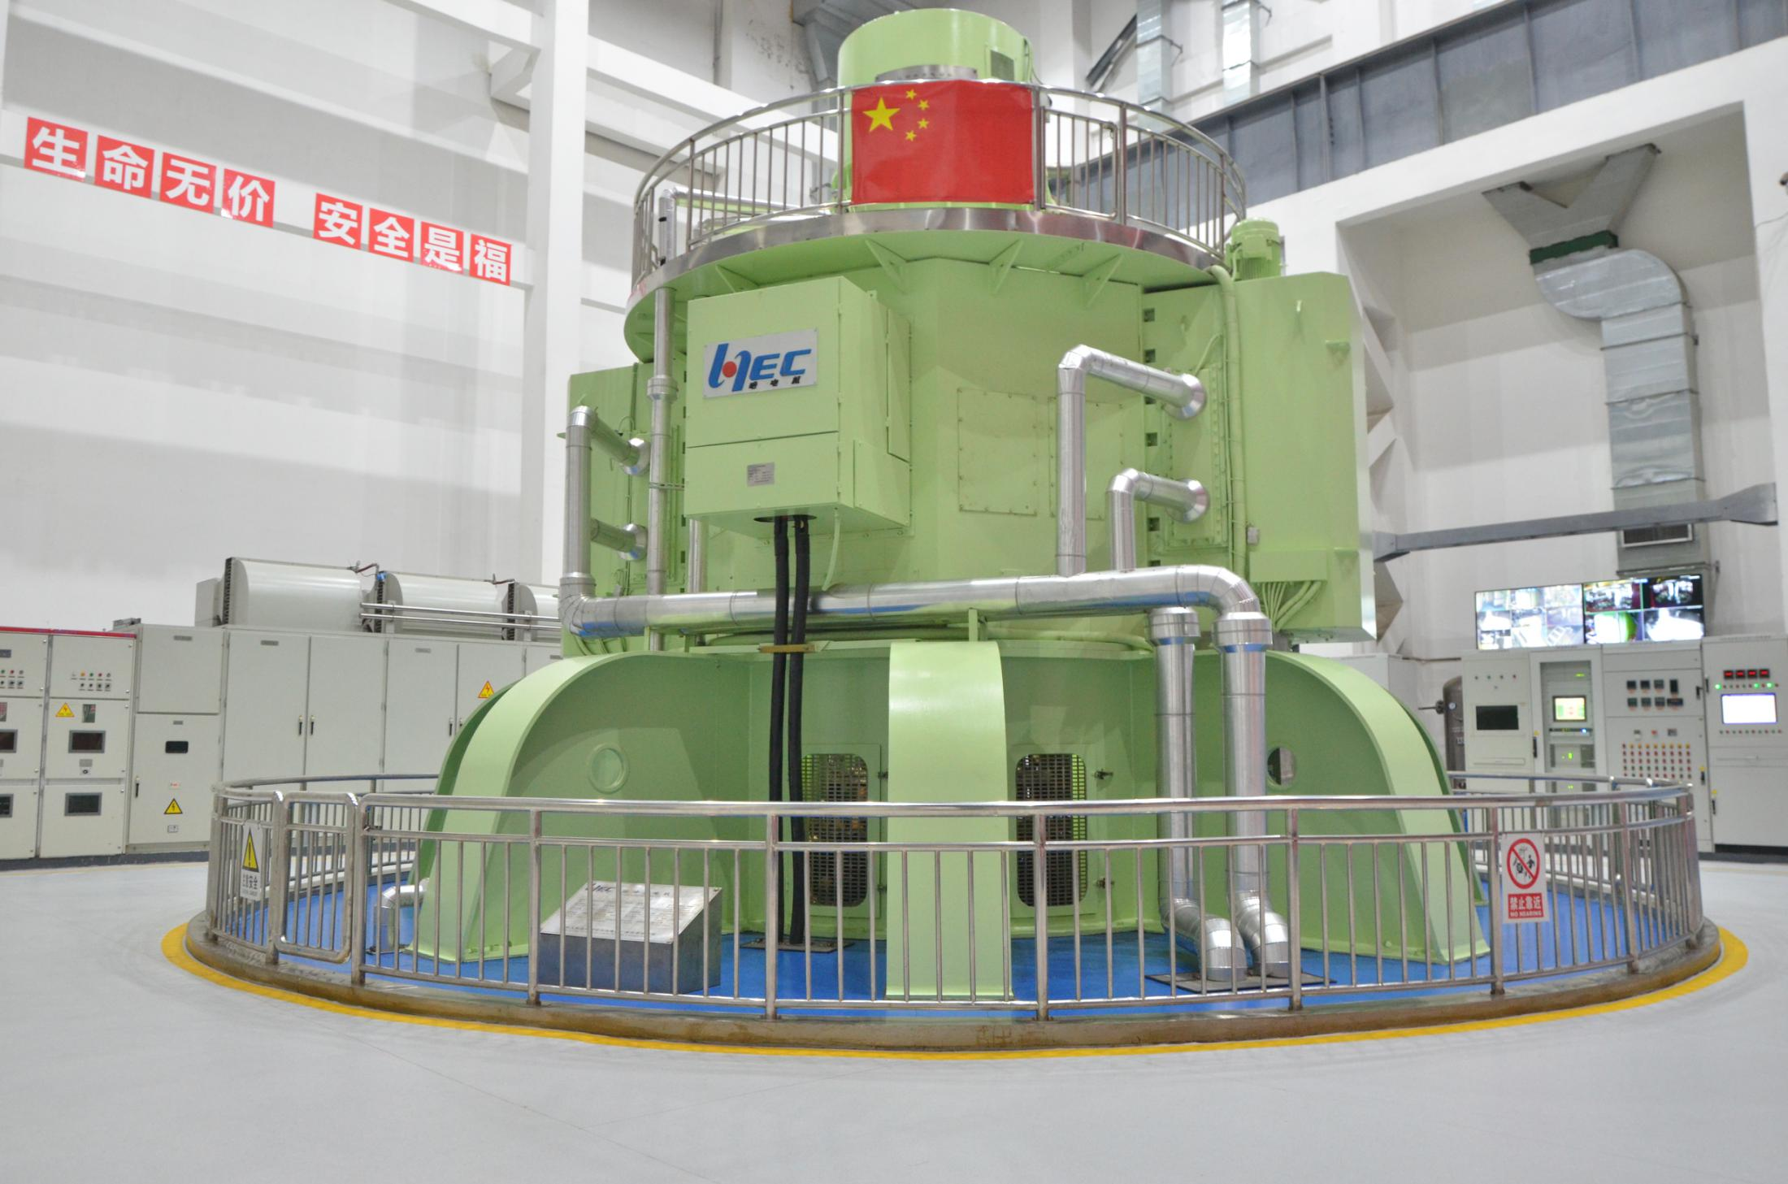
300MVA Motor Generator
The 300MVA/1.35GJ MG was developed to meet the requirements of high power and high stored energy of HL-3 Tokamak
It is the first high power vertical-shaft 6-phase pulsed MG in China, and the overall parameters have reached the international advanced level.
Main parameters：
Rated capacity 300MVA
Rated released energy 1.35GJ
Rated speed 500r/min
Total weight 800t
Rotor weight 400t
Total height 15.5m
Diameter 10.6m
Output current, 29kA
Six-phase (double Y shift 30°)

Slide 17
02
HL-3 upgrades

Slide 18
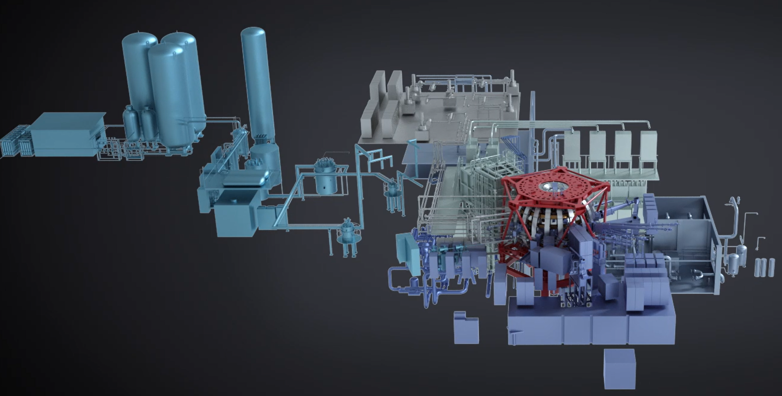
HL-3 upgrades and operation from 2022-2023
15 task forces
>1000 construction tasks of subsystems
>150 subsystem commissioning tasks

Slide 19
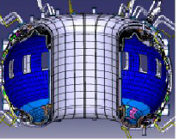
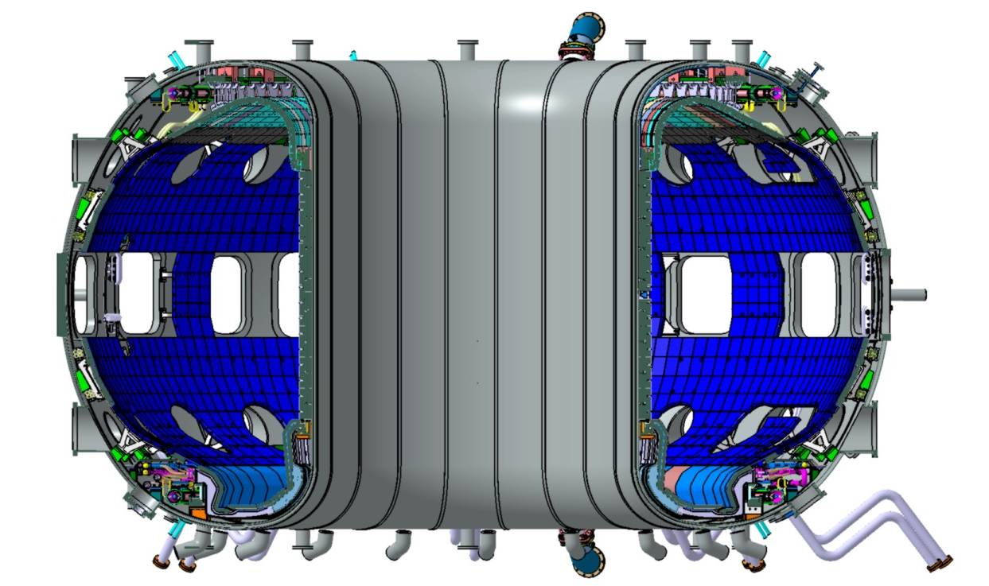
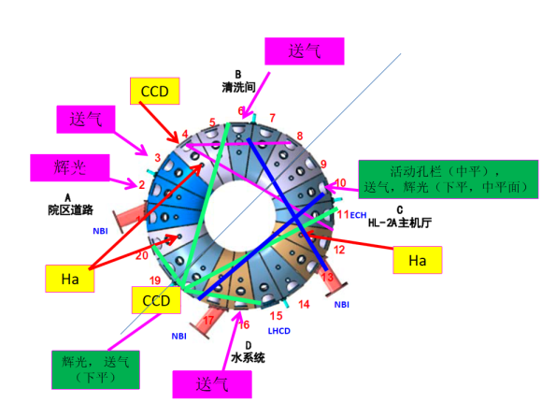
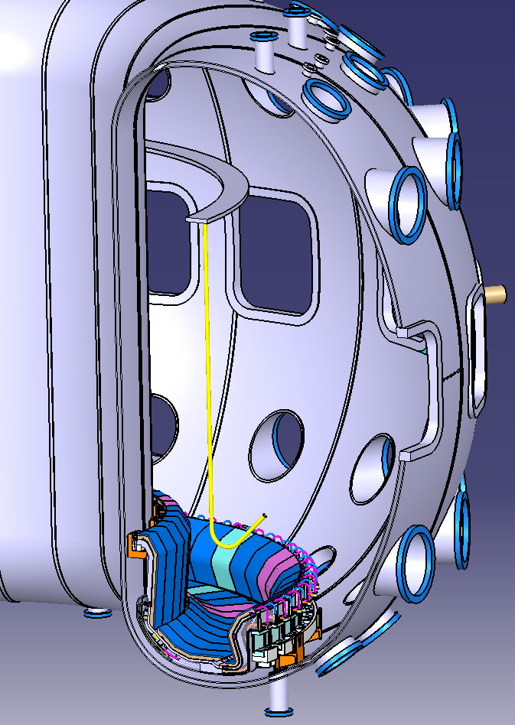
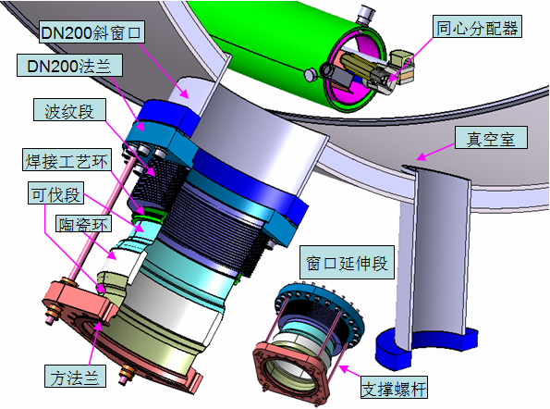
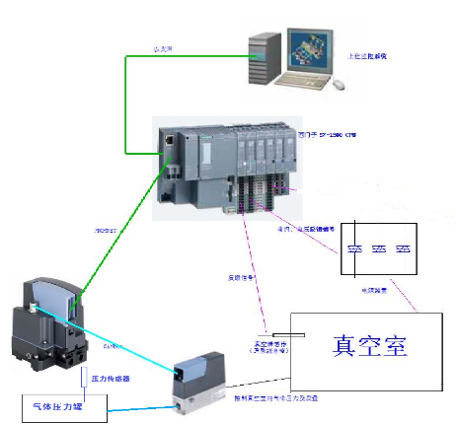
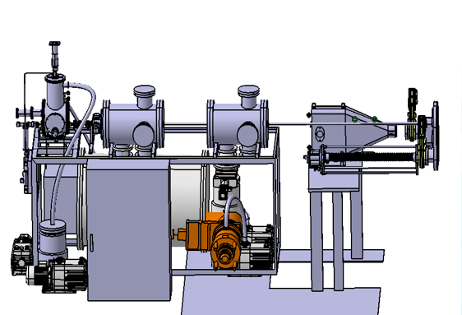
Main upgraded Systems of HL-3
First wall (new)
25 diagnostic systems (new)
Lower divertor (new)
RMP coils (new)
Magnetic measurement (upgrade)
Wall conditioning (upgrade)
Pellet injection (new)
Toroidal Cryopump (new)

Slide 20







Main upgraded Systems of HL-3
Power supply (upgrade)
Pumping system (upgrade)
ECRH、LHCD (new)
Cooling system (upgrade)
NBI (new)
Baking system (upgrade)
PCS (new)
Cryogenic system (new)

Slide 21


First wall
Full carbon wall has been installed in 2022.
  Heat load: ~ 1MW/m²
  Accuracy: <±2 mm, height difference of adjacent graphite tiles: < ±0.25 mm.
Stainless steel first wall
2020-2021
Carbon-based first wall 2022.08.31

Slide 22




Lower Divertor and Toroidal Cryopump
Lower Divertor :
Flexible divertor configurations for heat and particle flux control.
Tolerable heat flux: $≥$ 7 MW/m² for t ≥ 5 s & Ip >1.8 MA.
High accuracy: ±0.25mm at striking point
Toroidal Cryopump (TCP)
Pumping speed: 50m³/s for H₂, 200 W/4.5K
TCP
Installation of the final Divertor component
Welding pipes of TCP

Slide 23








Diagnostics
More than 20 diagnostics installed for plasma control and measurements of profiles, impurity, heat and particle flux.
Parameter | Diagnostic techniques | Channels, Resolution
n_{e} | FIR interferometer FMCW reflectometer THz interferometer | 5 chs, 0.1ms, 10 cm Edge,10 μs, 1 cm 1 ch, 306.9 GHz, 5 μs
T_{e} | Thomson scattering ECE | 5 chs, 100 ms, > 1cm 60 chs, 5μs, 1.5 cm (~ 30m corrugated WG)
I_{p}, Vloop, Wdia, R_{dis}, Z_{dis} | Magnetic probes | >10us
Impurity | VUV SX array Bolometer | 500-2000Å, 1 ch, 2 MHz Poloidally 6 arrays 80 chs, 50 μs, 2 cm
Images | CCD | tangential, topview, wide field in midplane
Divertor parameters | Target Langmuir probes | 516 chs, 1.8 cm
Fueling | SMBI | 10 Hz, duration $≥$0.5 ms, midplane&divertors

Slide 24




Resonant magnetic perturbation (RMP)
n=1
RMP coils
n=4
Present Status
Coil number: 2x8=16
Dominant perturbation: n=1, 2, 4
Chirikov factor: σ>1.1
RMP current: 10kAt
Perturbation: 0~100 Gs
Next step
Power debugging
ELM/RWM Suppression Experiments
Error field compensation
…

Slide 25



Fueling systems
Gas puffing : 4 sets
SMBI: 3 sets, LFS, HFS, Divertor (Multi-channel, mixture gas with different ratio)
Pellet: 2 set, 1 for fueling (1mm, 60Hz, 100-300m/s), and 1 for shattered pellet injection
SMBI system
GP4
SMBI_DIV
#15
SMBI_HFS
#1
#10
GP1
GP3
Pellet injection system
Pellet
GP2
#5
SMBI_1

Slide 26





Heating & Current Drive System(Now)
NBI:
5 MW (80keV/45A/5s for D₂)
Co (2) & counter(1) injection
Injection direction: 38.6$°$
LHCD：
2 MW (3.7GHz)
Fully Active Multi-junction launcher
Peak parallel refractive index N//(0)= 2.25
ECRH：
2MW equatorial launcher(105 GHz/3s)
2MW upper launcher(105 GHz/3s)
0.5MW equatorial launcher(68 GHz/1s)
NBI
Equatorial launcher
Upper launcher

Slide 27
03
Recent milestones and experiments

Slide 28





Recent milestones of HL-3
Upgrade
Heating systems commissioning
4 Dec.,2020
First Plasma
>100 kA, >100 ms
feedback control
19 Oct.,2022
1MA plasma current
I_{p, max}= 1.15MA,
κ= 1.25, δ= 0.14
29 March,2023
Advanced divertor configuration
Tripod configuration
~0.6 MA
11 July,2023
1MA divertor discharge
1.05MA, ~750ms
25 Aug, 2023
H-mode discharge
I_{p}：0.5MA-1MA

Slide 29

Advanced divertor configurations
SN (red line, #1737)
SF (blue line, #1797)
Two advanced divertor configurations, the snowflake-minus (SF-) and snowflake-plus (SF+) achieved for the first time in HL-3.
magnetic surface broadening in the advanced configurations
increased contact area effectively reduced the heat flux

Slide 30

1MA plasma current and divertor configuration
The first discharge with 1MA plasma current and divertor configuration
July 11, 2023

Slide 31



1MA plasma current and divertor configuration
Diverted plasma discharges (I_{p} ~ 1.1 MA) and k=1.5.
Flat-top q₉₅ = 2.6 - 3.4.

Slide 32


First H-mode on HL-3
Realization of H-mode 15 days after combined commissioning of NBI, ECRH and LHCD
A solid foundation for high current H-mode operation

Slide 33


H-mode with plasma current>1MA
H-mode operation achieved for the first time in HL-3
H-mode achieved with 0.5-1MA plasma current at total auxiliary heating power around 2.4 MW (NBI+EC+LHW)
1 MA H-mode discharge operated at q₉₅ < 3 and q_{min}<1, with notable sawtooth and internal kink mode.

Slide 34



H-mode with plasma current>1MA
H-mode Operation (Ip=0.5 MA)
H-mode Operation (Ip=1.0 MA)
Parameters | Shot 3331 | Shot 4077
I_{p} (MA) | 0.5 | 1.0
B_{T} (T) | 1.7 | 1.6
R (m) | 1.75 | 1.79
a (m) | 0.54 | 0.62
n_{e} (10¹⁹m⁻³) | 2.9 | 4.53
P_{oh} (MW) | 0.22 | 0.45
P_{aux} (MW) | 1.64 | 2.32
q₉₅ | 4.6 | 2.8

Slide 35
04
D-T operation plan

Slide 36



D-T operation plan of HL-3 tokamak
The JET DT operation experiment has been verified through METIS, and the experiment is basically consistent with the simulated fusion power.
Simulated by METIS, HL-3 has the feasibility to produce fusion power to 10 MW.
D：T=50:50
Simulated by METIS
HL-3 3MA，3T
NBI power
ICRH power
Fusion power
D-T operation of JET
Check the reliability of METIS
Fusion power produced by HL-3 has been simulated by METIS.

Slide 37

D-T operation plan of HL-3 tokamak
To demonstrate D-T plasma operation and advanced control with fusion power up to 10 MW on HL-3 tokamak.
2025
2027
~2030
Milestones
First DT experiment
Ti > 10keV
Fusion power up to 10 MW
I_{p}>1MA，
Advanced divertor,
H mode
I_{p}~1.5MA ， Advanced divertor,
H mode
Ti~10 keV
𝒏_{𝒊} 𝑻_{𝒊} 𝝉_{𝑬}≥ 1×10²⁰ m⁻³·keV·s；
β_{N}>3
P_{fus}~1MW
I_{p}≥2.5MA
B_{t}≥2.2T
𝒏_{𝒊} 𝑻_{𝒊} 𝝉_{𝑬}~ 10²¹
m⁻³·keV·s
^{Pfus~10MW}
Dec
Dec
Dec
Dec
Dec
Dec
Dec
Dec

Slide 38
Device upgrade plan of HL-3 tokamak
Heating and Current Drive power ：11MW--->44MW
Plasma current（I_{p}）and toroidal magnetic field(B_{t} ）：Ip≥2.5MA，Bt≥2.2T
Power supply system: 460MVA--->600MVA
Plasma control system：AI control
Diagnostics：diagnostics of fusion products, profiles, impurity, heat and particle flux
Tritium cycle and safety containment system
Radiation protection system
Divertor, first wall, cooling system, Cryogenic system，……

Slide 39
05
Summary and outlook

Slide 40
Summary and outlook
HL-3 Tokamak has the ability of burning plasma operation (ion temperature T_{i}>10KeV, plasma current I_{p} ~ 3MA). Various advanced divertor configurations can be tested, and high-performance plasma physics research can be done.
The installation of first wall, divertor, diagnostic systems, and auxiliary heating systems (ECRH, LHCD, NBI, total 11MW) is complete and commissioning is underway. The following milestones have been realized:
Divertor configuration with 1.2 MA plasma current
H mode confinement operation with 0.5-1.0 MA plasma current
snowflake divertor configuration
Next step: Further improve the heating power (to 44MW)and operation capability, achieve high performance plasma, and address critical physics and technology issues for ITER & fusion reactors .

Slide 41
Experimental campaigns 2024-2025
1st campaign
2nd campaign
3rd campaign
Engineering
commissioning
31/8
Ip≥1.6MA，T_{i}≥10 keV
1/3
30/4
20/6
31/10
30/4/2025
Experimental topics
Plasma control optimization
High Heating power commissioning
Advanced Scenarios and experiment
MHD control (Disruption, ELMs etc)
Divertor high heat flux control
1st campaign experimental conditions
Ip = 0.5~1.2MA, Bt =1.0~1.7T；n_{e}=2~4 x10¹⁹/m³
ECRH ~1.2MW, NBI≥1.5 MW，LHCD ~0.5MW
Single null, snowflake divertor configuration
Joint experiments are highly welcome!

Slide 42
Thank you for your attention!
Lijun CAI
on behalf of HL-3 Team
Southwestern Institute of Physics, CNNC
Karlsruhe, Germany，Mar.19，2024

