Slide 1
EU-DEMO Design Exploration
EU – China collaboration on CFETR and EU-DEMO Reactor Design 4th Technical Exchange Meeting
M. Coleman^{1,2}, H. Zohm^{1,3}, C. Bourdelle^{1,4}, G. Graziosi^{1,5},
F. Maviglia^{1,6}, A. Pearce², M. Siccinio^{1,3}, A. Spagnuolo^{1,7}, S. Wiesen^{1,8}
1: EUROfusion Consortium, Boltzmannstr. 2, 85748 Garching, Germany
2: United Kingdom Atomic Energy Authority, Culham Science Centre, Abingdon, Oxfordshire, OX14 3DB, United Kingdom
3: Max-Planck-Institute for Plasma Physics, 85748 Garching, Germany
4: CEA, Alternative and Atomic Energies Agency, F-13108 St. Paul-Lez-Durance, France
5: Ansaldo Nucleare S.p.A., Via Nicola Lorenzi 8, 16152, Genoa, Italy
6: Associazone EURATOM-ENEA sulla Fusione, C. R. Frascati, C.P. 65-00044, Frascati, Rome, Italy
7: Karlsruhe Institute for Technology, Hermann-von-Helmholtz-Platz 1, 76344 Eggenstein-Leopoldshafen, Germany
8: DIFFER – Dutch Institute for Fundamental Energy Research, Eindhoven, The Netherlands

Slide 2
Outline
Motivations for changing the EU-DEMO baseline
Design philosophy
$q_{95}$ as a plasma physics “margin”
0-D design optimisation problem
Results
Discussion
Conclusions

Slide 3
Motivations
The last official 0-D baseline for EU-DEMO was produced in 2017 [1], in anticipation of the G1 Gate Review (2020).
The G1 Gate Review identified several major issues with the EU-DEMO baseline [2, 3, 4]:
The strong sensitivity of plasma performance to confinement assumptions, as validated by transport calculations.
The unacceptably high divertor heat fluxes during inevitable re-attachment events.
The relatively high toroidal field and high EM loads require large and expensive mechanical structures.
The lack of a viable solution for breeding blanket maintenance.
Furthermore, there is a general desire to keep machine size ($R_{0}$) low, in response to market forces.
Finally, the EU-DEMO stakeholder requirements were also re-assessed:
$P_{el,net }$= 300 – 500 MWe
$τ_{pulse}≥$ 2 hours

Slide 4
Design philosophy
Aspect ratio, $A$, was identified early-on as a key parameter which could relax the technological demands on:
The divertor ($P_{sep}B_{T}/q_{95}{AR}_{0}$)
The TF coils ($B_{T}$)
This was confirmed in preliminary design space exploration studies, where the “classical” EU-DEMO design optimisation problem was solved – minimising $R_{0}$.
The uncertainties in the quality of the plasma confinement are significant.
Different assumptions in the same codes result in $P_{fus}$ ~ 2000 MW $±$ 50% [5]
Such a large variation cannot be accommodated for in engineering design.
We must have margin on the performance of the plasma.
The plasma safety factor, $q_{95}$, was selected as the design parameter in which the margin for plasma physics uncertainties is encapsulated.

Slide 5
Design philosophy
A decision was taken to produce a PROCESS [6, 7] design point at fixed machine geometry, but with variable performance.
This will enable more studies to be carried out more quickly, as CAD and meshes, etc. can be re-used.
This will enable the DEMO Central Team to develop their systems / push performance / reduce their margins within a relatively well-defined geometrical envelope.
Higher fidelity studies can then be used to “update” the performance estimates for the reactor, e.g. in terms of:
$P_{el,net}$
$τ_{pulse}$
...

Slide 6
$q_{95}$ as the plasma physics “margin”
The uncertainties in the plasma confinement are too large to manage from an engineering design perspective.
The problem statement:
We design and build a machine according to the best available knowledge and understanding.
$P_{fus}$ is found to be lower than anticipated in the reference scenario.
We must recover the fusion power, but without changing the machine (which has been built).
Our solution: design with$q_{95}>q_{{95}_{min}}$, such that, if confinement is less good than anticipated:
➔ reduce $q_{95}$
➔ increase $I_{p}$
➔ increase $n$
➔ recover reference $P_{fus}$
The previous 2017 baseline has $q_{95}$ = $q_{{95}_{min}}$ = 3.0, which is considered an operational limit
Essentially no margin for plasma physics ➔ A “physics and magnet” EU-DEMO design point has been used since 2018
In the following, we take ${q_{95}}_{min}$ = 3.3, aiming for a hybrid regime.

Slide 7
Divertor protection criterion
In the G1 baseline, $P_{sep}B_{T}/q_{95}{AR}_{0}$ [8] was used as the divertor protection criterion, with:
$P_{sep}B_{T}/q_{95}{AR}_{0}≤$ 9.2 MW.T/m (equivalent ITER value)
In a loss of detachment event (LODE), we assume that the plasma re-attaches with a $λ_{q}$ according to the Eich scaling [9].
At the outer divertor target, following [10], this results in a heat flux: ${\dot{q}}_{div,outer}$~ 83 MW/m²
This is well above the maximum heat flux that can be mitigated with an emergency target sweeping manoeuvre ~60-70 MW/m² [10]
For reasonable machine size, divertor target sweeping is still required for a LODE, but the lower the re-attached heat flux, the better.
$P_{sep}B_{T}/q_{95}{AR}_{0}≤$ 6.0 MW.T/m was chosen, i.e. ${\dot{q}}_{div,outer}$ ~50 MW/m²

Slide 8
Constraints robust to changes in $q_{95}$
For a design point at a reference $q_{95}$ > ${q_{95}}_{min}$, when reducing $q_{95}$ ${\overset{→}{}q_{95}}_{min}$, some constraint values are affected.
The notation ${\left(x\right)}^{∗}$ is used to indicate the value of $x$ when $q_{95} \overset{→}{}$ ${q_{95}}_{min}$
In particular, the divertor protection criterion and pulse length have to be adjusted:
${\left(P_{sep}B/q_{95}AR_{0}\right)}^{∗}=\frac{q_{95}}{q_{{95}_{min}}}$ $P_{sep}B/q_{95}AR_{0}$
${\left(τ_{pulse}\right)}^{∗}=\frac{{q_{95}}_{min}}{q_{95}}τ_{pulse}$
${\left(τ_{pulse}\right)}^{∗}$ accounts for the increase in plasma current reducing the pulse length, but is a slight simplification of the real poloidal flux balance constraint

Slide 9
Design optimisation problem
maximise:${\left(τ_{pulse}\right)}^{∗}$
subject to:
${\left(P_{sep}B/q_{95}AR_{0}\right)}^{∗}≤$ 6.0 MW.T/m
1.1 ${≤f}_{LH}≤$ 1.2
$f_{GW}≤$ 1.2
${f_{GW}}_{ped}≤$ 0.85
$σ_{TF,max}≤$ 580 MPa
$σ_{CS,max}≤$ 660 MPa
${σ_{VV}}_{TFCFD}≤$ 93 MPa
$n_{cycles}≤{n_{cycles}}_{CS}$
…
With:
Nb₃Sn, SS316 TF coils
Nb₃Sn, SS316 CS coils
WCLL blanket ($e_{mult}$ = 1.2, $η_{thermal}$ = 0.316)
Radiation-corrected $H^{∗}$ = 1.1
Reactor lifetime = 70 dpa
40 MW electron cyclotron current drive
…
Scalings:
$H$ ➔ IPB98(y,2) [11]
$P_{LH}$ ➔ Martin et al. [12]
…

Slide 10
Parameter space
Preliminary design space exploration studies identified the region of interest as:
$A∈$ [2.7 – 2.9]
$R_{0}∈$ [8.5 – 8.9] m
$q_{95}∈$ [3.3 – 3.8]
Combined with the “stakeholder requirement” of:
$P_{el,net}∈$ [300 – 500] MWe
This 4-D space was scanned with PROCESS [6,7], solving the aforementioned optimisation problem at each point.
Results are shown in 2-D ${\{q}_{95}, P_{el,net}\}$ for a combination of $\{A, R_{0}\}$.

Slide 11
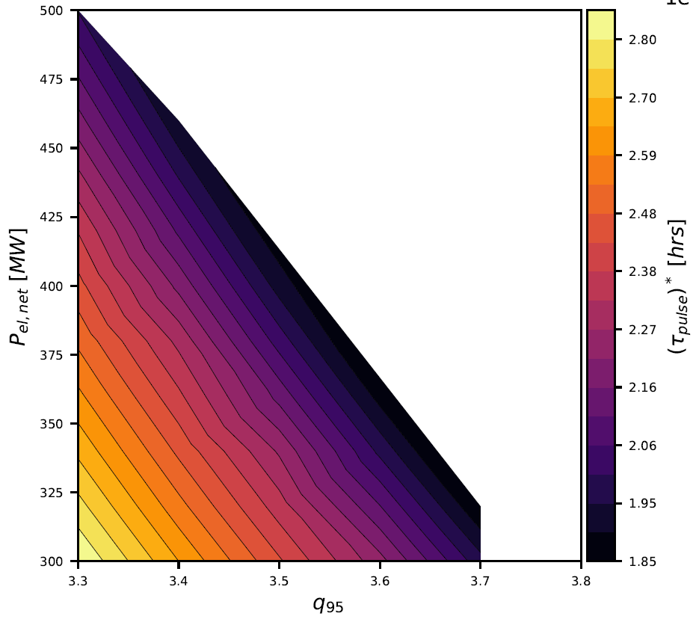
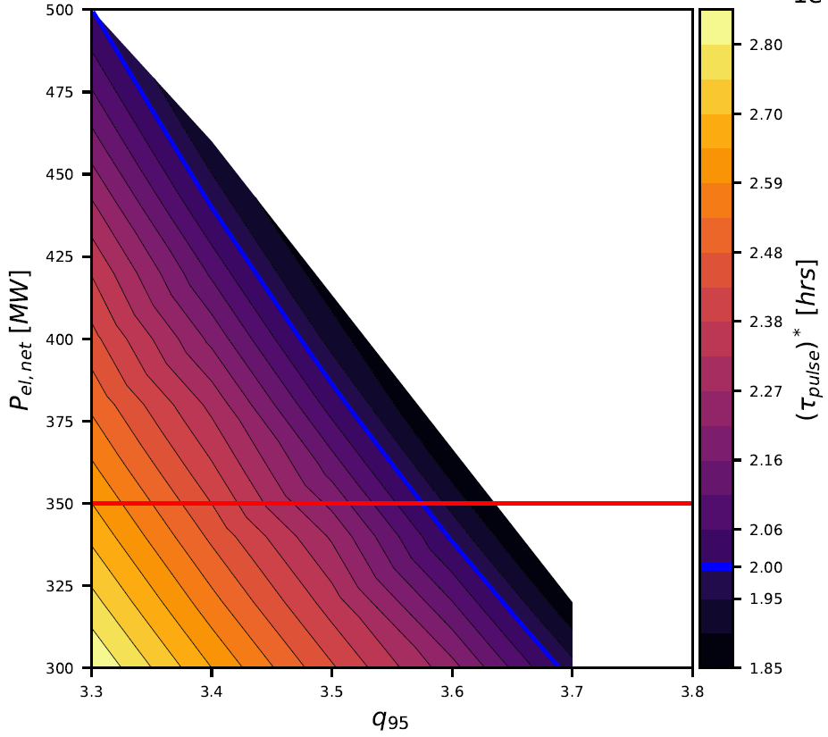
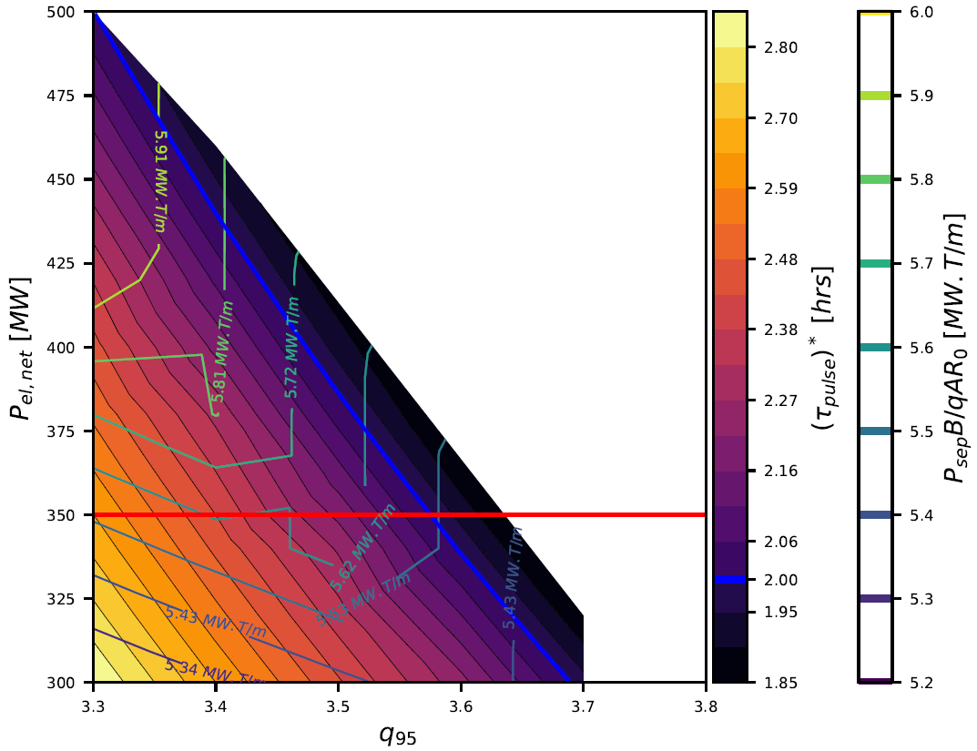
Design space for $A$ = 2.8, $R_{0}$ = 8.6 m
White: no solution
${\left(τ_{pulse}\right)}^{∗}≤$ 2.0 hours
$P_{el,net} ≤$ 350 MWe
viable design space
selected point

Slide 12
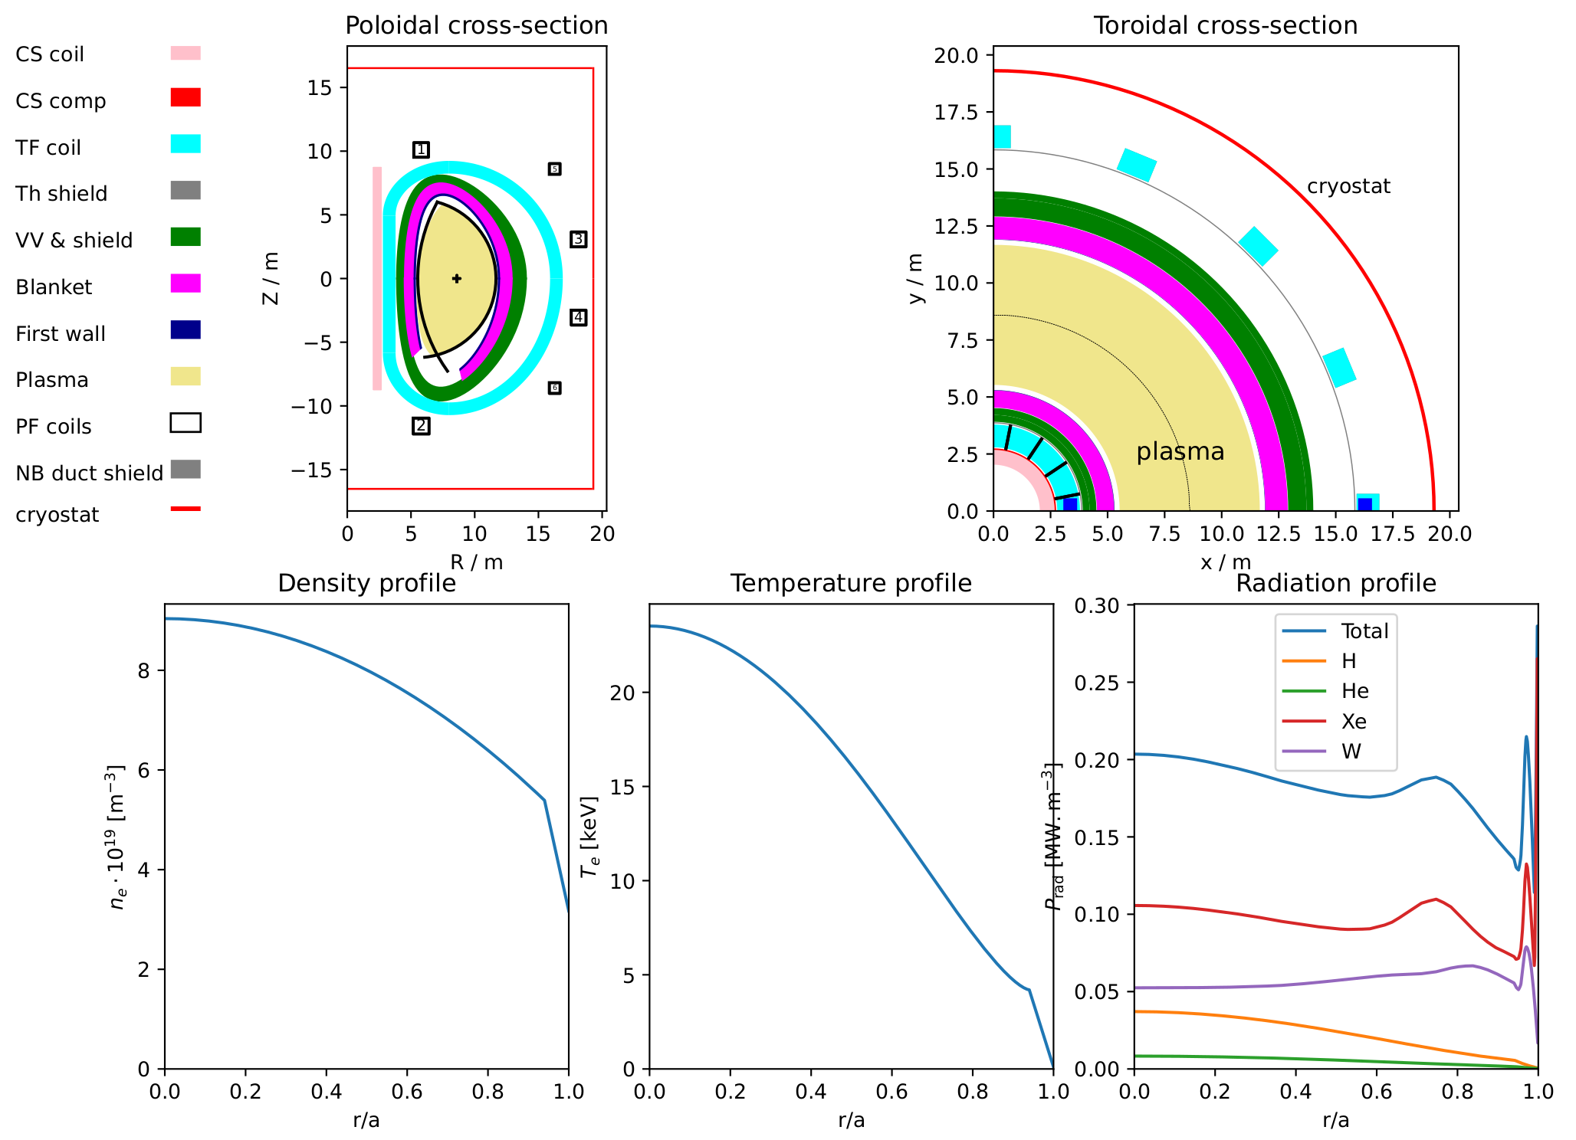
EU-DEMO 2024 proposal (nominal performance)

Slide 13
0-D quantification of the plasma physics margin, in terms of $H$98
In this approach, $q_{95}$ as been used explicitly as the “margin” parameter for the epistemic uncertainties in plasma physics.
It is useful to relate this to more well-known H-factor, which has a similar role.
The fictional scenario is as follows:
EU-DEMO is built as per the 0-D specification, with $q_{95}$= 3.6 and $P_{fus}$ = 1652 MW.
It is then discovered that the reference operational scenario at $q_{95}$ = 3.6 leads to $P_{fus}≪$ 1652 MW
We assume that reducing $q_{95} \overset{→}{}$ ${q_{95}}_{min}$ = 3.3 recovers ${\left(P_{fus}\right)}^{∗}$ = $P_{fus}$
In order to relate this to $H$, we (artificially) declare that this difference is due solely to poor confinement

Slide 14
0-D quantification of the plasma physics margin, in terms of $H$98
The operational response in the case of unexpectedly low $P_{fus}$ would be:
Decrease from $q_{95}$ = 3.6 to ${\left(q_{95}\right)}^{∗}$ = 3.3
Increasing $I_{p}$ commensurately:
${\left(I_{p}\right)}^{∗}=\frac{q_{95}}{{\left(q_{95}\right)}^{∗}}I_{p}$
Increasing density at fixed Greenwald fraction:
${\left(n_{e}\right)}^{∗}=f_{GW}\frac{{\left(I_{p}\right)}^{∗}}{πa^{2}}$
Ignoring changes to Ohmic heating power, Bremsstrahlung, synchrotron, and core radiation terms, we have:
${\left(P_{net}\right)}^{∗}=P_{net}$ and$\frac{W_{th}}{{\left(τ_{E}\right)}^{∗}}=\frac{W_{th}}{τ_{E}}$, thus ${\left(τ_{E}\right)}^{∗}=τ_{E}$
Separating out the $I_{p}$ and $n_{e}$ terms in the IPB98(y,2) scaling law [11], we have:
${\left(τ_{E}\right)}^{∗}={\left(\frac{{\left(I_{p}\right)}^{∗}}{I_{p}}\right)}^{0.93}{\left(\frac{{\left(\overline{n_{e}}\right)}^{∗}}{\overline{n_{e}}}\right)}^{0.4}\frac{{\left(H\right)}^{∗}}{H}τ_{E}$
Finally:
${\left(H\right)}^{∗}={\left(\frac{q_{95}}{{\left(q_{95}\right)}^{∗}}\right)}^{−1.33}H=$ 0.89 $H$
As such, the tolerable underperformance in terms of H98 is:
$ΔH=H−{\left(H\right)}^{∗}=$ 0.11

Slide 15
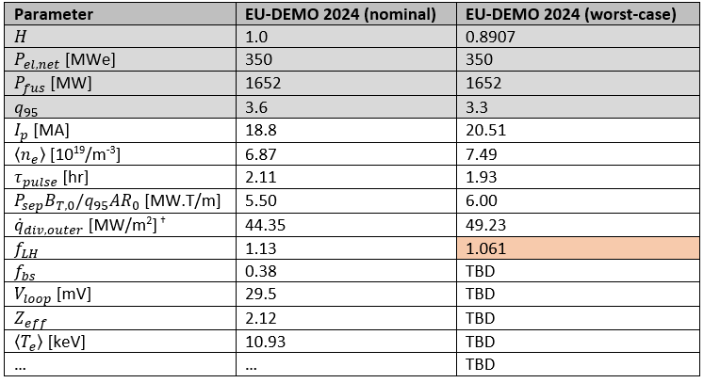
What happens if $H$ = 0.89 ?
Using the simple 0-D model described, we can assess the impact on machine parameters
Grey rows indicate the prescribed changes
Note:
Geometry is fixed
Coil performance is fixed
$f_{LH}$ falls slightly below 1.1, but well within the error bars for the Martin [12] scaling

Slide 16
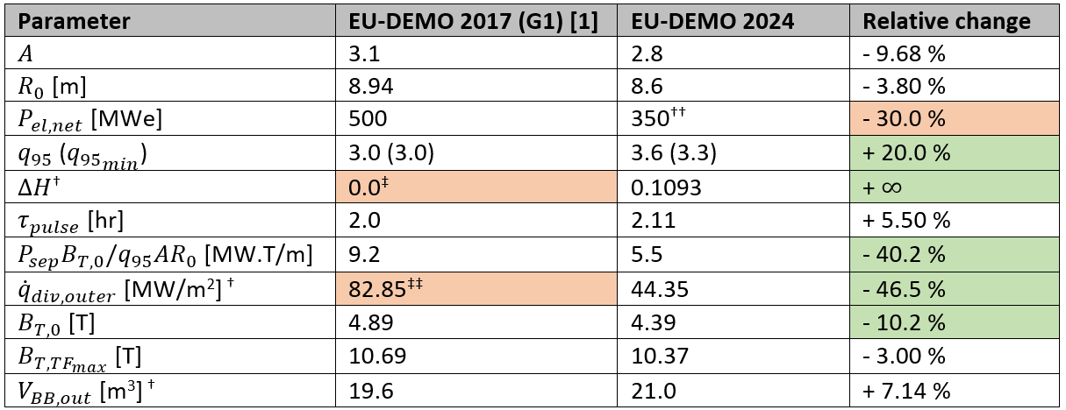
Comparison with EU-DEMO G1 (2017)
‡ In the G1 baseline, $q_{95}$ = ${q_{95}}_{min}$ = 3.0, meaning no margin to recover the nominal fusion power in the case of poor confinement.
†† If confinement is as anticipated (i.e. $H$ = 1.0), it would theoretically be possible to increase $P_{el,net}$ by approximately 15% to ~ 400 MWe [13].
‡‡ Value above emergency reattachment sweeping manoeuvre ~60-70 MW/m² [10]

Slide 17
Discussion
Reducing $q_{95}$ implies increasing in plasma current and density, and indeed changing many other plasma quantities.
Many systems are unaffected by these changes during nominal operation.
Many systems can preserve their operational strategy and procedures (e.g. balance of plant, magnets, vacuum system, remote maintenance, etc.)
No “upgrades” to commissioned systems are required.
No new systems are required.
However, such modifications to the plasma will affect the reactor sub-systems in several ways:
Some load cases during off-normal operation are increased (e.g. disruptions, HALO currents, VDEs, etc.) because of the larger plasma current.
Some systems have to be designed with the “worst-case” as a reference for nominal operation, e.g.:
Fuelling to maintain higher density,
Plasma stability control at higher density and current,
EC current drive efficiency will potentially decrease, so sufficient gyrotrons must be installed for the worst-case.

Slide 18
Conclusions
The previous EU-DEMO “G1” design point from 2017 exhibits several major issues:
No margin for plasma physics uncertainties.
Unacceptably high divertor heat fluxes during inevitable re-attachment events.
High toroidal field and high EM loads require large and expensive mechanical structures.
Lack of a viable solution for breeding blanket maintenance.
The new proposed 0-D design point for EU-DEMO addresses some of these weaknesses:
A robust plasma physics margin has been included, by means of $q_{95}$, ~ 10 % margin on $H\text{.}$
The divertor heat fluxes during reattachment are almost a factor 2 lower.
The toroidal field on axis is 10% lower, with little variation in the peak toroidal field.
Breeding blanket maintenance has not been addressed.
This proposal is undergoing more in-depth analysis and is still subject to change.
It has not yet been approved by the DEMO Project Board.

Slide 19
Thank you
EU – China collaboration on CFETR and EU-DEMO Reactor Design 4th Technical Exchange Meeting
M. Coleman^{1,2}, H. Zohm^{1,3}, C. Bourdelle^{1,4}, G. Graziosi^{1,5},
F. Maviglia^{1,6}, A. Pearce², M. Siccinio^{1,3}, A. Spagnuolo^{1,7}, S. Wiesen^{1,8}
1: EUROfusion Consortium, Boltzmannstr. 2, 85748 Garching, Germany
2: United Kingdom Atomic Energy Authority, Culham Science Centre, Abingdon, Oxfordshire, OX14 3DB, United Kingdom
3: Max-Planck-Institute for Plasma Physics, 85748 Garching, Germany
4: CEA, Alternative and Atomic Energies Agency, F-13108 St. Paul-Lez-Durance, France
5: Ansaldo Nucleare S.p.A., Via Nicola Lorenzi 8, 16152, Genoa, Italy
6: Associazone EURATOM-ENEA sulla Fusione, C. R. Frascati, C.P. 65-00044, Frascati, Rome, Italy
7: Karlsruhe Institute for Technology, Hermann-von-Helmholtz-Platz 1, 76344 Eggenstein-Leopoldshafen, Germany
8: DIFFER – Dutch Institute for Fundamental Energy Research, Eindhoven, The Netherlands

Slide 20
References
[1] DEMO1 Reference Design – 2017 March (“EU DEMO1 2017”) – PROCESS Full Output https://idm.euro-fusion.org/default.aspx?uid=2NDSKT, Wenninger, 2017.
[2] https://idm.euro-fusion.org/?uid=2PD458&version=v1.0
[3] https://idm.euro-fusion.org/?uid=2P46UG&version=v1.1
[4] https://idm.euro-fusion.org/?uid=2P7SFG&version=v1.2
[5] C. Bourdelle et al. 2023 https://idm.euro-fusion.org/?uid=2QV33T&version=v1.0
[6] M. Kovari et al. 2014 Fus. Eng. Design 89 pp 3054-3069
[7] M. Kovari et al. 2016 Fus. Eng. Design 104 pp 9-20
[8] H. Zohm et al. 2017 Nucl. Fusion 57 086002
[9] T. Eich et al. 2013 Nucl. Fusion 53 093031
[10] M. Siccinio et al. 2019 Nucl. Fusion 59 106026
[11] ITER Physics Expert Group on Confinement and Transport et al. 1999 Nucl. Fusion 39 2175
[12] Y. Martin et al. 2008 J. Phys.: Conf. Ser. 123 012033
[13] M. Siccinio 2024 private communication - METIS study

Slide 21
Back-up slides
EU – China collaboration on CFETR and EU-DEMO Reactor Design 4th Technical Exchange Meeting
M. Coleman^{1,2}, H. Zohm^{1,3}, C. Bourdelle^{1,4}, G. Graziosi^{1,5},
F. Maviglia^{1,6}, A. Pearce², M. Siccinio^{1,3}, A. Spagnuolo^{1,7}, S. Wiesen^{1,8}
1: EUROfusion Consortium, Boltzmannstr. 2, 85748 Garching, Germany
2: United Kingdom Atomic Energy Authority, Culham Science Centre, Abingdon, Oxfordshire, OX14 3DB, United Kingdom
3: Max-Planck-Institute for Plasma Physics, 85748 Garching, Germany
4: CEA, Alternative and Atomic Energies Agency, F-13108 St. Paul-Lez-Durance, France
5: Ansaldo Nucleare S.p.A., Via Nicola Lorenzi 8, 16152, Genoa, Italy
6: Associazone EURATOM-ENEA sulla Fusione, C. R. Frascati, C.P. 65-00044, Frascati, Rome, Italy
7: Karlsruhe Institute for Technology, Hermann-von-Helmholtz-Platz 1, 76344 Eggenstein-Leopoldshafen, Germany
8: DIFFER – Dutch Institute for Fundamental Energy Research, Eindhoven, The Netherlands

Slide 22
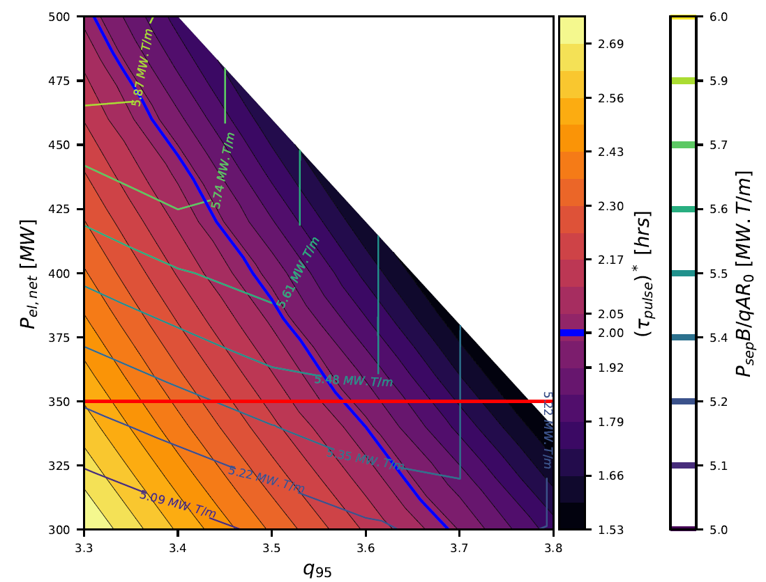
Design space for $A$ = 2.7, $R_{0}$ = 8.7 m
White: no solution
${\left(τ_{pulse}\right)}^{∗}≤$ 2.0 hours
$P_{el,net} ≤$ 350 MWe

Slide 23
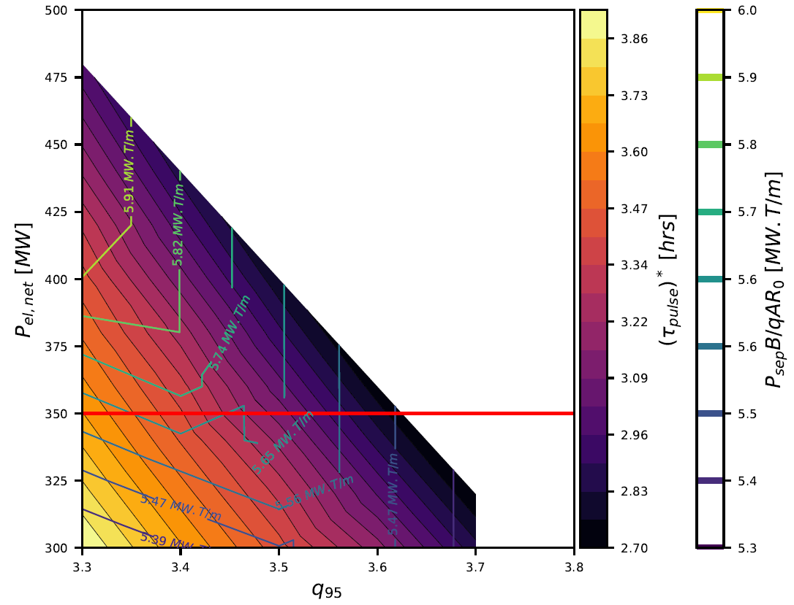
Design space for $A$ = 2.9, $R_{0}$ = 8.8 m
White: no solution
${\left(τ_{pulse}\right)}^{∗}≤$ 2.0 hours
$P_{el,net} ≤$ 350 MWe

Slide 24
Consistency
Since EU-DEMO 2017, several detailed studies have led to new inputs / constraints in 0-D models:
Fatigue was found to be a design-driving issue in the central solenoid (CS)
HCPB and WCLL blanket design has progressed: new numbers for energy multiplication, $e_{mult}$, thermal to electric conversion efficiency, $η_{thermal}$, and pressure drop now mean that the two designs are no longer roughly equivalent in terms of plant electrical power output.
The previous G1 0-D baseline was HCPB, and at the time was very similar to a WCLL baseline in terms of $P_{el,net}$.
Since 2017, the WCLL blanket was chosen as a reference.

Slide 25
Detailed comparison with G1

