Slide 1
Rationale for considering a VNS
4th Technical Exchange Meeting on the China - CFETR and EU-DEMO Reactor Design
Tuesday, 19 March 2024 - Friday, 22 March 2024
G. Federici
Thanks: DCT and WPDES Teams,
in particular: C. Bachmann, M. Siccinio, F. Maviglia, C. Gliss, C. Luongo, L. Giannini and the CREATE Team
Companion talks
Blanket Testing & Qualification Needs and Options Giacomo Aiello
VNS Physics Mattia Siccinio
VNS Engineering Christian Bachmann
The material contained in this presentation cannot be reproduced without the consent of the authors

Slide 2
Why are we doing this?
Many international studies concluded that the tritium breeding blanket is at very low TRL. No blanket has ever been built or tested. There is an urgent need to qualify blankets in the fusion nuclear environment.
The role of ITER in de-risking DEMO in the area of breeding blanket is becoming questionable (delays). The TBM is not enough to qualify the Breeding blanket.
Risk mitigation options need to be studied. We have concluded that using of DEMO operation for qualification of breeding blanket is very risky, and at best is very expensive and takes very long time
A feasibility assessment for a 14 MeV Volumetric Neutron Source (VNS is undertaken in EUROfusion with a scope to deliver the results by the end of 2024.
A VNS focus would on testing/ development of FNT components, complement ITER (focused on burning plasma physics) and complement DONES (which is focused on large dpa in small material samples).

Slide 3
VNS Drivers
Mission:
Rationale for a VNS: G. Federici, Nucl. Fusion 63 (2023) 125002.
Address largest knowledge gap we have in fusion: performance and reliability breeding blanket for any machine concepts.
Testing TBMs in ITER in de-risking DEMO breeding blanket is not sufficient
P_{fus}: ~30 MW, Tritium consumption <1 kg/year.
Reliable plasma scenario, based on beam-target fusion (Q ≤ 1).
Steady-state plasma operation.
Peak neutron wall load: 0.5 MW/m², peak lifetime neutron fluence: 30-50 dpa.
Testing: available equatorial ports and outboard wall > 10-30 m² of exposed first wall.
Ability to test several candidate blanket/coolant concepts.
Well established technologies for magnets, VV and NBIs.
Design and construction: Parallel to ITER and prior to the finalization of DEMO design.

Slide 4
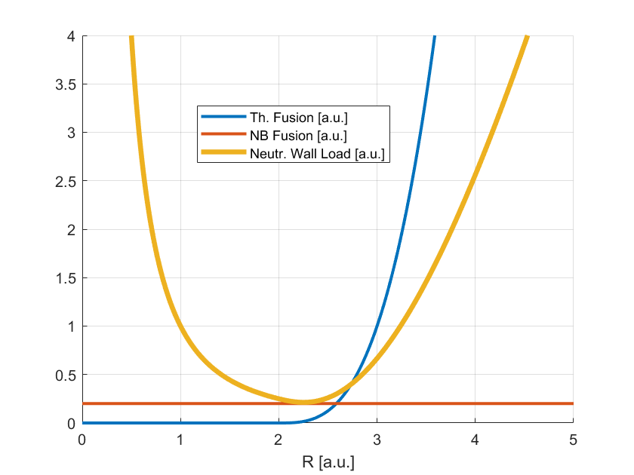
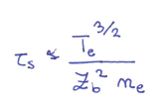
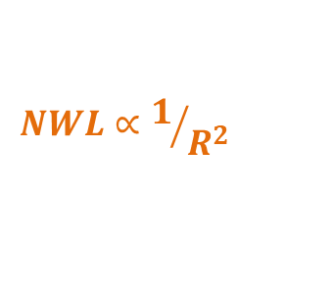
VNS Physics Basis
$$NWL=\frac{0.8×P_{fus}}{S}$$
The device should be a 14 MeV neutron source with a peak NWL of at least ~ 0.5 MW/m²
The only way to keep the machine size low is to rely on beam-target fusion reaction.
Beams are also employed to drive the plasma current.
The JET record shot is actually an example for such a plasma, but NWL would be too small (factor 5-10).
Necessity of high power installed.
Technological
Constraints
The neutron rate is independent on the plasma density! However, it goes like Te^{3/2}. Additional electron heating helps.
$$P_{fus}∝R^{3}$$
$NWL∝$R
$$NWL∝1/{R^{2}}$$
Too big size/costs
High density is needed for beam shine-through & power exhaust.

Slide 5
Potential Technical Showstoppers VNS
PHYSICS
Equilibrium and VS: very challenging (tiny plasma, distant coils)
Mitigation: lower aspect ratio A, plasma, stabilizing plates for VS, equilibrium in-vessel coils, optimising elongation (high values are better for equilibrium, but worse for vertical stability).
Beta limit
Mitigation: lower β_{Ν} - e.g. through high magnetic field, higher current. Target: β_{Ν} < 3.5%
Fast Particle Confinement (NB and α).
Mitigation: higher current, lower A - Beam particles well confined
Divertor/ power exhaust
Mitigation: optimise divertor geometry and impurity mix for dissipation (keeping Zeff low in the core to ensure a sufficiently high slowing-down time), maximise neutral pressure
ENGINEERING
N- shielding inboard TF coils and NBI ports: difficult (for a given B₀, increasing the shield increase the TF coil inner leg max field)
Mitigation: advanced shield compositions (WC, W₂B₅. etc)
Magnets / Equilibrium:
Mitigation: stabilizing plates, inner coils, PF coil nearer to vessel/ plasma, intra-vessel coils (Cu)
Neutral beam: Pumping/ regeneration and availability/maintainability challenging
Mitigation: improve regeneration of NBI pumps, NBI pumping advanced concepts
Integration/ maintenance in-vessel components:
Mitigation: develop robust solutions for mechanical and hydraulic connections
Consolidate testing strategy, improve (simplify) breeding blanket design
Mitigation: testing strategy in port out/ of ports

Slide 6
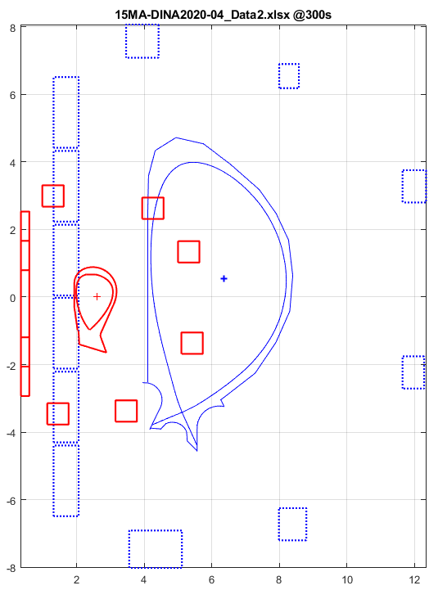
Proposed Design Point #2
The new design point takes into account all the lesson learned in the first iteration. Further analysis are in progress
R (m) | 2.53
B_{T,0} (T) | 5.4
Aspect Ratio | 4.6
k | 1.5
NBI (MW) | 42.5
Beam (keV) | 120
EC (MW) | 10
q95 | 3.05
<n> 10²⁰ m⁻³ | 1.1
Greenwald Fraction | 0.59
W conc. average | 9.99E-06
Peak NWL (MW/m²) | 0.5
Ave NWL (MW/m²) | 0.30399
BetaN (%Tm/MA) | 3.3455
Fusion Power (MW) | 29
Centr. Te (keV) | 12.0848
Ip (MA) | 1.75
li3 | 0.75774
loop voltave (mV) | 9.36
D fraction in bulk pl | 0.203
Power Divertor (MW) | 53
RU Flux Consumption (Wb) | 4.07
Results:
Equilibrium currents
With the aid of Intra Vessel coils (ITVC) Currents, within mag. Input limits ≈|8MAturns|
The central solenoid must be also used to shape the plasma.
Next steps: study full scenarios (i.e. Ramp-up, SOF).
Controllability – with the aid of ITVC the usable degrees of freedom for the shape control increase from 3, to 5 (there are usually 6 dof in a tokamak device, i.e. ITER/DTT/DEMO).
Passive Vertical stability
Stability margin are acceptable even without passive stabilizing plates.
ITER
VNS
≈3.8m
≈2.1m
≈5.74m
≈2.6m
Ratio distance (plasma boundary↔coils)/ (plasma core↔coils) smaller in VNS (e.g. ≈2.6/2.1, v.s. 5.7/3.8 in ITER): coils “see” plasma more like a point from afar, with less dof. to control the shape.
Courtesy of Create

Slide 7
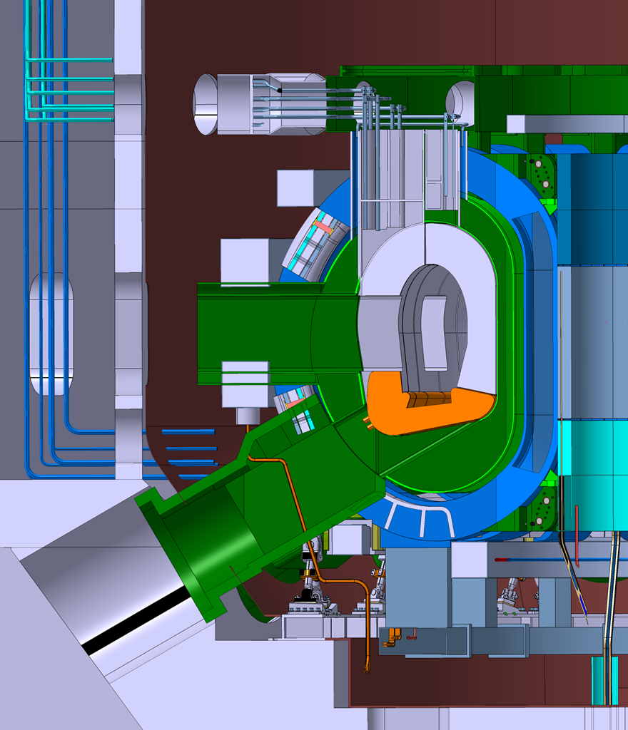
Required developments during feasibility study (by 12-2024)
Exclude technical showstoppers, major feasibility issues
Additional studies
Impact of adopting a limiter confined plasma
Impact of using negative ion beams 200-300 keV
Explore also additional VNS devices dominated by beam target fusion (NBI): Stellarators, Mirrors
Improvements of the “magnetic cage”
Define a realistic testing strategy
Preliminary cost assessment and forward planning:
Timing
17Apr. 2024 - Interim report presented to GA
9 Oct. 2024 – Final report presented to GA (final written report by end of 2024)

Slide 8
Thank You
Do you have any questions?

