Slide 1
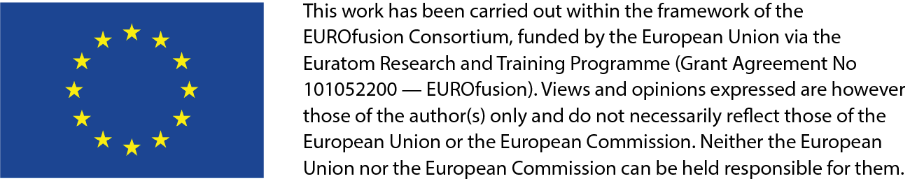
Testing and quantification needs for the Breeding Blanket
EU-CN collaboration on CFETR and EU-DEMO
4th Technical Exchange Meeting
G. Aiello, S. D’Amico, G. A. Spagnuolo, G. Federici, F. A. Hernandez, and the DEMO Central Team

Slide 2

Outline
Breeding blanket technology development strategy
What does it mean to qualify a nuclear component?
  Example: fuel assembly qualification
Breeding blanket concepts
Breeding blanket nuclear qualification needs:
  Basic experiments and Single-effect experiments
  Multiple-effect/interactions
  Integrated experiments in representative environments
Facilities for BB qualification
EU Volumetric Neutron Source concept (FUTURE)
Testing options: Pro. & Cons.
  TBM-like vs. Segment – testing goals
  Target irradiation levels for testing
  Testing approaches
Conclusion
Notes:
In this talk I will present the updated strategy we are following in EUROfusion in order to achieve breeding blanket qualification.
I will explain where this strategy comes from, by what it is inspired
what blanket concepts we are presently considering,
the challenges and the different steps involved in this qualification going from basic experiments, single and multi-effect interactions up to integrated mock-ups testing in relevant environments,
Which facilities we are using
And in particular, how we plan to finally achieve this qualification through a Volumetric Neutron Source by testing of prototypes in an operational environment.

Slide 3
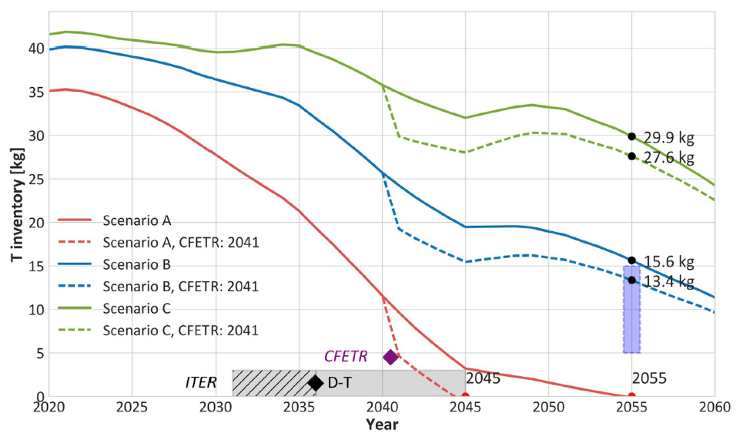
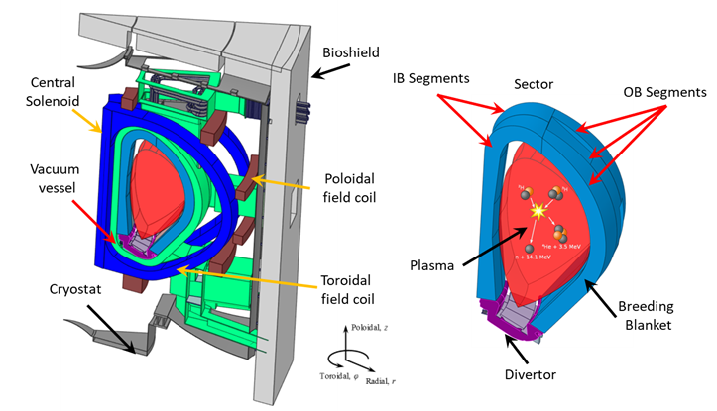
Breeding blanket technology development strategy
Breeding blanket technology is crucial for the development of fusion power, but its maturity is currently very poor.
  Heat removal for electrical production: (~300-500 MWe) predictably and safely, with minimal environmental impact
    use Reduced Activation Ferritic-Martensitic ‘RAFM’ steel → EUROFER
    minimization of tritium permeation, dust and corrosion products generation
  Breed tritium: “a 2 GW fusion power DEMO will consume around 111 kg T/FPY, and this clearly underscore the indispensable requirement to achieve T-self-sufficiency”
  Contribution to nuclear shielding
A revised and reinforced breeding blanket development strategy is needed to address technical gaps and reduce safety and licensing risks.
The proposed strategy can be articulated in 3 different phases:
  Phase 1: consolidate basic data on materials and technical processes
  Phase 2: perform multiple-effects and multiple-interactions experiments on reduced-scale mock-ups
  Phase 3: perform fully-integrated tests on full-size components in representative operating conditions.
M. Kovari et al, (2018) Tritium resources available for fusion reactors, Nuclear Fusion, 58, 026010, DOI: 10.1088/1741-4326/aa9d25
Notes:
The breeding blanket is of course THE enabling technology for fusion electricity production. It must do so in a safe and reliable way. In order to limit the environmental impact, it must use specific reduced activation materials and limit radioactive releases. It must at the same time produce tritium, in the order of 100kg/fpy for a 2GW (in order to understand, the present amount of tritium in the world is ~40kg, and it will be used by upcoming D-T machines), and shield the Vacuum Vessel from neutron irradiation.
All this, insuring sufficient availability for reliable electricity production.
Its maturity level is however still very poor and a sound strategy is needed to address the technical gaps and reduce the risks. This strategy must go trough basic data acquisition on the fundamental phenomena and individual technologies, to multiple effects and interactions, up to full performance evaluation through testing integrated mock-ups in relevant environment.

Slide 4
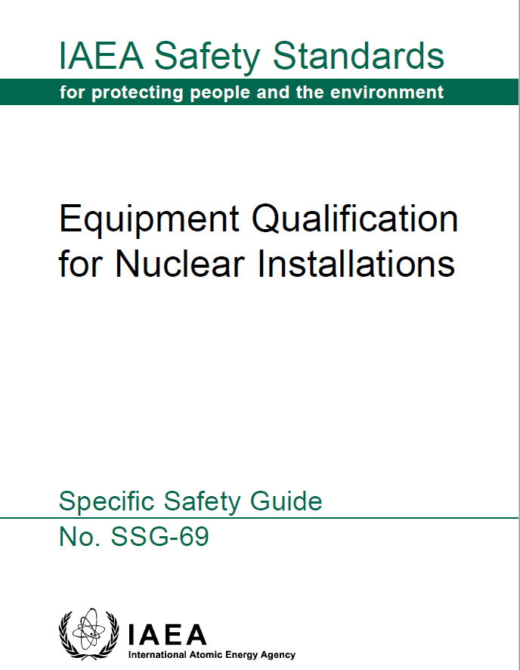


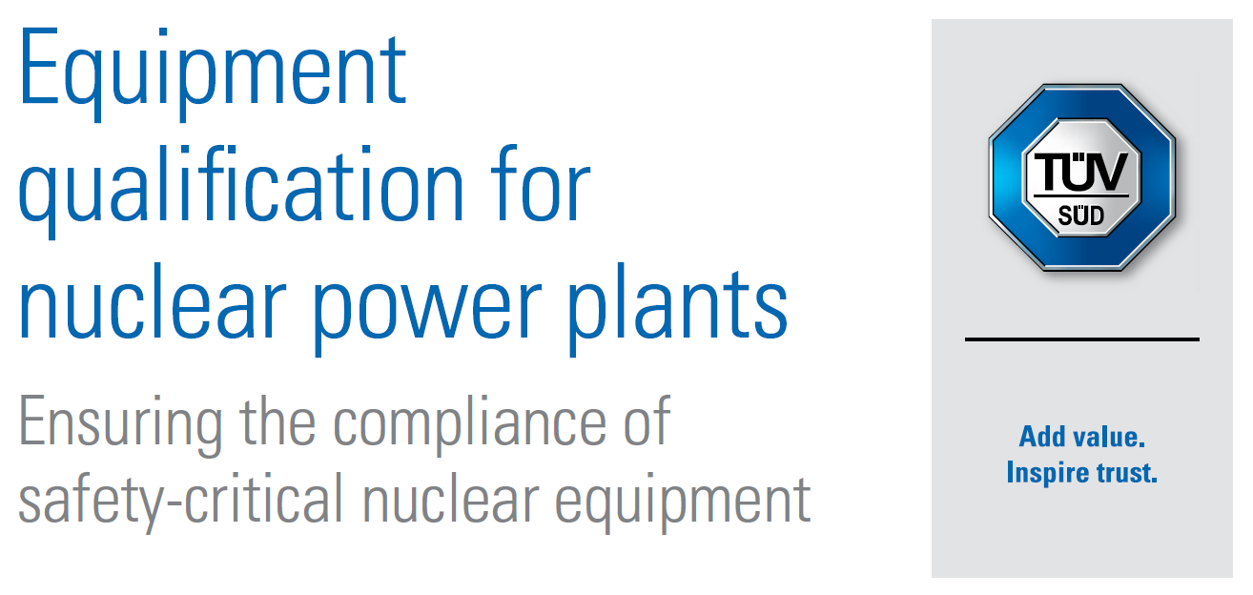
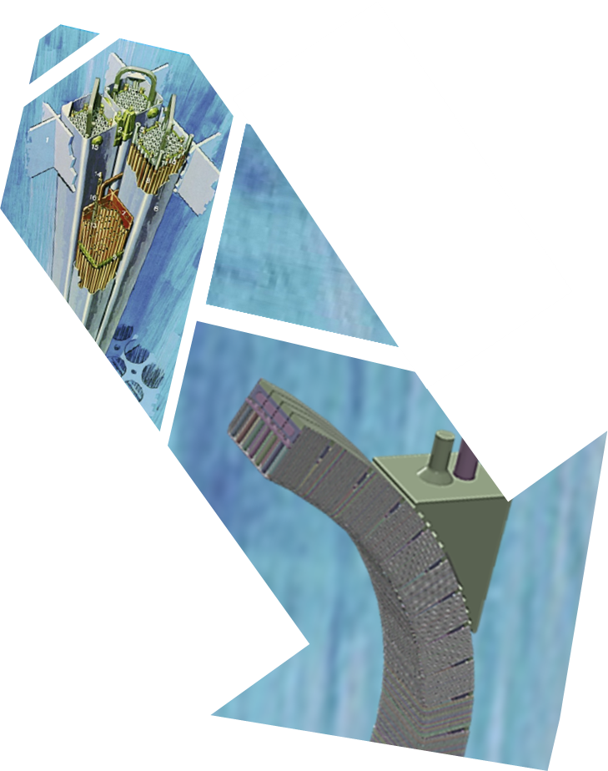
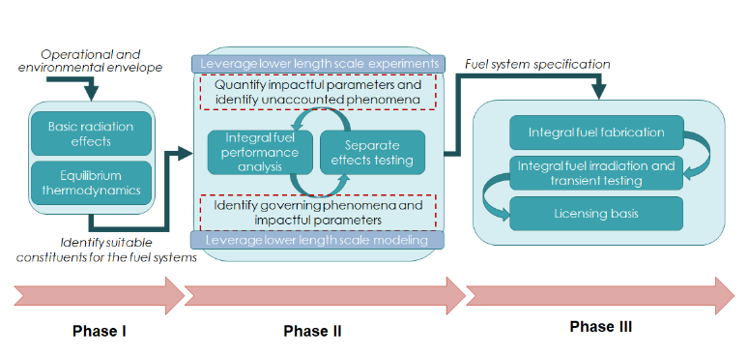
Qualification of a nuclear component: fuel assembly
Fuel assembly qualification is a critical process to ensure the safe and efficient operation of nuclear reactors. It is carried out according to established and harmonized procedures.
Qualification involves a series of steps and considerations, including:
  Material selection
  Design and analysis → The fuel element and assembly design is reviewed to ensure that it meets all applicable codes and standards
  Manufacturing → The manufacturing process is tested to ensure that the fuel elements are produced consistently and meet all requirements
  Quality control and inspection
  Irradiation testing → Several fuel elements are irradiated in a test reactor to evaluate their performance under actual operating conditions
  Safety and regulatory compliance
  Post-irradiation examination → Fuel elements and assembly are examined after irradiation to learn more about their performance and to improve fabrication process
  Data analysis and modelling
G. Federici, (2023) Testing needs for the development and qualification of a breeding blanket for DEMO, Nuclear Fusion, 63, 125002, DOI: 10.1088/1741-4326/ad00cb
System
Technology
Depending on the specific technology, Breeding Blanket concepts are today between TRL 2 and 4
Concept
U.S. NRC, NUREG-2246, Fuel Qualification for Advanced Reactors
Notes:
This strategy is in fact modelled on the same approach used in qualifying fission nuclear components, like for example the fuel elements.
Qualification of fuel elements is performed according to established and harmonized procedures, according to international guidelines like those published by IAEA.
It involves several defined steps, starting from the selection of appropriate materials, design and manufacturing according to qualified procedures and inspection techniques, up top the point where the “prototype” fuel element is tested inside a reactor under actual operating conditions. Post irradiation examination and data analysis are then performed to confirm expected outcomes and possibly improve the design and manufacturing.
This process is schematically represented below, going through three phases already mentioned, with those relevant for fusion highlighted in red.
An alternative way to look at this process is through the notion of TRL, going from the proof of concept, to the development of the technology, to the qualification of the final system. Depending on the specific technologies, the TRL level of the blanket is between 2 and 4, the higher levels being attainable only through integrated testing in representative environment, that is TBM testing and testing in a fully operational fusion environment, that is exactly a VNS.

Slide 5
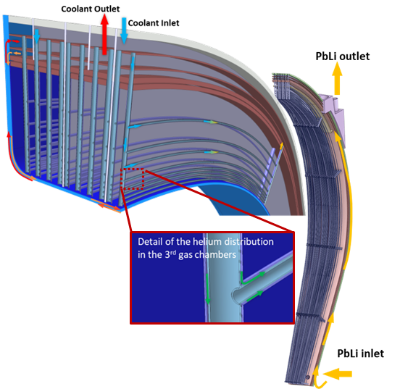
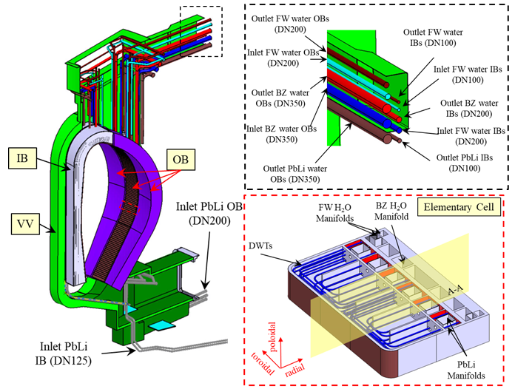
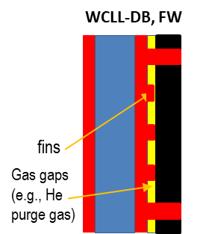
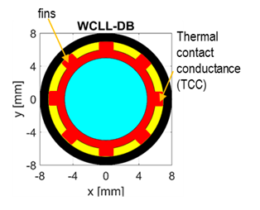

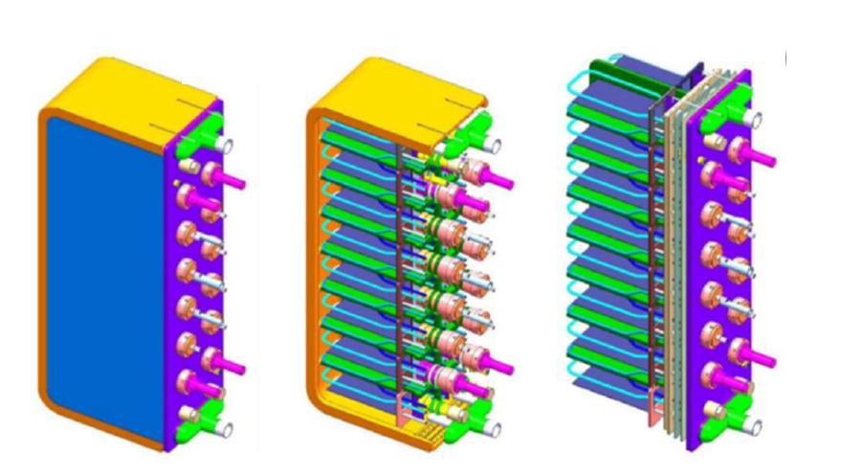

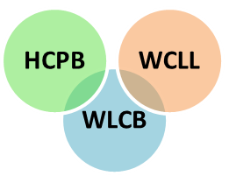
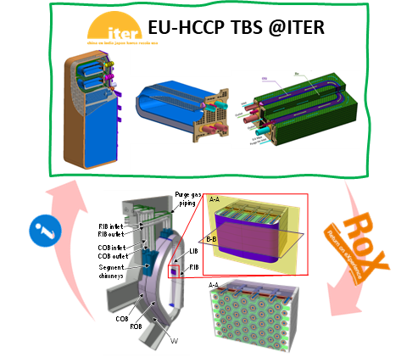

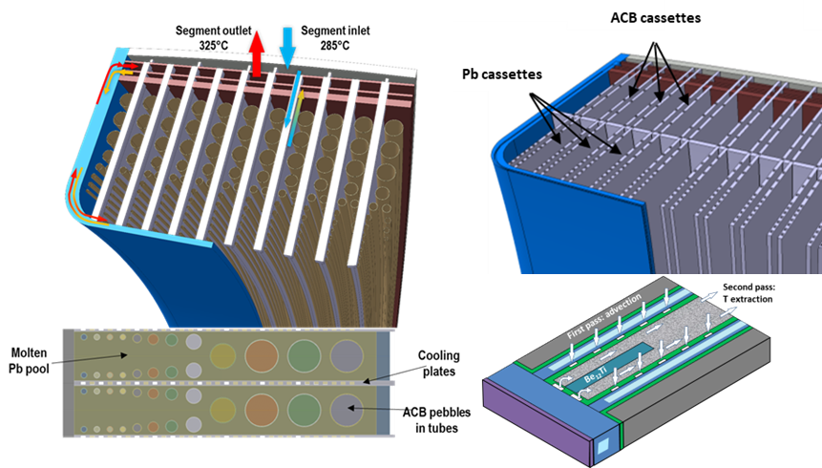
Breeding blanket concepts in EU
EUROFER97 (300-550°C)
Li₄SiO₄ + 35 mol% Li₂TiO₃
(⁶Li at 60%)
Molten Pb or solid Pb compound
Water (285-325°C @ 15.5 MPa)
Helium Purge Gas
EUROFER97 (300-550°C)
Li₄SiO₄ + 35 mol% Li₂TiO₃
(⁶Li at 60%)
Beryllide (TiBe₁₂)
Helium (300-520°C @ 8 MPa)
Helium Purge Gas
WLCB
HCPB
WCLL-db
EU-WCLL TBS @ITER
WCLL
EUROFER97 (300-550°C)
PbLi liquid (~330 °C @ 0.25-1.55 MPa)
(⁶Li at 90%)
Water (295-328°C @ 15.5 MPa)
Notes:
In Europe, or rather in EUROfusion, we are developing several blanket concepts. All use EUROFER97 as structural material with a temperature window of operation between 300 and 550C.
The WCLL uses water cooling in PWR conditions and PbLi eutectic for breeder/multiplier.
The WCLL-db is an evolution of the WCLL to improve reliability.
The HCPB uses ceramic pebbles an Beryllide as breed and multiplier material and is helium cooled.
The WLCB is the latest concept, combining the advantages of HCPB and WCLL to achieve a simpler and more reliable design.
Some of these concept will benefit from the RoX of operating corresponding TBMs in ITER, but not all concepts can be tested in ITER for reasons of time and space in the machine.

Slide 6






Breeding blanket qualification strategy
Theory/Modelling
Design Codes
Basic
Separate Effects
Multiple Interactions
Partially Integrated
Integrated
Component
Fusion Env. Exploration
Concept Screening
Performance Verification
Design Verification
Reliability Data
Property Measurement
Phenomena Exploration
Non-Fusion Facilities
Fusion-relevant Facilities
TRL 1-3
TRL 3-6
TRL 6-8
Basic experiments
Single-effect experiments
Multiple-effect/multiple-interaction experiments
Partially integrated experiments
Integrated experiments
Component test
  Basic or intrinsic property data
  Single material specimen
  Explore a single effect, phenomenon, or interaction of a limited number of phenomena to develop understanding and models
  a single environmental condition and a clean geometry
  Explores multiple environmental conditions and multiple interactions to develop understanding and prediction capabilities
  Includes identifying unknown interactions and directly measuring specific parameters
  Partial integration test but without some important environmental conditions for large cost savings
  All key physical elements of the component and not necessarily full scale
  Concept verification and identification of unknowns
  All key environmental conditions and physical elements, although often not full scale
  Design verification and reliability data
  Full-size component under prototypical operating conditions
M.A. Abdou et al. (2015) Blanket/first wall challenges and required R&D on the pathway to DEMO, FED 100, 2-43, DOI: 10.1016/j.fusengdes.2015.07.021
Notes:
How we want to qualify these concepts ?
Following the TRL methodology, it is a progressive approach that starts with qualifying the basic material in a given state, then going to single-effect experiments (adding the effect of a single environmental condition), to multiple effects testing between interacting phenomena (ex: corrosion and n-irradiation), goes to testing of integrated small-size mock-ups but with all the key elements of the component in a relevant, although not completely representative environment, mainly to limit cost. And then in the final phases going to test prototype components in representative environment to identify and quantify unknown effects. And then ending with the test of a full-size component in order to validate and qualify the final design, also to obtain reliability data.
At the beginning these tests can be made in non-fusion relevant facilities, but then – as the TRL increases – we must move to more and more relevant environments and so we need fusion-specific facilities.
In parallel to the testing activities a strong effort is needed to develop modeling and design tools, starting from the basic physics, basic theories up to the development and validation of appropriate design codes.

Slide 7
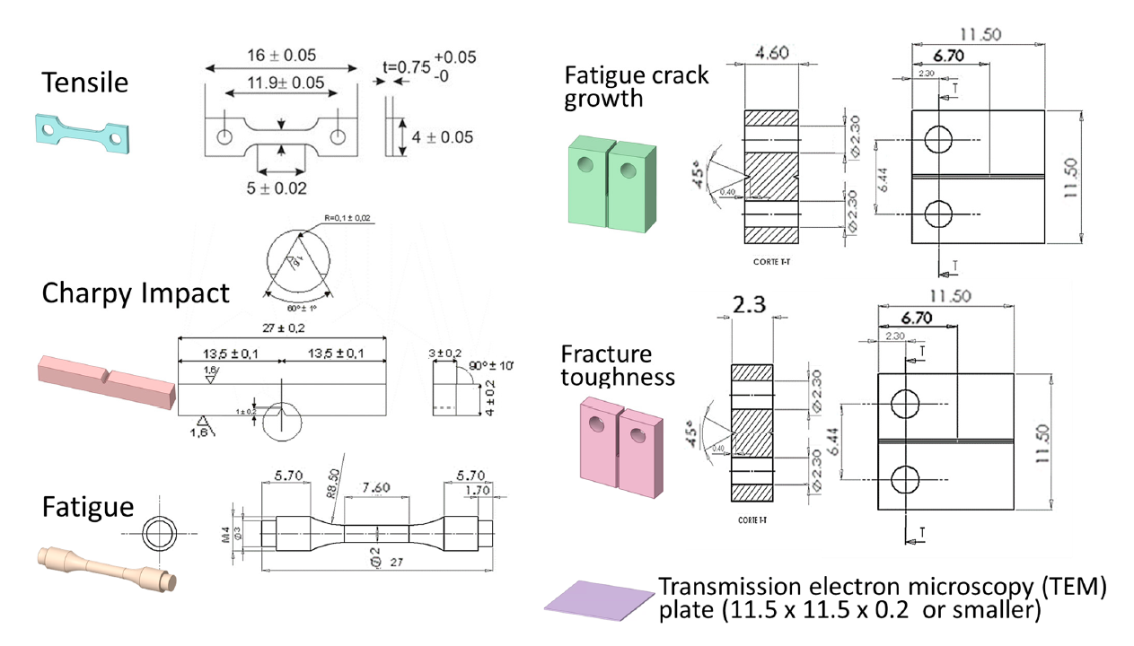
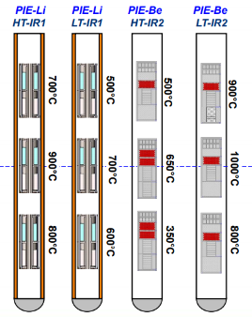
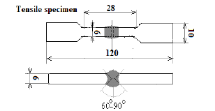
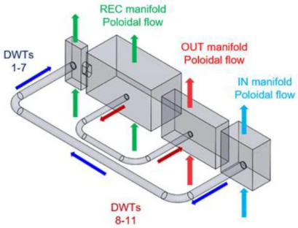
Some Basic and Single-effect experiments (TRLs 1-3)
Basic experiments
  Measure basic structural material properties under neutron irradiation (e.g. yield strength, fracture toughness, and swelling).
  Utilize standard techniques and small specimens.
  Measure basic solid breeder properties under irradiation (e.g. thermal conductivity, T-retention, creep, strength, and surface characteristics).
  Focus on standard post-irradiation determination of properties.
  Measure basic solid multiplier properties under irradiation (e.g. swelling, irradiation creep, mechanical prop.).
  Focus on standard post-irradiation determination of properties.
  Define recycling processes of irradiated Beryllium/Beryllide.
The basic tests should be conducted on a high number (i.e. thousands) of specimen of small dimensions (~1-2 cm³).
  Determine improved cross-section data (especially for ceramics).
  Correlate the effect of radiation damage (dpa and He production) on structural/functional material properties.
  Measure the basic volatility of chemically active materials under plausible fusion operating or accident conditions.
    Measurements include temperature, calorimetry, and weight loss.
  Determine isotope cross-sections and assess the radioactivity of engineering materials.
  Measure the decay gamma spectrum and count rate, as well as characterize the activating neutron fluence and spectrum.
  Quantify the rates of neutron-induced sputtering that contribute to the transp. of activated materials
    Measurements involve monitoring fluid chem., filtering, and exposed-surface examination.
From Y. Qiu et al 2022 J. Nucl. Eng. 3(4), 385-397
Single-effect experiments
  Structure Thermo-Mechanical Response
  Measure stress, strain and determine failure modes.
  Study radiation effects, surface damage effects, and thermal effects.
  Weld Behavior
  Measure stress, strain, and perform post-test examination.
  Determine effects of differential swelling and creep.
  Liquid Metal MHD flows.
  Measure heat transfer, temperature profiles, stresses , pressure drop, flow distribution, velocity profiles, and corrosion. eddy currents, electric potentials, and magnetic flux density.
  Solid Breeder Tritium Recovery
  Determine basic permeation data, changes in permeation mechanisms, surface barriers effectiveness, and radiation effects.
  Measure tritium activity over time, temperature, and post-test examination
The single-effect tests should be conducted on a high number (i.e. hundreds) of specimen or small, simple geometries in dedicated test benchs
  Solid Breeder and Structure Mec. Interaction
  Address issues of solubility, diffusivity, surface migration, desorption, purge flow effects, mass transfer, tritium permeation, and tritium recovery within the solid breeder.
  Tritium Permeation through Structural Material
  Address mechanical interaction issues, including strain accommodation
  Measure stress and strain in the structure, cracking and redistribution in the breeder, and overall deformation and failure modes
  Env. Assisted Cracking
  Determine the ductility degradation of structural materials, leading to early failure through crack growth, due to both stress corrosion and liquid metal embrittlement.
From A. Collaku et al. 2023 J. Energies, 16, 2246
A. Abdou, et al, (1984) FINESSE: A Study of the Issues, Experiments and Facilities for Fusion Nuclear Technology Research and Development, UCLA-ENG--84-30-Vol.2, https://doi.org/10.2172/5507921
Notes:
Some examples of basic and single-effect experiments that we have already performed or we plan to perform in TRLs 1-3 are presented in this slide.
For example, measure structural materials/breeder and multiplier properties, with and without irradiation. Determine cross-section data for neutronic analyses and reactivity of chemical processes. This is done on material specimens of small, dimensions for thousands of single tests.
Then single effect experiments, like study the thermo-mechanical response of the structure under heat flux, or MHD flows of PbLi under a magnetic field, interaction between solid breeder and structure (pebble bed thermo-mechanics) or the effects of corrosion.
This must be done on a high number of simple geometries in dedicated laboratory-scale test benches.

Slide 8
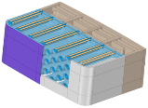
Some Multiple-effect/interaction experiments (TRL 3-6)
1) Heat Transfer Experiments
2) Breeder/Structure Thermo-Mechanical Interactions
3) Neutronics Prediction Validation
  Testing goal:
  Empirical study of heat transfer within realistic BB geometries.
  Evaluate the long-term performance of the assembly, considering both MOL and EOL conditions.
  Reproduction of Conditions:
  Neutrons for bulk heating and radiation effects on heat transfer.
  Reproduce environmental conditions (temp., pres., vel., etc.).
  Testing goal:
    Measure temperature changes and stress levels at BOL.
    Assess radiation-induced thermal conductivity changes. creep, and swelling, among other effects.
  Reproduction of Conditions:
  Neutrons for bulk heating and irradiation effects.
  Replicate BB geometry and temperatures.
  Simulate cycling using submodules.
  Testing goal:
  Confirm predictions for tritium breeding, nuclear heating and induced activation.
  Assess tritium inventory.
  Reproduction of Conditions:
  Use of fusion spectra in the testing process.
  Replicate similar geometries with mock-ups.
  Emulate the local neutron field.
Increased size of the testing
6) Submodule Thermomechanical Verification
4) Tritium Permeation
5) Tritium behavior in thermal and flow transients
  Testing goal:
  Validate the thermomechanical design.
  Assess temperature variations and stress levels.
  Conduct post-test examination for signs of cracks, deformation, any other visible changes.
  Reproduction of Conditions:
  Neutrons for heating and to induce specific reactions (i.e. damages).
  Emulate other loads (e.g. press., EM, temp., etc.)
Testing goal:
  Assess tritium permeation rates into the coolant.
  Measure tritium activity within the tritium carrier and analyse the tritium form.
  Evaluate the surface conditions of the clad material.
  Reproduction of Conditions:
  Neutrons for the tritium and heat source distribution.
  Replicate breeder, T-carrier and coolant conditions.
  Testing goal:
  Examine the behavior of tritium inventory within breeder unit cells under thermal or flow transient.
  Measure the temperatures of breeder, structure and coolant.
  Monitor activity levels in the coolant and tritium carrier.
  Reproduction of Conditions:
  Emulate coolant conditions and T-carrier conditions
  Neutrons for the tritium and heat source distribution and irr. effects.
Increased size of the testing
A. Abdou, et al, (1984) FINESSE: A Study of the Issues, Experiments and Facilities for Fusion Nuclear Technology Research and Development, UCLA-ENG--84-30-Vol.2, https://doi.org/10.2172/5507921
Notes:
As we move to multi-effects testing, we must grow in size, going from small to bigger mock-ups representative of the component’s geometry. Here we must be pay attention at recreating the “relevant” environment to study multiple interactions. This is not yet a fully representative environment but tailored to the phenomena we want to study.
For example Heat transfer experiments with bulk heating and heat flux and active cooling in representative geometry. Breeder/structure interactions with neutron irradiation under cycling conditions. Tritium production and tritium recovery experiments under neutron irradiation replicating breeder, tritium carrier and coolant conditions to measure retention and permeation rates.
Now staring from the multiple-effect/multiple interactions experiments we need of course dedicated fusion-specific facilities, nuclear and non-nuclear…

Slide 9
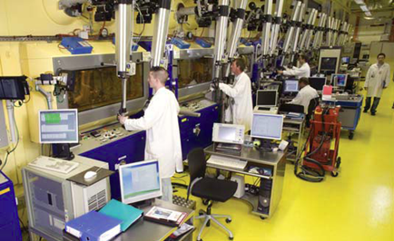
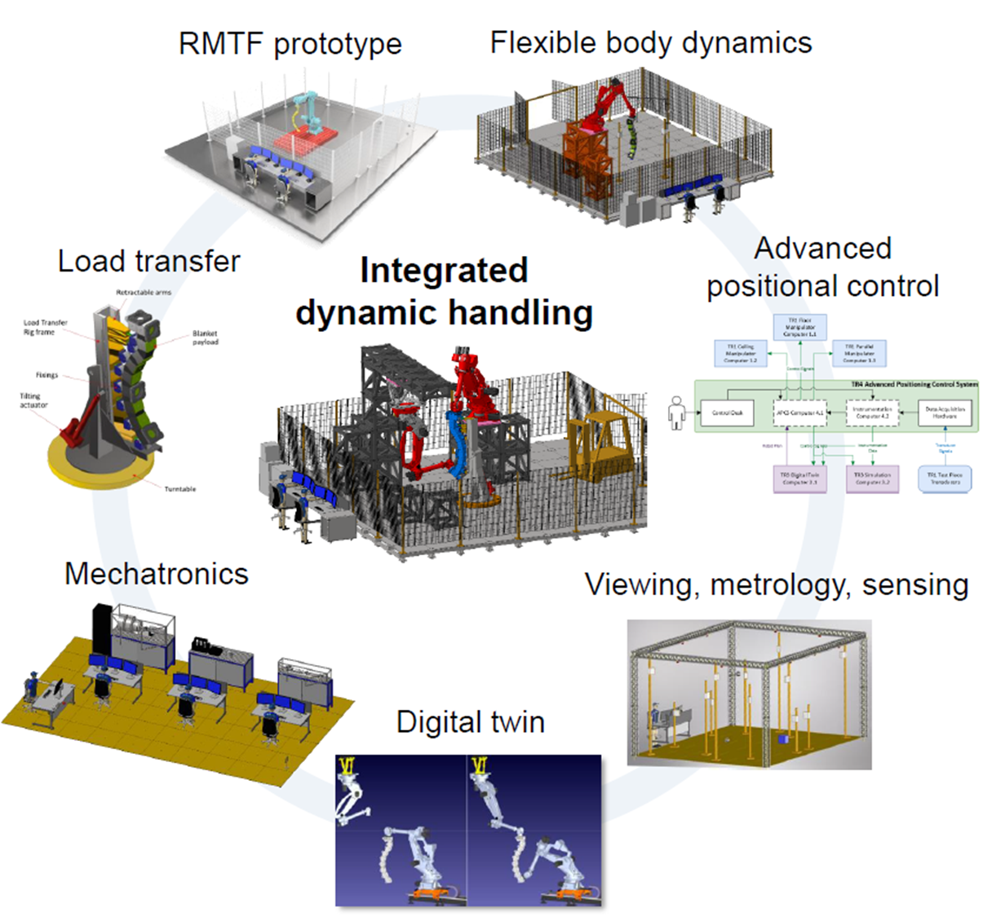
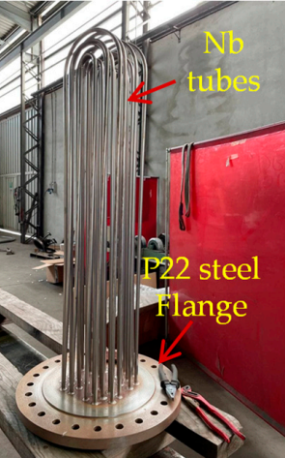
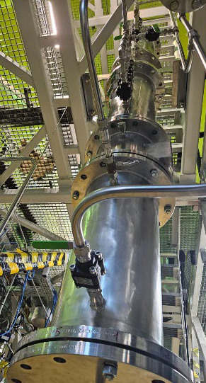
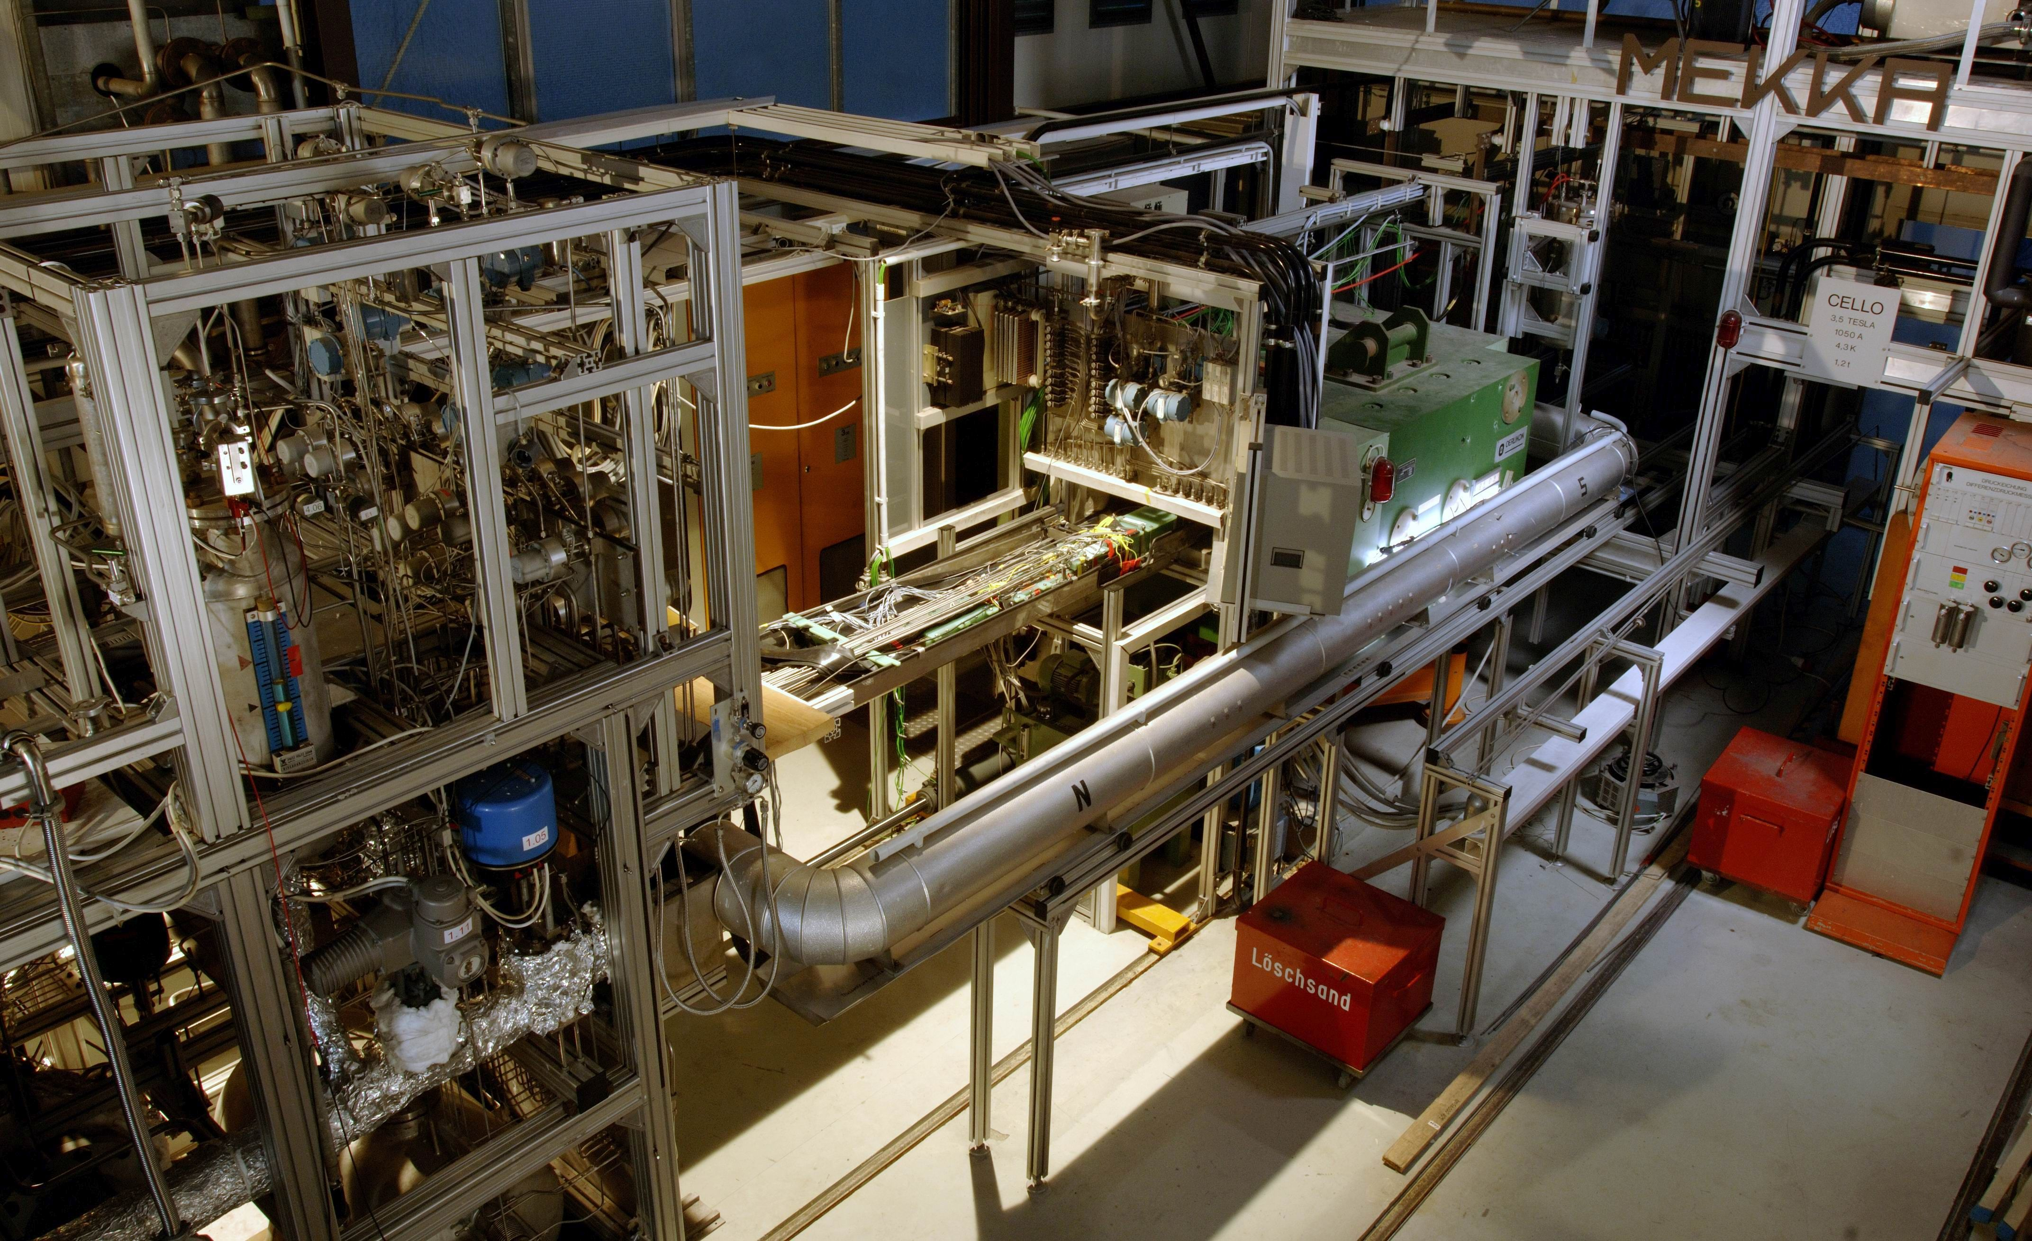
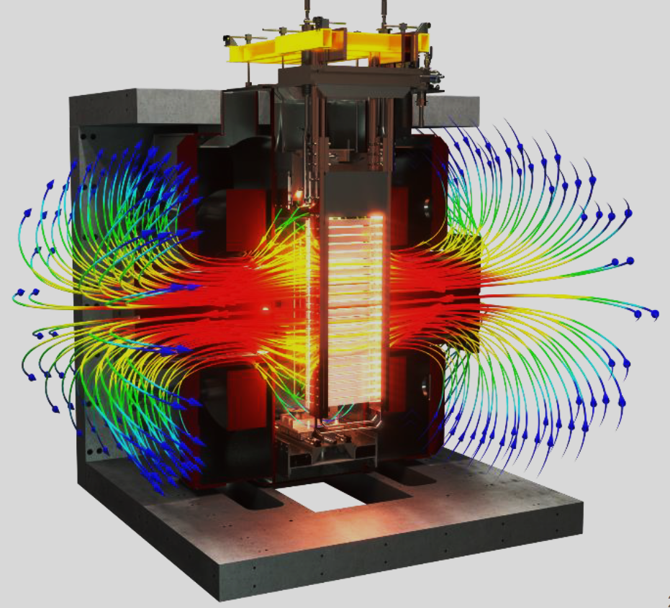
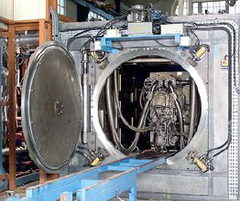
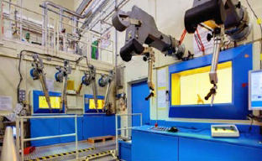
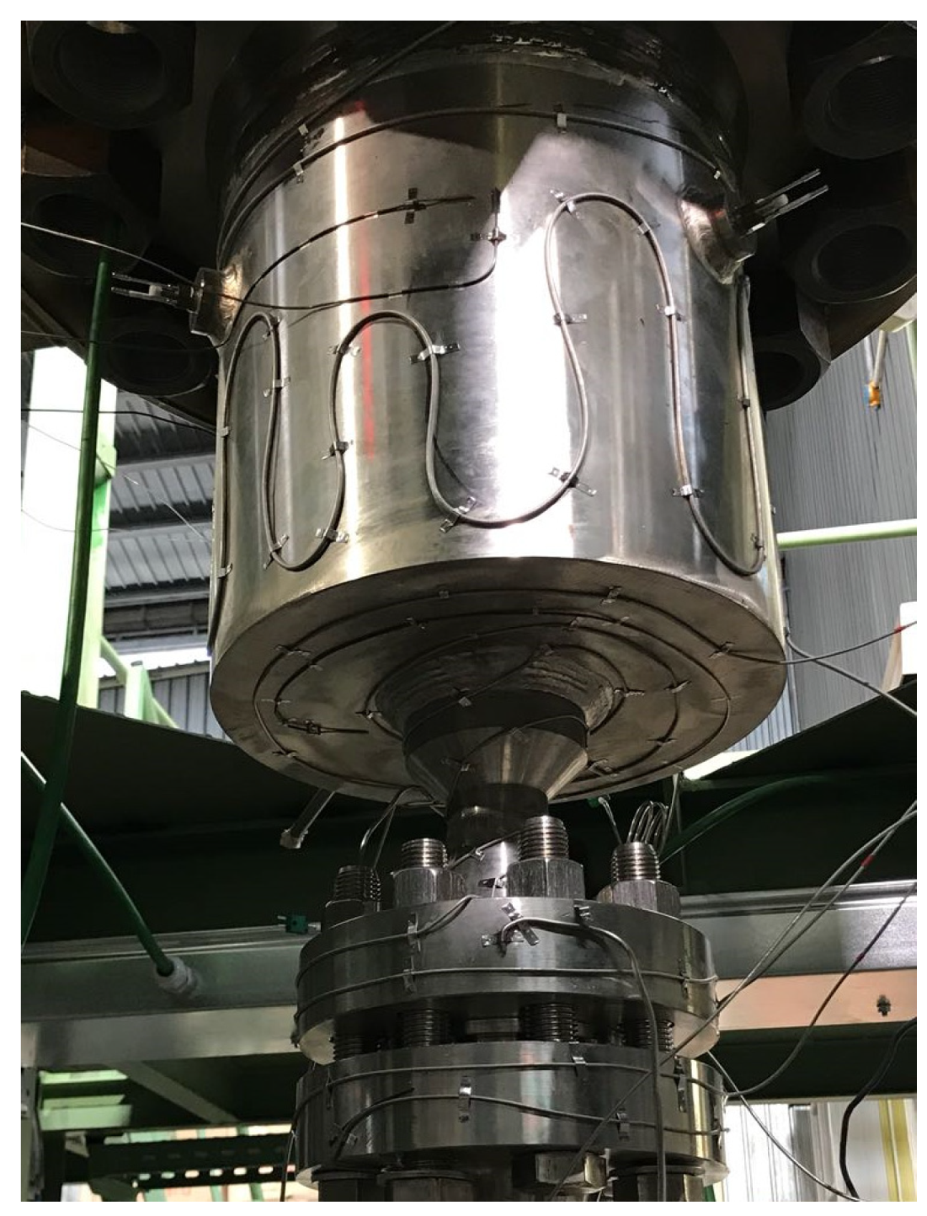
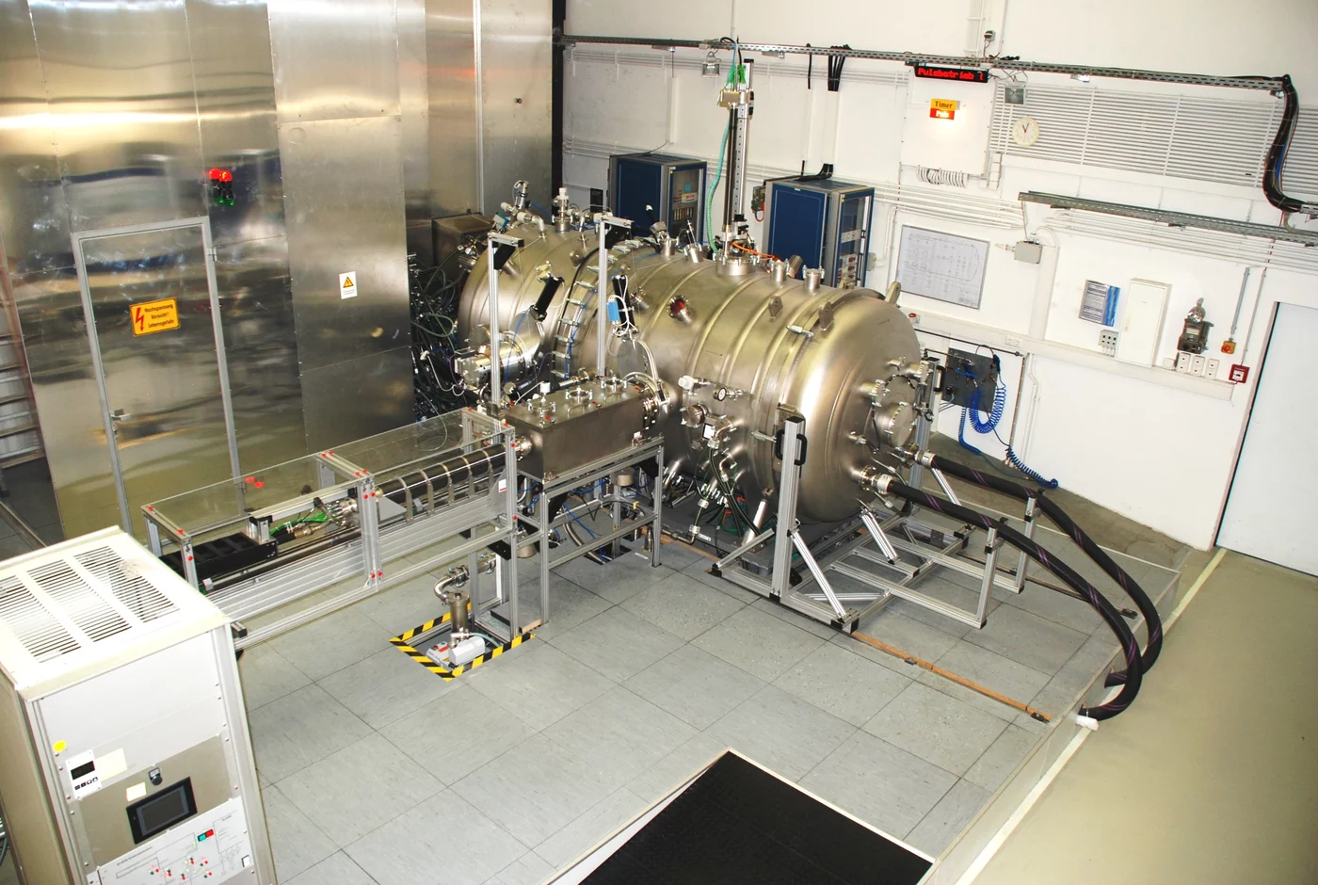
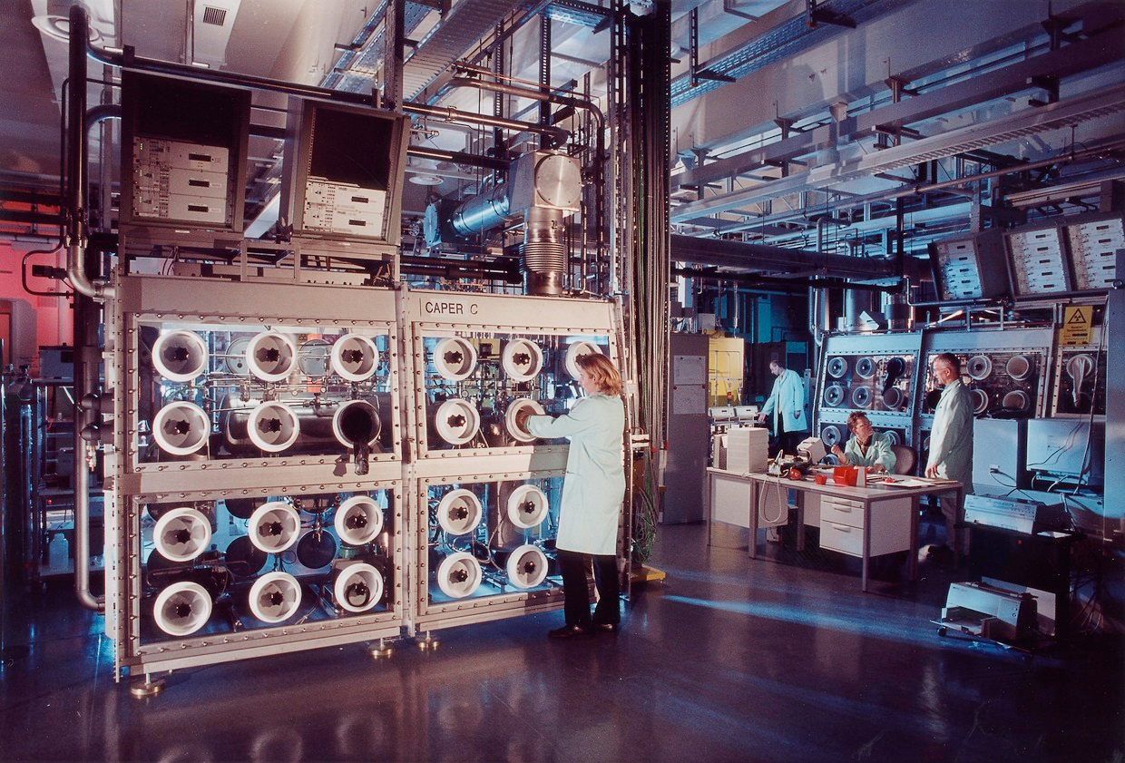
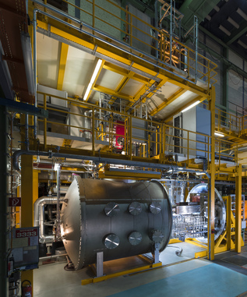
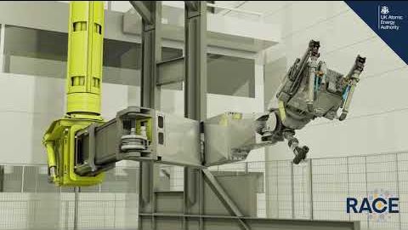
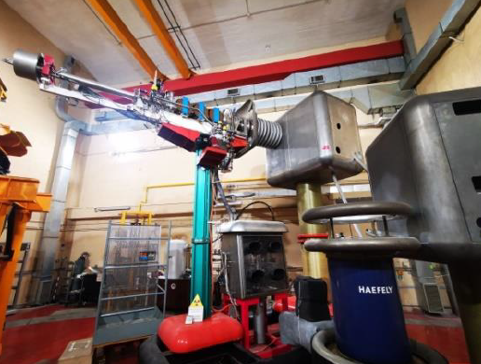
Facilities for non-nuclear BB qualification
Existing or being upgraded
New or to be upgraded
BREEDING BLANKET & REMOTE MAINTENANCE
WCLL TER
BREEDING BLANKET &
BALANCE OF PLANT
BREEDING BLANKET & HHFCs
TRITIUM EXTRACTION SYSTEMS AND REMOVAL SYSTEM & FUEL CYCLE
BREEDING BLANKET & MATERIALS
HELOKA (KIT)
MEKKA/MAPLE (KIT)
KALOS (KIT)
IELLO (ENEA)
LIFUS5 (ENEA)
WATER LOOP - WP (ENEA)
CHIMERA (CCFE)
others
TARM/RACE (CCFE)
RMTF prototype
PHMTF, HPTF, VPTF
others
FML (KIT) LECI (CEA)
HML (FZJ) FNG (ENEA)
others
GLADIS (MPG-IPP)
HADES (CEA)
WATER LOOP - WP (ENEA)
CHIMERA (CCFE)
others
HCPB TER Test Rig (KIT)
WCLL TER Test Rig (ENEA)
H3AT (CCFE)
DIPAK (KIT)
others
TLK (KIT)
HCPB Getter beds
MEKKA
CHIMERA
LECI
FML
HADES
RTMF
WCLL PAV
LIFUS5
HELOKA
TLK
GLADIS
FNG
Notes:
Here we have some examples of the facilities available in Europe.
Facilities for breeding blanket and balance of plant:
Heloka – He cooled loop under heat flux
MEKKA – Liquid metal loop with magnetic field to study MHD.
LIFUS5 – to study PbLi-water interaction.
GLADIS and HADES, for HHF FW testing
CHIMERA for testing of modules under heat flux, volumetric heating and magnetic field.
Facilities for testing of Remote maintenance procedures (RACE laboratory).
Facilties for tritium extraction and fuel cycle management
Like the TLK, or the test rig for WCCL PAV and Getter beds for HCPB
And of course facilities for PIE examination of materials

Slide 10
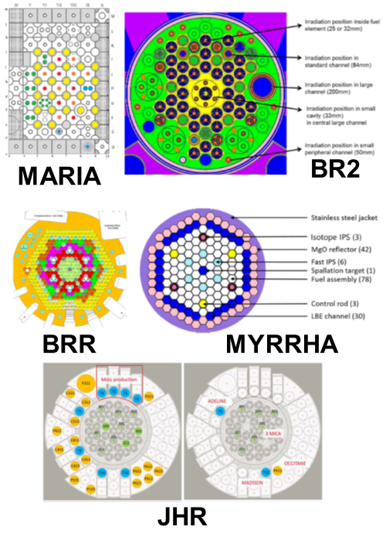
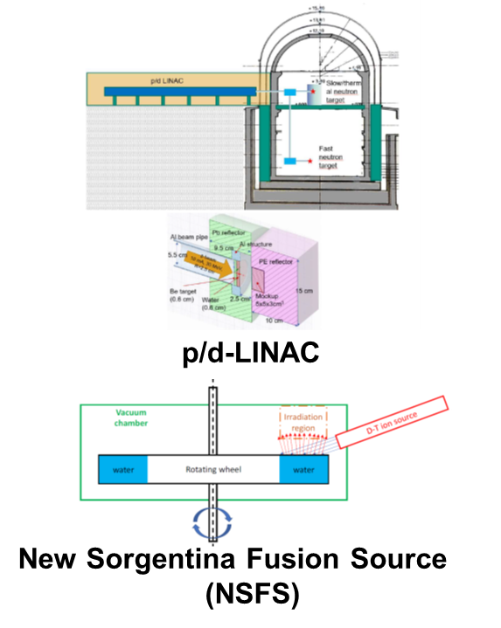
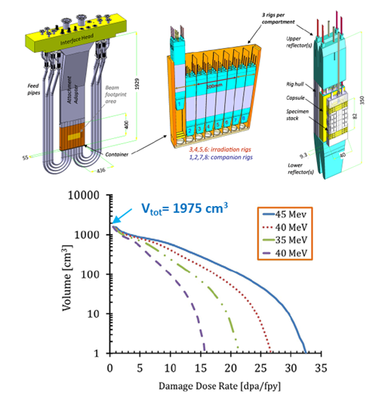
Facilities for nuclear (non-fusion) BB qualification
Theory/Modelling
Design Codes
Basic
Separate Effects
Multiple Interactions
Partially Integrated
Integrated
Component
Fusion Env. Exploration
Concept Screening
Performance Verification
Design Verification
Reliability Data
Property Measurement
Phenomena Exploration
Non-Fusion Facilities
BB
Qualification
Fusion-relevant Facilities
Material Testing Reactors (MTRs):
already available
material specimen irradiation
Φ_{thermal} < 1E15 n/cm²/s
3-18 dpa/fpy (Ø 25 – 86 mm)
p/d Accelerator-based Neutron Sources:
Available or available in 5 years (estimated)
Functional material specimen irradiation
Φ between 1E5 – 1E13 n/cm²/s
up to 0.1-5 dpa/fpy (V < 1 l)
Deuteron accelerator with liquid (e.g. Lithium) target (IFMIF-DONES):
available in 10 years (estimated)
material specimen irradiation
Φ < 1E15 n/cm²/s @ High-Flux Test Module (HFTM)
Up to 35 dpa/fpy (V < 2 l)
MTR
p/d acc.
DONES
Non-Nuclear testing facilities
Notes:
Ten we have the facilities for nuclear qualification, although still not necessary fusion-relevant.
Those are first the exiting material test reactors in EUROPE, like the BR2 reactor in Belgium, bagira in hungary or maria in Poland. They can achieve high neutron-fluxes, but the neutron spectrum is different from fusion. Then we have p/d neutron sources, with relevant neutron spectrum but limited fluence and volume, and finally the IFMIF-DONES facility under construction where we will have fusion-relevant spectrum, a high fluence to achieve blanket-relevant dpa levels in a short time, but still limited volumes and limited capability to test large-scale mock-ups.
With these facilities we are still limited to low TRLs.

Slide 11
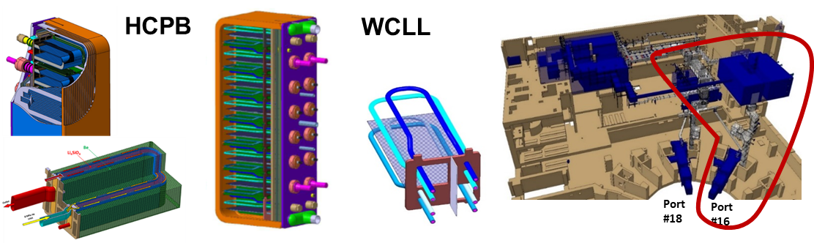
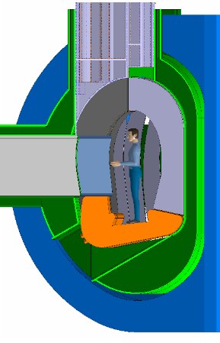
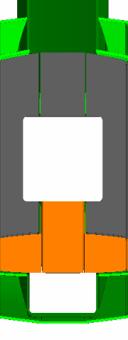
Facilities for nuclear (fusion relevant) BB qualification
Theory/Modelling
Design Codes
Basic
Separate Effects
Multiple Interactions
Partially Integrated
Integrated
Component
Fusion Env. Exploration
Concept Screening
Performance Verification
Design Verification
Reliability Data
Property Measurement
Phenomena Exploration
Non-Fusion Facilities
BB
Qualification
Fusion-relevant Facilities
Volumetric Neutron Source (VNS):
available in 15 years (estimated)
suitable for module and sector testing
Φ < 1E15 n/cm²/s
4-6 dpa/fpy (V from 0.8 m³ to tens of m³)
Conduct irradiation tests aiming at:
establishing acceptable blanket performance;
exploring coupled phenomena and unexpected synergistic effects;
identifying early life failure mode and rates;
MTR
p/d acc.
DONES
TBM
VNS
Non-Nuclear testing facilities
Notes:
In order to reach the higher TRLs and achieve the final blanket qualification, we need fusion-specific facilities to teste large-scale integrated mock-ups or full-segments are needed.
Those would be ITER and the corresponding TBM program, but especially the new Volumetric Neutron Source where we should be able to reach 5 dpa/year in a fully representative operational fusion environment

Slide 12
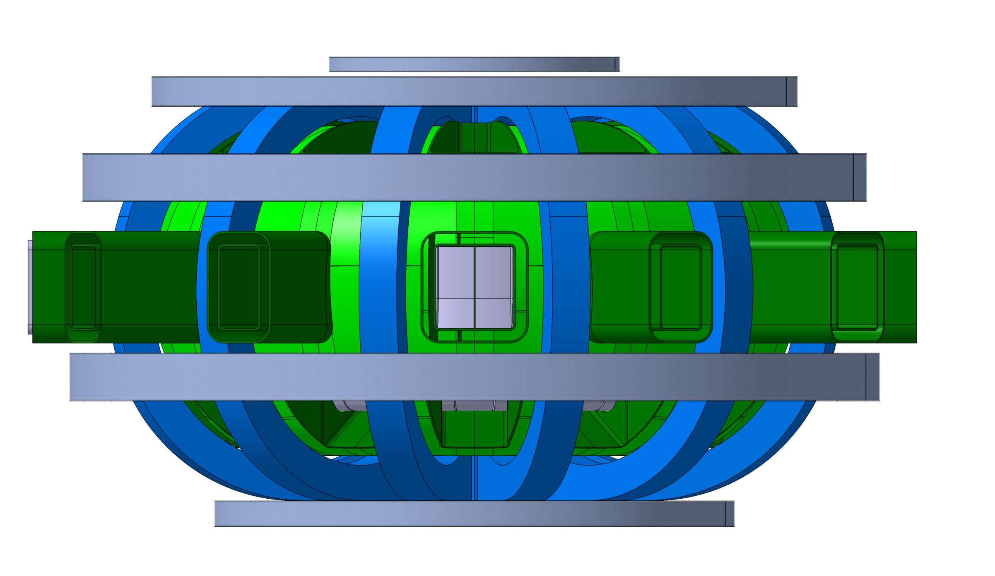
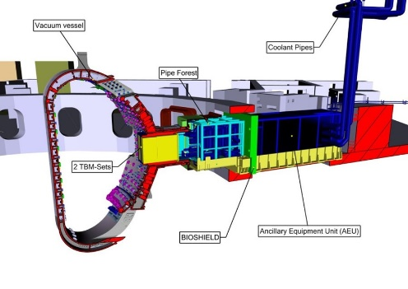
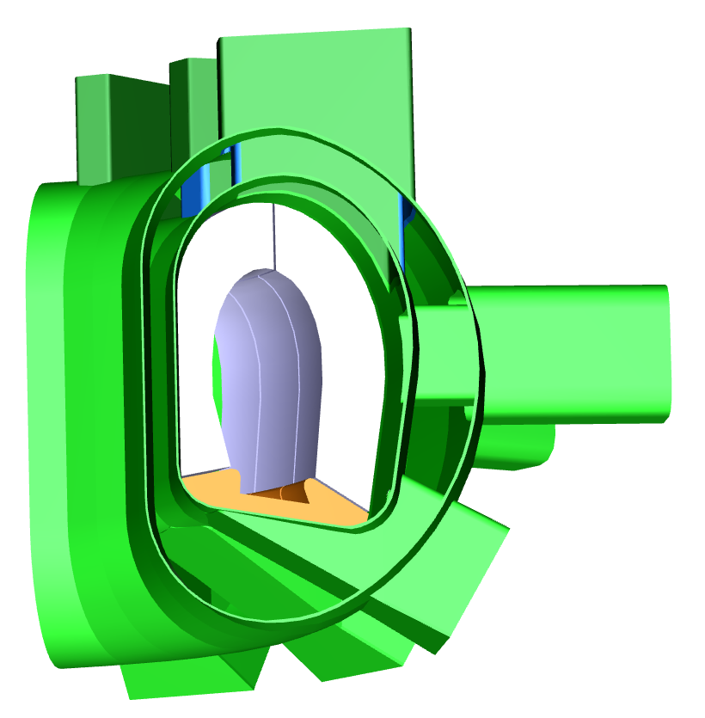
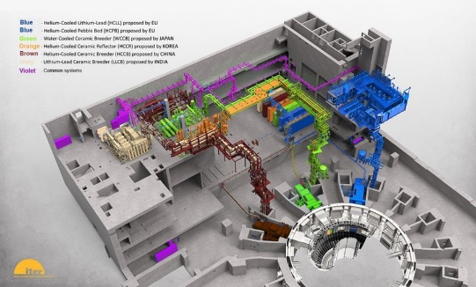
Blanket testing options in a VNS
TBM-ITER like
DEMO-BB like
Pro
More adherent to DEMO BB segments (poloidal distribution of NWL, remote maintenance, manufacturing & assembly, etc.)
Con
Higher risk associated to the testing (→ longer unavailability in case of failures)
Pros
Reduced risk for FUTURE in case of failure of the test (→ dummy used to replace the test)
Easily removable
Ancillaries systems integrated in port cell
Faster dose damage accumulation
Cons
Small volume (→ low T gen. rate)
Limited by the availability of the eq. ports
Not representative of DEMO BB geometry.
TBM Parameters (per port)
P_{therm} = ~710 kW
G_{t} = ~26 mg/d → ~9 g/fpy
< 5 dpa/fpy (max)
NWL_{max} = ~0.5 MW/m²
DEMO-like Parameters
1 segment | 1 sector (3 x segments)
P_{therm} = ~400 kW | P_{therm} = ~1.2 MW
G_{t} = ~71 mg/d → ~26 g/fpy | G_{t} = ~214 mg/d → ~79 g/fpy
< 3 dpa/fpy (average) | < 3 dpa/fpy (average)
NWL_{ave} = ~0.3 MW/m² | NWL_{ave} = ~0.3 MW/m²
If the whole OB is used as BB→ G_{t} = ~940 g/fpy
Assuming 15% cut-outs → G_{t} = ~800 g/fpy
Removing the OB nearby the NBI → G_{t} = ~530 g/fpy
Notes:
In VNS we will have the possibility to test TBMs as well as representative segments (not DEMO scale). Both have advantages and drawbacks.
TBM testing allow for reduced risk of failure (TBM inside the port), easy integration/maintenance and faster dose accumulation.
However it is not really representative of demo geometry and still limited in volume for example for if we want to test the tritium fuel cycle.
The testing of segment would instead allow to reproduce the conditions of DEMO, in a fully representative geometry with the same load distributions using manufacturing and maintenance sequences directly transferable to DEMO. It will also allow to test the performance of the auxiliary systems. But of course, the failure of a segment could have a considerable impact on the availability of the machine.
One other advantage is that tritium production would be non-negligible, contributing to the operation of the machine.

Slide 13
TBM-like vs. Segment – testing goals (TRL 6-8)
Goals for TBM testing
Goals for Segment testing
Detect unforeseen failures due to the abrupt changes of material properties at in early irradiation phase.
Detect early failures due to residual stresses introduced during manufacturing/effects of stress concentration in singular zones (ex. welds)
Validation of integrated operation of auxiliary systems
Validate nuclear data (cross sections) in a representative spatially varying neutron flux spectra (tritium production, transmutations, activation…)
Validation of modelling tools used for design (T permeation / T retention, MHD flows, pebble-bed thermo-mechanics, etc…)
Validation of corrosion laws.
Check for initial changes in DBTT, (position and temperature dependent)
Qualification of C&S w.r.t. DEMO relevant damage modes (also) in irradiated conditions (irradiation creep, creep-fatigue interaction, fatigue crack growth, swelling…)
Qualification of representative manufacturing and assembly techniques.
Collection of statistical data on failure modes/frequencies for reliability analyses.
Check for long term effects of n-irradiation on breeder/multiplier materials (irradiation creep, swelling, T burn-up factor, dust formation…)
Check for additional effects of swelling/He embrittlement/changes in DBTT that appear at higher doses
Qualification of performances of auxiliary systems (T extraction)
Check for long-term corrosion effects (IA-SCC, corrosion fatigue, thinning)
Validation of ACP codes and radioactive source terms.
“Limited” neutron fluence
“DEMO-level” neutron fluence
Notes:
Based on these considerations, we can define a sequential approach with different goals for TBM and Segment testing.
The first goal of the TBM would be to detect unknown phenomena and early failures due to fusion environment, In parallel we can validate the integrated operations of the auxiliary systems, and confirm the predictions of modelling tools. We can also check for additional degradation phenomena like changes in DBTT and corrosion laws under neutron-irradiation.
The goals for the segment testing are instead to qualify the operation of the blanket and the expected performance. In terms of qualification of C&S for design and manufacturing, collection of data for reliability analyses. Check for long-term irradiation effects like swelling, irradiation creep, t-burn-up factor, dust formation, He-embrittlement, etc. We could validate the performance of the auxiliary systems as well as codes for Activated Corrosion Products and calculation of radioactive source terms.
The consequences of this sequential approach is that TBM would be limited to low-fluences while in the segment testing we should go for DEMO-level neutron fluence.

Slide 14
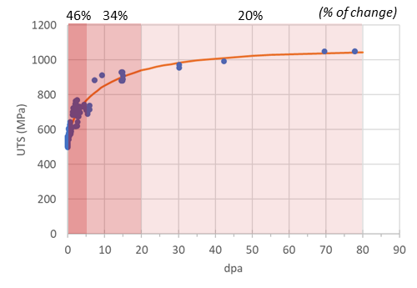
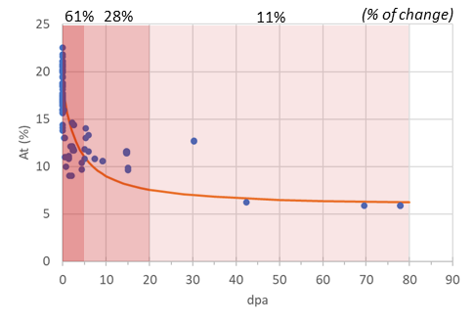
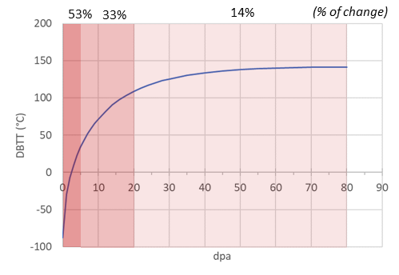
Determining TBM fluence target: approach (in progress)
Assessing unknown phenomena and detecting early failures is the main goal of TBM testing.
Those come (mostly) from the initial rapid change of material properties due to the fusion environment.
Example of EUROFER: change of selected material properties with irradiation
Ultimate tensile strength
Total elongation
Change of DBTT
For most properties, the change after ~5 dpa is ~50% of the total change at saturation.
5 dpa is proposed as target dose for testing of TBMs.
After 20 dpa, the change is >80% of the total change at saturation
20 dpa is proposed as (minimum) target dose for testing of whole segments.
The TBM fluence target can/will depend on the specific blanket concept
Notes:
How to determine the target TBM fluence?
Like said, assessing unknown phenomena and detect early failures is the main goal of TBM testing. Those come mostly from the initial rapid change of material properties due to the fusion environment.
Let’s consider the example of EUROFER and the effects of irradiation. The dark red zone represents 5 dpa, the red zone 20 dpa and the light-red 80 dpa, the limit for which we have data. These data show saturation, which a quite common situation with irradiation.
Now, what we can see is that For most properties, the change after ~5 dpa is ~50% of the total change at saturation.
5 dpa is proposed as target dose for testing of TBMs.
After 20 dpa, the change is ~80% of the total change at saturation
20 dpa is proposed as (minimum) target dose for testing of whole segments.
Of course this is a possible approach, it’s a choice. And the target will depend on the specific blanket concept.

Slide 15
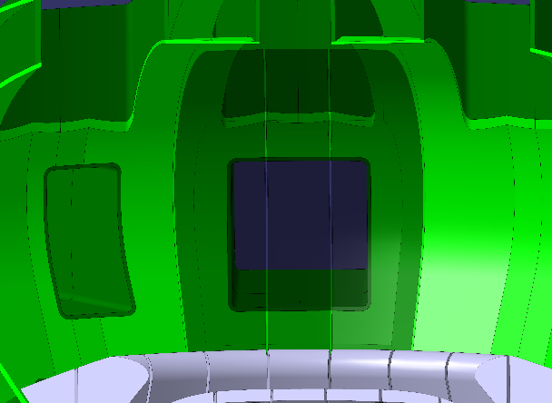
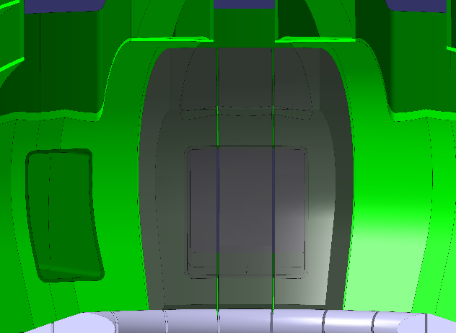
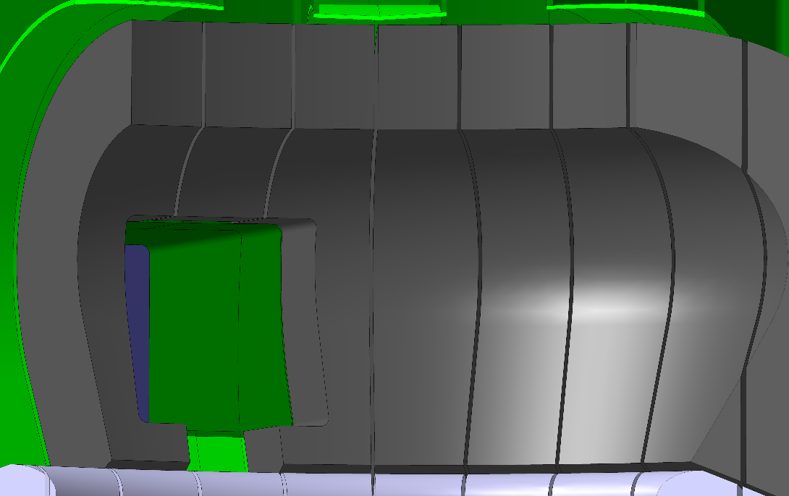
Testing approaches
3 x “TEST SECTORS”
1 TBM or 3 segments (mutually exclusive)
Test sectors can be dedicated to specific blanket concepts :
  Water cooled / 2 concepts up to 20 dpa
  Helium cooled / 2 concepts up to 20 dpa or 1 concept up to
  40-50 dpa
  Advanced concepts / TBD
Simplifies the engineering of the machine: all service pipes for BB concepts go through the equatorial port
Limits available space for testing.
Aaa
3 x TBM-like + sectors available in Outboard Blanket
Parallel testing of TBMs and corresponding blanket segments
Increases testing possibilities.
Potential for non-negligible tritium production (not self-sufficiency)
Strongly complicates the engineering of the machine: service pipes for all blanket types must be integrated at the design phase (or rebuilt).
Notes:
Now, where we want to test.
There are 2 possible approaches. One is to use “test sectors” where the TBM is replaced by 3 segments in the corresponding sectors. It limits the space available for testing, but simplifies considerably the engineering of the machine because all service pipes would go through the equatorial port.
The second approach is to use in parallel the equatorial ports for TBMs and the available outboard sectors of the machine for testing. This increases the test possibilities and has also potential for non-negligible tritium production. But it would strongly complicate the engineering of the machine because service pipes for all different blanket concepts will have to be installed since the beginning or rebuilt.

Slide 16
Conclusion
The BB and its ancillaries are first of a kind technologies that have never been built and tested.
To increase its TRL, it is imperative to prioritize the nuclear qualification of the BB in a fusion relevant environment.
The assessment of neutronic responses (e.g., activation and tritium production) can be carried out in currently accessible Materials Test Reactors or, in the future, in p/D accelerators and IFMIF/DONES, although there are limitations due to the different spectra and limited volume available for testing.
To assess multiple/integrated effects, larger volumes (i.e. prototypes) are needed on short time scales. For the moment, only the TBM might address this point. A VNS complements and reinforce these assessments.
With the successful establishment of this nuclear R&D program (e.g. MTR, p/D accelerator, IFMIF-DONES, ITER with TBM RoX, and a VNS), the next fusion device (i.e. DEMO) could potentially serve as a prototype power plant.

Slide 18






Neutron irradiation also affects Divertor operation
W
SAA CuCrZr
Change in thermo-physical properties
  Reduction of thermal conductivity (20%-30%) will lead to higher
  absolute temperatures as well as higher thermal gradients
Change in thermo-mechanical properties
  Hardening/softening, loss of ductility, embrittlement, shift
  of DBTT (W), will lead to higher stresses, lower capacity to
  accommodate deformation and potential change of failure modes
Dimensional instabilities (swelling)
  Critical for the copper interlayer, will add to thermal stresses,
  further reduce ductility and, above a certain limit (3% in steels),
  cause sudden failure by void coalescence and grain boundary
  decohesion
dose
W
CuCrZr
W
CuCrZr
Unirradiated
T_{test}=150°C
Irradiated 0.19 dpa
T_{test}=T_{irr}= 150°C
W/CuCrZr joint
No Cu interlayer
A VNS could also contribute to qualify the operation of the divertor in a DEMO relevant environment (heat and particle fluxes, temperatures, thermal gradients, neutron doses)
0.5%/dpa
Swelling rate

Slide 19


Challenges related to the breeding blanket
Changes in properties and behaviour of materials
Deformation and/or breach of components
  Effect of heat flux and cycling on fatigue or crack growth-related failure
  Magnetic forces within the structure (including disruptions)
  Premature failure at welds and discontinuities
  Failure due to hot spots
  Interaction of primary and secondary stresses and deformation
  Effect of swelling, creep and thermal gradients on stresses conc.
  Failure due to shutdown residual stresses
  Interaction between surface effects and first wall failures
Tritium permeation through the structure
  Effectiveness of tritium permeation barriers
  Effect of radiation on tritium permeation
Structural activation product inventory and volatility
Mechanical and materials interactions
  Corrosion
  Mechanical wear and fatigue from flow-induced vibrations
  Failure of coolant wall due to stress corrosion cracking
  Failure of coolant wall due to liquid-metal embrittlement
Thermal interactions
  Response to cooling system transients
  Flow sensitivity to dimensional changes
  Coolant/coatings/structure interactions
w/o neutrons
w/ neutrons
Fusion environment
Coolant/structure interactions
Structure
Tritium recovery and inventory in solid breeder materials
Liquid breeder tritium extraction
Temperature limits and variability in solid breeder material
Temperature limits
Thermal conductivity changes under irradiation
Effect of cracking
Effect of T mass transfer
Breeder behaviour at high burn-up/high dpa
Breeder and purge
Solid breeder mechanical and materials interactions
  Clad corrosion from breeder burn-up products
  Strain accommodation by creep and plastic flow
  Swelling driving force
  Stress concentrations at cracks and discontinuities
  Thermal expansion driving force
Neutron multiplier mechanical interactions
  Beryllium/beryllide swelling (swelling driving force in beryllium)
  Strain accommodation by creep in Beryllium/beryllide
  Mechanical integrity of unclad Beryllium/beryllide
Thermal interactions
  Breeder/multiplier-structure heat transfer (gap conductance)
Chemical reactions
Tritium inventory
Tritium trapping
Uncertainties in achievable breeding ratio
Uncertainties in required breeding ratio
Permeation from breeder/multiplier to blanket coolant
Failure modes and frequencies (i.e. low reliability & availability)
Nuclear heating rate predictions
Blanket response to near blanket failures
Assembly and fabrication of blankets
Recycling of irradiated lithium and beryllium
Prediction and control of radioactive effluent
Solid Breeder/multiplier/structure interactions
General blanket
MHD pressure drop and pressure stresses
MHD and geometric effects on flow distribution
MHD insulating coating fabrication, integrity and in-situ self-healing
Stability/kinetics of tritium oxidation in the coolant
Helium bubble formation leading to hot spots
Coolant/purge steam containment and leakage
Activation products in PbLi
Liquid-metal purification
Coolant/liquid breeder-mult.
M. A. Abdou, et al, (1985) A Study of the Issues and Experiments for Fusion Nuclear Technology, Fusion Technology, 8:3, 2595-2645, DOI: 10.13182/FST85-A24685

Slide 20


Issues related to the BB
Ideal sequence of plasma operation and scheduled maintenance periods during the first DEMO operating phase
Low reliability & availability
The DEMO targets are:
  Operational Availability (OA), as the proportion of time the system is running with respect to the total system lifetime
    OA = ∑ Up times / Total time = 30% (i.e. 7430 h / 24768 h )
  Inherent Availability (IA), as the proportion of time the system is running with respect to the time the system is running plus the time the system is shut down due to failures (time for corrective maintenance)
    IA = ∑ Up times / (Total time – PM Time) = 48% (i.e. 7430 h / ( 24768 h – 9144 h))
The BB system affect largely the DEMO availability targets → large number of components that can fail.
The most critical components of the breeding blanket are the welds sealing against in-box coolant leak and the welds sealing against the in-VV coolant leak.
In the 3 years of the first operating phase:
Plasma operation 15,624 h
Preventive maintenance 9,144 h
Total 24,768 h
 | HCPB | WCLL | WCLL-db (opt) | WCLL-db (cons) | WLCB
Welds in BB sealing against in-box coolant leak | ~ 416016 | ~427712 | ~99248 | ~198496 | ~17312 (Cooling Plate)
T. Pinna, et al., Approach in improving reliability of DEMO, Fusion Engineering and Design, Volume 161, 2020, 111937, doi.org/10.1016/j.fusengdes.2020.111937.

Slide 21
Breeding blanket qualification needs
1) Heat Transfer Experiments
2) Breeder/Structure Thermo-Mechanical Interactions
3) Neutronics Prediction Validation
4) Tritium Permeation
5) Tritium behavior in thermal and flow transients
  Testing Scenario:
  Utilize small blanket unit cells as test assemblies to address heat transfer issues.
  Focus on empirically studying heat transfer within realistic breeder blanket (BB) geometries.
  Consider the possibility of multi-cell experiments, especially when conducted alongside tritium recovery experiments.
  Evaluate the long-term performance of the assembly, considering both MOL (Middle of Life) and EOL (End of Life) conditions.
  Reproduction of Conditions:
  Neutrons are crucial for bulk heating and radiation effects on heat transfer.
  Replicate the exact geometry, including breeder microstructure and surface roughness.
  Match mechanical boundary stress, coolant and tritium carrier temperature, pressure, velocity, power density, and t carrier chemistry to reproduce required environmental conditions.
  First Set of Tests (BOL - Beginning of Life):
    Measure temperature changes.
    Assess stress levels.
    Conduct post-test examination for gap size analysis, detection of cracks, evaluation of sintering or settling, examination of swelling, other changes).
  Second Set of Tests (MOL/EOL - Middle of Life/End of Life):
  Account for radiation-induced thermal conductivity changes.
  Study the impact of radiation on temperature profiles.
  Analyze swelling, radiation-induced creep, and sintering, among other effects.
  Reproduction of Conditions:
  Replicate temperature conditions.
  Emulate coolant and purge pressure.
  Neutrons are crucial to recreate bulk heating conditions and irradiation effects.
  Replicate BB geometry.
  Simulate cycling using a BB submodule.
  Testing Scenario:
  Confirm predictions for tritium breeding and nuclear heating.
  Verify predictions for induced activation.
  Multiple tests may be required to achieve the necessary accuracy.
  Post-Test Examinations:
  Measure activation levels.
  Assess tritium inventory.
  Determine neutron fluence.
  Reproduction of Conditions:
  Use of fusion spectra in the testing process.
  Replicate similar geometries with mock-ups.
  Emulate the local neutron field.
Testing Scenario:
  Assess tritium permeation rates into the coolant.
  Perform tests under actual geometry and operating conditions.
  Measure tritium activity within the tritium carrier.
  Monitor pressure variations in the system.
  Analyze the tritium form.
  Evaluate the surface conditions of the clad material.
  Utilize Post-Irradiation Examination (PIE) techniques to determine surface conditions.
  Reproduction of Conditions:
  Use neutrons to provide the tritium and heat source distribution.
  Replicate breeder temperature conditions.
  Emulate coolant conditions.
  Testing Scenario:
  Examine the behavior of tritium inventory within breeder unit cells.
  Investigate tritium responses under thermal or flow transient conditions.
  Measure the temperatures of both the breeder material and coolant.
  Monitor activity levels in the coolant and tritium carrier.
  Conduct post-test examinations to assess tritium inventory, cracking or other changes.
  Reproduction of Conditions:
  Emulate coolant conditions, including flow and temperature.
  Match tritium carrier conditions, including temperature, tritium partial pressure, and impurities.
  Maintain a similar geometry for the testing setup.
M. A. Abdou, et al, (1984) FINESSE: A Study of the Issues, Experiments and Facilities for Fusion Nuclear Technology Research and Development, UCLA-ENG--84-30-Vol.2, https://doi.org/10.2172/5507921
Increased size of the testing

Slide 22
Breeding blanket qualification needs
6) Submodule Thermomechanical Verification
7) Full-Module Thermal and Corrosion Testing
8) Blanket Response to Coolant Transients
9) Tritium Recovery Assessment
10) Module Lifetime Verification
  Testing Scenario:
  Validate the thermomechanical design through testing.
  Subject a section of a sub-module to stress conditions similar to those encountered in an operating blanket.
  Measure temperature variations within the module.
  Assess stress levels experienced by the module.
  Conduct post-test examination for signs of cracks, deformation, any other visible changes in the module's structure.
  Reproduction of Conditions:
  Employ neutrons as a source of heating and to induce specific reactions within the module (i.e. material damage).
  Replicate temperature gradients.
  Emulate other loads (e.g. pressure, EM, etc.)
  - BOL Performance Testing:
  Address uncertainties stemming from unexpected design-specific synergies.
  Deal with challenges related to the poor modeling of precise module geometry.
  - MOL Performance Testing:
  Account for the extended operation of the blanket.
  Address uncertainties arising from nuclear and non-nuclear effects during prolonged operation.
  - EOL Performance Testing:
  Determine which effects are likely to be life-limiting for the blanket in its end-of-life phase.
  Reproduction of Conditions:
  Fusion spectrum is critical to replicate the appropriate conditions.
  Ensure that all other environmental aspects are present during testing.
  Testing Scenario:
  Simulate critical incidents to assess the module's response under adverse conditions.
  Subject a full or almost full module to scenarios involving loss of flow or loss of coolant.
  Measure temperature variations within the module.
  Monitor stress levels experienced by the module.
  Record coolant pressure and flow rate during the scenario.
  Conduct a thorough examination of the module after the scenario.
  Look for any signs of deformation or failure in the module's structure.
  Reproduction of Conditions:
  Neutrons play a crucial role in simulating volumetric heat generation rates in a fusion reactor.
  Implement a magnetic field to accurately simulate system transients during the testing process.
  Ensure that all other environmental aspects are present during testing.
  Testing Scenario:
  Conduct in-situ tritium activity measurements in tritium carrier and coolant streams.
  Perform post-test tritium assays to determine the location and magnitude of the tritium inventory.
  Reproduction of Conditions:
  Neutrons play a crucial role in producing tritium, inducing damage and swelling in solid breeder materials and structures, generating heat within the blanket module.
  The fusion spectrum is highly important for integrated testing.
  Ensure that all other environmental aspects are present (tritium transport mechanisms, coolant flow, temperatures, etc.).
  Testing Scenario:
  Conduct comprehensive tests on the full module.
  Focus on identifying structural failure modes.
  Measure local temperatures and stresses within the module.
  After testing, perform a thorough post-test examination to determine the root causes of any observed failures or issues.
  Reproduction of Conditions:
  Neutrons are vital because they serve as a heating source, induce specific reactions within the module and cause significant damage, affecting structural integrity.
  Reproduce similar temperature gradients and stress fields.
  Ensure the neutron spectrum is accurately tuned.
  Include surface heat flux in testing.
  Reproduce plasma interactions in the testing environment.
M. A. Abdou, et al, (1984) FINESSE: A Study of the Issues, Experiments and Facilities for Fusion Nuclear Technology Research and Development, UCLA-ENG--84-30-Vol.2, https://doi.org/10.2172/5507921
Increased size of the testing

Slide 23












Breeding Blanket Qualification Needs: ongoing R&D efforts
General blanket: Fabrication of (functional material) tritium breeding ceramics in pebble form
KArlsruhe Lithium OrthoSilicate UPgrade (KALOS-UP)
The facility uses a melt-based process to produce Advanced Ceramic Breeder (ACB) pebbles. The major interesting points are:
the KALOS-UP facility is the only European facility to produce ceramic breeder pebbles
the semi-continuously operating facility will be able to cover any needs for breeder blanket mock-ups and the ITER TBMs in the coming years
in view of DEMO and beyond, this facility will demonstrate the transferability to a large-scale production of ACB
provision of ACB pebbles for the DEMO blanket qualification in all accelerator driven neutron sources available along the timeline
demonstration of ability to use the facility for direct reprocessing and lithium replenishment of used pebbles (long term perspective)
O. Leys et al, (2019) Ceramic Pebble Production from the Break-Up of a Molten Laminar Jet, Oral Presentation, ILASS–Europe 2019
Lithium orthosilicate pebbles with 35 mol% lithium metatitanate
Continuous operation by the end of 2024
KALOS-UP Input Data for the EUROfusion Facility Review, 2023

Slide 24



Breeding Blanket Qualification Needs: ongoing R&D efforts
Coolant/structure: thermal interactions
Helium Loop Karlsruhe (HELOKA)
WATER LOOP (WL)
HELOKA is a test facility comprising several experimental loops using high pressure, high temperature helium as coolant and a High Heat Flux (HHF) test rig
WL as a part of the W-HYDRA platform (ENEA-Brasimone) is a large/medium scale water coolant plant that will provide water coolant at high pressure and temperature allowing multi-purpose experiments
Executive design and Procurement phases ongoing
A. Abou-Sena et al, (2022) Experimental Thermal–Hydraulic Testing of a Mock-Up of the Fuel-Breeder Pin Concept for the EU-DEMO HCPB Breeding Blanket, J. Nucl. Eng. 2023, 4, 11–27, DOI: 10.3390/jne4010002
Validation of single-effect phenomena in key BB elements:
heat transfer in DEMO BB relevant geometries
functional and pre-manufacturing qualification (HHF + code validation)
development and validation of predictive tools (extension of benchmark database)
qualification of flow distribution and design robustness against uncertainties as well as operational procedures
preliminary assessment of structural/functional/coolant interactions
Water Loop (WL) Input Data for the EUROfusion Facility Review, 2023

Slide 25



Breeding Blanket Qualification Needs: ongoing R&D efforts
P4D1: Leo Bühler
Coolant/liquid breeder-multiplier interactions: liquid metal magnetohydrodynamics (MHD)
Magnetohydrodynamic Experiments in NaK Karlsruhe (MEKKA)
Magnetohydrodynamic PbLi Experiment (MaPLE)
MEKKA uses NaK as a surrogate liquid metal: it enables experiments to be performed at room temperature (MP: -12 °C)
MaPLE uses prototypical eutectic PbLi (MP: 235 °C) at 300°C and enables experiments with combined MHD and buoyancy effects
Commissioning by the end of 2023
MEKKA Input Data for the EUROfusion Facility Review, 2023
MEKKA and MaPLE are unique and complementary facilities for addressing MHD challenges for liquid metal BB
Fundamental experiments will be performed in generic geometries for:
  improving the understanding of coupled multiphysics phenomena
  provide insight for designers of liquid metal blankets
Development and validation of predictive tools (extension of benchmark database)
Validation of design concepts of liquid metal blankets (mock-up tests)
MaPLE Input Data for the EUROfusion Facility Review, 2023
C. Mistrangelo et al, (2023) Magneto-convective flows around two differentially heated cylinders, Heat and Mass Transfer, DOI:10.1007/s00231-023-03350-2
C. Mistrangelo et al, (2021) MHD R&D Activities for Liquid Metal Blankets, Energies, 1996-1073, DOI:10.3390/en14206640

Slide 26



Breeding Blanket Qualification Needs: ongoing R&D efforts
P1A3: Thomas R. Barrett
Coolant/liquid breeder-multiplier interactions: Heat Flux, MHD and EM effects
The Combined Heating and Magnetic Research Apparatus (CHIMERA) fusion technology test facility is under construction, and it will be capable of multiple effects/partially integrated testing of fusion component modules up to the size of the ITER Test Blanket Module box, under independent or combined conditions of in-vacuum high heat flux, static and pulsed magnetic fields, and high temperature/pressure (PWR-like) water cooling
The capacity to perform high heat flux testing at component scale, with integrated magnetic fields will allow:
testing and verification of diagnostics and equipment within magnetic fields where EM loads along with thermal and mechanical loads can be evaluated to verify comparisons with models and for design verification
Commissioning by the end of 2025
Component test module
4m high magnetic shield wall
Water cooling and vacuum plant room
Test mock-up preparation stand
CHIMERA device
Pulsed magnetic field coils
20 tonne crane
DC Power Supplies and HVAC
Surface heating system (@0.5MW/m²)
Aerial isometric view (computer-aided design) above the CHIMERA facility
T. R. Barrett et al, (2023) CHIMERA Fusion Technology Facility: Testing and Virtual Qualification, Fusion Science and Technology, DOI: 10.1080/15361055.2022.2147766
Vertical cross section showing illustration of the SC magnet field lines coloured by magnetic flux density

Slide 27



Testing approaches
Stage 1 - low dpa (4-6dpa)
Stage 2 - high dpa (>20 dpa)
TBM-ITER like
DEMO-BB like
Option 1
Testing of:
  different BB concepts
  BB sub-modules
  DIV & LIM mock-ups
  …
Easily removable
Ancillaries syst. within port cell
X_{sector}
Option 1A
Testing as Option1 with higher testing surface but remote handling of the lateral modules more complex
Ancillaries systems within port cell
Splitting of shielding blanket
X_{sector}
Y_{segment}
X_{sector}
Option 1B
Combination of Option1/1A plus the possibility to use the Upper Port
X_{sector}

