Slide 1
VNS physics basis and scenario
19/03/2024 EU- China 4th Technical Exchange Meeting
M. Siccinio
with contributions of E. Acampora, R. Ambrosino, C. Bourdelle, V. Di Marzo, E. Fable, F. Maviglia, G. Pautasso, L. Pigatto, E. Poli, A. Snicker, D. van Eester, P. Vincenzi, S. Wiesen

Slide 2
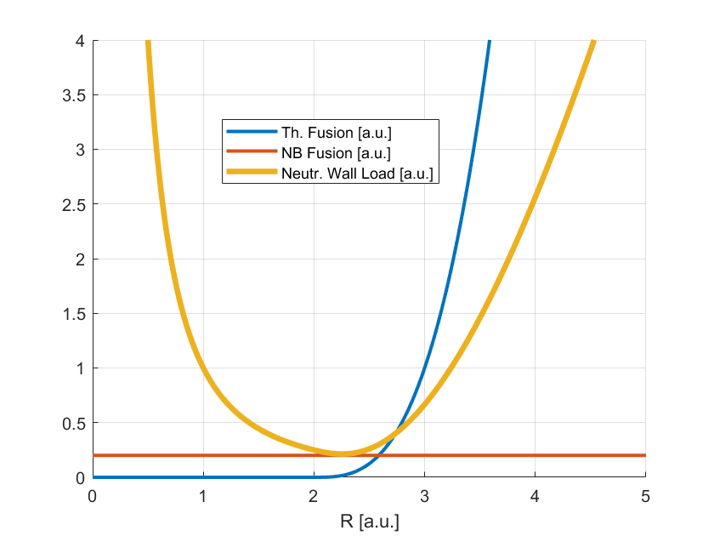
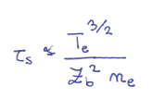
VNS Physics Basis
$$NWL=\frac{0.8×P_{fus}}{S}$$
The device should be a 14 MeV neutron source with a peak NWL of at least ~ 0.5 MW/m²
The only way to keep the machine size low is to rely on beam-target fusion reaction.
Beams are also employed to drive the plasma current. No space for a large CS!
The JET record shot is actually an example for such a plasma, but NWL would be too small (factor 5-10).
Necessity of high power installed.
The neutron rate is (at zeroth order) independent on the plasma density! However, it goes like Te^{3/2}. Additional EC electron heating is foreseen.
Technological
Constraints
$$P_{fus}∝R^{3}$$
Too big size/costs and T consumption
Competition between performance (NWL) and stability ($β_{N})$.
Knobs: Aspect Ratio A and Magnetic Field Strength B
$$NWL∝1/{R^{2}}$$
$NWL∝$R

Slide 3
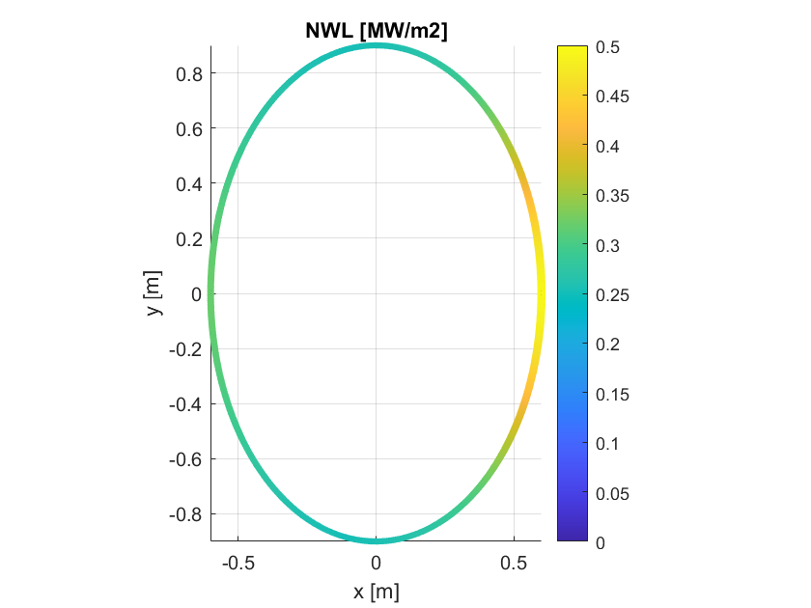
Identified design point (METIS)
Data: M. Siccinio
INPUT:
Major Radius = 2.53 m
Toroidal Field = 5.4 T
Aspect Ratio = 4.6
Sep. Elongation = 1.5
NBI Power = 42.5 MW
Beam Energy = 120 keV
EC Power = 10 MW
Safety Factor q95 = 3.0524
Line average density = 11e19m^{-3}
Greenwald Fraction (output) = 0.59522
W conc. average = 9.987e-06
RESULTS:
Peak NWL = 0.49249 MW/m2
Av. NWL = 0.30399 MW/m2
BetaN = 3.3455 %Tm/MA
Fusion Power = 29.0285 MW
Centr. El. Temperature = 12.0848 keV
Pl. Current = 1.7563 MA
Th. Beta Poloidal = 1.6027
Tot. Beta Poloidal = 2.569
Norm. Shafranov Shift (estimate) = 0.23253
Internal Inductance li3 = 0.75774
Loop Voltage = -9.3641 mV
D Fraction in Bulk Plasma = 0.20262
Power to Divertor = 53.3318 MW
M. Siccinio | WPDES End of Year Meeting | December 14th-15th, 2023| Page 3

Slide 4
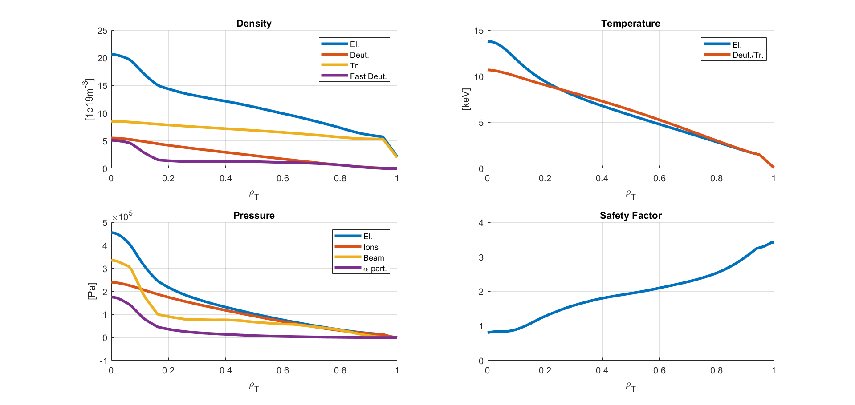
ASTRA Profiles
Data: E. Fable
Relevant kinetic profiles have been calculated with the code ASTRA.
VNS is characterized by a significant pressure gradient in the centre, due to the beam injection.
Electrons are the mostly heated species. This is of course desirable.
Flat-q profile. ST volume extremely reduced.
W-transport is expected to play a significant role, especially because of the high rotation.
This still has to be consistently explored.

Slide 5
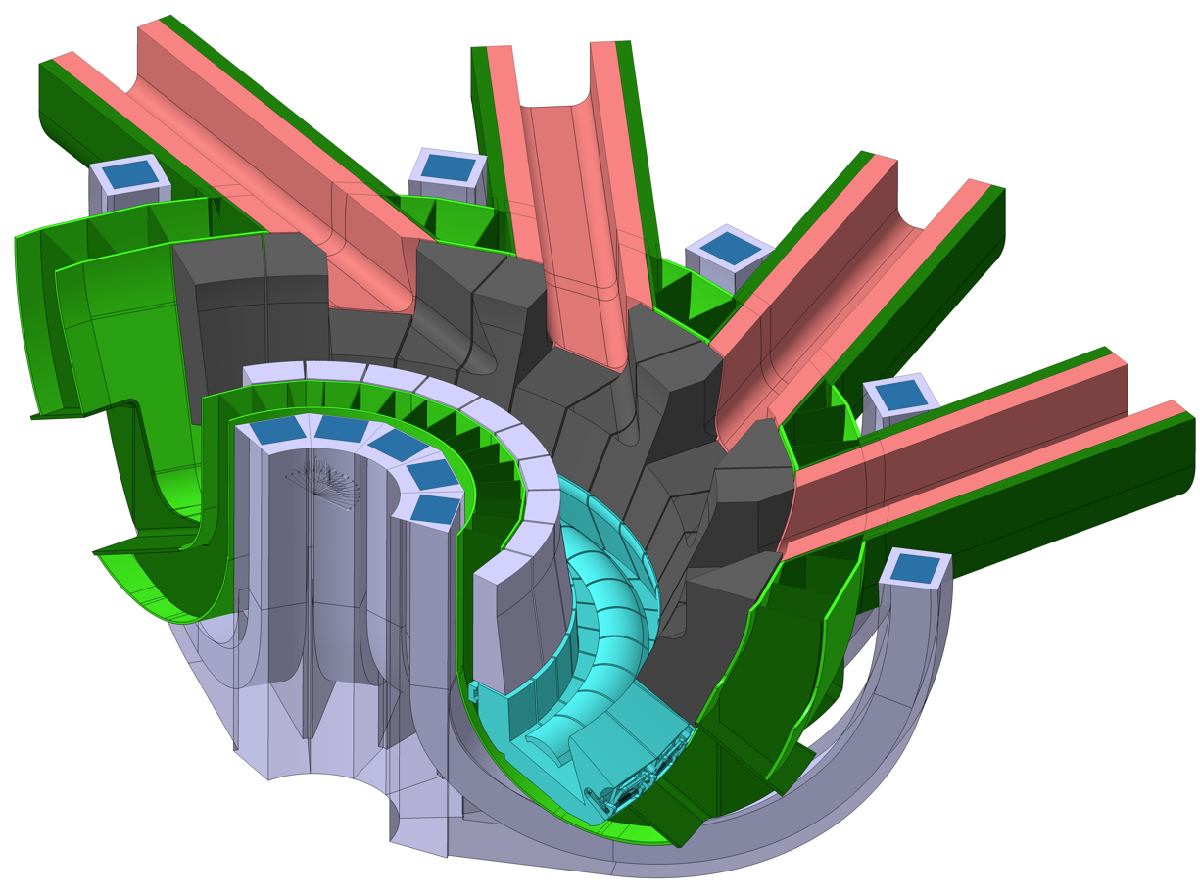
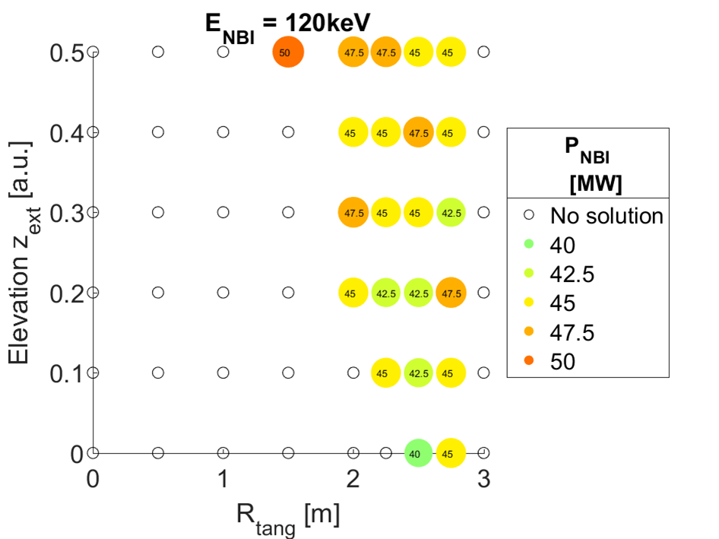
NB configuration, 42 MW, 120 keV
Data: P. Vincenzi, Ch. Bachmann
12 TF coils allow the integration of an ITER-like NB duct in-between TF coils.
Optimization study finds the beam should target the midplane tangential to the major radius.
Blanket
NB duct liner
TF coil
MHD-related considerations may however lead to a revision (see later on).

Slide 6
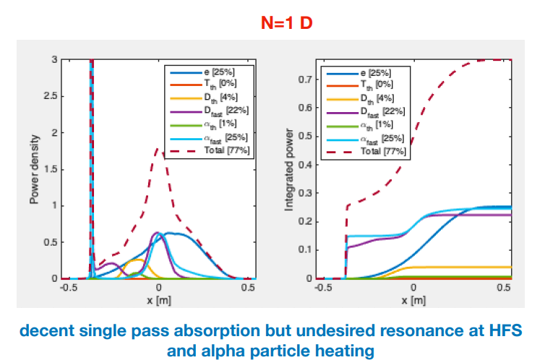
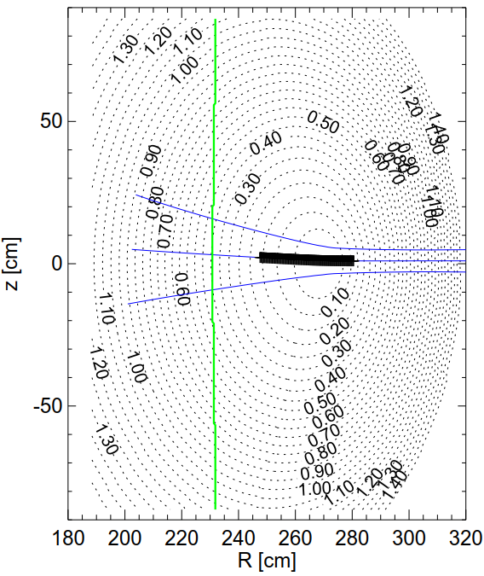
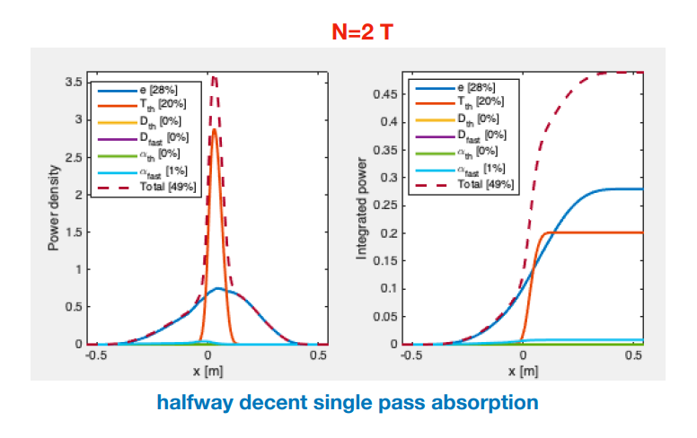
Electron cyclotron and ion cyclotron
Ion cyclotron (IC) is instead not foreseen in the VNS baseline.
VNS is equipped with 42 MW of NB and also with 10 MW of electron cyclotron (EC).
Main functions of EC:
Heat the electrons in the centre to boost $P_{fus}$
Drive plasma current (if needed)
Control of W accumulation (central heating)
Stabilise NTM ($q=2$ and $q=3/2$)
Equatorial injection:; maximum ECCD 41.5 kA/MW for frequency 164 GHz and toroidal injection angle 30°.
Top injection (no baseline): maximum ECCD 46.3 kA/MW for frequency 172 GHz.
Using criterion j_{CD} > 1.2 j_{bs} [Zohm 07] gives a power required for NTM suppression of ca. 6 MW for q=2 and 2 MW for q=3/2.
The idea (JET-like) of boosting fusion power via IC heating of beam particles is not viable in VNS!
Reason: D-ions have the same resonance as alpha particles
2 T heating still usable for e-heating (second harmonic more effective than first in single pass absorption, f = 60 MHz)
Data: E. Poli, D. Van Eester

Slide 7
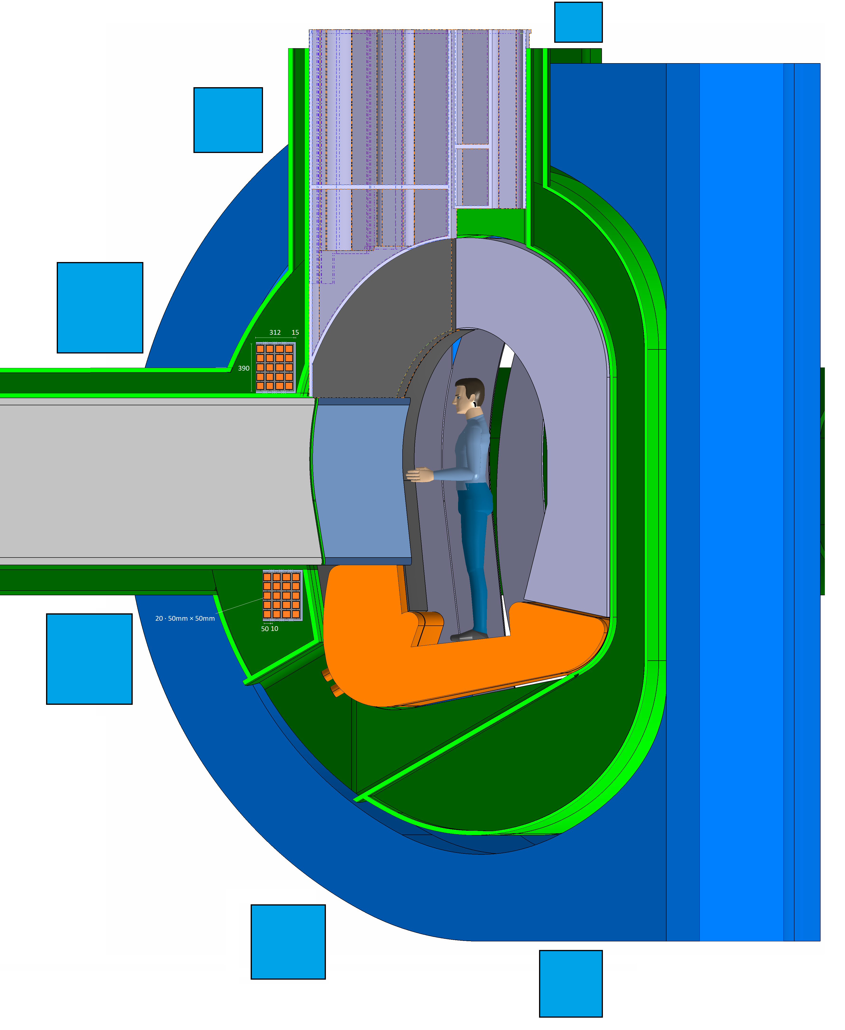
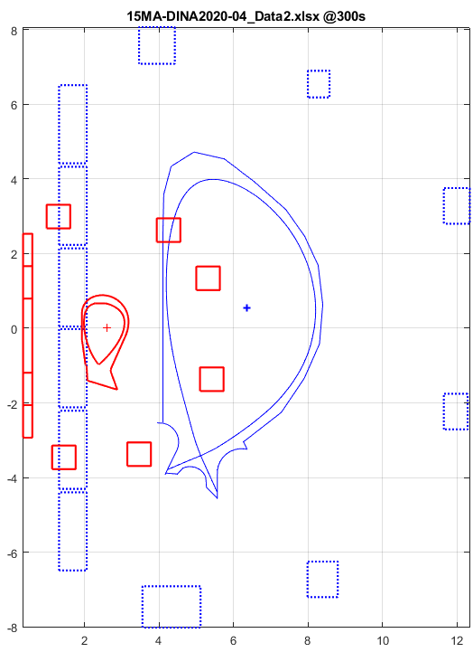
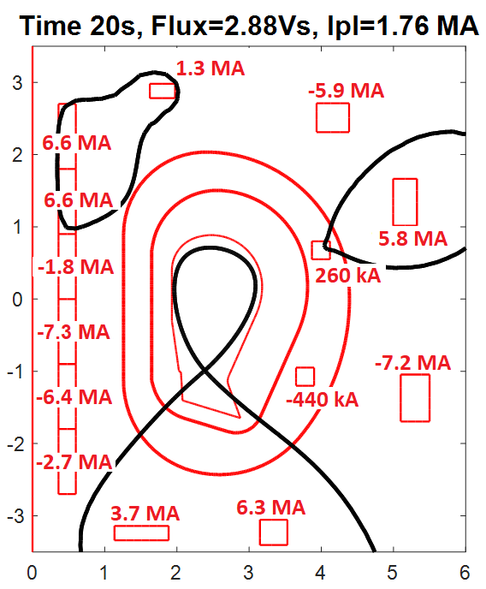
Plasma equilibrium
Data: R. Ambrosino, F. Maviglia
High equilibrium currents in PF coils
(~7 MA/coil) to control I_{p} = 1.76 MA.
This is due to the large distance of the PF from the (tiny) plasma.
For plasma equilibrium and control additional copper coils could be required closer to the plasma (see Ch. Bachmann’s presentation)
A significant role to obtain the equilibrium is played by the CS.
Strong reduction of the available flux for the current ramp-up.
ITER
VNS
≈3.8m
≈2.1m
≈5.74m
Cu-coils
≈2.6m
Ratio distance (plasma boundary↔coils)/ (plasma core↔coils) smaller in VNS (e.g. ≈2.6/2.1, v.s. 5.7/3.8 in ITER): coils “see” plasma more like a point from afar, with less dof. to control the shape.

Slide 8
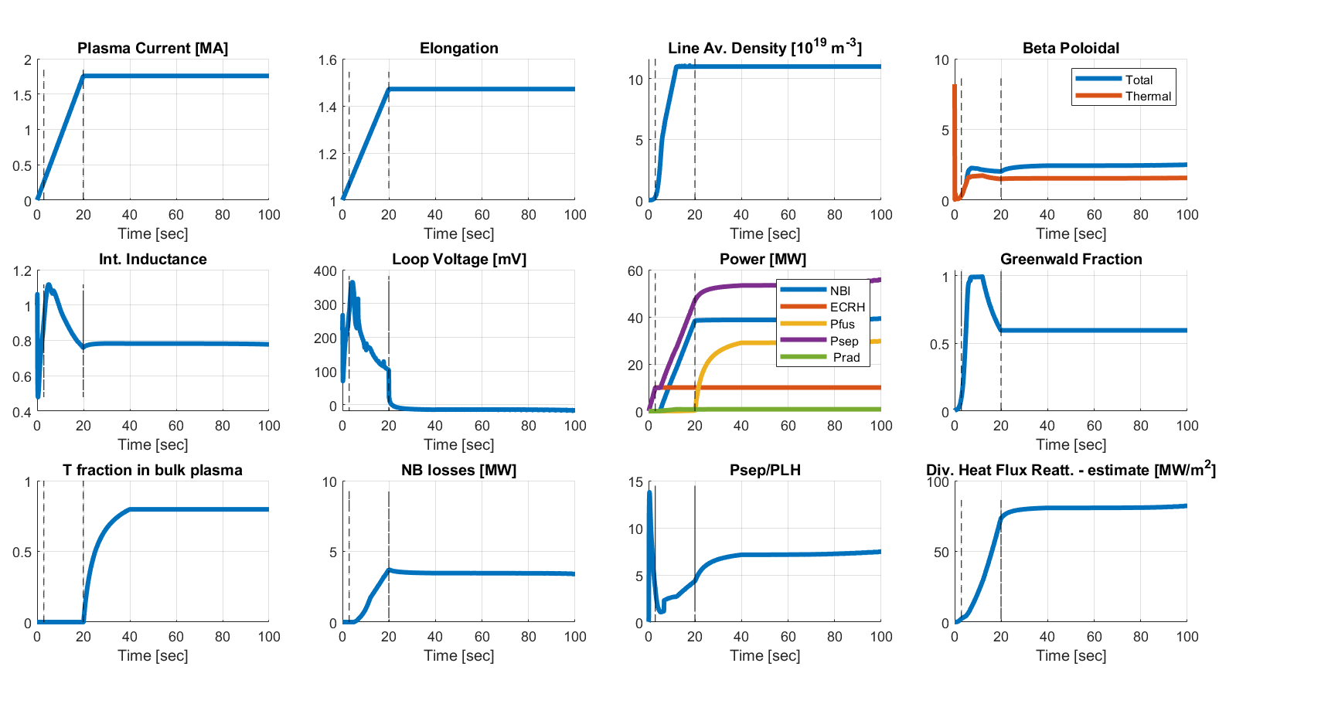
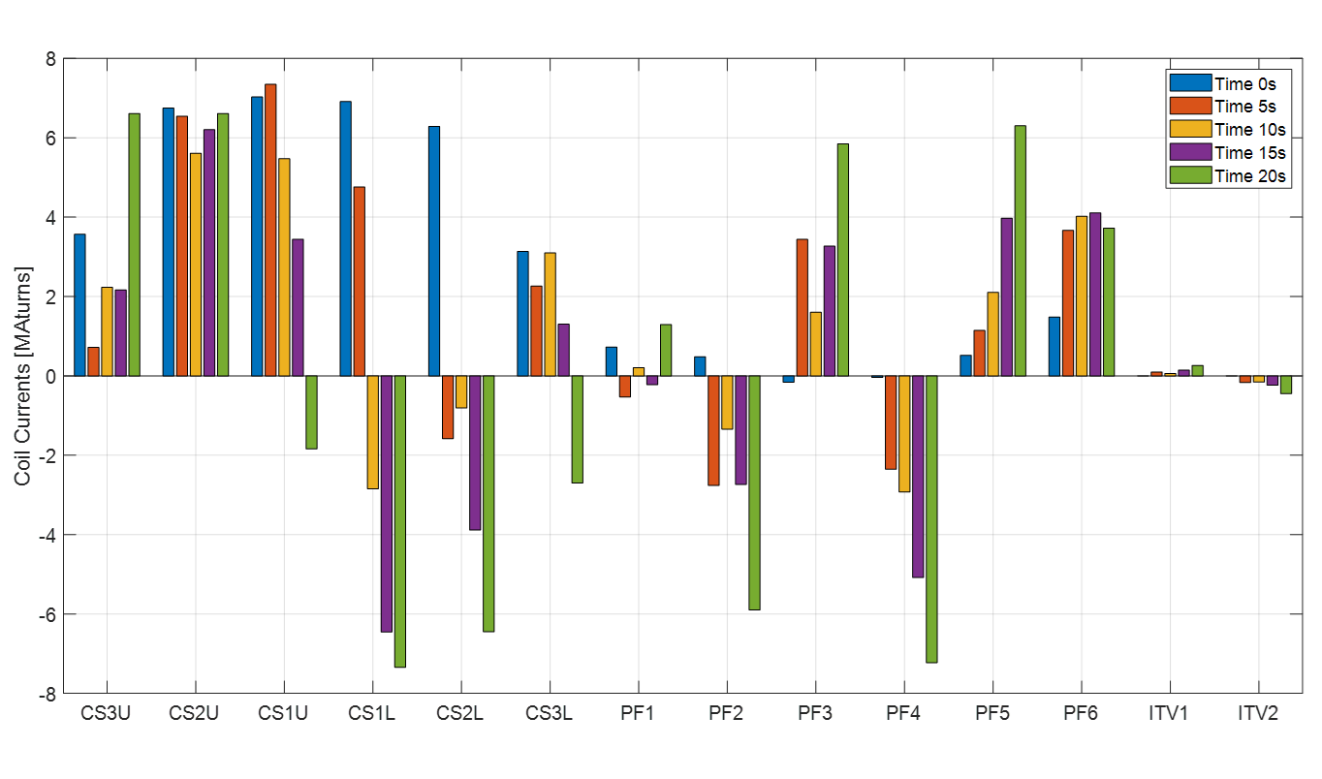
Ramp-up scenario
Definition of RU-trajectory
Current ramp quite slow (20 sec, 0.08 MA/sec), same for elongation. Maximize controllability!
Density ramp in 15 sec (reduces NB losses and $β_{pol}$), but within Greenwald limit.
EC ramp in 3 sec (for W and to reduce resistivity)
NB ramp in 15 sec but starting from t = 5 sec (to avoid shine through)
Smooth trajectories in $β_{pol}$ and $l_{i}$, acceptable NB losses and divertor flux.
From the magnetic point of view, this trajectory looks marginal but feasible.
Flux Consumption: 3.7 Wb
Heat loads on FW during limiter phase still to be assessed
Data: R. Ambrosino, M. Siccinio

Slide 9
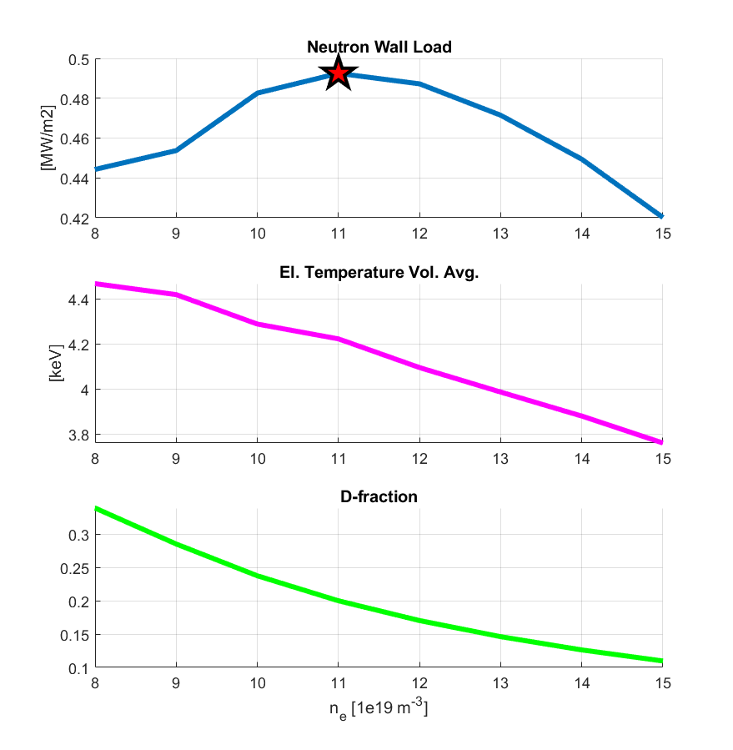
Density optimisation
At zeroth order, the fusion power (or the NWL) is independent on the background plasma density.
In reality, there is a non-monotonic dependence. The current VNS design point has been chosen in correspondence of the maximum.
At too low density, the D-dilution in the T plasma becomes strong (the D source is NB -> fixed).
At too high density, the electron temperature drops, negatively impacting the beam slowing-down time.
The VNS density value may still be adjusted in view of power exhaust-related considerations (see S. Wiesen – next talk).
Data: M. Siccinio

Slide 10
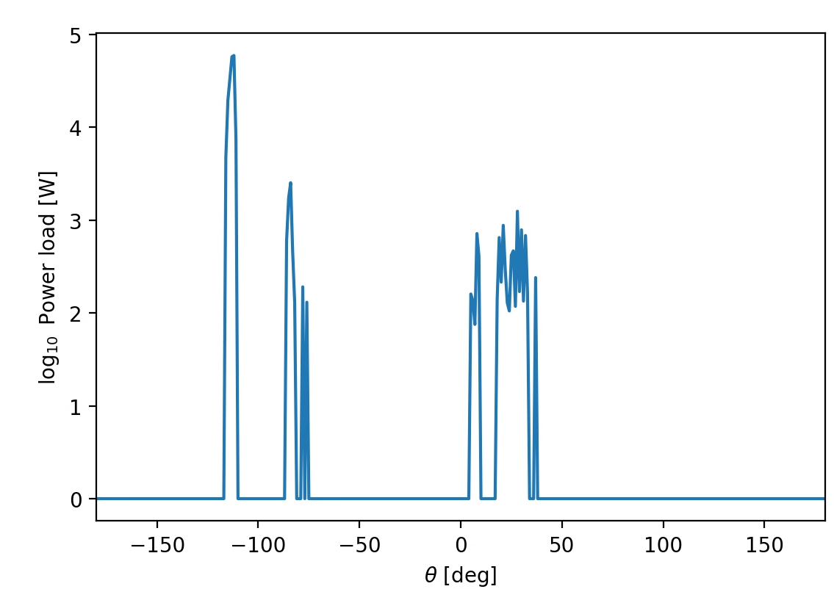
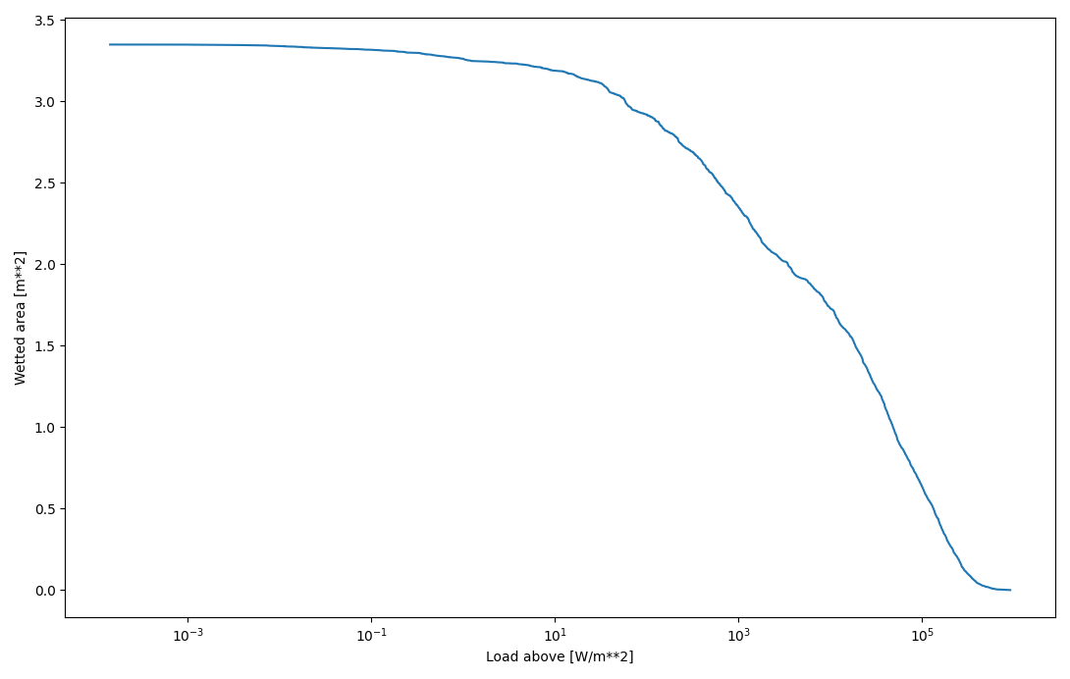
Wall loads
Data: A. Snicker
NB particles
Steady-state wall loads:
Fast particle losses were found uncritical by ASCOT simulations.
Beam particles well confined (losses below 2%)
Alpha particle less confined (losses ~10%, no hot spots detected)
α-particles
Transient wall loads
A detailed analysis of the transient heat loads on the FW (ramps/disruptions) is not foreseen in this feasibility study.
However, the plasma energy content is low (~ 3 MJ).
No major issues expected regarding transient heat loads.
Electromagnetic loads may instead be more problematic – see
Ch. Bachmann
Wetted Area [m²]
Load above [W/m²]

Slide 11
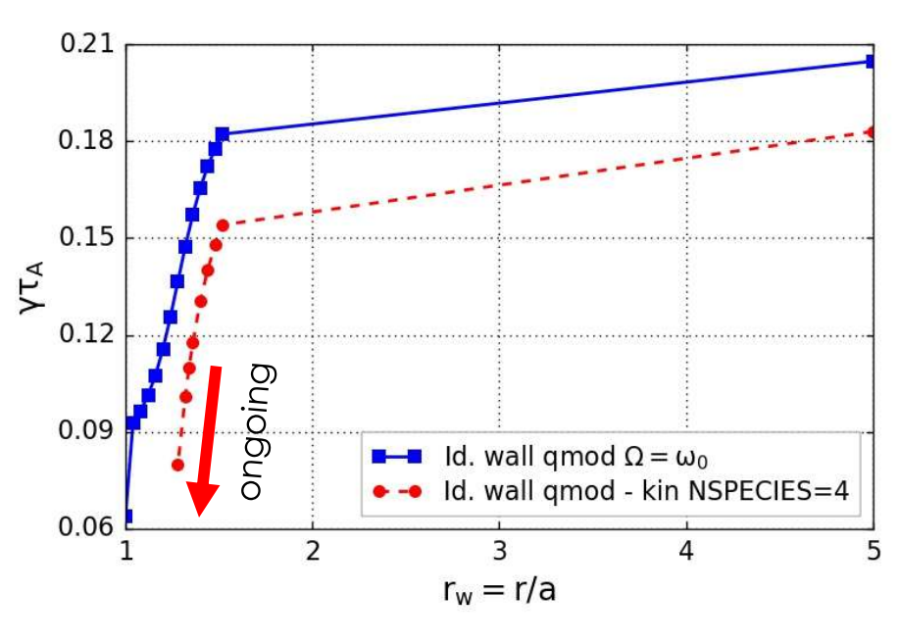
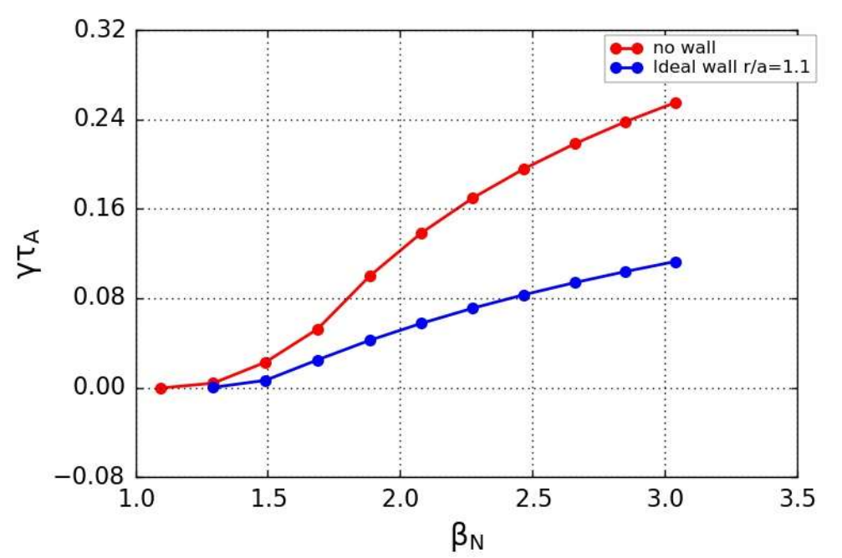
Beta Limit
A small plasma with high power injected is prone to pressure-driven MHD instabilities like RWM.
These would require dedicated in-vessel coils for their (active) control and significantly enhance the risk of disruption.
VNS must be designed to be stable against these modes!
In spite of the very large fast particle population present (which has a stabilising effects) and of the all-in-all low value of β_{N} = 3.35% the MHD stability of the VNS plasma cannot be clearly demonstrated (flat q profile, large pressure gradients).
Possibly, a more careful tailoring of the CD profiles is required!
Data: L. Pigatto

Slide 12
Conclusion and open points
During the VNS feasibility study, solutions have been found for the following physics aspects:
Identification of a design point with peak NWL ~0.5 MW/m² and steady state operation.
Definition of a magnetic equilibrium
Definition of a ramp-up trajectory
Confinement of fast particles (fusion α’s and NB particles)
Physics integration of H&CD auxiliaries (EC, NB and IC)
Instead, other aspects are still open, or anyway still show criticalities
Power exhaust (see next talk – S. Wiesen)
Magnetic controllability (e.g. VS)
Global MHD stability
Plasma operation (e.g. with respect to tungsten accumulation)
Consequences of disruptions (see Ch. Bachmann – this session)

