Slide 1
EU-VNS exhaust assessment with SOLPS-ITER
Technical Exchange Meeting on CFETR and EU-DEMO Fusion 19.3.2024
S. Wiesen, Ch. Bachmann, M. Siccinio, J. Boscary, R. Neu, F. Maviglia, G. Federici and the EU DEMO PSD team

Slide 2
Rapid assessment of EU-VNS exhaust capabilities
First tests: conformal approach → started late summer (geometry rev1) → we do not have the time to assess divertor shape systematically, stopped Also: there is not much of flexibility w.r.t divertor volume/size
For a fixed divertor shape: T + Ne, first real scans → early September (rev2) → bad compression, not sufficient to limit Zeff (core compatibility)
Test T + Ar, 3rd scan, revised divertor shape → late September (rev3) → Good w.r.t Zeff (Ar compression!) but requires significant T-throughputs (uncertainty in pump speed)
Run T + Ar + He, 4th scan, Helium pump assessment→ late October (rev4) → Gives better idea about pumping and thus on more realistic throughput
Run T + Ar + He, 5th scan, using updated divertor geometry with dome → from February 2024 (rev5) → ongoing, towards finalised divertor design, complete mapping of exhaust operational space
S. Wiesen | 4th EU-CN CFETR/DEMO meeting | 19 March 2024

Slide 3
Underlying SOLPS-ITER model
Run SOLPS-ITER with EIRENE kinetics: T + Ne; T + Ar; T + He + Ar
Puffing T₂ and Ar from LFS wall
Disregard D+ source from NBI in core
Radial transport flat D_{perp} = 1 m²/s for both T & Ne, χ_{e}= 1m²/s, χ_{i}=0.75 m²/s
Pumping albedo in PFZ corresponding to 200 m³/s pumping speed
Use flux BC on core side (i.e. “top pedestal”)
New VNS divertor
Scan Ar content & scan T₂ gas-puff
→ bring down total heat-flux (plasma, neutrals, radiation) below 10MW/m²

Slide 4
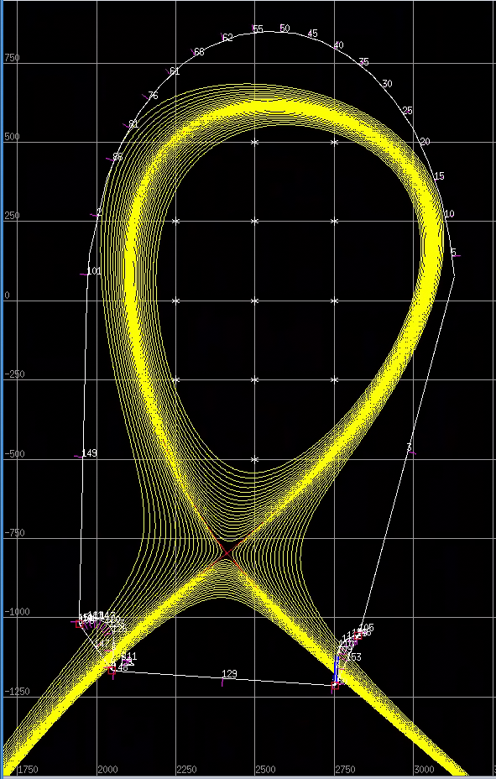
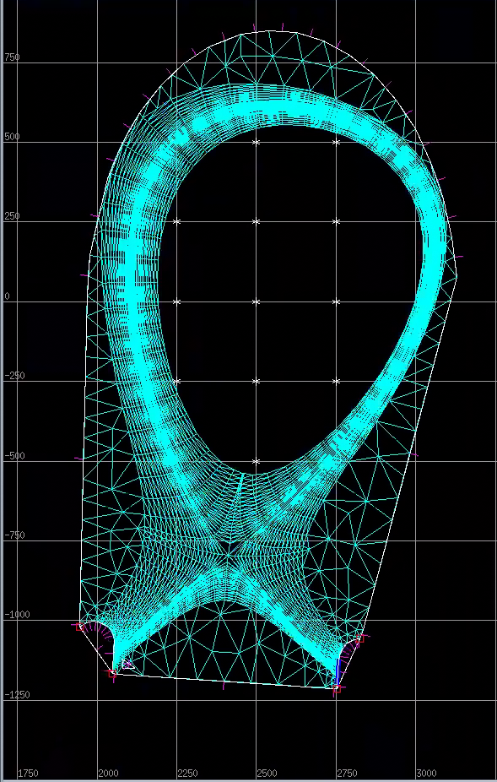
First grid attempt, simple divertor geometry, T + Ne
P_{edge}
T₂, Ne puff
pump
S. Wiesen | 4th EU-CN CFETR/DEMO meeting | 19 March 2024

Slide 5
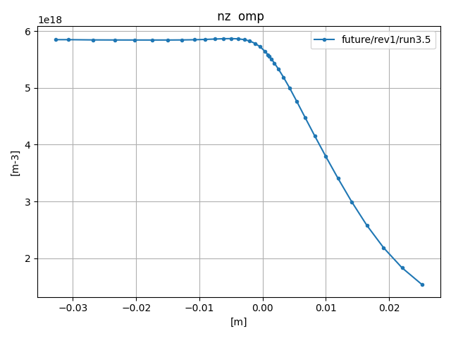
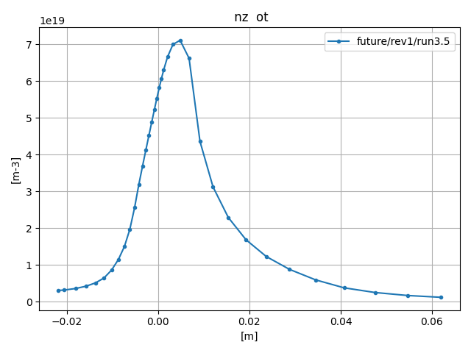
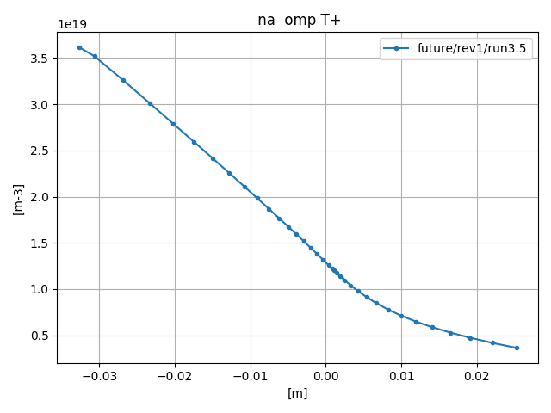
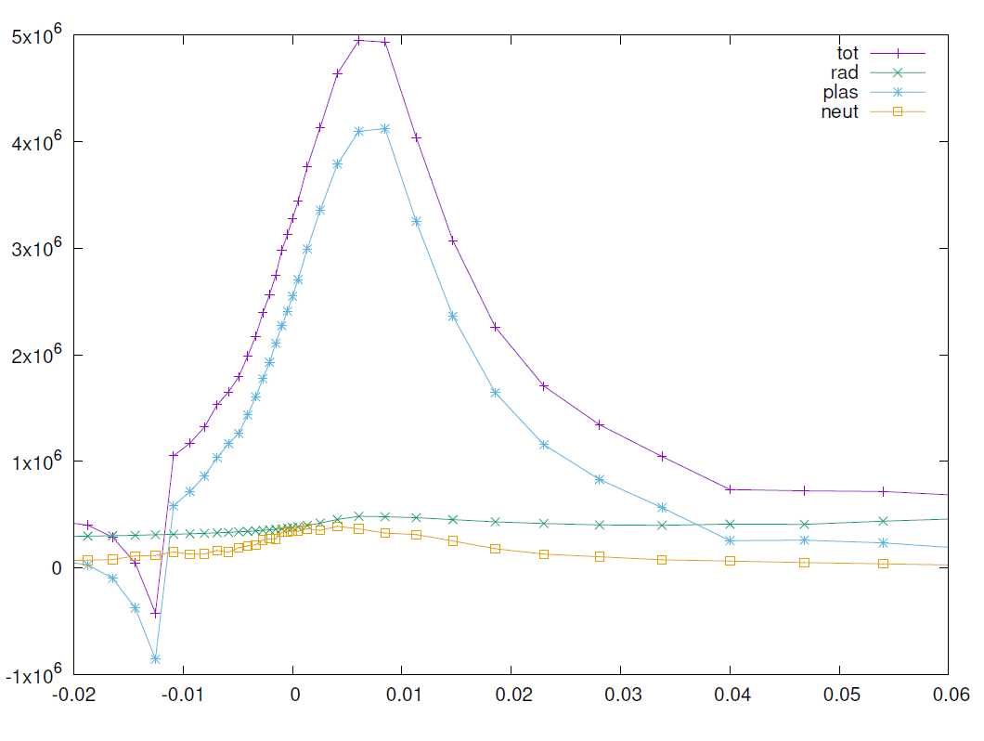
P_{edge} = 40MW, “best case” with Neon seeding
$$n_{z}=\sum_{i}{n_{Ne}^{i+}}$$
LFS
Heat-flux
Γ_{Ne} = 5e21 1/s
<Z>_{core}: ~ 6
Neon compression at separatrix ~ 10.5 → bad compression → attempt Argon instead
S. Wiesen | 4th EU-CN CFETR/DEMO meeting | 19 March 2024

Slide 6
Siccinio EU-VNS model: NWL, pulse length
Any Zeff > 1.5..2 is problematic w.r.t NWL goal and pulse length
S. Wiesen | 4th EU-CN CFETR/DEMO meeting | 19 March 2024

Slide 7
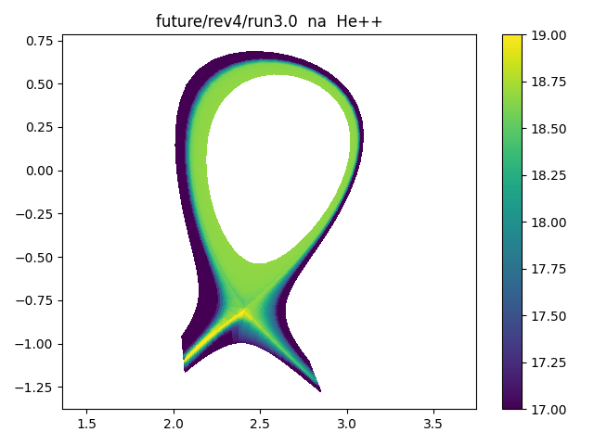
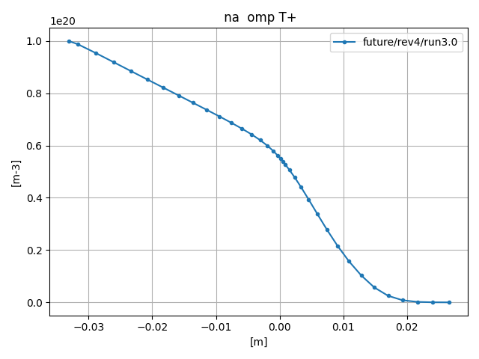
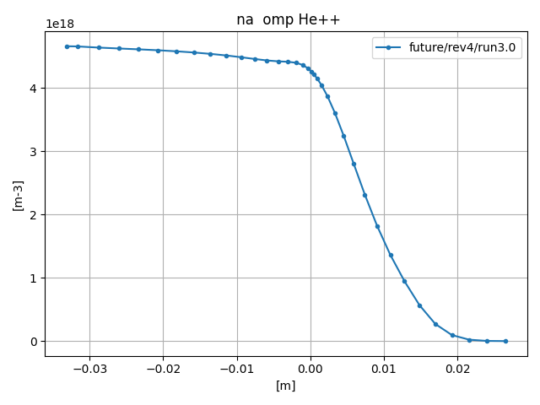
Revised geometry (rev4, no dome) → Helium pumping assessment
The pumping albedo varied to reproduce a Z_{eff} ~ 1.2 (He) in a high-density case Γ_{T,tot} = 3.7e22 (core) + 1e22 (gas) Γ_{Ar} = 1.00e19 1/s P_{rad} 6MW n_{sep} 7.3e19 m⁻³
P_{edge}
T₂, Ar puff
pump
S. Wiesen | 4th EU-CN CFETR/DEMO meeting | 19 March 2024

Slide 8
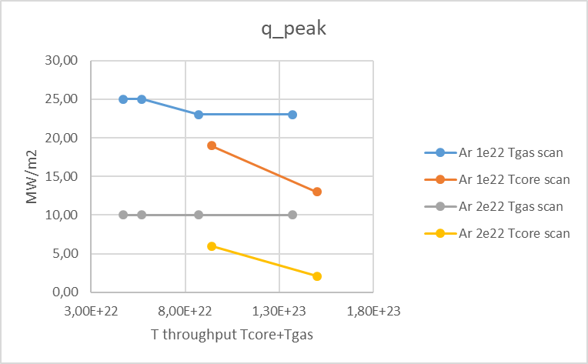
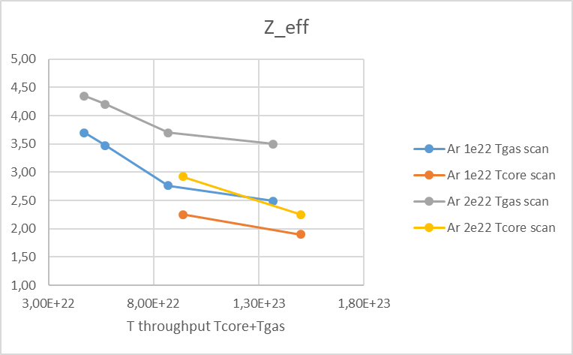
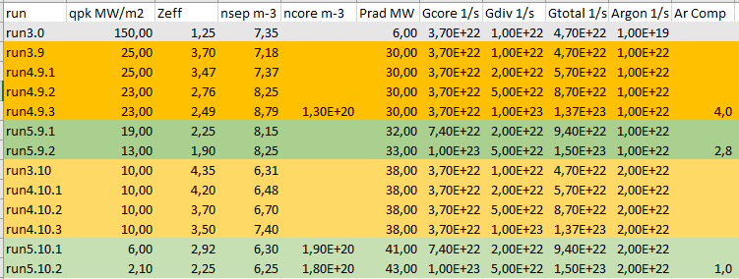
Towards mapping VNS operational space: T + He + Ar
Nice results in terms of Z_{eff} and q_{peak} but at high cost: 3 times larger T-throughput (incl. pellets) compared to ITER! and close to n_{GW}
S. Wiesen | 4th EU-CN CFETR/DEMO meeting | 19 March 2024

Slide 9
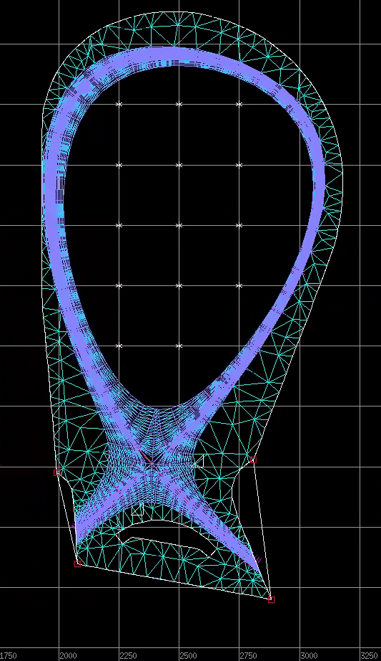
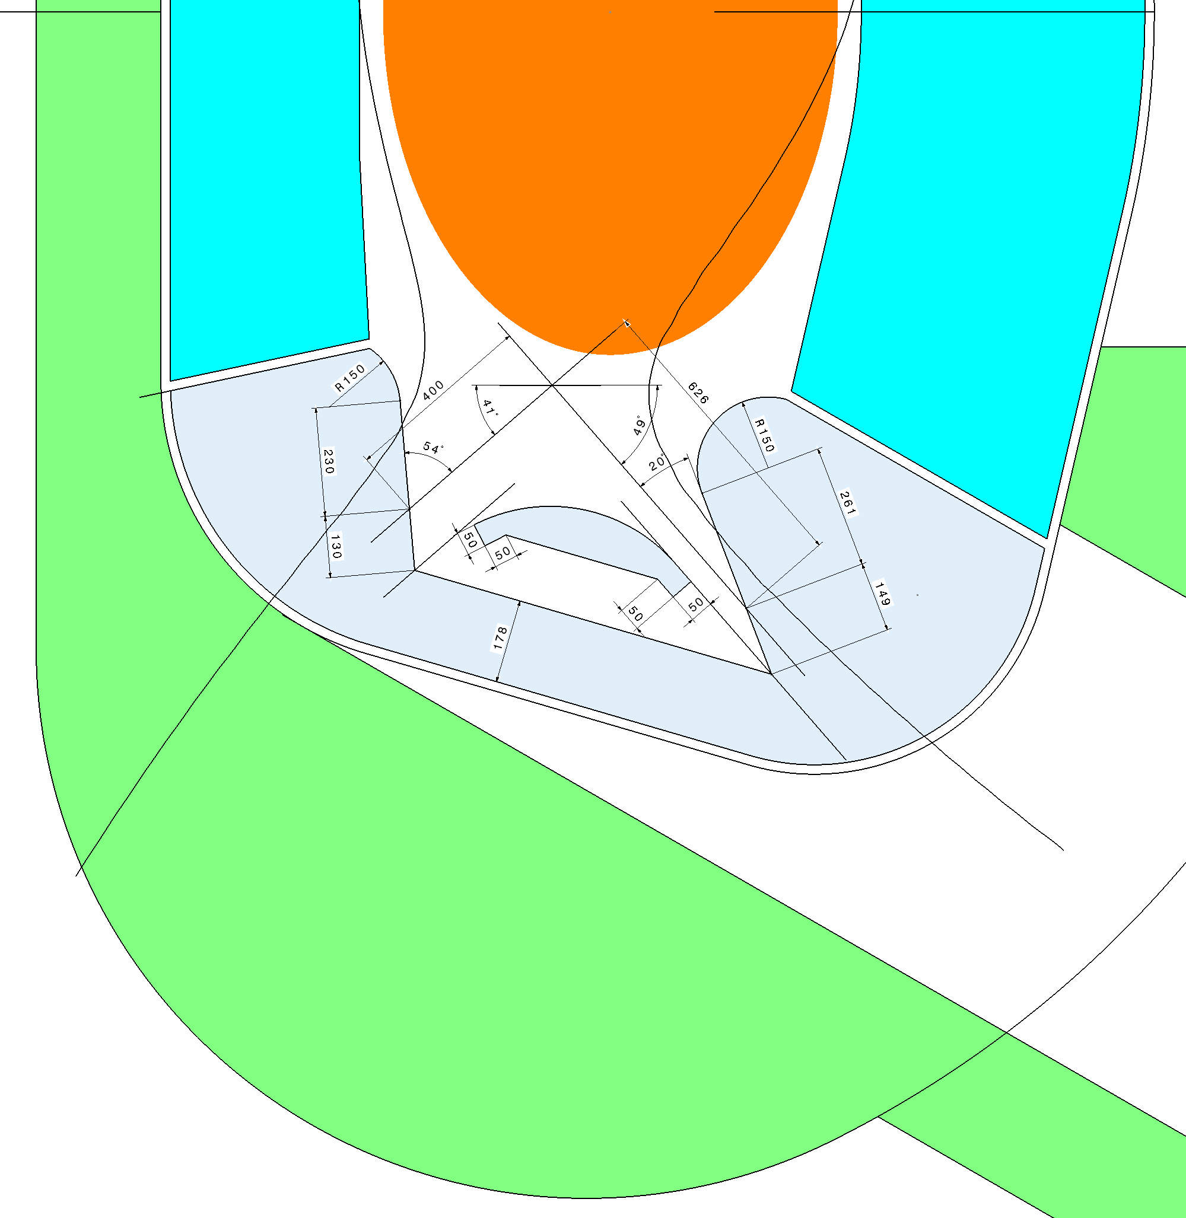
New EU-VNS divertor design
T₂ puff
pump
Ar puff
S. Wiesen | 4th EU-CN CFETR/DEMO meeting | 19 March 2024

Slide 10
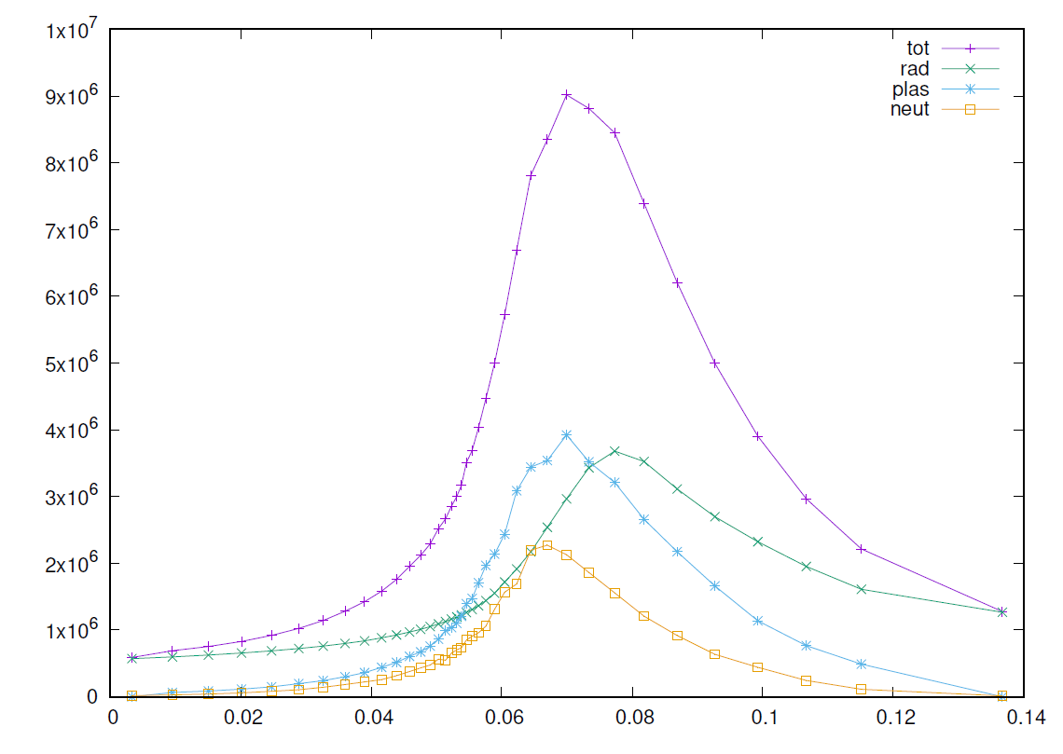
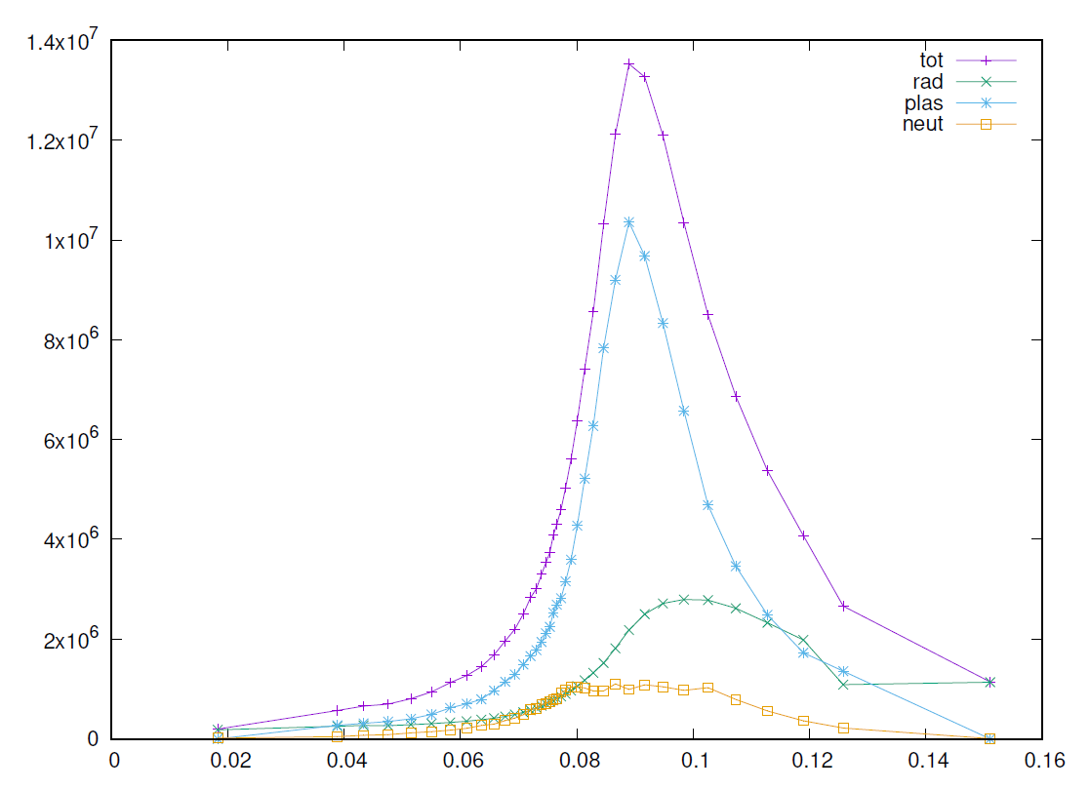
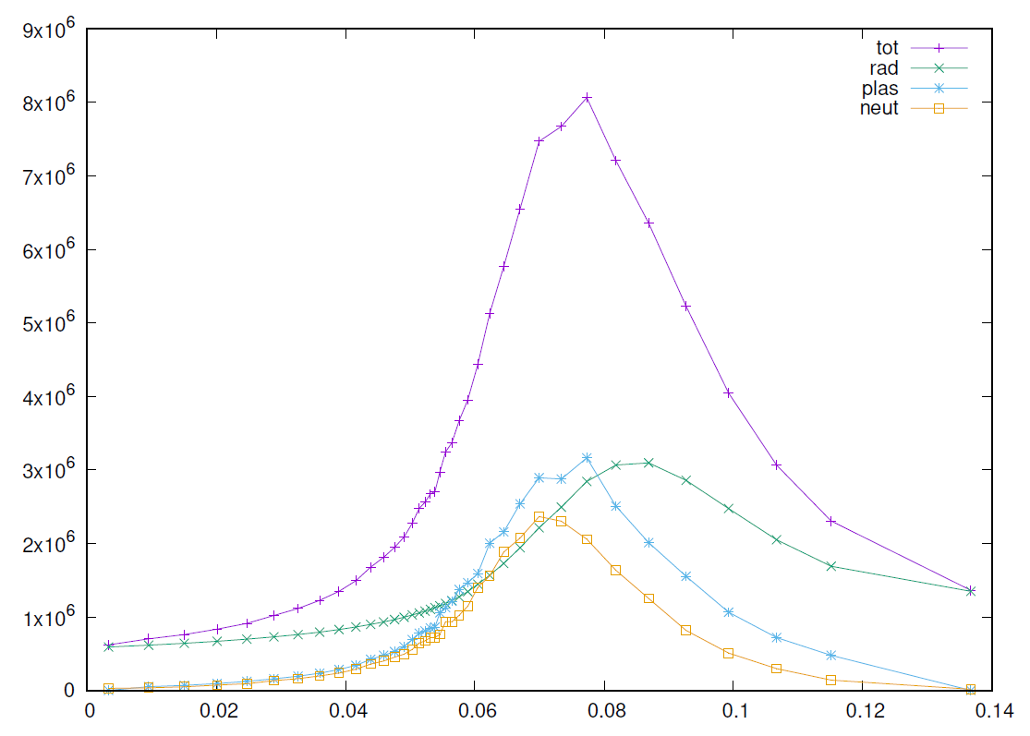
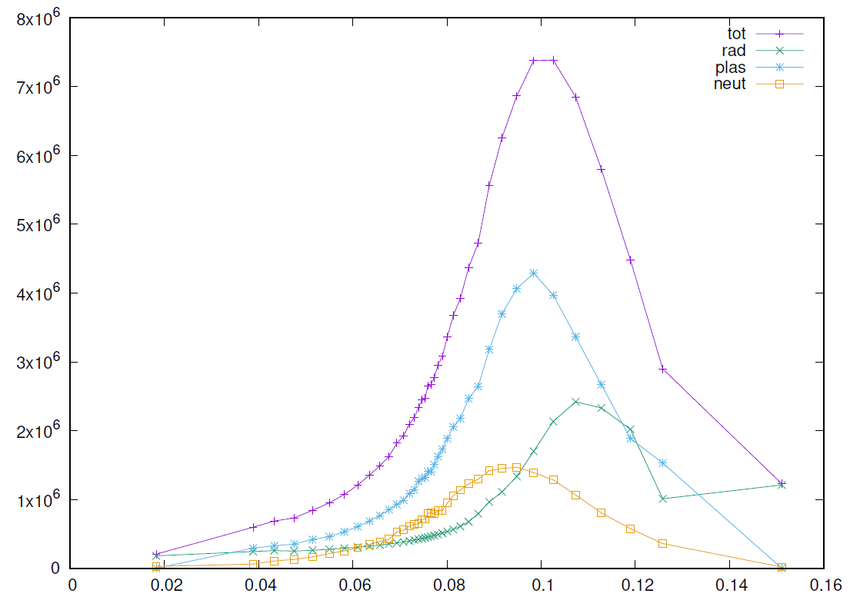
(Very) new results: gas-puffs only, with dome and updated equilibrium
HFS
LFS
10
14
Target heat-loads MW/m²
Γ_{Ar}=5e19s⁻¹, Γ_{T}=2e22s⁻¹
<Z>_{core}: ~ 3.25
Ar comp spx ~ 9
9
8
Higher throughput
Γ_{Ar}=5e19s⁻¹, Γ_{T}=3e22s⁻¹
<Z>_{core}: ~ 3.13
Ar comp spx ~ 11.5
Improved Compression
S. Wiesen | 4th EU-CN CFETR/DEMO meeting | 19 March 2024

Slide 11
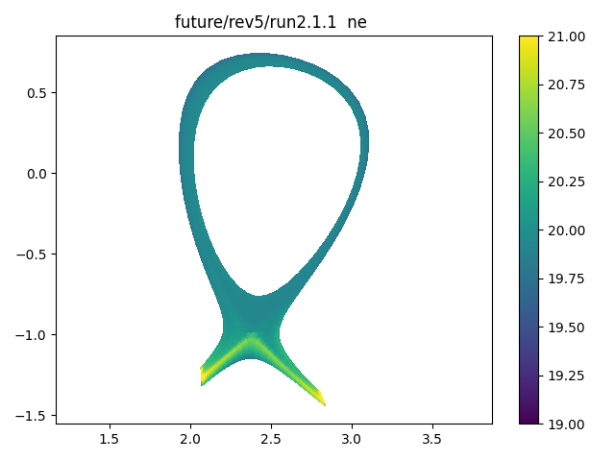
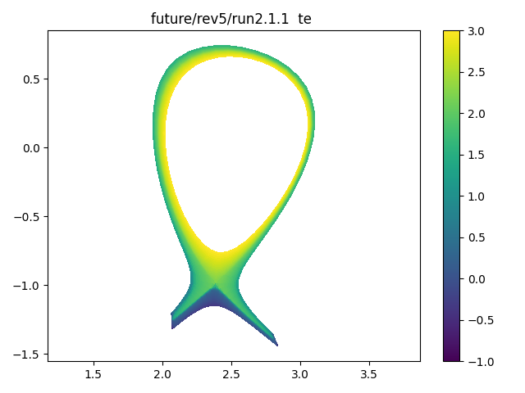
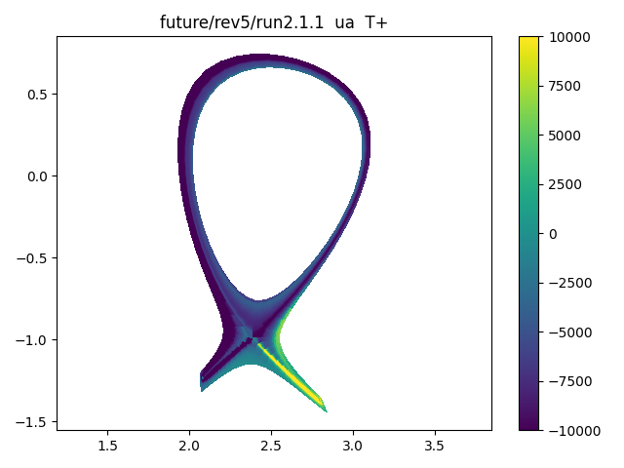
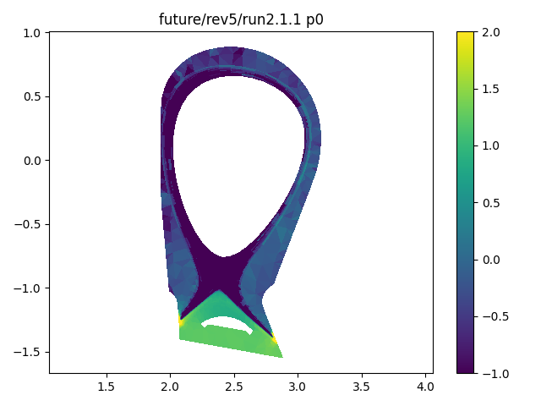
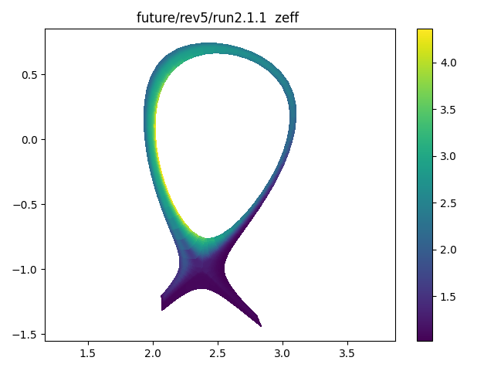
Results from higher throughput
ne
Te
u||
p0
Zeff
Parallel flows enhance Argon compression at LFS
S. Wiesen | 4th EU-CN CFETR/DEMO meeting | 19 March 2024

Slide 12
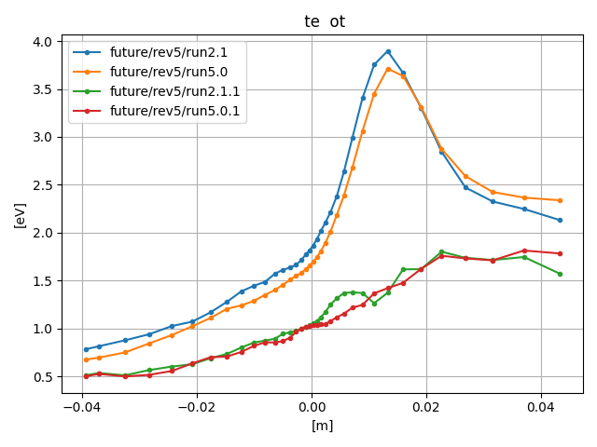
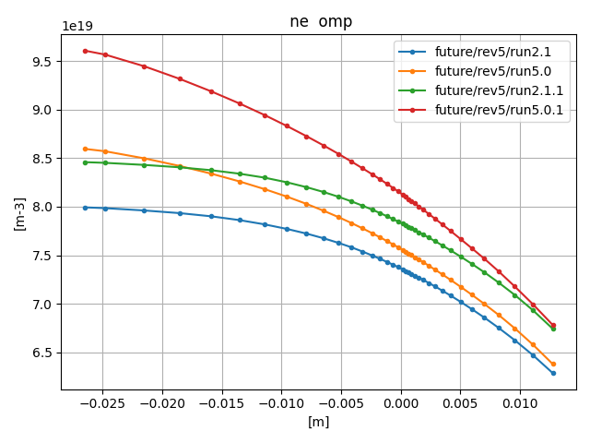
Core particle fuelling more efficient & keeping Zeff low
higher total throughput
Core fuelling is facilitated by pellets – would open a larger operational space
S. Wiesen | 4th EU-CN CFETR/DEMO meeting | 19 March 2024

Slide 13
Summary
It seems there is a finite exhaust operational space existing for EU-VNS (P_{edge} 50MW)
Zeff at the core can be maintained < 3 compatible with operational requirements (METIS)
Argon seeding more favourable compared to Neon, compression induced by parallel flows
Pellet fuelling from core more efficient w.r.t keeping Zeff low and the heat fluxes < 10MW/m²
Symmetrisation of loads between LFS/HFS possible
Detailed analysis ongoing: mapping out of operational space and assessing heat loads across all PFCs (including dome structure)
S. Wiesen | 4th EU-CN CFETR/DEMO meeting | 19 March 2024

