Slide 1
VNS Engineering
19/03/2024
C. Bachmann

Slide 2
VNS Overview
Mission:
Rationale for a VNS: G. Federici, Nucl. Fusion 63 (2023) 125002.
Address largest knowledge gap we have in fusion: performance and reliability breeding blanket for any machine concepts.
The role of ITER in de-risking DEMO breeding blanket is becoming questionable
P_{fus}: ~30 MW, Tritium consumption <1 kg/year.
Reliable plasma scenario, based on beam-target fusion (Q ≤ 1).
Steady-state plasma operation.
Peak neutron wall load: 0.5 MW/m², peak lifetime neutron fluence: 30-50 dpa.
Testing: available equatorial ports and outboard wall > 10-30 m2 of exposed first wall.
Ability to test several candidate blanket/coolant concepts.
Well established technologies for magnets, VV and NBIs.
Design and construction: Parallel to ITER and prior to the finalization of DEMO design.
Non-technical benefits
Forces cultural shift to concept engineering developments (nuclear performance, reliability growth, RH)
Provides additional experience in design, construction, licensing and operation of nuclear a fusion device
Keep industry, private Investors and governments' interest high

Slide 3
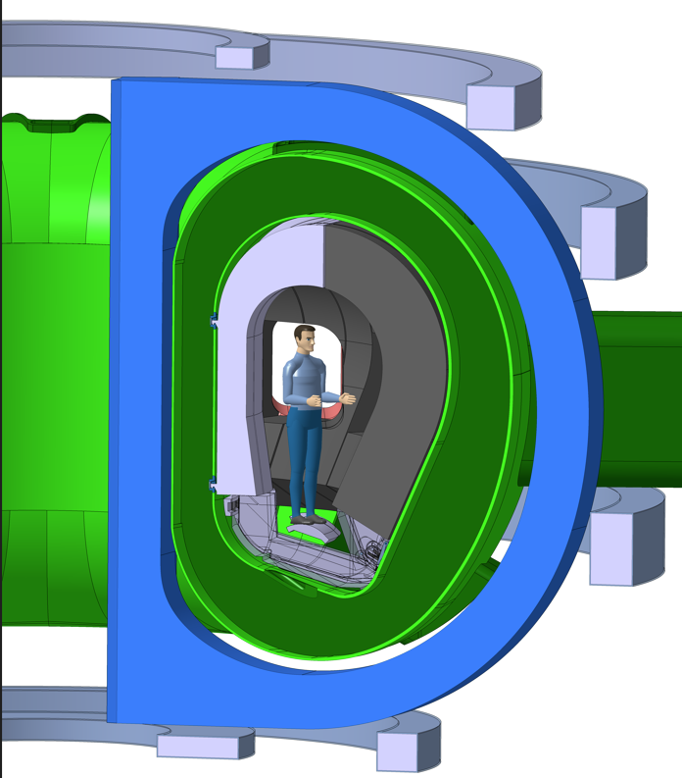
Smallest VNS we could find: R = 2.53m, B₀ = 5.4 T
A=4.6 | High aspect ratio to create space on the inboard side while minimising the surface
CS | Nb₃Sn, sized to ramp up the plasma, I_{p} = 1.76 MA
TF coil | Nb₃Sn, B_{max} =12.8 T – trading-off B with TFC size
n-shield (inboard) | 25 cm (BLK) + 41 cm (VV)
k₉₅ = 1.35 | Plasma elongation required for divertor strike lines and shape control
β_{N} < 3.5% | Achieved through high B, high I_{p}, not too high A
VV
Shield blanket
R₀ / B₀ | 2.53m / 5.4 T | P_{fus} | 29 MW
A | 4.6 | Peak / avg. NWL | 0.49 / 0.3 MW/m²
I_{p} | 1.76 MA | β_{N} | 3.35%Tm/MA
NBI / EC power | 42.5 / 10 MW | Centr. Elec. temp | 12.1 keV
q₉₅ | 3.05 | Th. / Tot. beta pol. | 1.6 / 2.57
Line avg. density | 11e19 /m³ | Norm. Shafr. shift | 0.23
Greenwald frac. | 0.6 | li | 0.76
W conc. avg. | 1 e-5 | Loop voltage | -9.4 mV
Divertor
TF coil

Slide 4
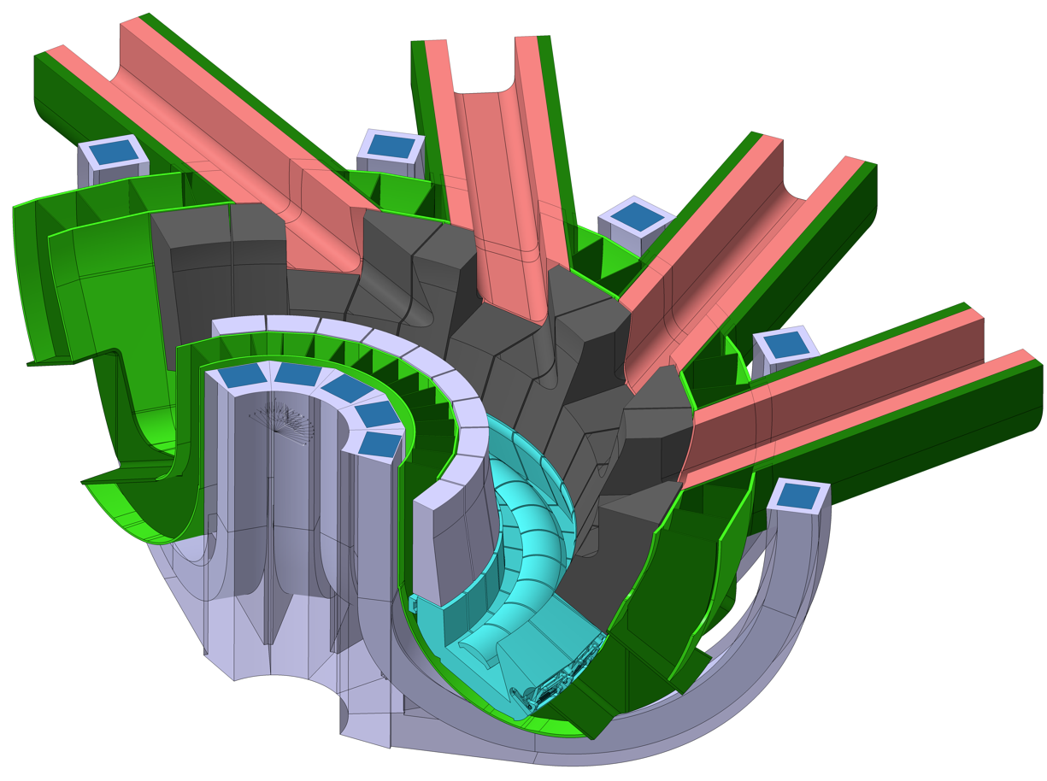
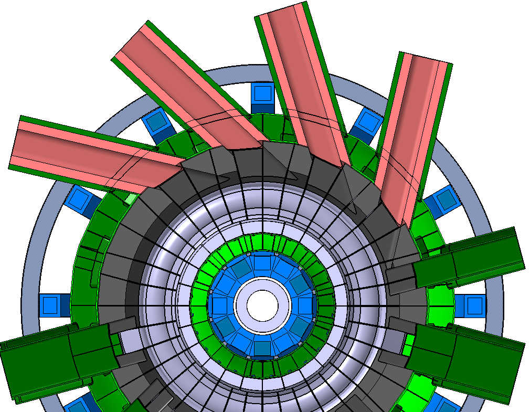
NB configuration, 42 MW, 120 keV
12 TF coils allow the integration of an ITER-like NB duct in-between TF coils.
Blanket
NB duct liner
TF coil

Slide 5
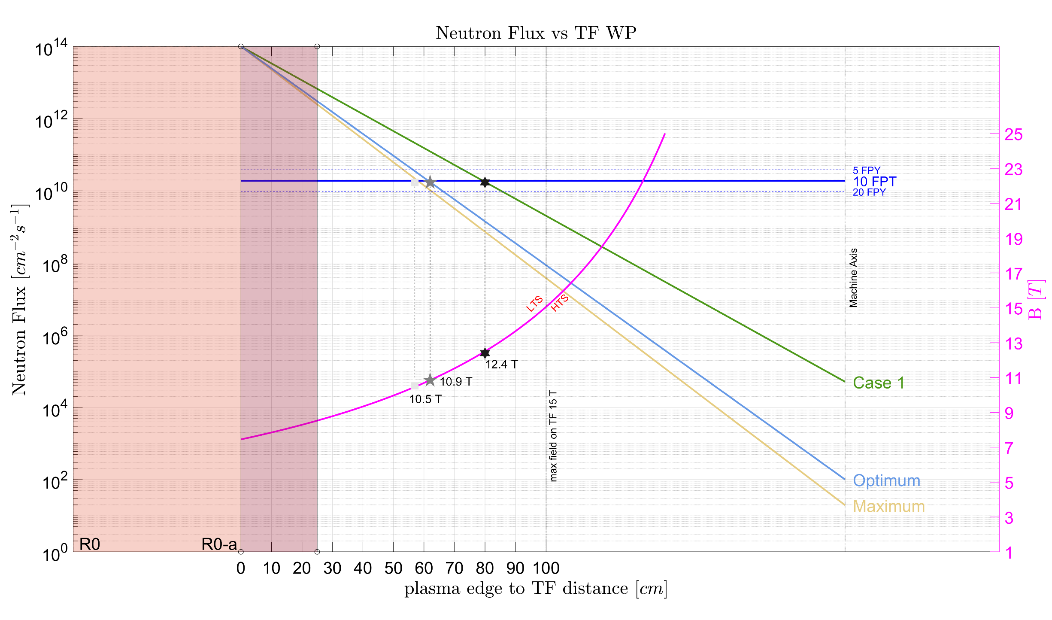
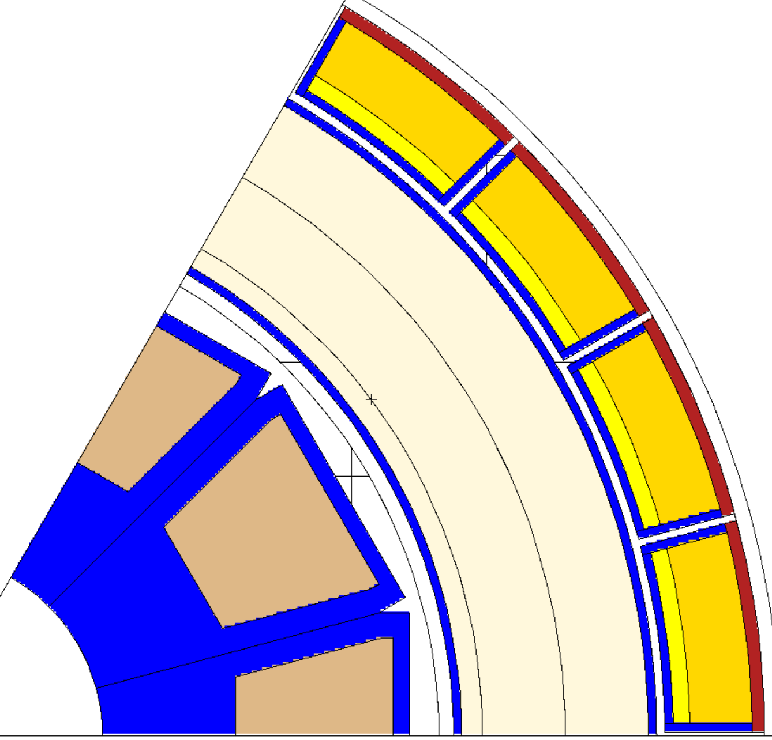
Inboard n-shielding: compact radial build
Influence of efficiency of n-shielding :
-1 cm of n-shield = -0.1T on TF WP
 | Neutron-shielding sizing studies
 | Dose in epoxy / 10 fpys [MGy] Limit: 50 MGy |  |  | N-heating [W/m³] Limit: ~444 W/m³ (TF cond.)
t_{VV} | 43 cm | 41 cm | 38 cm | 43 cm | 41 cm | 38 cm
0 | 20 | VNS | 35 | 235 | VNS | 323
VV filled by
B4C + water
W₂B₅
n-shielding:
25cm shield blanket filled with advanced n-shielding material, e.g. W₂B₅, WC
41cm VV filled on the inboard side with advanced n-shielding material
41 cm
25 cm

Slide 6
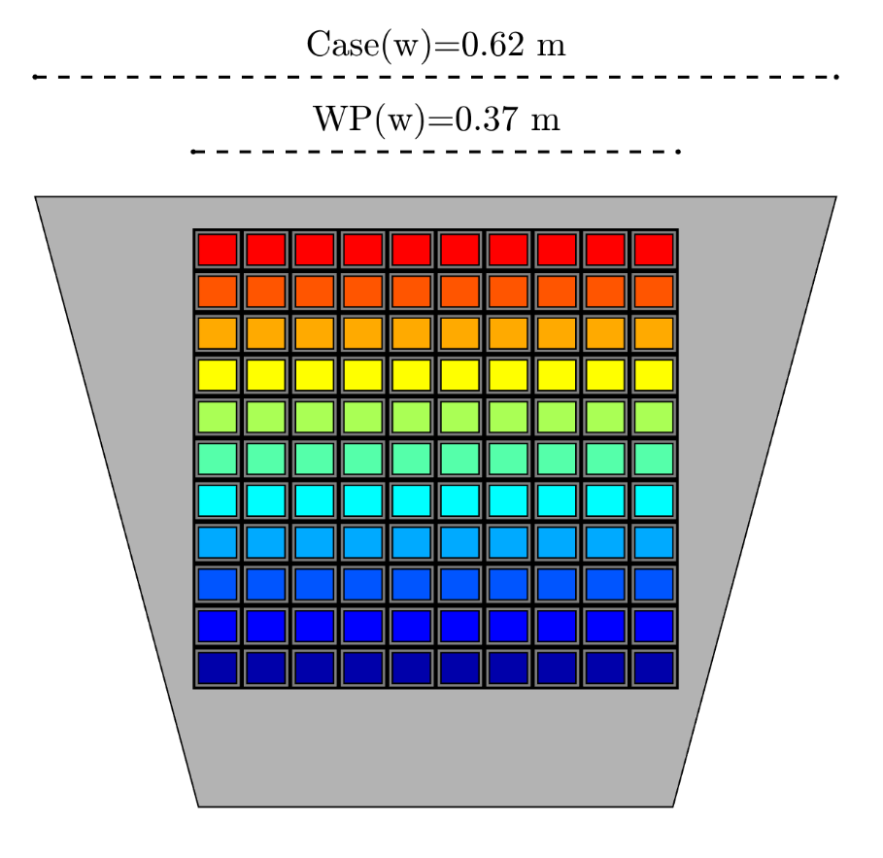
Magnet design
In-plane membrane stress
Maximum field: 12.8 T
TF coils based on Nb₃Sn technology, HTS as an option
Pancake winding
Quench voltage <5 kV
Cost estimate for 12 TF coils: ~60M€
Design of structures not yet done.
σ_{max inner, membrane} = 259 MPa
σ_{max outer, membrane} = 181 MPa
Out-of-plane
bending stress
σ_{max inner, out-plane bend} = 75 MPa
σ_{max inner, out-plane bend} = 282 MPa
6.0m
470 MPa

Slide 7
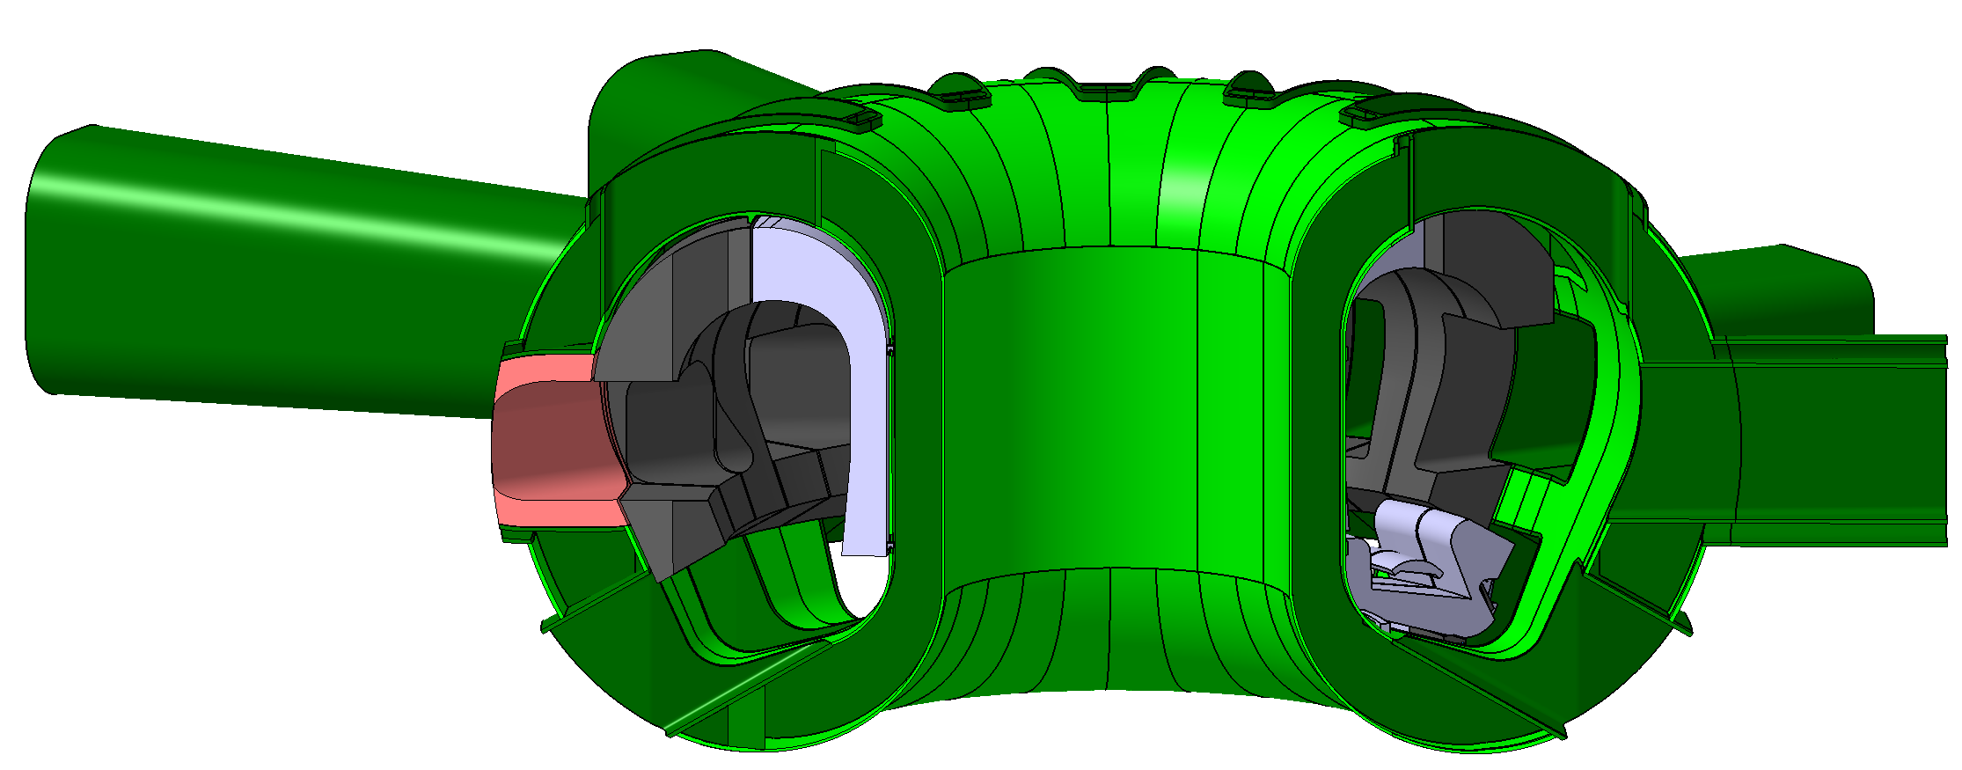
Vacuum vessel
Design:
Double-wall structure: stainless steel XM-19, 316(L)N
Shell thickness (tentative): 20 mm
n-shielding plates: 304, B₄C, or others
Operation:
Coolant: liquid water
Operating (tentative): 50°C @ 11 bar
Baking (tentative): 150°C @ 17 bar
C. Bachmann | Vacuum vessel | June 2023 | Page 7

Slide 8
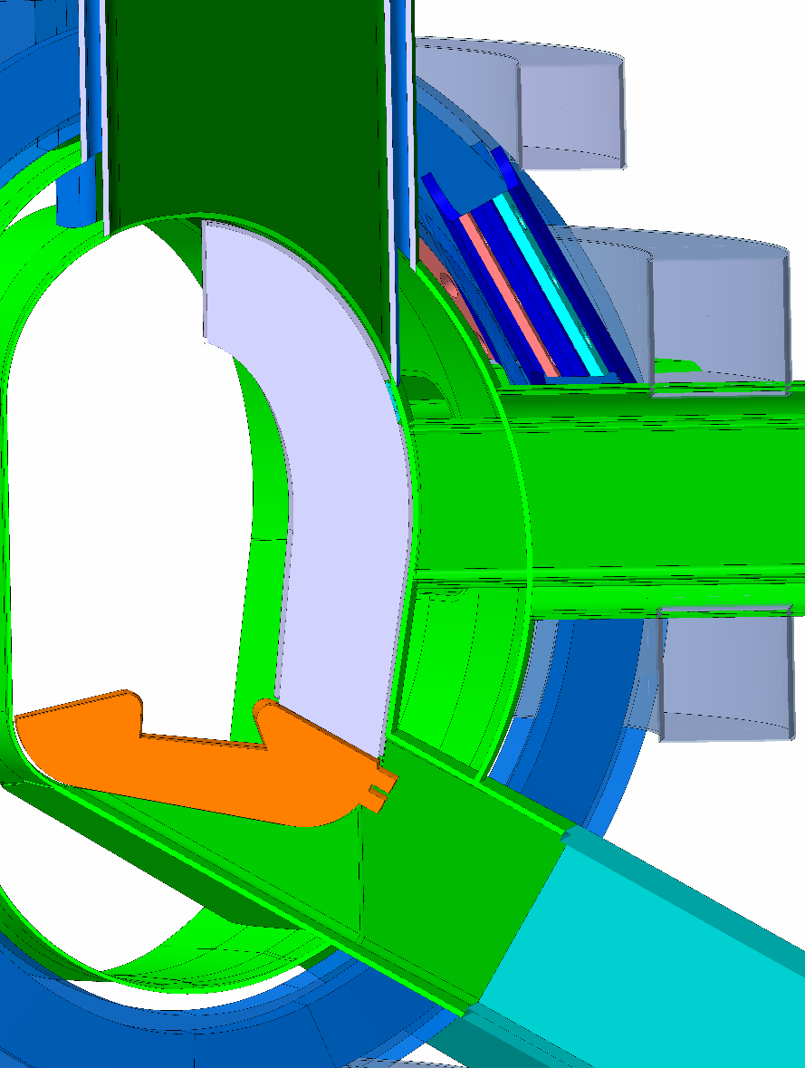
Additional equilibrium coils closer to the plasma
Three possible locations:
Ex-vessel (superconducting) coils.
In-vessel (on VV inner shell) e.g., ITER ELM coils
Intra VV, in-between VV inner and outer shells
  n-shielding function of VV potentially impaired, tbc.
Selection of integration concept:
Ex-vessel coils: poor accessibility for in-situ winding hence 12 window-frame coils → assembly concept to be developed.
In-vessel coils discarded: insufficient space for ~20 turns (ITER ELM coils: 6 turns), too high voltage during disruptions.
Intra-VV coils
  Relatively high Cu-cross section → low resistive heating → sufficient cooling by VV coolant.
  Lower Intra-VV coil: 0.5 MA / 21 turns.
  Upper Intra-VV coil: 0.25 MA / 11 turns.
  Max. voltage during disruption: 2.4 kV (→ ITER-like MgO, [Encheva, IEEE (2022)])
  But: No repair possible.

Slide 9
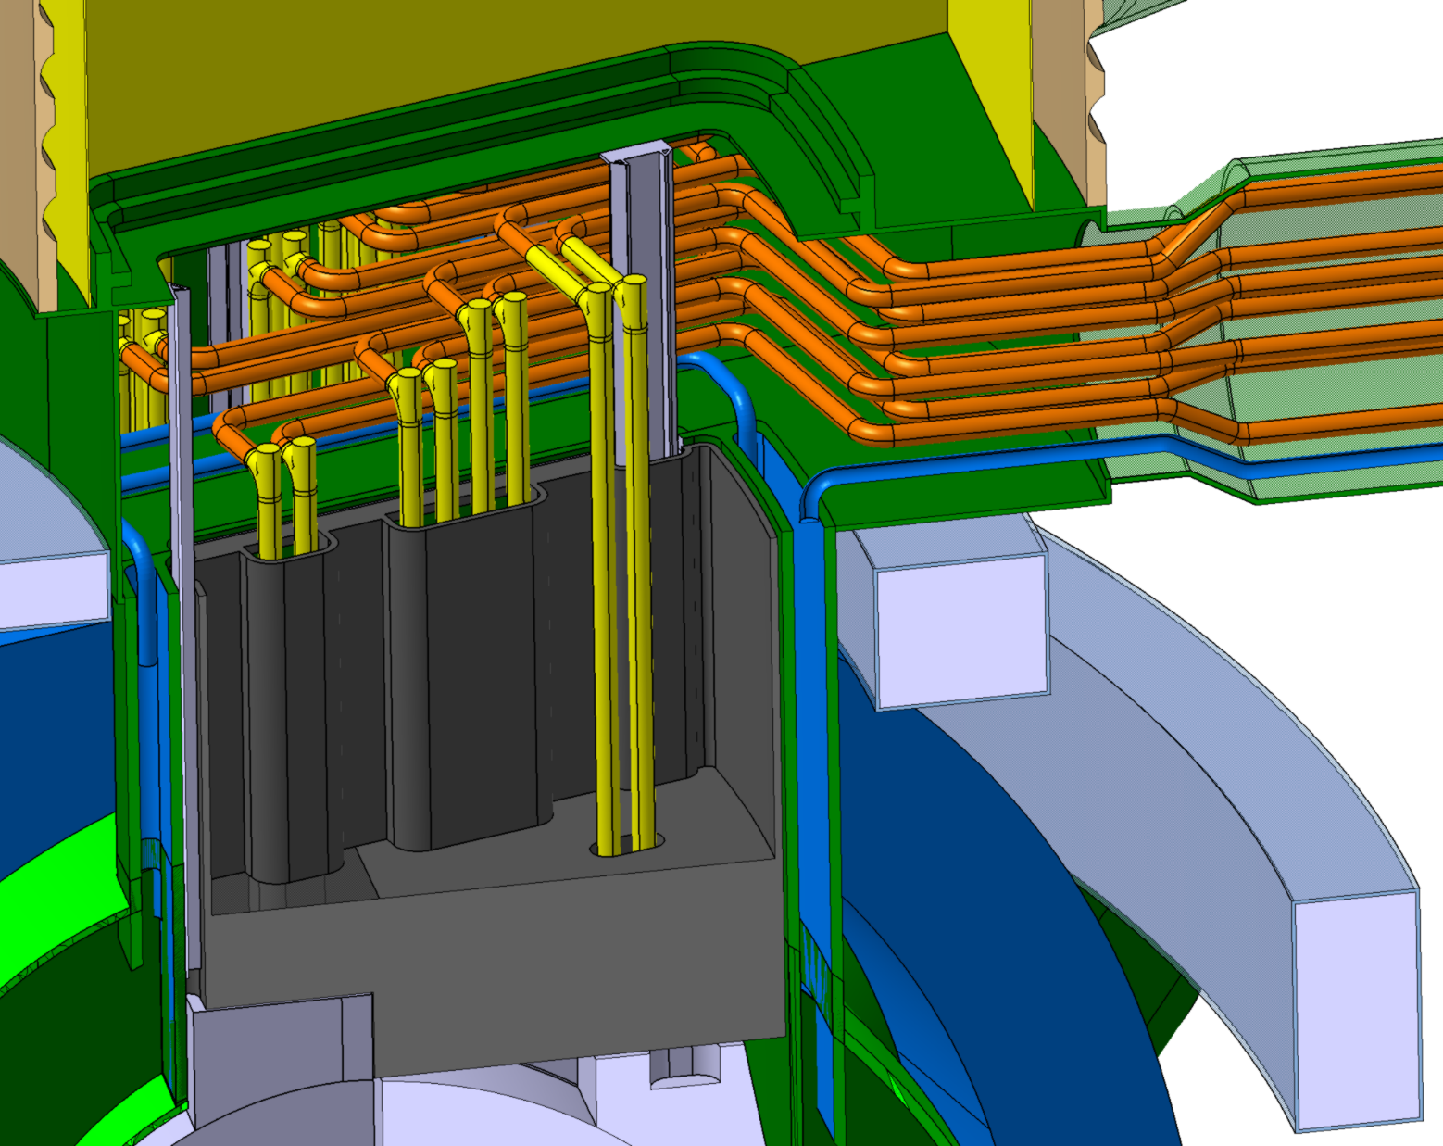
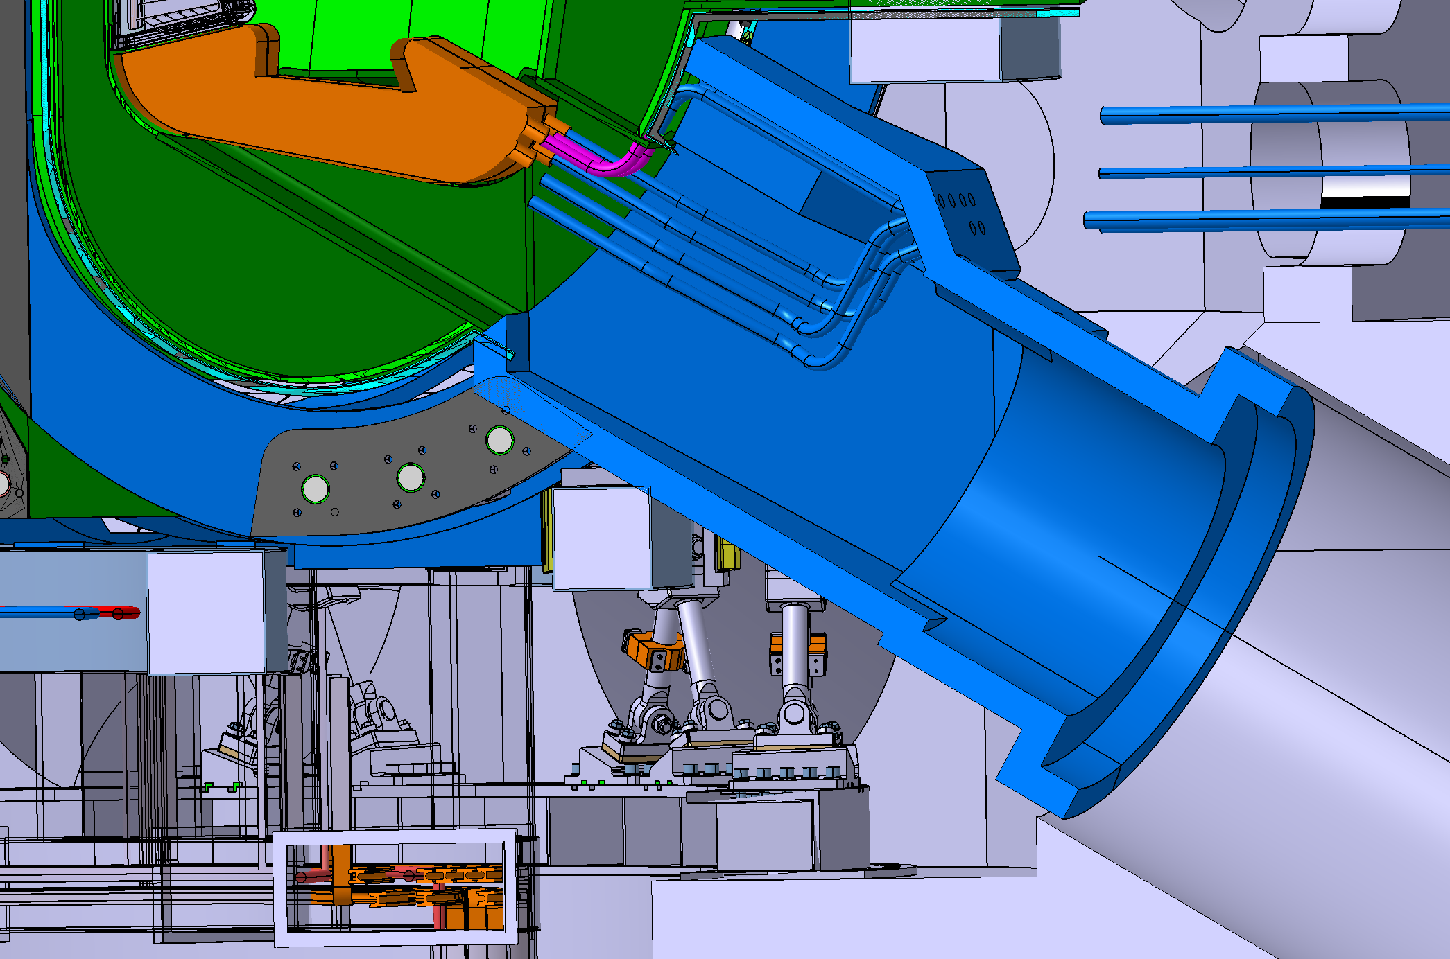
RH - all tools operate inside ports except divertor toroidal mover
12 port cells in the hall above the bioshield for individual access to blanket vertical segments.
Adapted ITER divertor RH concept:
n-shield plug behind divertor in non-pumping ports.
Separate access hatch for pipe tools above cryopump flange.
Blanket cooling pipes integrated and accessible inside the 12 upper ports.

Slide 10
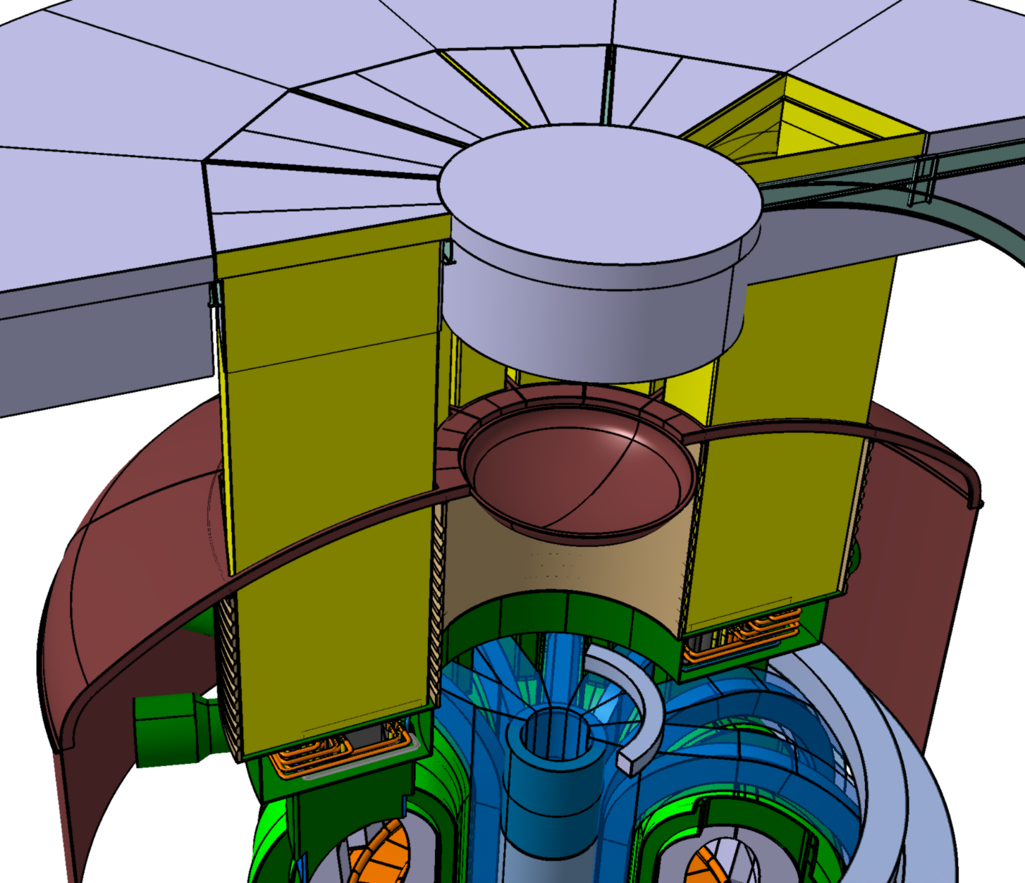
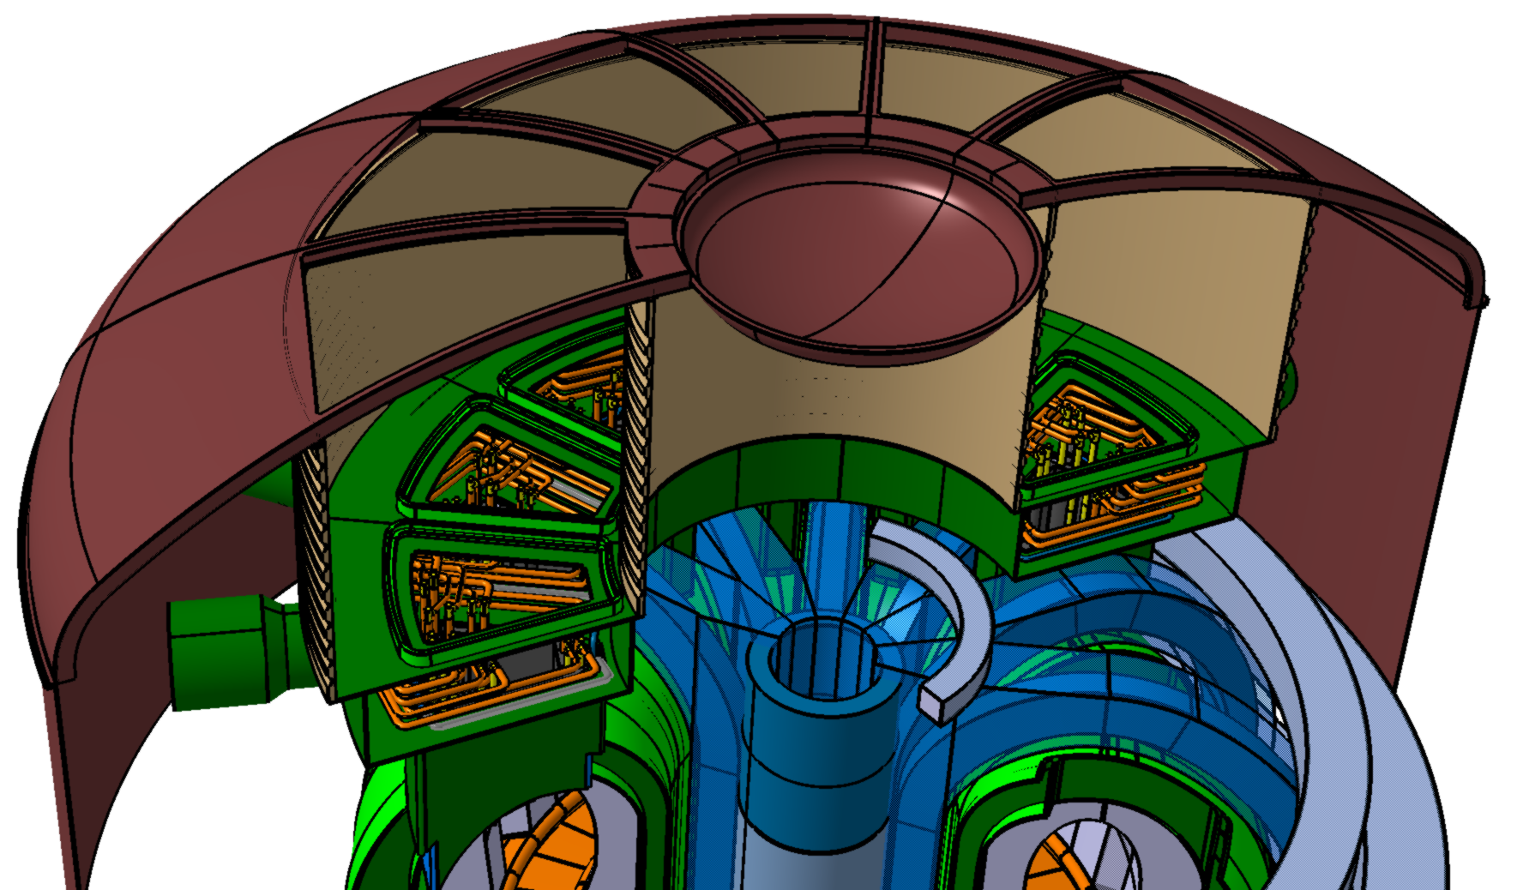
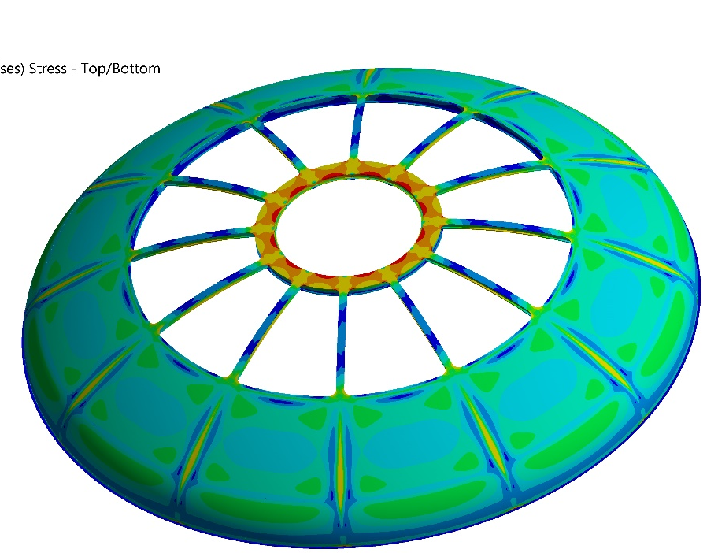
Design for blanket vertical maintenance
Contamination protection structure:
Bioshield roof,
Containment sleeve
Cryostat bellows
Cryostat top lid

Slide 11
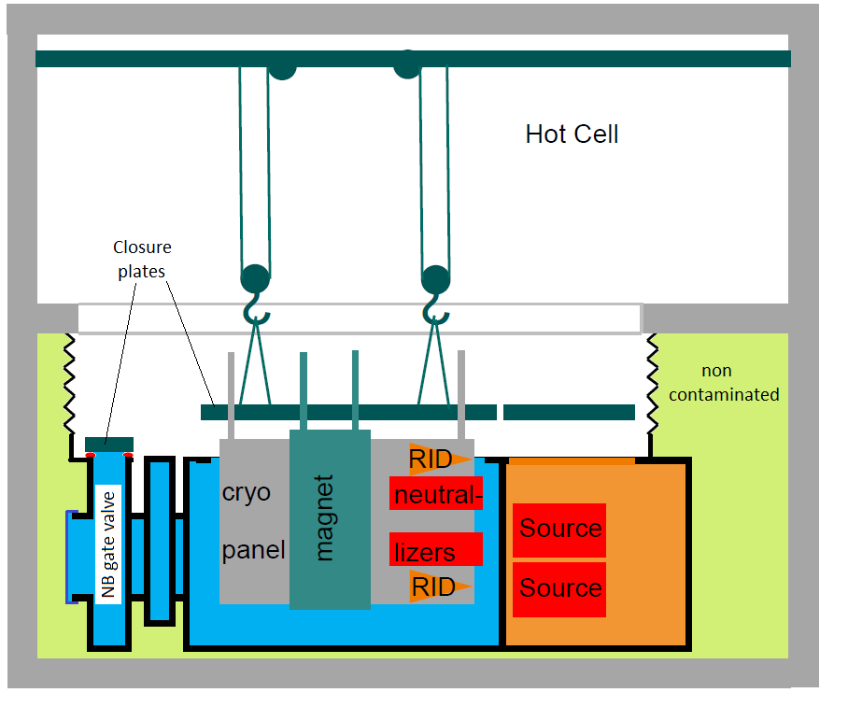
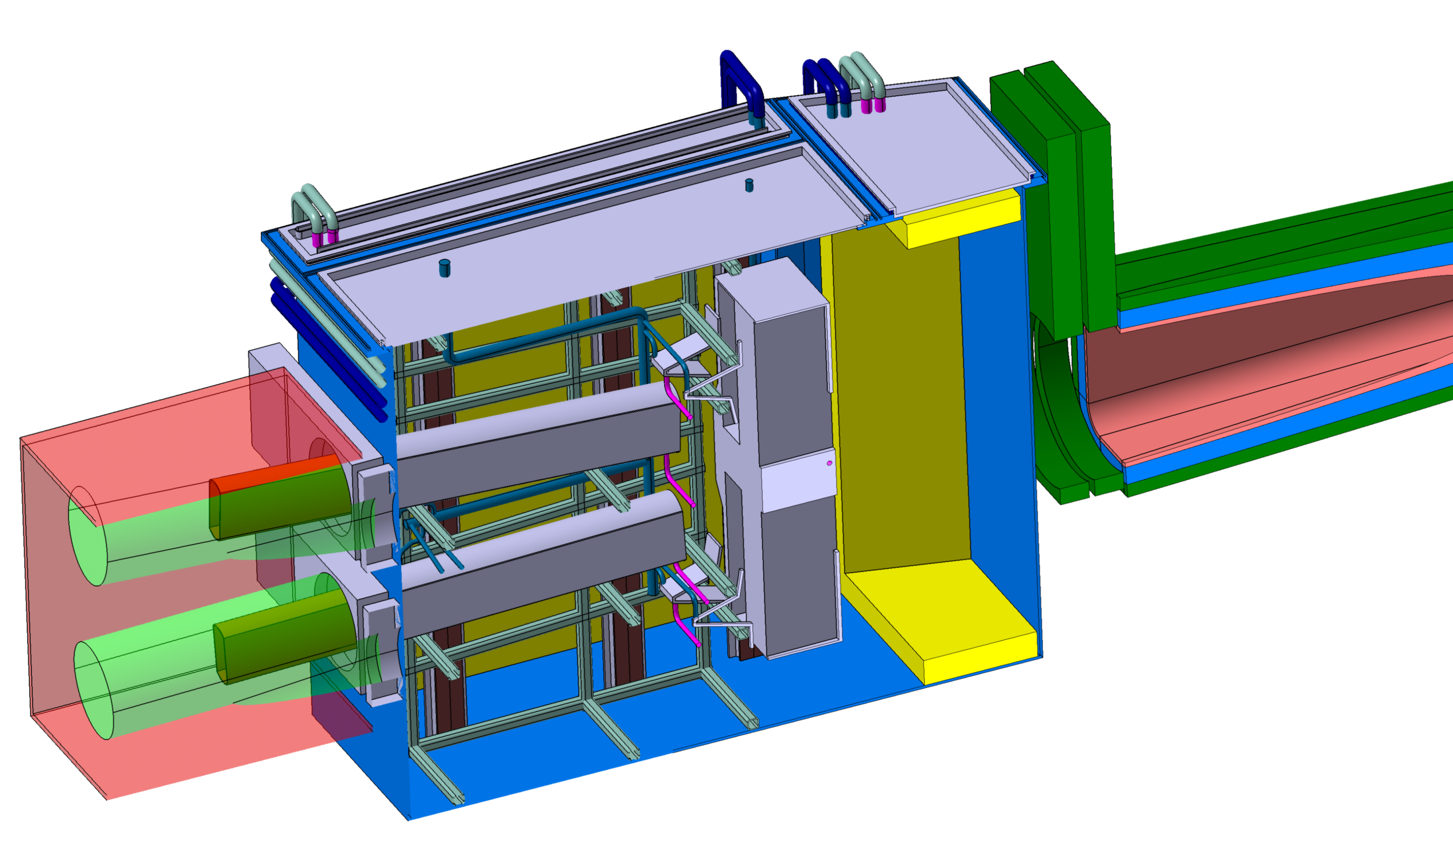
NB maintenance
Remote replacement of entire NBI box:
Separation of NB box from VV with two gate valves
Transport of entire NB box to hot cell building.
Operations in hot cell building:
Access from the top, no contamination of NB box.
Hot cell operations in parallel to plasma operation.
NB injector box
Closure plates
Gate Valve and Fast Shutter
Cryolines
NB duct
RF Sources
C. Bachmann | FUTURE machine | July 2023 | Page 11

Slide 12
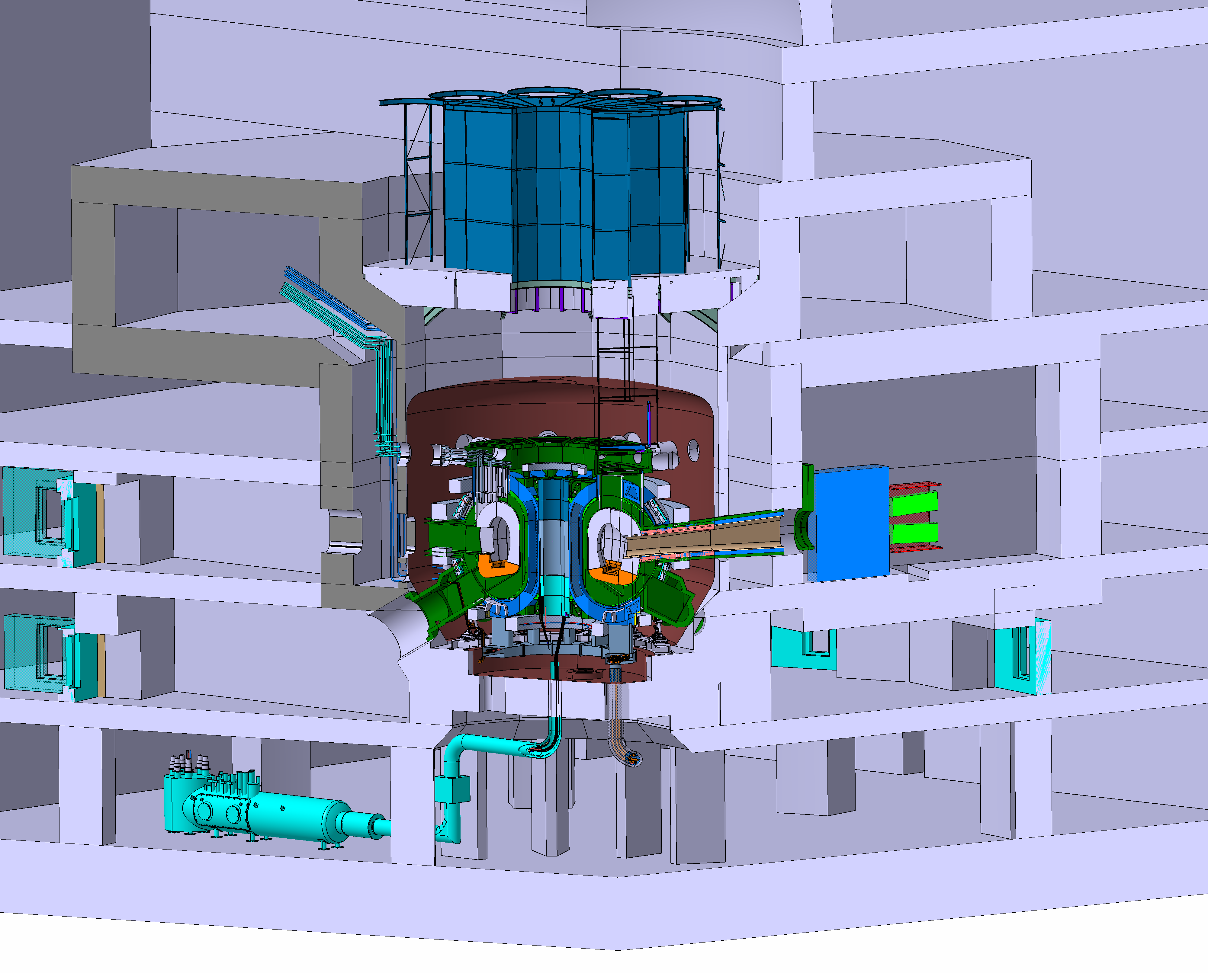
Activated cooling water routing
Activated cooling water routed in well-shielded areas segregated from other plant equipment → double-wall bioshield.

Slide 13
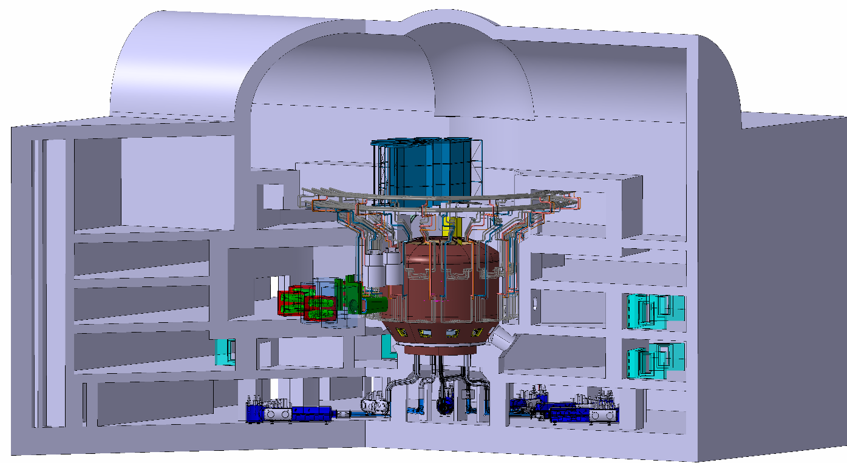
Tokamak building
Large NB cell with 4 NB injectors.
NB cell (2nd confinem.) fully inside building (3rd conf.)
All magnets & cryo feeders in ground level B2.
No lower pipe chase (because of small machine size)
Activated water segregated from other plant areas.
Machine assembly path & blanket transfer to AMF
~50m
PHTS Level
Low radiation level
AUX & testing
Divertor and vacuum pumping
Magnet feeder level
~78m

Slide 14
High electrical power consumption
System | Active Power
NBI (42.5 MW) | 120 MW
EC (10 MW) | 25 MW
Intra-VV coils | 5 MW
Magnets | 0.7 MW
Cooling water system | 5 MW
Cryoplant & Cryodistr. | 3.5 MW
Tritium Plant | 1 MW
SIC components | 2.3 MW
TOTAL | 170 MW
VNS can be operated with reduced aux. heating at reduced P_{fus} and neutron flux.

Slide 15
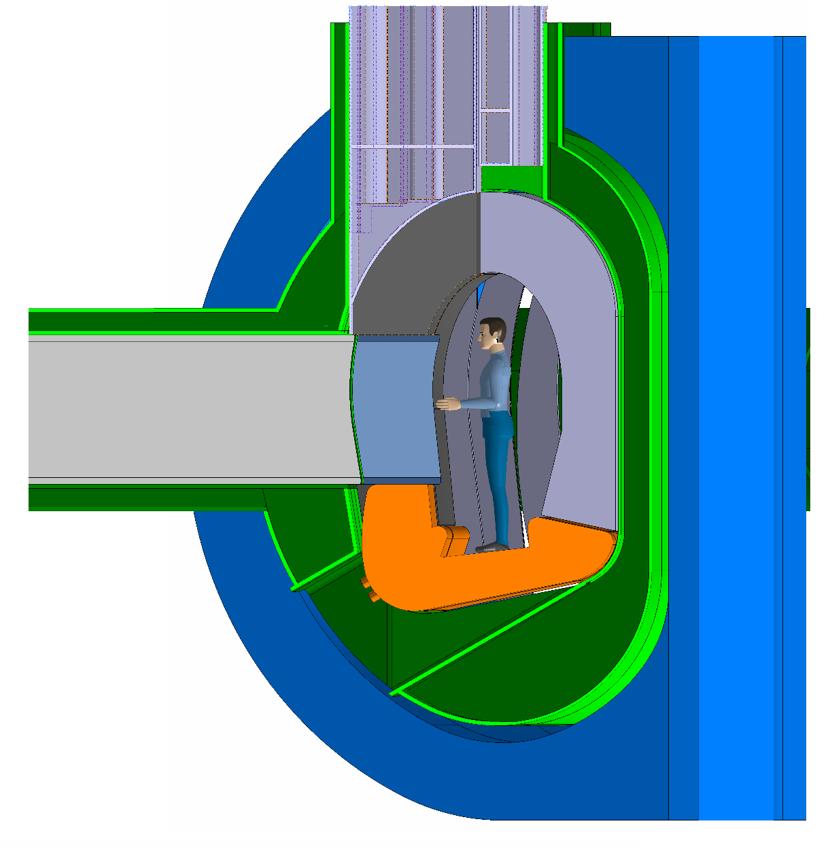
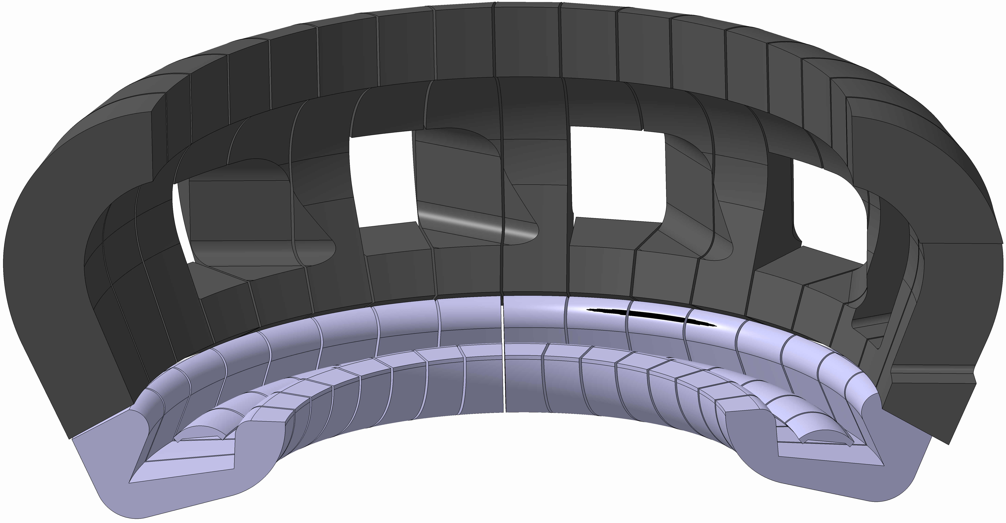
Testing opportunities
Phase | Commissioning (non-nuclear) | Pre-qualification (moderate n-fluence) | High fluence phase (high n-fluence, 30-50 dpa)
Installation | Port plugs | Port plugs, some outboard segments | Port plugs, most outboard segments
Operation | Cooling loops | Cooling loops, Tritium removal loop | Cooling loops, Tritium removal loop
Test condition | Surface heat flux, EM loads (below nominal) | Surface heat flux Volumetric n-heating Few dpa | Surface heat flux Volumetric n-heating High dpa
~29m²
TBM-like plug:
A = ~1.2 m²
C. Bachmann | FUTURE basic design | Oct. 2023 | Page 15

Slide 16
Required developments during feasibility study (in 2024)
VNS technology:
ITER-like: Magnets (possibly HTS), VV, divertor, shield blanket, tokamak cooling, T-fuel cycle, safety/licensing, TBM.
New: Steady-state NBI, NB RH, blanket RH, intra-VV coils.
Remaining technical showstoppers:
Reliable divertor detachment (without impacting too severely on Zeff and hence the performance)
Steady-state plasma operation (continuous NB).
Concept for equilibrium coils closer to the plasma.
Mechanical integration of in-vessel components.
Remote maintenance concepts for blankets, divertor, and NBI.
Verification of neutron shielding structures, incl. ports.
Testing opportunities:
~3 test ports with ~1 m² each.
~29 m² outboard blanket FW.
10 full power years to ~50 dpa.

Slide 17
Thank you for your attention

Slide 18
Backup slides

Slide 19
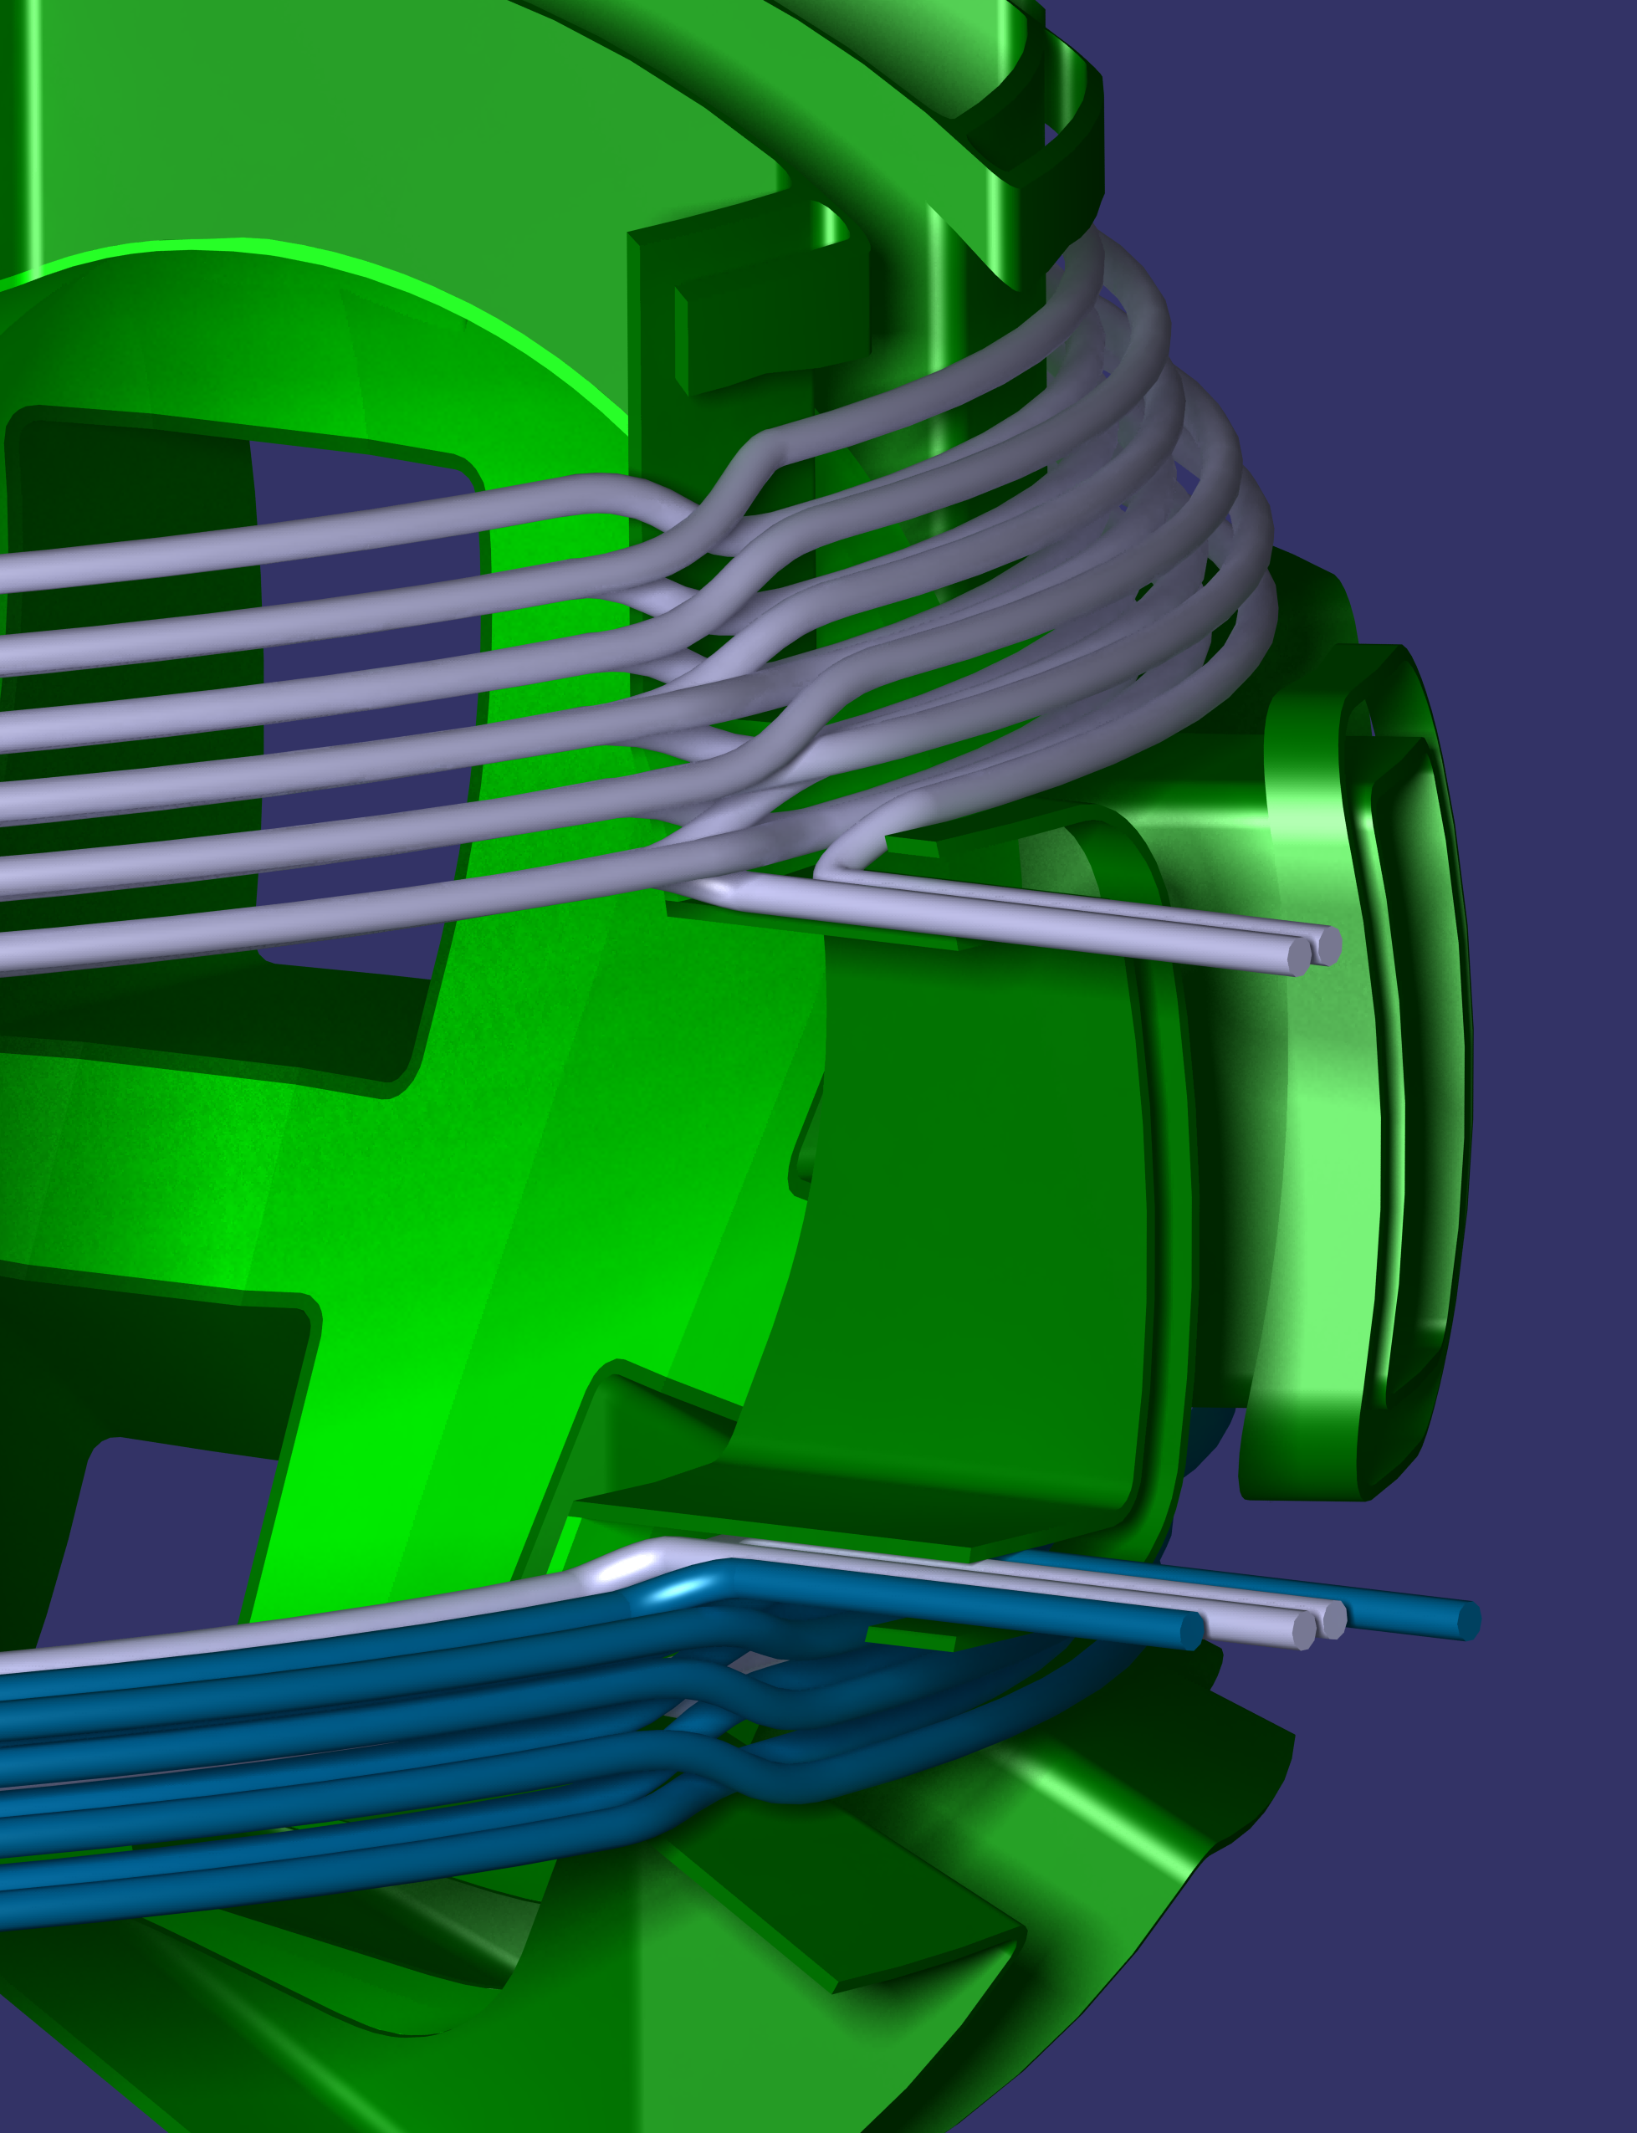
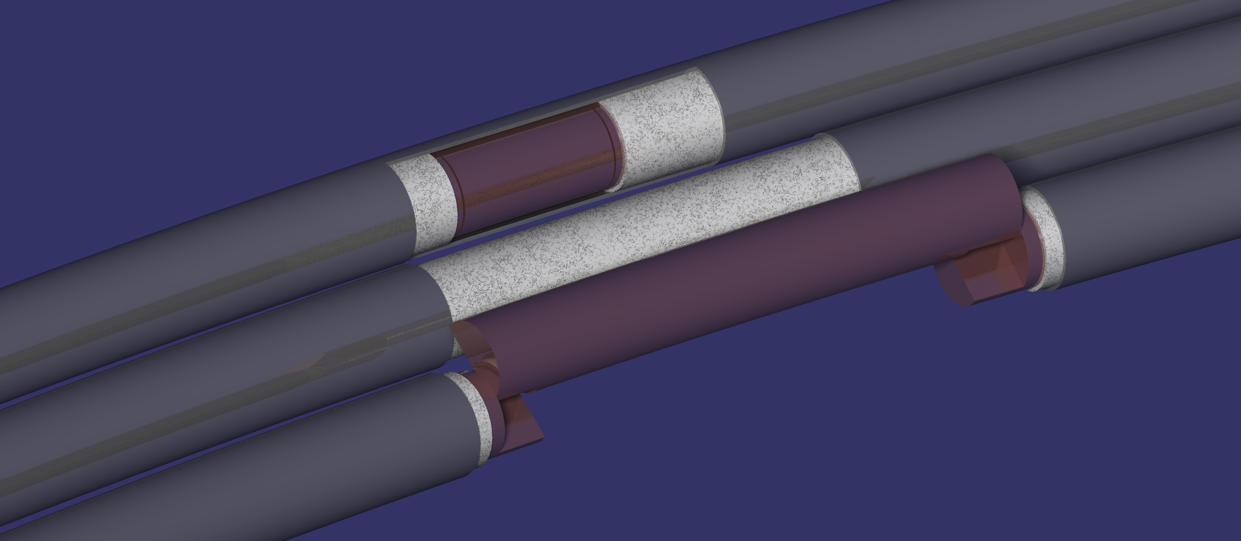
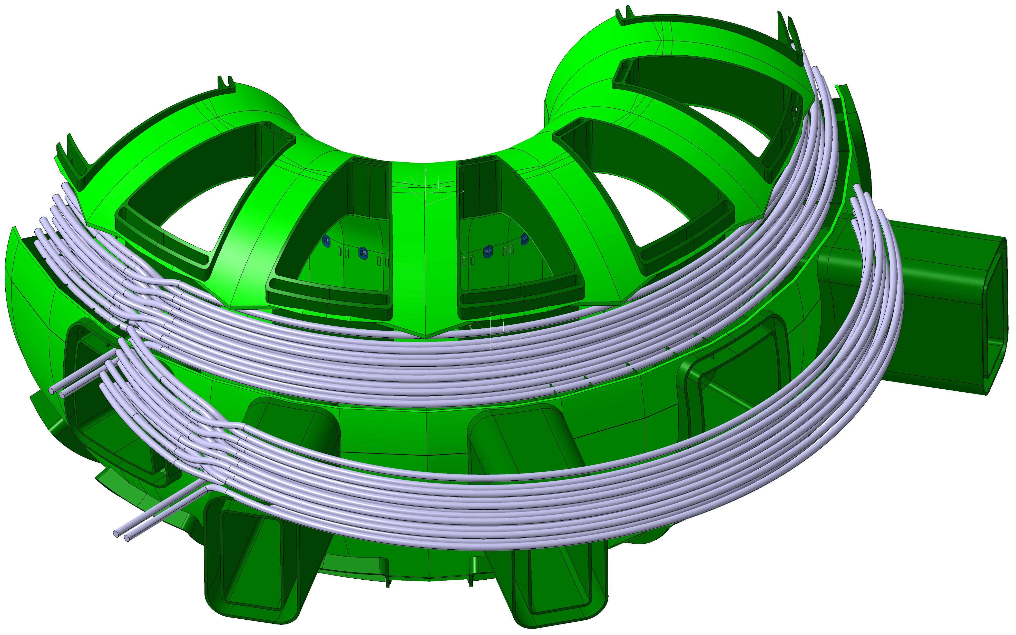
Intra-VV Coils Installation Concept
Federici, Bachmann, Siccinio | February 2024

Slide 20
Steels for VV and in-vessel components, DCT
Stainless steel @ T<200°C – 316L(N) or 316Ti:
long-term activation due to Nickel
    VV (316L(N)/XM-19): safety-class component, up to 2.75 dpa with moderate qualification program e.g., for weldments
    Divertor cassette / shield blanket (316Ti): non-safety-class, possibly non-PED component, up to 20-40 dpa, with moderate qualification program.
EUROFER: @ T>350°C: 40-50 dpa
@ T<350°C (PWR water-cooling): up to 20 dpa
Difficult manufacturing (post-weld heat treatment required), difficult design due to high pressure coolant
    Divertor cassette / shield blanket
    Outboard BB
    TBM
15-15Ti: water or He-cooling: up to 40-50 dpa (tbc), no post-weld heat treatment, not an off-the-shelf product,
material characterization program required
    currently not considered
VV | Divertor cassette |  |  | Shield blanket | Outboard BB
XM-19, 316L(N) | 316Ti | or | EUROFER | 316Ti | EUROFER
50 – ~60°C, 11 bar | ~50°C, 20 bar | or | PWR | ~50°C, 20 bar | PWR | or | Helium
Tentative choices:
C. Bachmann | FUTURE machine | July 2023 | Page 20

Slide 21
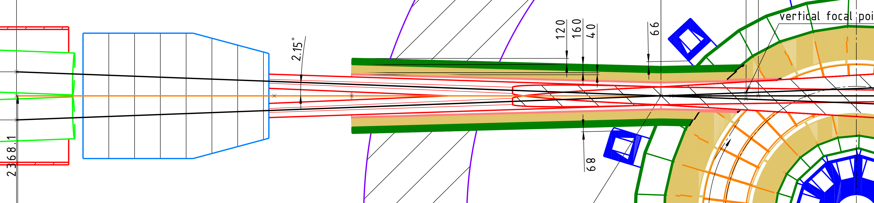
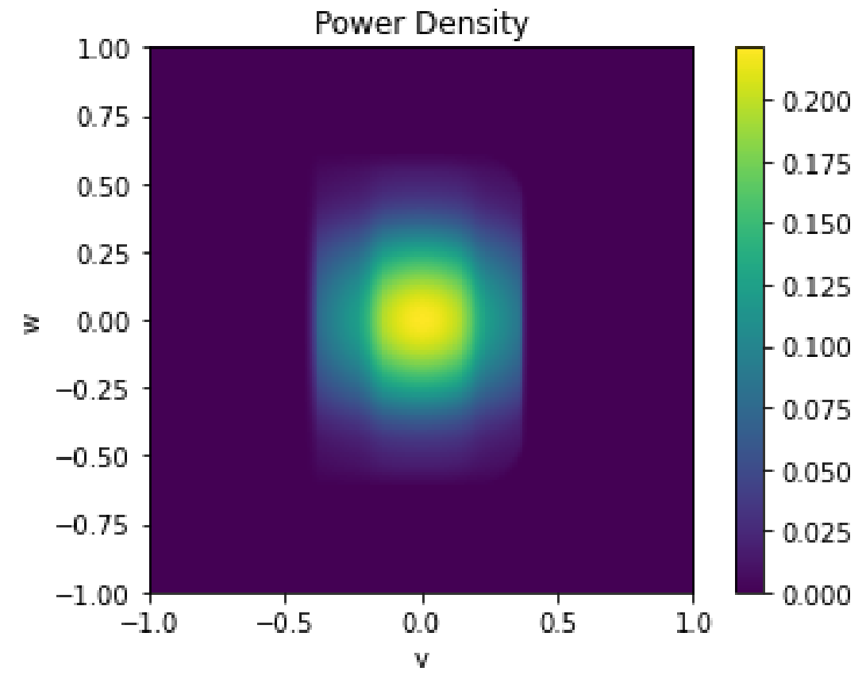
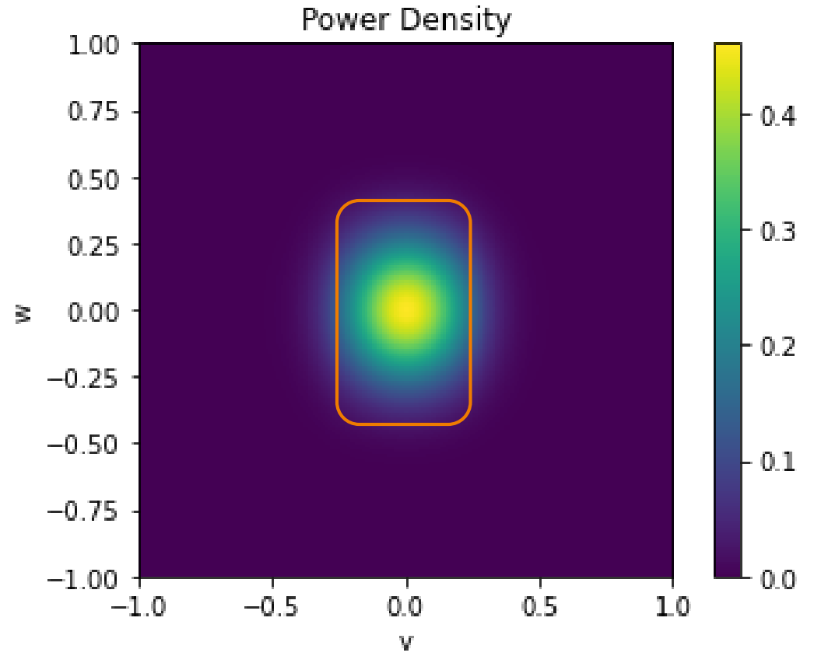
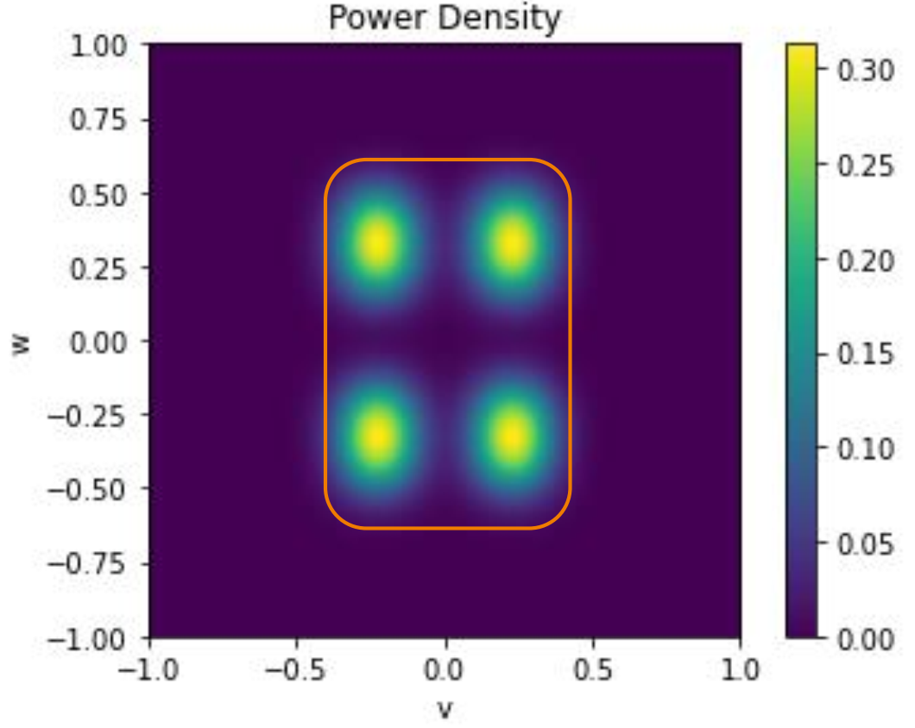
NBI geometrical transmission, IPP
#3
Beam geometry choices and assumptions:
All beamlets focussed on the level of the TF coils (point #2) → narrowest cross section.
Assumption: Beamlet divergence = 0.8°
Expected power transmission: 75%
#2
#3
#2
#1
Transmitted: 0.75
#1
Transmitted: 0.82
Transmitted: 0.97

Slide 22
NBI vacuum – internal pump, DCT, IPP
NBI concept
AUG NBIs with 4 sources per box: 13.3 MW/box
Cryo pumps inside each NBI box: surface area ≈36m²
NBI Box
Pumping speed
Ion Source
Beam D⁰ 13.3MW
Required pressure
≈1E-2 mbar (@300K)
Accelerator
Required gas target thickness
≈ 2 x 10²⁰/m²
25 mbar.L.s⁻¹
Neutralizer
1E-3 mbar
1E-4 mbar
1E-5 mbar
Cryo pump
NBI operation
FUTURE NBI power of ≈40MW ►3 boxes in operation, 1 in regeneration.
With staged pumping set-up required throughput is expected to be achievable
Explosion limit 1.6% hydrogen in air ► ≈2h operation, ≈ 40 min regeneration
A sufficiently low regeneration time (<40 min) is expected
A setup with 4 NBIs seems feasible

Slide 23
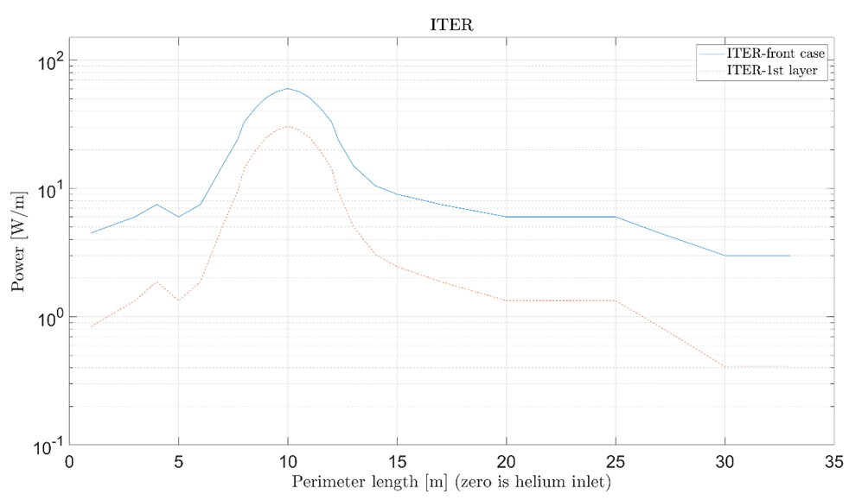
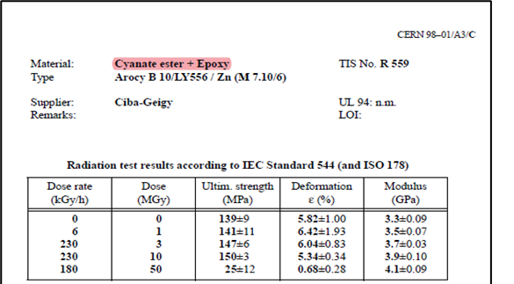
TF WP dose and heat load limits, DCT
Dose Limit: 50 MGy
Critical part: The winding pack ground insulation (plasma side) defines the dose limit.
For Cyanate Ester, or Cyanate Ester + Epoxy the limit is 50 MGy lifetime.
Predictions based on 10 fpy:
  Associated heat load: 305 W/m³ < 444 W/m³
  Associated n-flux: 1.9E10 n/s cm²
→ Dose limit is likely the driving criterion.
Heat load limit: 444 W/m³ (peak), 102 W/m³ (avg.)
Critical part: 1st layer of conductors.
Based on expected values in ITER TF coil.
We assume the same volumetric heat load on the first winding pack layer for ITER and VNS (which we know can be removed).

Slide 24
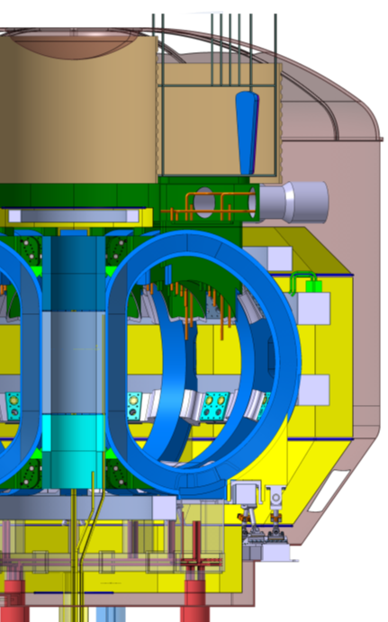
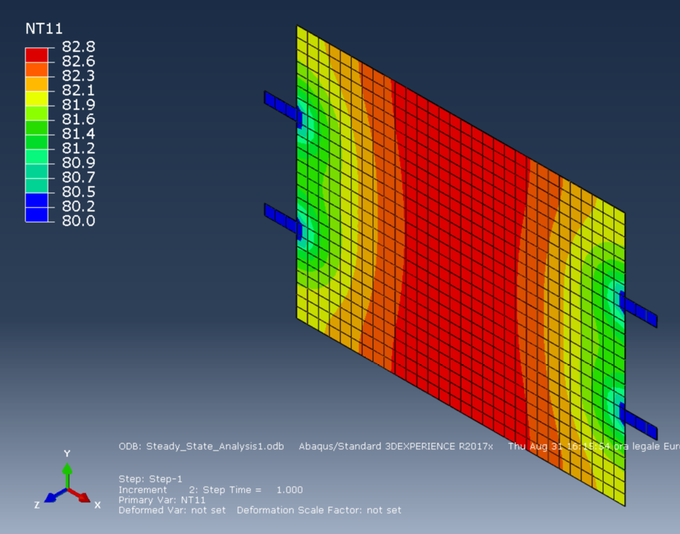
Thermal shields, DCT, ENEA, LT Calcoli
Cryostat thermal shield concept:
Current design basis:
Thermal shield with multi-layer insulation (MLIs) to reduce active cooling.
Conduction cooling in-between pipes via copper strips or similar
VV thermal shield concept:
Assessment of conduction cooling via copper strips to 80K pipes
TS UPR PORT PANEL LHS/RHS
TS UPPR PANEL LEFT/RIGHT
TS INBOARD PANEL LHS/RHS
TS EQ. PORT PANEL LHS/RHS
TS OUTBOARD PANEL LHS/RHS
TS LWR PANEL LHS/RHS
TS LWR. PORT PANEL LHS/RHS

