Slide 1
CFTR – EU DEMO March 2024
Safety overview and licensing
J. Elbez-Uzan
DEMO CENTRAL TEAM / SAFETY OFFICE
Project Leader WP SAE

Slide 2
Table of Content
1. Safety Objectives
2. Safety design engineer
3. Licensing Process

Slide 3
Safety objectives for fusion reactors and licensing process
Lower radiotoxic inventory
No long-term consequences of accident scenarios
Lower environmental legacy (less long-lived wastes)
Joelle Elbez-Uzan | CFTR-EU DEMO| 19th March 2024 | Page 3

Slide 4
 | workers | public | environment
Normal | 10 mSv/y Average | 0.1 mSv/y | Minimization of waste No environmental impact
Incident | 20 mSv max per incident | Below the annual authorized limit | Very limited impact
 |  | 0.1 mSv per incident
Design Basis Accident | Accidental doses less than 50 mSv (1) for emergency situations necessitating an intervention preventing others to receive doses | No immediate or deferred counter measures (no sheltering, no evacuation) | No accident leading to exceed World health Organization food and water quality criteria
 |  | 10 mSv effective dose for both short term and long-term situations for fence and most exposed populations
Beyond Design Basis Accident / Design Extended Conditions | Constraints from implementation of accident / post-accident management < 100 mSv (2) | No cliff edge effects; no sheltering; counter measures limited in time and space
IAEA objective in G.S.R part 7 (req 5.55) no emergency worker is subject to an exposure in an emergency that could give rise to an effective dose in excess of 50 mSv other than: (1) For the purposes of saving human life or preventing serious injury; (2) When taking actions to prevent severe deterministic effects or actions to prevent the development of catastrophic conditions that could significantly affect people and the environment; (3) When taking actions to avert a large collective dose.
IAEA objective in G.S.R part 7 (lowest table 1.1 guidance values)

Slide 5
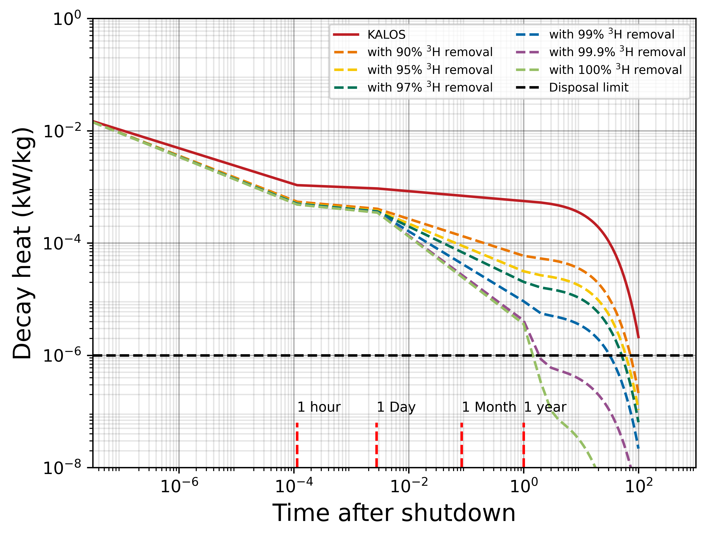
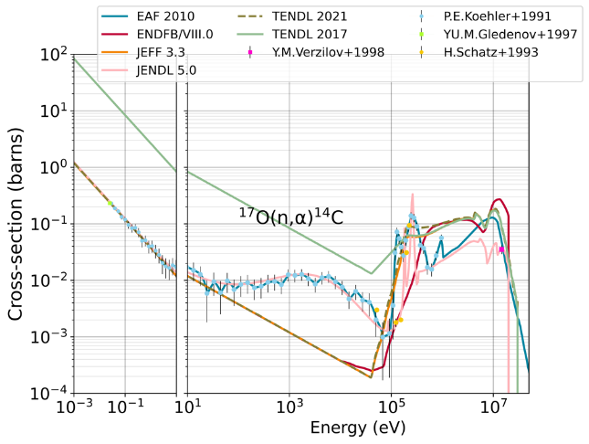
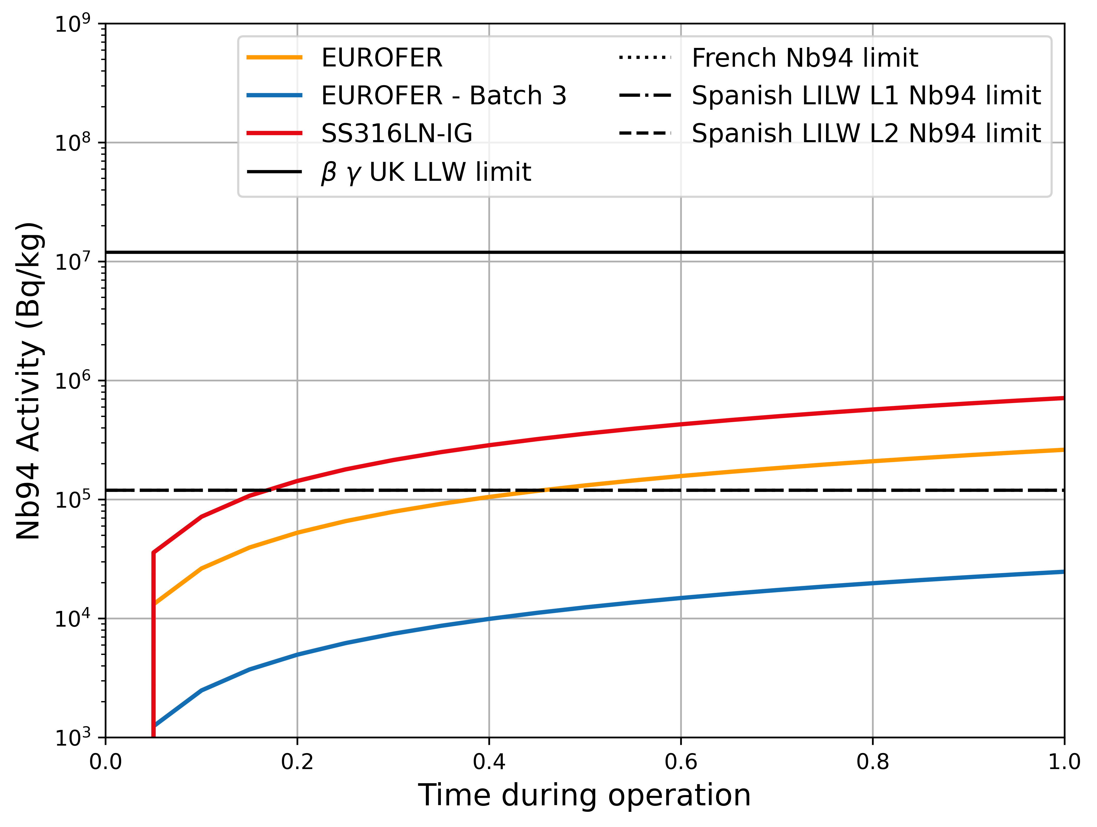
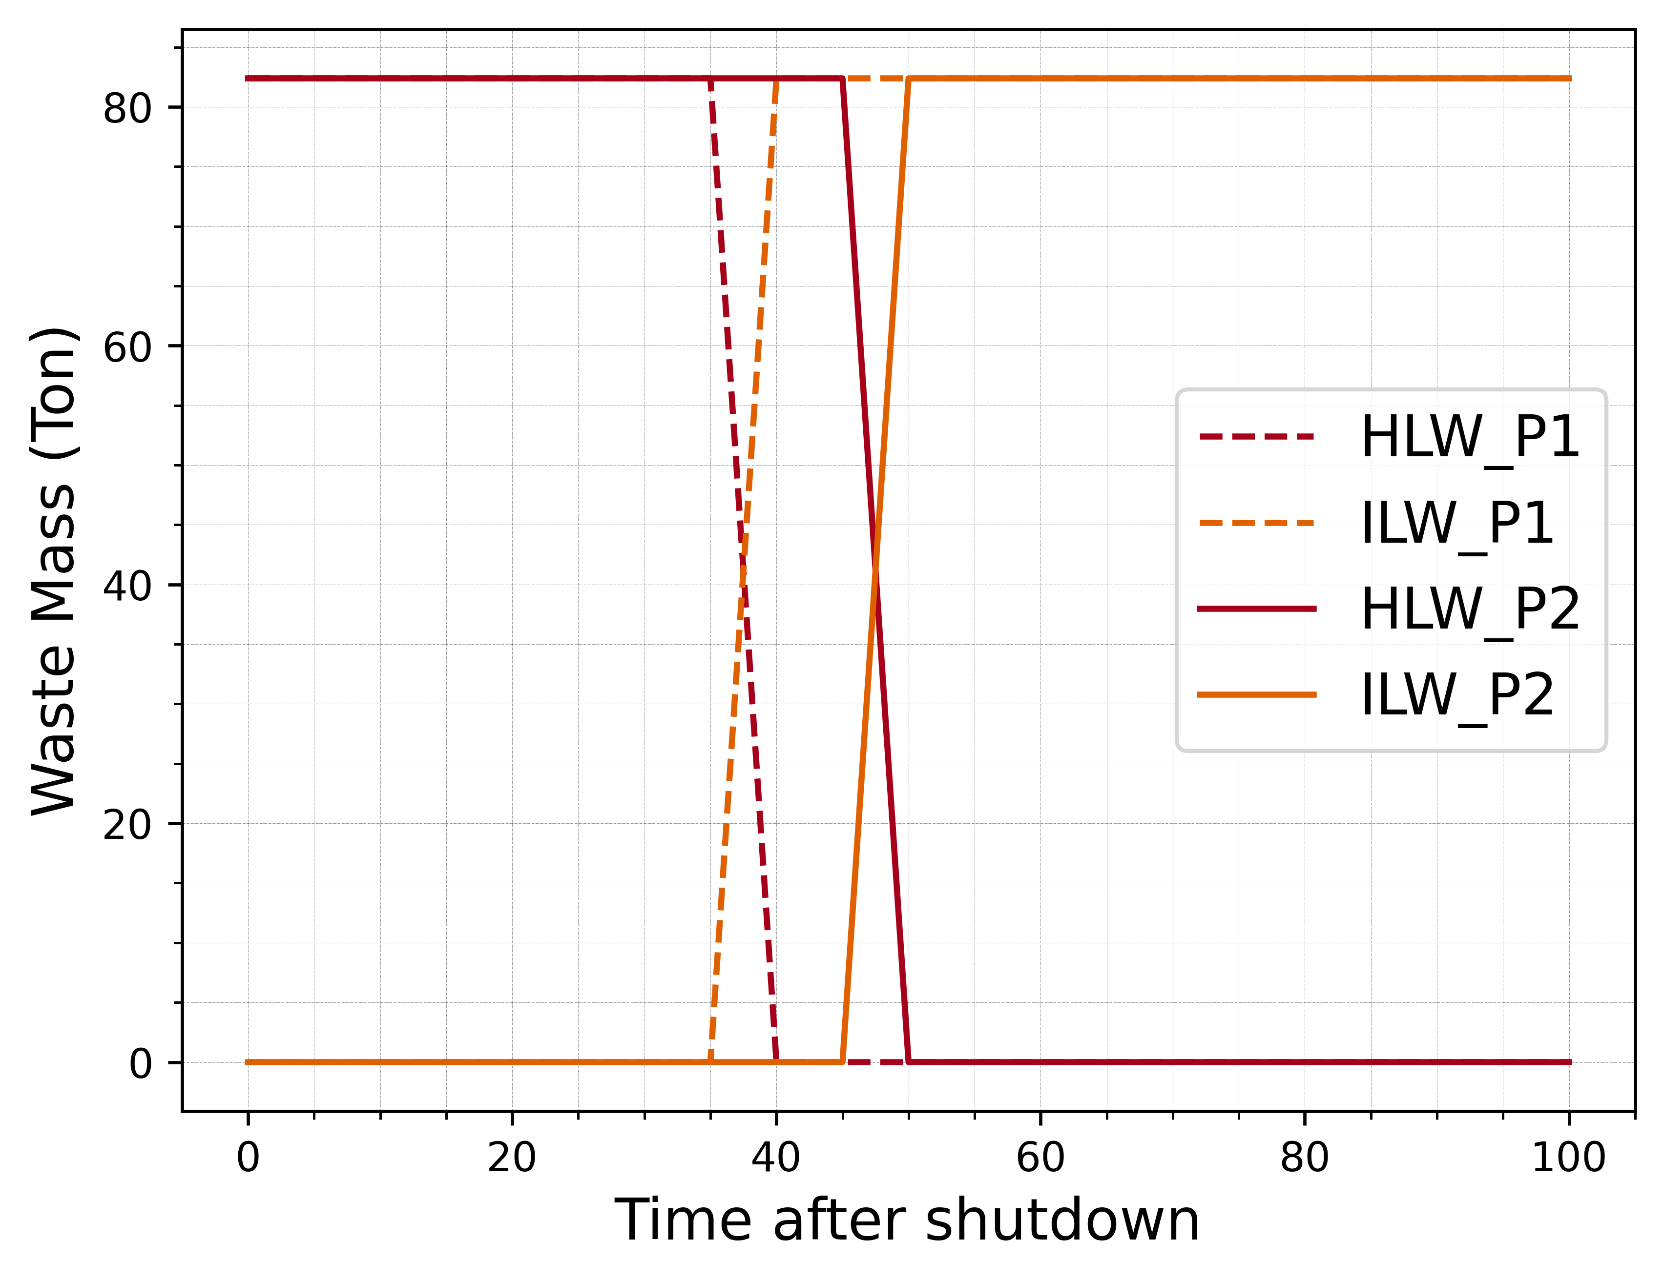
Parameters affecting waste classification
Choice of Nuclear Data Library
Tritium removal by fuel cycle
Shielding and moderation by water
Impurity content in materials
Operation time

Slide 6
Waste amounts
Global waste classification for the HCPB and the WCLL blanket design in DEMO 2017 baseline model according to the UK and the French waste classification; assuming 99% tritium removal through fuel cycle
HLW: High Level Waste
ILW: Intermediate Level Waste
LLW: Low Level Waste
ExW: Exempted Waste
OoS: Out of Scope (only in UK)

Slide 7
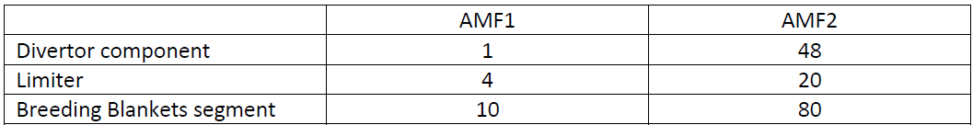
Active Maintenance Facility
Pre-conceptual design developed under EC framework contract with Ansaldo
  Objective: two bounding variant studies targeting the demonstration of the maintainability of the DEMO machine:
    - A first variant named AMF1 should be focused on setting up a minimal maintenance scenario → learning phase;
    - and a second variant named AMF2, dealing with a larger spectrum of maintenance scenarios → maintainability must be effective (availability target).
  Main functions: transportation, receipt and dispatch, storage, decontamination (dust, Activated Corrosion Materials), cutting, detritiation, characterization, packaging & waste buffer storage.

Slide 8
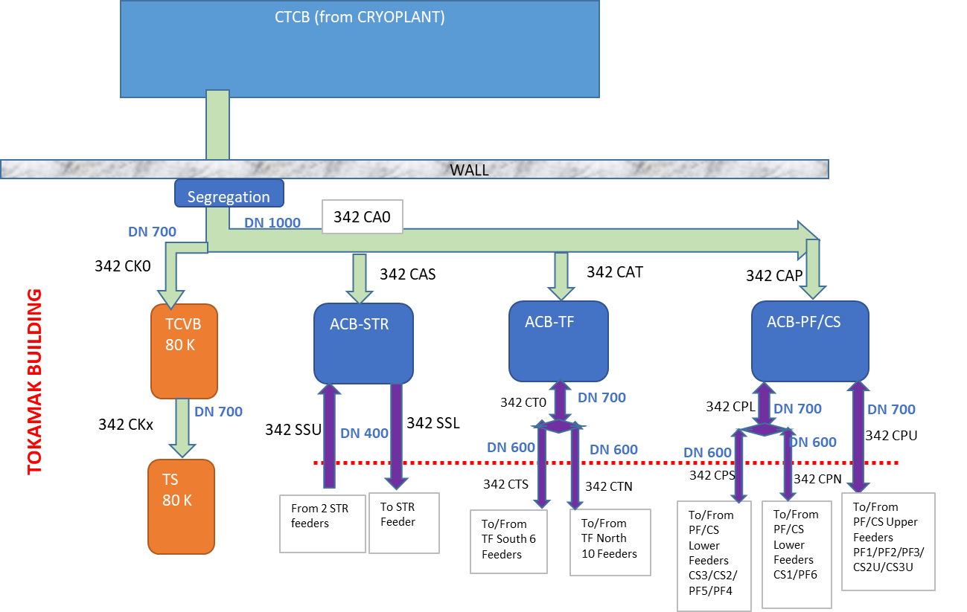
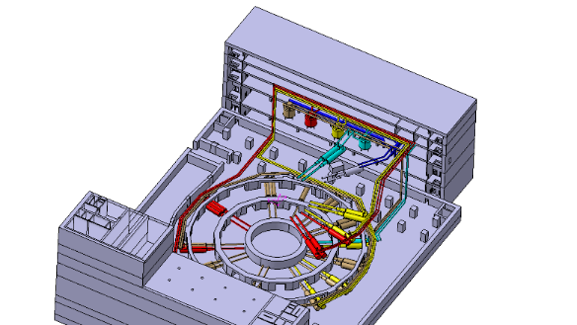
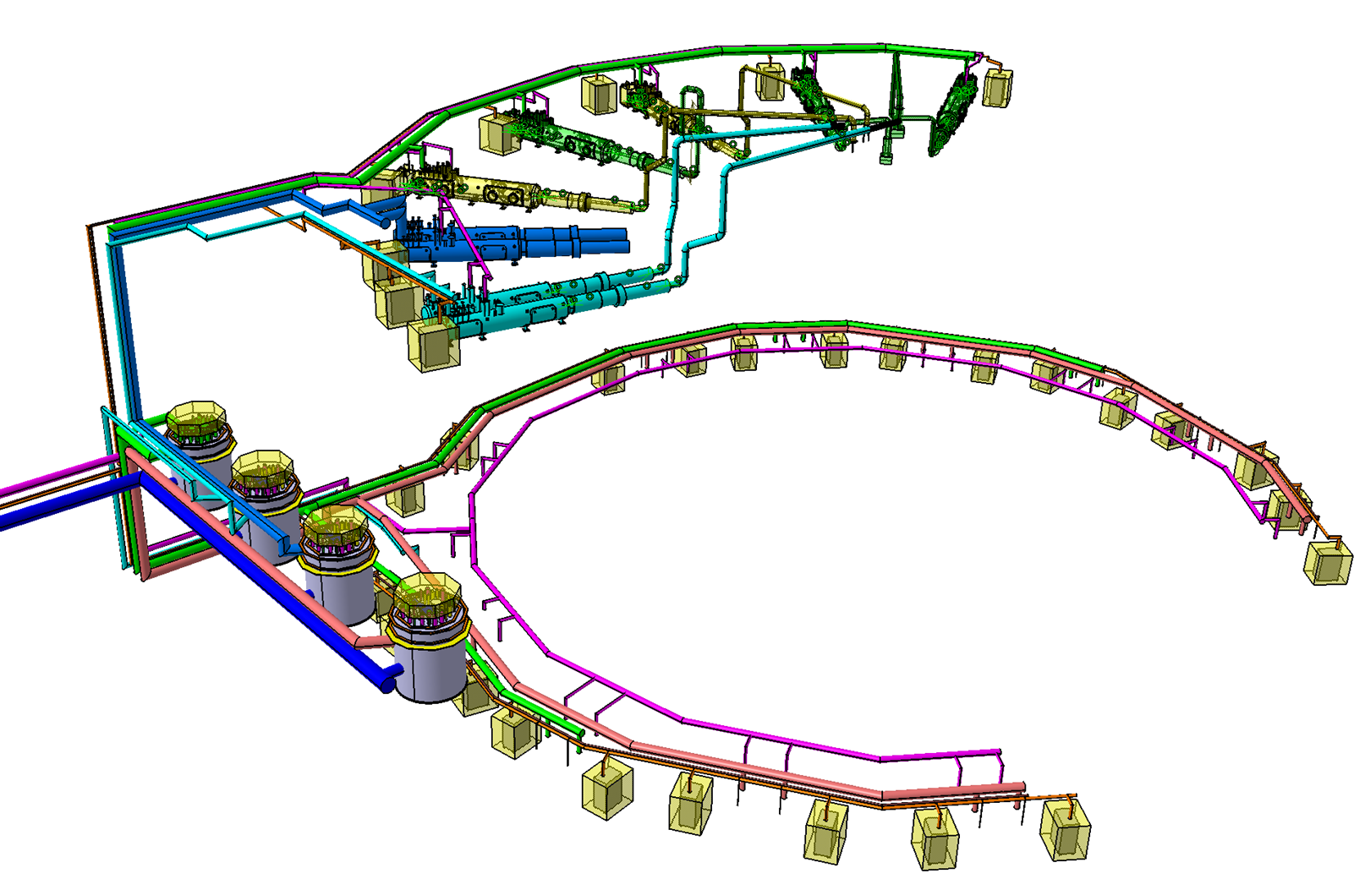
Task on Cryoplant/ Cryoplant Engineer 2023
A conceptual design of the DEMO Cryoplant has been defined in 2019-2021 with support of CEA and Industry.
In 2022 - 23 attention was devoted to Cryo-distribution in the tokamak building
Consolidated the heat loads, defined the PFDs, implementation in 3D of the preliminary design
Definition of the input data for the TS with Industry via CEA to be launched in 2024: lessons learnt from ITER (isolation/segregation of the two huge cryo-inventories, i.e. in cryoplant and in TB, limitation of accidental inventory released in TB, adequate layout to avoid challenging of Safety functions because of decrease of the environmental temperature.
Cryodistribution in the tokamak building involved two floors (as in ITER)
Cryogenic lines + ACB’s

Slide 9
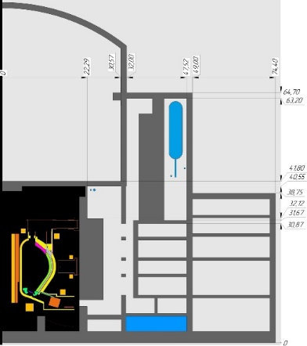
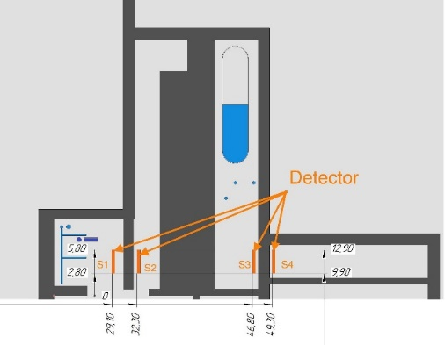
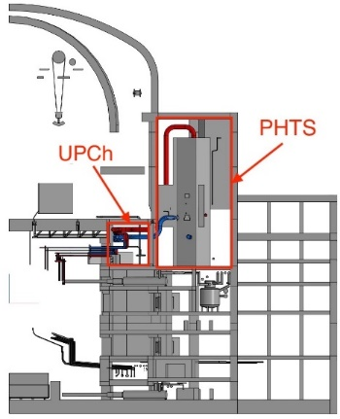
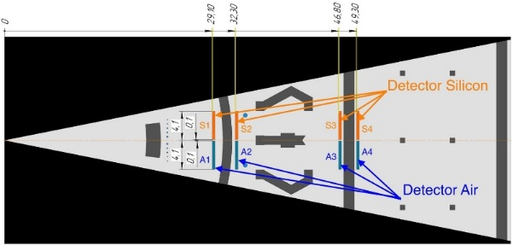
Dose Rates and Shielding analysis (Ukrainian University)
Objective of the task is the assessment of the dose rate during operation and at shutdown in areas of the tokamak building (e.g. PHTS vaults, UPC, Port Cell, etc.) and a shielding analysis too.
A simplified water-cooled breeding blankets (WCLL BB) Primary heat transfer system was created using the Monte Carlo Serpent code.
Detector | Neutron flux, n/(cm²·sec) | Photon flux, p/(cm²·sec) | Biological dose rate, μSv/h | Dose rate in silicon, Gy/s
S1 (UPCh) | 8.4E+06 | 1.6E+10 | 2.9E+08 | 1.5E+01
S2 (PHTS_01) | 6.7E+06 | 2.4E+10 | 5.0E+08 | 1.7E+01
S3 (PHTS_02) | 4.0E+06 | 1.0E+10 | 1.9E+08 | 6.4E+00
S4 (BLDG_14_mid) | - (low statistic) | 1.6E+02 | 1.2E+02 | - (low statistic)
The Serpent simulation results for the operational mode mainly from activated water (N-16, N-17)
Detector | Photon flux, p/(cm²·sec) | Biological dose rate, μSv/h | Dose rate in silicon, Gy/s
S1 (UPCh) | 3.8E+02 | 2.9E+00 | 2.2E-10
S2 (PHTS_01) | 2.3E+02 | 1.7E+00 | 1.1E-10
S3 (PHTS_02) | 1.2E+02 | 8.7E-01 | 5.1E-11
S4 (BLDG_14_mid) | - (low statistic) | - (low statistic) | - (low statistic)
The Serpent simulation results for the maintenance mode case (radioactivity only from ACP in water)
Objectives : 10 μSv/h workers, 0.5 μSv/h population

Slide 10
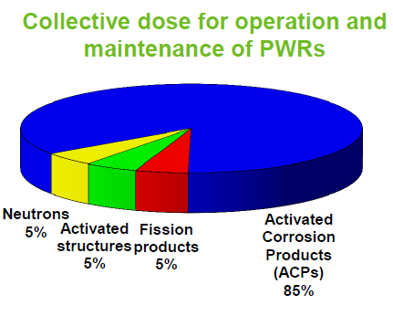
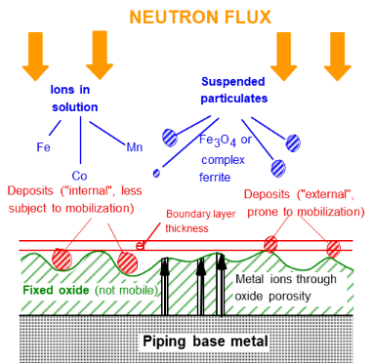
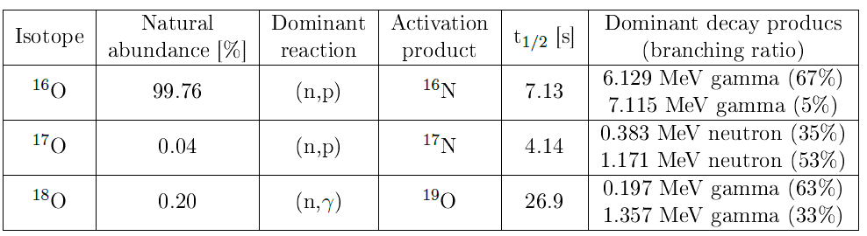
Impact of the water activation on the worker doses:
Water is the coolant of Div, FW, BB (WCLL) and VV . It becomes radioactive due to
  Activated Corrosion Product (ACP)
The most dosing situations shall be identified
The management of the water contamination thresholds shall be implemented
Courtesy: F. Dacquait, CEA
2. H and O of the cooling water
The impact to the public and the workers in the surrounding areas could be significant
The intelligent layout
The impact on the electronics shall be solved by suitable location of the SIC electronic
  Fusion energetic neutron fluxes produce ³H, ¹⁶N, ¹⁷N, ¹⁸N, ¹⁹O (negligible in fission reactors where the neutron energies are lower, 14.1 versus 2.5 MeV).
Radioactive contamination of water is one of the driver the integration in the building and systems design approach.

Slide 11
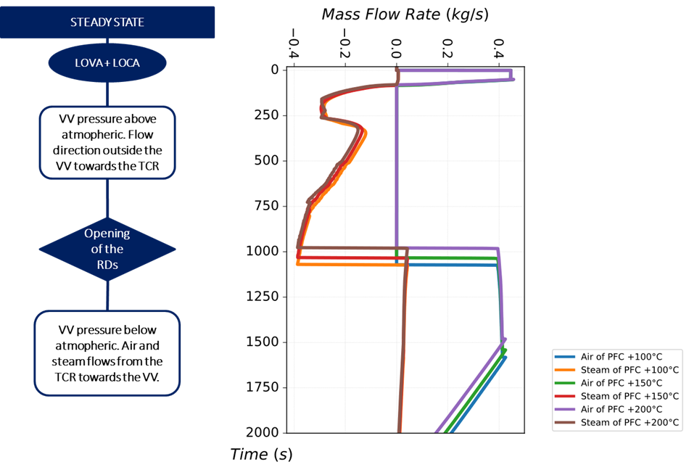
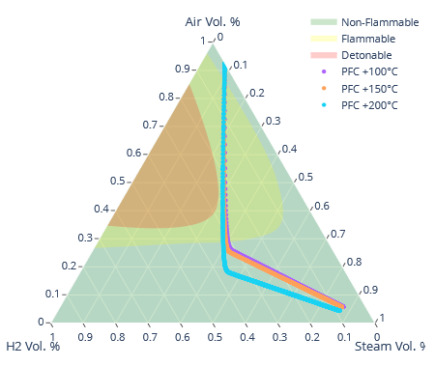
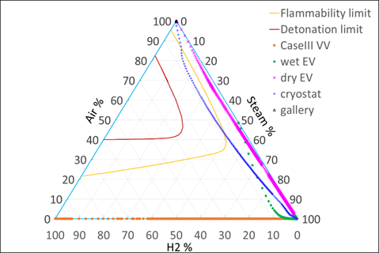
Outcomes accident analysis
Several studies have assessed the reactor structures to withstand different loads, from hydrogen explosion risks, cryogenic pressurization, fire hazards, and tritium release scenarios.
A combined small in-vessel LOCA and small LOVA has been investigated for both WCLL and HCPB concepts for the risk associated with hydrogen explosion
WCLL in E-DS
HCPB
Both WCLL and HCPB designs could effectively prevent hydrogen explosions in the VV. However, this framework has emphasized the importance of VVPSS design in mitigating explosion risks by installing PARs within the VVPSS tanks.
Reference: WCLL: EFDA_D_2RA35Q HCPB: EFDA_D_2RHX3E
Joelle Elbez-Uzan | CFTR-EU DEMO| 19th March 2024 | Page 11

Slide 12
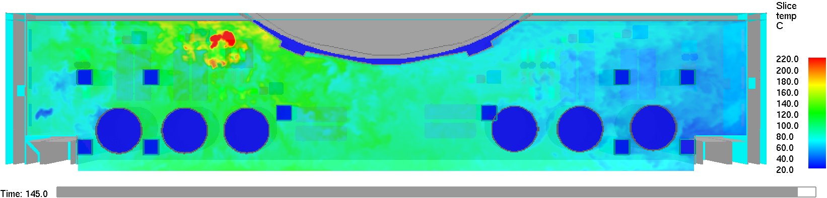
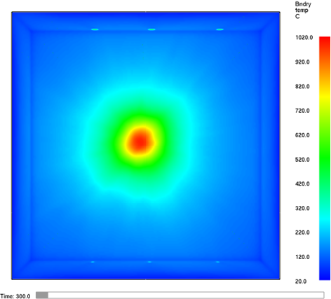
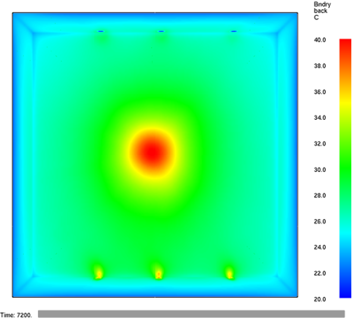
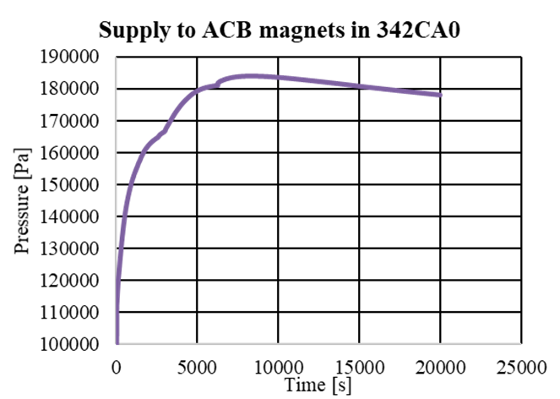
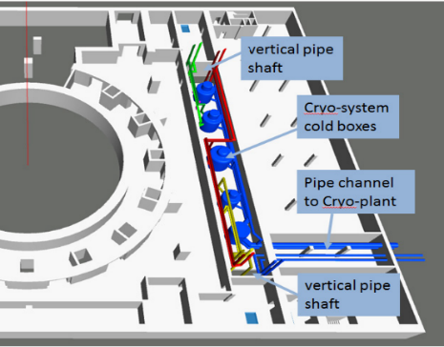
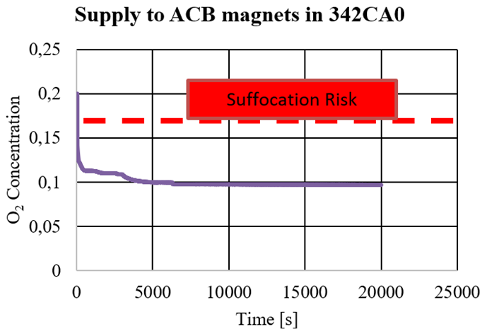
Outcomes accident analysis
Fire accident analysis
Evaluate potential and worst-case fire scenarios.
Understand impact on fire zoning and radioactive release risks.
Preliminary Findings:
  Fire sector boundary robustness analyzed.
Importance of Design Considerations:
  Compartmentalization to mitigate fire hazards.
  Ventilation to ensure confinement and reduce fire risks.
Accidents in cryogenic systems
Study on pressurization of Tokamak Building Rooms (ACB area) due to a break of a liquid Helium pipe
Preliminary Findings:
  Liquid Helium pipe break cause high pressurization: P higher than 200 kPa if over 400 kg of Helium is spilled.
  Temperature potential drop below 200 Kelvin, posing risks to equipment/instrumentation.
Importance of Design Considerations:
  Mitigation strategies onvestigated: Flaps and isolation valves.
Joelle Elbez-Uzan | CFTR-EU DEMO| 19th March 2024 | Page 12

Slide 13
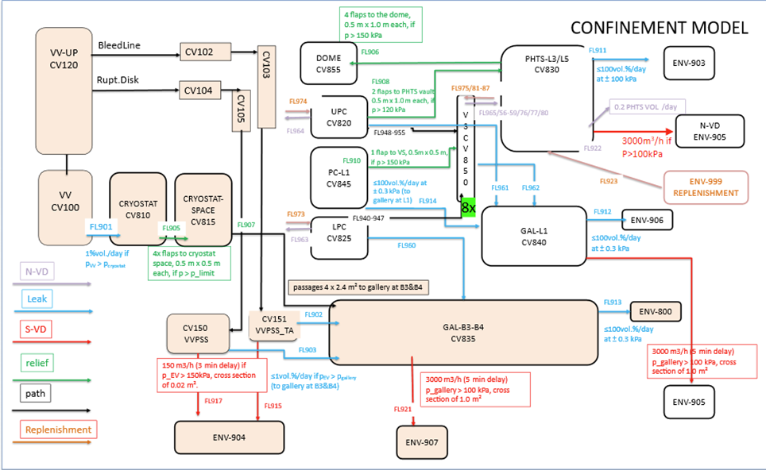
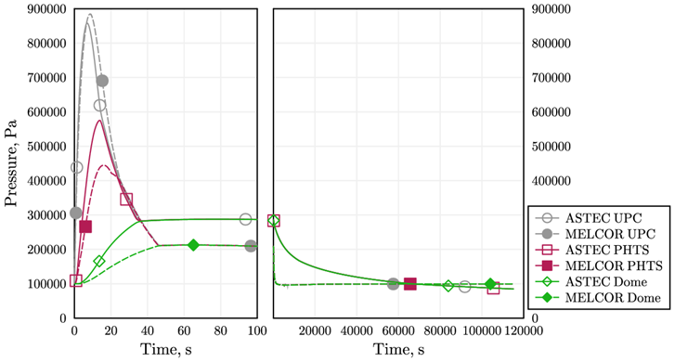
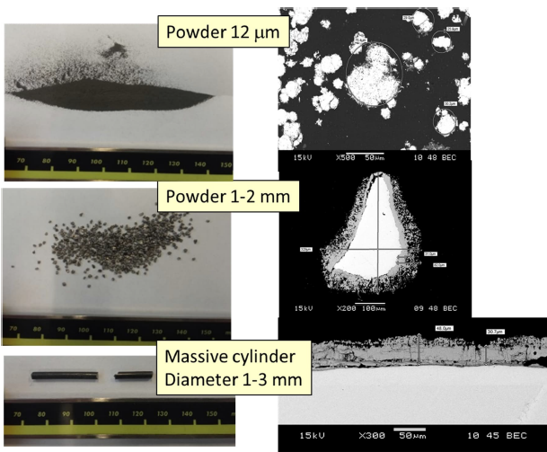
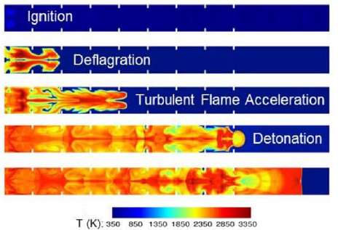
Outcomes accident analysis
DEC Analysis & code benchmarking
Double end guillotine pipe break in FW and BZ HTS in UPC room (MELCOR-ASTEC benchmark)
Preliminary Findings:
  Approximately 425 tons of water released into exVV containment volumes within 143 seconds
  UPC room peak at 887.2 kPa within 8.65 seconds.
Importance of Design Considerations:
  Highlighted the need for pressure mitigation systems to address accidental loads that jeopardize the tokamak building's integrity
Further activities
Tritium accident scenarios
Liquid metal accident analyses
Dose calculation and dose code development
Safety code development
Experiments for tungsten/water interaction
Development of OSCAR code for ACP calculation in water and LiPb
Development of codes for activation calculation in flowing fluids
Joelle Elbez-Uzan | CFTR-EU DEMO| 19th March 2024 | Page 13

Slide 14
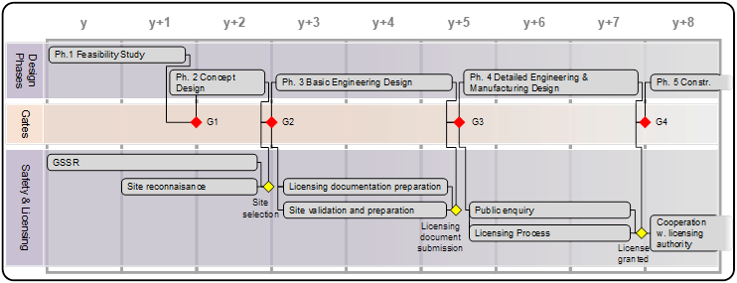
LICENSING PROCESS - REMINDER

Slide 15
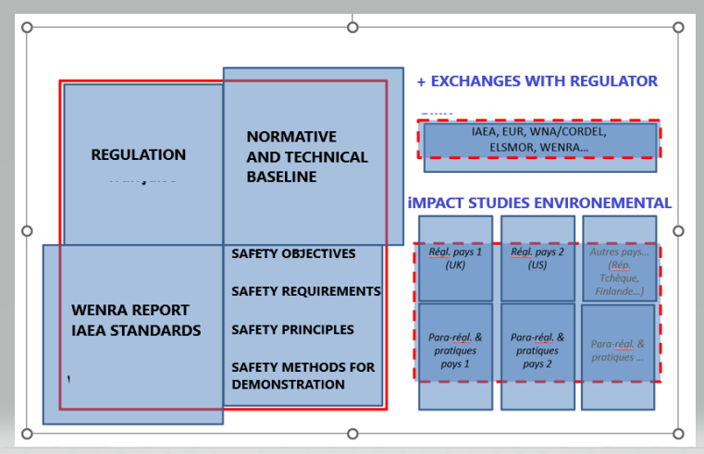
BUILD A SAFETY BASELINE – SAFETY ASSETS OF FUSION

Slide 16
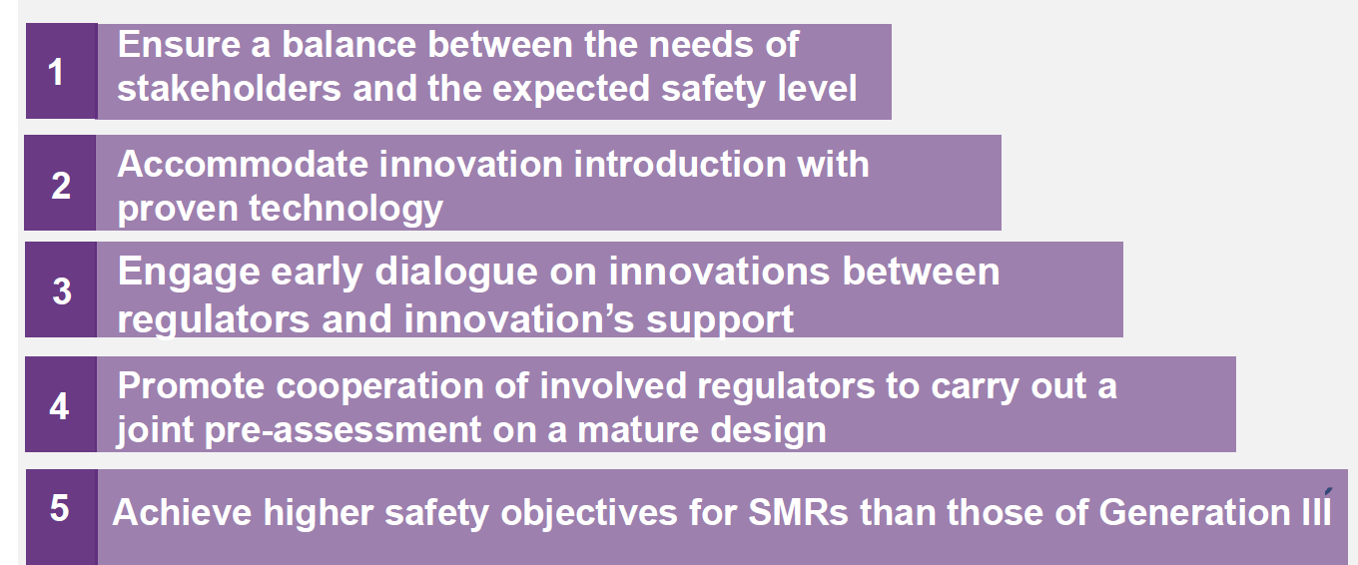
KEY ASSETS FOR A SUCCESSFUL LICENSING PROCESS
Fusion vs Fission

Slide 17
QUALIFICATION SAFETY COMPONENTS/FUNCTIONS
Qualification is a key parameter in the safety demonstration
Objective of qualification: demonstrate that the safety function can be achieved at any time to bring and maintain the safe state of the plant

Slide 19
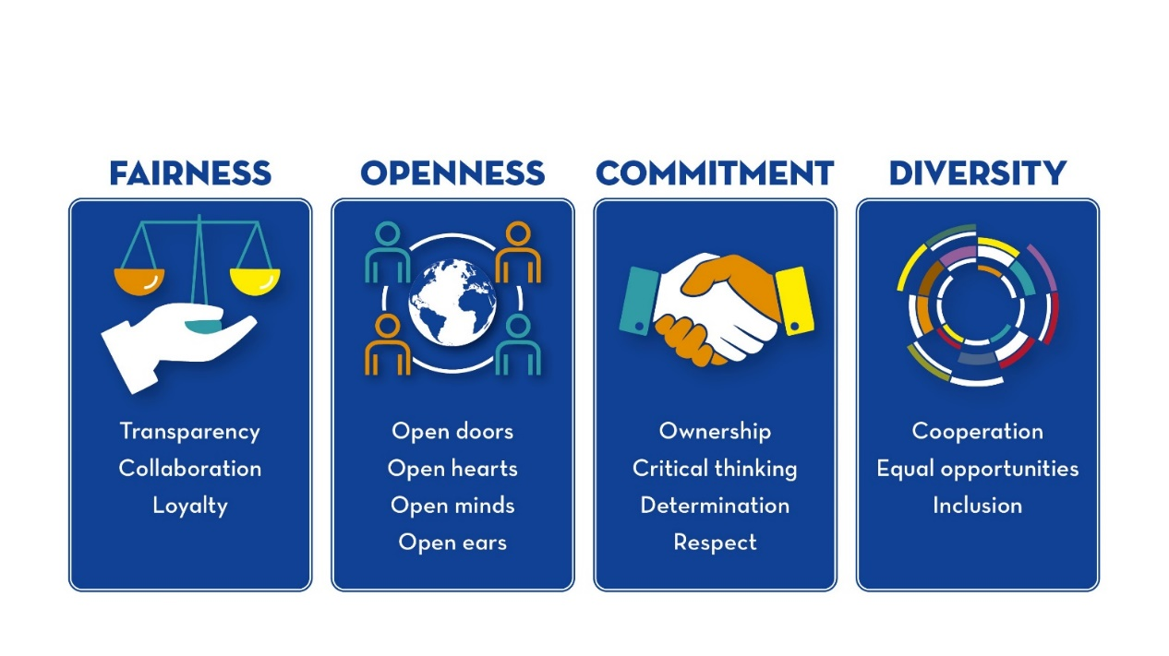
THANK YOU FOR YOUR ATTENTION !

