Slide 1


  Fusion Safety and Radiation Protection
  for BEST
Presented by Shanliang Zheng
On behalf of Safety Working Group
BEST Team
  March 19, 2024
  EU-China Collaboration on CFETR and EU-DEMO Reactor Design,
  4th Technical Exchange Meeting, Mar. 19-21, 2024, KIT, Germany

Slide 2
Introduction
Staged operation
Radiation safety
Tritium safety
Summary
CONTENTS

Slide 3


Introduction (1/3)
BEST experimental facility
  Cat.-I radiation facility → radiation safety
  Cat.-A site of handling unsealed radioactive materials → tritium handling
Individual licenses for radiation safety and tritium
  Site construction and machine assembly
  Radiation safety license for operation
  License to hold/handle tritium
BEST will operate in pulsed D-T mode and produce fusion power up to 200MW
  Pulsed D-T operation
    Short pulse: P_{fus} 100-200MW, 5-10 s, ≤7.1E+20 n (4mg-T)
    Long pulse: P_{fus} 20-50MW, 1000 s, ≤1.8E+22 n (90mg-T)
  T inventory site limit: 110 grams

Slide 4
Introduction (2/3)
Staged approach for BEST licensing
  To periodically renew/update licenses for operation and tritium material handling
  To minimise on-site tritium inventory
  To allow the development of RH technology and equipment
Staged D-T operation
  D-T commissioning phase: 2g+3g+5g T
  Phase I: neutron yield ~ 2.5E+23 ➔ (to consume ~1.25 g-T)
  Phase II: neutron yield ~1E+24 ➔ (to consume ~5 g-T)
  Phase III: neutron yield ~ 2.5E+25 ➔ (to consume ~125 g-T)
Safety functions
  Confinement of radioactive and explosive materials
  Limitation of ionizing radiation

Slide 5
Introduction (3/3)
Radiation safety
  Nuclear performance
  Radwaste assessment: no generation of high or intermediate level waste
  Shielding adequacy
Tritium safety
  To minimize the impact of tritium release to the environment
  To minimize tritium inventory, e.g. optimization vs. operation scenario
  Confinement implementation
  Security and accountancy
Other hazards, e.g. earthquake, flood, fire
Other source terms, e.g. activated dust, ACP, cryogenic coolant, stored energy

Slide 6
Staged operation (1/4)
D-T commissioning phase
Operation preparation
  To test all fueling systems and neutron diagnostics
  To develop tritium measurement techniques
  To explore effective methods for tritium removal and recovery
  To establish the T fuel cycle
0.01% “global” burn-up fraction assumed
P_{fus} (MW) | pulse length (s) | pulse num | n-yield | T required (g/pulse) | T consumed (g/pulse) | T consumed (mg)
10 | 5 | 200 | 3.35E+21 | 0.9 | 8.7E-5 | 18
20 | 5 | 100 | 3.35E+21 | 1.8 | 1.8E-4 | 18
100 | 1 | 100 | 3.35E+21 | 1.8 | 1.8E-4 | 18
total | / | 400 | 1.1E+22 | / | / | 54

Slide 7
Staged operation (2/4)
Phase-1: neutron yield up to 2.5E+23
To minimize tritium inventory required for targeted operation, ~20g-T
  To explore effective methods for tritium removal and recovery
  To achieve T fueling efficiency ~20% ➔ preparation for next phase
To start from low burn-up fraction, e.g. ~0.05%
P_{fus} (MW) | pulse length (s) | pulse num | n-yield | T required (g/pulse) | T consumed (g)
20 | 10 | 3000 | 2.14E+23 | 3.5 | 1.06
50 | 5 | 300 | 2.67E+22 | 4.4 | 0.13
200 | 5 | 10 | 3.56E+21 | 17.7 | 0.02
total | / | 3310 | 2.14E+23 | / | 1.2
Example Operation Scenario

Slide 8
Staged operation (3/4)
Phase-2: neutron yield up to 1E+24
To achieve long pulse operation, e.g. 100s for 20MW fusion power
To achieve higher burn-up fraction ➔ preparation for next phase
  0.4% for 50MW
  1% for 200MW
Start from 0.1%
P_{fus} (MW) | pulse length (s) | pulse num | n-yield | T required (g/pulse) | T consumed (g)
20 | 100 | 1000 | 7.12E+23 | 17.7 | 3.54
50 | 5 | 3000 | 2.67E+23 | 2.2 | 1.33
200 | 5 | 100 | 3.56E+22 | 8.9 | 0.18
total | / | 4100 | 1.01E+24 | / | 5.1
Example Operation Scenario

Slide 9
Staged operation (4/4)
Phase-3: neutron yield up to 2.5E+25
To achieve long pulse operation up to 1000s ➔ heat extraction demonstration
To repeat burn-up fraction for 50MW (~0.4%) and 200MW (~1%)
Exploration/trial experiments
  Direct internal recycling for T fuel cycle
  A few longer pulse up to 3600s (constrained by T → lower fusion power, e.g. 10MW)
  High-Q operation → fusion power up to 400MW
P_{fus} (MW) | pulse length (s) | pulse num | N-yield | T required (g/pulse) | T consumed (g)
50 | 10 | 30000 | 5.34E+24 | 1.1 | 26.59
50 | 1000 | 100 | 1.78E+24 | 110.8 | 8.86
200 | 10 | 25000 | 1.78E+25 | 1.8 | 88.62
400 | 5 | 10 | 7.12E+21 | 1.8 | 0.04
total | / | 55110 | 2.49E+25 | / | 125
Example Operation Scenario

Slide 10
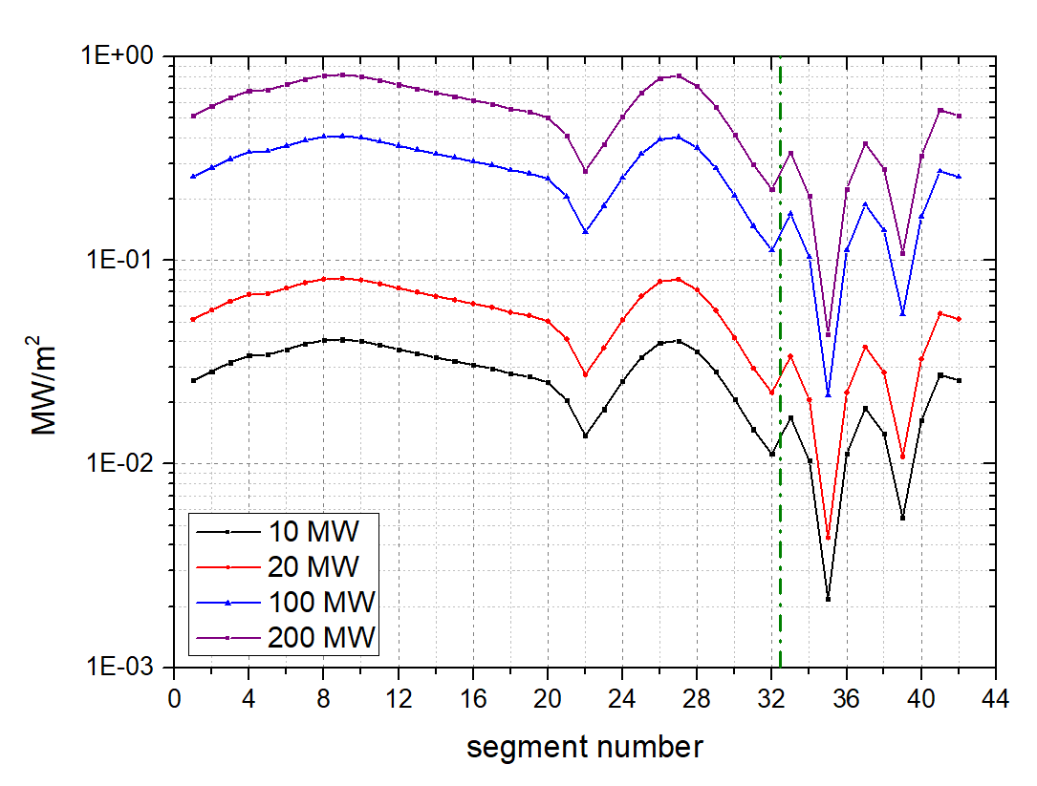
Radiation safety (1/4) – nuclear responses
Radiation damage: ~0.04 DPA (corresponding to 2.5E+25 neutron yield)
Shielding capability
  From plasma chamber to VV, the attenuation factor can be up to 3-4 orders of magnitude
  Up to 2-3 orders of magnitude attenuation through 40cm shielding blanket
  Caveats in the design integration with penetrations and gaps
Neutron Wall Load

Slide 11
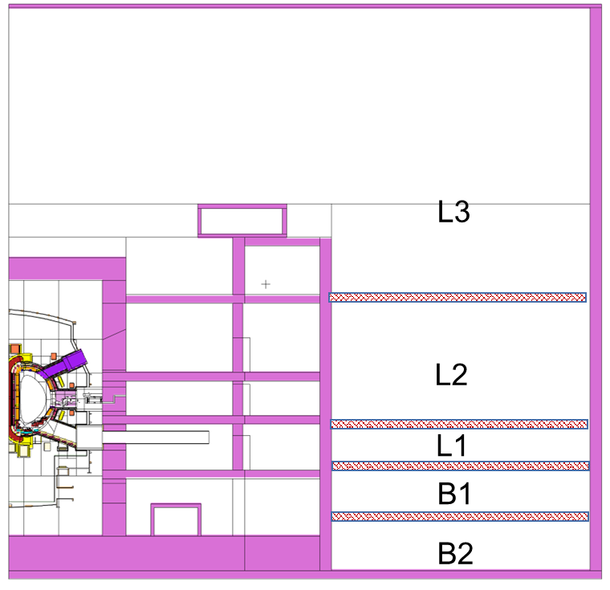
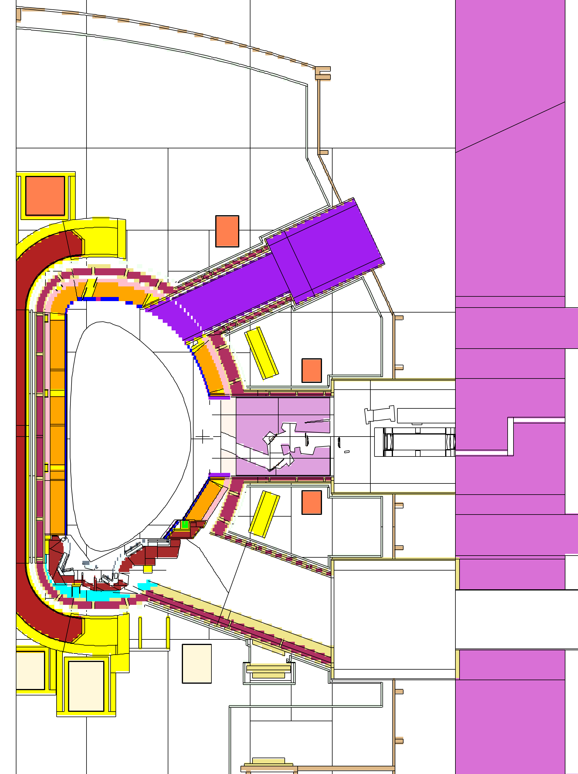
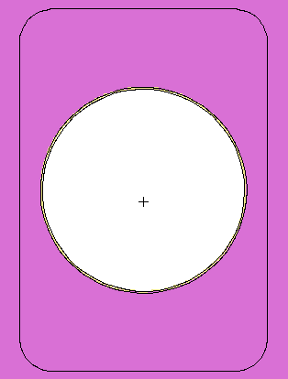
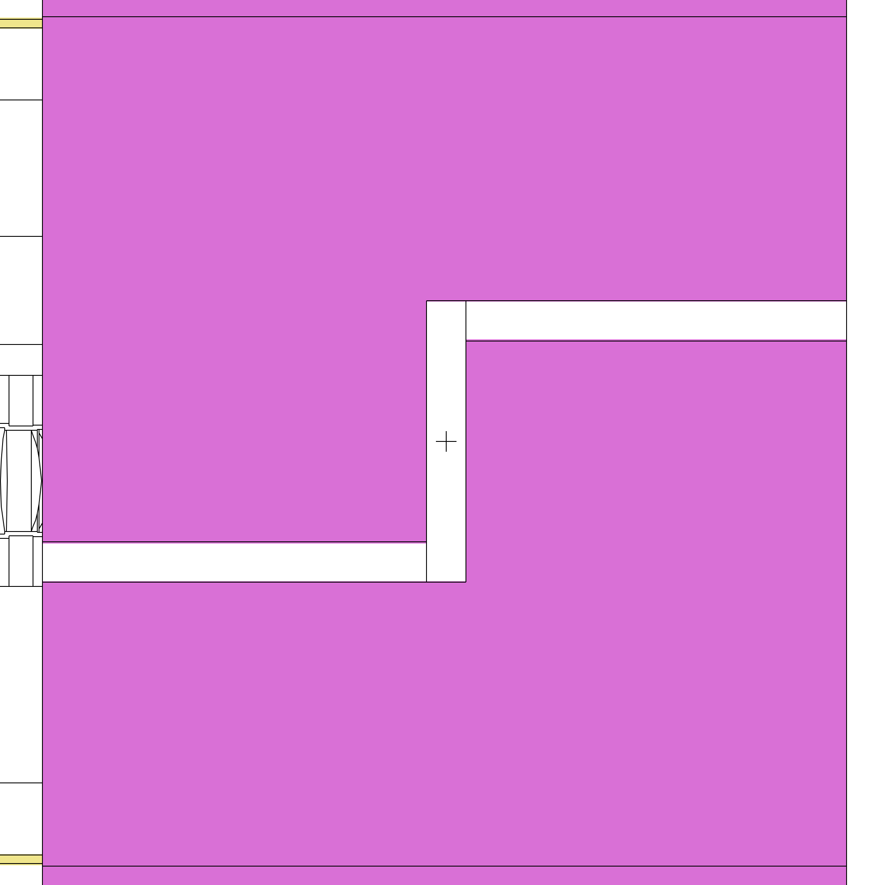
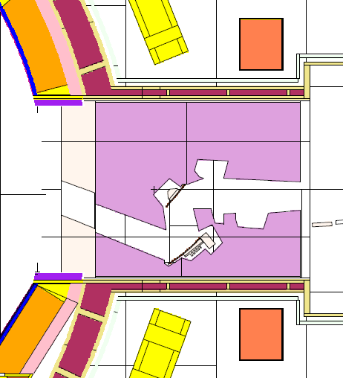
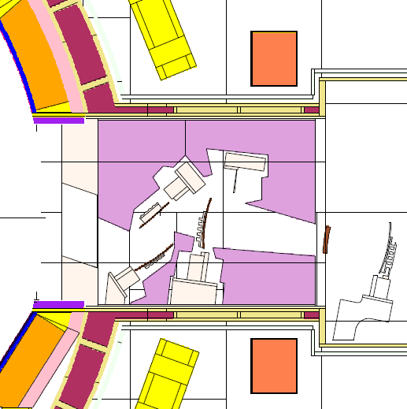
Radiation safety (2/4) – shielding
Representative penetration features included in the neutronics model
Bio-shield
B-B lower port
EQ-port
d=0.1m
d=1.2 m
1m
Penetration representatives
B
B
Tokamak complex
(vertical cross-section)
Tokamak in building (vertical cross-section)

Slide 12
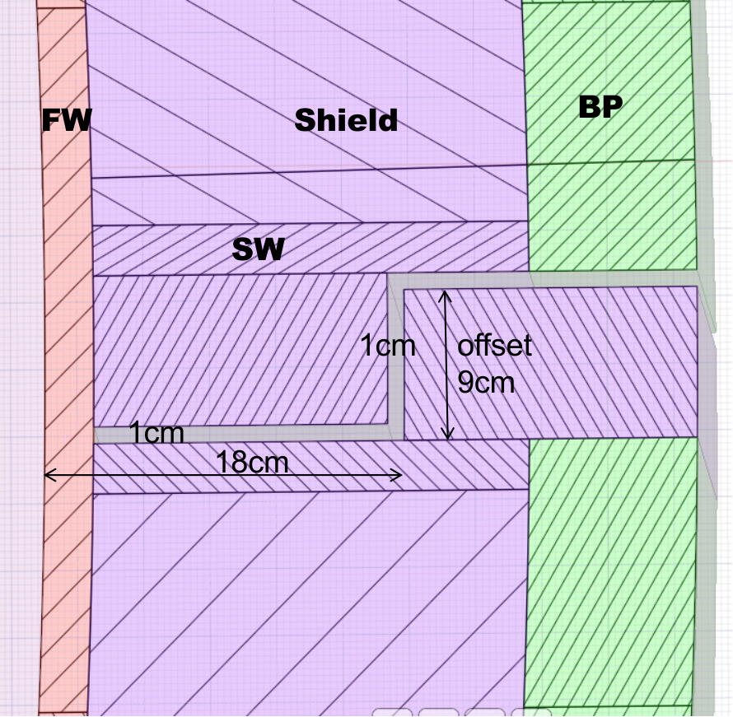
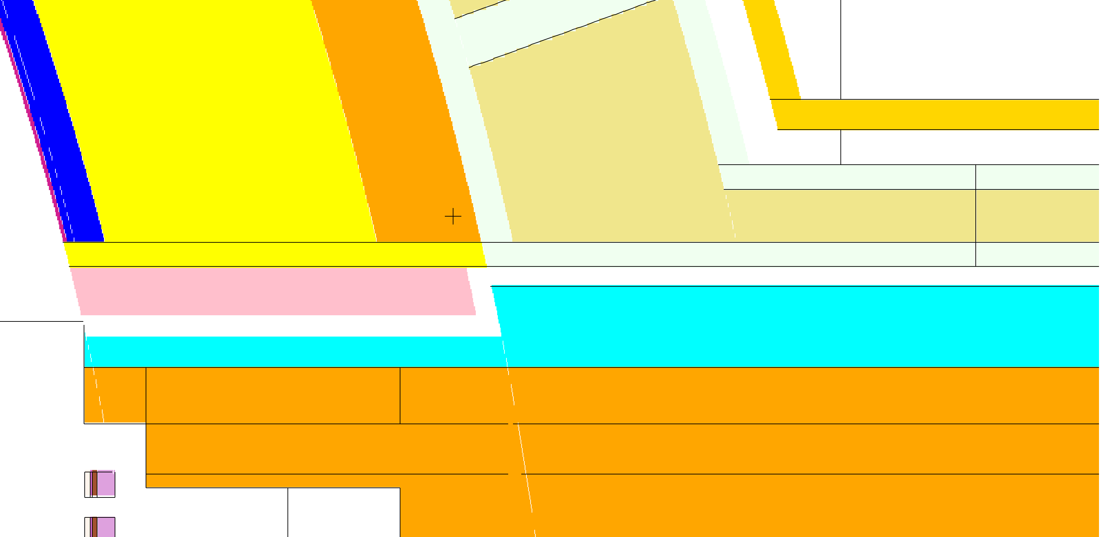
Radiation safety (3/4) – shielding
Dogleg design is adopted where possible for the streaming paths to compensate the shielding capability compromised by penetration effects
Blanket
Equatorial port
BLK
VV
toroidal
gap width: 2 cm
offset: 5 cm
radial gap: 2 cm
distance from PFC to to labyrinth: 40 cm
gap width: 1 cm
offset: 9 cm
radial gap: 1 cm
distance from PFC to labyrinth: 18 cm
radial

Slide 13
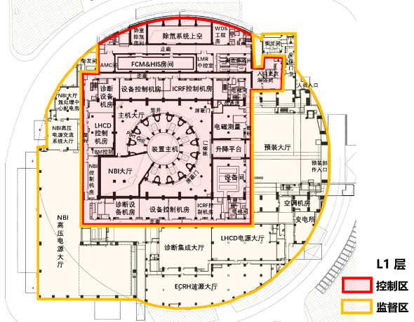
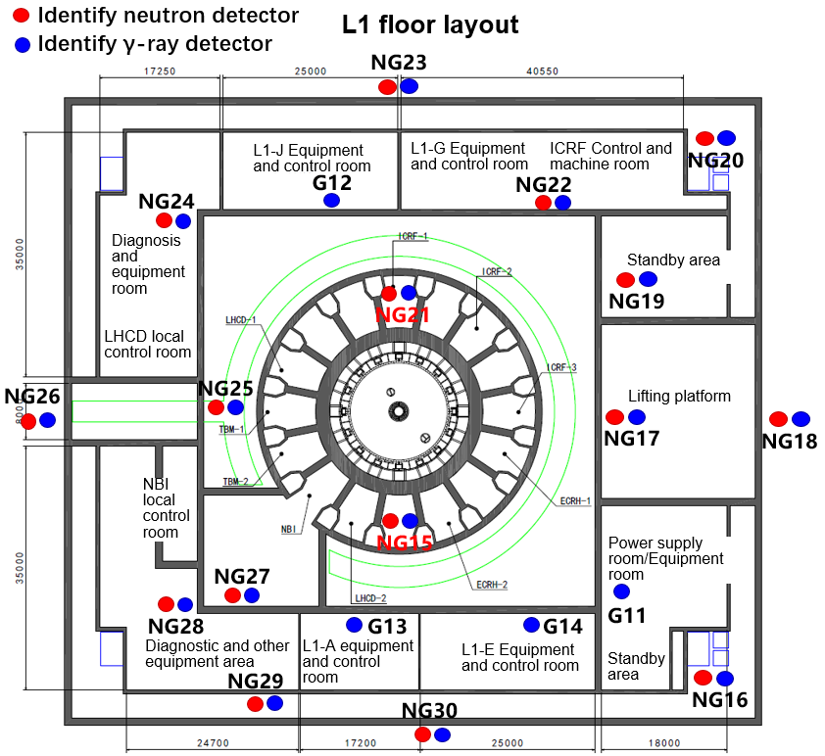
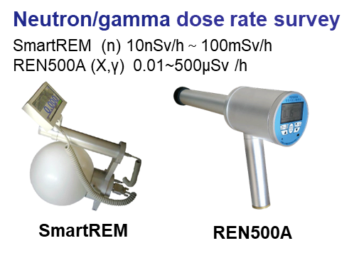
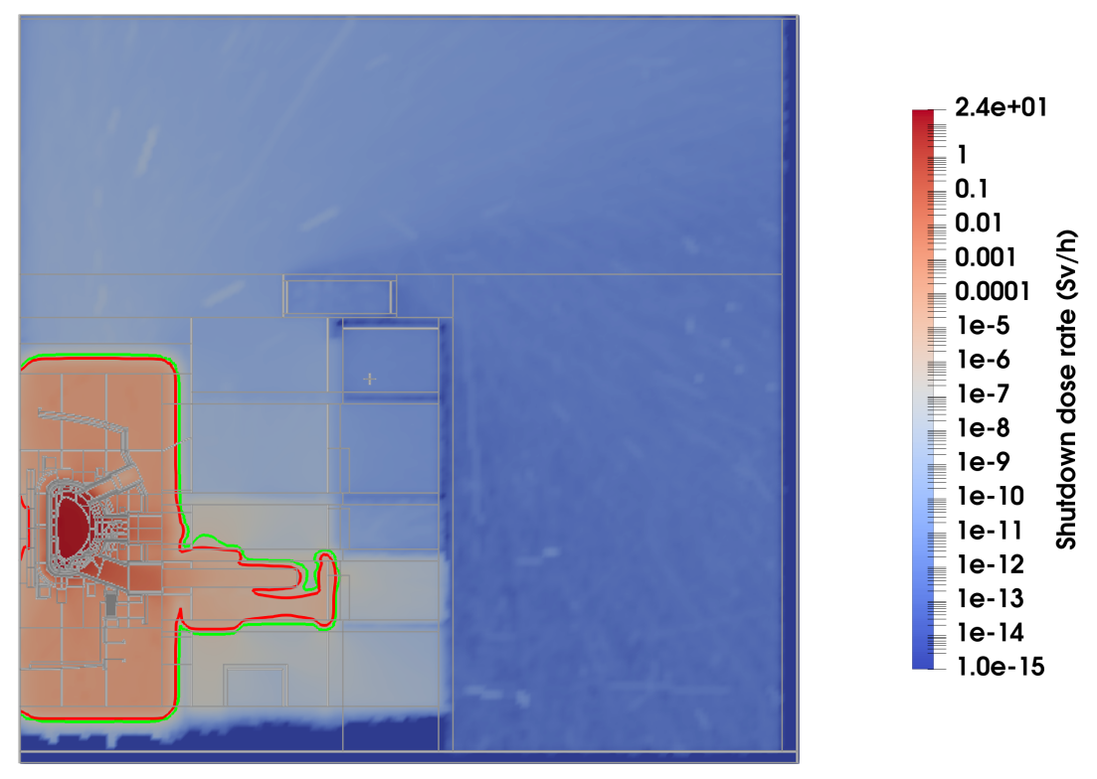
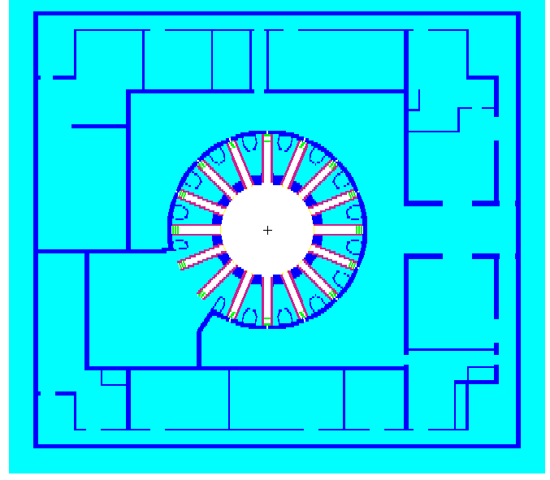
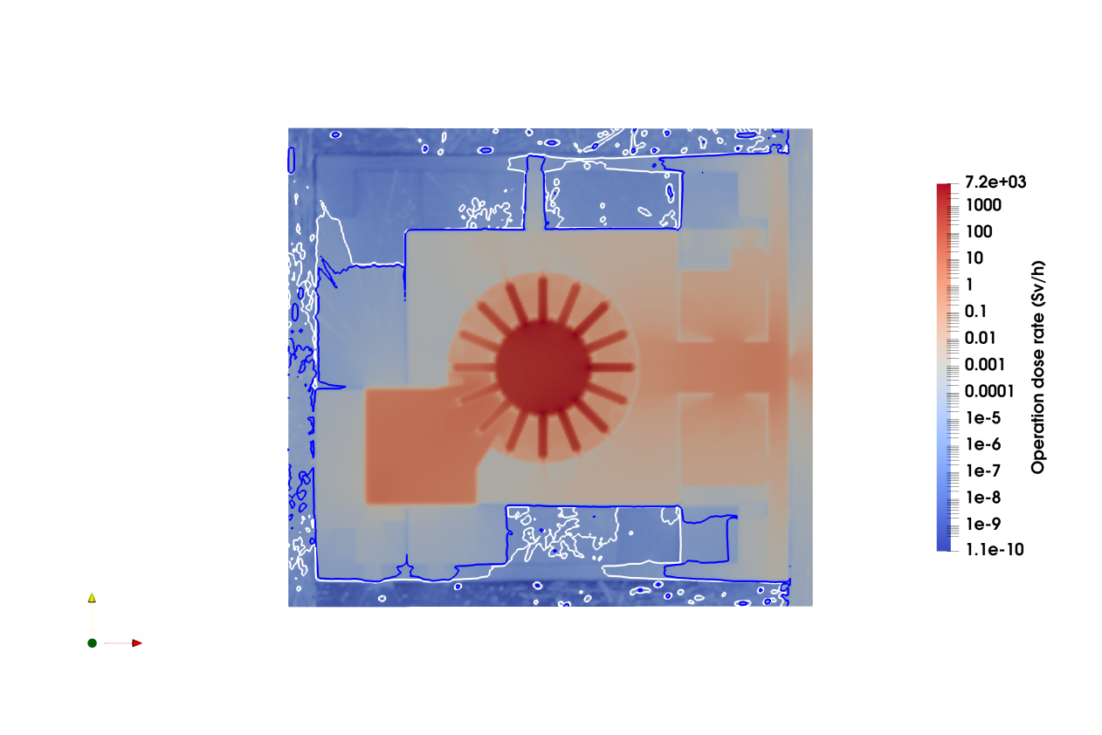
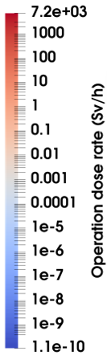
Radiation safety (4/4)
Radiological zoning defined; radiation safety managed with N/P dose measurement&monitoring
  Controlled zone: personnel access not allowed during plasma operation
  Supervised zone: personnel access allowed during plasma operation
Cooling time <1 year
LLW
Cut-through lower port
Operational dose @20MW
Red 2.5 uSv/h，green 0.25 uSv/h
SDDR@1d after 50MW*1000s
Comp. | Vol.（m³） | Mass (t) | After 1yr cooling
Blanket | 82.5 | 531 | LLW
Divertor | 29.6 | 202 | LLW
Mid-port | 56.9 | 257 | LLW
TFC | 66 | 398 | LLW
PFC | 52 | 310 | LLW

Slide 14
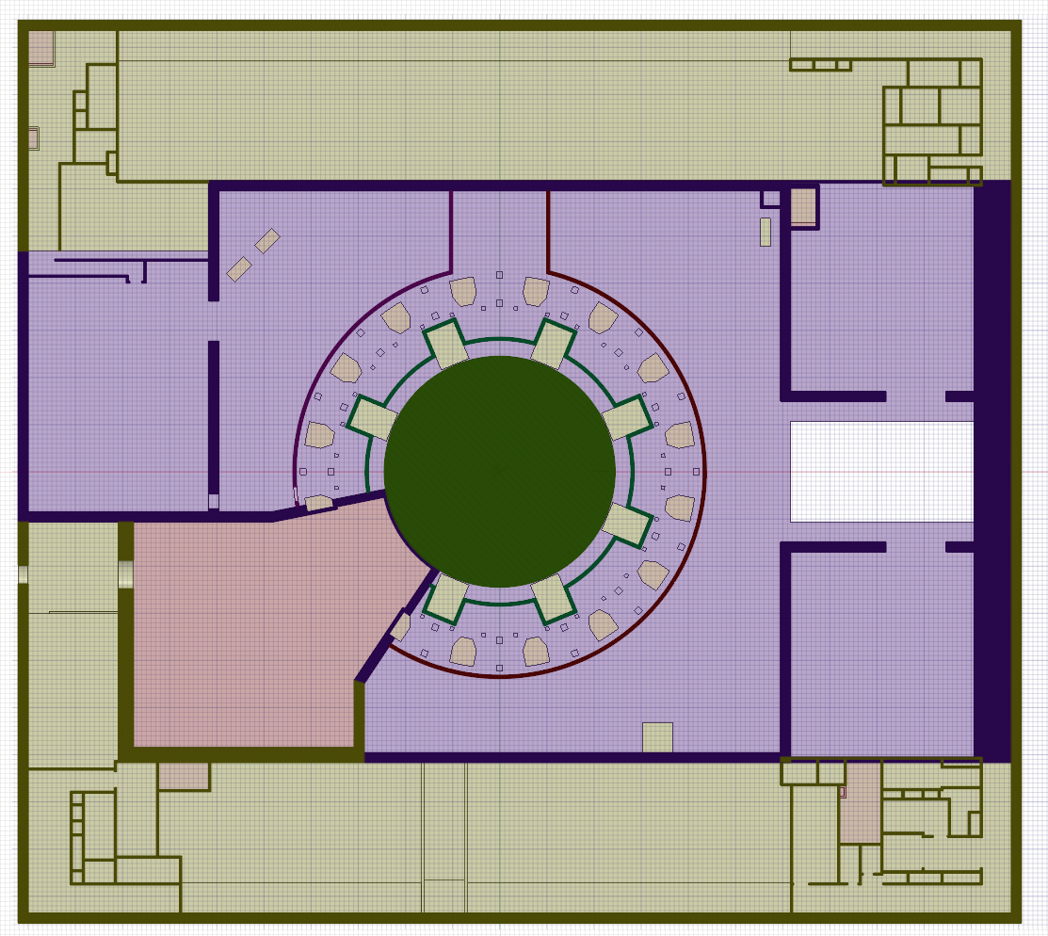
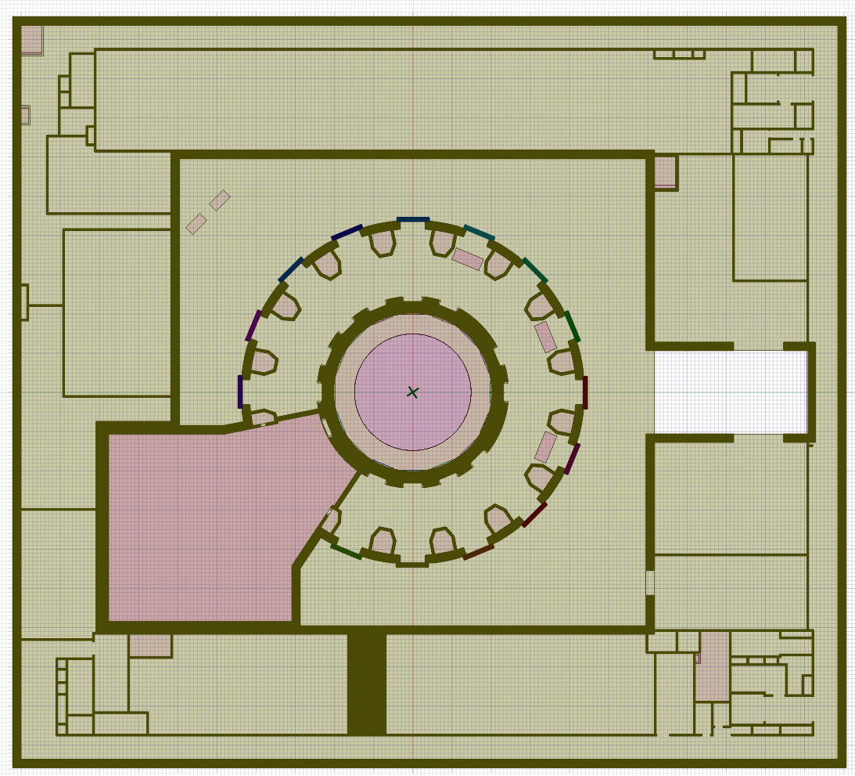
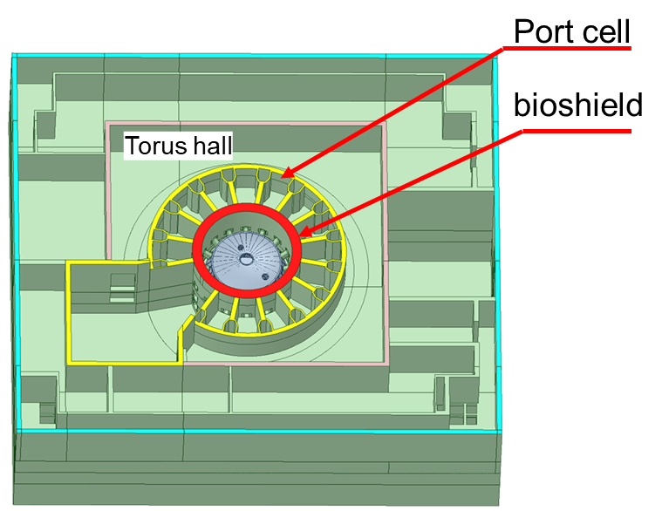
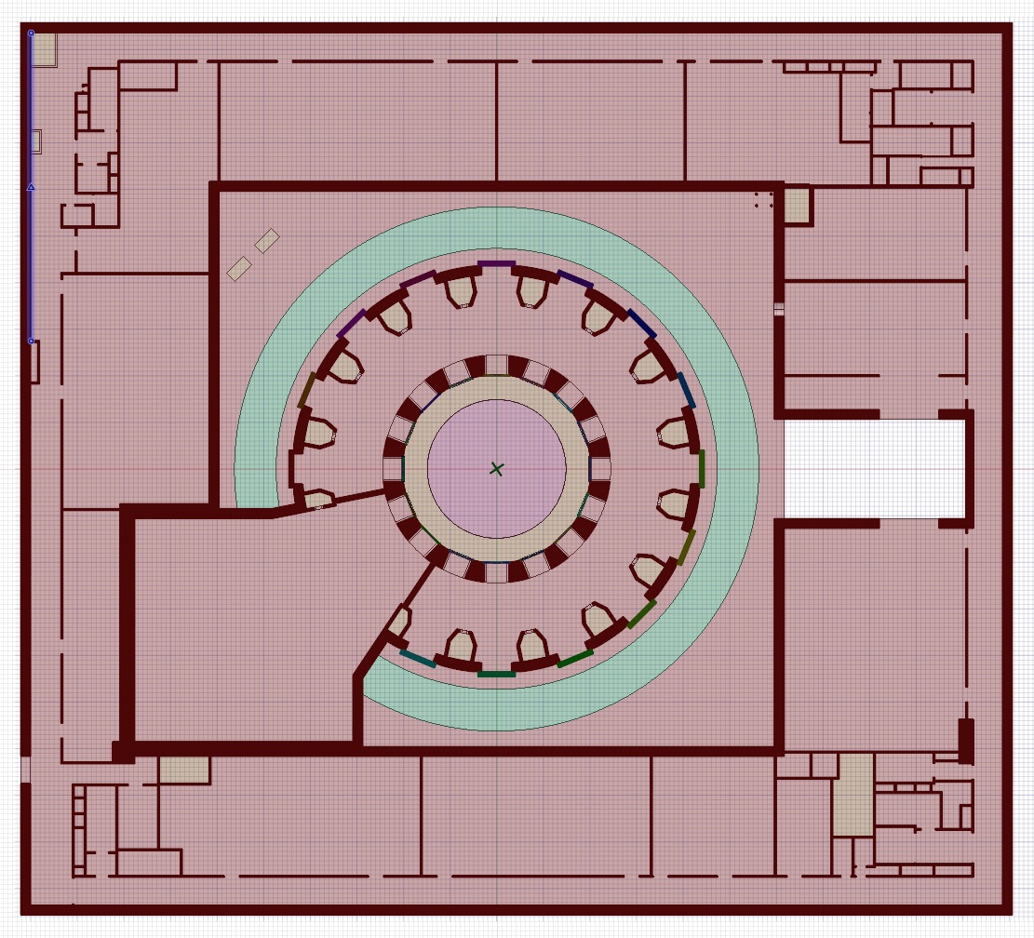
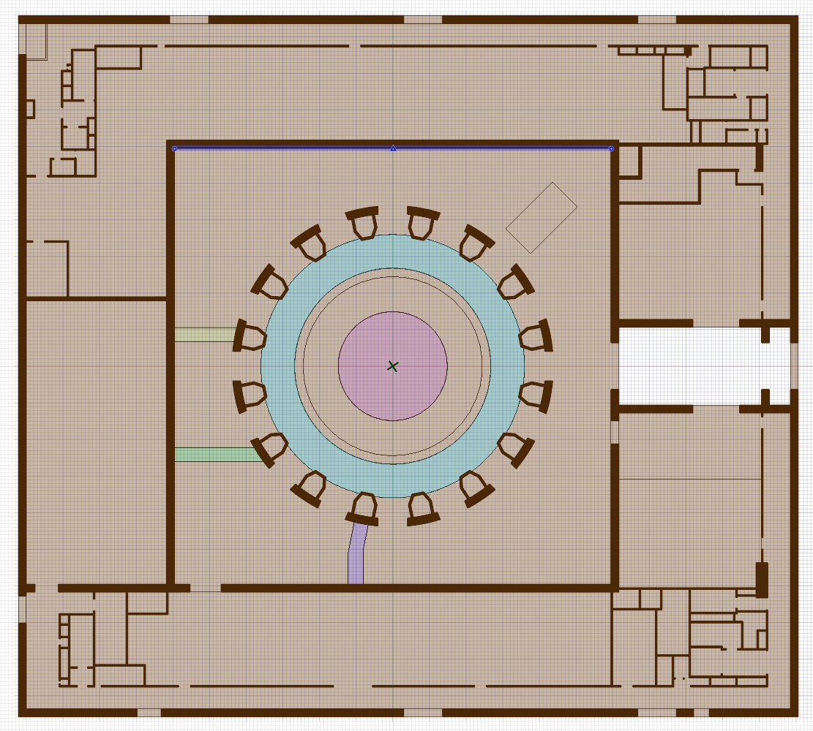
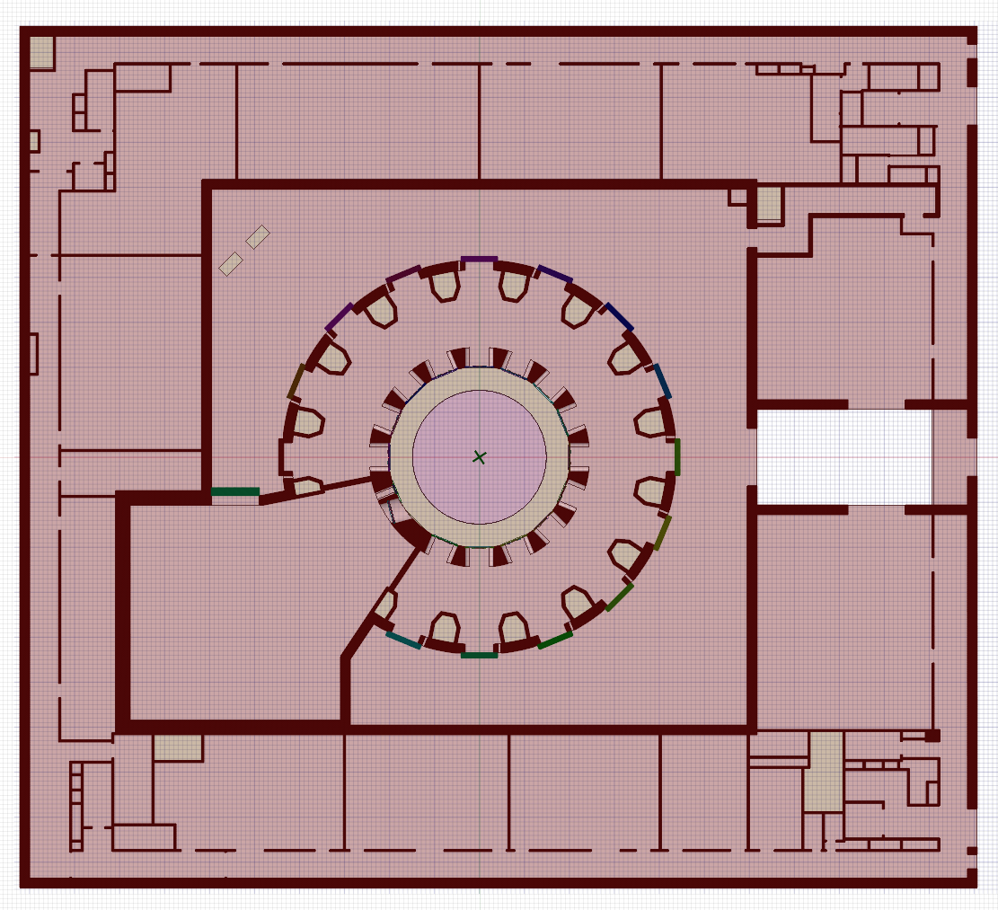
Tritium safety (1/4)
L3
Ventilation zoning defined for tritium safety management
Passive and active barriers implemented to ensure T confinement
  1st confinement barrier: Vacuum vessel, processing pipes/container, valves
  2nd confinement barrier: port cell (with doors), detritiation systems, glove boxes
  Last confinement barrier: torus hall (with doors), processing rooms
Tritium accountancy and safety ➔ Tritium measurement and monitoring
L2
B1
B2
L1

Slide 15
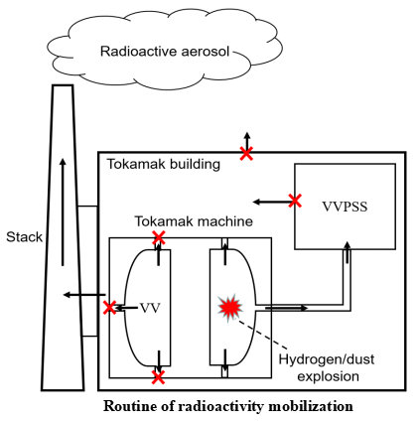
Tritium safety (2/4)
To develop the sequences and paths for the migration and release of radioactive species, e.g. T
  Failure modes
  Design basis accidents, e.g. lines broken + DS
  Beyond design basis accidents, e.g. lines broken + DS strike
T plant
x
Tokamak
Building
x
x
Tokamak
machine
Radioactive inventory
stack
M
Process lines broken
Path：
VV
ST
ST-VS
DS
Stack
Environment
Q%
V1%
V2%
M is the initial quantity of radioactive inventory inside VV, e.g. dust, tritium…
Q% is the migration ratio of the radioactive inventory from the VV
V1% is the cleaning efficiency
V2% is the Tritium filteration efficiency
Schematic diagram of radioactive migration path in LOVA accident

Slide 16
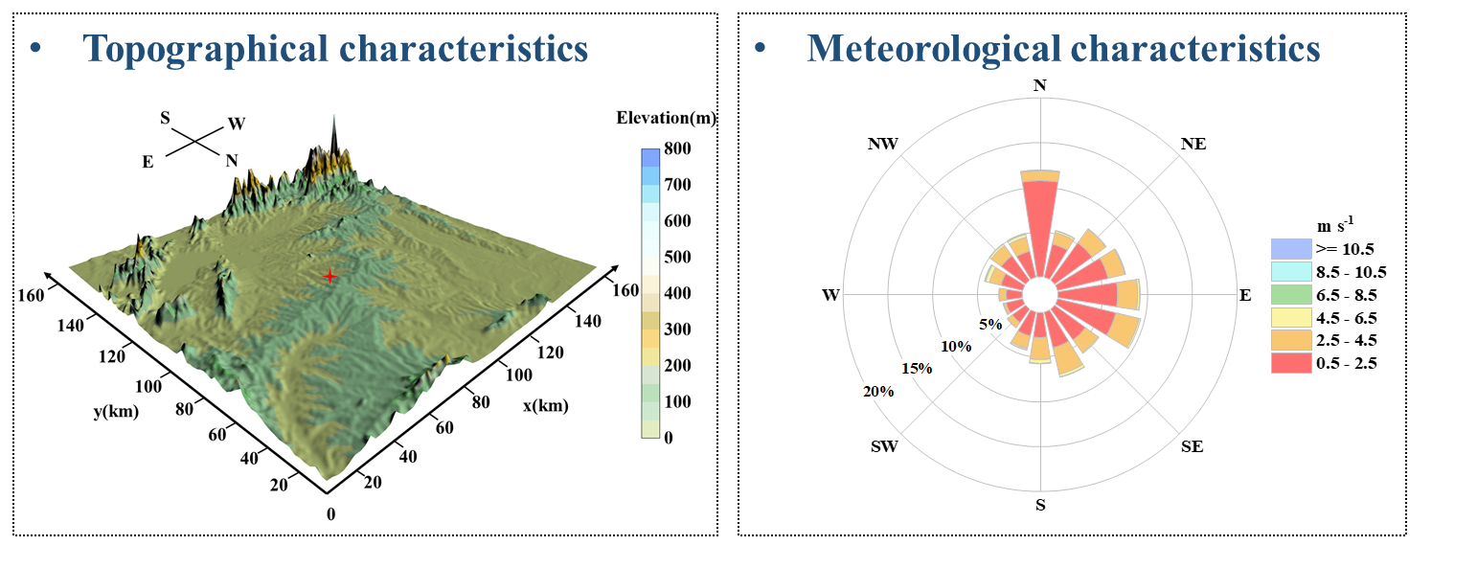
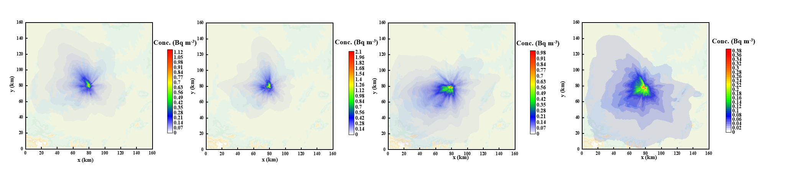
Tritium safety (3/4)
Tritium concentration distribution around BEST site
Max. tritium concentration appears in Summer
Tritium release source term: 0.6 g/a assumed
Release height: 10 m
Evaluated dose ~0.13-4.5 µSv/a
(Inhalation & skin-absorption)
Surrounding buildings taken into account
Spring
Summer
Autumn
Winter
0.01
0.01
0.02
0.01
Tritium concentration distribution for four seasons

Slide 17
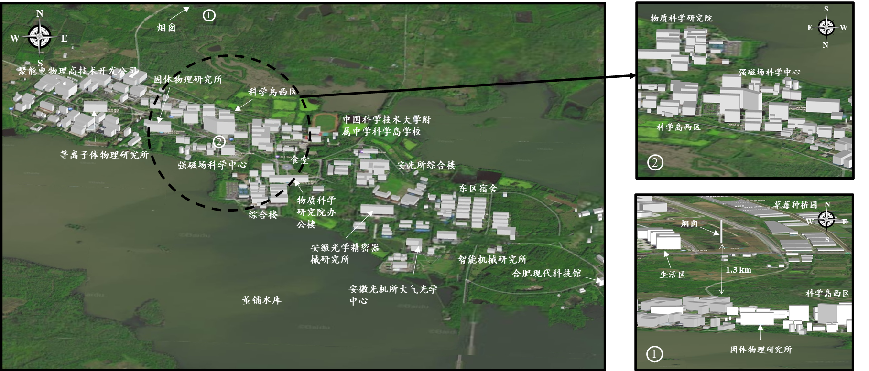
Tritium safety (4/4)
Transient release in 5s (extreme)
  Tritium release source term: 100 g (extreme)
  Release through stack results in ~0.25 mSv @1.3km
Release via natural convection after the pressure balance
  Tritium release source term: 110 g (extreme)
  Release at ground level results in ~0.77 mSv @60m @(3+4)d
Stack release

Slide 18
Summary
Construction authorized based on the environmental impact evaluation/justification
Staged approach to license BEST facility and to operate it safely
Constraints applied to radiation exposure and tritium inventory for the radiation safety and tritium safety
Next step, more to do towards BEST operation (license)
  To develop fault sequences and to estimate the consequences accordingly
  To assess the full set of safety source terms, e.g. activated dust, activated coolant, ACP and magnetic stored energy
  To model the migration process of radioactive materials from generation to release
  To evaluate the impact to the workers and the public under accident scenarios
  R&D support … …
Joint efforts needed to conquer more & different technical challenges for DEMO!

Slide 19
  EU-China Collaboration on CFETR and EU-DEMO Reactor Design,
  4th Technical Exchange Meeting, Mar. 19-21, 2024, KIT, Germany
  Thanks
  for your attention!

