Slide 1


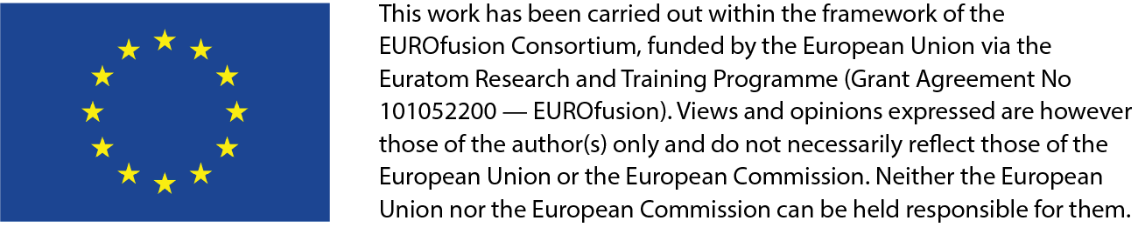
Development of the DEMO plasma diagnostic and control system
EU – China collaboration on CFETR and EU-DEMO Reactor Design
4th Technical Exchange Meeting
19-21 March 2024, KIT, Karlsruhe, Germany
Wolfgang Biel^{1,2} , M. Ariola³, F. Maviglia⁴ and contributors to EUROfusion WPDC and WPDES
¹Institute of Energy- and Climate Research, Forschungszentrum Jülich GmbH, Germany
²Department of Applied Physics, Ghent University, Belgium
³Universita’ di Napoli “Parthenope”, Consorzio CREATE, Italy
⁴Eurofusion Technology Department
w.biel@fz-juelich.de, ariola@uniparthenope.it, Francesco.Maviglia@euro-fusion.org

Slide 2














List of contributors
EUROfusion work package “DEMO diagnostic and control” (WPDC)
W. Biel^{1,2}, E. Alessi³, M. Ariola⁴, M. de Baar⁵, C. Baumann¹, M. van Berkel⁵, I. Bolshakova⁶, D. Borodin¹, T. Bosman⁵, K. J. Brunner⁷,
M. Chernyshova⁸, P. David⁹, D. Dunai¹⁰, I. Duran¹¹, S. Entler¹¹, L. Giannone⁹, A. Gusarov¹², S. B. Korsholm¹³, Y. Kost⁶, R. Luis¹⁴,
A. Malaquias¹⁴, O. Marchuk¹, F. Maviglia¹⁸, E. Perelli Cippo³, A. Pironti¹⁵, A. Quercia¹⁵, J. Řeboun¹⁶, G. Renko¹⁷, N. Rispoli³, D. Sarajlic¹⁷, M. Siccinio^{9,18}, A. Silva¹⁴, G. Tartaglione⁴, P. Turjanica¹⁶, W. Treutterer⁹, G. Verdoolaege², S. Wiesen^{1,18}, M. Zerbini¹⁹, H. Zohm^{9,18}, et al.
¹Institut für Energie- und Klimaforschung, Forschungszentrum Jülich GmbH, Germany
²Department of Applied Physics, Ghent University, Belgium
³ISTP-CNR, Istituto per la Scienza e Tecnologia dei Plasmi, Milano, Italy
⁴Universita’ di Napoli “Parthenope”, Consorzio CREATE, Italy
⁵DIFFER, Eindhoven, Netherlands
⁶Magnetic sensor laboratory, Lviv, Ukraine
⁷Max-Planck-Institut für Plasmaphysik, Greifswald, Germany
⁸IPPLM, Warsaw, Poland
⁹Max-Planck-Institut für Plasmaphysik, Garching, Germany
¹⁰EK-CER, Budapest, Hungary
¹¹Institute of Plasma Physics, Czech Academy of Science, Praha, Czech Republic
¹²SCK CEN, Mol, Belgium
¹³DTU, Department of Physics, Lyngby, Denmark
¹⁴Instituto de Plasmas e Fusão Nuclear, IST, Universidade de Lisboa, Portugal
¹⁵Università degli Studi di Napoli Federico II, Consorzio CREATE, Italy
¹⁶University of West Bohemia, Research and Innovation Centre for Electrical Engineering (RICE), Czech Republic
¹⁷Cosylab, Ljubljana, Slovenia
¹⁸EUROfusion Power Plant Physics and Technology (PPPT) department, Garching, Germany
¹⁹ENEA, Fusion and Nuclear Safety Department, C. R. Frascati, Via E. Fermi 45, 00044 Frascati (Roma), Italy

Slide 3
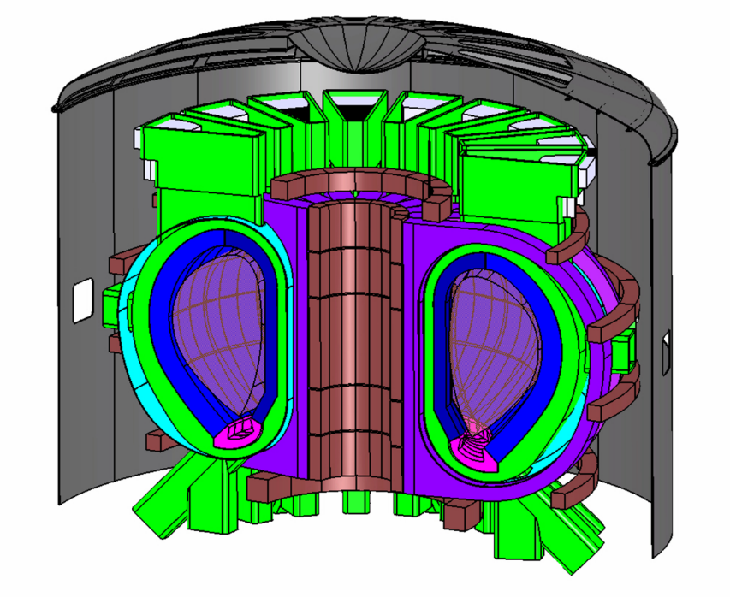
Main input assumptions for the development of the DEMO D&C system
See also C. Bachmann, ISFNT 2023; M. Siccinio et al. FED 2020
  Pulsed DEMO tokamak as baseline
  Machine size ~ 1.5 times of ITER
  Plasma scenario with
    predominantly ohmic current drive
    confinement quality H_{H98y2} ~ 1
    high core radiation fraction but P_{sep} ~ P_{heat}-P_{rad,core} > P_{LH}
    high plasma density with fully detached divertor plasma operation (lower single null)
    no ELMs / very small ELMs (→ E_{ELM}/100)
  Vertical maintenance concept for blanket
    only limited access for diagnostics from the top side
  Large equatorial ports
    main access for diagnostics
Main DEMO parameters:
R₀ ~ 9 m
a ~ 2.9 m
B₀ ~ 5 T
P_{therm} ~ 2 GW
P_{el,net} ~ 300…500 MW
t_{pulse} > 2 h

Slide 4
Summary of the DEMO diagnostic and control concept
See also W. Biel et al. FED 2022
Control quantity | Operational limits | Diagnostics | Actuators + interactions
Plasma current / Edge safety factor q₉₅ | safety factor limit (q₉₅) | Magnetic diagnostics Faraday sensors | CS coils Auxiliary heating
Plasma position and shape, incl. vertical stability | Wall loads (FW and div.) Max. Δz / VDE disruption | Magnetic diagnostics MW reflectometry, ECE Neutron/gamma diagnostics IR polarimetry/interferometry Radiation power profile | PF + CS coils Auxiliary heating
Plasma edge density and temperature | Density limit Stable confinement Access for div. detachment | MW reflectometry, ECE IR polarimetry/interferometry Spectroscopy (pellet injection) | Pellet injection (fuel) Gas injection ECR heating
Fusion power | Wall loads (FW and div.) LH threshold | Neutron diagnostics Density and temp. measurement FW/blanket and div. power (for calibration only) | Auxiliary heating Pellet injection (DT ratio) Impurity gas injection PF+CS coils (shaping)
Power loss across the separatrix | Radiation limit LH threshold, divertor loads | Spectroscopy+radiation meas. Plasma heating power | Gas + Pellet injection Auxiliary heating
Divertor detachment and heat flux control | Divertor wall loads LH threshold | IR/VIS/UV spectroscopy Divertor thermo-currents Neutron flux, reflectometry | Gas injection (impurities + fuel) Pellet injection (fuel) PF coils
(MHD) plasma instabilities | Various | Reflectometry, ECE Radiation power measurements Neutron/gamma diagnostics IR polarimetry/interferometry Magnetic diagnostics | Auxiliary heating ECCD PF coils
Events (impurity ingress, component failure) | Various | All | All
Disruption mitigation | All | All | Matter injection
equilibr. control
Work in progress to define the
structuring and hierarchy of control
(supervisory control)
W. Treutterer, M de Baar, et al.
kinetic control
+ Collective Thomson Scattering
Event control

Slide 5
Irradiation issues for diagnostic front-end components on DEMO
Displacement damage / fpy
at inboard side
U. Fischer et al.,
FED 2016
Typical fluence behind the blanket:
ITER: 1 GGy
0.1 dpa
DEMO: 1-10 GGy
0.5-5 dpa (for 5 fpy of operation)
(recent design iterations show smaller values)
(G. Vayakis,
ITER_D_26ZGC3)
Radiation effects on diagnostic components:
radiation-induced electromotive force (RIEMF)
temperature-induced electromotive force (TIEMF)
radiation-induced thermoelectric sensitivity (RITES)
radiation-induced absorption (RIA)
radio-luminescence
thermal conductivity decrease
volume changes (swelling)
…..
Neutron fluence behind the DEMO blanket may be 5…50 times larger than on ITER
→ Move vulnerable components more away from the plasma / improve durability

Slide 6
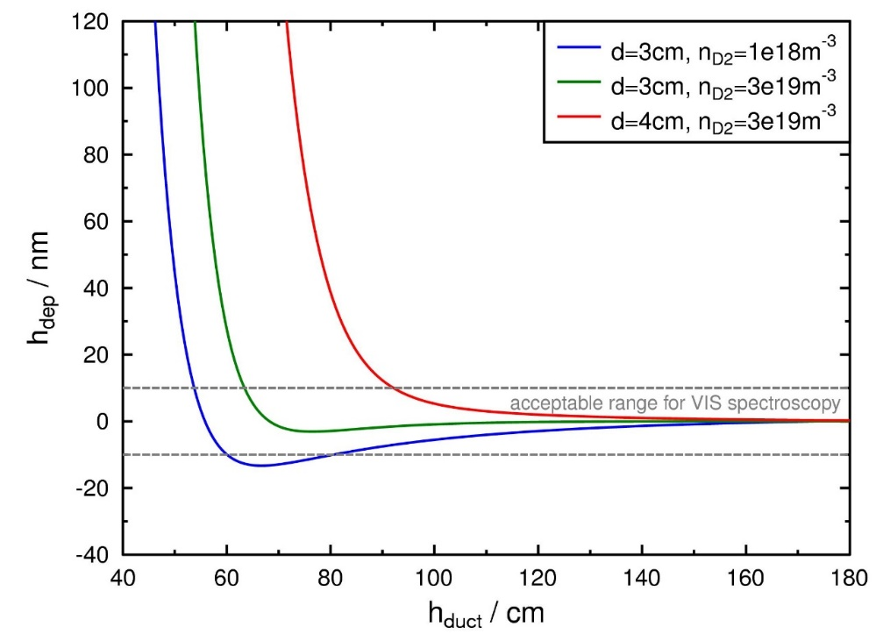
Durability of optical mirrors for DEMO: erosion/deposition due to CX neutrals (with gas target in the duct)
Modelling of plasma-wall interaction
near a diagnostic duct (cylindr. geometry):
W. Biel et al. FED 2022, using the model by M. Z. Tokar, Nucl. Fusion 2018
Mirror surface deposition per full power year:
duct diametre d
duct length h
Elongated ducts with gas target (n_{D2} = 3e19 m⁻³) for 1st mirror protection
h/d > 20 for IR diagnostics (interferometry, thermography)
h/d > 28 for VIS spectroscopy
h/d > 30 for VUV spectroscopy
Refined modeling started in 2022 using the ERO code
(C. Baumann et al., FZJ)

Slide 7
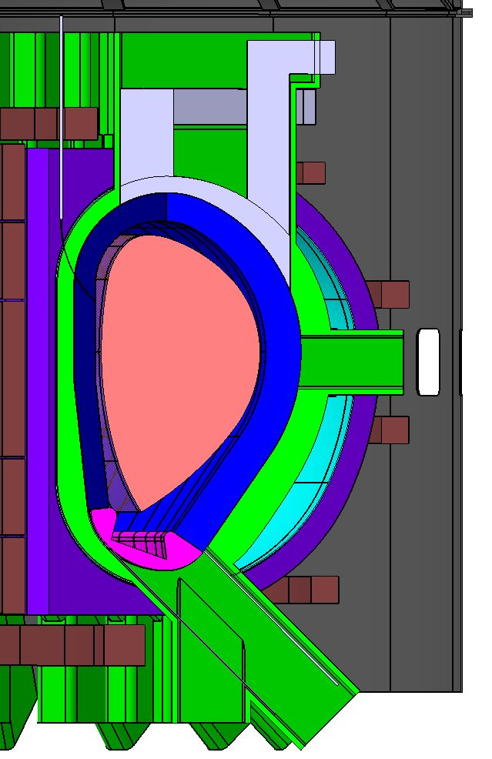
WPDC concept for implementation of diagnostic front-end:
Limitation of the design towards durable components; set back mounting positions
In front of blanket and divertor:
  No diagnostic components
Within blanket area/port area:
  Diagnostic ducts for spectroscopy, Prad, interferometry/polarimetry, neutron+gamma diagnostics
Diagnostic slim cassette (DSC):
  Metallic microwave antennae+waveguides within „diagnostic slim cassettes“
Behind the blanket/magnetic strips (MS):
  Magnetic sensors (metal+ceramic) & cabling within „magnetic strips“
Port plugs:
  Optical mirrors (metallic) and beam paths
  signal routing, penetrations (cables, tubes) and/or windows
Behind the divertor target:
  Implementation of sheath voltage or thermo-current measurement
  „Magnetic strip“ with some magnetic sensors
Ex vessel
  Detectors, cabling, fibres, …
vertical ports
DSC
equatorial
ports
MS
lower ports

Slide 8
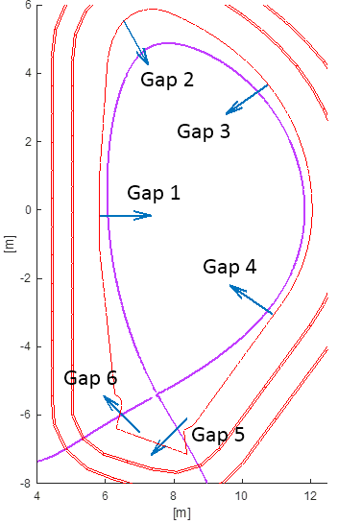
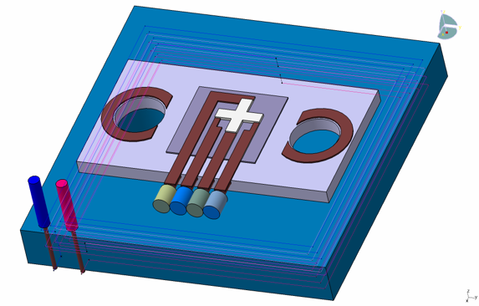
Equilibrium control
M. Ariola, A. Quercia, A. Pironti, I. Duran, I. Bolshakova, et al.
Main requirements:
Horizontal and vertical position of the current centroid remain within +/- 15 cm around nominal position
Minimum distance between separatrix and first wall in all poloidal locations always remains larger than 8 cm
Fig.: Combined inductive+Hall sensor
Error estimation for centroid position:
∆B ~ 8 mT, ∆r = ∆Z ~ 1 cm
Main open issue:
Irradiation hardness of magnetic sensors
→ Major R&D issue for the future
A. Quercia et al. NF 2022
Subsystem | No. sectors/ no. per sector
Inner vessel tangential pick-up coil | 4-8/30
Inner vessel normal pick-up coil | 4-8/30
Inner vessel flux loops | -/6
Inner vessel saddle coils | T.B.D./24
Diamagnetic loops | 4/1
Diamagnetic loop compensation coils | 4/1
Diamagnetic loop compensation saddles | 4/2

Slide 9
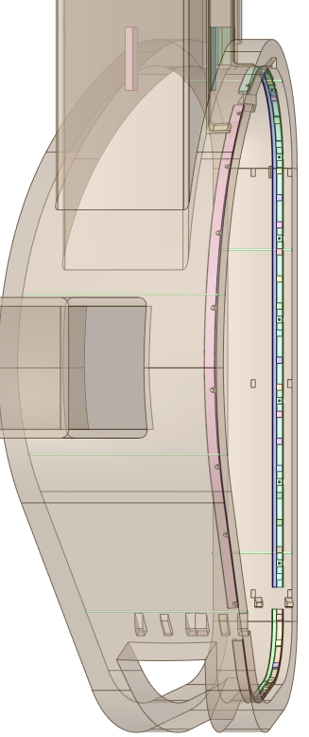
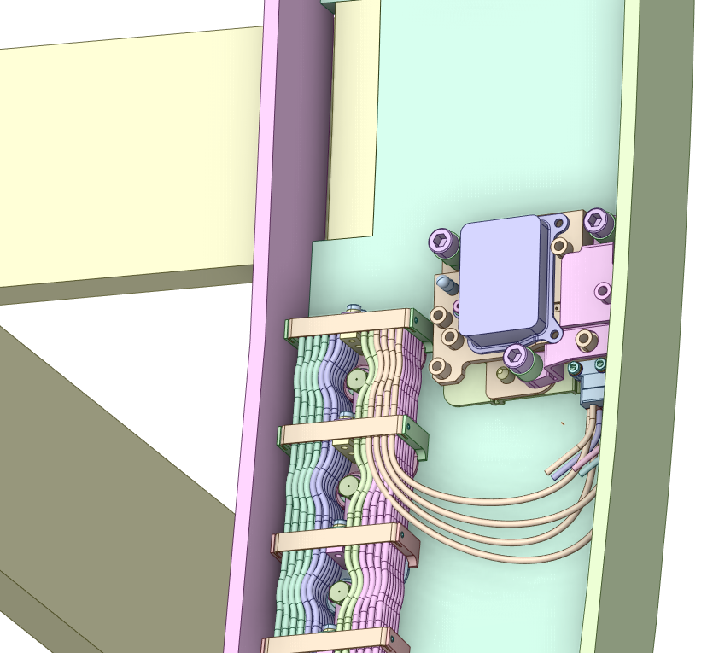
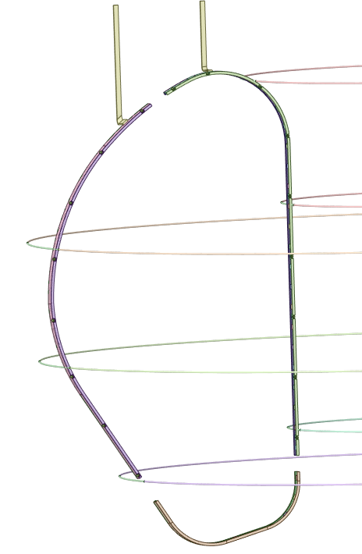
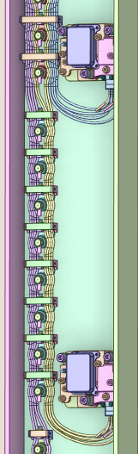
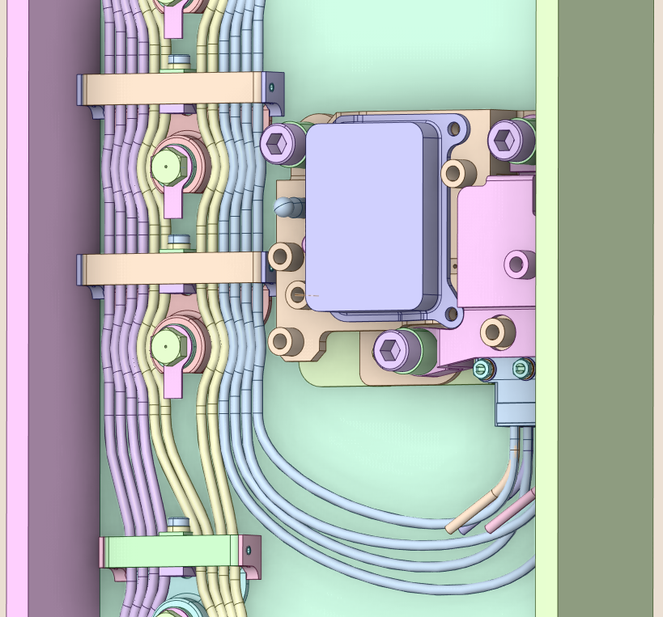
‘Magnetic strip’ concept for integration of magnetics
Cable structures
Cable
looms
Cable structures (UP)
Cable routing
(limited space)
VV attachment bosses
IB
25-26
probes
Magnetics sensors
~60 probes (strip)
+ 6 full flux loops
to be integrated with
24 saddle loops
4+4 sectors
(redundancy included)
Full flux loops
OB
22-23
probes
Probe + cables detail
Cable
looms
BB keys
(constraint)
Divertor
11 probes
BB: 10-12 cm radial carving required
25 cm (toroidal) x 8cm (radial)

Slide 10
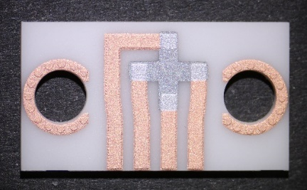
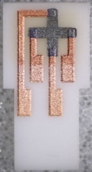
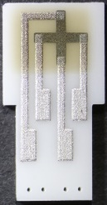
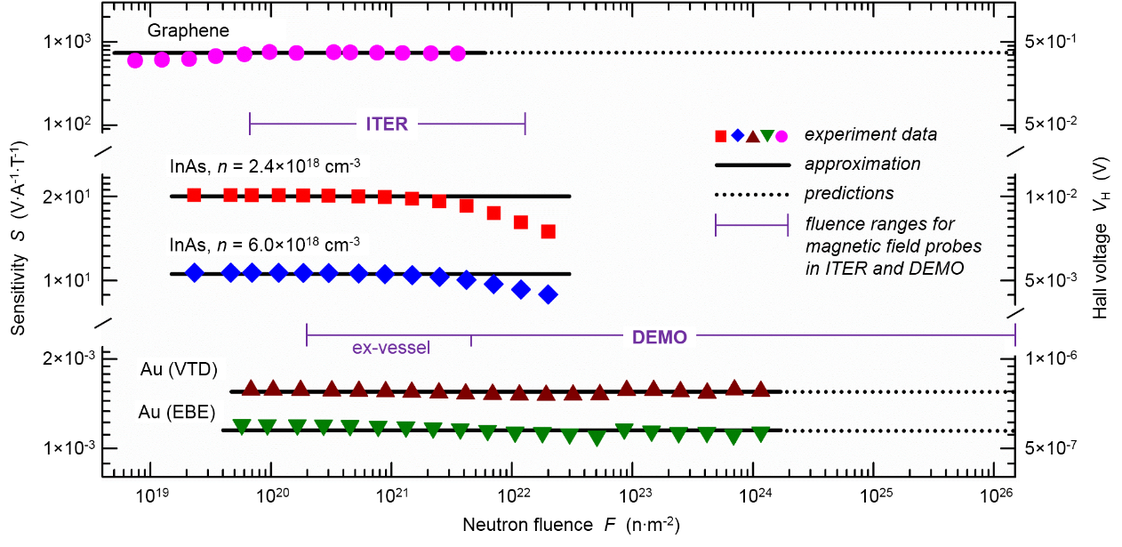
Hall sensor development
I. Duran, I. Bolshakova, et al.
Antimony Hall sensor prototypes
Hall materials under investigation
See also S. Entler et al. FED 2020
18 mm
6.5 mm
Sensitivity [V/AT]
See also I. Bolshakova et al. NF 2017
DEMO in vessel
Neutron fluence n/m²

Slide 11
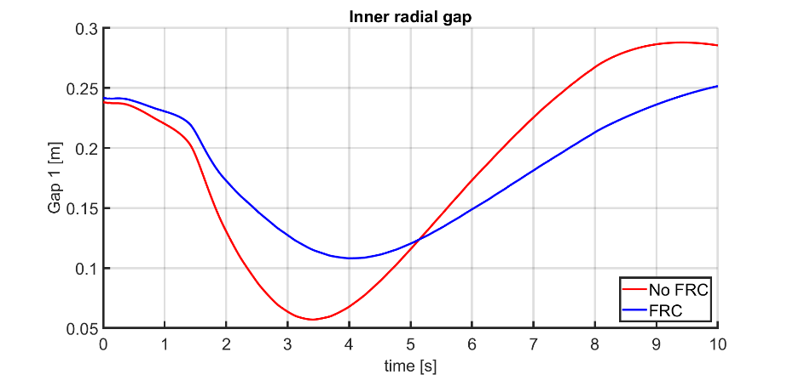
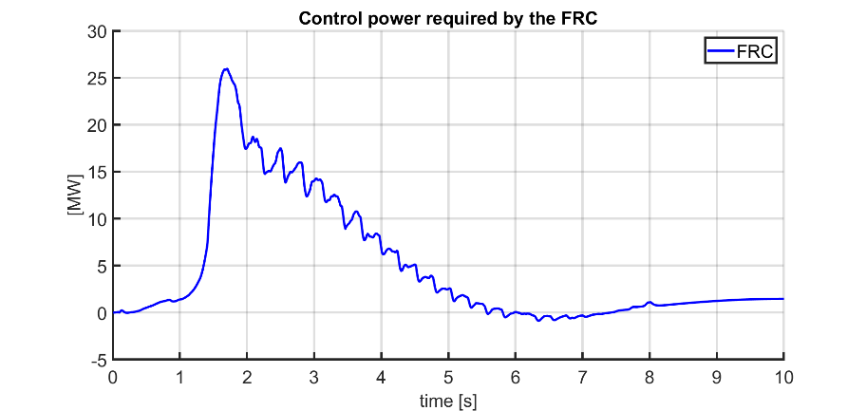
Equilibrium control simulations: loss of power event
M. Ariola, A. Pironti, G. Tartaglione, et al.
Main requirements (repeated):
Horizontal and vertical position of the current centroid remain within +/- 15 cm around nominal position
Minimum distance between separatrix and first wall in all poloidal locations always remains larger than 8 cm
Numerical simulation of equilibrium control
with and without in vessel control coils (CREATE)
Controller | Minimum distance from wall | Maximum power
w/o fast radial circuit | 5.7 cm | //
w fast radial circuit | 10.8 cm | 26 MW
Feasibility of in vessel control coils under investigation
See also
M. Ariola et al. FED 2019
G. Tartaglione et al. 2023 (submitted)

Slide 12
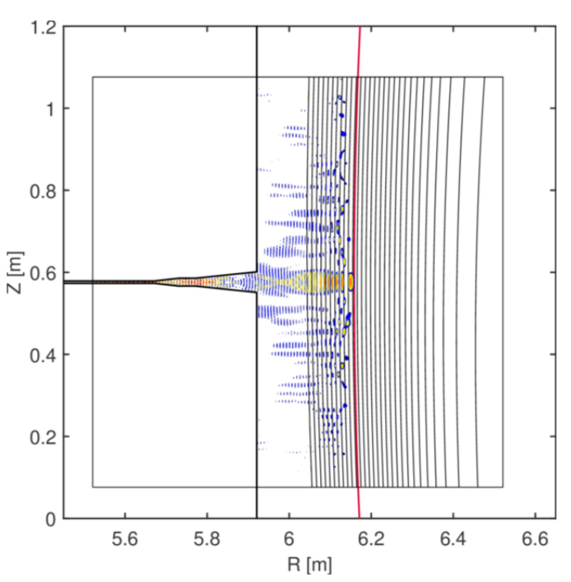
Equilibrium control: microwave reflectometry
A. Silva, R. Luis, et al.
Main requirements (repeated):
Horizontal and vertical position of the current centroid remain within +/- 15 cm around nominal position
Minimum distance between separatrix and first wall in all poloidal locations always remains larger than 8 cm
Simulation of reflec-tometry performance
using the REFMUL* family codes →
Accuracy for gap determination better than 1 cm in most poloidal locations
F. da Silva et al 2022 JINST 17 C01017
F. da Silva et al, ISFNT 2023
J. Santos et al., ISFNT 2023

Slide 13
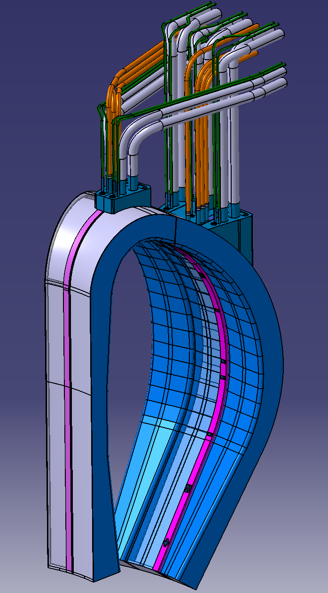
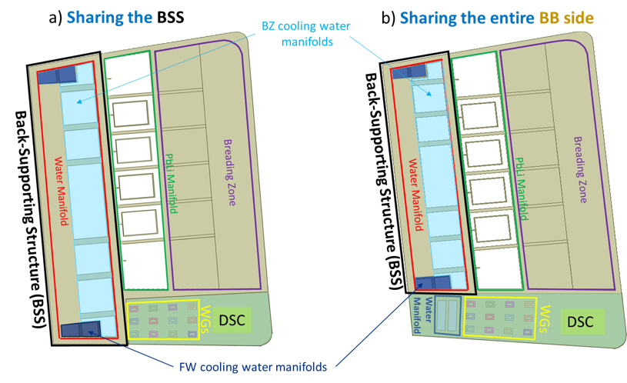
Diagnostic slim cassette (DSC) integration with the Breeding Blanket (BB)
R. Luis, A. Malaquias, et al.
Waveguide extensions (routed through BB chimneys)
DSC inboard and outboard segments in different vertical planes
Interfaces with the BB
  Sharing the BB First Wall (FW) and Back Support Structure (BSS)
  DSC integrated/attached to the BB segments
25 cm (toroidal)
See also J. Belo et al. NF 2021

Slide 14
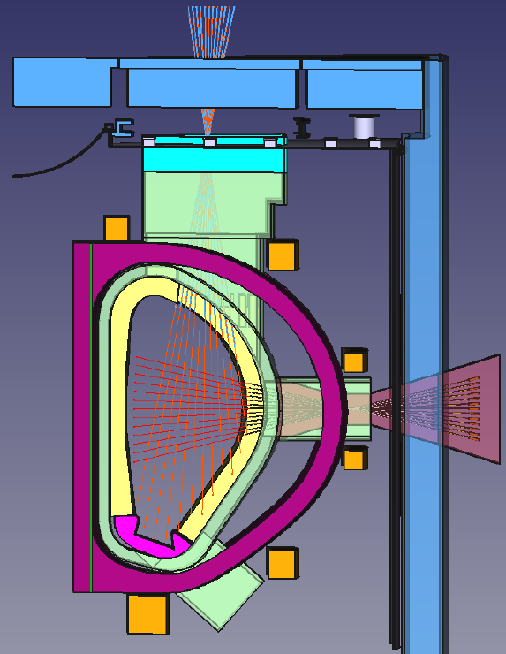
Burn control: neutron camera for fusion power measurement
Main requirements:
Pedestal top density should remain at a level of 85% +/- 5% of the Greenwald density limit
Fusion power should remain within +/- 20% of the nominal value; variations above +/- 10% for < 20 seconds.
Separatrix power P_{sep} should be controlled at a level of 20% above the LH threshold (to be refined)
P_{sep} = P_{α} + P_{aux} – P_{rad}
Two instruments (n and γ) to be located into the same structure with a camera (i.e. multiple LOS) structure (horizontal and vertical).
Active parts (i.e. detectors) to be placed outside the bioshield.
Detailed design work ongoing; main features include:
Gamma-ray detectors positioned behind neutron detectors
Neutron attenuator positioned in the LOS between n and γ detectors
Easy access required for n detectors
Detector R&D started: stability of calibration to be validated
See also M. Cecconello et al. JINST 2019; L. Giacomelli et al. JINST 2022

Slide 15
Burn control: Radiation power (Prad) measurement
Main requirements (repeated):
Pedestal top density should remain at a level of 85% +/- 5% of the Greenwald density limit
Fusion power should remain within +/- 20% of the nominal value; variations above +/- 10% for < 20 seconds.
Separatrix power P_{sep} should be controlled at a level of 20% above the LH threshold (to be refined)
M. Chernyshova et al.
P_{sep} = P_{α} + P_{aux} – P_{rad} (scenario control and divertor control)
Plasma core radiation in the range of E > 1 keV
Detector R&D in preparation (GEM detectors)
See also
M. Chernyshova et al.
JINST 2022

Slide 16
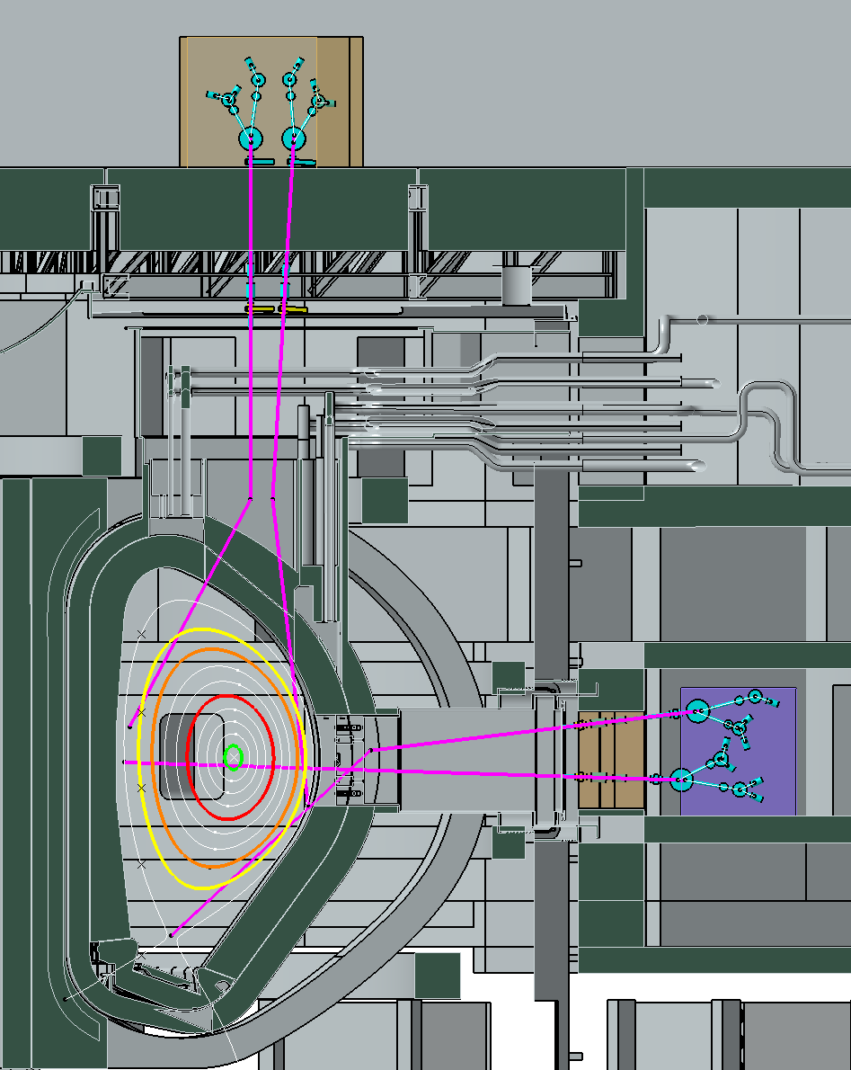
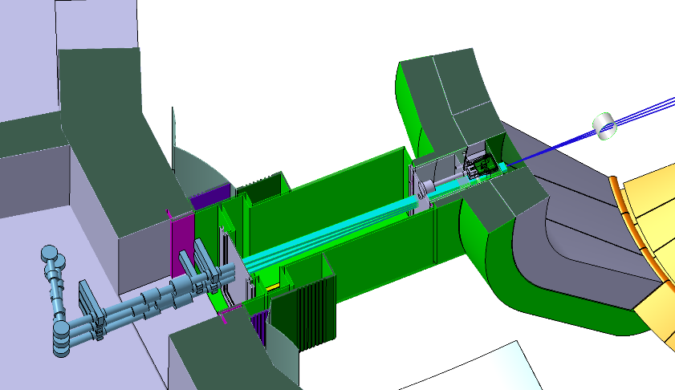
Burn control: VUV spectroscopy and X-ray spectroscopy
O. Marchuk, A. Krimmer, W. Biel, et al.
VUV spectroscopy
Injected impurities concentration feedback for control (Ar, Xe, Kr)
Edge channels: Early detection of transient impurity ingress
X-ray spectroscopy
Impurity concentrations and ion temperature in core plasma
Crystals for Xe, (Kr) and W
Neutron streaming issue to be solved (caused by large duct diametre)
VUV spectroscopy
In-port mirrors
(edge channels)
Vacuum extensions
Spectrometers with gratings and detectors

Slide 17
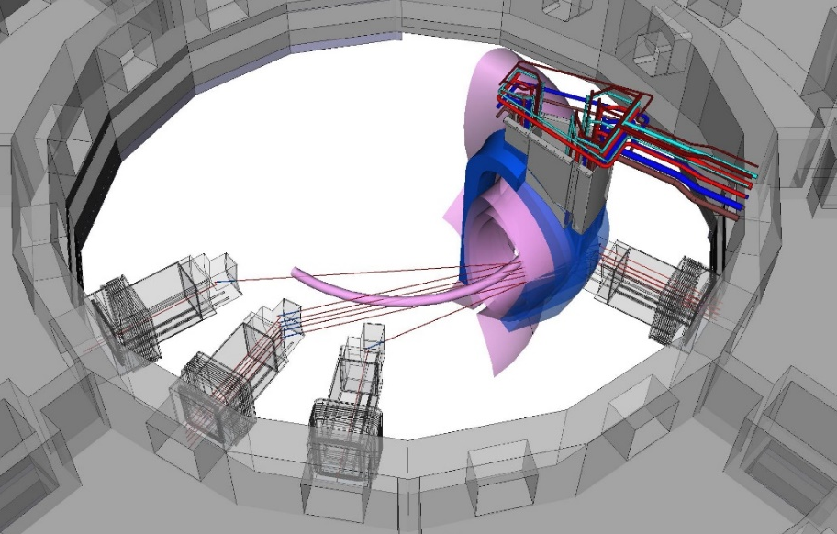
Core density control: IR interferometry
Measurement of the line integrated plasma density, and vertical position during startup
Features:
Laser wavelength of 10/5 µm, (currently) dispersion interferometer
4 cm x 1 m beam ducts with gas target for protection of the plasma facing mirrors
Active environmental phase drift compensation and beam steering
See also
K. J. Brunner et al.; 2022; JINST 17 C04001
Two variants under investigation:
Double-pass design with
retro-reflectors
Single pass design with
more windows
  much lower risk option
Major issues:
Mirror lifetime
Window lifetime
Long-term Laser stability
Alignment stability
Lifetime of beam steering
components
n+5 port
n+4 port
n+3 port
K. J. Brunner, G. Jereb et al.

Slide 18
Burn control simulations under development
Main requirements (repeated):
Pedestal top density should remain at a level of 85% +/- 5% of the Greenwald density limit
Fusion power should remain within +/- 20% of the nominal value; variations above +/- 10% for < 20 seconds.
Separatrix power P_{sep} should be controlled at a level of 20% above the LH threshold (to be refined)
E. Fable, P. David, F. Janky, et al.
FENIX tokamak flight simulator
code under development
ASTRA code coupled with model
for controllers, actuators and
diagnostics in Simulink
Shown here:
Plasma and control reaction on
missing pellets (MP)
Specific DEMO diagnostic and
actuator properties to be included
Integration of kinetic and magnetic
Control under way
See also:
F. Janky et al. FED 2017
C Wu et al. FST 2023

Slide 19
Divertor (detachment) control
D. Dunai, C. Pastor, M. Cavedon,
Ch. Baumann, D. Borodin, T. Bosman, et al.
Main requirements (repeated):
Plasma at strike point should be strongly detached (T < 2 eV)
Pedestal top density should remain at a level of 85% +/- 5% of the Greenwald density limit
Separatrix power P_{sep} should be controlled at a level of 20% above the LH threshold (to be refined)
IR/VIS/UV divertor spectroscopy is designed to provide signals for detachment control (power exhaust and burn control).
Main approach is the measurement of line intensity ratios of hydrogen or helium spectral lines
Optical design studies, CAD, first mirror lifetime studies and spectra modelling are ongoing.
SOLPS + collisional radiative modelling (CRM) → S. Wiesen et al.
Feasibility of these lines of sight has to be checked when changing the DEMO baseline

Slide 20
Divertor (detachment) control (2)
Main requirements (repeated):
Plasma at strike point should be strongly detached (T < 2 eV)
Pedestal top density should remain at a level of 85% +/- 5% of the Greenwald density limit
Separatrix power P_{sep} should be controlled at a level of 20% above the LH threshold (to be refined)
D. Dunai, C. Pastor, M. Cavedon,
Ch. Baumann, D. Borodin, T. Bosman, et al.
Emissivity / ph/sm²sr
T_{e} /eV
T_{e} /eV
SOLPS runs after
F. Subba et al. NF 2021
Modelling (SOLPS, CRM) and experimental investigations (on TCV) are ongoing to identify radiation features sensitive to detachment and viable for DEMO real-time control

Slide 21
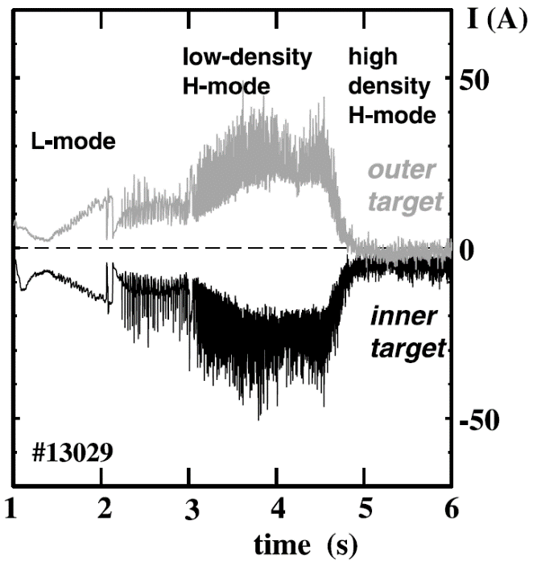
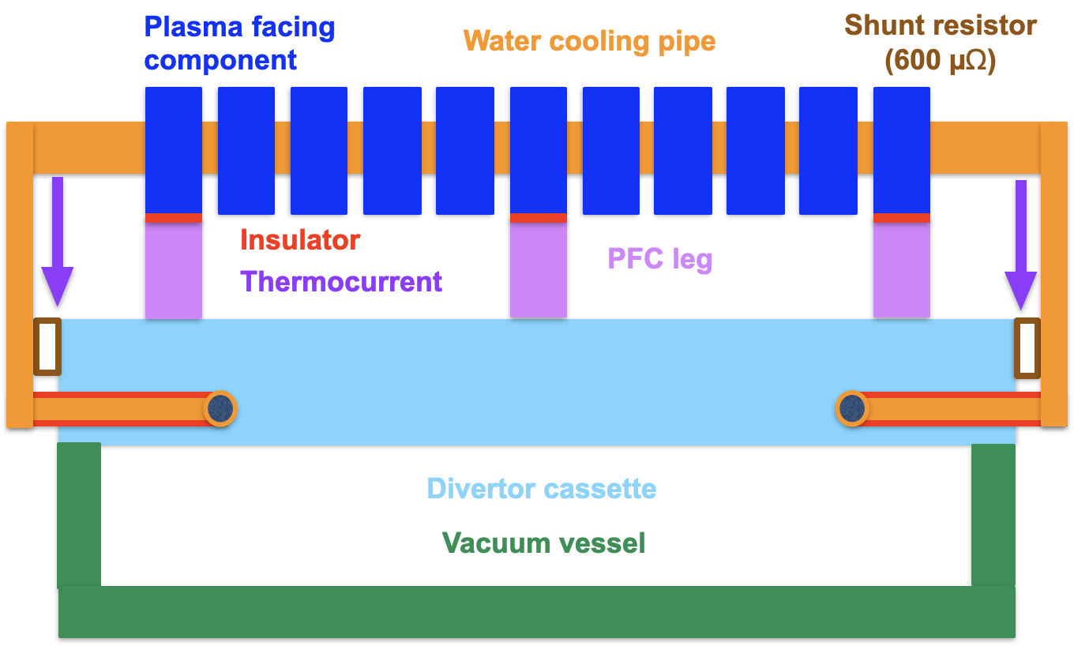
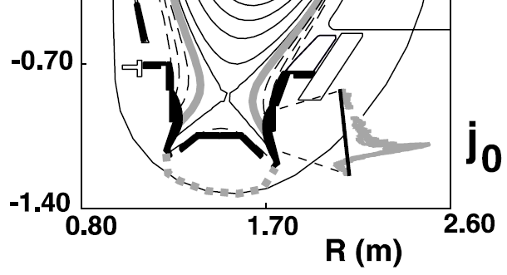
Divertor thermo-current measurement
Principle:
sheath voltage at divertor target depends on plasma temperature
L. Giannone,
G. Renko, et al.
A. Kallenbach et al., J. Nucl. Mat. 2001
Study on implementation on DEMO:
isolate coolant tubes against vacuum vessel
use coolant tubes as shunt resistor
implementation in each divertor target
Feasibility depends on durability of insulators against neutron irradiation and limit of current in water cooling pipes.
Low signal levels are expected.
See also S. El-Shawish FED 2020

Slide 22
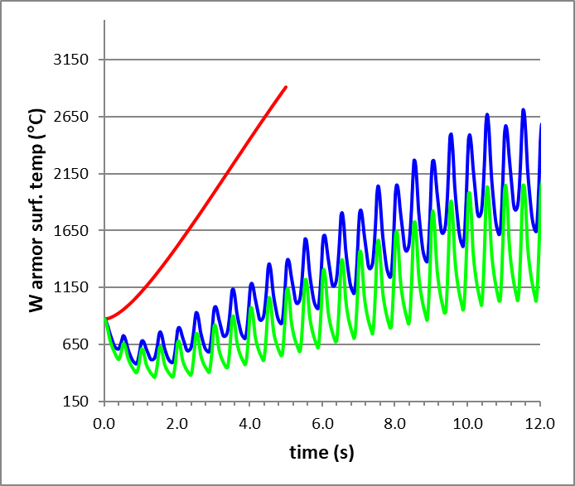
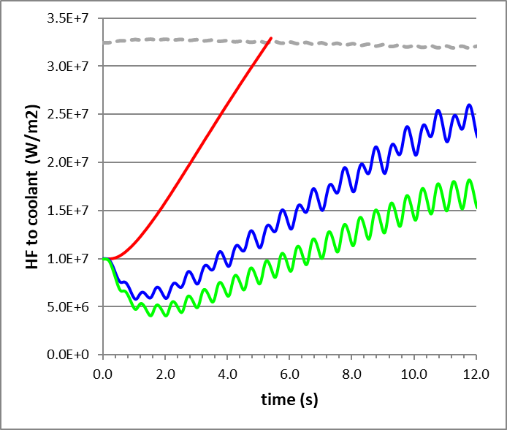
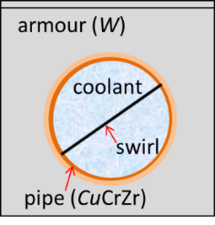
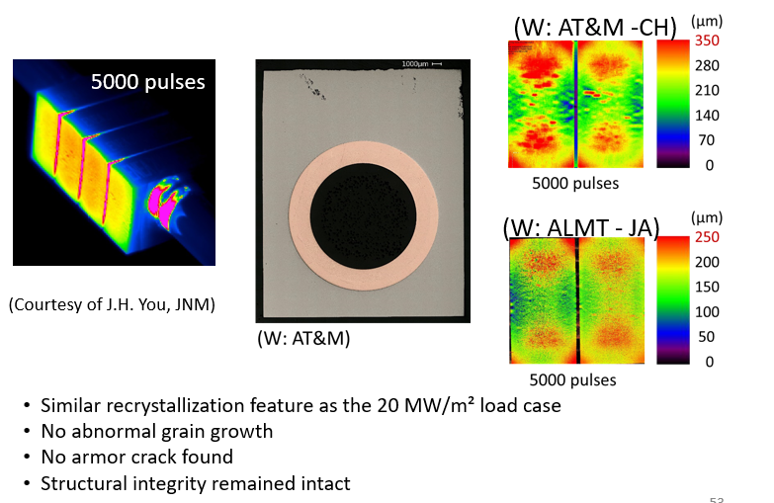
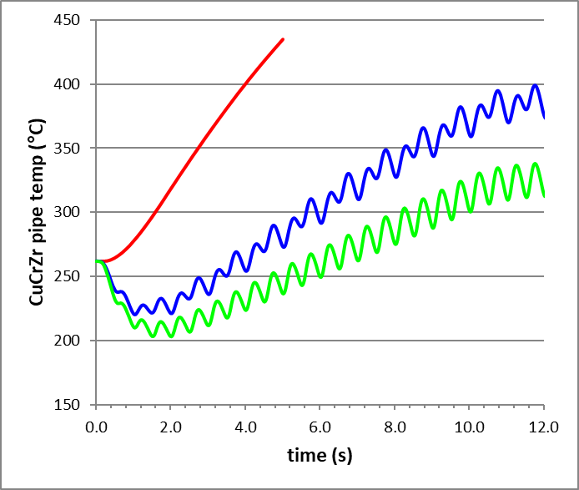
Power exhaust w-monoblock technology limits including sweeping
Heat flux ramp from 10MW/m² to 70MW/m² in 10s (to mimic reattachment):
melting
2)
1)
Critical Heat Flux
t_{surf} (°C)
HF (W/m²)
recryst.
No Sweep
Sweep 10 cm 1 Hz
Sweep 20 cm 1 Hz
t_{pipe} (°C)
3)
HF to coolant: In SS the CHF (pipe burn out) is reached in 5s, while the 10cm-1Hz sweeping is marginal, and the 20cm-1Hz allows 50% margin.
W armor temp.: In SS the W surface melt at ≈6s the CHF time, while in the sweeping cases it does not reach melting. In the 20cm-1Hz the temp. reaches 2000°C(> W-recrystallization: issue if kept too long).
CuCrZr pipe temp.: The pipe softening temperature of 350°C is reached in 2.7s in SS, and 8.6s in 10cm-1Hz seeping, while it is not reached for 20cm-1Hz.
soft./aging
Experiment carried out in GLADIS shows unirradiated PFC functional integrity after 5000 pulses (≥1h at 1Hz) at equivalent 70MW/m² (JH. You submitted to JNM)

Slide 23
Summary of the DEMO diagnostic and control concept
See also W. Biel et al. FED 2022
Control quantity | Operational limits | Diagnostics | Actuators + interactions
Plasma current / Edge safety factor q₉₅ | safety factor limit (q₉₅) | Magnetic diagnostics Faraday sensors | CS coils Auxiliary heating
Plasma position and shape, incl. vertical stability | Wall loads (FW and div.) Max. Δz / VDE disruption | Magnetic diagnostics MW reflectometry, ECE Neutron/gamma diagnostics IR polarimetry/interferometry Radiation power profile | PF + CS coils Auxiliary heating
Plasma edge density and temperature | Density limit Stable confinement Access for div. detachment | MW reflectometry, ECE IR polarimetry/interferometry Spectroscopy (pellet injection) | Pellet injection (fuel) Gas injection ECR heating
Fusion power | Wall loads (FW and div.) LH threshold | Neutron diagnostics Density and temp. measurement FW/blanket and div. power (for calibration only) | Auxiliary heating Pellet injection (DT ratio) Impurity gas injection PF+CS coils (shaping)
Power loss across the separatrix | Radiation limit LH threshold, divertor loads | Spectroscopy+radiation meas. Plasma heating power | Gas + Pellet injection Auxiliary heating
Divertor detachment and heat flux control | Divertor wall loads LH threshold | IR/VIS/UV spectroscopy Divertor thermo-currents Neutron flux, reflectometry | Gas injection (impurities + fuel) Pellet injection (fuel) PF coils
(MHD) plasma instabilities | Various | Reflectometry, ECE Radiation power measurements Neutron/gamma diagnostics IR polarimetry/interferometry Magnetic diagnostics | Auxiliary heating ECCD PF coils
Events (impurity ingress, component failure) | Various | All | All
Disruption mitigation | All | All | Matter injection
equilibr. control
kinetic control
+ Collective Thomson Scattering
Event control

Slide 24
Summary and conclusions
An initial concept for the DEMO plasma diagnostic and control (D&C) system has been developed
List of the main control issues and their allocation to measurements and actuators has been set up; structuring ongoing
Diagnostics were selected according to their robustness and coverage of control issues
Feasibility and performance of control procedures are being explored by means of simulations
Aiming to achieve reliable plasma operation on DEMO with high performance near operational limits
Key issues for the further development and diagnostic integration are:
  In vessel components are subject to extreme loads
  Allocation and plasma access are constrained by the needs for first wall integrity and optimization of tritium breeding
  Remaining uncertainties in the definition of plasma scenario and machine design

